Slide 1
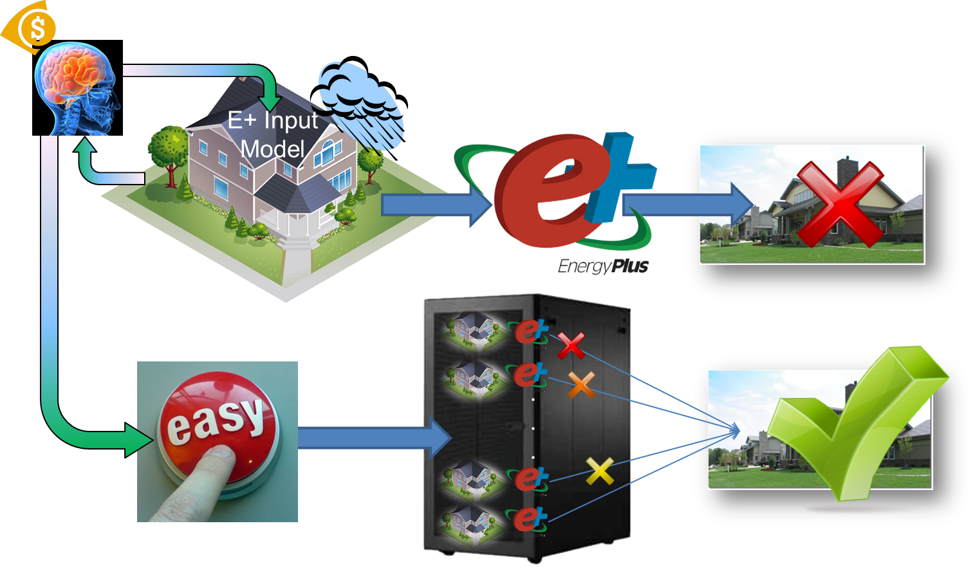
BTO Program Peer Review
Autotune Building Energy Models
Joshua New
Oak Ridge National Laboratory
newjr@ornl.gov, 865-241-8783
April 2, 2013

Slide 2
Purpose & Objectives
Problem Statement:
“All (building energy) models are wrong, but some are useful”
22%-97% different from utility data for 3,349 buildings
More accurate models are more useful
Error from inputs and algorithms for practical reasons
Useful for cost-effective energy efficiency (EE) at speed and scale
Calibration is required to be (legally) useful
ASHRAE G14 (NMBE<5/10% and CV(RMSE)<15/30% monthly/hourly)
Manual calibration is risk/cost-prohibitive
Development costs 10-45% of federal ESPC projects <$1M
Need robust and scalable automated calibration for market
Adjusts parameters in a physically realistic manner
Scales to any available data and model (audit)
Notes:
Quote from George E.P. Box, born 1919, professor emeritus of statistics at the University of Wisconsin
Advanced building systems and software algorithms continue to increase in complexity and the result is initial energy use estimates differ 30-93% from actual energy use [EPS - http://www.earthadvantage.org/assets/uploads/EPS_Pilot_Report_2008.pdf]. The cost of manually calibrating the 1000s of inputs to match the true building parameters is financially infeasible for all but the very largest of projects, limiting the creation and efficacious use of energy models. A scalable and robust automated method for calibrating a building description to match all available data is needed to accelerate private sector solutions for implementation at speed and scale in light commercial and residential buildings (only 5% of current ESCO market - http://emp.lbl.gov/sites/all/files/PRESENTATION%20lbnl-3479e-ppt.pdf).
@article{inaccuracy_hers99,
title={A Rating Tale},
author={Scott Pigg},
year={2001},
publisher={Home Energy Magazine}
}
@article{inaccuracy_eps09,
title={Energy Performance Score 2008 Pilot: Findings and Recommendations Report},
author={Earth Advantage Institute and Conservation Services Group},
year={2009},
publisher={Home Energy Magazine}
}
@article{inaccuracy_assessment12,
title={Assessment of the U.S. Department of Energy's Home Energy Scoring Tool},
author={D. Roberts, N. Merket, B. Polly, M. Heahey, S. Casey, and J. Robertson},
year={2012},
publisher={National Renewable Energy Laboratory}
}
@article{inaccuracy_ornl84,
title={Actual Electricity Savings and Audit Predictions for Residential Retrofit in the Pacific Northwest},
author={E. Hirst, D. White, R. Goeltz, M. McKinstry},
journal={Energy and Buildings},
volume={8},
pages={83--91},
year={1985},
}

Slide 3
Purpose & Objectives
Impact of Project:
Reduces transaction cost of developing and selling EE improvement projects in existing buildings
Enables the ESCO business model to reach smaller buildings and projects
Enables speed and scale deployment approaches based on every building in served area having a continuously maintained calibrated model (audit)
Enables tracked actual performance of implemented EE measures to improve model (audit) over time
Project endpoint is an automated calibration package that users of simulation tools can deploy as they choose.

Slide 4
Purpose & Objectives
Project Focus:
Objective: Develop a generalized, automated model (audit) tuning methodology that enables the model (audit) to reproduce measured data as best it can, by selecting best-match input parameters in a systematic, automated, and repeatable fashion.
BTO Goals: supports the BTO overarching goal of reducing building energy use 50% by 2030
BTO strategic programs: Autotune is listed as a “key service” within the BTO Strategic BEM Portfolio

Slide 5
Approach
Approach:
Multi-objective optimization algorithms to minimize error between simulation output and measured data by intelligently adjusting building model inputs
Sensitivity analysis and uncertainty quantification to determine importance of individual parameters
Suite of machine learning algorithms to generate calibration functions based on building dynamics
Quantify trade-off between tuning accuracy and amount of data available
Creation of intuitive Autotune application on user’s PC or website with database, software tools, and accelerated tuning agents in the background

Slide 6
Approach
Approach:
Demonstrations of end-to-end Autotune prototype on:
ORNL’s fleet of research houses and light commercial test buildings (flexible research platforms)
Weatherization and audit buildings “in the wild”
Key Issues:
How well does it reproduce measured data?
How long does it take?
How well does this represent the actual building?

Slide 7
Approach
Distinctive Characteristics:
Method scalable to available data
Methods employed are model (audit) agnostic
Can be used to speed up model (audit) runtime
Capabilities in place for big data mining
Interactive dashboard for Autotune progress
Repeatable tuning results

Slide 8
Accomplishments and Progress
Accomplishments:
End-to-end Windows desktop prototype created
Overnight tuning of envelope-only parameters, 61% as accurate as 4 man-months of effort
Autotune 156 EnergyPlus inputs in 3 hours on desktop was within 30¢/day (actual use $4.97/day)
Autotune for National Energy Audit Tool (NEAT)
15 inputs (±30%), reduced error 48%, 20mins on netbook
Experts would have tuned same way; 9,154 buildings
Trinity test shows G14 compliance and realistic tuning
Outputs: CV(RMSE)<2.5%, NMBE<1% both hourly and monthly
Inputs: For 60% range, Autotune is close to real value (within 8% when tuning to hourly data, 15% when tuning to monthly data)
Notes:
NEAT uses variable degree-day engine, took ~1 week to adapt Autotune to use engine, 15 parameters and ranges (most plus/minus 30%) defined by experts, 48.3% average reduction in error verified by experts to turn the same knobs in the same way and to the same amounts as they would have; tested on only one building and have data for ~9,154 buildings of which a subset may be used for validation (human vs. computer)
No method/guideline for what constitutes “good” for inputs so compared Autotune to verify it outperformed other methods

Slide 9
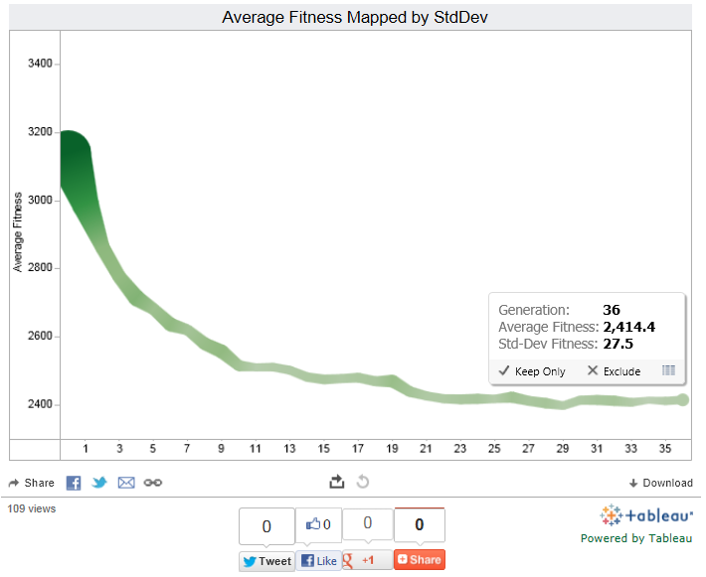
Accomplishments and Progress
Accomplishments:
Titan scalability – 65k cores, 262,144 EnergyPlus (9TB), 44mins
MLSuite allows easy use of software on supercomputers
Tableau and Google Vis API interactive visualization and comparison of all Autotune experiments
Progress on Goals:
Tuning accuracy satisfies ASHRAE Guideline 14
Less than 3 hours on standard computer
Physically realistic results
http://autotune.roofcalc.com
Notes:
This is including disk I/O time storing 15-minute resolution output, 35MB *.csv file/simulation

Slide 10
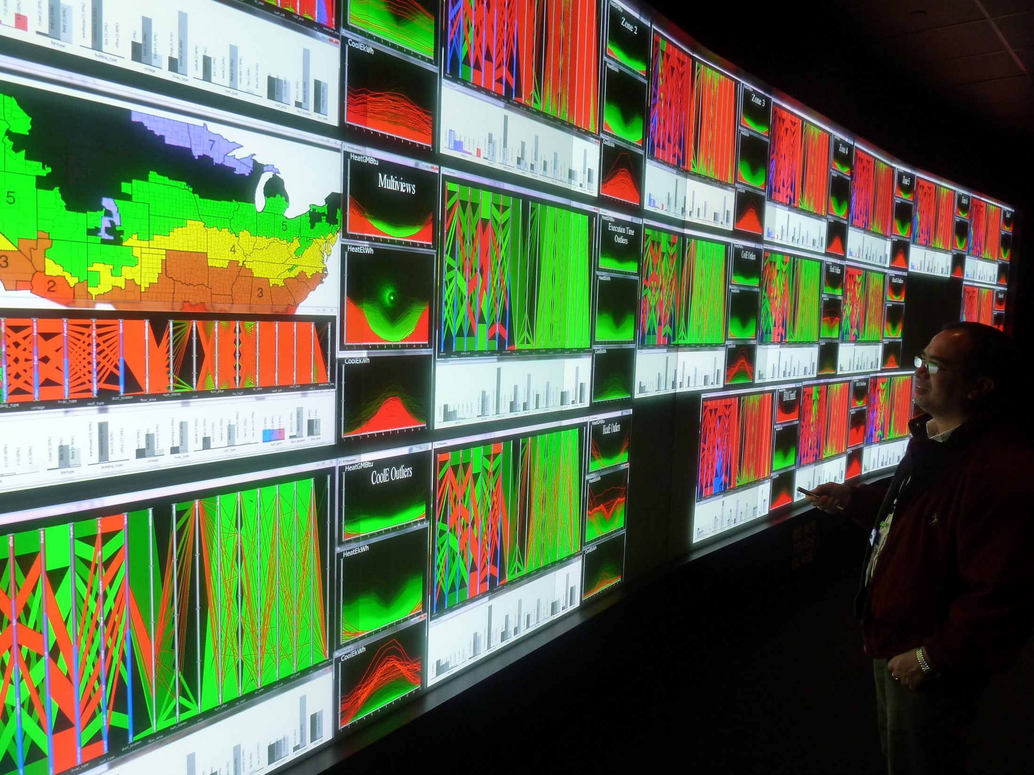
Accomplishments and Progress
Awards/Recognition:
2+ million core-hours, 4 competitive awards (free cost share)
Extreme Science and Engineering Discovery Environment (XSEDE)
Nautilus 30k core-hours (CY11), 200k (CY12), 500k (CY13)
Oak Ridge Leadership Computing Facility (OLCF)
Jaguar 500k core-hours (CY12), Titan 500k (CY13), Frost 200k (CY13), Lens/EVEREST (CY12&13)

Slide 11
Project Plan & Schedule
Project initiation date: Oct. 2011 (FY12) Project planned completion date: Sept. 2014 (FY14) Schedule and Milestones: FY12 – 10 DOE deliverables on time and budget
FY13 – 7 of 14 DOE deliverables so far, all on time and budget
Notes:
Initially planned as FY12-FY14 project, all scheduled milestones and deliverables have been met on time and on budget

Slide 12
Project Budget
Budget History
FY2012 |  | FY2013
DOE | Cost-share | DOE | Cost-share
$650k | $980k | $264k | $1,225k
Cost to Date:
FY12: fully costed
FY13: $119k (45%)
Funding Sources:
Notes:
Does not include ZEBRAlliance data (which is invaluable but hard to put a dollar figure on).

Slide 13
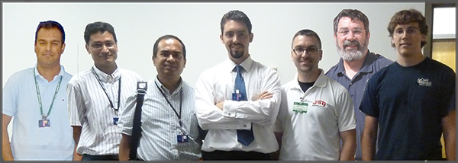
Project Integration, Collaboration & Market Impact
Partners, Subcontractors, and Collaborators:
Technology Transfer, Deployment, Market Impact:
Autotune Invention Disclosure filed
5 software systems to copyright and release
Plan to deploy Autotune in FY13
Karpay Associates
Jacksonville State University
The University of Tennessee

Slide 14
Project Integration, Collaboration & Market Impact
Communications (selected): 1 PhD Dissertation, 2 journals, 5 conference, 6 submitted soon, 5 internal reports (250+ pages)
Published:
New, Joshua R., Sanyal, Jibonananda, Bhandari, Mahabir S., Shrestha, Som S. (2012). "Autotune EnergyPlus Building Energy Models." In Proceedings of the 5th National SimBuild of IBPSA-USA, International Building Performance Simulation Association (IBPSA), Aug. 1-3, 2012. [PDF pre-print]
Sanyal, Jibonananda, Al-Wadei, Yusof H., Bhandari, Mahabir S., Shrestha, Som S., Karpay, Buzz, Garret, Aaron L., Edwards, Richard E., Parker, Lynne E., and New, Joshua R. (2012). "Poster: Building Energy Model Calibration using EnergyPlus, Machine Learning, and Supercomputing." In Proceedings of the 5th National SimBuild of IBPSA-USA, International Building Performance Simulation Association, Aug. 1-3, 2012. [PDF]
Accepted:
Garrett, Aaron, New, Joshua R., and Chandler, Theodore. “Evolutionary Tuning of Building Models to Monthly Electrical Consumption”. ASHRAE Conference in Denver, CO, June 22-26, 2013.
Sanyal, Jibonananda and New, Joshua R. “Simulation and Big Data Challenges in Tuning Building Energy Models”. IEEE Workshop on Modeling and Simulation of Cyber-Physical Energy Systems, May 2013.
Planned/submitted:
Edwards, Richard E., New, Joshua R., and Parker, Lynne E. “Constructing Large Scale EnergyPlus Surrogates from Big Data”. To be submitted to Energy & Buildings Journal, 2013.
Garrett, Aaron and New, Joshua R. “Scalable Evolutionary Tuning of Building Models to Multiple Channels of Sub-Hourly Data”. To be submitted to ASHRAE, New York City, NY, Jan. 18-22, 2014.
Internal:
Edwards, Richard E., and Parker, Lynne E. (2013). “MLSuite - FY2012 Final Report”. 68 pages
Garrett, Aaron and New, Joshua R. (2012). “An Evolutionary Approach to Parameter Tuning of Building Models”. 68 pages
Edwards, Richard E., New, Joshua R., and Parker, Lynne E. (2012) “Approximate l-fold cross-validation with Least Squares SVM and Kernel Ridge Regression”. 9 pages

Slide 15
Next Steps and Future Plans
Next Steps and Future Plans:
BTO – finish Autotune project as detailed
BTO – deploy in residential and commercial building integration program elements
Weatherization – Autotune NEAT comparison of human vs. computer calibration
Federal Energy Management Program – ESPC ENABLE program
Notes:
Autotune NEAT = modern-day Paul Bunyan
DOE claims 1 million homes weatherized with ARRA funding…I’m sure ORNL’s WIP team played a big role in facilitating that:
http://www.forbes.com/sites/justingerdes/2012/09/30/obama-administration-marks-1-million-homes-weatherized-under-the-stimulus/
List by location for CY11: http://energy.gov/downloads/arra-homes-weatherized-grantee

