Slide 1
Visual Analytics for Relationships in Scientific Data
Joshua New
Ph.D. Defense
April 8, 2009
Notes:
Before I motivate my dissertation “Visual Analytics for Relationships in Scientific Data”, let me introduce myself.

Slide 2
Introduction Short Bio
Education
B.S. double-major Comp. Sci. & Math, Physics minor 2001
M.S. Computer Systems & Software Design 2004
Admitted into Ph.D. program at UT 2004
Granted a research assistantship 2005 with Dr. Huang’s SeeLab
Work experience
Database Administrator (Ft. McClellan, AL) 1997-2001
GRA at JSU (Jacksonville, AL) 2001-2004
GRA at UTK (Knoxville, TN) 2005-2009
Intern at ViTAL Images (Minneapolis, MN) 2006
Intern at ORNL (Oak Ridge, TN) 200[5,7,8]
Notes:
My name is Joshua New and I obtained my bachelors and masters degrees from JSU. I was one of three PhD students (along with Markus Glatter and Kanan Balajee) admitted to UT and subsequently granted a research assistantship with Dr. Huang. My work experience includes working as a database adminstrator over the personal property system used to shut down Ft. McClellan, research assistant positions at JSU and then UTK, and several internships during my studies here, at ORNL, and also at ViTAL Images, a company developing medical imaging software.

Slide 3
Introduction Motivation
Scientific research now generates many complex, domain-specific datasets.
Extraction and identification of meaningful relationships has become a central problem of scientific research.
Challenges need to be addressed concurrently to provide scientists with the necessary tools, methods, and systems.
Notes:
Over the past couple of decades, thanks in part to the widespread adoption of the computational paradigm, the number and complexity of scientific data sets has exploded for many disjoint domains often with no unifying paradigm or workbench for knowledge discovery.
Extraction and identification of actionable relationships from complex data has become one of the central problems of scientific research; a bottleneck leading to the common problem of being drowned in data, and yet starved of information.
The problems at hand are multifold and need to be addressed concurrently to provide scientists with the necessary tools, methods, and systems that can be applied synergistically to data from many domains.

Slide 4
Introduction Motivation
Relationship representation for scientific data
Why Visualization?
Role of Visual Analytics
Science of analytical reasoning facilitated by interactive visual interfaces
Domain-agnostic paradigm
Notes:
The more I talk to scientists from different domains, the more aware I am of the lack of formal analysis and rigor in some parts of their scientific process. Indeed, many of their problems could be solved optimally once the problem is phrased in terms of a graph-theoretic problem.
Representing data as a combination of a database of item information and weights of relationship between those items give fundamental data structures on which more sophisticated algorithms and data-sharing systems can be achieved.
A common question is: If we have algorithms, then why do we need visualization? Vis rests upon the assumption that no matter how good pattern recognition and algorithmic automation is, the best it can be is semi-automatic within the context of the entire scientific process; there is no magic to jump from fuzzy concepts to fully substantiated and verifiable specifications.
Whether it’s counter-terrorist raids or armed robots on the border of north Korea, there are areas of legal liability in which traceability to a human decision from an informed individual rather than an autonomous computer system is necessary.
Following the Sept. 11th attacks, the newly formed DHS facilitated outgrowth of the scientific vis and information vis communities to create NVAC. It was established in 2004 near PNNL to respond to terrorist threats using intelligence analysts with tools that leverage the high-broadband pathway from the eye to the brain. New techniques are needed for analyzing social networks as well as relationships present in scientific data.
A domain agnostic framework and toolset is needed to facilitate interactive exploration that allows human-in-the-loop decision calls on algorithm trade-offs and conflicting information for a specific hypothesis being investigated.

Slide 5
Introduction Overview
Graph decomposition of multivariate data
How do genes and gene clusters regulate one another?
Optimization framework for linkable pairwise relationships
How do simulation variables interact to cause climate change?
Feature-specific identification of a relationship
What variables constitute a visible phenomenon in a visualization?
Notes:
To be more specific, I’ve broken the task of analyzing relationships in scientific data into 3 subtasks and motivate each with a standing question in the domain-specific sciences:
To be as general as possible, I wanted to analyze multivariate data in which (just like in Excel) each row is an object and columns are information related to that object; a matrix of numbers. We could then represent relationship strengths between objects (Pearson’s correlation) as weights in a weighted-edge graph. Complex relationships can then be rephrased as a graph decomposition problem. For example, in systems genetics data, scientists are interested in discovering how groups of genes (such as paracliques or mostly completely connected subgraphs) can regulate or be regulated by individual genes (or one another).
As is often the case with causality, a chain of objects may work together in concert to give rise to a particular behavior. Finding and conveying this specifically pairwise behavior in the context of climate data with thousands of variables per grid location is an area of active study.
Finally, can we map a relationship back to feature-specific properties that underlie that relationship? This is particularly important in visualization tasks such as physical simulations or medical imagery in which an expert can identify a location of interest but does not know what features constitute, for example, tumors in magnetic resonance imagery
In order to demonstrate the domain-agnostic approach of this study, let me introduce the four datasets I will use throughout this work…

Slide 6
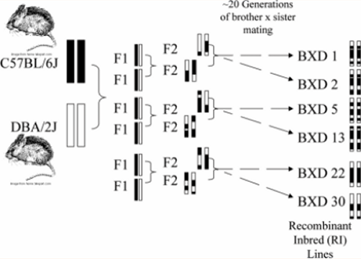
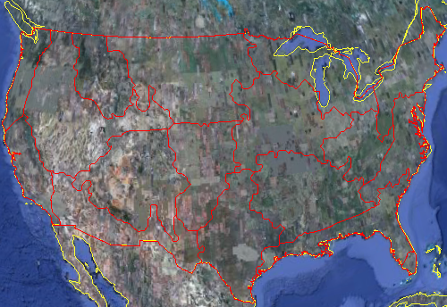
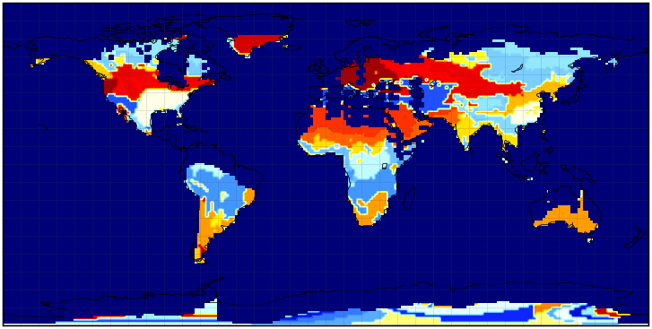
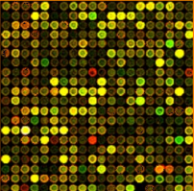
Introduction Datasets
Systems Genetics Data Elissa Chesler et al., Dr. Langston et al.
Climate Data – CLAMP Drake, Erickson and Hoffman
Biographical data Microarray Correlation Genotypes Gene Expression QTLs MRI Phenotypes
Systems Genetics Database
IPCC A2 climate simulation Years: 2000-2099 by month 256x128 grid; 63 land vars Total data size: 29GB
7,443 genes cerebellum U74

Slide 7
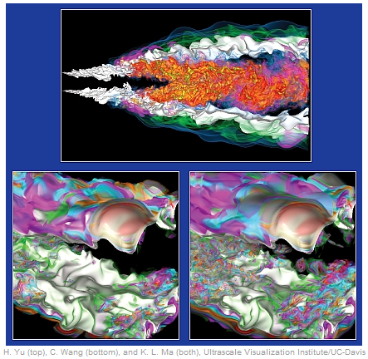
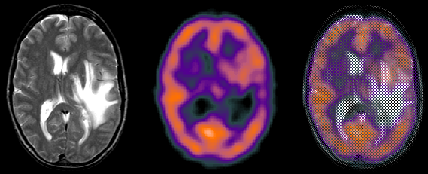
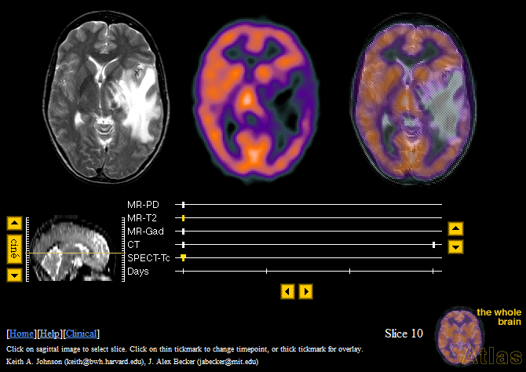
Introduction Datasets
Jet Combustion Data Jackie Chen (SNL); SciDAC
Medical Data Whole Brain Atlas, Harvard
Turbulent Combustion 480x720x120 grid 122 timesteps 5 variables Total data size: 95GB
Multiple disease cases Biographical data Case synopses Multiple imaging modalities

Slide 8
Sections
1
2
3
Graph Decomposition of Multivariate Data
Optimization Framework for Pairwise Relationships
Feature-Specific Identification of a Relationship
Notes:
I have broken up the proposed solutions into 3 subproblems:
First, I propose data structures and algorithms geared toward elucidating relationships by leveraging statistics, graph algorithms, learning systems, and visualization within a single graph decomposition system.
Second, I define a way to phrase the problem of pairwise relationships and a framework for optimizing the detection of these relationships; and
Third, I will discuss recent work on how to open the black box of learning system segmentations to precisely identify the variables underlying an observed relationship

Slide 9
Sections
1
2
3
Graph Decomposition of Multivariate Data
Scalable Data Servers for Visualization
of Large Multivariate Data
Feature-Specific Identification of a Relationship
Notes:
Let’s start with the concept of “Graph Decomposition” for scientific data. On the following slides, I will cover some the basic ideas, data structures, novel algorithms, visualizations, and other technical details of my approach.

Slide 10
Graph Decomposition Data Structure – Graph
Lower-triangular matrix – O(|V|²)
0 1 2 3 … |V|
Matrix[0][0]=NULL
Matrix[1]
Matrix[3]
Matrix[2]
8*|V|² bytes
=> |V|² bytes
Notes:
The data structures and management need to be optimized for the kind of data and investigative processes commonly used in scientific research.
The storage of the graph structure is one of the most crucial, being the only O(|V|²) structure used
Most software packages represent a graph using a double-precision floating point adjacency matrix (usually with LOTS of overhead, as much as 3x); with 3GB of addressable memory and no overhead, the maximum size graph that can be stored in core is ~19k vertices; without any space for algorithms or other data.
*click*
Based on observations, we made 2 simplifying assumptions: an undirected graph and 4 significant digits was sufficient (due to commonly noisy data) to reduce memory use by nearly an order of magnitude
*click*
We then store the matrix in a one-dimensional array that takes advantage of cache coherence; but we also build 2d pointers on top of it as this small space overhead results in huge time savings for most graph algorithm, in addition to being more intuitive (ie. Edge between two specific vertices)

Slide 11
Graph Decomposition Algorithms – Graph Layout
Graph Layout – O(M|V|²)
Parameter Defaults
Graph Layout Spring Equations
float ao=1.0471976f, so= 0.1f, ar= 1.0471976f, sr= -1.0f;
float grav= 0.1f;
int rd=-1, termAbs=-1, termPer=-1, springAlgo= 0;
float thresh; int absValFlag=1, attractFlag=1;
Best to Worst (in time):
Attract Algo 3/Attract Algo 4; Repulsive Algo 1; Attract Algo 0; RepAlgo2/RepAlgo3/RepAlgo4; Attract Algo 1; Repulse Algo 0;
Algo 2:
Notes:
In order to visually convey relationships among data items, it is necessary to use a vertex placement algorithm which preserves the relationships encoded by the edge weights: typically using physical simulation to minimize the energy of the system in which edges are treated as springs and calculating 4 main forces through M iterations.
*click*
As with most physical simulations, graph layout algorithms typically use many parameters which must be investigated. There is oscillation, oscillation reaction intensity, rotation, rotational reaction intensity, strength of gravity pulling towards the center, maximum round cutoff, target absolute temperature, target relative temperature, spring algorithm type, edge threshold, absolute value for whether positive and negative edges should be treated similarly, and whether high weights should pull together or push apart
*click*
I have tried 16 spring equations in which delta is the euclidean distance between the current pair of vertices; and list the final 4 equations used here with 2 models being attractive (high edge weight pulls vertices together) and 2 being repulsive
*click*
I conducted time/optimality tradeoff analysis to determine which algorithms were the “best” in terms of minimizing the final system energy in the least amount of time;

Slide 12
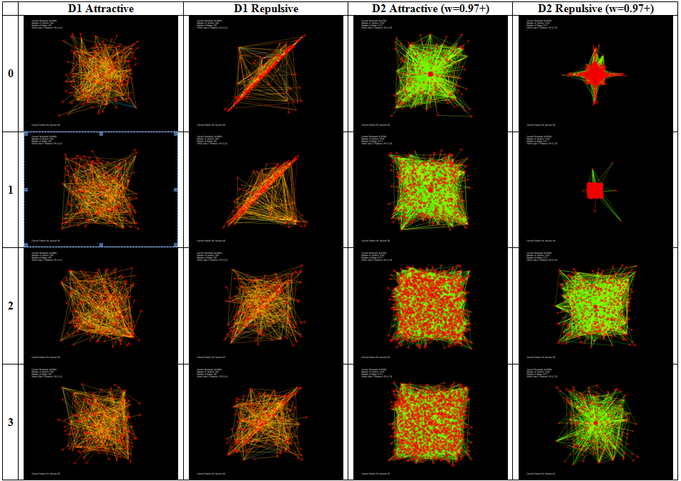
Graph Decomposition Algorithms
Graph Layout – O(M|V|²)
Algo 2:
Notes:
While system temperature is a nice, objective metric upon which to base graph layout, it proved insufficient; I spent 3 months inspecting graph layouts visually to search for pathological problems. Here we have 4 different algorithms on 2 different datasets (a repulsive and attractive algorithm each) such as the larger dataset D2 showing over-clustering at the center of the dataspace (data occlusion) and the reduction to planar behavior in repulsive algorithms (structures as artefacts of the layout algorithm)
A system was also written in Open Inventor that allows real-time visualization of the “annealing” process without slowing down the physical simulation; allowing computational steering of the layout by moving individual points of interest around in 3D

Slide 13
Graph Decomposition Algorithms – Graph Layout
Graph Layout Algorithm Performance
|V| | |E| | SeeGraph’s 3D Fruchterman-Reingold | SeeGraph’s 3D Kamada-Kawei | GeNetViz’s 2D Kamad-Kawei
254 | 401 | 0.538s | 0.777s | ~20 mins
2150 | 6171 | 34.652s | 6mins 13.041s | ~1.5 days
12343 | 28338 | 21mins 36.118s | 1hr 48mins 18.858s | ~6 days
Notes:
We have implemented and optimized (as previously discussed) 2D and 3D versions of: Kamada-Kawei, Fruchterman-Reingold, and energy-barrier algorithms which has significantly decreased the amount of time necessary to create a meaningful graph layout
While most authors do not share the time required for their layout algorithms, we obtain two orders of magnitude enhanced performance over Shawn Ericson’s GeNetViz, 411 times faster on a 12k node graph
I thought that if I could get the right parameter settings and spring equations that structures in the data would pop out of the screen
The graph layouts allows graphs to be visualized; however, graphs were still complex and the human visual system can’t reliably track relationships for graphs as small as a few dozen vertices; a way to drill down to subsets of interest proved necessary. The magic is in the analytics.
We support several well-known graph algorithms such as edge thresholding, shortest path, induced subgraph, largest connected component, and several others. While these graph-theoretic algorithms alone don’t constitute a contribution to the field of computer science, we did extend one shortest path algorithm to leverage commodity hardware acceleration through the use of…general purpose computation on graphics processing units

Slide 14
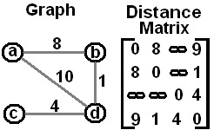
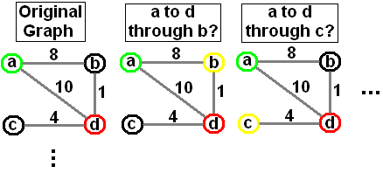
Graph Decomposition Algorithms – GPGPU
Floyd-Warshall – O(|V|³)
void floydWarshall(int numVerts, float** edgeWeights) {
int i,j,k; float newDist;
for(k=0; k<numVerts; k++)
for(i=0; i<numVerts; i++)
for(j=0; j<numVerts; j++) {
newDist=edgeWeights[i][k]+edgeWeights[k][j];
if(newDist < edgeWeights[i][j]) {
edgeWeights[i][j]=newDist;
//Add to matrix if want to store a path
}
}
}
Radeon HD 4670@$70 320procs@750Mhz=240Ghz
8+1=9<10
Notes:
Video cards have been pushed by market pressures of the killer app of gaming, doubling in capability roughly every 9 months instead of every 18-24 months as is the case with CPUs according to Moore’s Law. Since 2004, API hooks have been introduced to allow custom code to be run on graphics cards.
Who wouldn’t like a 240Ghz machine for $70?
*click*
Floyd-Warshall is an O(|V|³) all-pairs-shortest-path algorithm in which you iteratively try an intermediate vertex between each pair of vertices and update the distance matrix if the shortcut is better
*click through example*
In this example going from vertex a to d, b is shorter with a distance of 9 although c is not because you can’t get to c from a
This algorithm is only 6 lines of shader code that will allow it to be computed on the video card

Slide 15
Graph Decomposition Algorithms – GPGPU
Floyd Warshall’s All Pairs Shortest Path (APSP) averaged over 5 runs:
Number of Vertices | 128 | 256 | 512 | 1024
CPU (time in ms) | 9.4 | 75 | 753.2 | 5875
GPU (speedup) | 0.75x | 0.80x | 1.02x | 0.86x
GPU-Vec (speedup) | 0.43x | 1.60x | 2.15x | 2.16x
Pentium Xeon 2.0 Ghz, 2GB RAM, WinXP; Quadro FX 1000 (8x300=2.4Ghz)
Number of Vertices | 128 | 256 | 512 | 1024
CPU (time in ms) | 6 | 51.8 | 439.8 | 3436
GPU (speedup) | 2.14x | 3.45x | 4.04x | 4.03x
GPU-Vec (speedup) | 0.97x | 4.39x | 7.94x | 8.19x
4/6/09
245x @ $70
AMD Athlon64 2.2Ghz, 2GB RAM, WinXP; 7800GT (20*400=8Ghz)
Notes:
Computational results for two separate systems show a speedup over the CPU times for graphs large enough to overcome the computational overhead of loading the data from memory to the GPU’s texture memory with a maximum speedup of around 8x
This study was done in 2005 and extrapolating to today’s hardware would give a 245x speedup over a 2.2Ghz Athlon with a $70 video card

Slide 16
Graph Decomposition Demo
Demo Considerations:
Size: distance matrix entries much larger than single pixel so we can see; only 32 vertices/columns
Color: the non-vectorized version is shown so that we have sensible gray-scale (higher number mean higher edge weights)
Speed: slowed down so humans can see (every ½ second we try a new intermediate vertex)
APSP Demo
Notes:
*After demo*
Moving from hardware-accelerated graph algorithms to interactive querying…

Slide 17
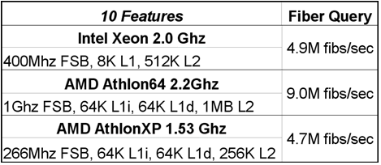
Graph Decomposition Algorithms – Interactive Queries
Compound boolean range query
M=3, N=2 (M>N in practice)
Notes:
It is often the case that a domain expert is interested in relationships involving data points that meet very specific criteria in regard to a phenomenon under study.
For this we provide a compound boolean range query defined as all data elements x such that feature i of x is between the lower and upper bound for all features. We use multiple queries in which each consecutive range is for the next feature with ranges connected by logical ANDs and multiple queries being connected by logical OR.
*click*
We use an MN-tree for specification of number of levels and high branching factor, respectively; resulting in partitioning of the sorted data into M^{N} consecutive runs in which the data item separating two neighboring runs is then used as the key in the corresponding node
*click*
I experimented with different processors and cache sizes to determine that M=5 and N=3 worked best for our application with over 9 million data items returned per second on a 2.2Ghz Athlon (AthlonXP comparable to Xeon only bc of L1 cache)
Since data items are sorted in the 1D array and left-branch comparisons are used, it is best to put the most queried variables at the beginning of the data
This is much better than standard database approaches which aren’t optimized for the access patterns induced by compound boolean range queries (IEEE Vis ‘93 workshop, Lecture notes in CS: Database issues for data visualization, no. 871)

Slide 18
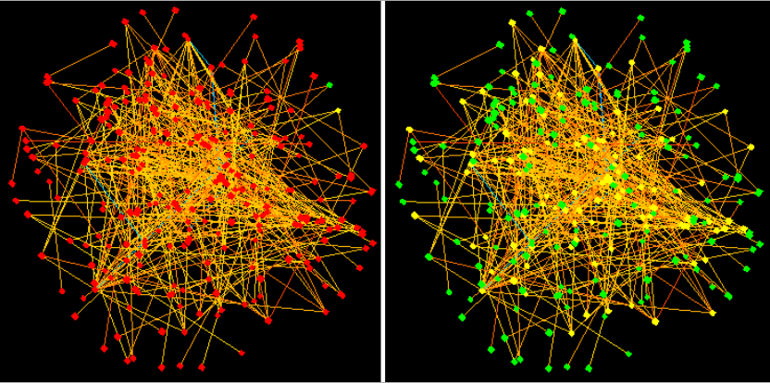
Graph Decomposition Algorithms – Uncertainty
Uncertainty-tolerant object selection
Reproducibility
demos/demo3.wel
scriptWaitTime 0
Load 0 0.85
featureColors 1
writeKaryo
For local0 0 17 1
Increment displayThresh 1
For local1 0 19 1
local4 numQueries
Increment local4 -1
For local2 0 local4 1
local3 local0
Increment local3 local0
Increment local3 4
fltQuery local2 local3 0.9999
Increment local3 1
fltQuery local2 local3 0.0001
EndFor
Notes:
Sometimes it is the case that a user does not know what relationships they are interested in until they see objects behaving in those relationships, introducing a large amount of uncertainty that must be mitigated for precise algorithmic behavior
For this, we use backprop neural networks to determine from the user’s selections and database information which objects exhibit similar properties; a major concern with backprop neural networks is training time, but we were able to keep this interaction transparent to the user
*click*
Once specified by the user, however, uncertainty becomes clear; in fact, by registering special functions with the OpenGL callbacks for keyboard and mouse processing, we can capture and store precisely what the user is doing in terms of variable changes, function evocations and even loops and branches; entire experiments can be recorded and applied to new datasets

Slide 19
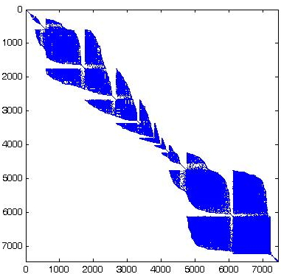
Graph Decomposition Visualization – BTD
Block Tri-Diagonalization (BTD)
Notes:
BTD works in a 4 step process: threshold the matrix to make it effectively sparse, apply Gibbs–Poole–Stockmeyer (GPS) algorithm to minimize the bandwidth (horizontal run) while changing the matrix eigenvectors only within some small tolerance for a permutation vector, permute the rows and columns of the matrix with that vector, and then erase areas off the diagonal in a way that changes the eigenvalue only within some small tolerance.
BTD description: green-clique, orange-bipartite graph, blue-perfect matching graph (bridge), red-star with a hub connecting many disjoint objects; we can then cut out this diagonal strip (which we refer to as a BTD belt) in order to save screen space while providing a birds-eye view of the entire dataset
*click*
We also see two sample BTD matrices from a synthetic dataset (cupid’s arrow) and the 7,443 gene system genetics dataset which have many interesting structures apparent

Slide 20
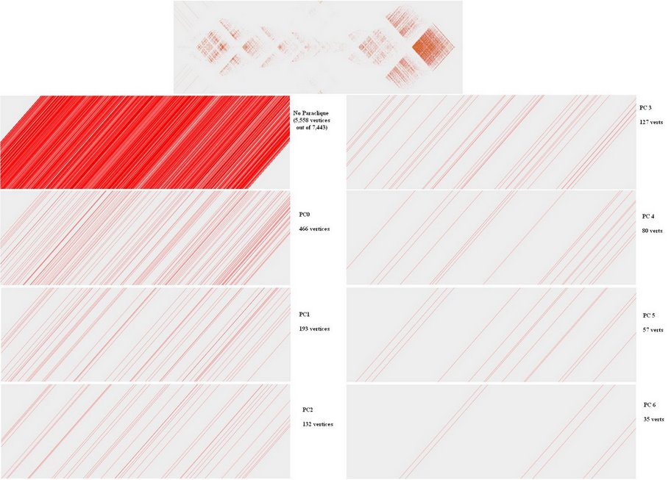
Graph Decomposition Visualization – BTD
Notes:
While BTD uses bandwidth minimization with structure preservation, it is interesting to note that because of the different optimality criteria (bandwidth rather than connectivity), the BTD structure shows information orthogonal to that of paraclique extraction. Though we have some dense structures, the BTD belts show lines for each vertex in the paraclique spread throughout the space.

Slide 21
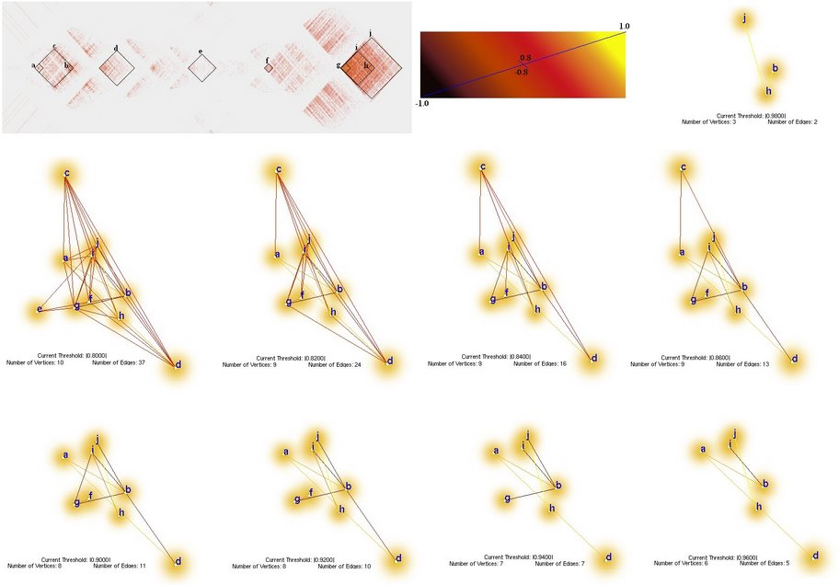
Graph Decomposition Algorithms – LoD Graphs
LoD Graph Construction
Any set of graphs (paracliques, chromosomes, …) become “supernodes” containing as members all vertices of the corresponding graph
Edge set constructed for this vertex set of supernodes using average edge weight between all members of supernode pairs (or vertices)
Supernode stores the ID of its members for training on original data
Quantitative queries remove supernode if all members fail
Notes:
While inspection and algorithmic processing of relationships among data items is certainly useful, (as with BTD) it is often the case that meta-relationships on higher levels of abstraction is necessary. In this respect, we allow any decomposed graph (through the use of any of the aforementioned tools) to be represented as a supernode vertex in which edges weights are computed by default as the average edge weight between all members of the supernode and all other vertices or members of other supernodes. Each supernode stores the ID of its members which is used for training the neural net on individual data items should supernodes be selected. Quantitative queries, by default, only remove a supernode if all members fail to meet a query’s critera.
Note: supernode creation is a memory intensive issue as the corresponding graph must be stored for each supernode.

Slide 22
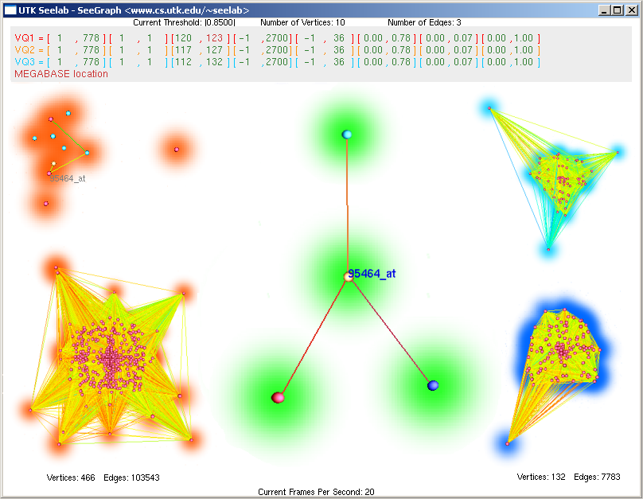
Graph Decomposition Results
Notes:
In this result, we have used database querying to create graphs of multiple paracliques (3 of which are shown here color-coded by vertex and vertex halo colors) to treat as supernodes; the LoD graph was constructed with all paraclique supernodes and original vertices, then the threshold cranked up to the max in order to find one gene that is highly correlated with multiple paracliques constituting a putative coregulator or “master switch” gene known as Pr1 and Tmem37.
Upon further study, the “master switch” gene voltage-dependent calcium channel gamma subunit-like protein which modulates electrical properties of neuronal cells and whose transcript abundance is correlated with stereotyped locomotor behavior induced in BXD mice by drugs such as cocaine or methamphetamine
We also show correlated genes on the same chromosome within 1, 5, or 10 megabases of the target gene as their physical proximity may allow them to help regulate the same networks as their transcripts are highly correlated to many paraclique members, and the QTL that regulates them also regulates many members of both paracliques

Slide 23
Graph Decomposition Conclusions
Contributions
Parameter settings and spring equations for graph layout algorithms
GPU-accelerated shortest path algorithm
Uncertainty-tolerant learning and scripting systems
BTD overview visualization
Method for constructing hierarchical graphs
Software Artefact:
SeeGraph - http://www.cs.utk.edu/~new/SeeGraph
12+ LOC, 101 features (readme.txt)
New methods of visualization, interaction, and handles larger data (50,000+ objects) than other packages
Notes:
We’ve loaded over 1 million items of material science data just for the interactive querying ability

Slide 24
Sections
1
2
3
Graph Decomposition of Multivariate Data
Optimization Framework for Pairwise Relationships
Feature-Specific Identification of a Relationship

Slide 25
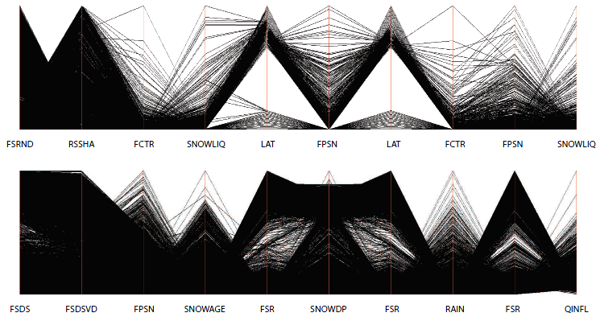
Pairwise Relationships Motivation
Multivariate relationships
Parallel Coordinate Plots
Unsolved problem of axis ranking
Notes:
While graph decomposition can provide a powerful and extensible paradigm for discovering actionable relationships among many data items, it is still important for the scientist to understand the multivariate patterns underlying the expression of that relationship
There exist a method for visualizing multivariate relationships known as parallel coordinate plots (describe based on picture)
*click*
While most parallel coordinate renderers allow a user to select or move the axes of a parallel coordinate plot, this becomes intractable for modern datasets, such as the IPCC climate dataset consisting of tens of thousands of variables
In such a large data space, an algorithm is needed which can detect trends in the data to create an axis ordering for elucidating the multivariate relationship

Slide 26
Pairwise Relationships Background
Graph Analysis (Wegman 1990)
Axis ordering – O(n!) permutations for every adjacency (but redundant)
Graph approach – All vertices adjacent form clique
Apply equation iteratively to cover all permutations
1
1
5
2
5
2
4
3
4
3
1
7
2
6
3
5
4
Thousands of permutations is intractable!
Need optimality criteria to guide a search

Slide 27
Pairwise Relationships Background
Search Criteria (Peng 2004)
Use clutter calculation between each pair of axes and seek to minimize
Brute force is TSP – find shortest path through n cities
Swap algorithm – swap M times but only if it decreases clutter
Can’t display all parallel coordinate axes
Have to find meaningful subsets of the data
Notes:
Heuristic swap algorithm used that essentially performs a stochastic gradient descent of the clutter method similar to genetic algorithms to only allow creation of better individuals; genetic algorithms 2-point mutation through swapping
No way to show all permutations because not enough pixels on a screen; rephrase the problem of finding a meaningful subset based on user-defined metric(s)

Slide 28
Pairwise Relationships Approach
Framework
Allow a user to optimize based on any metric (matrix of numbers)
Correlation
Image analysis of PCP renderings
Data-space clutter detection
Provide mechanisms for constraining search space
Evenly spaced temporal patterns
Patterns among a subset of variables
PCP Axis Layout Algorithms
Brute Force
Heuristic (Greedy, Greedy Pairs)
Graph-based (shortest path)

Slide 29
Pairwise Relationships Approach
Search Space
Brute force search for n variables, k axes
n choose k TSP instances
Generalization of TSP – find shortest path through k≤n cities
Brute force for n=63, k=7 in 6.5 days; stopped n=128,k=7 after 3 months
Heuristic Algorithms
Greedy algorithm – find highest edge weight, add highest edge weight connected to either end of the axis layout
Greedy Pairs – get k-1 highest edge weights, permute to find maximum
Notes:
Greedy algorithm not stable due to sensitivity to the starting location/pair

Slide 30
Pairwise Relationships Results
Brute Force | Greedy Pairs | Greedy
O(n!/(n-k)!) | O(kn²+k!) | O(n²+2kn)
Notes:
Greedy algorithm not stable due to sensitivity to the starting location/pair

Slide 31
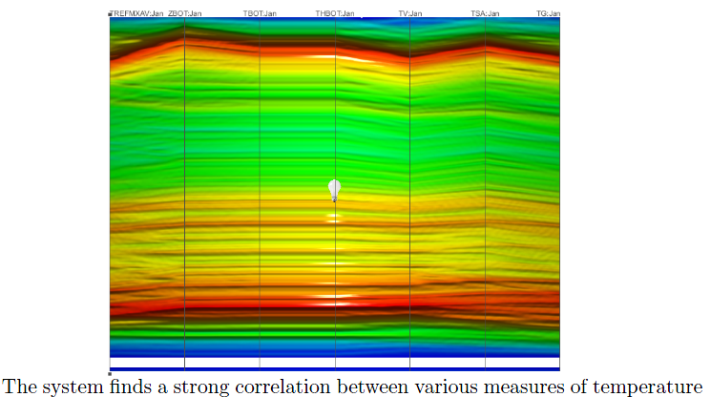
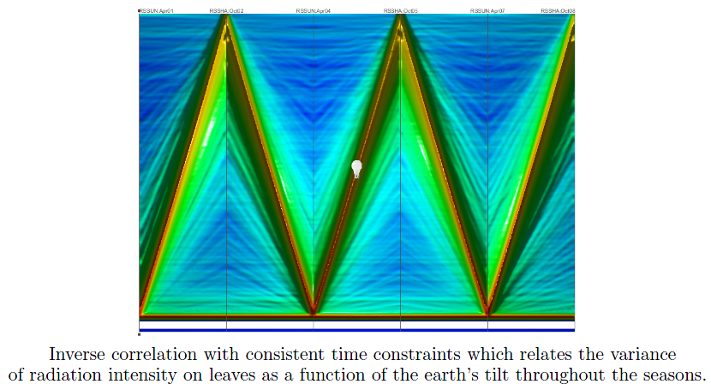
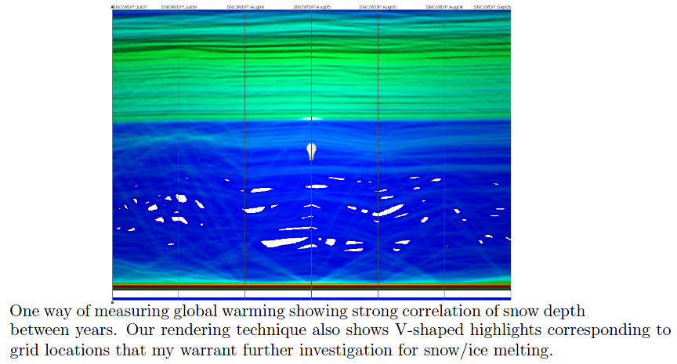
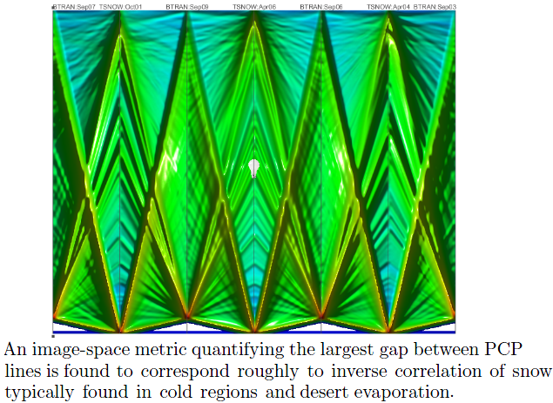
Pairwise Relationships Results
Notes:
Result1: (left to right) TREFMXAV-maximum average temperature at two meters, ZBOT-temperature and humidity at two meters, TBOT-atmospheric air temperature, THBOT-atmospheric air potential temperature, TV-vegetation temperature, TSA-air temperature at two meters, and TG-ground temperature
Result2: RSSUN/RSSHA are measures of leaf stomatal resistance which is dependent upon the incident photosynthetically active radiation. In this PCP, the system has selected axes which are inversely proportional in equidistant months (alternating April/October) in which the direct rays of the sun are at their maximal relative difference.
Result3: Shows a strong correlation in snow depth throughout the years. However, there are some highlighted ridges in our rendering corresponding to grid points whose snow depth have varied significantly and should be checked for location of important polar ice caps.
Result4: We computed the layout from a metric which measures the amount of gap between PCP rendering lines and shows the inverse correlation of snow temperature with evaporation. This is a common sense result to climate scientists in that evaporation occurs most in the hottest regions. However, we learned about the definition of our image metrics: the fact that the largest white spaces occur for plots where values are typically either very high or very low lead to this image (a duality or variant of inverse correlation allowing a possible connection from image space to relation space)

Slide 32
Graph Decomposition Conclusions
Contributions
General framework for matrix definition and restriction
Heuristic algorithms for NP-complete problem
Software Artefacts:
axislayout (added to SeeGraph)
climatize
metrics
seeNC
seeTxt
welify
Notes:
Contributions:
General framework for the creation and restricting assumptions on a matrix of variable relationships
Heuristic algorithms for maximizing a series of pairwise relationships

Slide 33
Sections
1
2
3
Graph Decomposition of Multivariate Data
Optimization Framework for Pairwise Relationships
Feature-Specific Identification of a Relationship
Notes:
So we’ve addressed complex variable relationships defined through graph decomposition as well as optimized pairwise relationship detection…now let us turn our attention to precisely what feature-specific variables underlie these types of relationships

Slide 34
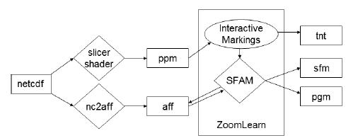
Relationship Variables Motivation
Map relationships to meaningful clusters
Map relationships to individual features if possible
Do this for relationships defined through uncertainty
Let users select items of interest from a visualization
Notes:
In this work, we set out with many lofty goals:
Map relationships to meaningful (domain-specific) clusters
Map relationships to behavior with individual features (in dataspace) if possible
For an extra challenge: Do this with the fuzziest and most ill-specified relationships (those selected by a user from a visualization)
*click*
Boxes denote data files and diamonds denote programs in which data is used to create a visualization image as well as a database of information that a learning system will interactively use based upon feedback from a user in order to determine what the user is interested in

Slide 35
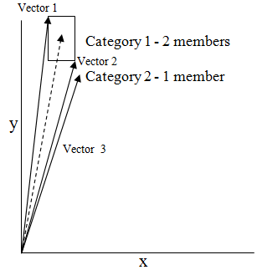
Relationship Variables Approach
Why Simplified Fuzzy ARTMAP (SFAM)?
Advantages
Online, incremental learning system
Fast and fuzzy
Supervised
Complement-coding
Disadvantages
Vigilance Parameter [0,1]
Sensitivity to the order of inputs
Addressing disadvantages
3 SFAMs at 0.75, 0.675, and 0.825
2 SFAMs at 0.75, different order
Notes:
Advantages:
1) It is an online/interactive and incremental learning system meaning that it can both learn and classify user selections as a user successively refines the system’s performance. This circumvents the laborious training time and scrapping/retraining necessary to incorporate constantly changing training datasets common for approaches such as backpropagation neural networks.
2) It is fast meaning it is able to learn in 5 epochs what takes most learning systems 1000s of epochs to learn. This can be used to provide real-time feedback as a user drills down on a specific pattern of interest; fuzzy in that it handles analog processing which incorporates fuzzy learning rules to model uncertainty
3) It is a supervised network (more powerful than unsupervised or reinforced since it is given the correct answer)
4) SFAM compliment-codes the incoming feature vector which doubles the feature vector length by subtracting each incoming feature from unity. This is a strength as it directly encodes the fact that users may be as interested
in the absence of data than its presence.
Disadvantages:
Vigilance parameter is a free variable which determines classification specificity. For example, I’m a male at 0.5, Joshua New at 0.9 and hopefully my SSN is 1.0
Addressing disadvantages:
Use a heterogeneous system of networks and allow them to vote, color-coding the confidence from the “wisdom of the virtual crowd”

Slide 36
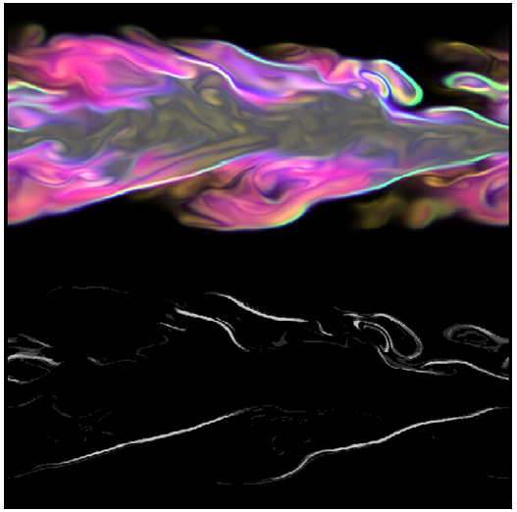
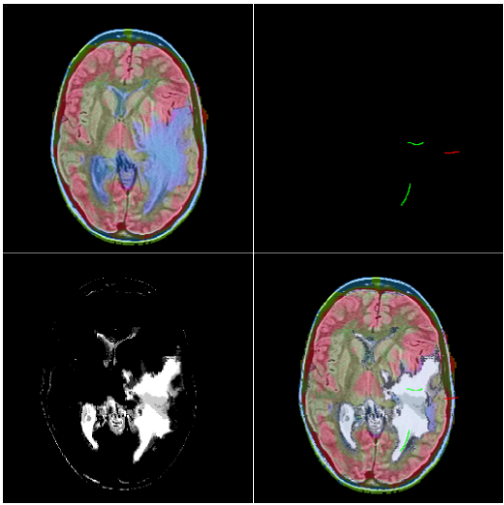
Relationship Variables Results
Notes:
In the turbulent jet combustion dataset, domain scientists are interested in areas along the border of the flame in which extinction and reignition of the flame occur. We use a custom shader to take a slice out of one timestep of this volumetric simulation and map 5 underlying variables to RGB. I simply selected some of the points along the boundaries as examples and other points as counterexamples and the learning system was able to identify the flame boundaries (here) based on only 5 (10 complement-coded) variables at each point.
In this dataset we’ve used image processing to create a color-fused result of multiple image modalities for a patient suffering from metastatic bronchogenic carcinoma (long history of tobacco use); by left and right-clicking, I’ve able to create a decent segmentation of the tumor with only three swipes of the mouse

Slide 37
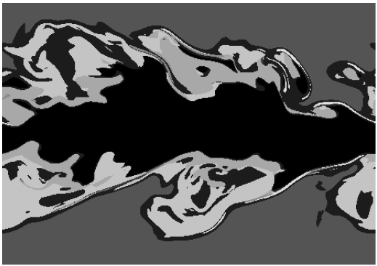
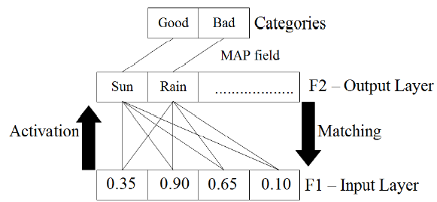
Relationship Variables Results
Notes:
Once we’ve trained the network based upon user selections, SFAM is used to classify the information in the following manner:
The input feature vector comes in for the variables underlying the current pixel
Activation and matching weights are used to determine the winner-take-all output node this item corresponds to
*click*
By coloring each pixel by the output node ID of a network, we can see that 45 training data points have resulted in only 5 categories.
*click*
In fact, by taking the matching weights of each output node, we can see the data centroids of the clusters defined by SFAM’s output nodes which clearly indicate difference in mixfrac (ratio of fuel to air) at boundary where it’s burning off, fuel inside the flame (higher mixfrac than boundary), air outside the flame where there’s nothing, etc.

Slide 38
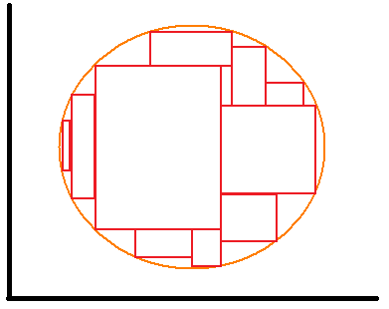
Relationship Variables Approach
Mapping to range queries (approximation with hypercubes)
Data-driven approach
Notes:
Cluster centroids are nice but it’d be better to have a tight definition on what constitutes a certain area of interest
To do this, we use CBRQ (introduced previously)
A hard problem for SFAM is approximating the equation of a circle because it essentially carves out hypercubes in which each output node corresponds to a hypercube; CBRQ carve out hypercubes as well so there’s a 1-1 mapping
While I started deriving math to map the matching weights centroid and activation weight extent to CBRQ, I discovered a more general, data-driven approach in which any clustering algorithm could be approximated using CBRQ by finding the max and min for each cluster.
This is still not completely general as some clustering systems like k-means use hyperspheres which may induce overlap of CBRQ when approximated with hypercubes

Slide 39
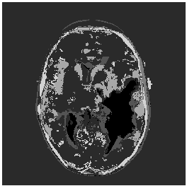
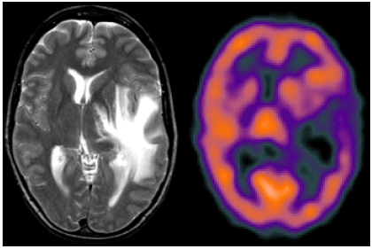
Relationship Variables Results
Notes:
So I wrote a program called pgm2cbrq which takes an ASCII image file of cluster IDs and finds the min and max for each feature for each cluster from the classified data and this is the result for the MRI data.
From the grayscale image, we can see that not only do we have material type for tumor, but also for areas of “edema” surrounding the tumor
Upon inspection of the CBRQ, the feature with the tightest range is a feature corresponding to the difference between the PD modality (proton density) and the spect modality (or blood flow)
*click*
And we can see that is the case from the original PD and SPECT modalities

Slide 40
Relationship Variables Results

Slide 41
Relationship Variables Conclusions
Contributions
Heterogeneous learning systems for interactive image segmentation
Mapping of categories to compound boolean range queries
Software Artefacts:
ZoomLearn
seePC
pgm2cbrq
nc2aff

Slide 42
Relationship Variables Demo
Learning Demo

Slide 43
Conclusions
Graph decomposition involving novel algorithms and visualization techniques was applied to systems genetics data to find individual genes which coregulate entire clusters of genes.
Linkable pairwise trends was used to establish axis ordering for PCPs and find known as well as novel trends in climate data
Ancillary variables underlying relationships for flame boundaries in physical simulation and tumor detection in medical imagery was quantified in a feature-specific manner
Notes:
This study has demonstrated several uncertainty-tolerant techniques for exposing relationships through the use of graph decomposition, linkable pairwise trends, and automated quantification of ancillary variables underlying the relationships.
Graph decomposition contributes novel algorithms and visualization techniques to address systems genetics data to find individual genes that putatively coregulate entire networks of genes
Linkable pairwise trends was addressed in the context of PCP axis ordering and used to find known as well as novel trends in climate data (as well as metric definitions)
Feature-specific variables underlying

Slide 44
Acknowledgements
This work was supported by and used resources of The University of Tennessee, the National Center for Computational Science (NCCS) at Oak Ridge National Laboratory (ORNL), and the Office of Science of the U.S. Department of Energy.
This work was supported in part by NSF CNS-0437508, and through DOE SciDAC Institute of Ultra-Scale Visualization under DOE DE-FC02-06ER25778 and by Dr. Elissa Chesler and Dr. Michael Langston’s UT/ORNL JDRD 2007.
EVEREST PowerWall and lens visualization clusters by NCCS and ORNL’s Visualization Task Group.
Systems genetics BXD data was made publicly by R. Williams and colleagues, manicured by Dr. Chesler et al., and processed by Dr. Langston et al.
Climate data provided by John Drake, David Erickson, and Forrest Hoffman, from the Carbon-Land Model Intercomparison Project (C-LAMP), partially sponsored by DOE SciDAC and the Climate Change Research Division of the Office of Biological and Environmental Research.
Medical imagery from the publicly available Whole Brain Atlas website of Harvard University.
Combustion data provided by Jackie Chen from Sandia National Lab and Kwan-Liu Ma as part of the SciDAC Ultrascale Visualization Institute.
Notes:
(read)

Slide 45
Visual Analytics Techniques for Interactive Exploration of Scientific Data
Thank you!
Questions?
Notes:
This completes my presentation, thank you very much! I will take any questions you may have.

Slide 47
Publications
“Dynamic Visualization of Co-expression in Systems Genetics Data”, Joshua New, Jian Huang, and Elissa Chesler, IEEE Transactions in Visualization and Computer Graphics, vol. 14, no. 5, 1081-1094, Sept/Oct, 2008.
“Time-Varying Multivariate Visualization for Understanding Terrestrial Biogeochemistry”, Roberto Sisneros, Markus Glatter, Brandon Langley, Jian Huang, Forrest Hoffman, and David Erickson III, Journal of Physics: Conference Series (SciDAC 2008), Seattle, WA, July 2008.
To be submitted:
“Pairwise Axis Ranking for Parallel Coordinates of Large Multivariate Data.”, Joshua New, Chris Ryan Johnson, and Jian Huang.
“Exposing the Black Box: Intuitive Representation of ARTMAP Networks”, Joshua New and Jian Huang, ACM SIGGRAPH Asia and ACM Transactions on Graphics.
Notes:
(read)

Slide 48
Graph Decomposition Data Structures - Database
Tree query structure – O(k|V|)
Notes:
A tree is built on a sorted list of data items to skip data items that are out of the specified ranges using cache coherent access of contiguous blocks from a linear list.
Optimizations include: the possibility deleting unwanted data for decreased storage overhead and efficient storage of sparse data sets.
compression can be used to optimize memory usage by trading time for space
Simplifying assumptions including no deleting or modifications to data elements allows faster retrieval time than traditional databases (such as Oracle)
Time is more important than space for interactive query results
This structure also allows us to treat NP-complete problems as a pre-computing step for interactively leveraging computational results from protected intellectual property or highly-optimized algorithms computed with supercomputers such as paraclique routines from Dr. Langston’s group

Slide 49
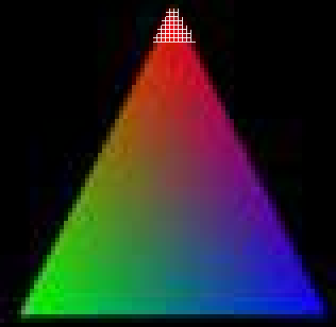
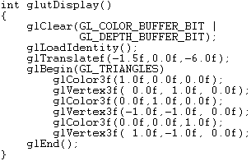
Graph Decomposition Algorithms – GPGPU
General Purpose computation on the Graphics Processing Units
Triangle ~3,042 pixels Each pixel processed by a
fragment processor
each frame (avg shader ~13 lines of code and rarely over 100)
Radeon HD 4670@$70 320procs@750Mhz=240Ghz
Notes:
Using an example, a simple triangle in which 3 colored points are specified using Open-source Graphics Library (OpenGL) contains a deceptively large number of computations.
Video cards have been pushed by the killer app of the gaming market, doubling in capability roughly every 9 months instead of every 18-24 months as is the case with CPUs according to Moore’s Law. Since 2004, API hooks have been introduced to allow custom code to be run on the vertex and fragment shaders (now unified shaders) of graphics cards.

Slide 50
Graph Decomposition Algorithms – GPGPU
Floyd-Warshall is O(n³) but shader program is O(n) where n=|V|
Copy Distance Matrix to Texture
each pixel corresponds to a normalized distance matrix entry
Render nxn quad in n passes
uniform int numVerts; //passed in from OpenGL program
uniform sampler2d data; //distance matrix
void main() {
int k; vec4 dist_ik, dist_kj, dist_new; //gl_TexCoord set by glTexCoord2f(x,y);
for(k=0; k<numVerts; k++) {
dist_ik = vec4(texture2D(data, gl_TexCoord[0].i, k/numVerts));
dist_kj = vec4(texture2D(data, k/numVerts, gl_TexCoord[0].j));
dist_new = dist_ik+dist_kj;
if( dist_new.x < vec4(texture2D(data,gl_TexCoord[0].i,gl_TexCoord[0].j)).x )
texture2D(data,gl_TexCoord[0].i,gl_TexCoord[1].j)).x=dist_new.x;
}
}
Note: vec4 distances are elements of 4 floating point numbers (RGBA)

Slide 51
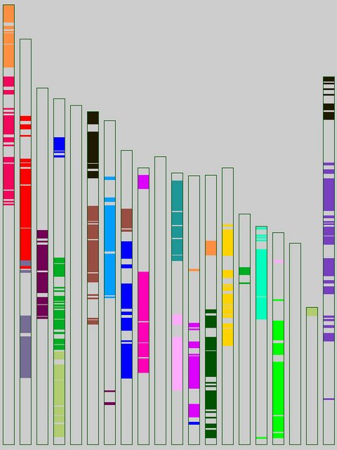
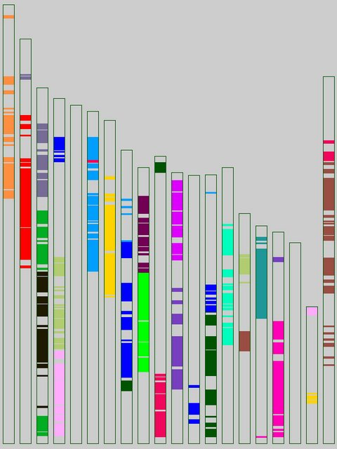
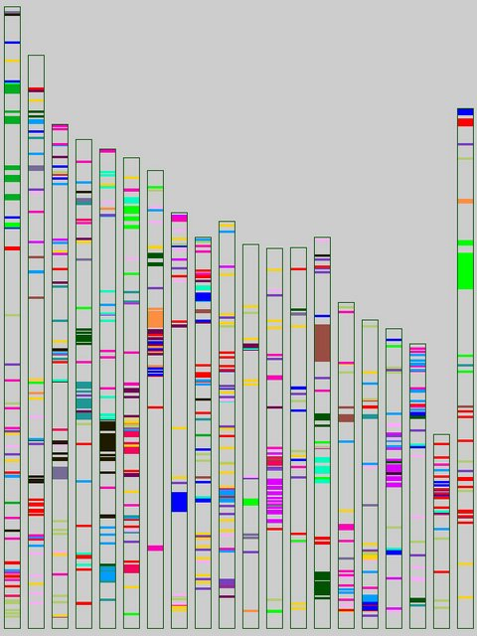
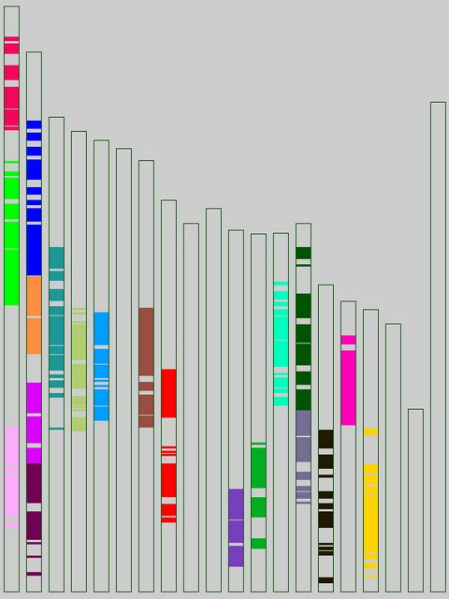
Graph Decomposition Visualization – karyotype
Automatic karyotyping; study of linkage disequilibrium
36axbxa
40axbxa
67si
89bxd
Notes:
Although node-link rendering of graphs and BTD are very powerful tools for the analysis of data, domain scientists are most comfortable looking at data in a manner that is consistent with their prior experience
As a proof of concept, this custom visualization was created in only a few days: these results show different strains of mice with genomes color-coded by the 20 largest paracliques for edge threshold of 0.10 (the lowest available)

Slide 52
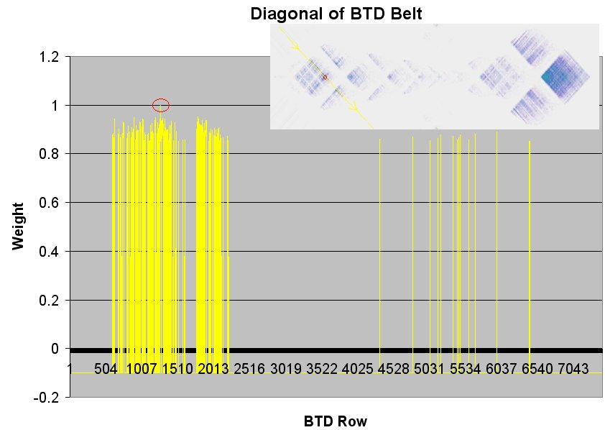
Graph Decomposition Visualization – BTD
Notes:
While BTD uses bandwidth minimization with structure preservation, it is interesting to note that because of the different optimality criteria (bandwidth rather than connectivity), the BTD structure shows information orthogonal to that of paraclique extraction. Though we have some dense structures, the BTD belts show lines for each vertex in the paraclique spread throughout the space.

Slide 53
Pairwise Relationships Background
Graph Analysis (Wegman 1990)
Axis ordering – O(n!) permutations for every adjacency (but redundant)
Graph approach – All vertices adjacent form clique
Thousands of permutations is intractable!
Need optimality criteria to guide a search
1
1
5
2
5
2
4
3
4
3
Notes:
Wegman got it wrong? N=5, (5+1)/2=3; I solved it in 2

Slide 54
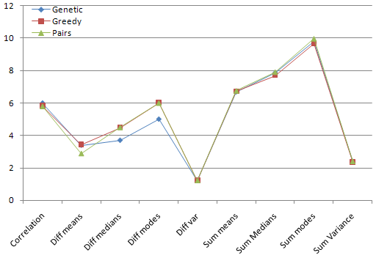
Pairwise Relationships Results
 | Genetic | Greedy | Pairs
Correlation | 5.993752 | 5.8302 | 5.7935
|Diff |means | 3.391725 | 3.429 | 2.872
|Diff |medians | 3.696394 | 4.4882 | 4.4882
|Diff |modes | 4.999826 | 5.9998 | 5.998
|Diff |variance | 1.216008 | 1.2163 | 1.1992
Sum means | 6.685559 | 6.7112 | 6.7525
Sum medians | 7.856794 | 7.6978 | 7.9117
Sum modes | 9.812484 | 9.669 | 9.9755
Sum variance | 2.379634 | 2.33664 | 2.3857
Notes:
Greedy algorithm not stable due to sensitivity to the starting location/pair

Slide 55
