Slide 1
Overview of CURENT
Control Architecture for the Future Power Grid
Kevin Tomsovic
University of Tennessee
CURENT Center Director
tomsovic@utk.edu

Slide 2
NSF Engineering Research Centers
NSF program of focused research on an engineering problem. Among the most significant investments NSF will make in an area with support for up to 10 years.
Program elements include:
  Outreach (K-12 education)
  Research experience for undergraduates
  Entrepreneurship training
  Industry program
  Systems engineering approach
  International collaboration

Slide 3
CURENT – NSF/DOE ERC
One of only two ERCs funded jointly by NSF and DOE. Core budget: ~$4M/year for 5-10 years but highly leveraged to be able to fully support programs.
CURENT only ERC devoted to wide area controls and one of only two in power systems.
Partnership across four universities in the US and various affiliated universities. Many opportunities for collaboration.
Expect 40+ industry members to eventually join. Presently have 36 members.
Center began Aug. 15th 2011 and graduated in 2022 but most of the programs are continuing in some form.

Slide 4
Why CURENT?
Energy sustainability is one of the most fundamental societal challenges.
Changing and uncertain generation mix; reliance on fossil fuels creates significant environmental and national security issues.
Solutions are being pursued which focus mostly on source and load.
  Renewable energy sources, mainly wind and solar
  Electric vehicles and energy storage
  Energy efficient lighting, appliances, and buildings
These solutions require a fundamentally new approach to electric delivery

Slide 5
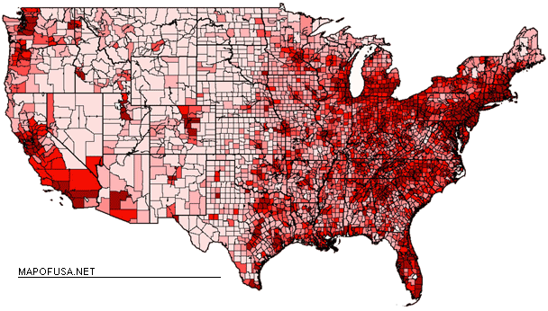
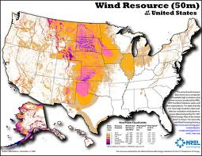
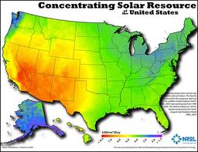
US Wind and Solar Resources
Wind
Population
Best wind and solar sources are far from load centers.
Transmission networks
must play a central role in
integration.
Solar
http://www.eia.doe.gov/cneaf/solar.renewables/ilands/fig12.html
Notes:
5
5
5
Mention wind in central, west
Mention population/load is far from these and grid not designed for such long transmission distances
5

Slide 6
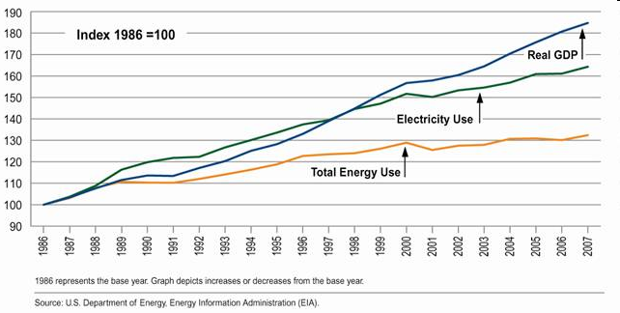
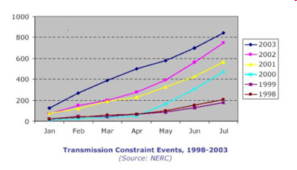
Aging Infrastructure
Growth in electricity consumption
Transmission constraint events
Transmission investment has lagged generation investment and led to several bottlenecks in the Eastern interconnect and Western interconnect.
Limited transmission impacting reliability and cost, preventing full use of renewables
Notes:
6
6
6
Grid aging, not designed for renewables
New breed engineers and leaders need new skills and perspectives
6

Slide 7
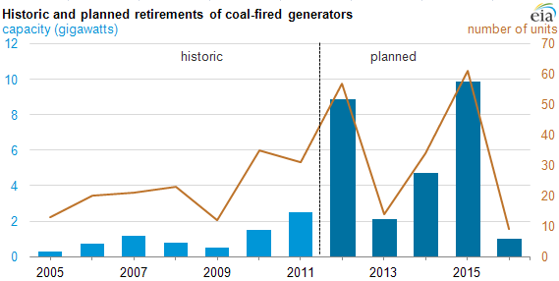
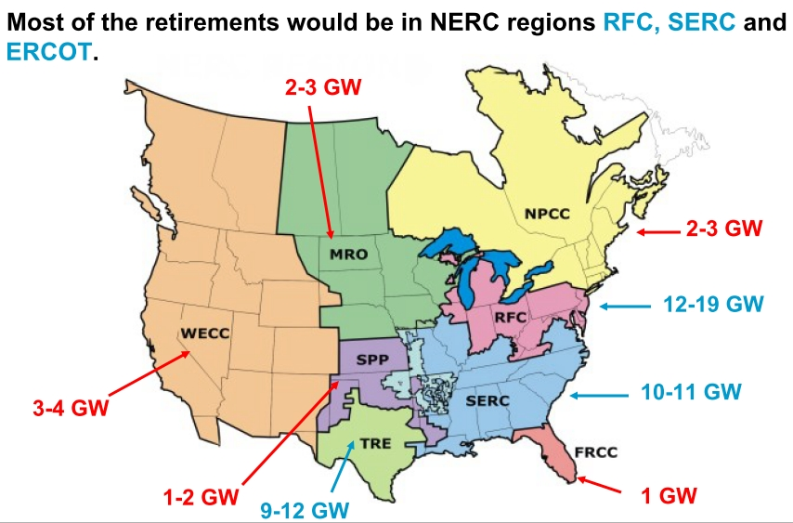
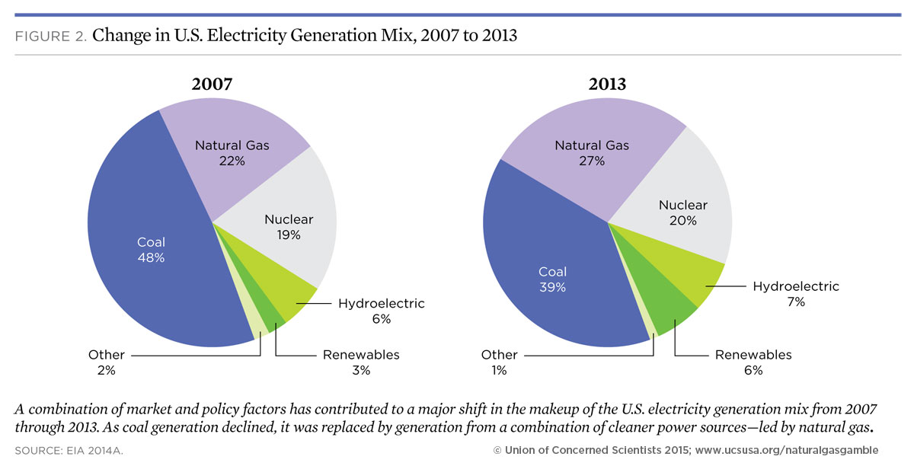
Rapid Retirement of Coal Plants in North America
Change in generation mix challenge long term planning
https://www.eia.gov/todayinenergy/detail.cfm?id=7290
Brattle Group http://grist.org/article/2010-12-13-new-reports-show-huge-wave-of-coal-plant-closures-coming/
http://www.ucsusa.org/clean-energy/coal-and-other-fossil-fuels/natural-gas-gamble-risky-bet-on-clean-energy-future#.VmOc48pgvAo
Notes:
7
7
7
Mention wind in central, west
Mention population/load is far from these and grid not designed for such long transmission distances
7

Slide 8

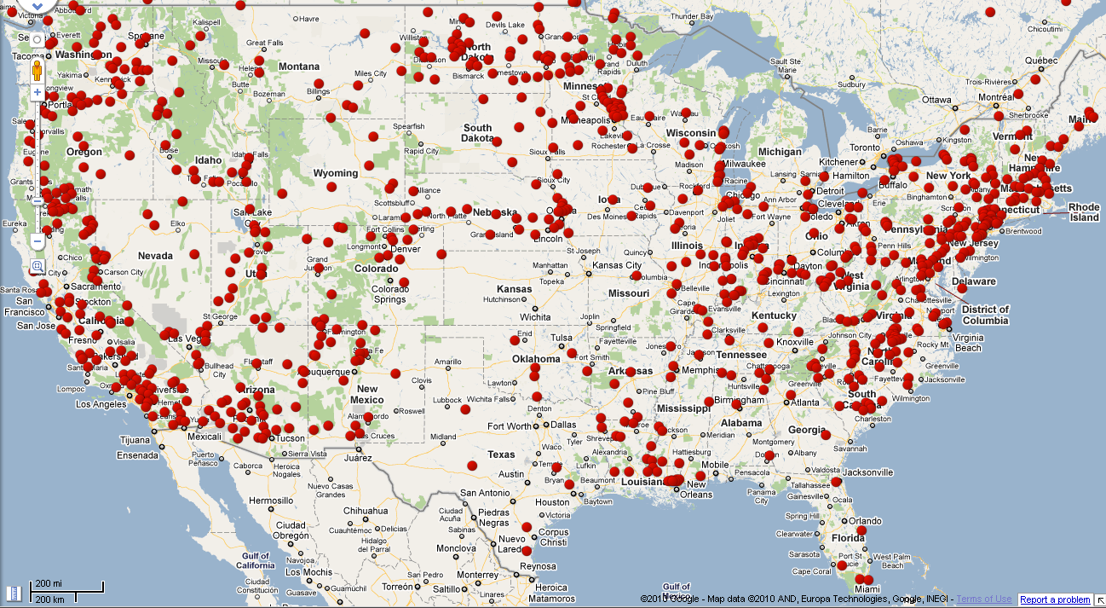
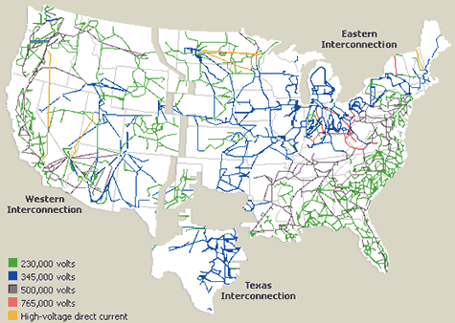
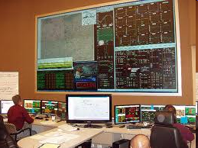

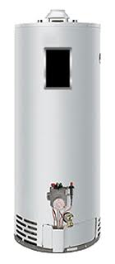
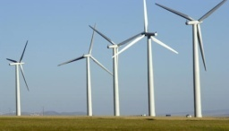
CURENT Vision
A nation-wide transmission grid that is fully monitored and dynamically controlled for high efficiency, high reliability, low cost, better accommodation of renewable sources, full utilization of storage, and responsive load.
A new generation of electric power and energy systems engineering leaders with a global perspective coming from diverse backgrounds.
Wide Area Control of
Power Grid
Power Grid
Measurement
& Monitoring
PMU
FDR
Storage
HVDC
Communication
Communication
Control
Solar Farm
Actuation
Wind Farm
Responsive Load
FACTS
Notes:
Talk about control philosophy and control architecture

Slide 9
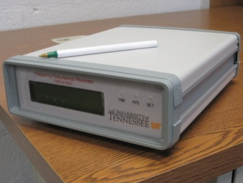
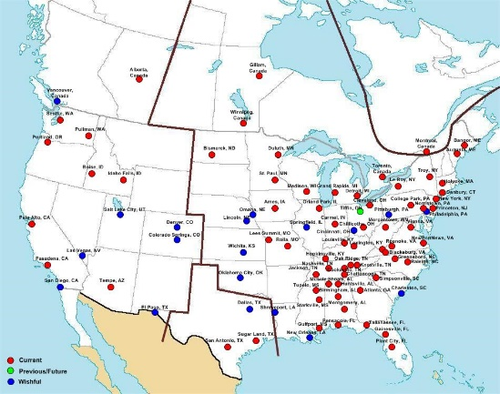
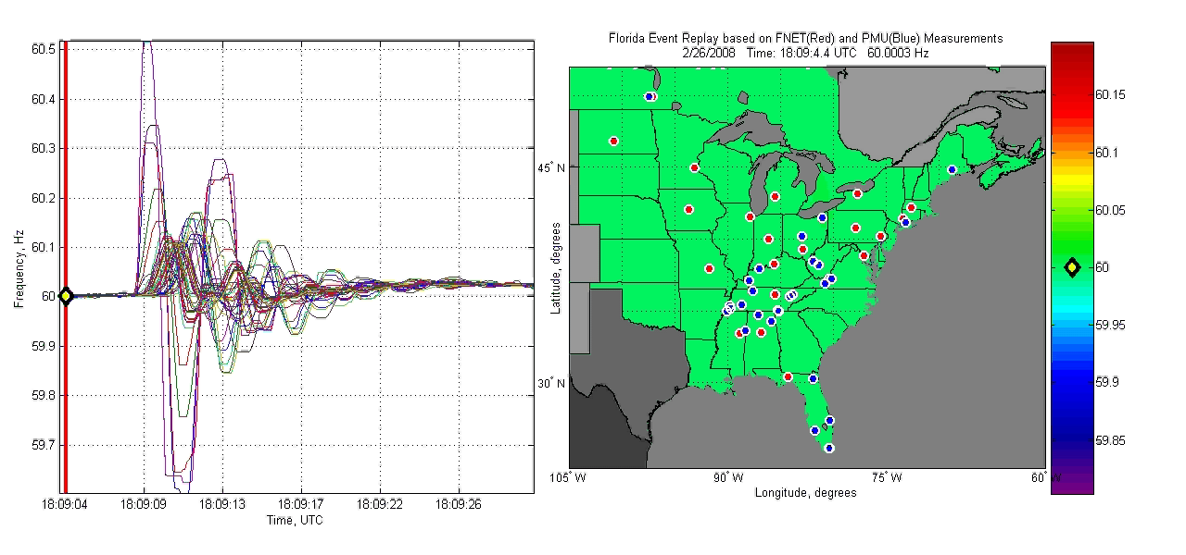
Wide Area Measurement
Unique Capabilities: UWA real-time grid monitoring system at UTK – Yilu Liu
FNET Monitors
in the Field
FDR Sensor
Notes:
Mention FNET developed by Yilu Liu
9

Slide 10
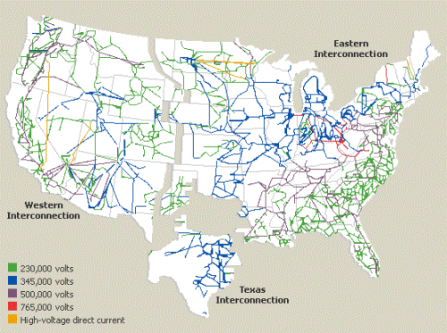
CURENT Engineered System
Today’s System
  Low penetration of renewable energy sources
  Dominated by inflexible AC transmissions; large capacity margin
  Load variability only; generation following load
  Limited situational awareness; mostly local control

Slide 11
CURENT Engineered System
Future System
DOE: “GRID 2030” VISION
Electricity Backbone, Regional Interconnection, Plus Local Distribution, Mini- and Micro-Grids
  High penetration of renewable energy sources (>50%)
  Flexible DC and AC transmissions with small ( ~0) margin
  Load and source variability; responsive load
  High situational awareness; ultra-wide-area control

Slide 12
Today’s Operations
Some wide area and some fast but not both
Ultra-wide
Area
Traditional uncoordinated controls
Distributed coordinated actuation with
extensive measurements
Minimal sensing
HVDC
Limited communication
Wide Area
Balancing
Authority
Unit
Commitment
Economic
Dispatch
AGC
RAS
Schemes
Region
SVC
Fixed Comp.
LTC
Substation
PSS
Device
Protection
AVR
Device
UFLS
Day
Hour
Minute
Second
Cycle

Slide 13
CURENT Control and Coordination Architecture
Global signals
Frequency and time
  Resilience and scalability by
  Distributed – renewables, grid, storage, and demand as active control participants
  Measurements (learning and adaptive, data-driven)
  Modularized, hierarchical, global signals so distributed with context
  Sharing resources (reduced impact of uncertainty)
Wide area measurements
Contextual
Level k
Global /Local
Control
C2-C3
layers
Local measurements
Contextual
Level k-1
C1 tier

Slide 14
Traditional Control/Actuation and Protection
  Generator controls
    Voltage regulation – AVR
    Power system stabilizer – PSS
    Automatic generator control – AGC
    Fast valving, dynamic braking
    Tripping of units
  Transmission
    Switched capacitors and reactors
    HVDC, STATCOM, SVC and FACTS (all limited)
  Load and distribution controls
    Switching
    Shedding for large customers or substations
    Limited voltage (mostly open loop or timed)
  Protection
    Over-current
    Differential
    Out of step
    Pilot relaying (nearby data)
    Special protection systems and remedial action schemes (some wide area information)
  System controls
    Unit commitment
    Economic dispatch (OPF)
    Voltage scheduling
    Load following
  ➔ Mostly local and if non-local probably not closed loop

Slide 15
Traditional Monitoring and Communications
  Communications
    SCADA via remote terminal units – polled 2-4 seconds; sent to control center
    Point-to-point – some pilot relaying; SPS and RAS (all fixed)
    Smart metering and distribution SCADA (still limited)
  Monitoring
    Transmission systems - voltages and currents at higher voltages, status of lines
    Some voltages and currents at lower voltages
    Substations – status, voltages, currents, relatively few PMU units (but rapidly growing), substation batteries, fault recorders, etc. Many variables not available to control center.
    Distribution systems – some status, very few other variables (but this is changing)
    Weather, water conditions, etc., – not well integrated into EMS
  ➔ Generally inflexible, limited in scope and variables monitored

Slide 16
Possible Future Control/Actuation and Protection
  Generator controls
    Contextual – supportive of global state of system
    Variable breakdown along time domain and phenomena (voltage, frequency) dependent on device
    Greater diversity of controls with associated with different unit types
  Transmission
    Pervasive electronics via HVDC, STATCOM, SVC and FACTS
    Other devices?
  Load and distribution controls
    Selective load shedding and scheduling
    Voltage scheduling for improved efficiency and security
  Protection
    New schemes to support overall system operation
    PMU based
  System controls
    Shorter time frame for scheduling (perhaps 5 minutes)
    Tertiary voltage control
    Frequency control replaced by phasor tracking
  ➔ Still have local controls but guided by system and closed loop

Slide 17
Possible Future Monitoring and Communications
  Communications
    SCADA gathers raw sampled data
    Information routing (e.g., publisher-subscriber model)
    Pervasive smart meters and distribution SCADA
  Monitoring
    Transmission systems – line sag, temperature
    Voltages and currents at lower voltages, some PMU
    Complete substation available to control center
    Detailed weather and other event information integrated into EMS
  ➔ Generally flexible, broad in scope and many variables monitored

Slide 18
Major Research Questions
Future Control Architecture
  Information flow
    What information is needed where?
    How much latency can be tolerated?
    Trade-off – more information leads to better decisions but slower response
  Control architecture
    Do all devices contribute to control?
    For which phenomena do devices contribute (some fast and some slow)?
    How much contribution is needed to ensure performance?
    Trade-off – more devices contributing properly expands viable operating region but requires greater sophistication and cost
  Economics and optimization
    What functionality should come from markets and what by regulation?
    Contributions from certain devices are more cost effective
    Trade-off – greater optimization leads to lower cost but requires more voluntary sharing of information and but some services may not lend themselves to an efficient market structure
  Design needs to be a series of trade-offs between communication needs, device sophistication, resiliency, speed of response, economic performance and device reliability vs. system reliability.

Slide 19
Frequency Control
Wide area with distributed actuation
Wide area communication
Distributed coordinated actuation
Ultra-wide
Area
Distributed Frequency Control
Extensive Sensing
Integrated Secure Dispatch and Frequency Control
Wide Area
HVDC
FACTS
Balancing
Authority
Economic
Dispatch
AGC
Demand
Response
Renewables
Support
Region
Substation
UFLS
Device
Day
Hour
Minute
Second
Cycle

Slide 20
Voltage Control
Wide area with distributed actuation
Wide area communication
Distributed coordinated actuation
Ultra-wide
Area
Distributed Voltage Control
Extensive Sensing
Voltage
Scheduling
Wide Area
HVDC
FACTS
Balancing
Authority
Region
Demand
Response
Renewables
Support
SVC
Fixed Comp.
LTC
Substation
AVR
Device
Day
Hour
Minute
Second
Cycle

Slide 21
Example Value of Improved Controls
Northwest Pacific Intertie
  Two 500kV AC lines and +/- 400kV DC line
    Designed for transfer of 2000 MW AC and 1440 MW DC
    Actual capacity was 1300 MW AC due to instability caused by AVRs
    Power system stabilizers allowed increase to 1800 MW AC
    Dynamic brake added at Chief Joe allowed up to 2500 MW AC
  Transmission upgrade – third AC line and DC upgrades
    AC capacity today about 4800 MW (primarily voltage)
    DC capacity today about 3000 MW
  ➔ 1990s work by DOE and BPA on WAMS and WACS a direct result of this type of need for improved controls.

Slide 22
Discussion
Reading list
C.W. Taylor, et al., “WACS – Wide-area stability and voltage control system: R&D and Online Demonstration,” Proceedings of the IEEE, Vol. 93, No. 5, May 2005.
V. Terzija, et al., “Wide-Area monitoring, protection and control of future electric power networks,” Proceedings of the IEEE, Vol. 99, No. 1, Jan. 2011.
K. Tomsovic, et al., "Designing the Next Generation of Real-Time Control, Communication and Computations for Large Power Systems," Proceedings of the IEEE, Vol. 93, No. 5, May 2005.
Notes:
22

Slide 23
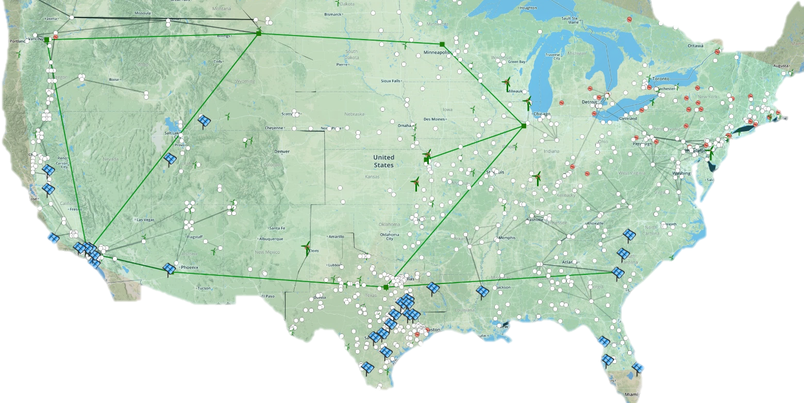
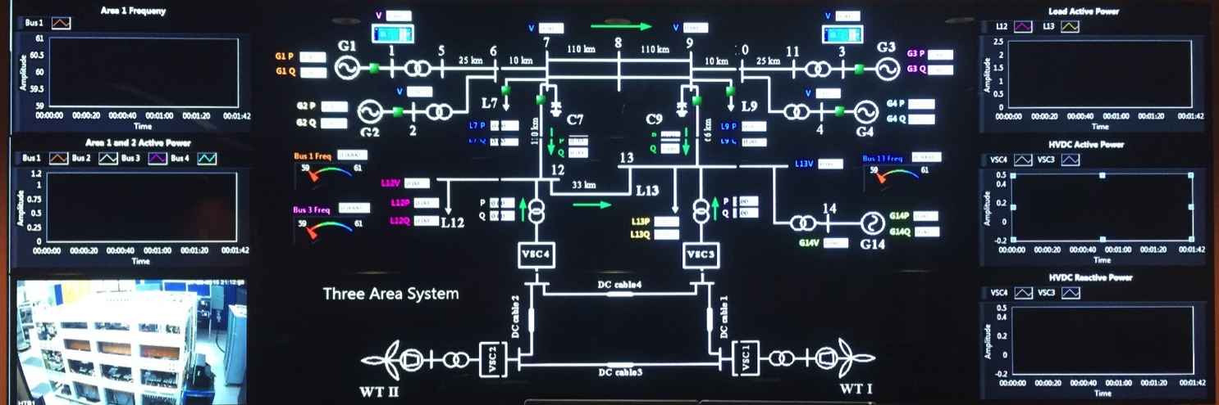
CURENT Testbed Projects
Large Scale Testbed (LTB): Virtual Grid Simulator with an Energy Management and Control System (Matlab based and Commercial-tool based)
Hardware Testbed (HTB):
Grid Emulator Development
and Real-time Scenario Demonstration
Regional and National Power Grid Models

Slide 24


Acknowledgements
This work was supported primarily by the ERC Program of the National Science Foundation and DOE under NSF Award Number EEC-1041877 and the CURENT Industry Partnership Program.
Other US government and industrial sponsors of CURENT research are also gratefully acknowledged.

