Slide 1
Patent Your Ideas in Electric Vehicle Related Power Electronics Domain
Kevin Bai
The University of Tennessee, Knoxville
hbai2@utk.edu
Power and Energy Seminar
February 2nd , 2024

Slide 2
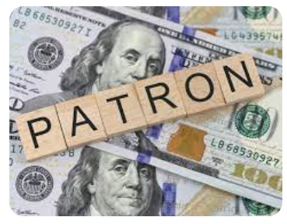
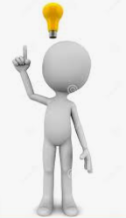

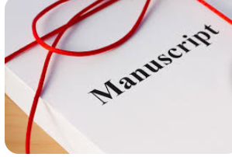
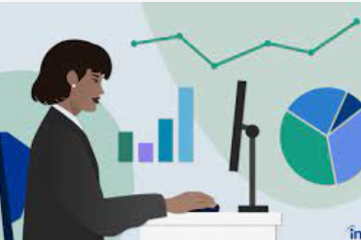
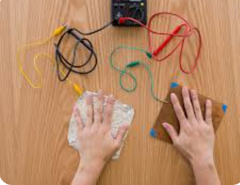
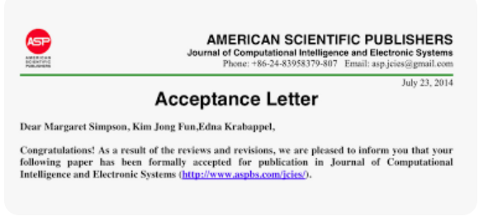
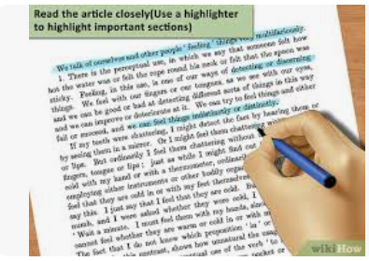
Paper

Slide 3
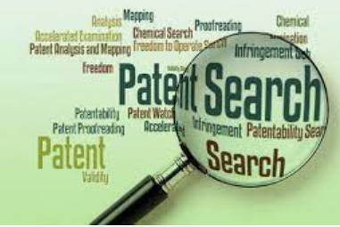
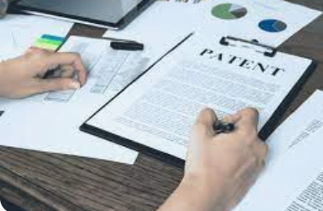
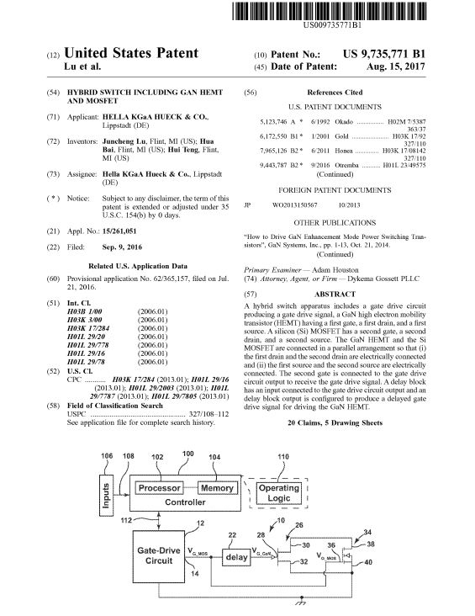
Patent
Notes:
There can be derivative patents; patent is also for preventing others from blocking you

Slide 4
Paper vs Patent
Abstract
Background
Summary
Introduction
Modeling, Analysis, etc
Description of Drawings
Experiments
Detailed Description
Claims
Conclusions
Abstract

Slide 5
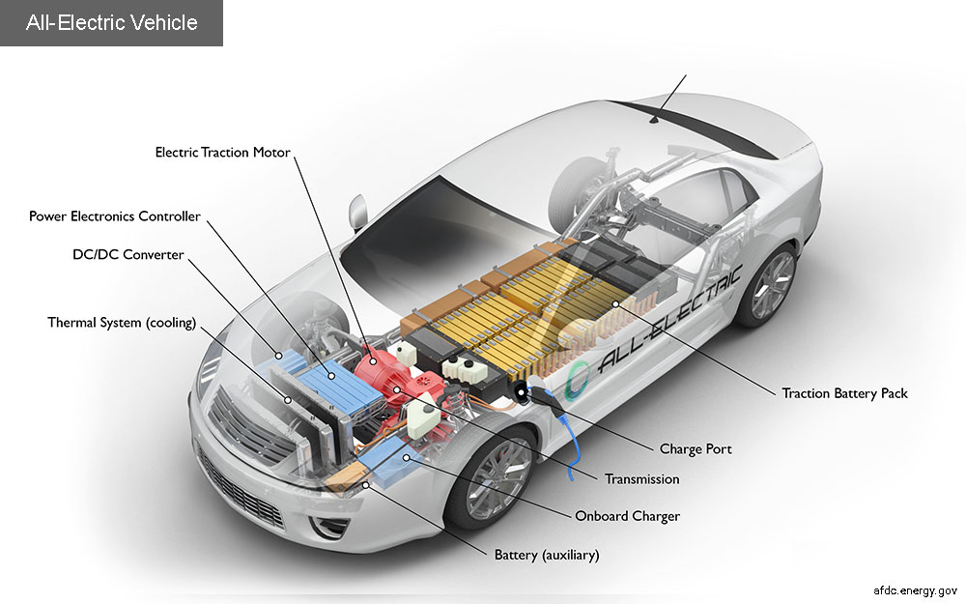
Electric Vehicles

Slide 6
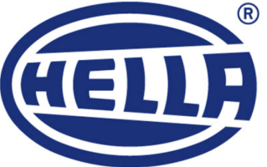
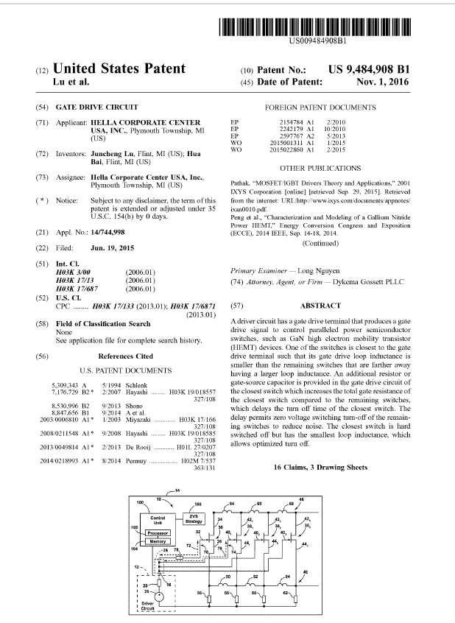
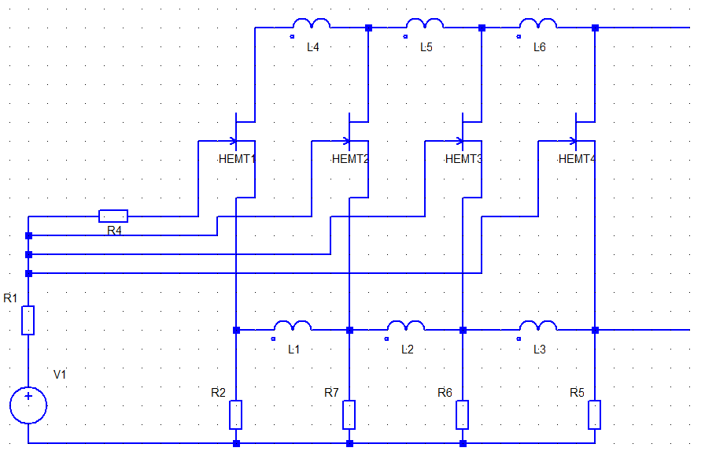
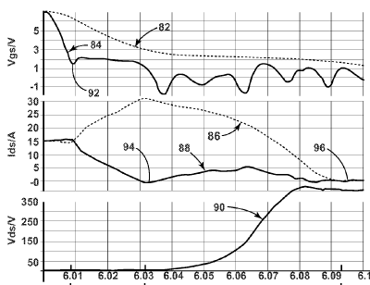
Case Study (1.1)
US Patent. Juncheng Lu, Hua Bai*, Alan Brown and Matt McAmmond, “Gate-drive Circuit,” US 9484908 B1.

Slide 7
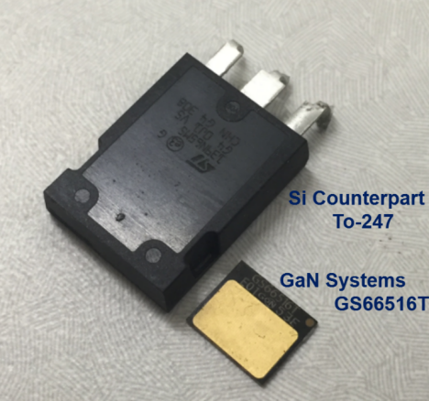
Case Study (1.2)
US Patent. Juncheng Lu, Hua Bai* and Alan Brown, “Hybrid Switch Including GaN HEMT and MOSFET,” US 9735771 B1, 2016.

Slide 8
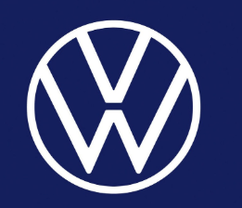
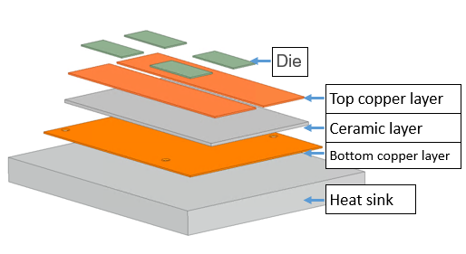
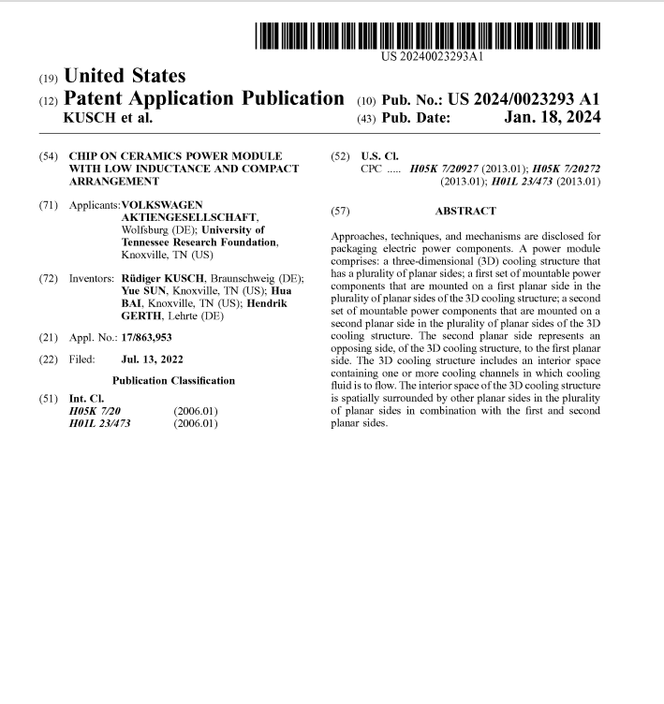
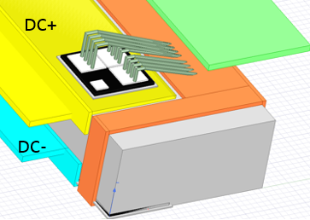
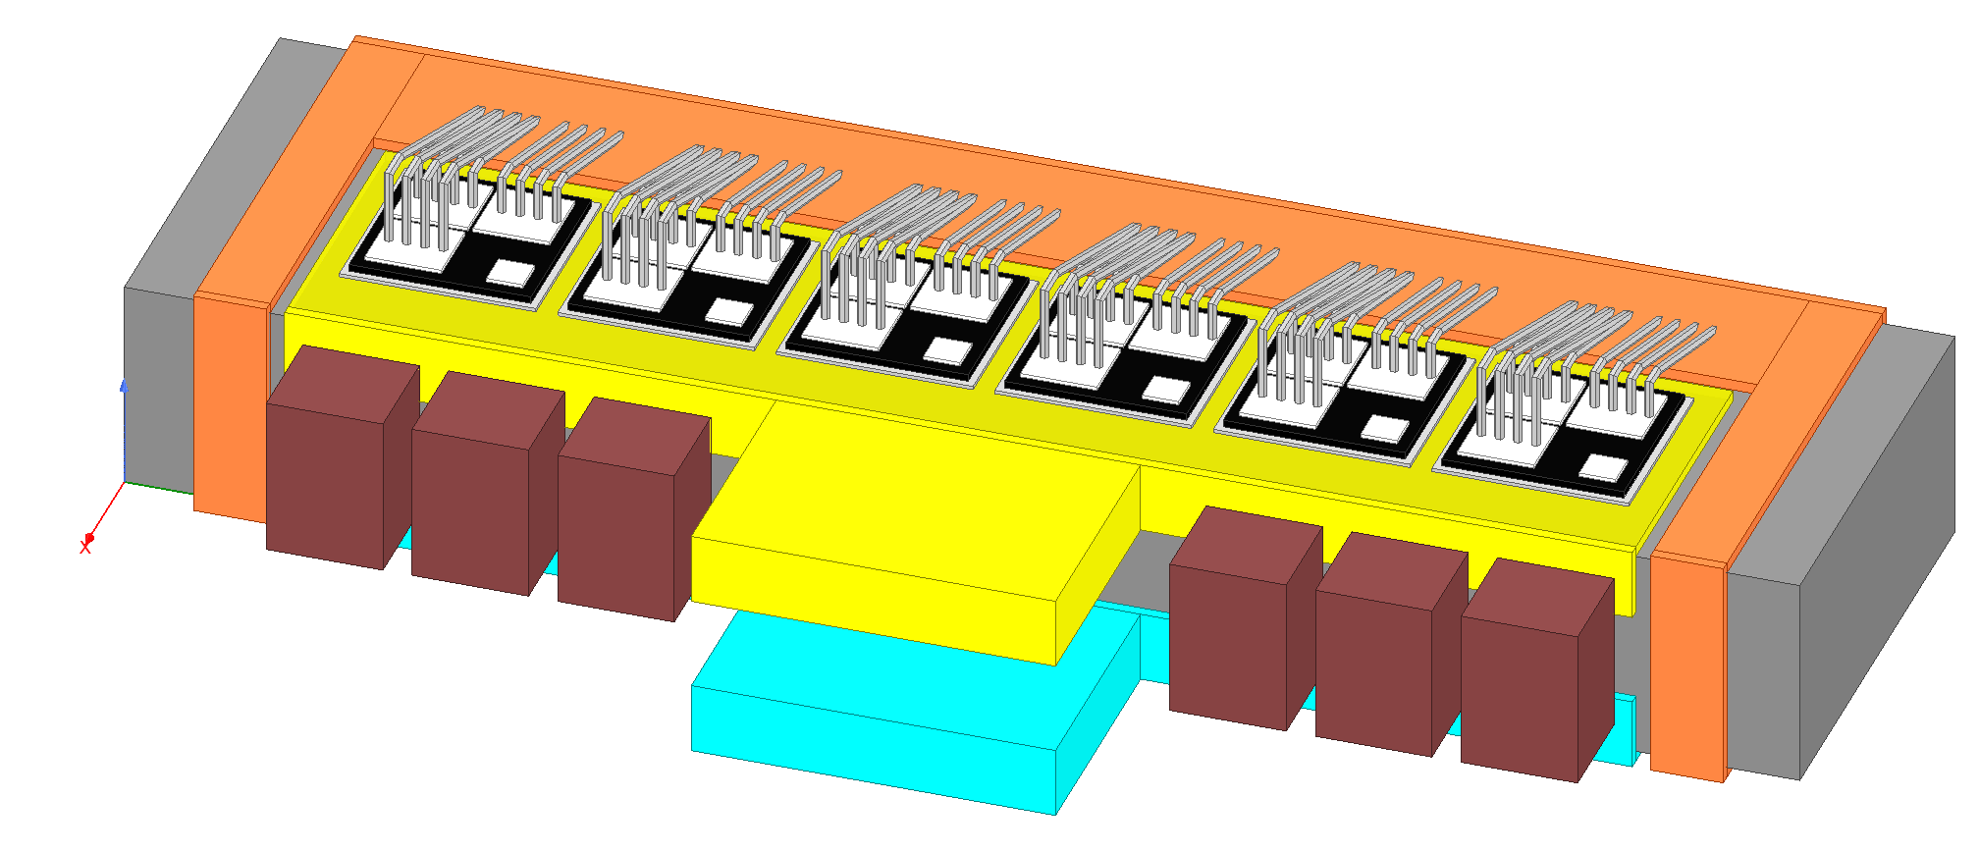
Case Study (1.3)
US Patent. Yue Sun, Hua Bai* and Ruediger Kusch, “Chip on ceramics power module with low inductance and very compact chip arrangement,” With Volkswagen Group of America, US 17/863,953 2022.

Slide 9
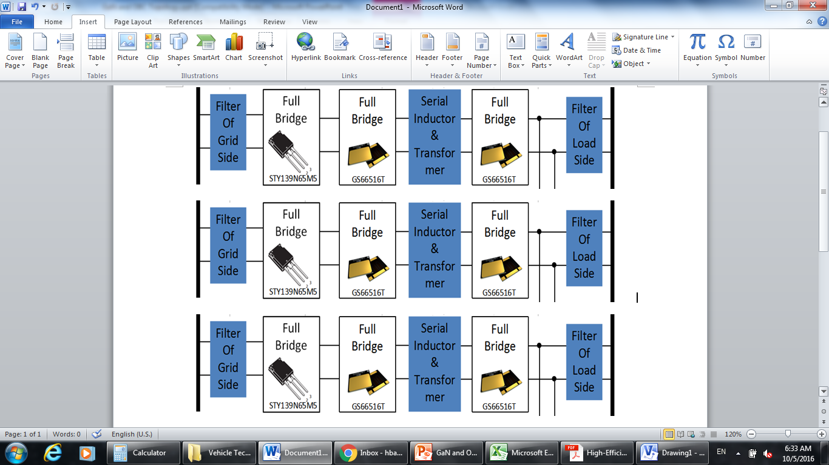
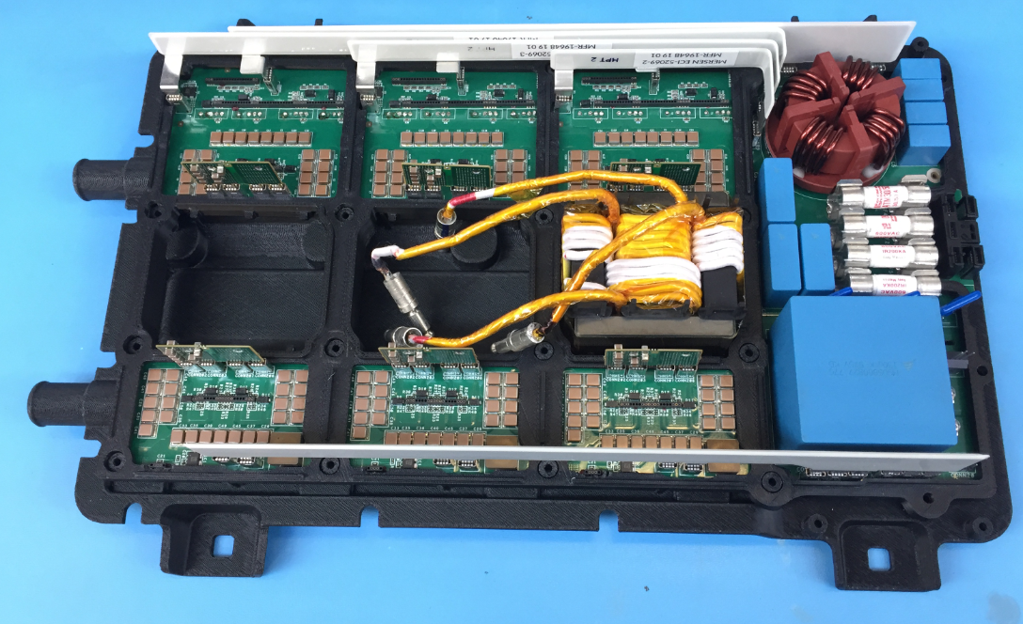
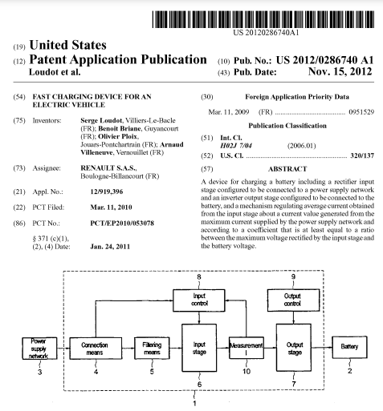
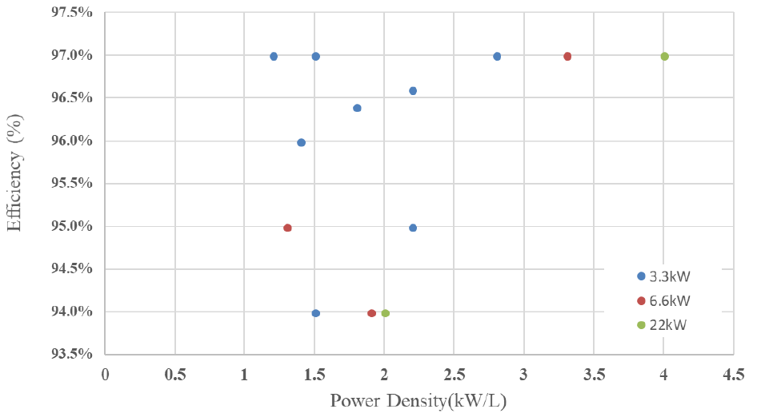
Case Study (2.1)
Final OBC
Efficiency & Power Density
US Patent. Hua Bai and Alan Brown, “Apparatus to realize fast battery charging and motor driving for electric vehicles using one AC/DC converter,” US 10/686,385, 2020

Slide 10
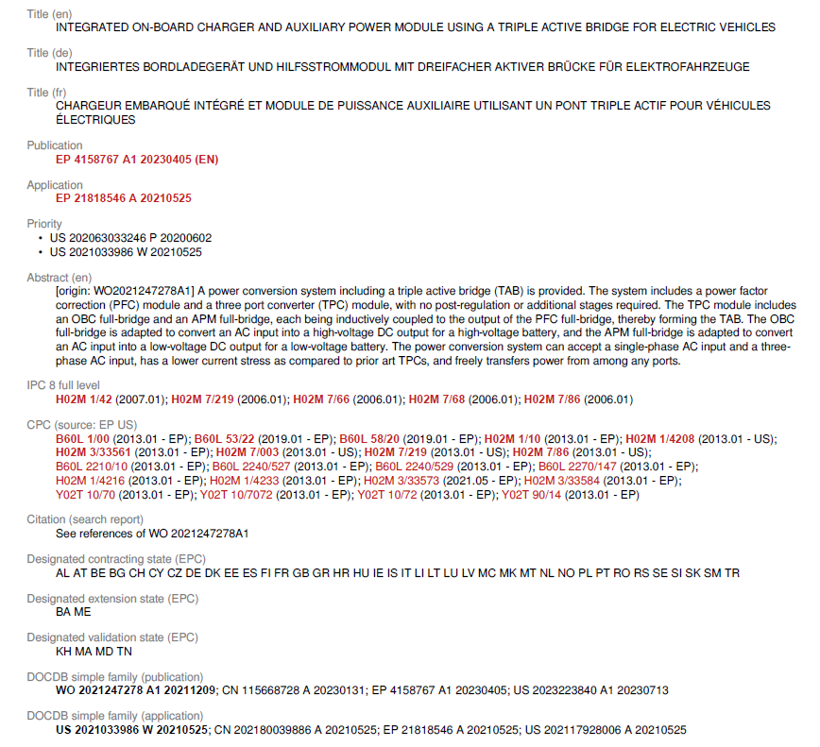
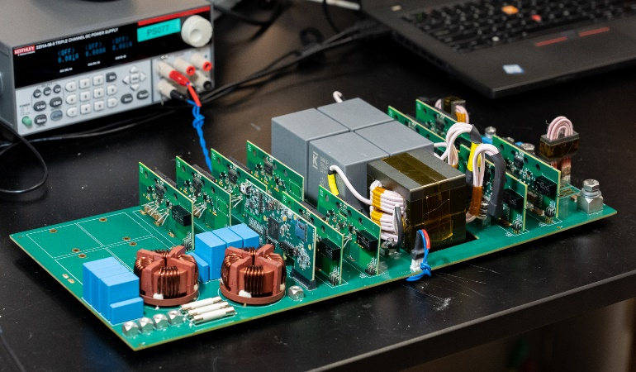
Case Study (2.2)
Final Prototype
US Patent. Liyan Zhu and Hua Bai*, “An Integrated on-board charger and auxiliary power module using a triple active bridge for electric vehicles,” US 17/928,006, 2021

Slide 11
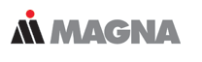
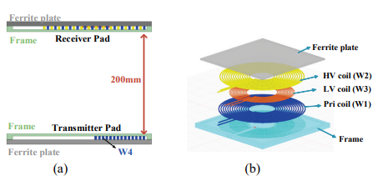
Case Study (2.3)
Global PCT. Liyan Zhu, Ziwei Liang, Yue Sun, Hua Bai* and Headley Phillips, “A Smart and Highly Compact Power Electronics Box to Provide Universal Charging Technologies (OBC, Wireless) Along with DCDC,” US 63/215,667, 2022.

Slide 12
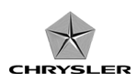
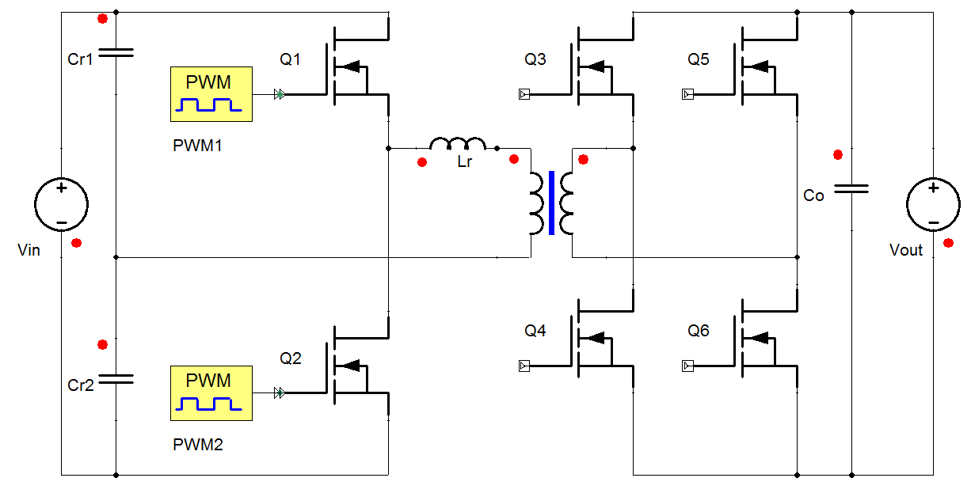
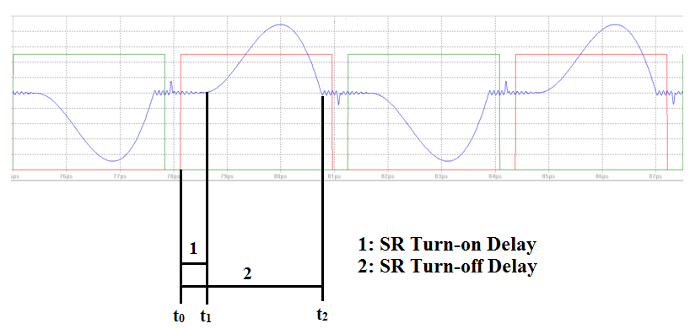
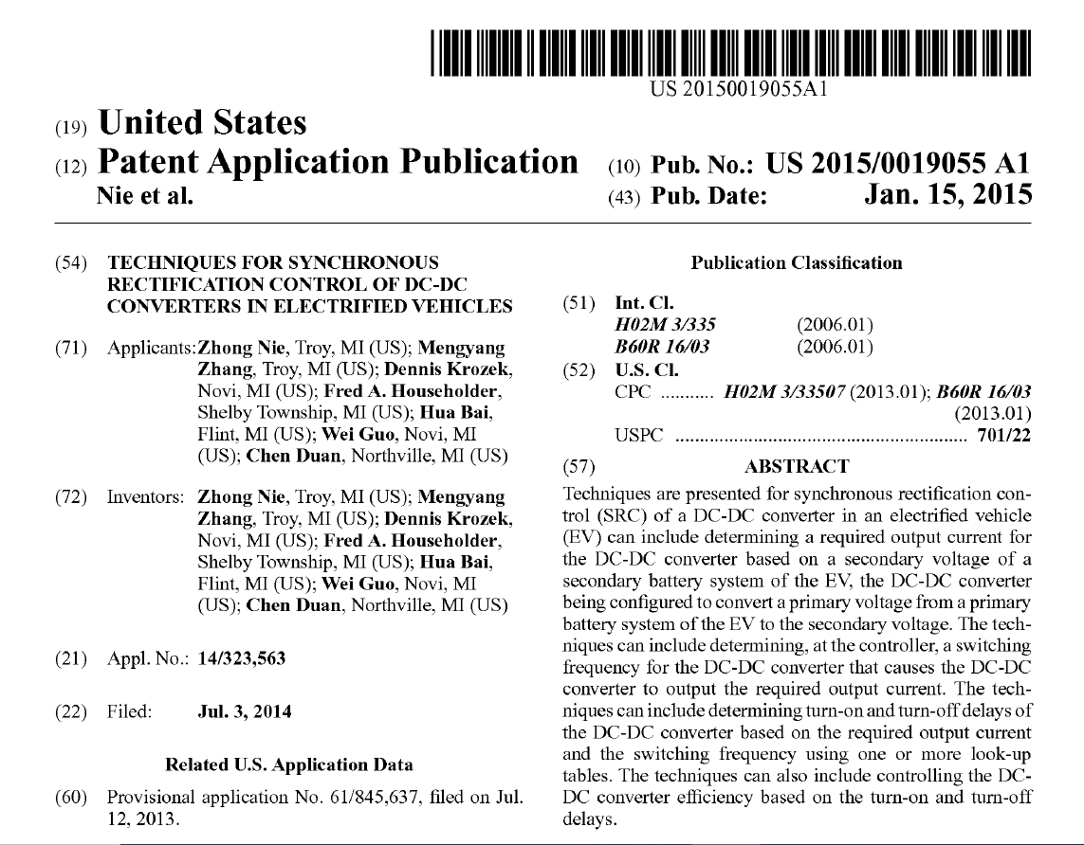
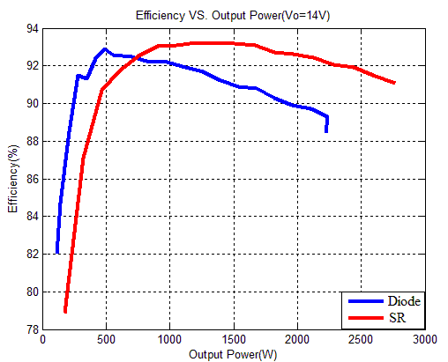
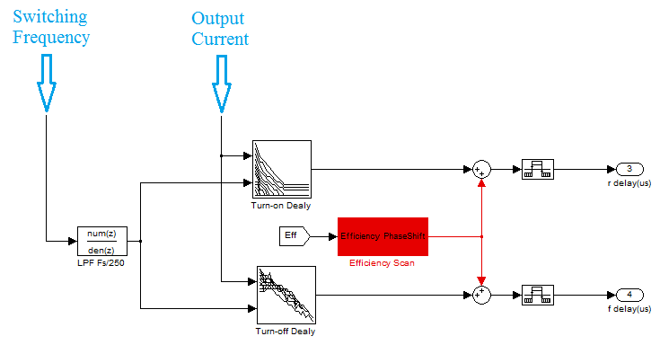
Case Study (3.1): E Alternator
U.S. Patent. Zhong Nie, Mengyang Zhang, Dennis Krozek, Fred Householder, Hua Bai*, Wei Guo and Chen Duan, “Techniques for Synchronous Rectification Control of DC-DC Converters in Electrified Vehicles,” US 9315166 B2, 2014.

Slide 13

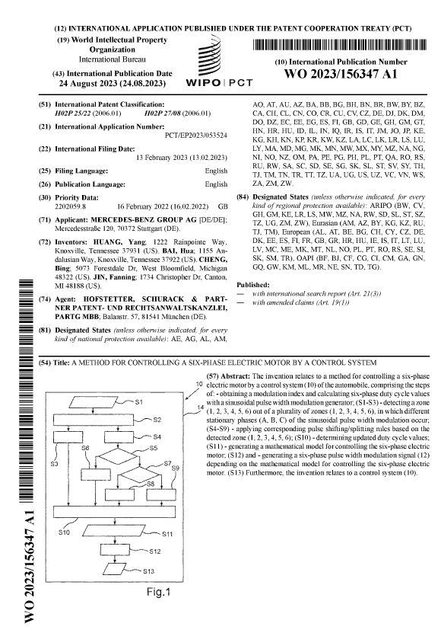
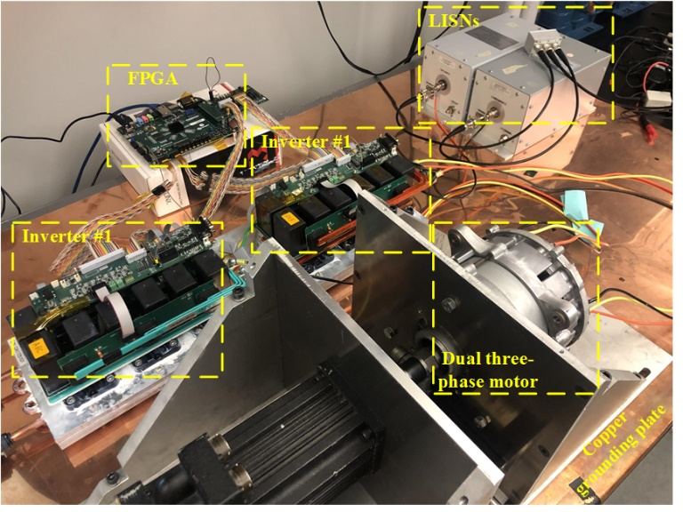
Case Study (3.2) EV Drive CM Reduction
UK/German Patent. Yang Huang, Ximu Zhang, Hua Bai*, Bing Cheng, “A Novel Zero Common-mode Voltage Modulation Scheme for Dual-three-phase Motor,” WO 2023/152367 A1, with Mercedes Benz, 2023

Slide 14
  Conclusion
Patent is not necessarily used to block your competitors, but more to prevent them from blocking you in the future;
Various approaches can be adopted to file a patent;
The multi-disciplinary nature of vehicles yields abundant patent opportunities (charger, inverter, dc-dc, power module, BMS, etc);
Think widely and wildly, then act fast.

Slide 15
