Slide 1
Energy Insecurity Impacts: A Mixed Method Approach with Micro and Macro-level Analysis
Chien-fei Chen, Ph.D.
Research Associate Professor and the Director of Energy & Environmental Justice
Institute for a Secure and Sustainable Environment (ISSE)
Director of Education and Diversity
NSF-DOE Engineering Research Center, CURENT
University of Tennessee, Knoxville

Slide 2
Framework of Energy Justice and Energy Trilemma with
Mixed-Methods
Macro-level:
Census tract, county, regional levels; Temporal & spatial analysis
Energy Efficiency, Housing & Health Equity
Accessibility& Affordability
Extreme Events& Resilience
Sustainability & Fair Infrastructure Transparency
Social-psychological Behavioral & Policy Factors
Community Engagement
Micro-level: Individuals
Survey & focus groups
Concentrated disadvantaged groups (minority women, low-income renters, low-income disable, renters & energy medical needs)

Slide 3
Energy Justice and Justice 40
Energy justice - the concepts of equity, affordability, accessibility and participation in the energy system and energy transition regardless of race, nationality, income or geographic location. (National Conference of State Legislatures).
Fairness, equity, democracy
Justice40 Initiative —a plan to deliver 40% of the overall benefits of climate investments to disadvantaged communities and inform equitable research, development, and deployment within the Department of Energy

Slide 4
Concentrated Social Vulnerability
Energy Burden
> Houses built pre-1980
> Lacks complete plumbing facilities
> Walkability, parks
> No Air-Conditioning
Percent of household income spent on electricity, natural gas, propane & water
Built
Environment
Social-Economic Status
Poverty, unemployment, income, education
Household Composition & Disability
Over age 65, under age 17,
Single-parent or female-headed households,
Persons with disabilities
Race/Ethnicity
Housing Type/Transportations
Multi-unit structures
Mobile homes, crowding
No vehicle, group quarters
Public Support
Assistance program
Health insurance
Access to information
No internet
Minimal or nonexistent English skills
Land Use Decision
Climate & Environmental Impacts
> Natural hazards – extreme heat, flooding, drought
> Air pollution; Potentially hazardous & toxic sites
> Risk management plan site
> Treatment, storage & disposal sites
> Lead, coal, etc.
Urban/rural boundary
Forest, Mining
Grassland
Cultivated crop
Biodiversity
Water
> Respiratory conditions (asthma, COPD)
> Chronic conditions (e.g., obesity, diabetes, cardiovascular issues)
> Poor mental health conditions
> Healthcare access
Indicators will be combined by assigning a quintile score to each of them (1 = least vulnerable to 10 = most vulnerable). Ranks will be added to create an overall vulnerability score
Health
Vulnerability

Slide 5
Beyond the Cost - Multidimensional Energy Insecurity
Behavioral | Physical health | Social-psychological
Trade-offs between household essentials: heat-or-eat; prioritizing rent or food over utilities; etc. Using inadequate heating sources: using oven for heat. Using unsafe fuel alternatives: burning trash, wood, peat, etc.; using solid carbon-based fuels; etc. Unsafe financial behaviors: taking out payday loans; playing “catch up”; prioritizing other bills; etc. | Thermal discomfort: keeping the home warmer/cooler than needed; heightened risk of fire due to unsafe alternatives. Poor ventilation: poor indoor air quality; mold; excess moisture; dampness. Inability to access medical services/supplies: telemedical services; electricity needed for medical equipment. Inability to store & prepare food: lack of access to refrigeration; unsafe food storage and preparation. | Psychological stress: anxiety; maladaptive coping; depression; sleeping disorders; etc. Education and work: lower educational attainment; missing school or work due to illness; unable to work from home. Bundled hardships: food, housing, water, and energy insecurity; limited resilience reserve.
Utilities, Landlords, Community Organizations, Energy Policy, and Law

Slide 6
Behavioral patterns are different when examining across subgroups and people are not just one kind…

Slide 7
Energy Behavior, and Technology Usage in Daily Life
1. U.S. Residential Energy Consumption Survey (RECS) conducted by Energy Information Administration (EIA) every 3 years;
  5,686 households, nationally representing 118.2 million housing units, with the “final weight” considered; 1,944 LIHs, 2,715 MIHs, and 1,027 HIHs, representing 43.0 million, 55.4 million, and 19.8 million residents in each category
  Survey blocks of interest: appliances, space heating, air conditioning, lighting, EE appliances (e.g., energy star products), smart grid technology, household characteristics (e.g., household size, income), energy practices and energy assistance (e.g., energy affordability and assistance received)
  The American Time Use Survey (ATUS) -3,584 LIHs, 4,885 MIHs, and 2,024 HIHs (N=10,493)
Notes:
Behavior patterns are different when looking closely on subgroups: People are not just one kind…

Slide 8
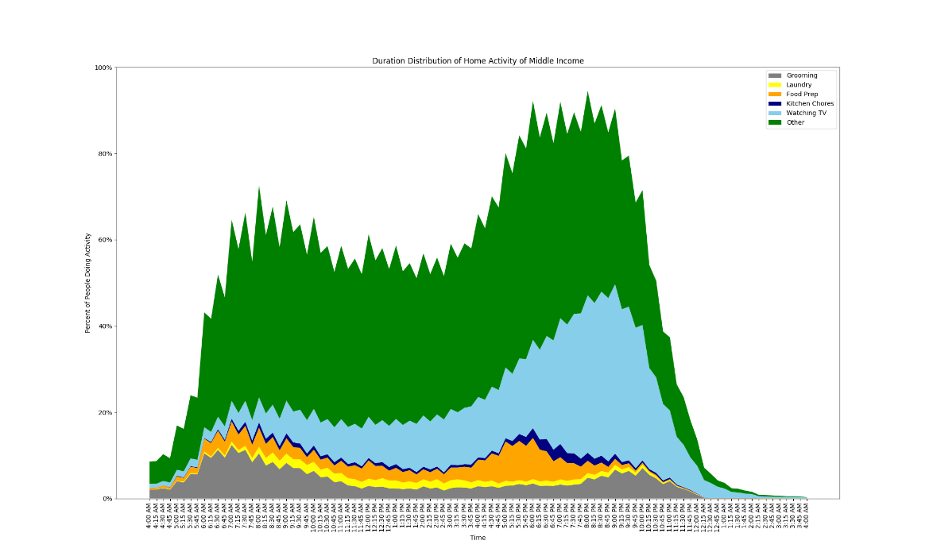
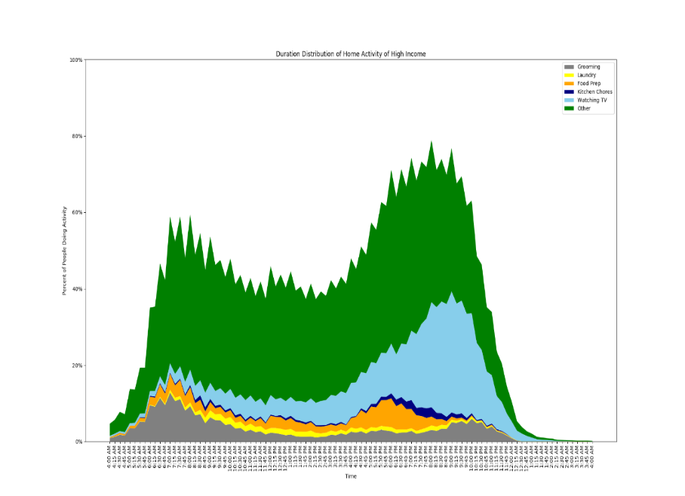
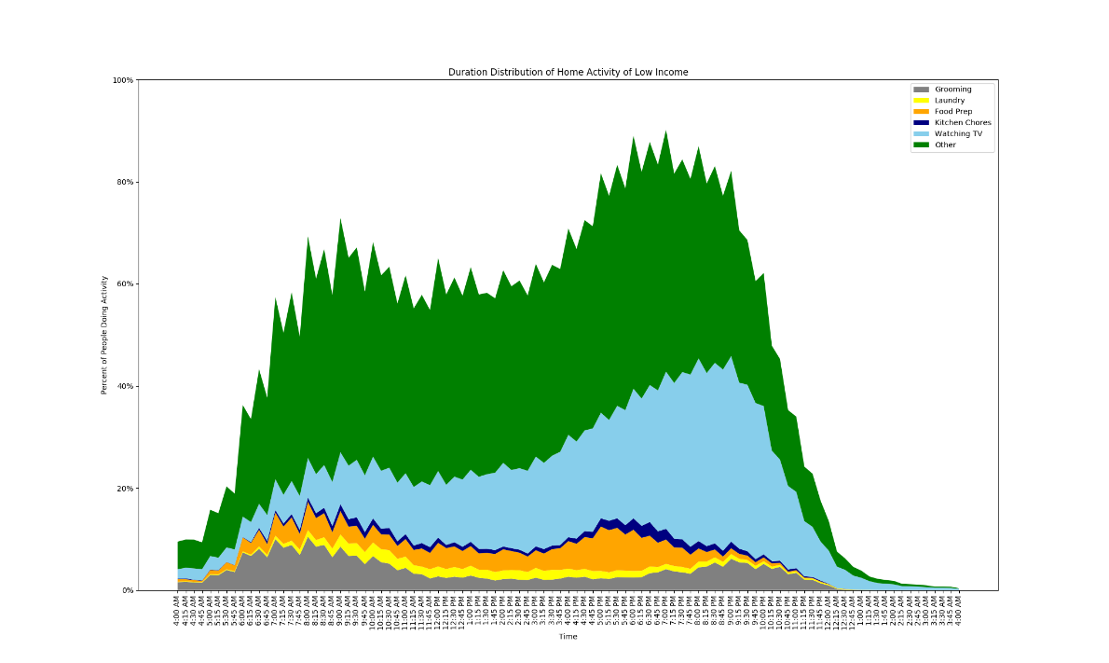
24 Hours of Household Activities Across Income Groups based on American Time Use Survey (ATUS)
LIHs
MIHs
HIHs
4 AM
7:45 AM
7:45 PM
4 AM
7:45 AM
7:45 PM
7:45 PM
7:45 AM
Level of summed activities is higher among LIHs from 7:45am to 7:45pm.
Morning peak is narrower and bigger day-time valley for HIHs. For HIHs, morning peak ends around 9 AM; MIHs ends around 10 AM; LIHs keeps stable after 10:30 AM.
Evening peak starts: LIHs- 4 PM; MIHs- 5 PM; HIHs- 5:30 PM.
Higher percentages of LIHs watched TV during the day
Higher percentages of LIHs engaging in laundry and food preparation during the day.
Grooming
Laundry
Food Prep
Kitchen Cleaning
Watching TV
Other

Slide 9
Space Heating Behaviors– Thermostat Control Strategies
Entire Sample
Owners of Programmable Thermostat
(52% of the entire sample)
Thermostat control strategies

Slide 10
Space Heating Behaviors: Income and Thermostat Set-points
Heater thermostat set-points at home by income and homeownership
Income and homeownership have significant impacts on thermostat set-points (base on chi-square test and regression models);
LIHs tend to set their heating temperatures higher, especially low-income renters.

Slide 11
Accessibility Justice of Low-income Households (LIHs)
Higher cost per sq. ft
LIHs spend more per square foot (M =
$1.67) than MIHs (M = $1.19) and HIHs (M
= 0.97), F(2, 5683) = 143.25, p < .001.
Low rates of receiving assistance
5.5% of households received assistance to pay bills or fix heating and cooling equipment
Low rates of participation in energy efficiency (EE) programs
Energy Efficiency Programs | Total | LIHs | MIHs | HIHs
Free or subsidized home energy audit | 2.1% | 1.6% | 2.4% | 2.2%
Utility or energy supplier rebate for new appliance or equipment | 3.6% | 1.9% | 4.0% | 5.8%
Recycling of old appliance or equipment | 5.6% | 3.2% | 6.3% | 8.8%
Tax credit for new appliance or equipment | 5.5% | 1.6% | 6.3% | 11.8%
Xu., X., & Chen, C.F. (2019). Energy Efficiency and Energy Justice for US Low-Income Households: An Analysis of Multi-Facet Challenges and Potential. Energy Policy, 128, 763-774.

Slide 12
Access to Smart Grid Technologies(智能電網技術)
LIHs do not have sufficient access to smart grid technologies (connecting with internet access)
Very few residents have actually viewed smart meter data (recording energy consumption data)
LIHs may be at disadvantage for demand response programs for reducing energy demand during peak hours and energy cost

Slide 13
Energy Burdens-Macro level (National Scale)…

Slide 14
Macro-Level: Energy Burden and Concentrated Disadvantage
Examines neighborhood locations, and socio-demographic and health indicators influencing energy burden (EB), accounting for electricity price in 2020
Demonstrates EB is not only a result of high household poverty but also of the high rates of residential racial-segregation experienced by people of color, particularly Black and Latino communities.
Research Questions:
What are the patterns of EB in terms of neighborhood and regional effects?
What are the main social-economics, race/ethnicity & health factors influencing EB, accounting for electricity price?
What are the link between EB and concentrated disadvantaged groups?

Slide 15
Social-economics and Health Predictors based on Concentrated Disadvantage Framework
State-level electricity price – as a control variable
Social vulnerability index (SVI) – a validated metric that uses census tract and county-level data include four themes: (1) socioeconomic status; (2) household composition and disability; (3) minority status and language; (4) housing type, transportation, household composition, and disability.
Public assistance in income, or welfare: provides cash payments, temporary Assistance to Needy Families (TANF), Supplemental Security Income (SSI) and noncash benefits (food stamps)
Families with female household heads: share of women householders with no spouse or partner present
Below poverty: people with household incomes at or below 200% of the Federal Poverty Level (FPL)
Households with disable population, aged 65 and aged below 17
Without health Insurance: estimate residents’ overall level of safe and secure employment
COVID-19 confirmed cases and mortality

Slide 16
Seven Representative Big Data Sources
American Community Survey (ACS)
CDC’s Social Vulnerability Index (SVI)
COVID-19 Community Vulnerability Index (CCVI)
U.S. Department of Energy’s Low-Income Energy Affordability Data (LEAD) Tool
U.S. Energy Information Administration (EIA)
John Hopkins’ COVID-19 Data
Safegraph Data Consortium
EB – Historical energy expenditure (electricity, fuel, and natural gas) and burden estimations among medium & low-income households (LIHs) were collected from the LEAD Tool by the National Renewable Energy Laboratory (NREL) and Department of Energy, and 2020 state-level energy expenditure data from Energy Information Administration (EIA).

Slide 17
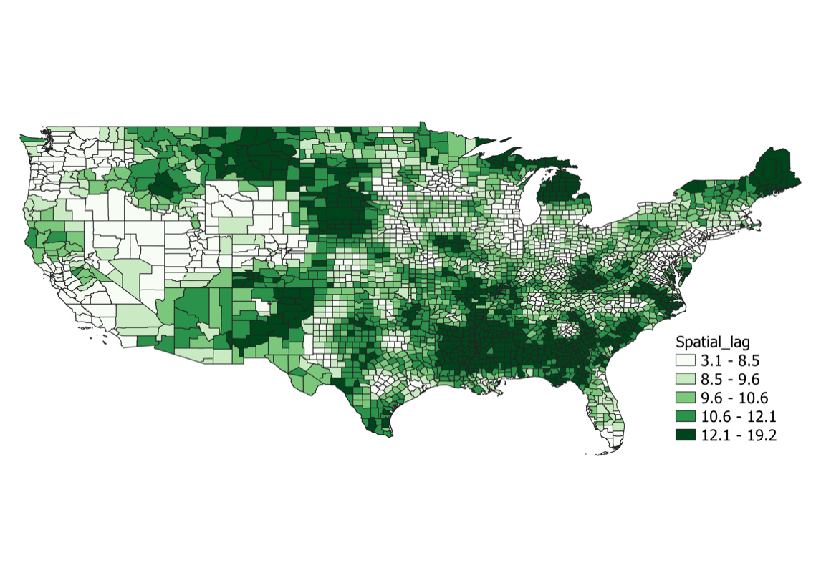
Low-Income Households’ Energy Burden (% of income spent on utility bill) based on DOE’s Data in 2020
Shen, Z., Chen, C.-F., H., Zhou, Fefferman, N. & Shrestha, S. (2023). Community vulnerability is the key determinant of diverse energy burdens in the United States. Energy Research and Social Science, 97, 102949.
Alabama, Kentucky, Mississippi, Tennessee

Slide 18
Energy Burden Distribution in 2020
Shen, Z., Chen, C.-F., H., Zhou, Fefferman, N. & Shrestha, S. (2023). Community vulnerability is the key determinant of diverse energy burdens in the United States. Energy Research and Social Science, 97, 102949.
East South Central: Alabama, Kentucky, Mississippi, Tennessee
West South Central: Arkansas, Louisiana, Oklahoma, Texas
South Atlantic: Delaware, DC, Florida, Georgia, Maryland, North Carolina, South Carolina, Virginia, West Virginia

Slide 19
Energy Burden over 20% by County Level in 2020
Georgia State average of energy burden was 12.63

Slide 20
Macro-Level: Median EB of Low-income Households in Rural & Urban Areas
5-year Average (2014-2018) & 2020
Areas | EB 2020 (%) | EB 2018 (%) | EB Difference (%) | Expenditure 2020 ($) | Expenditure 2018 ($)
Rural | 11.53 | 11.42 | 0.11 | 214.28 | 211.80
Urban | 8.60 | 8.54 | 0.05 | 174.69 | 173.44
Note: Based on the Kruskal-Wallis H-test
Rural LIHs spent 25.2% more on monthly utilities (an additional $38.37/month, $460.44/year) than their urban counterparts between 2014-2018.
This disparity grew marginally larger in 2020, as rural LIHs spent 25.4% more on utilities (an additional $39.59/month, $475.08/year) compared to urban LIHs.
Energy burden (EB): Rural areas have an average monthly burden of 11% or more, which is higher than those of urban areas. EB= % of income spending on utilities.
Notes:
Counties are identified as urban if they, in any way, spatially intersect “urbanized areas (UA) and urban clusters (UC)” as classified by the 2010 U.S. Census. UAs are comprised of contiguous census blocks that contain at least 50,000 people, whereas a UC contains between 2,500 and 50,000 people

Slide 21
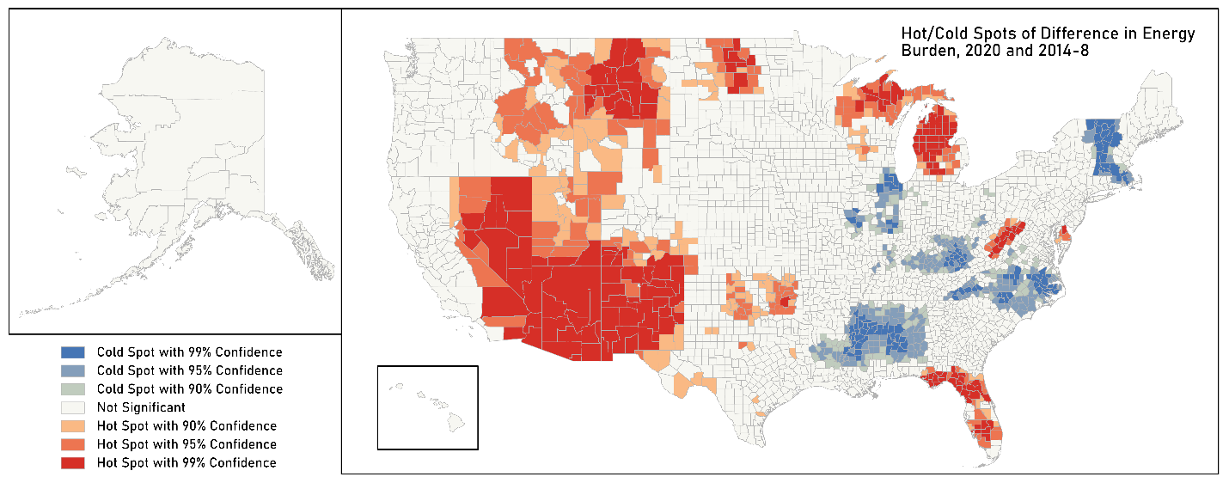
Hot/Cold Spots of Energy Burden Difference
2014-2018 vs. 2020
Blue indicates statistically significant spatial clusters of counties with decreased difference in energy burden, while red spots indicate increased difference in energy burden between 2014-2018 and 2020.

Slide 22
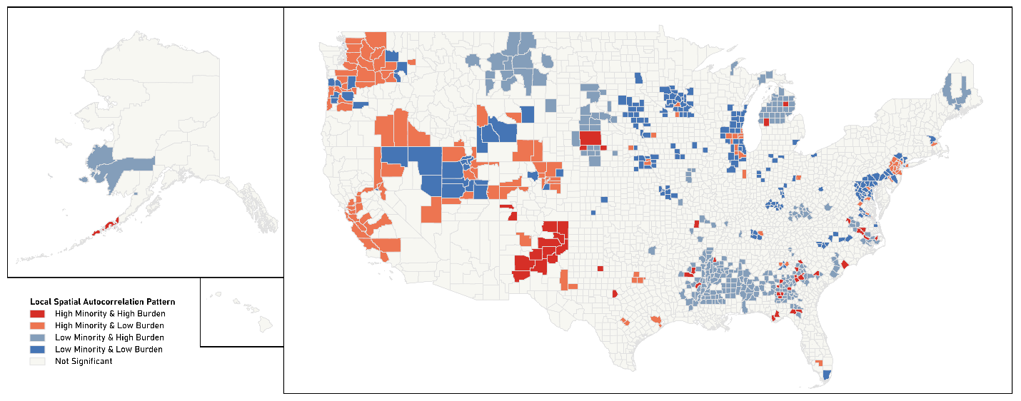
Interaction of Hispanic Population and Energy Burden (% of income spending on utilities) in 2014-2018 & 2020
Bivariate hot spot map: Lincoln (40.7% Hispanic & 19.6% EB), Guadalupe (37.1% Hispanic & 19.5% EB), Socorro (37.1% Hispanic & 16.1% EB), and San Miguel (35.2% Hispanic & 15.0% EB) are a few counties in New Mexico where a sizable cluster of both a large Hispanic population and high EB exists in 2020.
*Chen, C-F., Feng, J., Luke, N., Kuo, C-P, & Fu, J.S. (2022). Localized energy burdens and
concentrated disadvantage and the feminization of energy poverty. iScience, 25, 104139.

Slide 23
Energy Burden, Social Vulnerability Index & COVID Variables
SE = socioeconomic status,
HD = household composition & disability
ML = minority & language
HT = household type & transportation, EF = epidemiological factors
HS = health care system factors
The green (orange) shaded cells present their mean values are lower (higher) than their corresponding national mean values.
East South Cantal: Alabama, Kentucky, Mississippi, Tennessee
West South Central: Arkansas, Louisiana, Oklahoma, Texas
Shen, Z., Chen, C.-F., H., Zhou, Fefferman, N. & Shrestha, S. (2023). Community vulnerability is the key determinant of diverse energy burdens in the United States. Energy Research and Social Science.

Slide 24
Energy & Health- Micro Level

Slide 25
Latent Variables and Survey Measurement
  What to do when you do not have exact data to measure occupant behavior?
  Are you measuring the subjective concepts you are supposed to measure?
  A good definition of measurement is based on the theory → a good operational definition that is theoretical sound and practically measurable.
Latent variable or construct – a theoretical entity or construct that is used to explain one or more manifest variables. They cannot be directly measured but rather are approximated through various measures to assess part of the given construct (American Psychological Association)
Measure of subjective occupant behavior is a latent variable: thermal comfort, perceived indoor environment quality (IEQ), job satisfaction, attitudes toward energy saving;
Other examples: trust in utilities, cyber security, EV/AC data privacy concern
Latent variables lead to technology and policy adoption & decarbonization behaviors

Slide 26
Relationship between Mental Health and Heating Issue & Utility Hardship
US Sample | Dependent variable: Psychological stress
Independent variables | Standardized Coeff. (Beta) | Std. Error | F
Experience of heating predicament (equipment broke, could not pay for electricity, could not pay for gas, ran out of fuel) | .442*** | .015 | (1,1988) = 481.613***
Utility hardship (unsafe or unhealthy temperature, close off part of home, reduce expenses for meal or medicine, threaten disconnection from utilities) | .453*** | .015 | (1,1988) = 514.297***
Unsafe or unhealthy temperature | .282*** | .020 | (1,1988) = 171.241***
Close off part of home because could not afford to heat or cool it | .341*** | .020 | (1,1988) = 261.908***
Reduce expenses for meal or medicine | .454*** | .020 | (1,1987) = 515.766***
Threaten disconnection from utilities | .382*** | .017 | (1,1988) = 340.01***
Energy burden also increase psychological stress
*p < .05, ** p < .01, ***p < .001.

Slide 27
Energy Insecurity, Indoor Environmental Quality (IEQ) and
Mental Health – the UK Sample (N=2000)
IEQ difference across demographic groups
Regression result on energy/internet burden and IEQ
Regression result on IEQ and mental health
IEQ-1: Thermal discomfort:
Felt uncomfortably cold for extended periods, keep uncomfortable level temperature, put on more clothes, wrap up in blankets or use a hot water bottle to stay warm, unsafe/unhealthy temperature
IEQ-2: Poor housing quality:
Air quality/ventilation, too cold, weak roof and/or leaks, mold, cold water, lighting, noise

Slide 28
Utility Hardship, Behavior, IEQs and Mental Health
 | Independent variable: Mental Health
Dependent variables | Standardized Coeff. (Beta) | Std. Error | F
Utility hardship (disconnection threaten from utilities, unable to heat due to broken equipment, choose between paying bills and buying necessities (e.g. food, medicine, childcare), could not bathe or wash hands because water is too cold, skipped meals for paying utility bills) | .613*** | .011 | (1,2586) = 1560.704***
Changes in energy behaviors (more heating/lighting, lighting, hot water use, kitchen appliance use, electronic device use) | .183*** | .011 | (1,2586) = 90.092***
Thermal discomfort (felt uncomfortably cold for extended periods, keep uncomfortable level temperature, put on more clothes, wrap up in blankets or use a hot water bottle to stay warm, unsafe/unhealthy temperature) | .606*** | .014 | (1,2586) = 1498.803***
Poor housing quality (air quality/ventilation, temperature, weak roof and/or leaks, mold, cold water, lighting, noise) | .565*** | .012 | (1,2586) = 1210.951***
*p < .05, ** p < .01, ***p < .001.

Slide 29
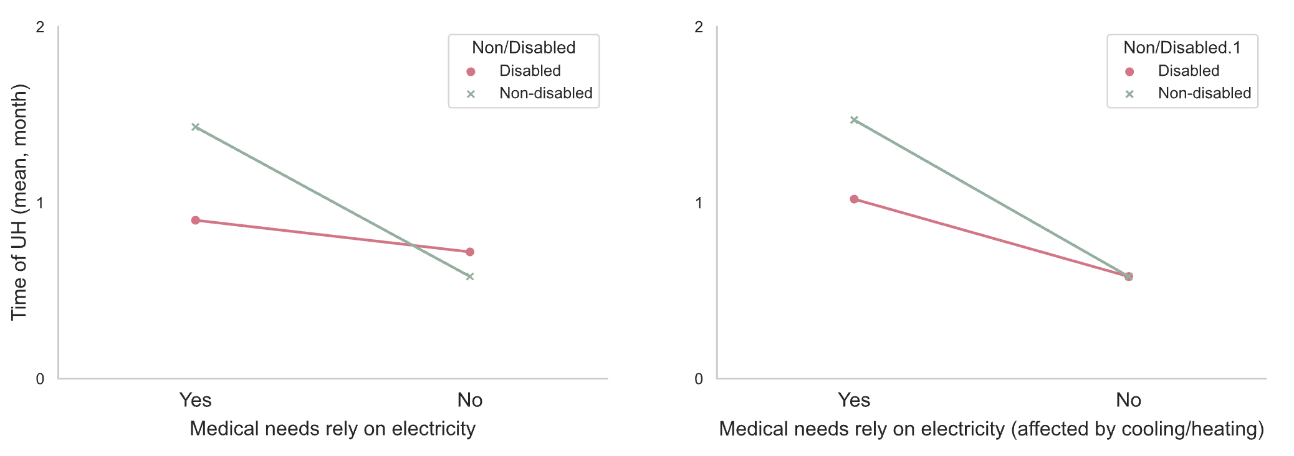
Utility Hardship and Interaction of Medical Needs * Disability
How many month has the participants experienced UH from March to June 2020 (within 4 month)
M= 1.43
M= 1.47
M= 0.72
M= 0.58
M= 1.02
M= 0.9
M= 0.58
M= 0.58
F(1,1986)=14.633***
F(1,1986)=8.201**
Non-disabled with medical needs that affected by heating/cooling have the highest UH, followed by disabled status with medical needs affected by heating/cooling.
People with medical needs rely on electricity have higher utility hardship (UH).
Non-disabled with medical needs have the highest UH.

Slide 30
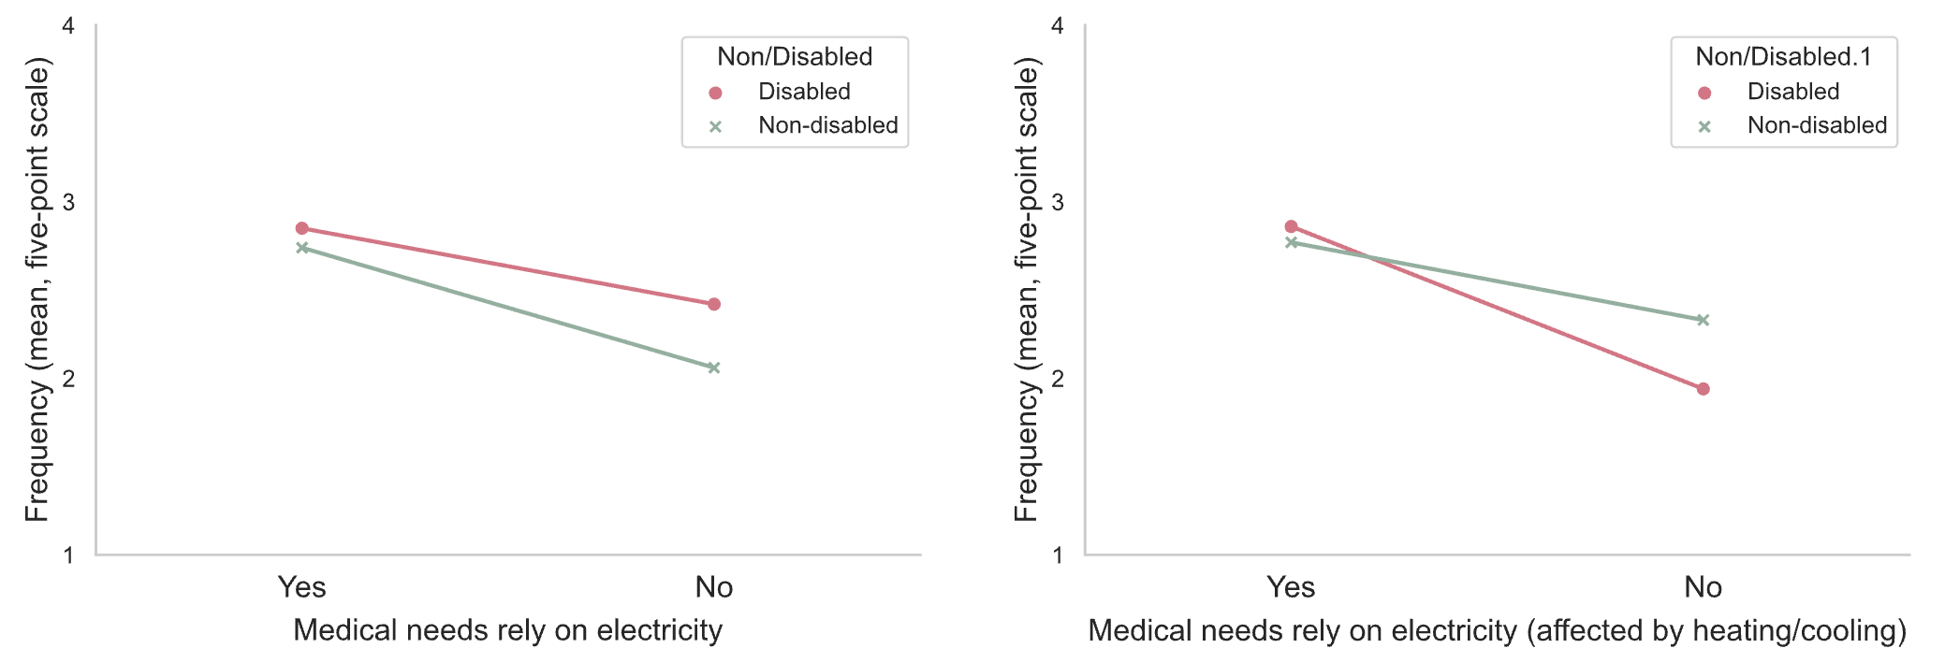
Thermal Discomfort and Interaction of Medical Deeds* Disability
IEQ-1 (Thermal discomfort) _ Felt uncomfortably cold for extended periods, keep uncomfortable level temperature, put on more clothes/ wrap up in blankets or use a hot water bottle to stay warm, unsafe/unhealthy temperature
M=2.85
M=2.86
M= 2.42
M= 2.33
M= 2.74
M= 2.77
M=2.06
M=1.94
F(1,2527)=2.924, p=.087
F(1,2530)=1,71, p=.191
Disabled with medical needs suffer more negative experience on thermal discomfort than people without medical needs.
Disabled with medical needs have more thermal discomfort issues than non-disabled, except non-disabled without medical needs affected by heating/cooling.

Slide 31
Utility Hardship, Health Disparity & Concentrated Disadvantage in the California and Florida, US (N= 1991) in 2021
People of color (POC) owner
LIH home owner
LIH women
Notes:
Utility hardship - kept housing at an unsafe temperature, reduced expenses on other necessities to afford energy bills, received disconnection threat due to nonpayment
Concentrated disadvantaged groups were more likely to experience utility hardship than their non-concentrated disadvantaged counterparts
E.g., low-income women were more likely to have issues than low-income men
POC and people with energy medical needs were more likely to experience utility hardship regardless income levels.
E.g., low-income POC and higher income POC were statistically likely to have utility hardship experiences

Slide 32
Social-psychological Factors & Home Energy Management System
Objectives:
Explores energy burdens, energy use patterns, climate change perceptions and the relationship between social-psychological and demographics factors, with residents’ acceptance of and willingness to pay (WTP) for home energy management systems (HEMS) during the pandemic.
Sampled (1) 632 N.Y. residents in 2020; (2) 1991 CA and FL residents in 2021 during early COVID-19 pandemic.
Social-psychological factors- trust, environmental concern, data privacy and cyber security concern, technology anxiety, relating to HEMS adoption
Analyze the factors affecting willingness to pay for HEMS
Chen, C.-F., Zarazua De Rubens, G., Xu, X., & Li, J. (2020). Coronavirus comes home? Energy use, home energy management, and the social-psychological factors of COVID-19. Energy Research and Social Science, 68, 101688.

Slide 33
Latent Variables and Survey Measurement
  What to do when you do not have exact data to measure occupant behavior?
  Are you measuring the subjective concepts you are supposed to measure?
  A good definition of measurement is based on the theory → a good operational definition that is theoretical sound and practically measurable.
Latent variable or construct – a theoretical entity or construct that is used to explain one or more manifest variables. They cannot be directly measured but rather are approximated through various measures to assess part of the given construct (American Psychological Association)
Measure of subjective occupant behavior is a latent variable: thermal comfort, perceived indoor environment quality (IEQ), job satisfaction, attitudes toward energy saving;
Other examples: trust in utilities, cyber security, EV/AC data privacy concern
Latent variables lead to technology and policy adoption & decarbonization behaviors

Slide 34
Structural Equation Modeling (SEM)
Survey responses could then be analyzed to identify patterns of interrelationships from which the values of the latent variable of conscientiousness are inferred.
SEM is a broad range of multivariate analysis methods, including exploratory factor analysis (EFA) and Confirmatory factor analysis (CFA), and path analysis, that examine variances and covariances to find interrelationships among latent variables
A hypothesis predicts that subjective thermal comfort leads to IEQ. Both are latent variables that are not directly observable but are defined regarding other relevant measurable variables, e.g., self-reports about attitudes toward IEQ and thermal comforts, or certain psychological tests, etc.

Slide 35
Factors that influence HEMS Adoption with Energy Features and Wellbeing Features
 | HEMS energy features | HEMS wellbeing features
 | β (Std.Coefficient) | Β
Constant
Risk perception | 0.040 | 0.006
Adoption intention |  | 0.213***
Perceived usefulness | 0.143** | 0.034
Perceived ease of use | 0.045 | -0.064*
Attitudes toward HEMS | 0.181*** | 0.340***
Perceived behavioral control | 0.092 | 0.224***
Social norms | 0.270*** | 0.110***
Cost concern | 0.079* | -0.029
Cyber security | -0.075* | 0.069***
Trust in utilities | -0.017 | 0.000
Technology anxiety | -0.014 | -0.005
R² | 0.484 0.472 41.315 0.000 | 0.678 0.670 86.499 0.000
Adjust R²
F
p
Cyber security concerns:
(1) Cyber hackers would break into HEMS network to access and misuse my personal information;
(2) Cyber hackers will break into HEMS network to manipulate my usage information;
(3) Cyber hackers will bring down HEMS to make the system unusable
Model was controlled for demographics
35

Slide 36
Multidimensional Factors of EV and Mobility Equality

Slide 37
Multidimensional Framework of EV Adoption in Nordic Countries
Socio-demographics
Technical Factors
Economic Factors
Behavioral-Psychological Factors
Income
Gender
Age
Number of children
Rural vs. non-Rural
Country
Car performance
Electric mobility
Financial attributes
Expected next car cost
Intention to buy a new car
Timing of purchase car in the next 5 years
Mobility practices
Frequency
Distance
EV experience
Driver license time
Number of cars
Ease of operation
Tech reliable
Speed
Design style
Fuel economy
Charging availability
Driving range
Charging time
Battery life
V2G capability
Sustainability
Energy efficiency appliances
Solar or sustainable system
Increase recycling
Eating less meat
Psychological
Trust
Anxiety
Sense of community
Environmental value
EV Adoption
(n = 4500)
Chen, C. F., Zarazua de Rubens, ,G., Noel, L., Kester, J. & Sovacool, B. (2020). An integrated method for assessing the socio-demographic, technical, economic and behavioral factors of Nordic Electric Vehicle adoption and the influence of Vehicle-to-Grid preferences. Renewable & Sustainable Energy Review.
Notes:
V2G is defined as technologies that allow EV owners not only to charge an EV, but also to store electricity in its battery and return it back to the electricity grid when the vehicle is connected to a home, work or public charging station

Slide 38
Results of Hierarchical Regression Models on EV Adoption
M1: Socio-demographics
M2:
Behavioral & Economic Factors
M3 & 4: Technical Factors
M 5: Sustainability behavior and values
Higher income
Male
Younger
More children
Rural vs. non-Rural
Iceland
Mobility practices
Frequency
Less driving distance
EV experience
Driver license time
Fewer cars
Electric mobility
Regular car
Energy efficiency appliances
Solar panel /renewables
Recycling
Change diet
Environmental values
Charging availability
Driving range
Charging time
Battery life
V2G capability
Easy operation
Tech reliable
Speed
Design style
Fuel economy
Financial attributes
Expected car cost
Buying a new car
Timing of purchase car in the next 5 years
Carry-over effect: people use fuel vehicles attributes as reference point, including fuel economy and financial savings, ease of operation,
Spell-over effect:
EV Adoption

Slide 39
Future Project: Community Engagement on EV Equity

Slide 40

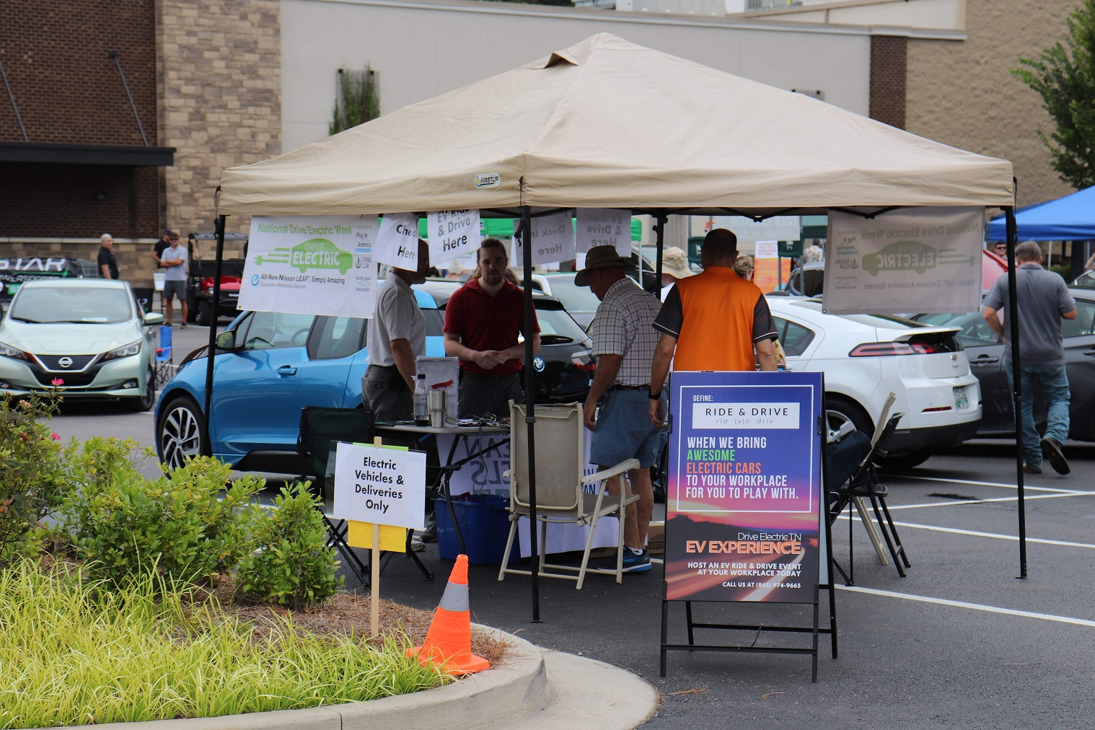
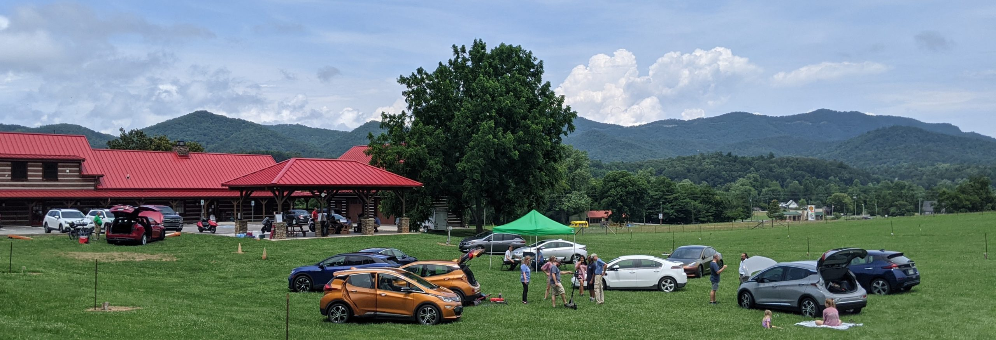
EV Community Outreach-Temptation Bundling to
Boost Acceptance in Tennessee
Bringing EV to Music, Art & Food Festivals
EV Awareness + Knowledge
Knoxville EV Association (KEVA) + Drive Eclectic TN-> Drive Electric USA
Community-centric Electrification for LIHs and Agriculture

Slide 41
Data Justice Issues
Data Justice in Energy and Environment
Measurement Bias – e.g., measure vulnerability using language skills and minority status together as an index (e.g., CDC SVI index)
Representation Bias – particularly related to race/ethnicity & incomes
Sampling Bias – how to reach low-income households and people without technologies or with disabilities
Selection Bias - Women being more likely to use Pinterest, Facebook, Instagram, while men being more active in online forums like Reddit or Twitter?
Some form of “big data” come from certain type of social media or the Web. LIHs are less likely than others to be present on the Web or certain types of social media (e.g., Twitter).
Some applications of ML methods have been critiqued for reproducing social or ethical biases.
Some big data analysis is seldom based on strong theorical foundation - must be cautious when linking the available information to underlying scientific concepts.
Simpson’s Paradox - a characteristic observed in underlying subgroups may be quite different from characteristic observed when these subgroups are aggregated; or interconnected factors.
Evaluation Bias – use of inappropriate and disproportionate benchmark for subgroups (e.g., energy burden rate, average energy burdens at the state level to examine extreme cases)
Aggregation Bias - conclusions are drawn for a subgroup based on observing other different subgroups

