Slide 1




Highlights from TF Report
Analysis and Quantification of Power System Resilience
IEEE PES Task Force On Methods for Analysis and Quantification of Power System Resilience
Alex Stankovic, TF Chair, SLAC
Kevin Tomsovic , TF Vice-Chair, UTK
Fabrizio De Caro, TF Secretary , Univ. of Sannio, Benevento, Italy

Slide 2






















TF Members^{(*)}
A.M. Stankovic (C)
K.L. Tomsovic (VC)
F. De Caro (S)
M. Braun
J.H. Chow
N. Čukalevski
I. Dobson
J. Eto
B. Fink
C. Hachmann
D. Hill
C. Ji
J.A. Kavicky
V. Levi
C-C. Liu
L. Mili
R. Moreno
M. Panteli
F.D. Petit
G. Sansavini
C. Singh
A.K. Srivastava
K. Strunz
H. Sun
Y. Xu
S. Zhao
(*) Affiliations in July 2022
Notes:
Here, the full list of all contributors.

Slide 3




Introduction
Resilience is a fairly new technical concept in power systems.
Thus, it is crucial tailor this concept to applications in power systems.
As a critical infrastructure, power systems have to be prepared to survive rare but extreme incidents to guarantee power supply to the electricity-dependent economy and society.
Resilience has to be integrated into planning and operational assessment concepts to design and operate power systems that are adequately resilient.
The presentation of today will mainly focus on the resilience planning stages, about differences between resilience and traditional reliability concepts.

Slide 4
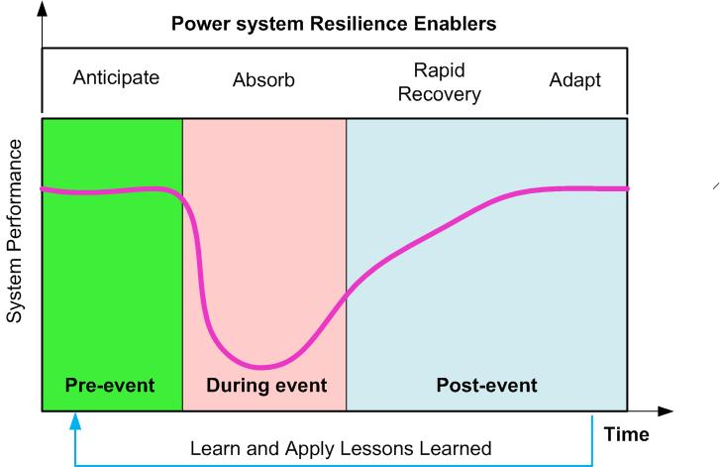
Definition of Resilience
“Power system resilience is the ability
to limit the extent, system impact, and duration of degradation in order to sustain critical services following an extraordinary event.”
Key enablers for a resilient response include the capacity to anticipate, absorb, rapidly recover from, adapt to, and learn from such an event.
Extraordinary events for the power system may be caused by natural threats, accidents, equipment failures, and deliberate physical or cyber-attacks.

Slide 5
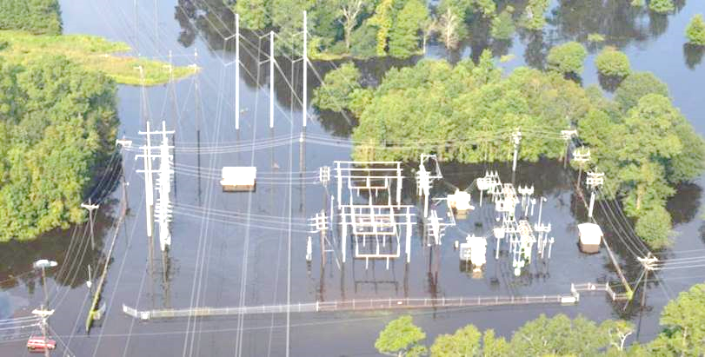
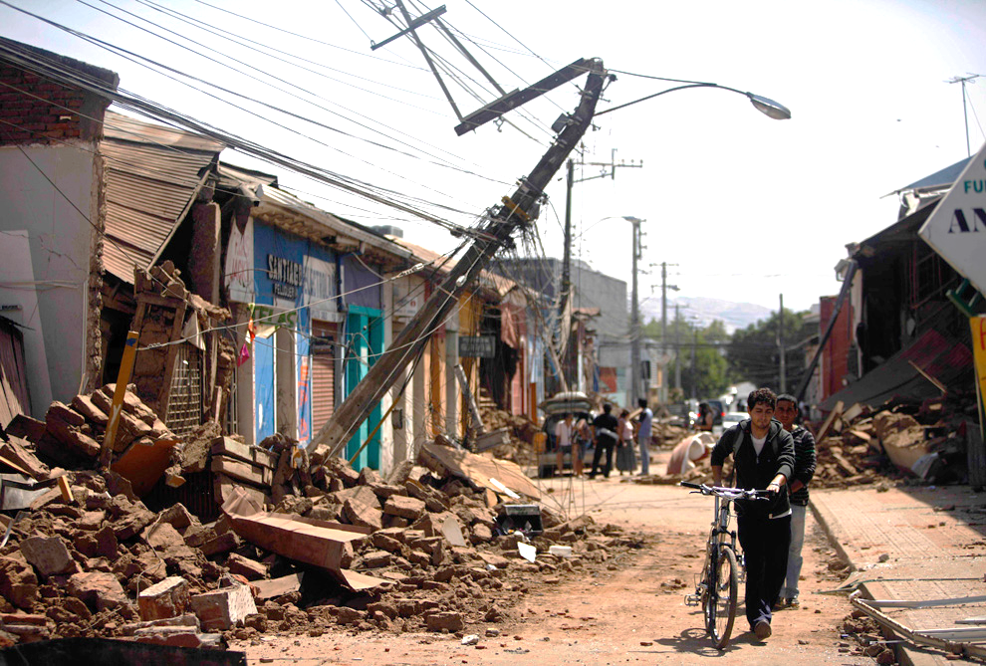
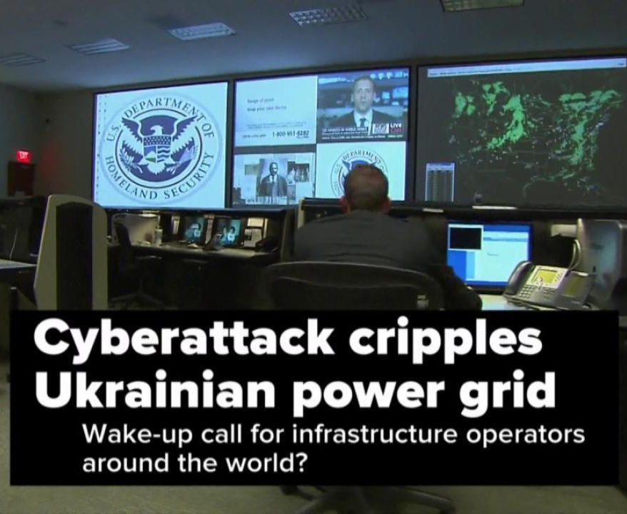
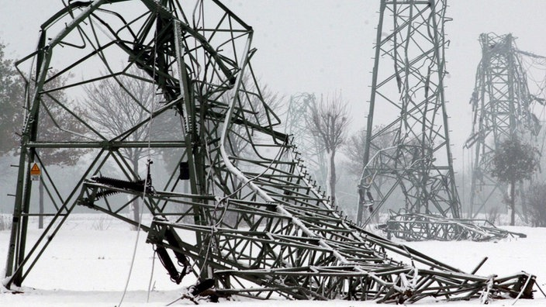
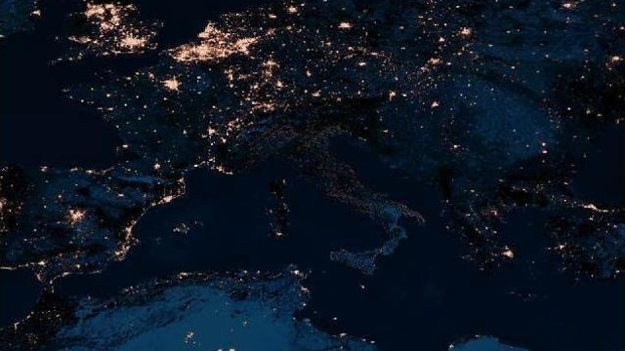
Why resilience is an urgent topic
In recent decades, power systems have experienced significant blackouts, leading to extended disruptions for numerous customers around the world.
These blackouts are primarily caused by High-Impact Low Probability (HILP) weather-related events such as winter storms, heatwaves, hurricanes, as well as earthquakes and deliberate human attacks.
The occurrence of these blackouts is amplified by the escalating frequency and intensity of weather-related HILPs, which is attributed to global warming.
Hurricanes and Floodings
Earthquakes
Cyber-attacks
Winter storms
Large Cascading
Conventional planning and operation methods, which prioritize reliability, are not adequately equipped to handle High-Impact Low Probability (HILP) events. As a result, researchers have begun to focus on the development of resilience-oriented planning and operation methods.

Slide 6
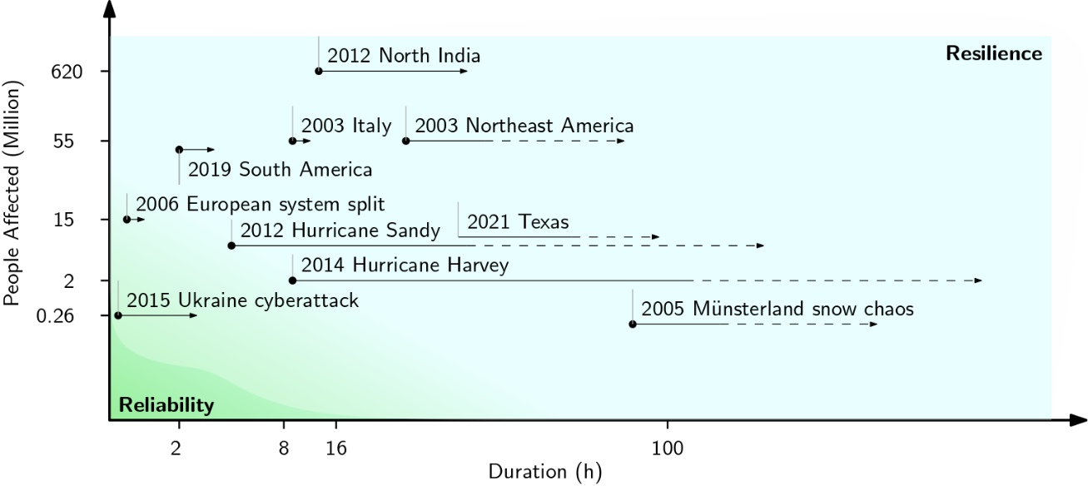
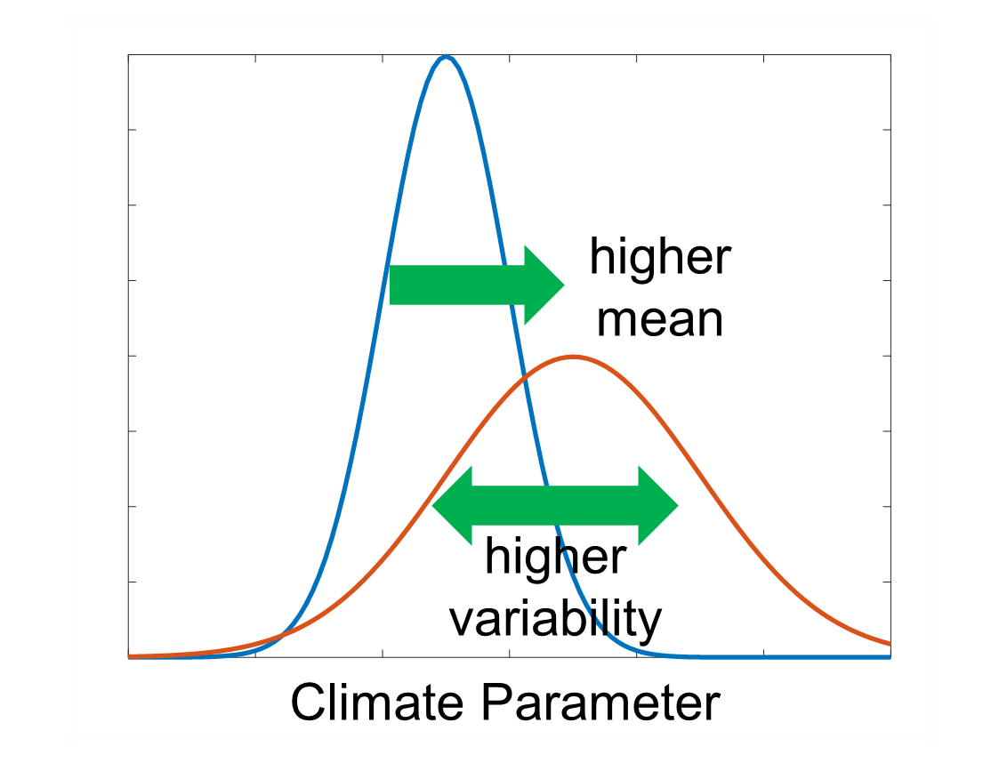
Why resilience is an urgent topic
past
today
Relative Frequency
Weather-based
event occurrence

Slide 7
Task Force Report
Reliability vs Resilience
Some mainly differences between Reliability and Resilience are:
Reliability | Resilience
It refers to high-probability low-impact events (HPLI) | It primarily refers to high impact low probability events (HILP)
It does not involve the joint analysis between coupled infrastructural systems | Resilience analysis may require the joint analysis of coupled infrastructural power systems (e.g., electrical and gas network)
It is paid for by the customer. | Resilience payments may also include society/taxpayers because of its broad social impact
The investment decisions are driven by reliability and N-1 security | The investment decisions can differ from the reliability-driven ones
It neglects community impact and response | Community impact and response are key aspects of resilience
Still, some aspects of reliability and resilience can overlap.
Resilience and reliability studies cannot be fully separated but must be considered as integrated aspects.

Slide 8
Task Force Report
Relationship with robustness, reliability, and security
The report analyzes the difference between these concepts and their targets according to the most accepted definitions:
Robustness
Reliability
Security
Resilience
Scenario independent, embedded in components design.
“It is the ability of a system in providing normal service to a
critical percentage of
clients under the condition that some components of the
system fail”
[ability to withstand disturbances]
Reliability aims to capture events that appear and re-appear with temporal regularity, like conventional outages.
It includes two aspects in power systems, adequacy (the ability of the system to supply aggregate load considering the scheduled and reasonably expected outages) and operating reliability (withstand sudden disturbances such as unexpected loss of components)
N-k security considers all possible k-tuples of outaged elements, typically in a deterministic framework.
Uneconomical and impractical for
k values that have been observed in resilience events due to the large number of cases to consider.
Need for scenario-based resilience studies, whose parameters differ from the ones assumed for reliability studies.
Scenario dependent if
we consider the restoration
and recovery stages.
[ability to withstand
disturbances and the ability of fast restoration and recovery]

Slide 9











Resilience of power systems
Differences respect with Robustness/Reliability/Security
and Resilience
scenario
Independent?
consider
n-k outages?
consider rare
outages?
consider systems interdependency?
Robustness
$$\text{✔}$$
-
-
-
Reliability
$$\text{✔}$$
✘/$\text{✔}$
$$\text{✘}$$
$$\text{✘}$$
Security
✘
$$\text{✔}$$
$$\text{✘}$$
$$\text{✘}$$
Resilience
✘
$$\text{✔}$$
$$\text{✔}$$
$$\text{✔}$$

Slide 10
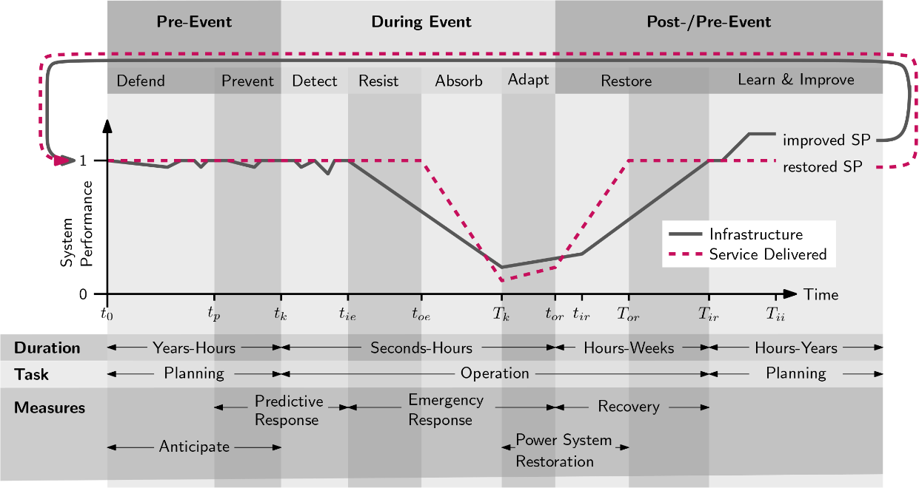
Multi-scale aspects of resilience
“Short-term” / “Pre-Event Prevent” phase on an hourly basis before the event is present, typically, in case of meteorological events.
“During-Event Detect” and “Resist” phases are again appropriate for meteorological disturbances; however, their duration can be very short in case of earthquakes and malicious attacks.
“During Event” stage is appropriate for a single disturbance event, and it does not cover multiple (meteorological) events whereby restoration starts before the second impact, etc.

Slide 11
Multi-scale aspects of resilience
Planning measures (long term) allow the development
of power systems by addressing technical, economic,
environmental, and social needs.
Preventive measures (short term) aim to allocate resources to
assure its adequate operation.
Traditionally implemented measures, driven by decades of
experience, are security and reliability-oriented, and need
to be revised to provide adequate resilience.

Slide 12



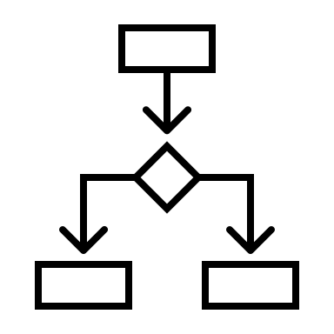


Multi-scale aspects of resilience
Pre-disturbance: planning and preventive aspects of resilience (Long Term)
To prepare the grid to face resilience events, possible improvements must be considered to find the trade-off between investments and financial impact on the customers/society/tax-payers caused by service interruptions and facilities disruption.
Weather and load patterns are dramatically changing according to nonlinear scales in the last decades.
In some cases, the infrastructure interaction must be considered.
Necessary to address complex optimization problems, which must consider resilience events,
and be sensible to the financial impact of the tail events
Reliability planning is often static and may fail to provide the needed coordination with operational procedures.
For this reason, one of the challenges is to produce adequate risk-based financial metrics and scenario generation/reduction tools.

Slide 13
Multi-scale aspects of resilience
Pre-Disturbance: planning and preventive aspects of resilience (long term)
Hardening-based: aimed to make the grid stronger / bigger.
vegetation management and trimming around the grid components
overhead lines replacement with underground cables
new lines installation (overhead/cable)
component reinforcement (substations, poles, etc.)
promotion of distributed energy resources (DER) in distribution grids along with the
capability for island/microgrid capability
Algorithmic or software-based: aimed to make the grid smarter and more flexible.
employment of load/DERs control strategies;
adoption of distributed monitoring, estimation, and control policies

Slide 14



Multi-scale aspects of resilience
Pre-Disturbance: Preventive Measures (Short Term)
The objective of this task is to allocate resources by considering options such as the optimal grid topology switching and/or distributed generation reserves to face a predicted resilience-event, in case of meteorological events.
The operating modes (or security-related states) of a power system may greatly amplify the impact of an external event.
High monitoring and detecting capability for early warnings of undesired operating mode transitions are essential for resilient power systems.

Slide 15






Quantifications methods metrics
Many metrics should be used to quantify the resilience of a system, in relation to the study, type of event, and desired granularity of the analysis.
Many Classifications:
Metrics for enabling investments: to quantify the resilience level of the system to pursue its enhancement through investments.
Metrics for stages of a resilience event: quantify the resilience level to assess the societal benefits at each stage.
Internal / External Metrics: to quantify the impact of the severe event on the grid, and of the grid on its customers / other infrastructure
Notes:
Each metric can be classified as:
internal: quantify the impact of the severe event on the grid
external: quantify the effect of the grid on its customer, other infrastructures, and

Slide 16

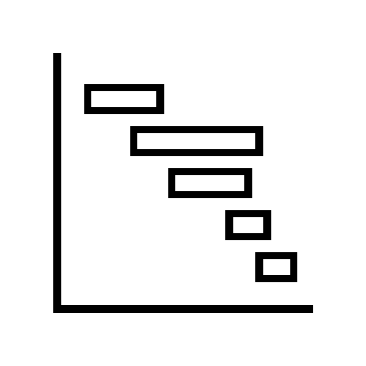

Quantifications methods metrics
Metrics for Overall System Resilience Investments: highlight risk for the system, needs for replacement, improvements, increasing redundancy, etc.
Metrics for Overall System Preparedness – Operational and Emergency Plans: Resource procurement, preparedness of operator to manage N-K contingencies, more effective maintenance plannings, etc.
Metrics for Emergency Response, Restoration and Recovery: Stimulate Power System Automation, Fast and Effective Support Decision Making Tools, etc.

Slide 17
Overall System Resilience Investments
Scheme | Investment Category | Investment Sub-Category | Metrics | Metrics Example
Traditional | Replacement | By Asset Types | Internal | Asset Health Index (AHI) / Age of Components Failure History
Traditional | Reinforcement | General New Connections | Internal | N-k; Lost Capacity vs Outage Duration
Traditional | Reliability | By Voltage Levels | Internal | Automation Level
System Resilience | Extreme Weather | By Weather Events | Internal/ External | Flood Probability / Tornado Category Design Standards
System Resilience | Other Natural Disturbances | Earthquakes Geomagnetic Volcanic | Internal/ External | Earthquake Magnitude Geomagnetic Field Variation Solar Storm Observations Volcanic activity index, Dispersal index Fragility Curves Design Standards
Network Resilience | Attacks | Physical Cyber | Internal/ External | Specific Sites Communication Systems Fragility Curves Design Standards

Slide 18
Overall System Preparedness – Operational and Emergency Plans
Scheme | Investment Category | Investment Sub-Category | Metrics | Metrics Example
Traditional | Yearly Planning | Maintenance; Yearly Hydro-Thermal Co-ordination; Spares | Internal/ External | Maintenance Risk; Tree Trimming; Yearly Production Cost
Traditional | Week-Ahead Planning | Construction Outages Generation Reserves Hydro-Thermal | Internal/ External | Operational N-k; Reserve Types and MW; Hydro-Schedule
Traditional | Day-Ahead Planning | Unit Commitment Economic Dispatching Frequency Response | Internal/ External | Generation MW and Bid Costs; Generation Droops
Traditional/ System Resilience | Workforce Resilience | Staff Renewal. Staff Training Mental Health | External | Staff Metrics are Age, Skills, Certification
System Resilience | Black Start | Transmission Distribution | Internal/External | Black-Start Units; Distribution Batteries; Processes
System Resilience | Brown Start | Transmission Distribution | Internal/External | Brown-Start Units and Compensators; Distribution Batteries; Processes
System Resilience | Emergency Plans | Attacks. Weather-Related Events Cyber Attacks | Internal/External | Alternative Supplies; Staff-on-Call; Weather-related metrics in Table 7.1; Increased attack penetration attempts; Employee disgruntlement; Increased international or terrorist tensions
System Resilience | Other | New Ancillary Services Resilience Tree Cut Pandemic | Internal/External | Generation and Demand MW; Distances Stockpiled vaccines PPE; Medical tests; Number of vaccinated employees

Slide 19
Emergency Response, Restoration and Recovery
Scheme | Investment Category | Investment Sub-Category | Metrics | Metrics Example
Traditional/ System Resilience | On-Network Devices | Protection; Automation; Special Control Schemes; Controls | Internal | Number of Sensors; Types of Communication Links; Control Devices
Traditional/ System Resilience | Control Room | Control System Hardware & Software; Operator Situational Awareness | Internal | Redundancy Level; Alert System
System Resilience | Emergency Planning | Market-Suspension; Cross-border Trading | Internal/External | Must-run Units; MW Exchanges; Emergency Rules

Slide 20


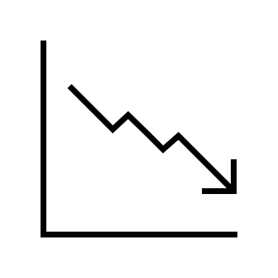

Metrics for resilience stage
All resilience stages should be considered to assess the societal benefits, necessary to motivate the high costly investment resilience-oriented.
The metrics for the initial outages describe the power system components that initially fail (or the extent of their failure), and the load or customers immediately shed either deterministically or probabilistically.
The metrics for cascading describe the extent to which the cascading increases the blackout beyond the initial outages by components outaged or load shed or describes the average propagation of cascading outages over a sample of cascades.
The most important restoration metrics that are reported to the regulator, are, for example, how many customers or how much power is restored.

Slide 21
Class. |  |  | Regulatory Interval
Period | Pre-Event | Event |  |  | Post-event – short term |  |  | Post-event – Long Term
Sub-period | Plan + Prevent | Detect Phase I |  | Emergency Respond Phase II | Restore Phase III | Recover | Recover | Adapt +Learn
Internal/ External | (I)/(E) | (I)/(E) |  | (I)/(E) | (I)/(E) | (I)/(E) | (I)/(E) | (I)/(E)
Metrics | Network Design vs Predicted Extreme Metrological Conditions (E): Predicted path/location and intensity of weather events Derecho; Rainfall; Flooding; Temperature, Earthquake (peak ground acceleration). Available Manpower (I/E): Maintenance crews; On-call staff; External staff (safeguard, military). Availability of Critical Tools and Facilities (I): SCADA; Protection systems and control telephony; Facilities for load-frequency control and security analysis; At least one separate control room with backup power supply for at least 24 hours. Readiness for System Defense Procedures (I): Frequency deviation management; Additional demand disconnection following low-frequency demand disconnection; Demand restoration; Voltage deviation management. Power flow management; National electricity transmission system warnings; Manual demand disconnection; Rota load disconnection. Availability of Critical Components (I): Black start units & interconnectors; Restoration substations; Power system synchronizer circuit breakers; Several types of generation reserve | Geographic (E): Number and size (km²) of outaged areas; Speed of (non-cascading) disturbance propagation through the network (hours before “hit”); Number of disconnected customers. Power System – Level 1 (I): Number and MVA rating of circuitry & transformers on outage; Number and MVA rating of generators (production and reserve) on outage; Number and MVA size of interconnectors disconnected; MW/ MWh generation on outage; MW/MWh demand on outage; Speed of (non-cascading) disturbance propagation through the network (MW/h for generation and demand); Outage duration (h); Amount of propagation of cascading outages; Rate and overlap of a number of component outages; Number and amount of MVA ratings of unrestored components outaged (all types). Power System – Level 2 (I): Number of islands; Status of synchronizer circuits; Violated constraints; Generation-demand mismatch System state (I): Normal State; Alert State; Emergency State; Blackout State; Restoration. Identification of the Specific System Defense Procedure and its Components (I) |  | Local Controls & Protection (I): Additional MW (MVAr) generation; Restored MW demand; Alleviated constraints. Centralized Controls & Protection (I): Additional MW (MVAr) generation; Restored MW demand; Alleviated constraints; Outage duration (h). Capacities to be Made Ready (I): Black (brown) start units (MW); Non-spinning reserve (MW); Mobile generation (MW); Emergency exchanges via interconnectors (MW) Power Carrying Components out of Service (I): Number and amount of MVA ratings of components outaged (all types); Number and amount of MVA ratings of unrestored components outaged (all types). Emergency Communication Systems (I) | Restoration Sizes (I): Number & MW rating of black (brown) start units; Number and size of islands; Number and MW rating of synchronized units; MW load Restoration Size (E): Number of customers per island or restoration stages; Total number of customers Restoration Times (I): Time (h) per island or restoration stage; Total time (h) Restoration Speeds (I): MW synchronized per hour per island or restoration stage; MW synchronized per hour; MW load restored per hour per island or restoration stage; MW load restored per hour. Critical Services (I/E): Above indicators for critical services (e.g., metro, electrified transport, hospitals). Power Carrying Components out of Service (I): Number and amount of MVA ratings of components outaged (all types); Number and amount of MVA ratings of unrestored components outaged (all types). | Times (I): Time to restore normal network configuration; Time to eliminate remaining violated constraints; Time to meet generation reserve requirements; Time to meet security constraints; Time to resume market operation. Damaged Assets (I): Identification of assets and repair time estimates. | Times (I): Time to restore normal network configuration; Time to eliminate remaining violated constraints; Time to meet generation reserve requirements; Time to meet security constraints; Time to resume market operation. Damaged Assets (I): Identification of assets and repair time estimates. | Electrical Service: Cumulative (over restoration stages) customer-hours of outages; Cumulative (over restoration stages) customer energy demand not served; Average percentage of customers under an outage in a specified time period. Critical Electrical Service: Cumulative (over restoration stages) critical customer-hours of outages; Critical customer energy demand not served; Average percentage of critical loads that experience an outage. Restoration: Time to recovery; Cost of recovery. Monetary: Loss of utility revenue; Cost of grid damages; Cost of recovery Community Function: Critical services without power (e.g., hospitals, fire stations, police stations); Critical services without power for more than N hours (N > hours of backup fuel requirement). Monetary: Loss of assets and perishables; Business interruption costs. Other critical assets: Key production facilities without power; Key military facilities without power.
Quantifications methods: metrics
Emergency Plans

Slide 22



Economic aspects of resilience
Resilience events have significant economic consequences. Some result directly from power interruptions, whereas other results from non-power system impact.
Interruptions of electric service have economic consequences for both the suppliers and customers. Furthermore, they can cause disruption in emergency situations.
The conventional cost-benefit analysis, in which prospective investments are evaluated by comparing the costs and benefits expressed in present value monetary terms, is challenging to apply to resilience investments, which aim to avert the consequences of events characterized by low probability, and uncertain timing, and high severity.

Slide 23
Economic aspects of resilience
Several difficulties inherent to economic studies of resilience projects:
There is no measure of financial effectiveness (e.g. profit standard), exacerbated by the different levels of risk aversion
of decision-makers; the monetary measure of benefits cannot be easily identified;
Whenever public funds are used, there is a tendency towards political influence;
There is no usual profit motive, and this can have a substantial effect on project effectiveness.
The economic value of resilience projects is considered in terms of “avoided damage costs,” or simply “damage costs.” Damage costs are looked at from the customer/ public point of view and they are driven by the event’s impact on society (by the consequences of the event).
A resilience planning must explicitly account for uncertainty regarding the events it seeks to address. It must account for
the current sparsity of information on the customer costs of the widespread and long duration of the power interruption.
There are several methods for estimating power interruption costs to customers:
Customer Survey based on surveying statistically relevant samples of utility customers
Regional Economic Modeling Methods for Estimating Customer Power Interruption Costs

Slide 24
Reliability vs Resilience oriented planning (Case Study)
The next slides show the conceptual difference between reliability and resilience in adopted metrics by using a simple but effective toy system analysis ^{(*)}.
We start with a simple system with 1 generator, 1 transmission line, and 1 aggregate load.
The aim is to improve its reliability / resilience level.
Node 1
Node 2
500 MW
∿
Transmission Link
500 MW
(*) Data shared / Methodology developed by Rodrigo Moreno, Mathaios Panteli, Pierluigi Mancarella, Hugh Rudnick, Tomás Lagos, Alejandro Navarro,
Fernando Ordoñez, and Juan Carlos Araneda, “From Reliability to Resilience”, IEEE POWER AND ENERGY MAGAZINE
Included in the TF Report. Some Parameters may have been changed in this example.

Slide 25
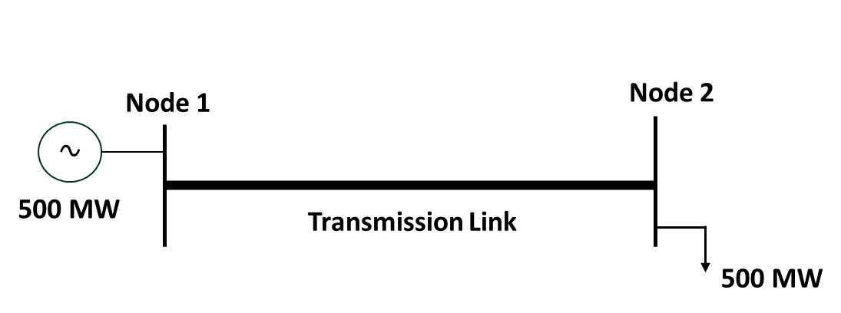
The system is not N-1 secure, hence, to increase the system security we have two approach:
Deterministic -> we needs two 2 links, with each of 500 MW capacity.
Probabilistic -> we need the balance between the improvement cost and expected penalty costs linked to the operating reliability loss (as a metric we use the Energy Not Serviced × Value of Lost Load)
Very Important Question: How much the effectiveness of a potential improvement changes according to the considered reliability / resilience-oriented approach?
Attention: The expected penalty cost must be estimated since their deterministic value is unknown in the planning stage.

Slide 26
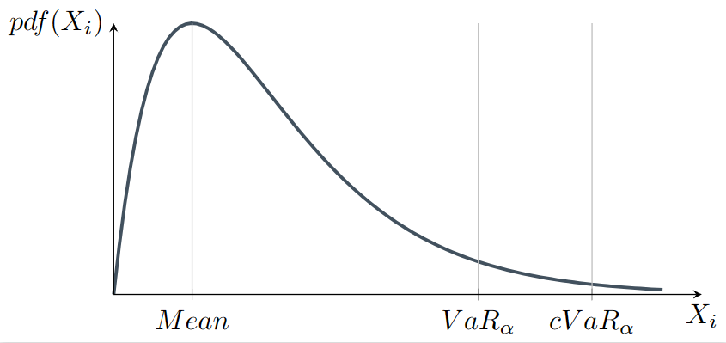

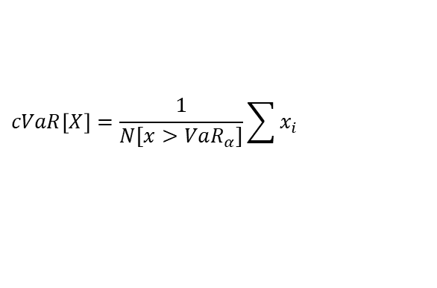
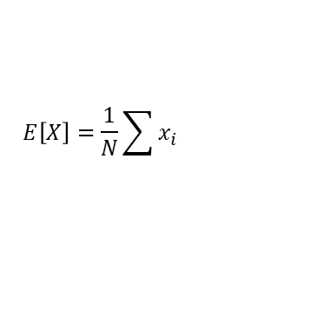
Expected Value vs Conditional Value at Risk
$X_{i}$ = Penalty Costs linked to outages caused by a given event (Ex. Winter Storms)
EENS
Low Impact High
Probability Event
$$E\left[X\right]=\frac{1}{N}\sum{x_{i}}$$
$$cVaR\left[X\right]=\frac{1}{N[x>VaR_{α}]}\sum{x_{i}}$$
CEENS
High Impact Low
Probability Event
One of the key difference between Reliability is Resilience is they refer to a different area of the distribution.

Slide 27
Assume a list of possible improvements.
Specify failure and repair rates for various weather conditions (e.g., fair and bad weather) and for the “improved system”.
Compute the System Operating State Probability (SSP) for each weather condition.
Calculate the weighted SSP, considering the duration of each weather condition over a year.
Link the related Equivalent Number of Service (ENS) value for each operating state.
Conduct a Monte-Carlo Simulation to sample ENS values, considering the probability of each operating state (Look to set a high number of sampling to catch rare events).
Calculate the Expected Energy Not Serviced (EENS) and the Conditional Value at Risk (cVaR EENS), along with the related costs, assuming a Value of Lost Load (VoLL).
Rank the list of improvements based on their final costs (Installation Cost + Penalty Cost for the Energy Not Serviced). Note that two different ranks can be established, one for reliability and one for resilience orientation.

Slide 28
Assume a list of possible improvements.
A) N-0 solution
B) N-1 solution
2 circuits each of 250 MW capacity
Installation Cost = 100 $/(MW∙km∙year)
Length = 200 km
No. of Circuits = 2
Investment Cost = $10,000,000
Increase Redundancy.
Component Robustness
is the same of case A.
2 Links each of 500 MW capacity
Installation Cost = 100 $/(MW∙km∙year)
Length = 200 km
No. of Circuit = 2
Investment Cost = $20,000,000
C) N-0 solution with shorter Outage Time
D) N-0 solution with underground cables
2 Links each of 250 MW capacity
Installation Cost = 100 $/(MW∙km∙year)
Length = 200 km
No. of Circuits = 2
Investment Cost = $10,000,000
More maintenance squad crews.
Higher repair transition rates.
2 Links each of 250 MW capacity
Installation Cost = 100 $/(MW∙km∙year)
Length = 200 km
No. of Circuits = 2
Investment Cost = $10,000,000
Components more robust
than the OHL ones against
a storms.
Lower failure rates.

Slide 29
Compute the System State Probability
Assumed Data
Fault (Fair Weather) = 0.2 occ/year
Repair Rate (Fair Weather) = 2,190 occ/year
Yearly Duration (Fair Weather) = 8759 h/year
Assumed Data
Fault (Fair Weather) = 0.2 occ/year
Repair Rate (Fair Weather) = 2,190 occ/year
Yearly Duration (Fair Weather) = 1 h/year
N-0 solution
N-1 solution
C1 | C2 | APC [MW] | PNS [MW] | State Prob.
OK | OK | 500 | 0 | 9.997629E-01
OK | F | 250 | 250 | 1.141707E-04
F | OK | 250 | 250 | 1.141707E-04
F | F | 0 | 500 | 8.781763E-06
C1 | C2 | APC [MW] | PNS [MW] | State Prob.
OK | OK | 1000 | 0 | 9.997629E-01
OK | F | 500 | 0 | 1.141707E-04
F | OK | 500 | 0 | 1.141707E-04
F | F | 0 | 500 | 8.781763E-06
PNS = Power Not Serviced
APC = Available Power Capacity
N-0 solution Shorter Outage Time
N-0 with underground cables
C1 | C2 | APC [MW] | PNS [MW] | State Prob.
OK | OK | 500 | 0 | 9.997874E-01
OK | F | 250 | 250 | 1.051379E-04
F | OK | 250 | 250 | 1.051379E-04
F | F | 0 | 500 | 2.283543E-06
C1 | C2 | APC [MW] | PNS [MW] | State Prob.
OK | OK | 500 | 0 | 9.998749E-01
OK | F | 250 | 250 | 6.106647E-05
F | OK | 250 | 250 | 6.106647E-05
F | F | 0 | 500 | 2.958146E-06

Slide 30
Compute EENS and CEENS
Assumed Data
VoLL = 1000 $/MW, α = 0.001
System | Investment Cost [$] | EENS [MWh] | CEENS [MWh] | EENS cost [$] | CEENS cost [$]
N-0 | 10,000,000 | 0.0617 | 475.5 | 540,273 | 4,165,380,000
N-1 | 20,000,000 | 0.0045 | 451.0 | 39,508 | 3,950,760,000
N-0 shorter outage time | 10,000,000 | 0.0539 | 312.3 | 472,405 | 2,735,310,000
N-0 buried underg. cables | 10,000,000 | 0.0323 | 331.0 | 282,839 | 2,899,560,000
N-0 solution
Reliability-based Rank [EENS cost]
Reliability-based Rank [CEENS cost]
Rank | System | EENS Cost [$] | Δgain%
1 | N-1 500 MW | 39,508 | -
2 | N-0 underground | 282,839 | 6,16
3 | N-0 shorter outage time | 472,405 | 10,96
4 | N-0 | 540,273 | 12,68
Rank | System | CEENS Cost [$] | Δgain%
1 | N-0 shorter outage time | 2,735,310,000 | -
2 | N-0 buried underg. Cables | 2,899,560,000 | 6
3 | N-1 | 3,950,760,000 | 31
4 | N-0 | 4,165,380,000 | 34

Slide 31
Rank the improvements considering the Total Cost
Assumed Data
VoLL = 1000 $/MW
System | Investment Cost [$] | EENS [MWh] | CEENS [MWh] | EENS cost [$] | CEENS cost [$]
N-0 | 10,000,000 | 0.0617 | 475.5 | 540,273 | 4,165,380,000
N-1 | 20,000,000 | 0.0045 | 451.0 | 39,508 | 3,950,760,000
N-0 shorter outage time | 10,000,000 | 0.0539 | 312.3 | 472,405 | 2,735,310,000
N-0 buried underg. cables | 10,000,000 | 0.0323 | 331.0 | 282,839 | 2,899,560,000
N-0 solution
Reliability-based Rank [EENS cost]
Reliability-based Rank [CEENS cost]
Rank | System | Total Cost [$] | Δgain%
1 | N-0 buried underg. cables | 10,282,839 | -
2 | N-0 shorter outage time | 10,472,405 | 2
3 | N-0 | 10,540,273 | 2
4 | N-1 | 20,039,508 | 49
Rank | System | Total Cost [$] | Δgain%
1 | N-0 shorter outage time | 2,745,310,000 | -
2 | N-0 buried underg. cables | 2,914,560,000 | 6
3 | N-1 | 3,970,760,000 | 31
4 | N-0 | 4,175,380,000 | 34

Slide 32
The “smarter” option (increasing the number of maintenance crews) is the best option to increase the resilience level, whereas the “more robust” option improves system reliability.

Slide 33
Further aspects can affect the effectiveness of
the proposed solution.
VoLL: if we increase this value to 30 k$/MW
the “N-1 solution” becomes more attractive
as reliability-oriented option.
Climate Change: If we change the ratio fair/bad
weather the occurrence of severe increases
affecting the system state probabilities.
In a similar way the increment in magnitude of the
extreme event is considered through the
fragility curves and the failure transition rates.

Slide 34

Conclusions
The Task Force has detected several key points, which are crucial to enhance the resilience:
Investigation of the resilience measures cost-effectiveness.
Importance of the cooperation between the several power systems actors (generation companies, transmission, and distribution grid operators).
Assessment of the benefits/detriments analysis of RES on system resilience.
Development of smart grids and microgrids to operate in islanding mode for resilience.
Risk analysis for a system to come under cyber-attacks, where it may increase because of the data exchanges volume growth.
Employment of climate, weather, geological and economic analysis to reduce a large number of scenarios by geographically identifying the main HILPs for a certain area.
Development of advanced resilience metrics able to characterize the different resilience aspects.
Possibility enabling Renewable Resource Participation in Resilience
Development, usage, and maintenance of system operator training simulator platforms.

Slide 35
THANK YOU FOR
YOUR ATTENTION
tomsovic@utk.edu
Executive summary: https://ieeexplore.ieee.org/document/9913670
Full task force report - https://resourcecenter.ieee-pes.org/publications/technical-reports/PES_TP_TR108_PSDP_AMPS_052223.html

Slide 36
Additional Slides ->

Slide 37
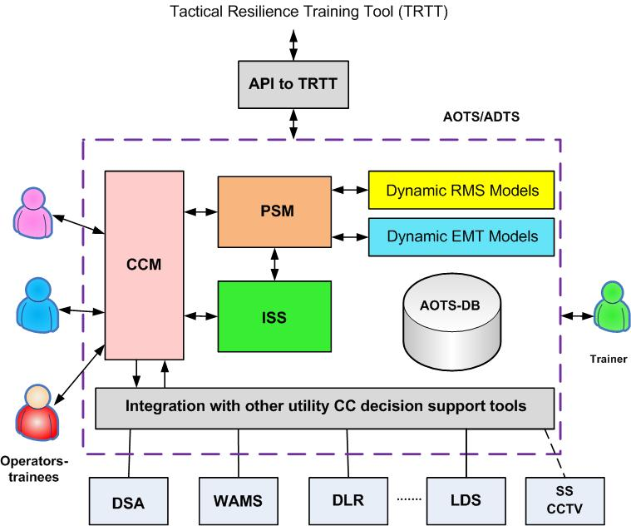
Task Force Report
Adaptation and learning
An augmented training advanced operator training simulator is needed for future power system operators. It needs to simulate power system conditions provoked by the extreme event typically followed by many elements of simultaneous or sequential (cascading) outages in the power system. Such an advanced OTS/DTS should have the following features:
Main OTS/DTS Capabilities
Main OTS/DTS Components
To represent the existing RTO/ISO/TSO information-control system at CC.
To execute a training scenario that accommodates extreme events and their consequences on the power system.
To represent effects and actions from other critical infrastructures (like telecommunication, gas, oil, coal, transport, water networks, etc.) that impact electricity system resilience.
To simulate event with cascading development.
Etc.
CCM: Control Center Model: it simulates the control center panel and interfaces available to the operator.
PSM: Power System Model: it consists of modules to simulate with the highest fidelity possible the power system behaviors
ISS: Instructor’s subsystem: produces scenarios and tracks operator behavior.

Slide 38
Case Study 2
A) N-0 solution
N-1 solution
2 circuits by each of 250 MW capacity
Installation Cost = 100 $/(MW∙km∙year)
Length = 200 km
No. of Circuits = 2
Investment Cost = 10,000,000 $
Increase Redundancy.
Component Robustness
is the same of case A.
2 Links by each of 500 MW capacity
Installation Cost = 100 $/(MW∙km∙year)
Length = 200 km
No. of Circuit = 2
Investment Cost = 20,000,000 $
C) N-0 solution with shorter Outage Time
D) N-0 solution with underground cables
2 Links by each of 250 MW capacity
Installation Cost = 100 $/(MW∙km∙year)
Length = 200 km
No. of Circuits = 2
Investment Cost = 10,000,000 $
More maintenance squad crews.
Higher repair transition rates.
2 Links by each of 250 MW capacity
Installation Cost = 150 $/(MW∙km∙year)
Length = 200 km
No. of Circuits = 2
Investment Cost = 15,000,000 $
Components more robust
than the OHL ones against
a storms.
Lower failure rates.

Slide 39
Compute the System State Probability
Assumed Data
Fault (Fair Weather) = 0.2 occ/year
Repair Rate (Fair Weather) = 2,190 occ/year
Yearly Duration (Fair Weather) = 8759 h/year
Assumed Data
Fault (Fair Weather) = 0.2 occ/year
Repair Rate (Fair Weather) = 2,190 occ/year
Yearly Duration (Fair Weather) = 1 h/year
N-0 solution
N-1 solution
C1 | C2 | APC [MW] | PNS [MW] | State Prob.
OK | OK | 500 | 0 | 9.997629E-01
OK | F | 250 | 250 | 1.141707E-04
F | OK | 250 | 250 | 1.141707E-04
F | F | 0 | 500 | 8.781763E-06
C1 | C2 | APC [MW] | PNS [MW] | State Prob.
OK | OK | 1000 | 0 | 9.997629E-01
OK | F | 500 | 0 | 1.141707E-04
F | OK | 500 | 0 | 1.141707E-04
F | F | 0 | 500 | 8.781763E-06
N-0 solution Shorter Outage Time
N-0 with underground cables
C1 | C2 | APC [MW] | PNS [MW] | State Prob.
OK | OK | 500 | 0 | 9.997874E-01
OK | F | 250 | 250 | 1.051379E-04
F | OK | 250 | 250 | 1.051379E-04
F | F | 0 | 500 | 2.283543E-06
C1 | C2 | APC [MW] | PNS [MW] | State Prob.
OK | OK | 500 | 0 | 9.998749E-01
OK | F | 250 | 250 | 6.106647E-05
F | OK | 250 | 250 | 6.106647E-05
F | F | 0 | 500 | 2.958146E-06

Slide 40
Compute the EENS and CEENS
Assumed Data
VoLL = 1000 $/MW
System | Investment Cost [$] | EENS [MWh] | CEENS [MWh] | EENS cost [$] | CEENS cost [$]
N-0 | 10,000,000 | 0.0617 | 475.5 | 540,273 | 4,165,380,000
N-1 | 20,000,000 | 0.0045 | 451.0 | 39,508 | 3,950,760,000
N-0 shorter outage time | 10,000,000 | 0.0539 | 312.3 | 472,405 | 2,735,310,000
N-0 buried underg. cables | 15,000,000 | 0.0323 | 331.0 | 282,839 | 2,899,560,000
N-0 solution
Reliability-based Rank [EENS cost]
Reliability-based Rank [CEENS cost]
Rank | System | EENS Cost [$] | Δgain%
1 | N-1 500 MW | 39,508 | -
2 | N-0 underground | 282,839 | 6,16
3 | N-0 shorter outage time | 472,405 | 10,96
4 | N-0 | 540,273 | 12,68
Rank | System | CEENS Cost [$] | Δgain%
1 | N-0 shorter outage time | 2,735,310,000 | -
2 | N-0 buried underg. Cables | 2,899,560,000 | 6
3 | N-1 | 3,950,760,000 | 31
4 | N-0 | 4,165,380,000 | 34

Slide 41
Rank the improvements considering the Total Cost
Assumed Data
VoLL = 1000 $/MW, α = 0.001
System | Investment Cost [$] | EENS [MWh] | CEENS [MWh] | EENS cost [$] | CEENS cost [$]
N-0 | 10,000,000 | 0.0617 | 475.5 | 540,273 | 4,165,380,000
N-1 | 20,000,000 | 0.0045 | 451.0 | 39,508 | 3,950,760,000
N-0 shorter outage time | 10,000,000 | 0.0539 | 312.3 | 472,405 | 2,735,310,000
N-0 buried underg. cables | 15,000,000 | 0.0323 | 331.0 | 282,839 | 2,899,560,000
N-0 solution
Reliability-based Rank [EENS cost]
Reliability-based Rank [CEENS cost]
Rank | System | Total Cost [$] | Δgain%
1 | N-0 shorter outage time | 10,472,405 | -
2 | N-0 | 10,540,273 | 1
3 | N-0 buried underg. cables | 15,282,839 | 31
4 | N-1 | 20,039,508 | 48
Rank | System | Total Cost [$] | Δgain%
1 | N-0 shorter outage time | 2,745,310,000 | -
2 | N-0 buried underg. cables | 2,914,560,000 | 6
3 | N-1 | 3,970,760,000 | 31
4 | N-0 | 4,175,380,000 | 34

Slide 42
Analyze the Pareto Front
The “smarter” option (increasing the number of Maintenance crews seems the better option) is
better than other solutions such increase redundancy or making the system stronger.

