Slide 1
Protection of Microgrid Systems with High Penetration
of Inverter-Based Resources
Max Ferrari and Leon Tolbert
CURENT Student Seminar
February 23, 2024

Slide 2
Microgrid Protection: Scope and Contributions
Problem
Objectives
Answer the long-standing question if an IBR can be modified to provide high fault current during faults
Contributions
VSC designed to to provide 3.0. p.u. during faults
Protecting inverter-based microgrids is challenging because of small fault contribution of Inverter Based Resources (IBRs)
Fuse to relay and relay-to-relay coordination in a radial microgrid
Control method to maintain stability and bandwidth criteria during both normal and faults conditions
>20 years of research on microgrid protection has not led to a commercially available microgrid relay to date [4]
This research proposes hardware and control modifications to an energy storage system (battery and inverter) as a solution to the challenges of microgrid protection
Short-circuit current magnitude drastically changes depending on operation mode
Explore adaptive protection to provide a solution to microgrid protection
Model-adaptive relay to adjust the relay curves’ sensitivity depending on microgrid generation and mode of operation
Existing protective devices for distribution not suitable for microgrids
Notes:
Protecting inverter-based microgrids is challenging because of very small fault contribution of Inverter Based Resources (IBRs), typically 1.0 to 1.5 p.u [7-10].
The short-circuit current magnitude in a microgrid drastically changes between grid-tied and islanded operation (50 p.u to 1.5 p.u) [4,6]
Protective devices for distribution, such as reclosers, relays and fuses, are typically not suitable for microgrid protection due to the dependence of these devices on the magnitude of the fault current [27, 28, 31]
Fuses are particularly affected because of their inverse characteristics; in some cases, fuses protecting the laterals will not melt for faults during islanded operation [11]
Coordination between fuses and relays is typically unattainable in inverter based microgrids
For complex microgrid with multiple DERs, may be multiple paths and bidirectional flow for the short-cirtcuit current
Variable short circuit current due to intermittent generation
>20 years of research on microgrid protection has not led to a commercially available microgrid relay to date [4]

Slide 3
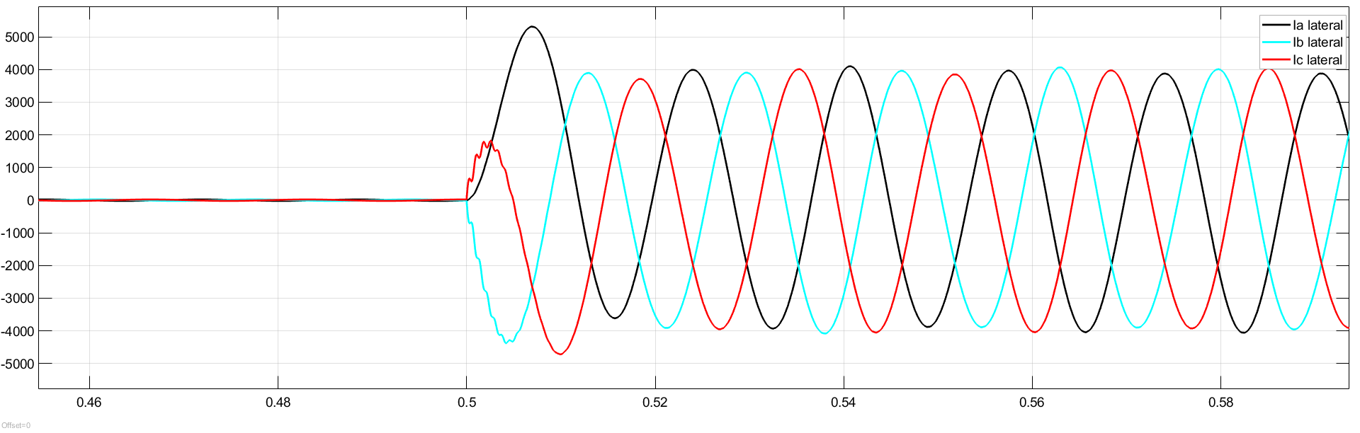
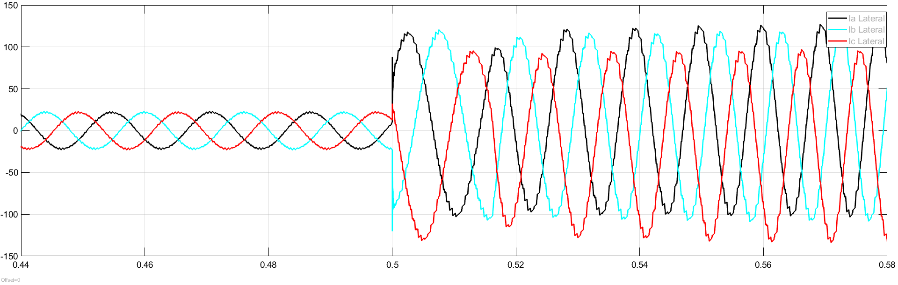
MICROGRID PROTECTION CHALLENGES: CASE STUDY
Grid-tied
Sunny day
2800 ARMS
100 T Grid-Tied
(PV-Inverter Current Controlled)
(1)
40 times nominal
3-phase Fault (.2 s)
off-grid
Sunny day
144ARMS
100 T Islanded
(PV-Inverter Voltage Controlled)
Grid tied
Island
2 times nominal
Load 25
293 kW 410 kva
(a)
(a) EPB’s Riverside Microgrid. Green dashed line encloses the microgrid. (b) Time Current Curve (TCC) for 100A S&C Positrol fuse and Intellirupter (PCR 03778).
3-phase Fault (.2 s)
(b)
Notes:
Melt curve fuse

Slide 4
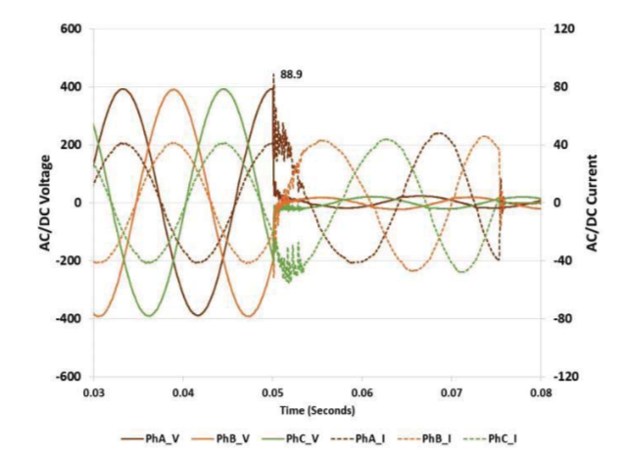
COMMERCIAL PV INVERTER FAULT CHARACTERISTICS
Brand | Model | Power Rating (kW) | Voltage rating (V) | Nominal Current (A) | Fault Current (A) | Ratio of Fault to Nominal
ABB | PRO-33.0-TL-OUTD | 33 | 480 | 50.3 | 50.3 | 1
ABB | TRIO-27.6-TL-OUTD | 28 | 480 | 45 | 46 | 1.02
FIMER | PVS-60-TL | 62 | 480 | 80 | 92 | 1.15
SMA | STP 30000TL-US-10 | 30 | 480 | 36.2 | 36.2 | 1.00
SMA | STP 50-US-40 | 50 | 480 | 60.2 | 64 | 1.06
SMA | STP 12000TL-20 | 12 | 280 | 17.4 | 17.4 | 1.00
Fault current limited to ~1.0 p.u.
Fault contribution for several PV inverter manufacturers
PV inverters limit to ~ 1.0 p.u.
Transient for 33 kW, 3-ph PV inverter at rated
power and unity power factor [47-51].
Fault current = Nominal current

Slide 5
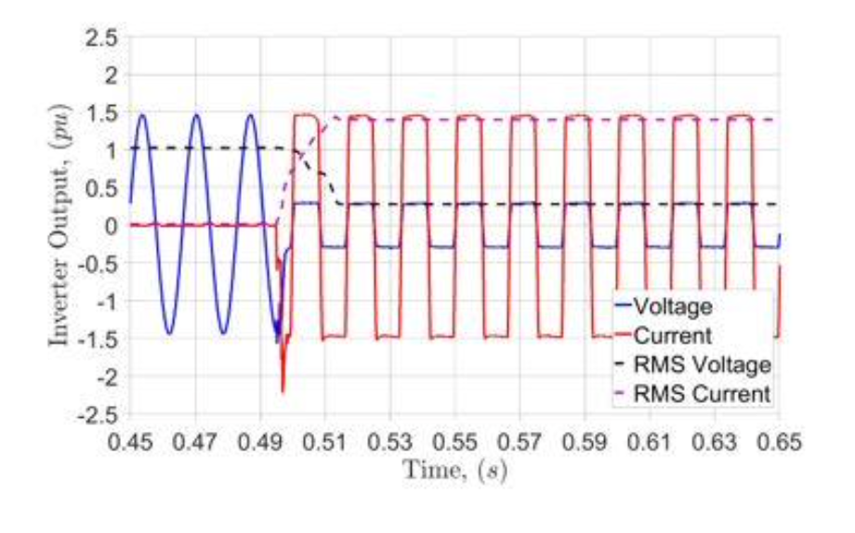
COMMERCIAL INVERTER FAULT CHARACTERISTICS
Brand | Model | Power (kW) | Voltage (V) | Nominal Current (A) | Fault Current (A) | Ratio
Oztek | OZpcs-RS40 | 40 | 480 | 50 | 63 | 1.3
Dynapower | Micro Power System | 125 | 480 | 150 | 213 | 1.4
SMA | Sunny Boy Storage 2.5 | 2.5 | 280 | 10.5 | 19 | 1.8
Firmer | React2-uno-5.0-tl | 5.0 | 280 | 22 | 22 | 1.0
Fault current limited to 1.5 p.u.
current clipped
Fault current from leading energy storage inverter manufacturers
PV inverters limit to ~ 1.5 p.u.
transient for 24 kW, 3-ph ES inverter at
rated power and unity power factor [47-51].

Slide 6
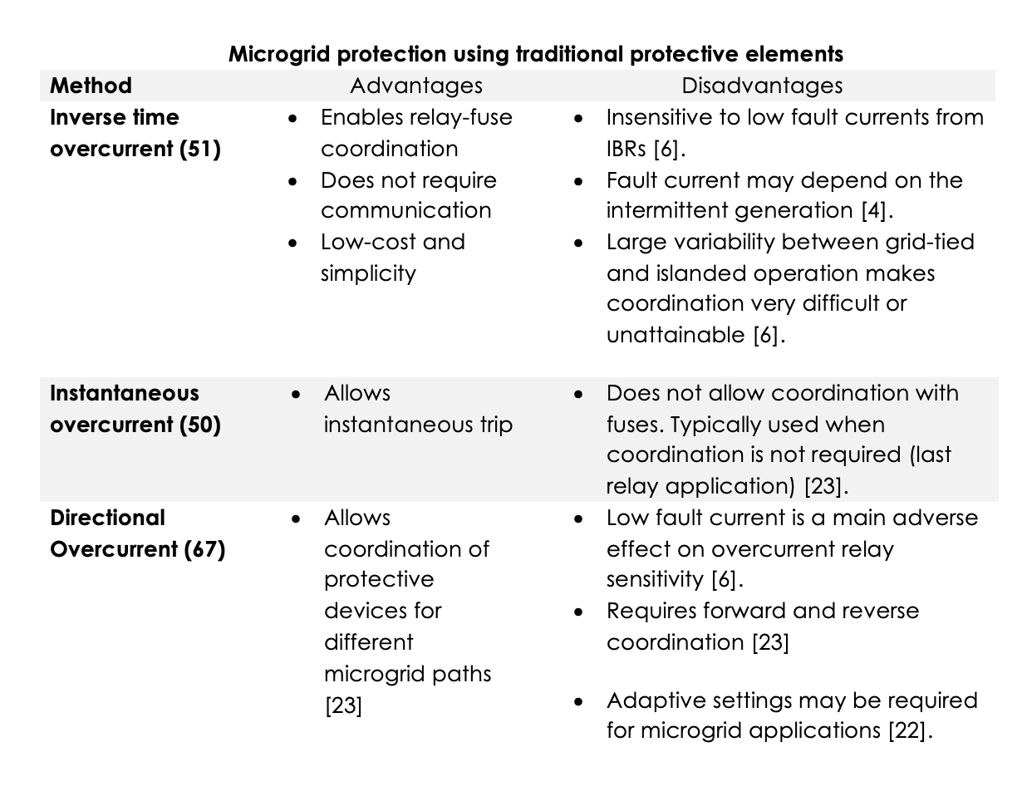
CONVENTIONAL PROTECTION APPLIED TO MICROGRIDS 1
Overcurrent protection is advantageous as it is simple, cheap and allows coordination and the use of fuses to protect laterals. However, overcurrent protection is unattainable as the IBRs limit their short-circuit current to close to their nominal current

Slide 7
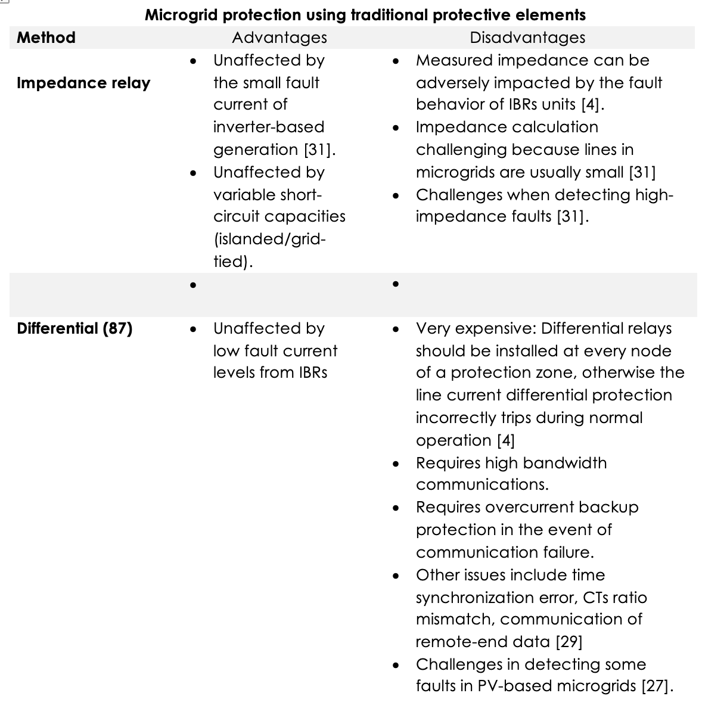
CONVENTIONAL PROTECTION APPLIED TO MICROGRIDS 2
The problems of low short circuit current created the need to start using protective devices that are not dependent solely on the current magnitude

Slide 8
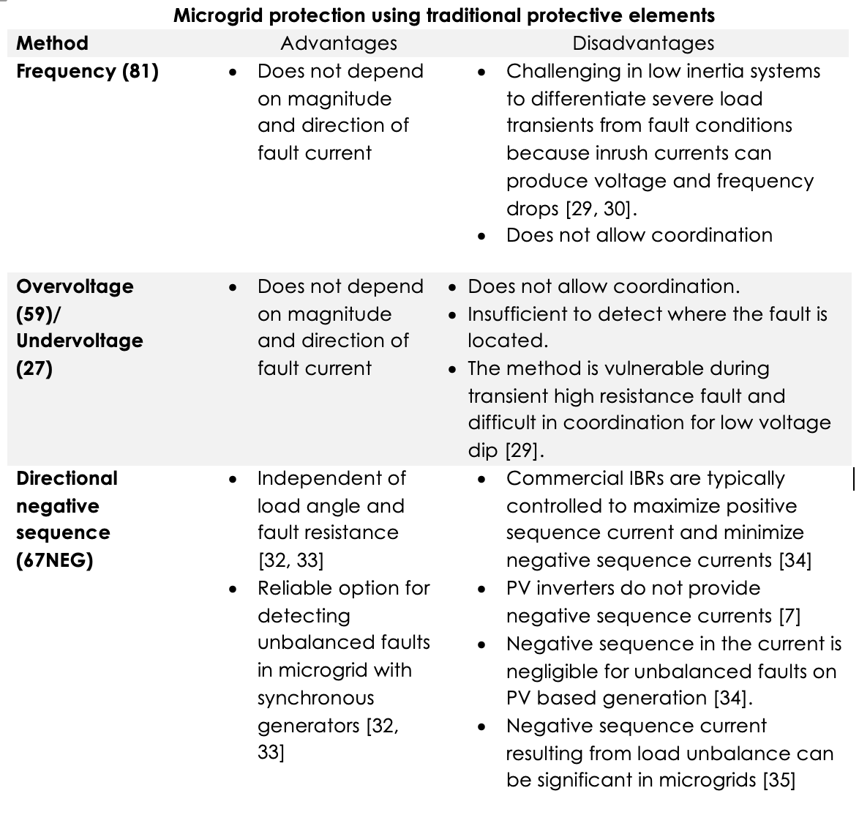
CONVENTIONAL PROTECTION APPLIED TO MICROGRIDS 3
The problems of low short circuit current created the need to start using protective devices that are not dependent solely on the current magnitude

Slide 9
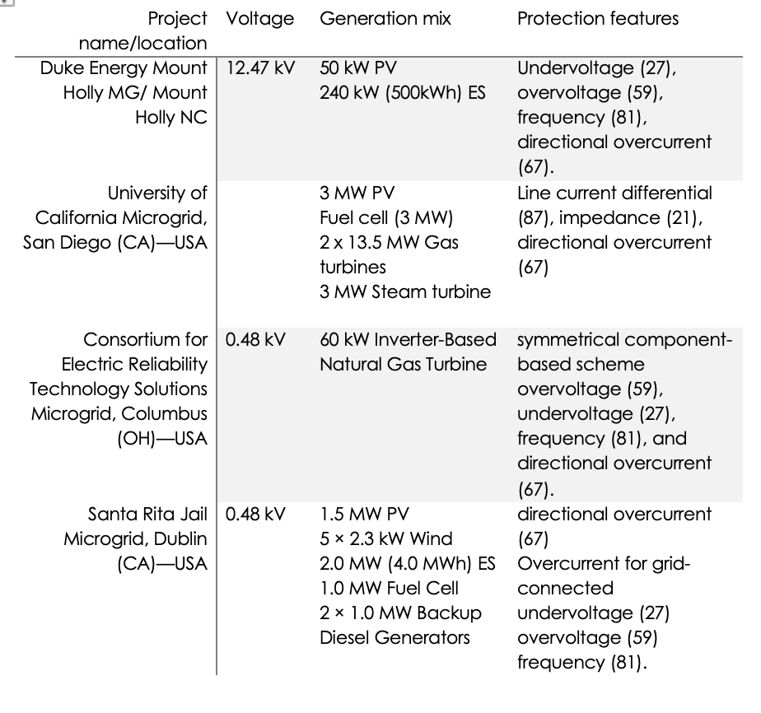
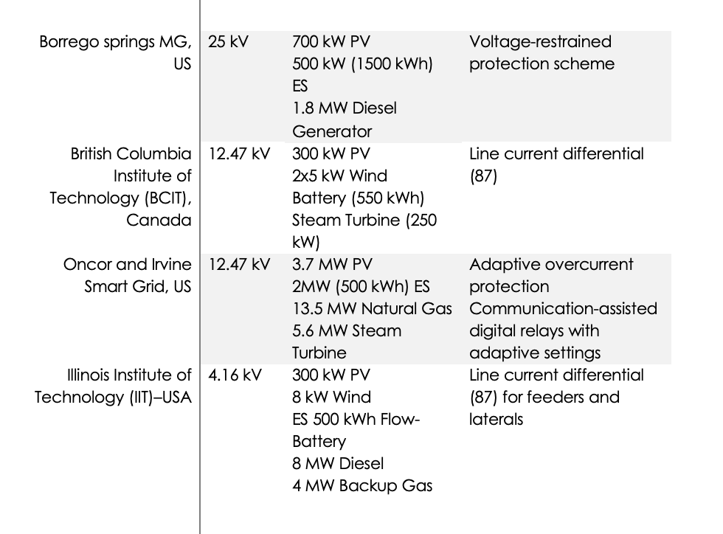

PROTECTION OF MICROGRIDS IN THE U.S.
Voltage/frequency
Synchronous Generation
Differential
Overcurrent
REFERENCES: 22,23,24.
Adaptive overcurrent

Slide 10
SUMMARY OF MICROGRID PROTECTION
Limited short-circuit current contribution from inverter-based generation causes many of the challenges when protecting microgrids in islanded operation.
Most previous work focus on the protective device for solutions instead of the culprit of the challenges, the inverter.
Line differential protection most effective way to protect microgrids. Drawbacks:
  very cost-prohibitive solution.
  requires a high bandwidth communication
  relay installation at every node of a protection zone,
  equipped with backup relays, such as directional overcurrent relays
Adaptive relay requires communication infrastructure and it may not be able to detect fault conditions if load is close to pickup.
  It does not solve fuse challenges.
  Limited to 4-7 protection settings groups
Other methods propose oversizing the whole IBR unit, which is cost prohibitive and impractical for real world applications.

Slide 11
    VOLTAGE SOURCE CONVERTER (VSC) DESIGN WITH INCREASED SHORT-CIRCUIT CONTRIBUTION

Slide 12
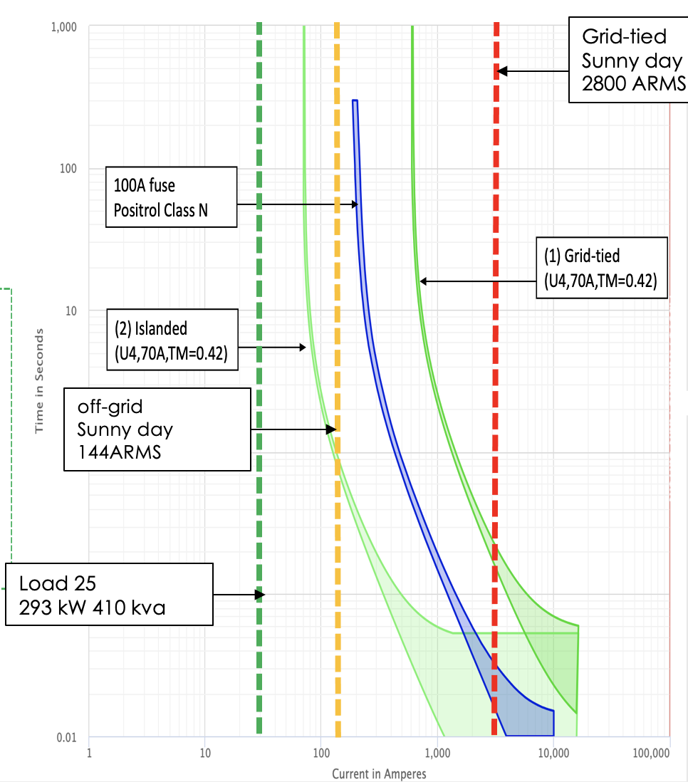
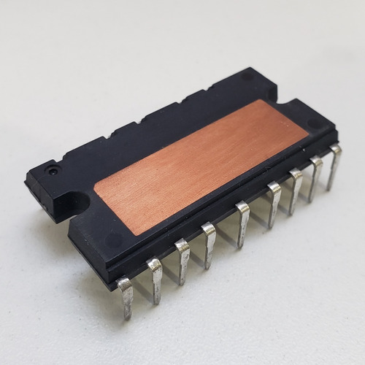
-Increase SCC of a generic VSC to enable legacy distribution protection
-Demonstrate full overcurrent coordination with fuses and reclosers
-Determine max SCC of normally rated IGBT
-Identify what components must be overrated to increase >3X SCC
-Evaluate full overcurrent coordination with fuses, primary relay and backup relay
-Evaluate LG,LL and 3-ph faults
-Grid-Filter inductor saturates at currents higher than its rated
-Nonlinear inductance introduces instabilities in the control
-Propose control to maintain stability criteria for normal and fault conditions
Objective
Hardware Approach
Control Approach
Coordination Study

Slide 13
ADVANTAGES OF PROPOSED METHOD
1) Enables the utilization of affordable overcurrent devices such as fuses, circuit breakers and reclosers
2) Enables fuse-relay coordination, and coordination between primary and backup relays
3) It is cost-effective since only the semiconductor and current sensor are oversized, while the rest of the inverter components remain at the designed rated power
4) No dedicated or additional unit is required; the ESS or PV inverter can be modified to provide the higher fault current

Slide 14
VSC DESIGN WITH INCREASED SHORT CIRCUIT CURENT CAPABILITY
Rated/Overrated
same SDIP-25 package
Overrated CT
Decoupling considering
saturable inductors
Adaptive control based on
available inductance
Energy storage system (Battery) with two-level three-phase inverter

Slide 15

ELECTROTHERMAL SIMULATION
Temperature
Electrothermal simulation block diagram

Slide 16
EXPERIMENTAL RESULTS, RATED VS OVERRATED MODULE UNDER 3-PH FAULTS
RATED DEVICE
OVERRATED
Experimental results showing inverter current during three-phase faults. Rated device providing the following fault current: (a) 1.25 p.u, (b) 1.5 p.u, (c), (d) 2.0 p.u (d) 3.0 p.u. Overrated device providing the following fault current: (e) 2.5 p.u. (f) 3.0 p.u.
Simulated temperature response using 4-layer Foster network for the following cases: Rated device providing the following fault current: (a) 1.25 p.u, (b) 1.5 p.u, (c), (d) 2.0 p.u (d) 3.0 p.u. Overrated device providing the following fault current: (e) 2.5 p.u. (f) 3.0 p.u.

Slide 17
IMPACTS OF OVERRATING POWER ELECTRONICS MODULE
PROTOTYPE INVERTER: (30A, 600V)
FULL SCALE INVERTER: (150A, 1200V)
Normal Operation
Overrated Device
Lower Losses & Junction Temp
Power losses prototype inverter (used in the research) and higher power inverter.
Overrated device is more efficient at normal operation and provides high current capability
ADDITIONAL BENEFITS OF OVERRATING POWER MODULE
Increases efficiency during normal operation (1.0 p.u.)
Enhanced grid support capabilities (LVRT, voltage support, frequency support)
Increased inertial response (more current available during transients)

Slide 18
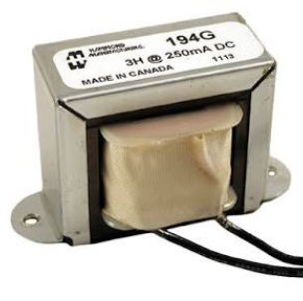
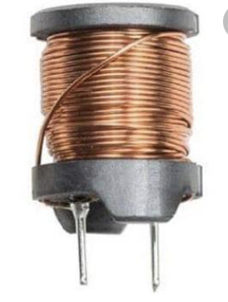
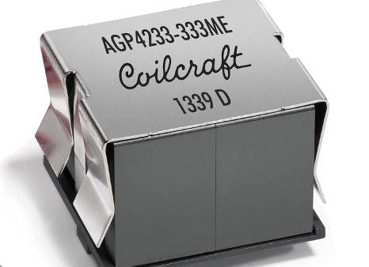

INDUCTOR SATURATION
(1) Silicon Steel core (10A)
Heavy and bulky
Typically found at LF applications
$$L_{s}=L_{o}+L_{2}i^{2}$$
(2) Ferrite core (10A)
HF applications (lower losses)
core saturates at lower flux density.
(3) Ferrite core (5A (4 x 334uH)
HF applications (lower losses)
core saturates at lower flux density.
Experimental characteristic of the nonlinear inductor used in this work. Inductor characterized at room temperature using DPG10 Power Choke Tester.

Slide 19
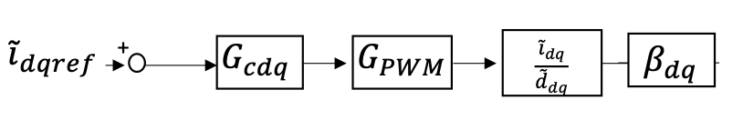

CONTROL STABILITY WITH SATURABLE INDUCTORS
Open Loop Transfer Function
PI
Time Delay
CC TF
Sensor Gain
-Stability margins depend on current setpoint.
-Severe oscillations when inductor saturates.
-Closed-loop current control may become unstable for deep core saturation.
$$T_{id}=β_{d}G_{cd}G_{PWM}\frac{V_{dc}}{\left(Ls+r\right)}$$
Bode plot for different inductance values due to core saturation effect of the steel iron core. L = 1.0 p.u. =1.2 mH. Controller gains (K_{p} = 0.75, K_{i} = 8.3)

Slide 20
CONTROL INSTABILITY WHEN NOT CONSIDERING INDUCTOR SATURATION
I=40A, L=.4 p.u.
I=25A, L=.7 p.u.
I=10A, L=1 p.u.
Step response for different inductance values due to core saturation effect of the ferrite core.
Experimental results ferrite core closed loop control. Inverter becomes unstable for currents >25A.

Slide 21

SECOND ORDER POLYNOMIAL VALIDATION
$$L_{s}=L_{o}+L_{2}i^{2}$$
Ferrite core (10A)
Second-order fit provided good representation of the nonlinearities of the inductor
(a)
(b)
Ferrite core model validation with second order polynomial fit. (a) linear region (b) nonlinear region

Slide 22
MODEL VALIDATION 3-PHASE INVERTER
(a)
(b)
(a) Simulation considering grid-filter saturation (b) experimental results
Second-order fit provided good representation of the nonlinearities of the inductor

Slide 23
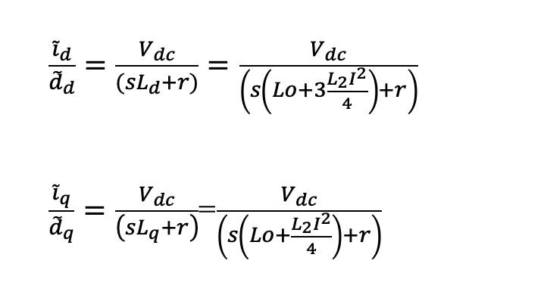

CONTROLLER DESIGN CONSIDERING NONLINEAR INDUCTOR IN THE DQ REFERENCE FRAME
Current transfer function
(1.7)
(1.8)
where
$$I>0$$
Small signal model of the inverter in dq coordinates including decoupling terms considering saturable inductors.

Slide 24
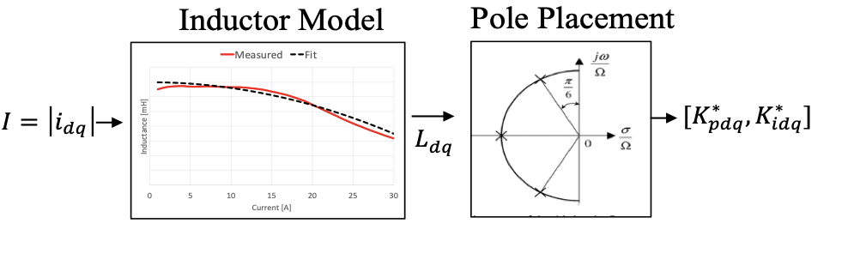
PI CURRENT CONTROLLER DESIGN CONSIDERING CORE SATURATION
Problem: Constant PI Controller tuned considering linear inductor makes the control unstable during faults due to the core saturation.
Proposed Solution: Consider the core saturation in the calculation to adaptively adjust the controller gains. With this method, we can make the inverter stable during short-circuit faults.
The proposed method consists of adaptively adjusting the integral and proportional gains considering the operating point of the inverter.
Notes:
he Butterworth polynomial is used to select the appropriate controller parameters
Butterworth polynomial and D-decomposition methods are applied to determine these parameters to ensure the system stability.

Slide 25
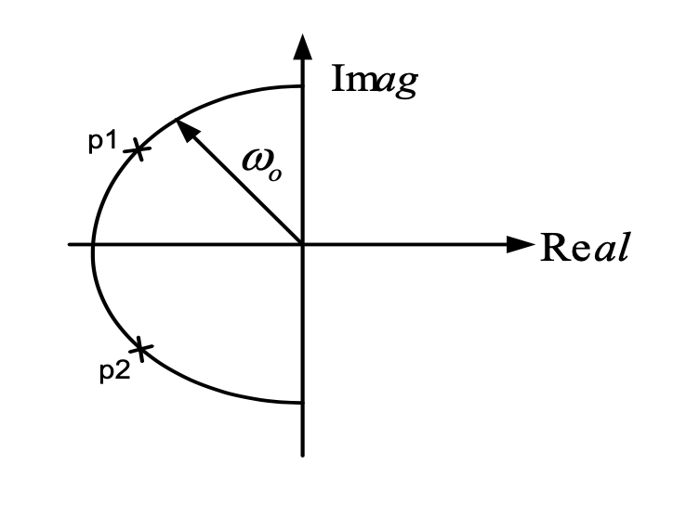



PI CURRENT CONTROLLER DESIGN CONSIDERING CORE SATURATION
Third-order Butterworth Polynomial optimizes the closed-loop eigenvalues
$s^{3}+\left(1+2ζ\right)ωs^{2}+\left(1+2ζ\right)ω^{2}s+ω^{3}$ (1.9)
The closed loop transfer function for the current control:
$$G_{id}=\frac{\left(V_{dc}\left(α−s\right)∗\left(K_{i}+K_{p}s\right)\right)}{s^{3}L_{dq}+s^{2}r+sαr−sβK_{i}V_{dc}+s^{2}L_{dq}α−{s^{2}βK}_{p}V_{dc}+{sβK}_{p}αV_{dc}+K_{i}βαV_{dc}}$$
(1.10)
$$Ld=Lo+3\frac{L_{2}I^{2}}{4}$$
$Lq=Lo+\frac{L_{2}I^{2}}{4}$.
Where the inductances are defined as:
The Butterworth method locates the eigenvalues uniformly in the left-half s-plane on a circle with radius $ω$

Slide 26


PROPOSED CONTROL
Comparing the coefficients in the Butterworth polynomial with the denominator of the closed-loop transfer function, we obtain:
$$K_{i}=\frac{ω^{3}L_{dq}}{βαV_{dc}}$$
$$K_{p}=\frac{ω^{2}L_{dq}\left(1+2ς\right)+{βK}_{i}V_{dc}−αr}{βαV_{dc}}$$
(1.12)
(1.11)
Normal
Operation
Fault
Operation
Adaptive controller gains considering core saturation.

Slide 27
PROPOSED CONTROL
CONSTANT PI METHOD
PROPOSED METHOD
PM and GM margin
depend on operating point
Same PM and GM margin
regardless of the operating point
Constant gain PI step response for different inductance values due to core saturation effect of the ferrite core .
L = 1.0 p.u = 1.3 mH.
Bode plot for different inductance values due to core saturation effect of the ferrite core. L = 1.0 p.u = 1.3 mH. PI gains calculated using the Butterworth polynomial.

Slide 28
EXPERIMENTAL RESULTS: CONSTANT PI vs. PROPOSED CONTROL
CLOSED LOOP CONTROL. 3-PHASE FAULT.
Experimental results. 3-phase faults.
PI constant gains.
Experimental results. 3-phase faults.
Proposed adaptive method

Slide 29
EXPERIMENTAL RESULTS: CONSTANT PI vs. PROPOSED CONTROL
CLOSED LOOP CONTROL. LINE-LINE FAULT
Experimental results. LL faults.
PI constant gains.
Experimental results. LL faults.
Proposed adaptive method

Slide 30
EXPERIMENTAL RESULTS: CONSTANT PI VS PROPOSED CONTROL
CLOSED LOOP CONTROL. LINE-GROUND FAULTS.
Experimental results. LG faults
PI constant gains.
Experimental results. LG faults.
Proposed adaptive method

Slide 31
COORDINATION STUDY
Fault current
Coordination study includes:
Fuse-blow
Primary protection
Backup Protection
For 3ph, LL and LG faults
TCCs for the 12.5A fuse. SEL 651R used as primary and backup relay. The CTs for both relays are 50-1 ratio. The pickup for the primary relay is 0.46 with a time dial of 1.5. The backup relay has a pickup of 0.5 with a time dial of 2.5. U5 curve for 51 protections is used for primary and backup relay.

Slide 32
COORDINATION STUDY: FUSES
(a)
(b)
(c)
Fuse clearing times for (a) LG, (b) LL, (c) 3-ph faults.
Experimental results read from SEL 651 (128 samples).

Slide 33
COORDINATION STUDY: PRIMARY RELAY
(a)
(b)
(c)
Primary relay clearing times for (a) LG, (b) LL, (c) 3-ph faults.
Experimental results read from SEL 651 (128 samples).

Slide 34
COORDINATION STUDY: BACKUP RELAY
(a)
(b)
(c)
Backup relay clearing times for (a) LG, (b) LL, (c) 3-ph faults.
Experimental results read from SEL 651 (128 samples).

Slide 35
VSC DESIGN CONCLUSIONS
Demonstrated that by over-rating just a few components, inverter can provide more than 3.0 p.u. of short-circuit current.
3.0 p.u. proved to be the minimum current that allows protection coordination
An online method to calculate the proportional and integral gains based on the available grid-filter inductance was derived and validated in hardware.
Experimental testing showed that full coordination in an islanded system can be achieved for LG,LL and 3-ph faults.

Slide 36
Publications
Maximilliano Ferrari, “Protection of Grid-Tied and Islanded Systems with High Penetration of Inverter-Based Resources” Ph.D. Dissertation, Energy Science and Engineering, The University of Tennessee, May 2023
M. Ferrari, L. M. Tolbert, “Inverter Design with High Short-Circuit Fault Current Contribution to Enable Legacy Overcurrent Protection for Islanded Microgrids,” IEEE Power and Energy Society General Meeting, Denver, CO, July 17-21, 2022, pp. 1-5
M. Ferrari, L. M. Tolbert, “Grid-tied PV Inverter With Oversized Power Module To Increase Its Low-voltage Ride Through (LVRT) Capabilities and VAR Support,” IEEE PES Innovative Smart Grid Technologies Latin America, San Juan, Puerto Rico, Nov. 6-9, 2023
A. Sundararajan, M. Olama, M. Ferrari, B. Ollis and G. Liu, "A Data Quality-Aware Framework to Reliably Forecast Photovoltaic Generation and Consumer Load for an Improved Resilience of Microgrids," 2022 IEEE 13th International Symposium on Power Electronics for Distributed Generation Systems (PEDG), 2022, pp. 1-6, doi: 10.1109/PEDG54999.2022.9923109.
M. Ferrari, B. Park and M. M. Olama, "Design and Evaluation of a Model-Free Frequency Control Strategy in Islanded Microgrids with Power-Hardware-in-the-Loop Testing," 2021 IEEE Power & Energy Society Innovative Smart Grid Technologies Conference (ISGT), 2021, pp. 1-5, doi: 10.1109/ISGT49243.2021.9372219.
Piesciorovsky, EC, Ferrari Maglia, MF. Comparison of high-speed adaptive and nonadaptive backup overcurrent protection on fuse feeders with sensors. Int Trans Electr Energ Syst. 2019; 29:e2812.

