Slide 1
DRAM Subsystem Organization
Channel
DIMM
Rank
Chip
Bank
Row/Column
Slide courtesy of Onur Mutlu, Carnegie Mellon University
Notes:
DRAM itself is organized as a hierarchy. The full DRAM subsystem includes channels, DIMMs, ranks, DRAM chips, banks, rows and columns, which are organized into the hierarchy shown on this slide. We’ll now look at each of these components in a bit more detail.

Slide 2
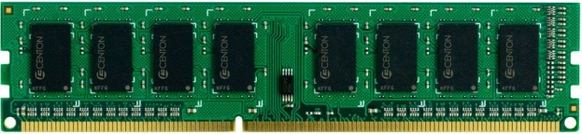
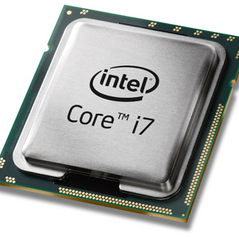
The DRAM Subsystem
“Channel”
DIMM (Dual in-line memory module)
Processor
Memory channel
Memory channel
Slide courtesy of Onur Mutlu, Carnegie Mellon University
Notes:
Each memory device is connected to a bus that is used to transfer data between the processor and memory.
The memory bus is divided into multiple channels. The memory controller, which is part of the processor, issues commands to each device over a particular channel, and the devices can respond by sending data back to the processor over the same channel. You can connect more than one DRAM module, which is also called a DIMM (or dual in-line memory module), to the same channel, but each channel can only sustain a limited amount of bandwidth. So, if you connect more than one device to the same channel, both devices will have to share the bandwidth that is supported by that channel.

Slide 3
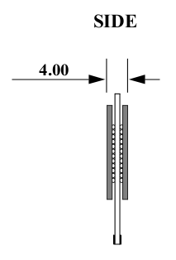
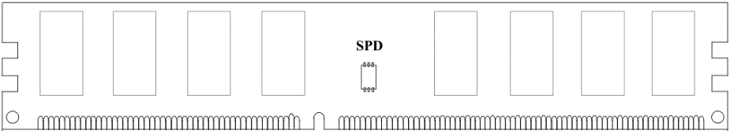
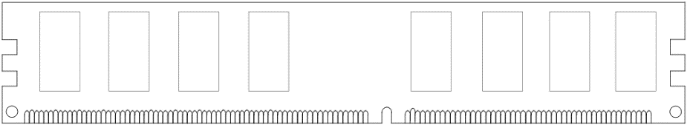
Breaking Down a DIMM
DIMM (Dual in-line memory module)
Side view
Front of DIMM
Back of DIMM
Slide courtesy of Onur Mutlu, Carnegie Mellon University
Notes:
Each individual DRAM module or DIMM typically has two sides with memory on each side. If you’ve ever had to purchase or replace DRAM in a computer, a DIMM is just one of the green sticks of memory you can buy at the store.

Slide 4
Breaking Down a DIMM
DIMM (Dual in-line memory module)
Side view
Front of DIMM
Back of DIMM
Rank 0: collection of 8 chips
Rank 1
Slide courtesy of Onur Mutlu, Carnegie Mellon University
Notes:
Each side of a DIMM is called a rank. Each rank is a collection of 4, 8, or 16 DRAM chips. As we’ll see, the rank is the set of memory that participates in a memory access.

Slide 5
Rank Design
Rank 0 (Front)
Rank 1 (Back)
<0:63>
<0:63>
Addr/Cmd
CS <0:1>
Data <0:63>
Memory channel
Slide courtesy of Onur Mutlu, Carnegie Mellon University
Notes:
Each rank shares the same address and command buses, but they can respond with different data elements. They also share the same data bus.

Slide 6
Breaking Down a Rank
. . .
Chip 0
Chip 1
Chip 7
Rank 0
<0:63>
<0:7>
<8:15>
<56:63>
Data <0:63>
Slide courtesy of Onur Mutlu, Carnegie Mellon University
Notes:
This figure shows the organization of a single rank. Remember each rank has 8 chips.
Each chip provides different pieces of a 64-bit word from the rank. Specifically, each chip provides a single byte of the 8 byte word.

Slide 7
Breaking Down a Chip
8 banks
Chip 0
Bank 0
<0:7>
<0:7>
<0:7>
...
<0:7>
<0:7>
Slide courtesy of Onur Mutlu, Carnegie Mellon University
Notes:
Let’s look inside each chip now.
Each chip consists of a set of banks. In today’s synchronous DRAM, we typically use 8 (DDR3) or 16 (DDR4) banks, but there’s no particular reason we need to use these values. There are various tradeoffs in having more or less banks and DDR3 and DDR4 have settled on 8 and 16.
Each bank can provide independent pieces of data to the bus, and the chip itself has a narrow interface, which helps keep costs low.
So, in this example we see that you can access 8 bits at a time from each bank, which is typical in modern systems.

Slide 8
Breaking Down a Bank
2kB
1B (column)
row 16k-1
Bank 0
...
row 0
<0:7>
Row-buffer
1B
1B
1B
...
<0:7>
Slide courtesy of Onur Mutlu, Carnegie Mellon University
Notes:
Let’s look inside the bank.
As I mentioned earlier, each bank is a 2-dimensional array of cells. If you break this down any further, you’d just be looking at individual DRAM cells, which are just a capacitor to hold the charge and a transistor to access the charge.
One important item to note is that each bank has a set of sense amplifiers, known collectively as the row buffer, which is used to read data in the bank. The size of the row buffer varies, but it’s typically 2KB, 4KB, or 8KB in modern DRAM devices.
Before the DRAM bank loads new data into a row buffer, the sense amplifiers that make up the row-buffer have to be “precharged” with a separate command from the DRAM controller. The precharge command basically sets the values in the row buffer “halfway” between a logical 0 and 1, allowing the small charge stored in each cell to be detected by the sense amplifiers.

Slide 9
Accessing DRAM
Memory controller decodes each address into a <row,column> pair
Open row policy:
  If the row buffer does not contain the proper row
    Precharge the row buffer to prepare to load the row
    Activate (RAS) opens row (places it into the row buffer)
  Read/write (CAS) reads/writes column in the row buffer
Closed row policy:
  Activate (RAS) opens row (places it into the row buffer)
  Read/write (CAS) reads/writes column in the row buffer
  Precharge after every read/write (overlap with read/write)
Slide courtesy of Onur Mutlu, Carnegie Mellon University
Notes:
When the processor generates a memory reference, the address is sent to the memory controller, which decodes the address and maps it to a particular bank, row, and column. Now, the memory controller will send a sequence of commands to the device to access the data. The exact sequence of commands depends on how the device manages the row buffer. There are a couple different row buffer management options used in modern memory devices.
The first option is called the open row policy. This approach keeps the row that was just accessed in the row buffer so that subsequent accesses do not need to activate or “open” the row again.
For this approach, if the row buffer does not contain the proper row, the controller issues a precharge command to prepare the row buffer for loading a new row. Then it sends an activate command, which is also called a row access strobe or RAS command, to load the correct row into the row buffer. When the correct row is loaded, the controller just sends a read or write command, which is also called a column access strobe or CAS command to access the data in the row. After it’s done accessing the data, the previous data will remain in the row buffer.
So, with this approach, memory references that access data in a row that is already loaded in the row buffer require only about 1/3 of the time of accesses that need to load a new row into the row buffer.
The other approach is called the closed row policy. With this approach, we close the row after every read or write to prepare the row buffer to load a new row for the next data access. In this way, every access requires activate, read or write, and precharge commands. However, it might still be faster than the open row policy for some access patterns because the column access command and the precharge command can be overlapped.
So, the basic tradeoff is as follows: In the open row policy, row buffer hits require time for 1 command, while row buffer misses require time for 3 commands, while in the close row policy, every data access is a row buffer miss, but misses only require time for 2 commands because we can overlap the read/write command with the precharge command. Both policies are still used by modern devices. I’ve also seen work that explores hybrid and reactive policies that use each approach at different times depending on the row buffer hit rate.

Slide 10
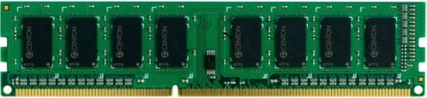


Transferring a Cache Block
Physical memory space
0xFFFF…F
Channel 0
...
DIMM 0
Mapped to
0x40
Rank 0
64B
cache block
0x00
Slide courtesy of Onur Mutlu, Carnegie Mellon University
Notes:
Now, let’s put this all together and look at how the system accesses bytes of memory in a cache block.
On the left, we have our address space. These are physical addresses. We’re accessing a cache block after there’s been a miss in the cache – so the virtual address has already been translated to a physical address. We’re going to assume 64 byte cache blocks for this example.
The cache block is then mapped some channel and rank in the DRAM. The memory controller determines which rank it needs to access when the processor gives it an address to access.

Slide 11
Transferring a Cache Block
Physical memory space
Chip 0
Chip 1
Rank 0
Chip 7
0xFFFF…F
. . .
...
<0:7>
<8:15>
<56:63>
0x40
64B
cache block
Data <0:63>
0x00
Slide courtesy of Onur Mutlu, Carnegie Mellon University
Notes:
If we look a little closer, we see that all 8 chips on the rank actually participate in the data access.
Basically, the system accesses 8 bytes of memory at a time.

Slide 12
Transferring a Cache Block
Physical memory space
Chip 0
Chip 1
Rank 0
Chip 7
0xFFFF…F
. . .
Row 0
Col 0
...
<0:7>
<8:15>
<56:63>
0x40
64B
cache block
Data <0:63>
0x00
Slide courtesy of Onur Mutlu, Carnegie Mellon University
Notes:
Let’s say that the first byte of the cache block starts at row 0, column 0 in the bank shown on the slide.
I should note, each bank is also spread out across all 8 DRAM chips. But the rank itself has multiple banks.
So, to access the first 8 bytes, it accesses a byte from each chip in row 0, column 0.

Slide 13
Transferring a cache block
Physical memory space
Chip 0
Chip 1
Rank 0
Chip 7
0xFFFF…F
. . .
Row 0
Col 0
...
<0:7>
<8:15>
<56:63>
0x40
64B
cache block
Data <0:63>
8B
0x00
8B
Slide courtesy of Onur Mutlu, Carnegie Mellon University
Notes:
So, you get the first 8 bytes.

Slide 14
Transferring a cache block
Physical memory space
Chip 0
Chip 1
Rank 0
Chip 7
0xFFFF…F
. . .
Row 0
Col 1
...
<0:7>
<8:15>
<56:63>
0x40
64B
cache block
Data <0:63>
8B
0x00
Slide courtesy of Onur Mutlu, Carnegie Mellon University
Notes:
Then, the next 8 bytes are mapped into the same row, but in column 1. And the next 8 bytes would be in column 2, and so on.
So, to complete access the cache block you’ll access this next 8 bytes.

Slide 15
Transferring a cache block
Physical memory space
Chip 0
Chip 1
Rank 0
Chip 7
0xFFFF…F
. . .
Row 0
Col 1
...
<0:7>
<8:15>
<56:63>
0x40
8B
64B
cache block
Data <0:63>
8B
0x00
8B
Slide courtesy of Onur Mutlu, Carnegie Mellon University
Notes:
And so on until you get the whole cache block.

Slide 16
Transferring a cache block
Physical memory space
Chip 0
Chip 1
Rank 0
Chip 7
0xFFFF…F
. . .
Row 0
Col 1
...
<0:7>
<8:15>
<56:63>
0x40
8B
64B
cache block
Data <0:63>
8B
0x00
A 64B cache block takes 8 I/O cycles to transfer (4 total cycles with DDR).
During the process, 8 columns are read sequentially.
Slide courtesy of Onur Mutlu, Carnegie Mellon University
Notes:
So, a 64-byte cache block takes 8 DRAM cycles to transfer the entire block. If we use DDR device, we can transfer data on both the rising and falling edge of the clock cycle, so we only 4 total cycles to transfer the 64-byte block.
In the process, 8 columns from the same row are read sequentially – assuming the data is mapped this way.

