Slide 1
Introduction to RNNs for NLP
Shang Gao

Slide 2
About Me
PhD student in the Data Science and Engineering program
Took Deep Learning last year
Work in the Biomedical Sciences, Engineering, and Computing group at ORNL
Research interests revolve around deep learning for NLP
Main project: information extraction from cancer pathology reports for NCI

Slide 3
Overview
Super Quick Review of Neural Networks
Recurrent Neural Networks
Advanced RNN Architectures
Long-Short-Term-Memory
Gated Recurrent Units
RNNs for Natural Language Processing
Word Embeddings
NLP Applications
Attention Mechanisms and CNNs for Text

Slide 4
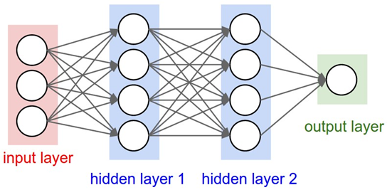
Neural Network Review
Neural networks are organized into layers
Each neuron receives signal from all neurons in the previous layer
Each signal connection has a weight associated with it based on how important it is; the more important the signal the higher the weight
These weights are the model parameters

Slide 5
Neural Network Review
Each neuron gets the weighted sum of signals from the previous layer
The weighted sum is passed through the activation function to determine how much signal is passed to the next layer
The neurons at the very end determine the outcome or decision

Slide 6
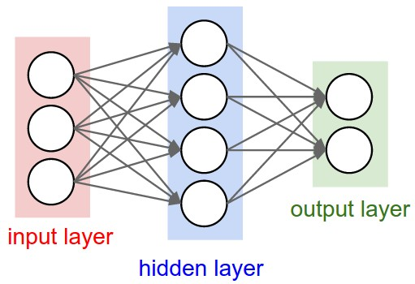
Feedforward Neural Networks
In a regular feedforward network, each neuron takes in inputs from the neurons in the previous layer, and then pass its output to the neurons in the next layer
The neurons at the end make a classification based only on the data from the current input

Slide 7
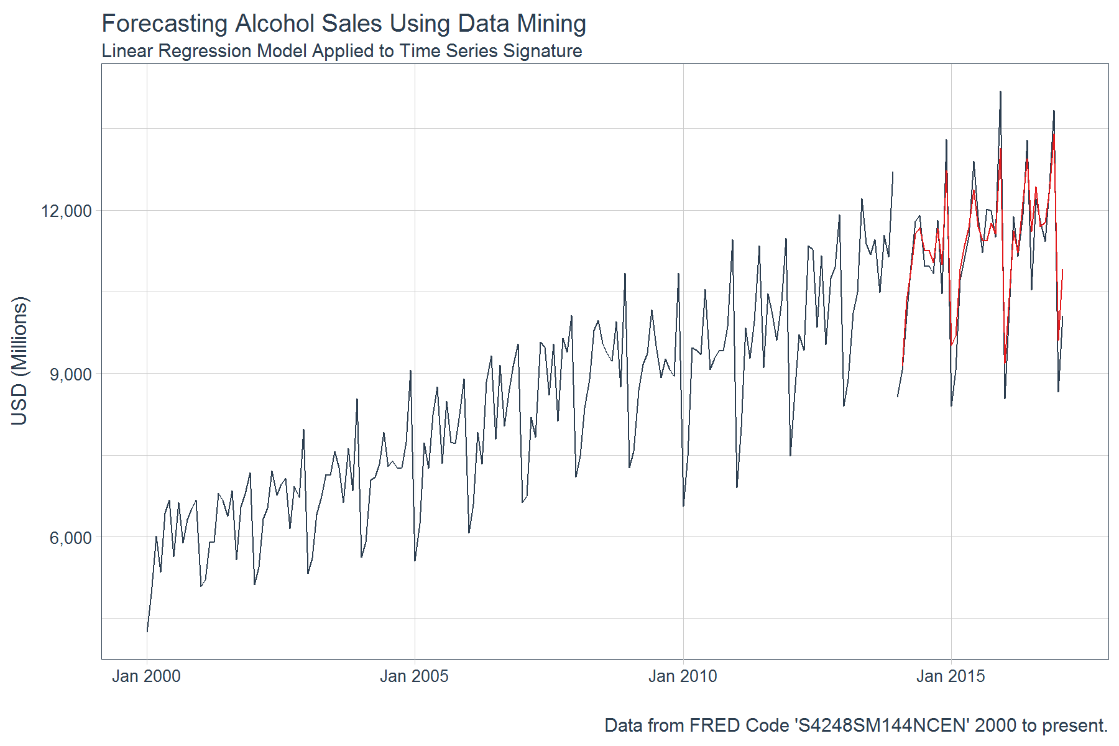
What About Time Series Data?
In time series data, you have to consider patterns over time to effectively interpret the data:
Weather data
Stock market
Speech audio
Text and natural language
Imaging and LIDAR for self-driving cars

Slide 8
Recurrent Neural Networks
In a recurrent neural network, each neuron takes in data from the previous layer AND its own output from the previous timestep
The neurons at the end make a classification decision based on NOT ONLY the input at the current timestep BUT ALSO the input from all timesteps before it
Recurrent neural networks can thus capture patterns over time

Slide 9
Recurrent Neural Networks
In the example below, the neuron at the first timestep takes in an input and generates an output
The neuron at the second timestep takes in an input AND ALSO the output from the first timestep to make its decision
The neuron at the third timestep takes in an input and also the output from the second timestep (which accounted for data from the first timestep), so its output is affected by data from both the first and second timestep

Slide 10
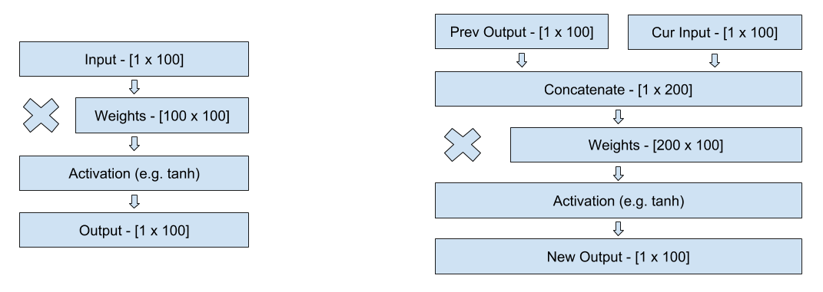
Recurrent Neural Networks
Recurrent: output = sigmoid(weights * concat(input, previous_output) + bias)
Feedforward: output = sigmoid(weights * input + bias)

Slide 11
Recurrent Neural Networks
Another way to think of RNNs is just a very deep feedforward neural network, where each timestep adds another layer of depth.
Every time there is another timestep, you concatenate the new input and then reapply the same set of weights
This is why with many timesteps, RNNs can become very slow to train.

Slide 12
Toy RNN Example Adding Binary
At each timestep, RNN takes in two values representing binary input
At each timestep, RNN outputs the sum of the two binary values taking into account any carryover from previous timestep

Slide 13
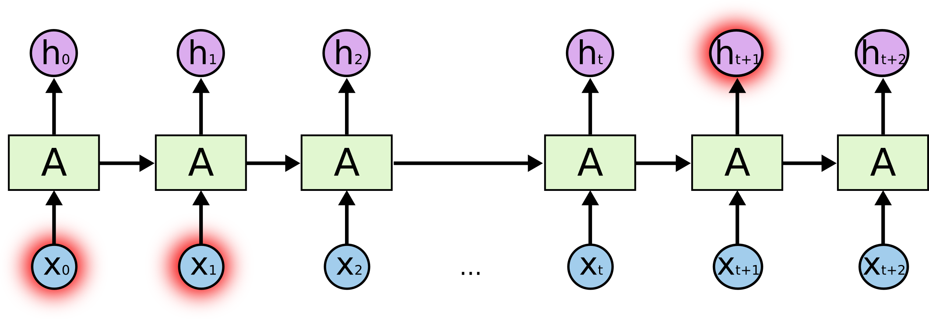
Problems with Basic RNNs
For illustrative purposes, let’s assume at any given timestep, decision depends 50-50 on current input and previous output
RNN reads in input data (x₀) at the 1st timestep. The output (h₀) at the first timestep depends entirely on x₀
At the 2nd timestep, the output h₁ is influenced 50% by x₀ and 50% by x₁

Slide 14
Problems with Basic RNNs
At the 3rd timestep, the output h₂ is influenced 25% by x₀, 25% by x₁, and 50% by x₂
The influence of x₀ decreases by half every additional timestep
By the end of the RNN, the data from the first timestep has very little impact on the output of the RNN

Slide 15
Problems with Basic RNNs
Basic RNN cells can’t retain information across a large number of timesteps
In practice, RNNs can lose data in as few as 4-5 timesteps
This is causes problems on tasks where information needs to be retained over a long time
For example, in natural language processing, the meaning of a pronoun may depend on what was stated in a previous sentence

Slide 16
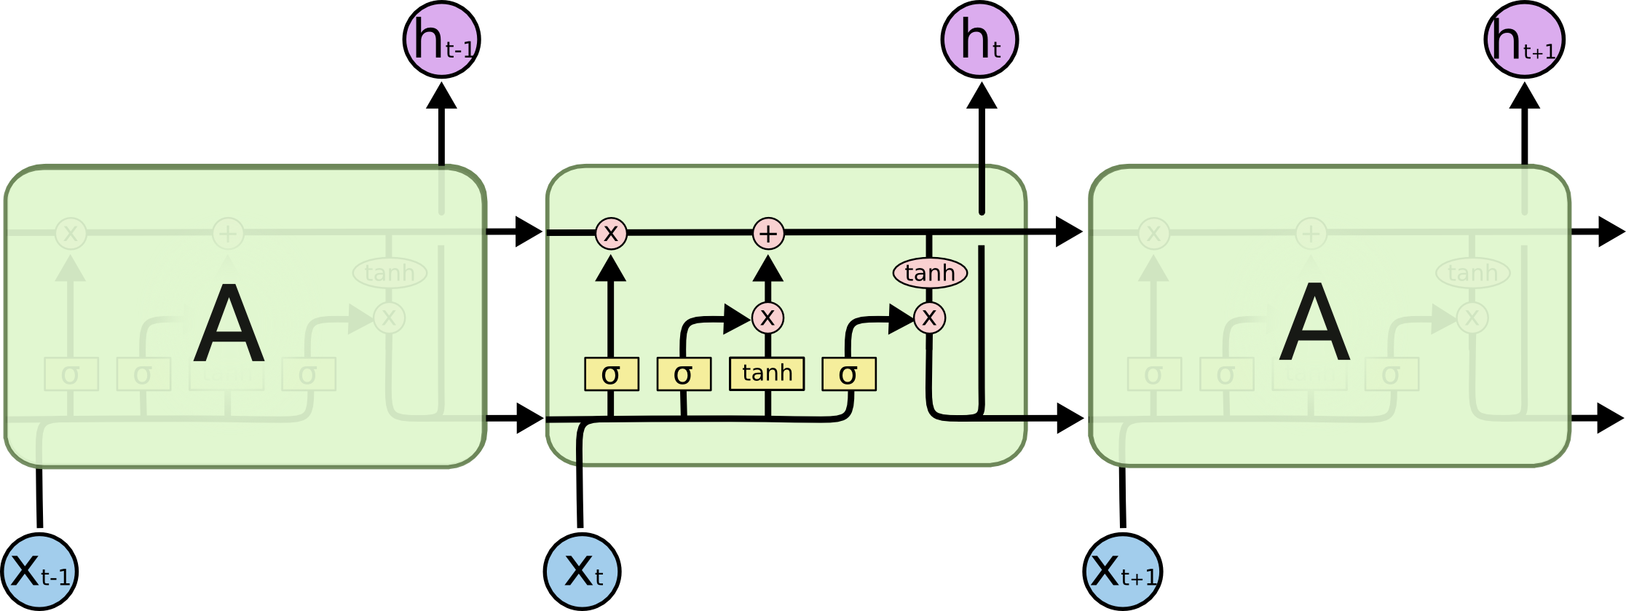
Long Short Term Memory
Long Short Term Memory cells are advanced RNN cells that address the problem of long-term dependencies
Instead of always writing to each cell at every time step, each unit has an internal ‘memory’ that can be written to selectively

Slide 17
Long Short Term Memory
Terminology:
x_{t} – input data at timestep t
C_{t} – internal memory of LSTM at timestep t
h_{t} – output of LSTM at timestep t

Slide 18
Long Short Term Memory
x_{t} – input data at timestep t
C_{t} – internal memory of LSTM at timestep t
h_{t} – output of LSTM at timestep t
Input from the current timestep is written to the internal memory based on how relevant it is to the problem (relevance is learned during training through backpropagation)
If the input isn’t relevant, no data is written into the cell
This way data can be preserved over many timesteps and be retrieved when it is needed

Slide 19
Long Short Term Memory
x_{t} – input data at timestep t
C_{t} – internal memory of LSTM at timestep t
h_{t} – output of LSTM at timestep t
Movement of data into and out of an LSTM cell is controlled by “gates”
A gate is a sigmoid function that controls the flow of information through the LSTM
Outputs a value between 0 (no flow) and 1 (let everything through)
Each gate examines the input data and previous output to determine how information should flow through the LSTM

Slide 20
Long Short Term Memory
x_{t} – input data at timestep t
C_{t} – internal memory of LSTM at timestep t
h_{t} – output of LSTM at timestep t
The “forget gate” outputs a value between 0 (delete) and 1 (keep) and controls how much of the internal memory to keep from the previous timestep
For example, at the end of a sentence, when a ‘.’ is encountered, we may want to reset the internal memory of the cell

Slide 21
Long Short Term Memory
x_{t} – input data at timestep t
C_{t} – internal memory of LSTM at timestep t
h_{t} – output of LSTM at timestep t
The “candidate value” is the processed input value from the current timestep that may be added to memory
Note that tanh activation is used for the “candidate value” to allow for negative values to subtract from memory
The “input gate” outputs a value between 0 (delete) and 1 (keep) and controls how much of the candidate value add to memory

Slide 22
Long Short Term Memory
x_{t} – input data at timestep t
C_{t} – internal memory of LSTM at timestep t
h_{t} – output of LSTM at timestep t
Combined, the “input gate” and “candidate value” determine what new data gets written into memory
The “forget gate” determines how much of the previous memory to retain
The new memory of the LSTM cell is the “forget gate” * the previous memory state + the “input gate” * the “candidate value” from the current timestep

Slide 23
Long Short Term Memory
x_{t} – input data at timestep t
C_{t} – internal memory of LSTM at timestep t
h_{t} – output of LSTM at timestep t
The LSTM cell does not output the contents of its memory to the next layer
Stored data in memory might not be relevant for current timestep, e.g., a cell can store a pronoun reference and only output when the pronoun appears
Instead, an “output” gate outputs a value between 0 and 1 that determines how much of the memory to output
The output goes through a final tanh activation before being passed to the next layer

Slide 24
Gated Recurrent Units
Gated Recurrent Units are very similar to LSTMs but use two gates instead of three
The “update gate” determines how much of the previous memory to keep
The “reset gate” determines how to combine the new input with the previous memory
The entire internal memory is output without an additional activation

Slide 25
LSTMs vs GRUs
Greff, et al. (2015) compared LSTMs and GRUs and found they perform about the same
Jozefowicz, et al. (2015) generated more than ten thousand variants of RNNs and determined that depending on the task, some may perform better than LSTMs
GRUs train slightly faster than LSTMs because they are less complex
Generally speaking, tuning hyperparameters (e.g. number of units, size of weights) will probably affect performance more than picking between GRU and LSTM

Slide 26
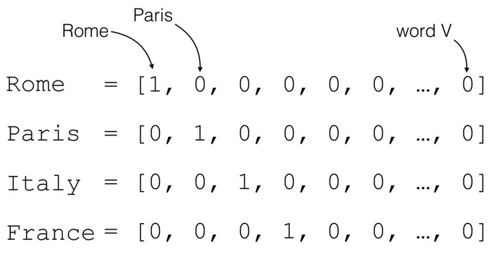
RNNs for Natural Language Processing
The natural input for a neural network is a vector of numeric values (e.g. pixel densities for imaging or audio frequency for speech recognition)
How do you feed language as input into a neural network?
The most basic solution is one hot encoding

Slide 27
One Hot Encoding LSTM Example
Trained LSTM to predict the next character given a sequence of characters
Training corpus: All books in Hitchhiker’s Guide to the Galaxy series
One-hot encoding used to convert each character into a vector
72 possible characters – lowercase letters, uppercase letters, numbers, and punctuation
Input vector is fed into a layer of 256 LSTM nodes
LSTM output fed into a softmax layer that predicts the following character
The character with the highest softmax probability is chosen as the next character

Slide 28
Generated Samples
700 iterations: ae ae ae ae ae ae ae ae ae ae ae ae ae ae ae ae ae ae ae ae ae ae ae ae ae ae ae ae ae
4200 iterations: the sand and the said the sand and the said the sand and the said the sand and the said the sand and the said the
36000 iterations: seared to be a little was a small beach of the ship was a small beach of the ship was a small beach of the ship
100000 iterations: the second the stars is the stars to the stars in the stars that he had been so the ship had been so the ship had been
290000 iterations: started to run a computer to the computer to take a bit of a problem off the ship and the sun and the air was the sound
500000 iterations: "I think the Galaxy will be a lot of things that the second man who could not be continually and the sound of the stars

Slide 29
One Hot Encoding Shortcomings
One-hot encoding is lacking because it fails to capture semantic similarity between words, i.e., the inherent meaning of word
For example, the words “happy”, “joyful”, and “pleased” all have similar meanings, but under one-hot encoding they are three distinct and unrelated entities
What if we could capture the meaning of words within a numerical context?

Slide 30
Word Embeddings
Word embeddings are vector representations of words that attempt to capture semantic meaning
Each word is represented as a vector of numerical values
Each index in the vector represents some abstract “concept”
These concepts are unlabeled and learned during training
Words that are similar will have similar vectors
 | Masculinity | Royality | Youth | Intelligence
King | 0.95 | 0.95 | -0.1 | 0.6
Queen | -0.95 | 0.95 | -0.1 | 0.6
Prince | 0.8 | 0.8 | 0.7 | 0.4
Woman | -0.95 | 0.01 | -0.1 | 0.2
Peasant | 0.1 | -0.95 | 0.1 | -0.3
Doctor | 0.12 | 0. 1 | -0.2 | 0.95

Slide 31
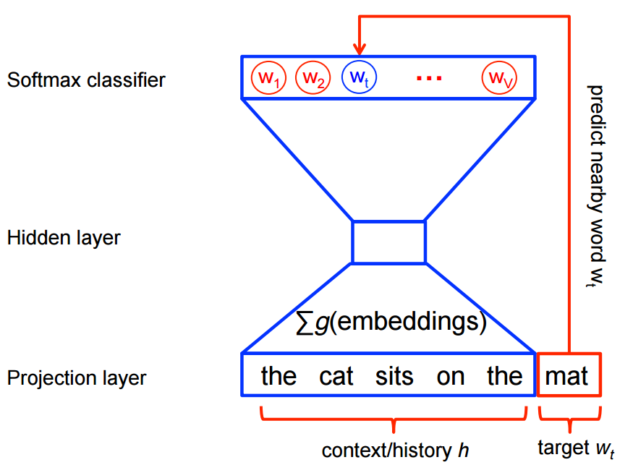
Word2Vec
Words that appear in the same context are more likely to have the same meaning
I am excited to see you today!
I am ecstatic to see you today!
Word2Vec is an algorithm that uses a funnel-shaped single hidden layer neural network to create word embeddings
Given a word (in one-hot encoded format), it tries to predict the neighbors of that word (also in one-hot encoded format), or vice versa
Words that appear in the same context will have similar embeddings

Slide 32
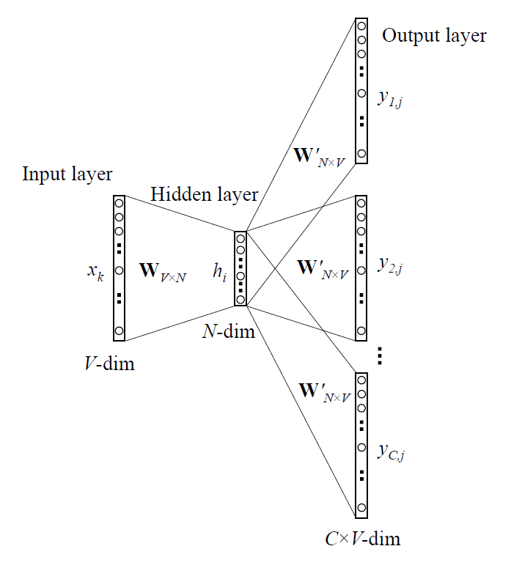
Word2Vec
The model is trained on a large corpus of text using regular backpropagation
For each word in the corpus, predict the 5 words to the left and right (or vice versa)
Once the model is trained, the embedding for a particular word is the row of the weight matrix associated with that word
Many pretrained vectors (e.g. Google) can be downloaded online

Slide 33
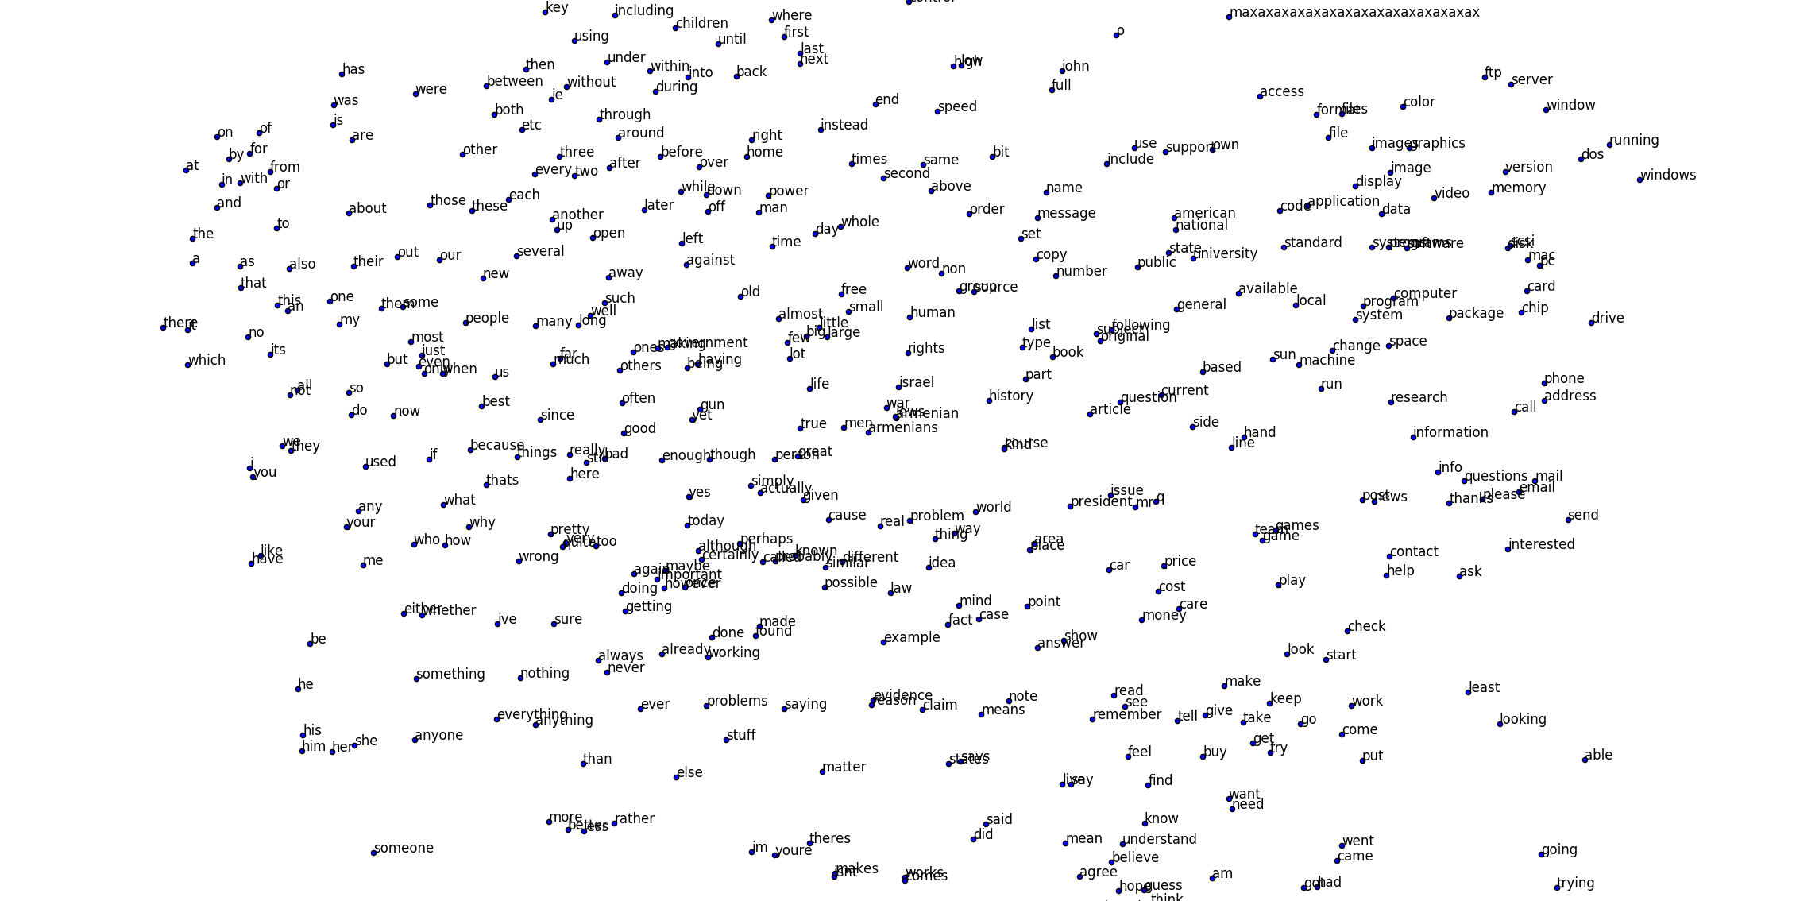
Word2Vec on 20 Newsgroups

Slide 34
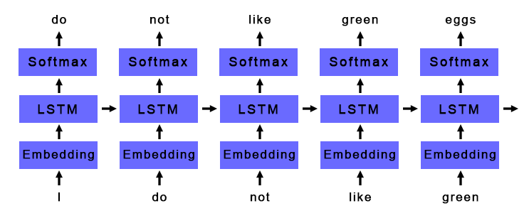
Basic Deep Learning NLP Pipeline
Generate Word Embeddings
Python gensim package
Feed word embeddings into LSTM or GRU layer
Feed output of LSTM or GRU layer into softmax classifier

Slide 35
Applications
Language Models
Given a series of words, predict the next word
Understand the inherent patterns in a given language
Useful for autocompletion and machine translation
Sentiment Analysis
Given a sentence or document, classify if it is positive or negative
Useful for analyzing the success of a product launch or automated stock trading based off news
Other forms text classification
Cancer pathology report classification

Slide 36
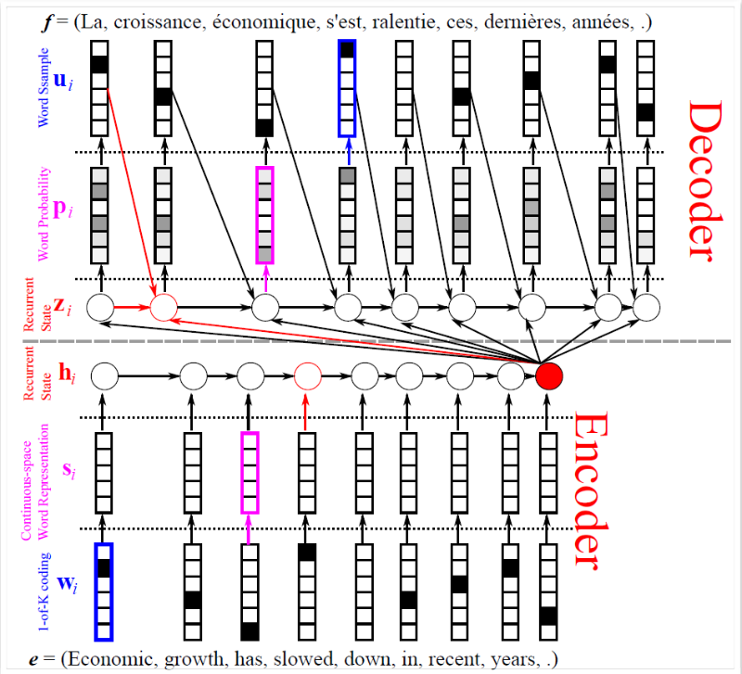
Advanced Applications
Question Answering
Read a document and then answer questions
Many models use RNNs as their foundation
Automated Image Captioning
Given an image, automatically generate a caption
Many models use both CNNs and RNNs
Machine Translation
Automatically translate text from one language to another
Many models (including Google Translate) use RNNs as their foundation

Slide 37
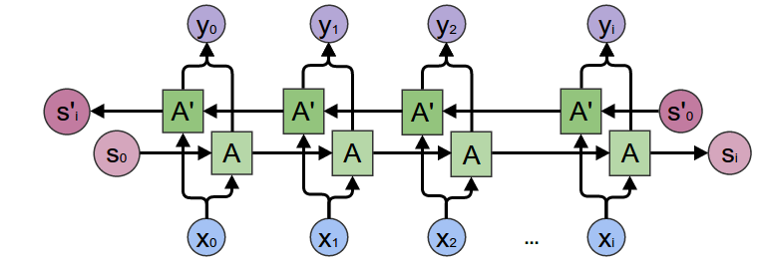
LSTM Improvements Bi-directional LSTMs
Sometimes, important context for a word comes after the word (especially important translation)
I saw a crane flying across the sky
I saw a crane lifting a large boulder
Solution - use two LSTM layers, one that reads the input forward and one that reads the input backwards, and concatenate their outputs

Slide 38
LSTM Improvements Attention Mechanisms
Sometimes only a few words in a sentence or document are important and the rest do not contribute as much meaning
For example, when classifying cancer location from cancer pathology reports, we may only care about certain keywords like “right upper lung” or “ovarian”
In a traditional RNN, we usually take the output at the last timestep
By the last timestep, information from the important words may have been diluted, even with LSTMs and GRUs units
How can we capture the information at the most important words?

Slide 39
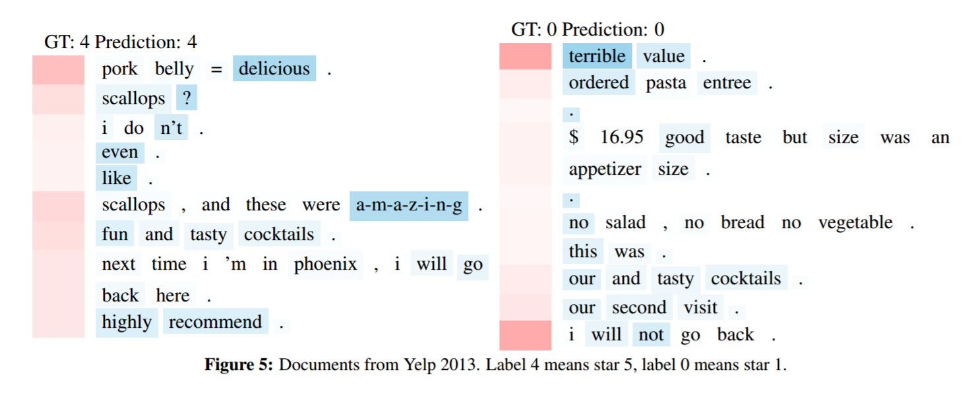
LSTM Improvements Attention Mechanisms
Naïve solution: to prevent information loss, instead of using the LSTM output at the last timestep, take the LSTM output at every timestep and use the average
Better solution: find the important timesteps, and weight the output at those timesteps much higher when doing the average

Slide 40
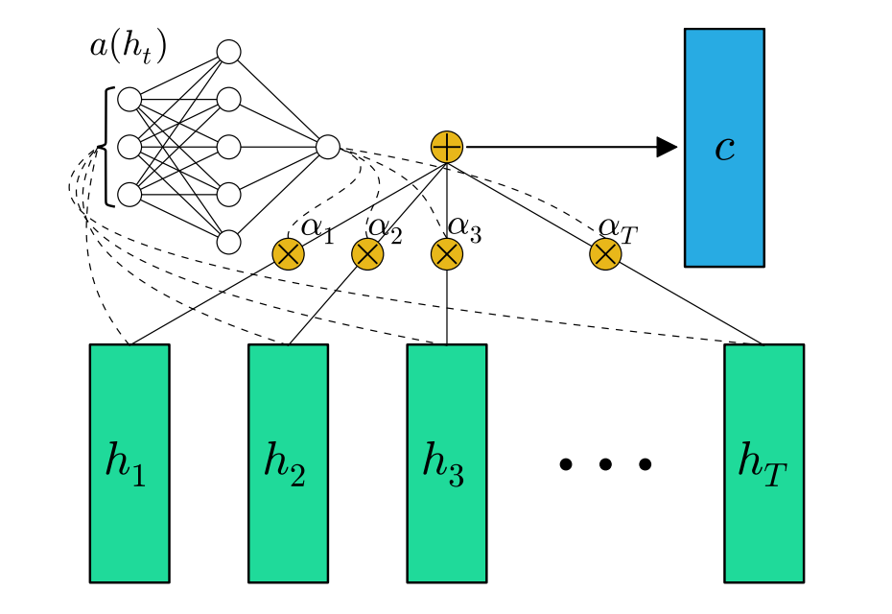
LSTM Improvements Attention Mechanisms
An attention mechanism calculates how important the LSTM output at each timestep is
At each timestep, feed the output from the LSTM/GRU into the attention mechanism

Slide 41
LSTM Improvements Attention Mechanisms
There are many different implementations, but the basic idea is the same:
Compare the input vector to some ‘context’ target vector
The more similar the input is to the target vector, the more important it is
For each input, output a single scalar value indicating it’s importance
Common implementations:
Additive: Single hidden layer neural network
Dot product

Slide 42
LSTM Improvements Attention Mechanisms
Once we have the importance values from the attention mechanism, we apply softmax to normalize
softmax always adds to 1
The softmax ouput tells us how to weight the output at each timestep, i.e., how important each timestep is
Multiply the output at each timestep with its corresponding softmax weight and add to create a weighted average

Slide 43
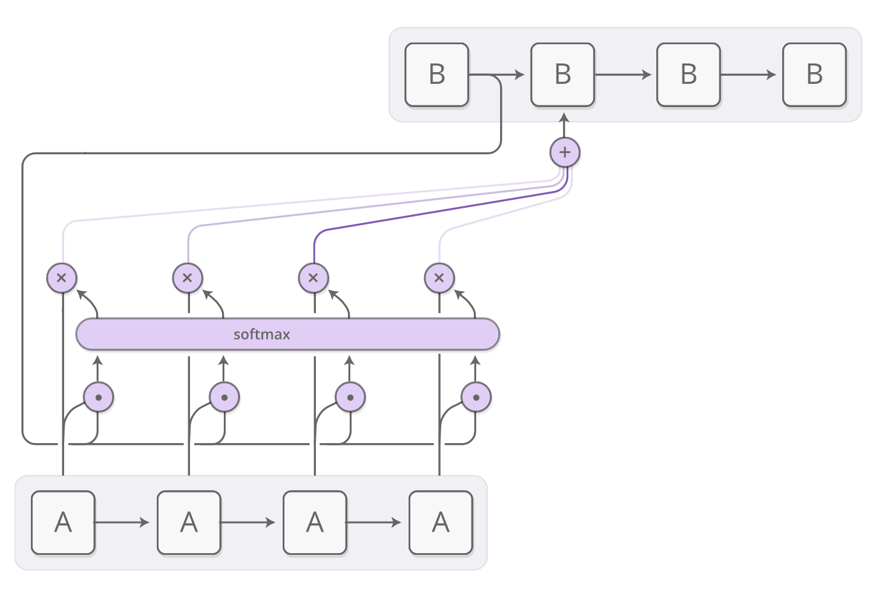
LSTM Improvements Attention Mechanisms
We initialize the “context” target vector based off the NLP application:
For question answering, can represent a question being asked
For machine translation, can represent the previous word or sentence
For classification, can be initialized randomly and learned during training

Slide 44
LSTM Improvements Attention Mechanisms
With attention, you can visualize how important each timestep is for a particular task

Slide 45
LSTM Improvements Attention Mechanisms
With attention, you can visualize how important each timestep is for a particular task

Slide 46
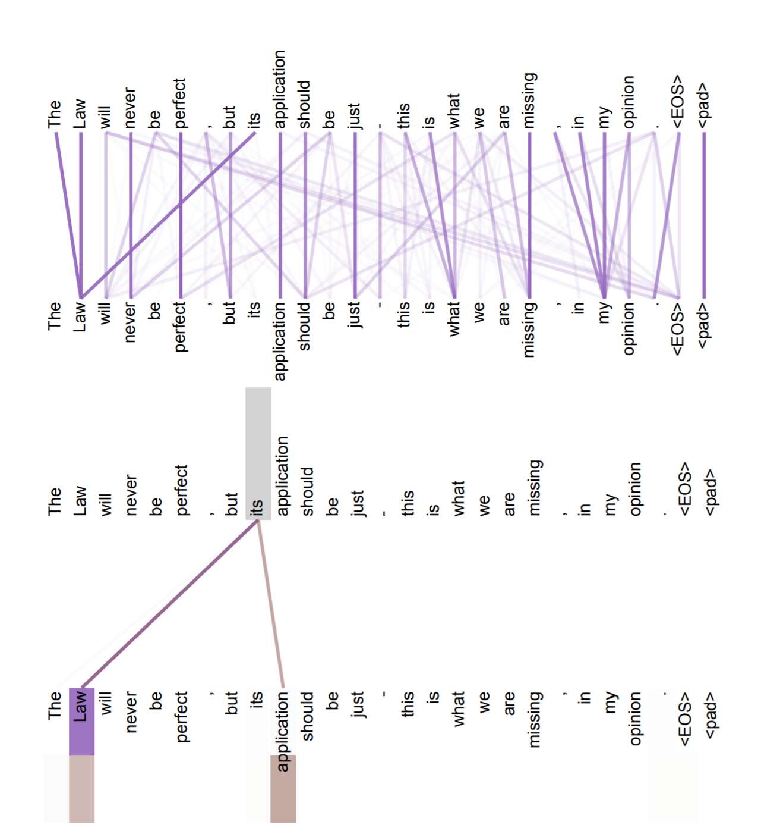
Self Attention
Self attention is a form of neural attention in which a sequence of words is compared against itself
This allows the network to learn important relationships between words in the same sequence, especially across long distances
Self-attention is becoming popular in NLP because it can find long distance relationships like RNNs but is up to 10x faster to run.

Slide 47
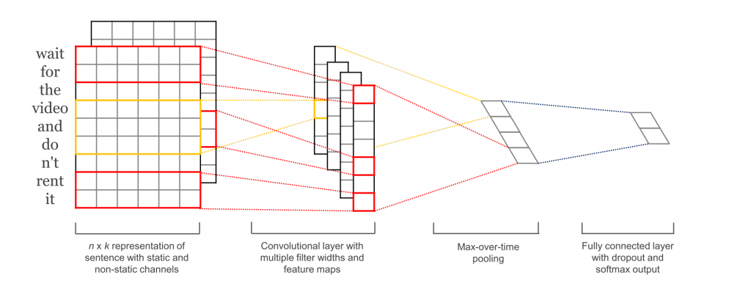
CNNs for Text Classification
Start with Word Embeddings
If you have 10 words, and your embedding size is 300, you’ll have a 10x300 matrix
3 Parallel Convolution Layers
Take in word embeddings
Sliding window that processes 3, 4, and 5 words at a time (1D conv)
Filter sizes are 3x300x100, 4x300x100, and 5x300x100 (width, in-channels, out-channels)
Each conv layer outputs 10x100 matrix

Slide 48
CNNs for Text Classification
Maxpool and Concatenate
For each filter channel, maxpool across the entire width of sentence
This is like picking the ‘most important’ word in the sentence for each channel
Also ensures every sentence, no matter how long, is represented by same length vector
For each of the three 10x100 matrices, returns 1x100 matrix
Concatenate the three 1x100 matrices into a 1x300 matrix
Dense and Softmax

Slide 49
Questions?

Slide 50
Cool Deep Learning Videos
Style Transfer - https://www.youtube.com/watch?v=Khuj4ASldmU
4 experiments where AI outsmarted its creators - https://www.youtube.com/watch?v=GdTBqBnqhaQ
One Pixel Attack - https://www.youtube.com/watch?v=SA4YEAWVpbk

