Slide 1
Autotune E+ Building Energy Models
Joshua New, Ph.D.
Building Technologies Research &
Integration Center (BTRIC)
Whole Building and Community Integration
for
SimBuild 2012
5th Nat’l Conf. IBPSA-USA
August 2, 2012
Notes:
I’m Joshua New and will be presenting on the Autotune project and how it might be useful for your research

Slide 2
Presentation Summary
Of what relevance is Autotune?
What is Autotune?
So what are you actually doing?
How can this help me?

Slide 3
Presentation Summary
Of what relevance is Autotune?
What is Autotune?
So what are you actually doing?
How can this help me?

Slide 4


Energy is the Defining Challenge of Our Time
Buildings in U.S.
  40% of primary energy/carbon, 73% of electricity, 34% of gas
Buildings in China
  60% of urban building floor space in 2030 has yet to be built
Buildings in India
  67% of all building floor space in 2030 has yet to be built
Global energy consumption
will increase 50% by 2030
“Upgrading the energy efficiency of America’s buildings is one of the fastest, easiest, and cheapest ways to save money, cut down on harmful pollution, and create good jobs…” President Obama, December 2, 2011, while announcing Better Buildings Challenge
Notes:
4
4
4
Why do I work in this area? I believe that energy is the defining challenge of our time: the one issue, more than any other, that will shape the fate of our planet, our economies and our nations. With only 5% of the world’s population, the US uses over 26% of the world’s primary energy. With near double-digit annual growth in important parts of the world, energy and its impact on the climate will increase in importance.
So what are we doing about it?

Slide 5
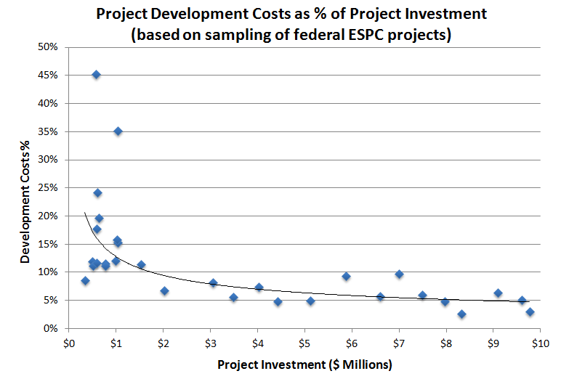
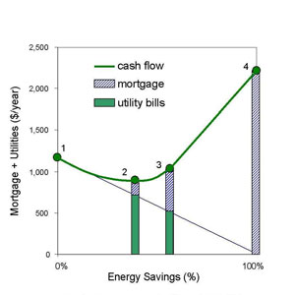
Need for Big-V Validation of Energy Models
CA Assembly Bills AB1103 and AB758
4.7 million commercial, 114 million residential
Small projects have higher overhead,
larger spread (risk)
Determination of optimal retrofit or
weatherization package for a building
WA NEAT/MHEA Wx measures,
BE-Opt, HES, etc.
Do measures match expected savings
Disambiguation of multiple measures
Notes:
CA has some progressive legislation that requires energy modeling and utility usage data anytime commercial property changes hands.
While this starts to mandate energy modeling penetration for a small fraction of the largest of the ~4.7 million commercial buildings in the US, the ~114 million residential buildings is a tougher nut to crack.
As for cost-effective technologies and retrofit measures, LEED-style accreditation, etc., the development cost as a percentage of project investment goes up tremendously for smaller projects…meaning most small projects can’t bear the financial burden of energy simulation or calibration.
More generally for energy simulation, there are a lot of great tools such as BE-Opt and Home Energy Saver which use well-known simulation engines to recommend retrofits or weatherization measures using return-on-investment metrics.
However, all the aforementioned tools (and underlying simulation engines) hinge on this one thing: having an accurate virtual representation of a real-world building (e.g. junk in junk out).
Unfortunately, buildings are not like cars or airplanes…buildings are typically “manufactured” in the field based on one-off designs with operational lifetimes of 50-100 years.

Slide 6
Presentation Summary
Of what relevance is Autotune?
What is Autotune?
So what are you actually doing?
How can this help me?

Slide 7
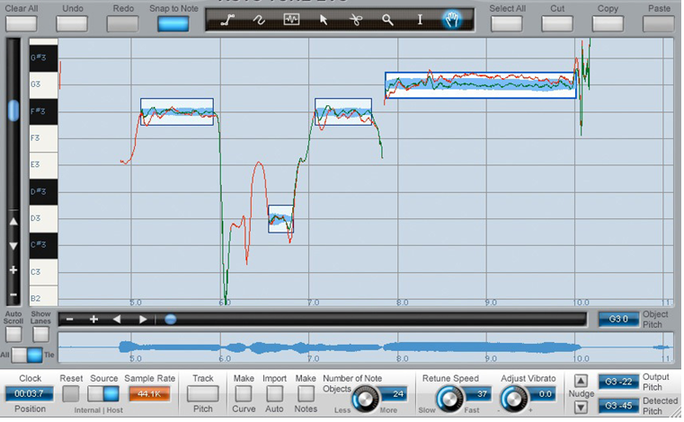



Analogical Reasoning
Timescale & Pitch matching - Cher’s “Believe” from 1998
Auto-tune the news:
http://www.youtube.com/watch?v=EzNhaLUT520 (original)
http://www.youtube.com/watch?v=QzRZWpeofic (tuned)
GarageBand for desktops
Vocal autotuning for smartphones

Slide 8
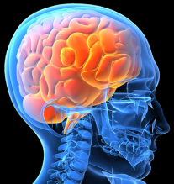
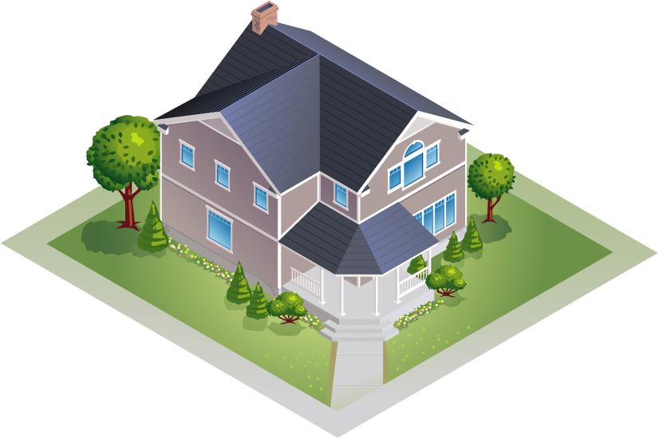

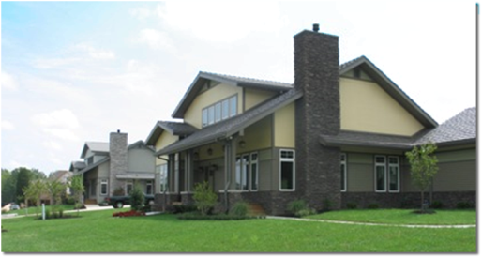

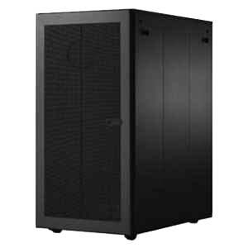
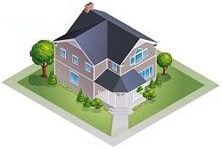





The Autotune Idea
Bridging the gap between the real world and the virtual one
E+ Input Model
.
.
.
Notes:
First, let’s briefly discuss the cost-prohibitive, business-as-usual approach to building energy modeling and how technology being developed aims to remove those barriers. A person builds an input file,
*CLICK advance*
runs it through a simulation engine, and compares it to sensor data.
*CLICK advance*
They never match.
*CLICK advance*
So you have this expensive feedback loop where an energy modeling expert tediously edits THOUSANDS of parameters - typically in a text file - for occupancy schedules, HVAC system configuration, material properties, etc. This is so expensive, validation of energy models is rarely performed. What everyone really wants is…
*CLICK advance*
An easy button
*CLICK advance*
Where instead maybe we spin this off, for a computer to solve for us.
*CLICK advance*
The base E+ input file won’t be accurate at first
*CLICK advance*
But our algorithms successively get better
*CLICK advance*
And better
*CLICK advance*
Until eventually
*CLICK advance*
It’s within an acceptable tolerance
*CLICK advance*
We then return that tuned model to the user.

Slide 9
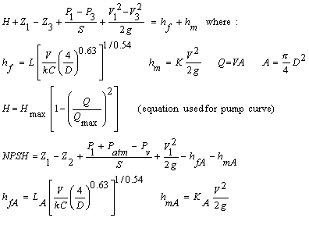
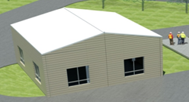
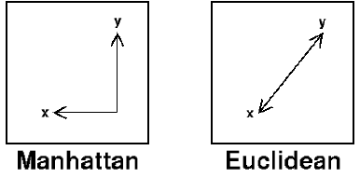


Mapping for Vector Distance
E+ variable name
E+ Input Model
main_Tot | None_Tot(1) | None_Tot(2) | HP1_in_Tot | HP1_out_Tot | HP1_back_Tot | HP1_in_fan_Tot | HP1_comp_Tot | HP2_in_Tot | HP2_out_Tot | HP2_back_Tot | HP2_in_fan_Tot
1172.5 | 0 | 0 | 6.75 | 18.75 | 0 | 0 | 0 | 6.75 | 18 | 0 | 0
Manual
mapping
initially
Avg
main_Tot | None_Tot(1) | None_Tot(2) | HP1_in_Tot | HP1_out_Tot | HP1_back_Tot | HP1_in_fan_Tot | HP1_comp_Tot | HP2_in_Tot | HP2_out_Tot | HP2_back_Tot | HP2_in_fan_Tot
1172.5 | 0 | 0 | 6.75 | 18.75 | 0 | 0 | 0 | 6.75 | 18 | 0 | 0
FRP sensor name
Same for output (fitness):
Malahanobis Weighting per dimension (addition/generalization of Euclid)
Notes:
Simple idea, but how do you do it and what do I mean by “close enough”
If you think as the internal variables of E+ as the software-state and sensor data as the sensor-state, they’re both a vector of numbers. We need to define a mapping between them. If you have a sensors and an internal variable of say
*CLICK*
“temperature north wall”, then it’s a 1-to-1 mapping. But we have temperature 3’, 5’, and 7’ above grade
*CLICK*
So maybe we need to average those. For HVAC…
*CLICK*
It can get really complicated. But luckily ORNL has the experts to help define these mappings
Once you have a mapping, you can transfer from sensor-state to software-state and iterate on the E+ inputs until these two vectors are close.

Slide 10

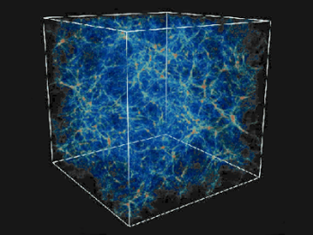
Computational Complexity
Problems/Opportunities:
Thousands of parameters per E+ input file
We chose to vary 156
Brute-force = 5x10⁵² simulations
E+ Input Model
E+ parameters
main_Tot | None_Tot(1) | None_Tot(2) | HP1_in_Tot | HP1_out_Tot | HP1_back_Tot | HP1_in_fan_Tot | HP1_comp_Tot | HP2_in_Tot | HP2_out_Tot | HP2_back_Tot | HP2_in_fan_Tot
1172.5 | 0 | 0 | 6.75 | 18.75 | 0 | 0 | 0 | 6.75 | 18 | 0 | 0
The Universe:
13.75 billion years?
Need 4.5x10³¹ of those
Notes:
The problem is that E+ input files have thousands of parameters (think back to the lines in your *.inp or *.idf files)
*CLICK*
We’ve identified ~156 that need to be varied (humans rarely more than 6…primarily infiltration, equipment schedules, etc.)
*CLICK*
And the experts have defined a min, max, and step-size that they would like to permute…yielding combinatorial explosion of 5x10^52 simulations
*CLICK*
Thankfully we have Jaguar, but…
*CLICK*
It would take all 299k processors running full tilt 4.5x10^31 lifetimes of the universe to brute force it…this problem would bring the 6th fastest supercomputer in the world to its knees…and this is just for 1 building

Slide 11
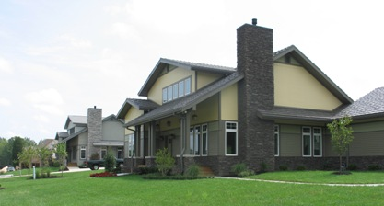
Standard Sensitivity Analysis
(but very large and systematic)
E+ Input Model
E+
main_Tot | None_Tot(1) | None_Tot(2) | HP1_in_Tot | HP1_out_Tot | HP1_back_Tot | HP1_in_fan_Tot | HP1_comp_Tot | HP2_in_Tot | HP2_out_Tot | HP2_back_Tot | HP2_in_fan_Tot
1172.5 | 0 | 0 | 6.75 | 18.75 | 0 | 0 | 0 | 6.75 | 18 | 0 | 0
main_Tot | None_Tot(1) | None_Tot(2) | HP1_in_Tot | HP1_out_Tot | HP1_back_Tot | HP1_in_fan_Tot | HP1_comp_Tot | HP2_in_Tot | HP2_out_Tot | HP2_back_Tot | HP2_in_fan_Tot
1172.5 | 0 | 0 | 6.75 | 18.75 | 0 | 0 | 0 | 6.75 | 18 | 0 | 0
11

Slide 12
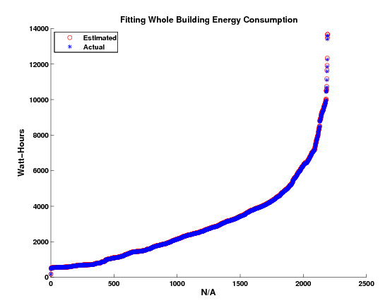
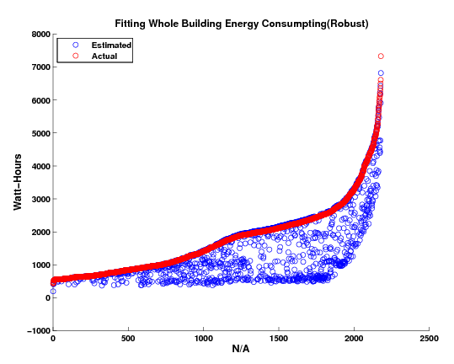
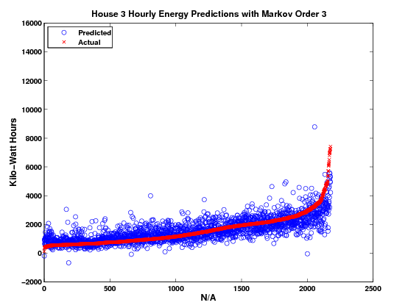
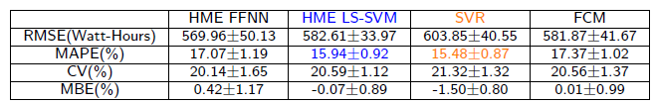
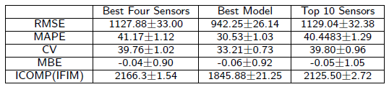
Example Results
Linear Regression predicting whole building energy use
Accuracy Metrics for best subset of sensors
House 1 (House 2 is similar)
House 3
House 3
Next hour
Notes:
The simplest algorithm was able to very accurately predict current-hour whole building energy consumption for some buildings, but not for a house with advanced energy efficiency and generation capabilities
We can even predict into the future what will happen next hour, perhaps to change HVAC control strategy and pre-heat or pre-cool the building…but as Yogi Berra said, “It’s difficult to make predictions, especially about the future.” He really meant accurate predictions.
*CLICK*
We have lots of metrics for determining accuracy. So while retrofitting an existing home with ~144 sensors is nowhere near cost-effective, we have identified the best 4 and best 10 sensors and the tradeoff in predictive accuracy.

Slide 13
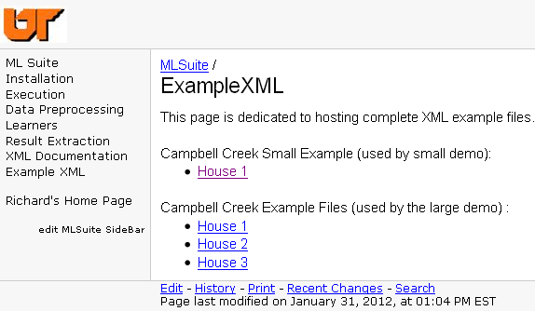

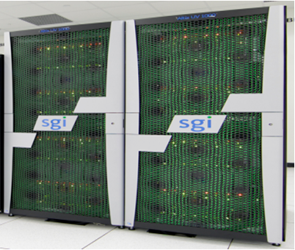
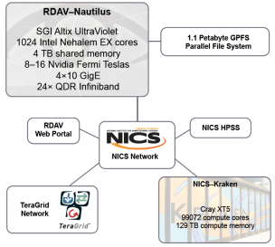

Machine Learning on Supercomputers
One year of 15-min data, 144 sensors/house
Support Vector Machines
Genetic Algorithms
FF/Recurrent Neural Networks
(Non-)Linear Regression
Self-Organizing Maps
C/K-Means
Ensemble Learning
Nautilus Supercomputer
Acknowledgment: UTK computer science Ph.D. candidate Richard Edwards; student of Dr. Lynne Parker
Notes:
The godfather of modern AI once said “the world is the best model of itself”
In that spirit, I proposed that we use sensor data to quantify the state of the world, then use machine learning algorithms to predict building characteristics (such as whole building energy consumption)
In partnership with UT, we have developed an XML-base ML_Suite with which we can easily define different AI tasks and run pattern recognition using UT’s Nautilus supercomputer

Slide 14

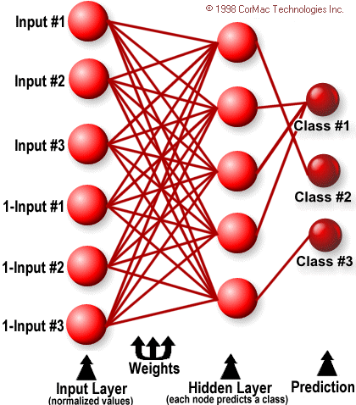
Learning Systems
Learning systems are like people – use wisdom of the crowds
Each learning system has its variance (good days and bad days):
SFAM Vigilance example
E+ Input Model
Simplified Fuzzy ARTMAP (SFAM)
  An AI neural network (NN) system
  Capable of online, incremental learning
  Takes seconds for tasks that take backpropagation NNs days or weeks to perform
14

Slide 15
Presentation Summary
Of what relevance is Autotune?
What is Autotune?
So what are you actually doing?
How can this help me?

Slide 16
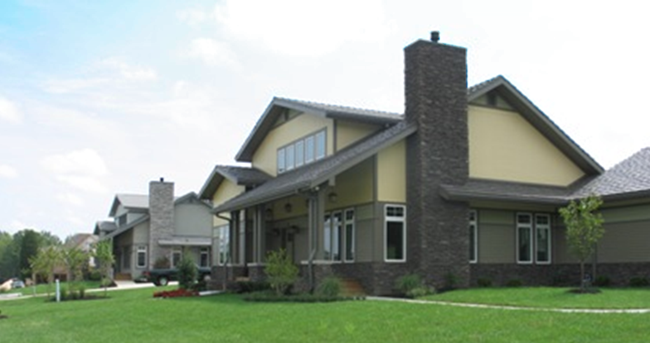
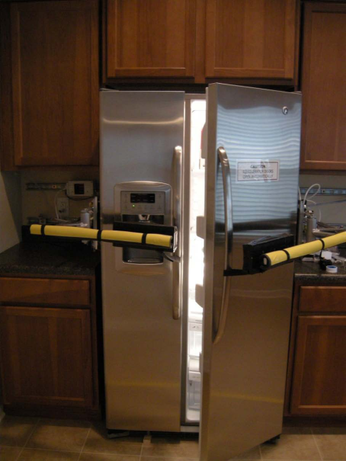
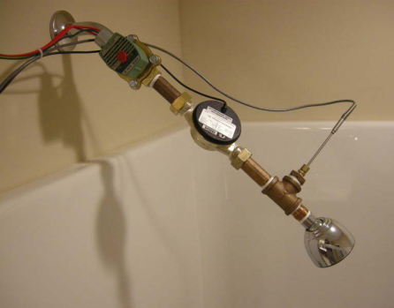
Real demonstration facilities
ZEBRAlliance homes
2800 ft² residence
269 sensors @ 15-minutes
50-60% energy savers
5M simulations of E+ model!
Heavily instrumented and equipped with occupancy simulation:
  Temperature
  Plugs
  Lights
  Range
  Washer
  Radiated heat
Dryer
Refrigerator
Dishwasher
Heat pump air flow
Shower water flow
Notes:
We have several ZEBRAlliance “robo houses” which has emulated occupancy with several appliances

Slide 17
Commercial Buildings
3M simulations of most common DOE reference buildings
  1M warehouse
  1M stand-alone retail
  1M medium office
Store secret golden model
Only look at “faux” sensor data E+ output for it
Autoune DOE reference building to golden model
Compare tuned model to golden model

Slide 18
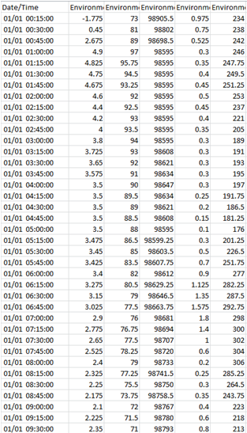
Large Data
156 inputs (permutes *.idf)
82 outputs @ 15m (*.csv)
!-Generator IDFEditor 1.41
!-Option SortedOrder ViewInIPunits
!-NOTE: All comments with '!-' are ignored by the IDFEditor and are generated automatically.
!- Use '!' comments if they need to be retained when using the IDFEditor.
!- =========== ALL OBJECTS IN CLASS: VERSION ===========
Version,
7.0; !- Version Identifier
!- =========== ALL OBJECTS IN CLASS: SIMULATIONCONTROL ===========
SimulationControl,
No, !- Do Zone Sizing Calculation
No, !- Do System Sizing Calculation
No, !- Do Plant Sizing Calculation
No, !- Run Simulation for Sizing Periods
Yes; !- Run Simulation for Weather File Run Periods
!- =========== ALL OBJECTS IN CLASS: BUILDING ===========
Building,
ZEBRAlliance House number 1 SIP House, !- Name
-37, !- North Axis {deg}
Suburbs, !- Terrain
0.04, !- Loads Convergence Tolerance Value
0.4, !- Temperature Convergence Tolerance Value {deltaC}
FullExteriorWithReflections, !- Solar Distribution
25, !- Maximum Number of Warmup Days
6; !- Minimum Number of Warmup Days
!- =========== ALL OBJECTS IN CLASS: SITE:LOCATION ===========
Site:Location,
Oak Ridge, !- Name
35.96, !- Latitude {deg}
-84.29, !- Longitude {deg}
-5, !- Time Zone {hr}

Slide 19
Large Data
8M sims * 7.24m = 110 compute-years (cloud=$77,226)
  “Free” supercomputers and desktop utility for multiple runs+upload
8M sims * 35MB = 267 TB database (cloud=$512,237/month)
  Cost-effective hardware (1 time, ~$28k)
Database engines: MyISAM load data 0.71s vs. InnoDB 2.3s
  Others: NoSQL/key-value pair, column-store, compression ratios
Database partitioned by month, views span tables
Software stack for analysis

Slide 20
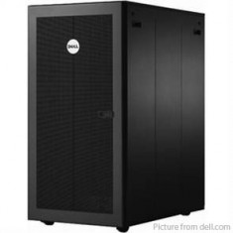


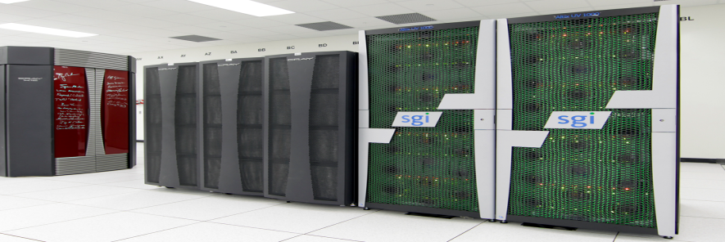


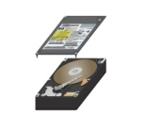


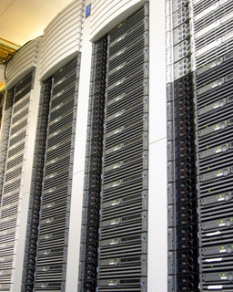

Making ORNL Data Available
Computing Resources
E+ Simulations
E+ Input Model
Jaguar Supercomputer
Nautilus
Web Server
PowerEdge R510
Data Mining
Automated process to run millions of simulations and host publicly online
96 ~ HP rx2600
Notes:
But thankfully the future is not about brute force, but finesse…
People that tour ORNL are constantly surprised with the research going on here, which is good, but also bad in that national labs are often accused of not sharing/disseminating the knowledge generated.
In the spirit of open science, we are beginning to run millions of E+ simulations and storing those in a database that’s publicly accessible so that it can be mined by companies, universities, policy-makers, and other organizations.
*CLICK advance*
We will use the aforementioned MLSuite to mine this data and find the actionable information and knowledge necessary for tuning building models.

Slide 21


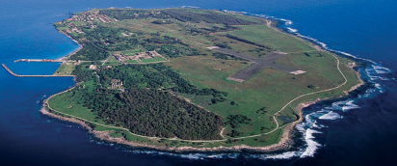


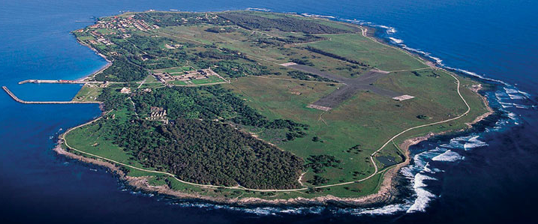
Genetic Algorithms
#1 problem with E+ is simulation speed
Use AI to approximate E+
Exact solution if in database (~milliseconds)
E+ Input Model
Approx. solution (seconds)
Exact solution (5-10 mins)
Dual buffer, Genetic Algorithm Island model for evolving tuned model
Multi-objective
Fitness evaluation
Slow buffer/island
Fast buffer/island
Notes:
The database and machine learning agents will help speed up E+ simulation runs from minutes to approximate solutions in seconds, or exact pre-computed solutions in milliseconds.
*CLICK *
Dr. Aaron Garrett at Jacksonville State University a dual-island genetic algorithm in which each E+ input file is an individual, “fit” individuals will become champions and transition to the smaller island to be processed by E+ rather than only the approximate E+. Through crossover, mutation, and other operators, successive generations of offspring from these files/individuals will constitute E+ input files that more closely match measured sensor data.
Now I’ve mentioned runtime speedup of approximate solutions and evolving tuned input files in the context of E+, but it should be pointed out that this is
*CLICK*
software agnostic and can be applied to any software model for which there is measured data.

Slide 22
Presentation Summary
Of what relevance is Autotune?
What is Autotune?
So what are you actually doing?
How can this help me?
“We speak piously of … making small studies that will add another brick to the temple of science. Most such bricks just lie around the brickyard.” –J.R. Platt (1964)

Slide 23
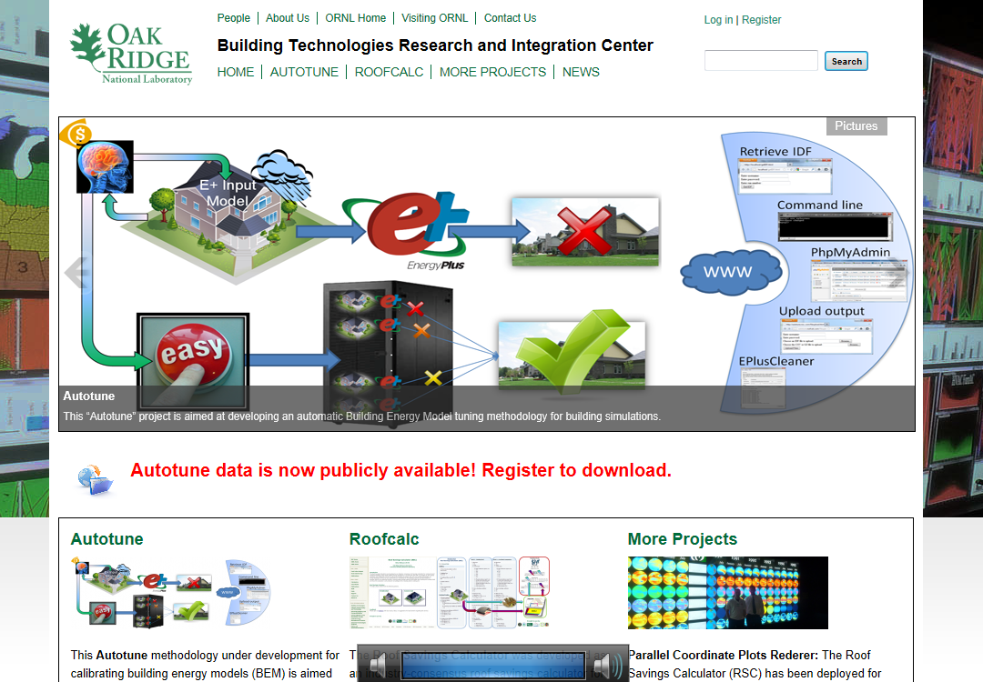

Data
Plan to make available in FY13
Will run on desktop machine (overnight testing, stop on demand)
I+O = 8M*156 + 8M*35,040*96 = 26.9 trillion data points (eventually)
TOTAL COST = 4.3 * 10⁻¹⁶ cent
Acknowledgement:
This research used resources of the AutotuneDB at the Oak Ridge National Laboratory, which was supported by the Office of Science of the U.S. Department of Energy.
http://autotune.roofcalc.com
Disclaimer:
No service-level performance or availability guarantees implied

Slide 24
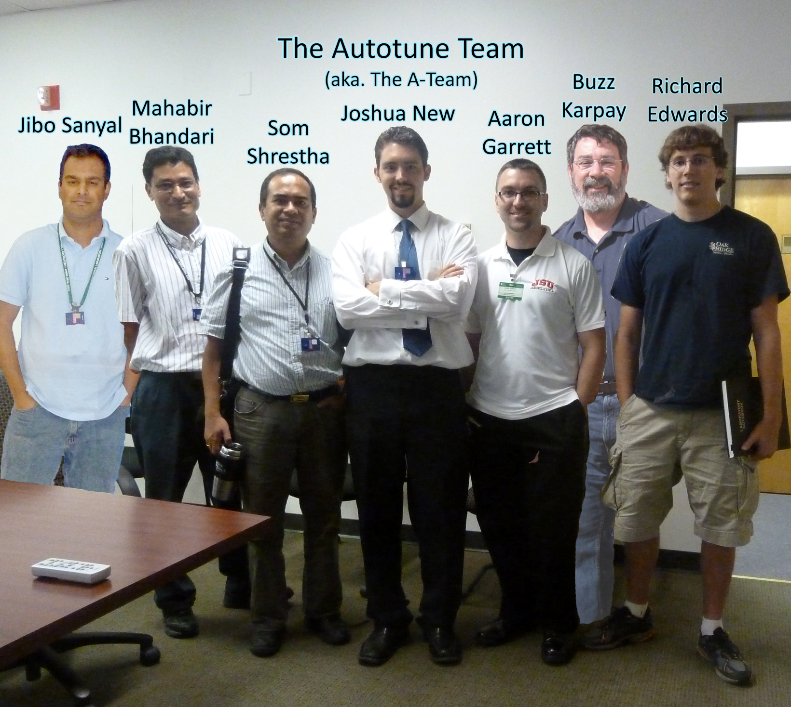
Thank you for your time!
QUESTIONS??
http://autotune.roofcalc.com

Slide 25
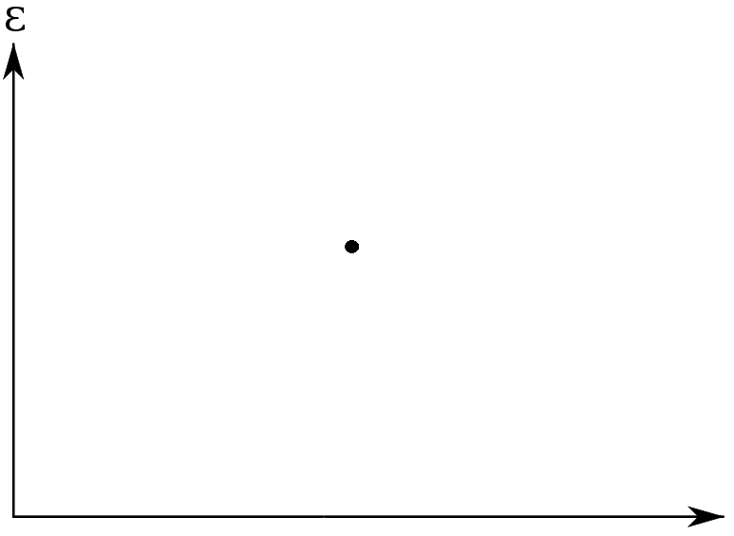
Overfitting
kBtu/ft²/yr

Slide 26
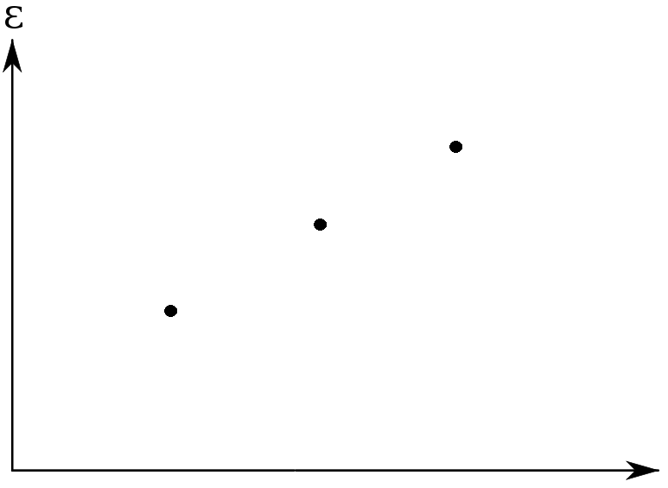
Overfitting

Slide 27
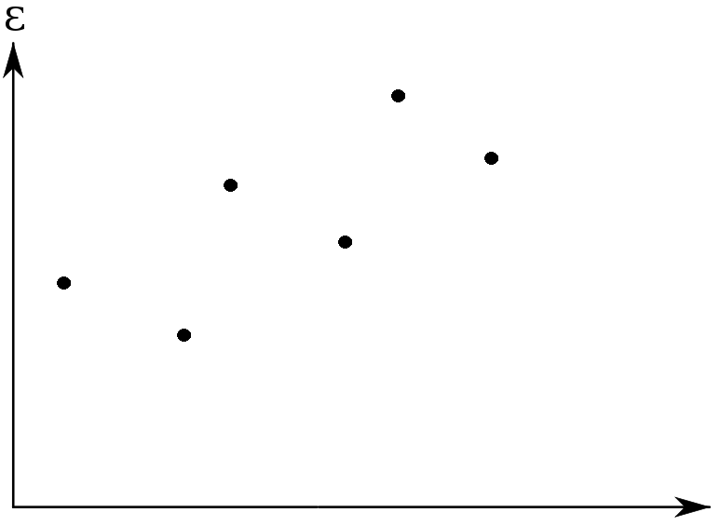
Overfitting

Slide 28
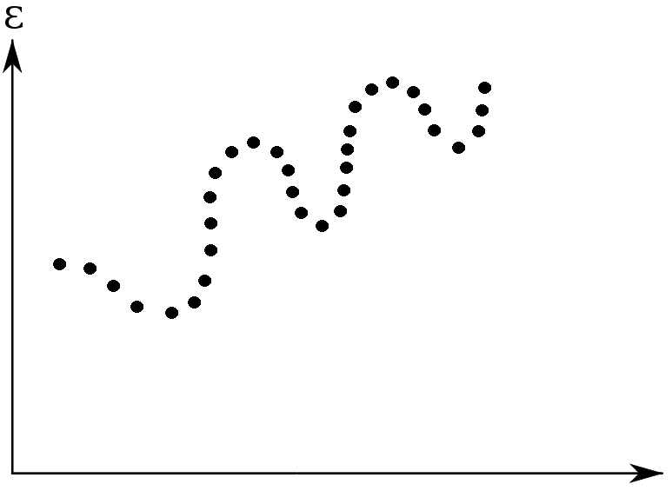
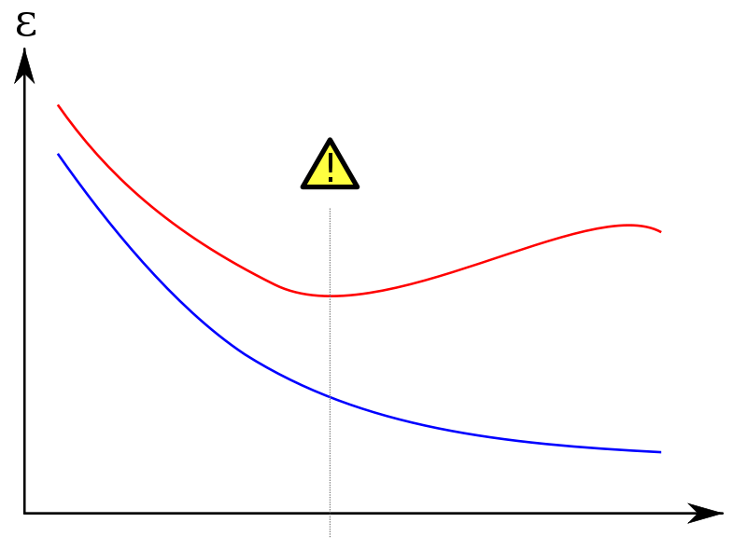
Overfitting

Slide 29
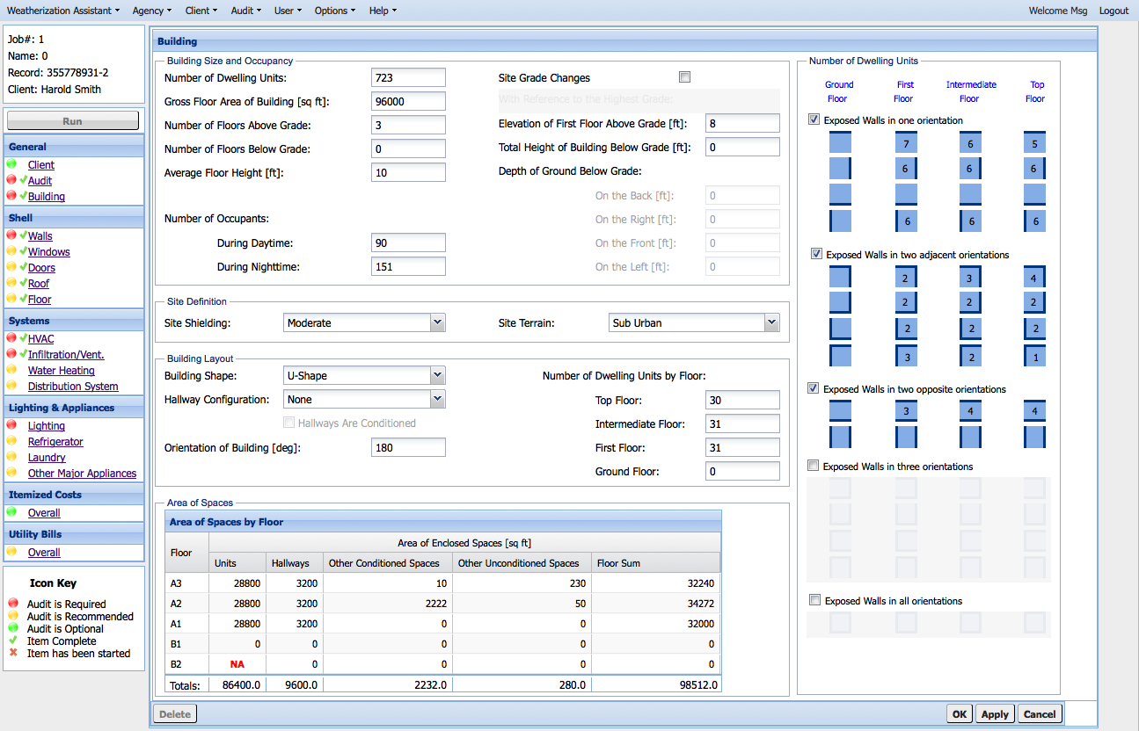
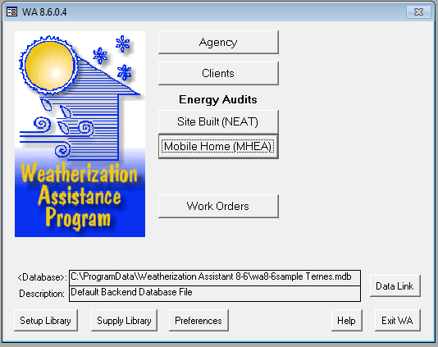
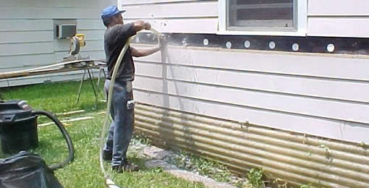
BTRIC 2011 accomplishments
Support for Weatherization and Intergovernmental Program (WIP) grows
Develop plan for new multi-family building audit
Make existing single-family and mobile home audits web-based
Continue the retrospective national evaluation of the Weatherization Assistance Program (WAP)
Initiate national evaluation of the State Energy Program (SEP) and the Energy Efficiency Block Grant Program (EEBGP)
Complete the planning for the national evaluation of ARRA Weatherization
Aided in the weatherization of 600,000 homes three months ahead of schedule
ORNL staff and subcontractors have been supporting the expenditure of over $10B in ARRA funds in the WIP portfolio
Notes:
Johney Greene recently pointed out a success with ORNL’s weatherization and intergovernmental program using the Weatherization Assistant to aid weatherization of 600,000 homes with ARRA funds. The Weatherization Assistant for residential buildings is the National Energy Audit Tool Neat.

Slide 30
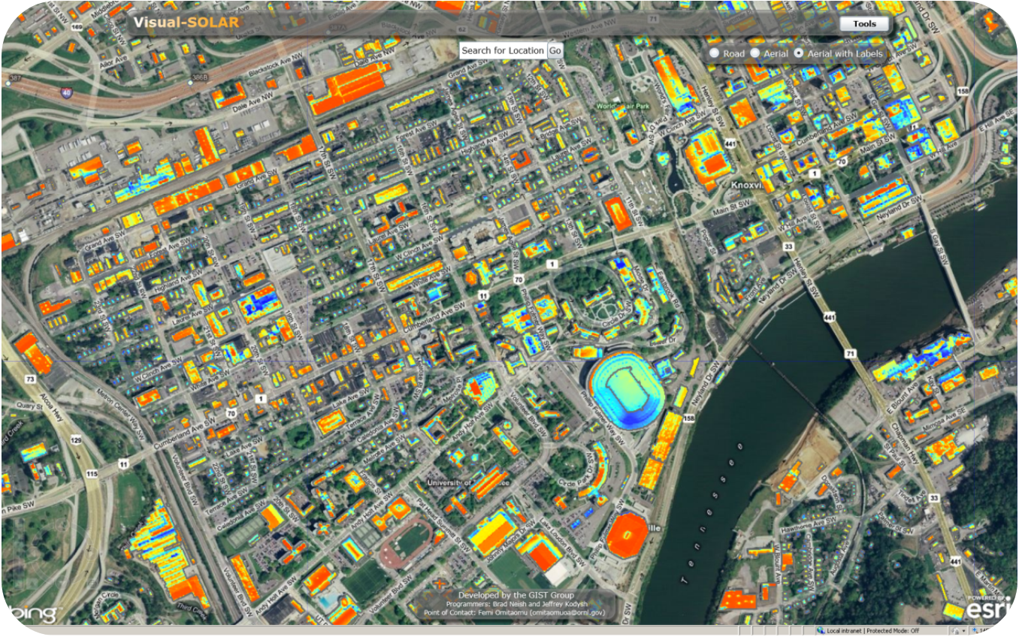
Web service integration
Utility
Data
Simulation Request
Data for Building(s)
Simulation Result
Tuned Sim Results
CoNNECT
Autotune
WxAssistant-NEAT
Notes:
Femi, myself, and the WIP team are working together to define a glue project that utilizes web services to leverage both utility data and simulation data to autotune simulations for complex simulation-based analysis displayed within CoNNECT.

Slide 31







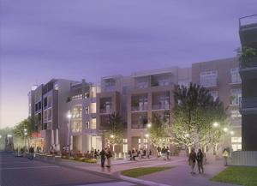
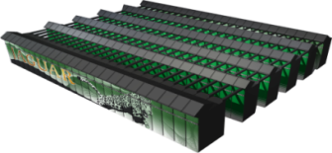

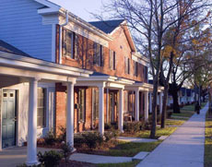
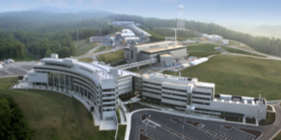

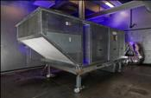
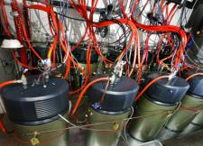
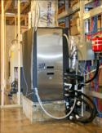



Science to transform today's buildings into smart, responsive, and efficient structures
Experimental S&T Capabilities
Modeling and Visualization R&D
Better Buildings via Novel Tools and Technologies
Building Science
Data/Knowledge
Materials Science
Web-Based Tools
Data/Knowledge
Computational Science
Automated Model Calibration
Next Generation Commercial Buildings
Neutron Science
Industry CRADAs
Data/Knowledge
Innovative Products
Sensors, Controls, Grid
Next Generation Residential Buildings
Data/Knowledge
Notes:
There are several fundamental and experimental technologies which feed into the 4th paradigm eScience for visualization and analysis as well as for collaboration with industrial partners which can deploy new and cost-effective technologies at speed and scale

Slide 32




4th Paradigm
Empirical – guided by experiment/observation
  In use thousands of years ago, natural phenomena
Theoretical – based on coherent group of principles and theorems
  In use hundreds of years ago, generalizations
Computational – simulating complex phenomena
  In use for decades
Data exploration (eScience) – unifies all 3
  Data capture, curation, storage,
  analysis, and visualization

Slide 33




4th Paradigm
Johannes Kepler
3 laws of planetary motion:
Elliptical orbit (based on location of Mars)
Planets sweep out equal areas in equal times
The square of the periodic times are to each other as the cubes of the mean distances

Slide 34

4th Paradigm
#3 - Computer simulation

Slide 35


Slide 36


4th Paradigm
#4 - Visualization and Analysis

Slide 37

4th Paradigm

Slide 38



Visual Analytics (AI)
Sensor-based Energy Modeling

Slide 39



Multidimensional Visualization
2D Scatterplot
3D Scatterplot
7D Rubiks Cube (5⁷, 78,110 moving parts)

