Slide 1
Network Flow Algorithms for Robotic Food Delivery
Mridula Venkatasamy
Glory Ademola
David Cornett

Slide 2

Test Questions
Which Researchers proved the Max Flow=Min cut theorem?
What function from the osmnx library was used to generate the graph?
What search algorithm does Dinic’s leverage to construct the level graph?
https://forms.gle/AS1aE4Zj9ucRtJVo6

Slide 3
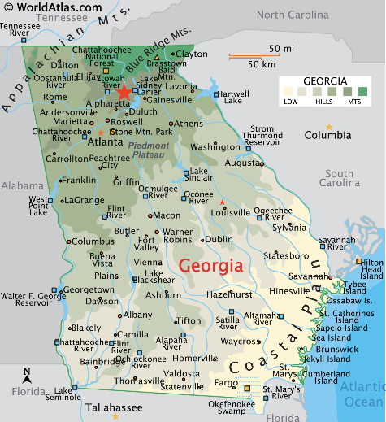


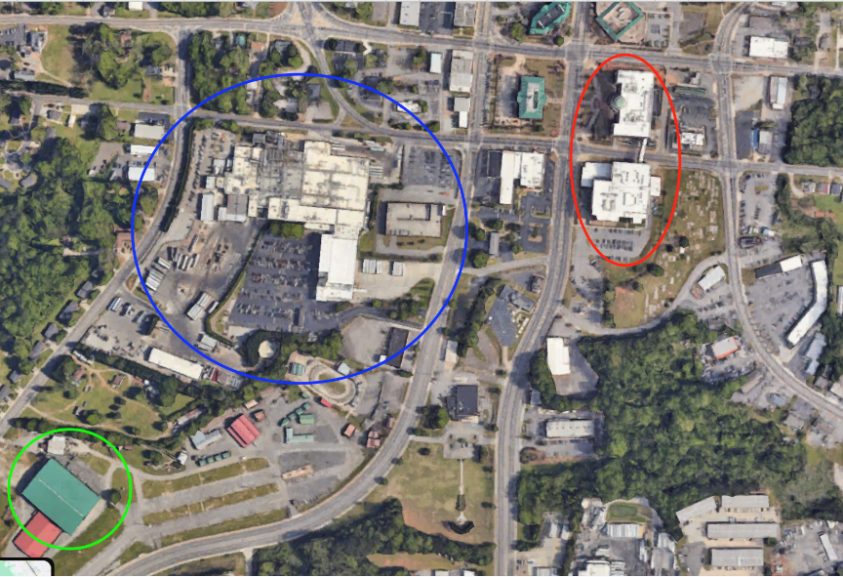
Mridula Venkatasamy
M.S. Computer Science
B.S Computer Science: Georgia State University
Advisor: Dr. Hector Santos
Research:
  Computer Vision
  Stakeholders: UTK Football Team and Joe Gibbs Human Performance Institute
  Automating Biomechanical Analysis of Sprint Assessment
Born and raised in Georgia

Slide 4
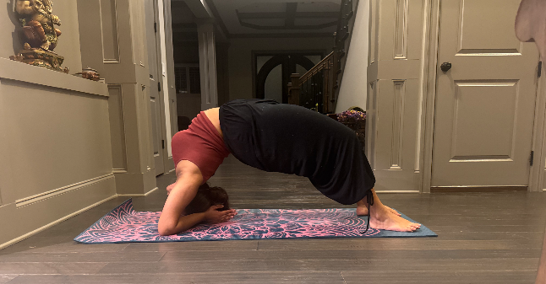
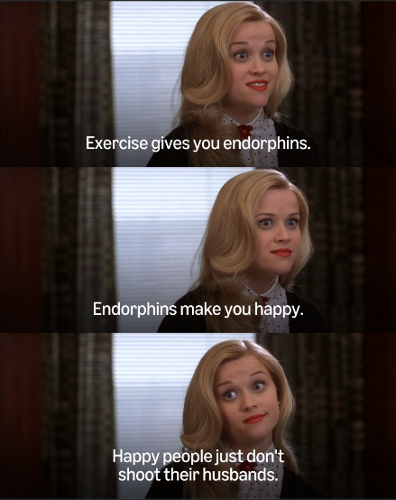
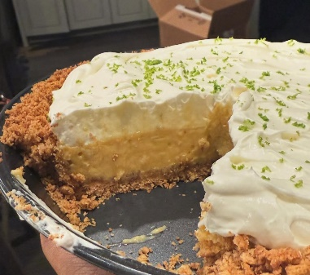
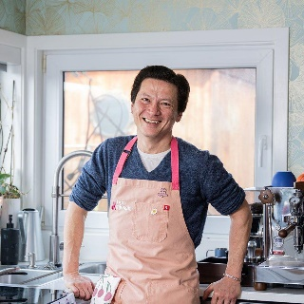

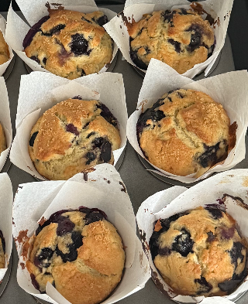
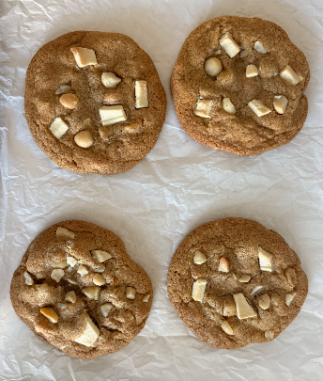
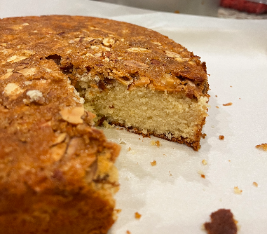

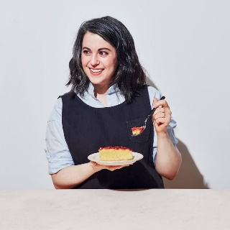

Hobbies!
If I’m not on campus, then I’m probably either at my apartment, the gym, or a yoga studio :)

Slide 5

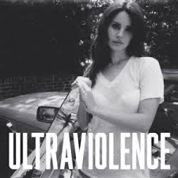





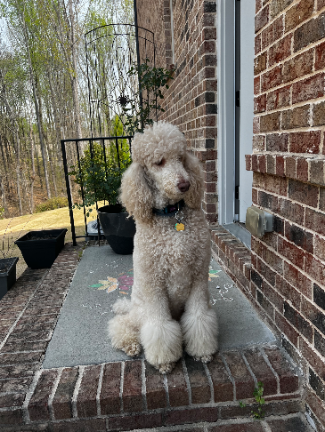
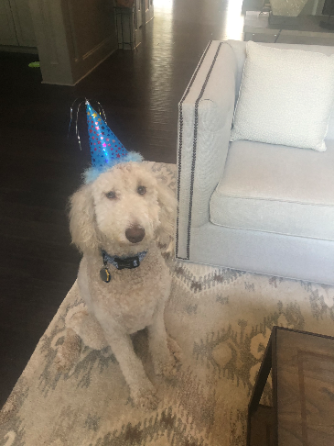

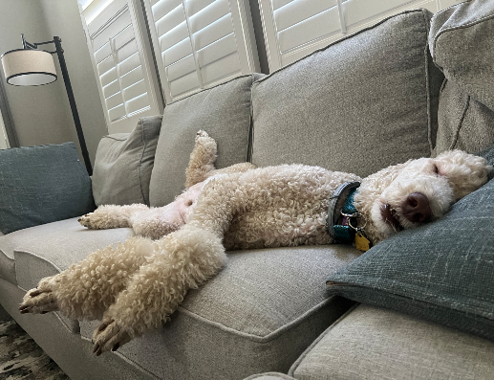


My faves
Music, sports/tv, and Harley

Slide 6

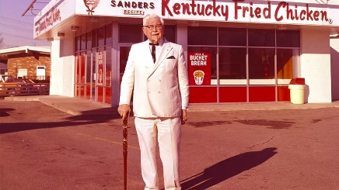


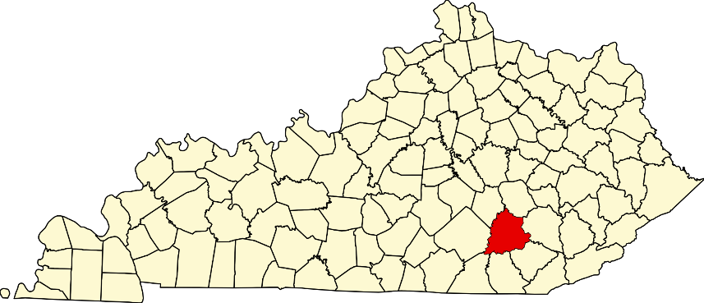

David Cornett
PhD Computer Science
  Dissertation Advisors: Dr. Hector Santos and Dr. Fnu Suya
MS Computer Engineering
  Thesis Advisor: Dr. Mongi Abidi
BS Computer Engineering
BS Computer Science
Oak Ridge National Laboratory
  R&D Staff
  Human Analysis & Biometrics Group
London, KY

Slide 7
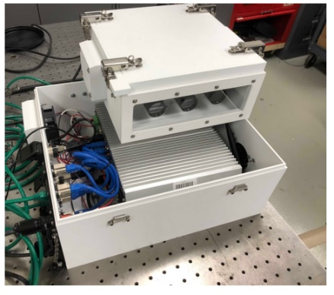
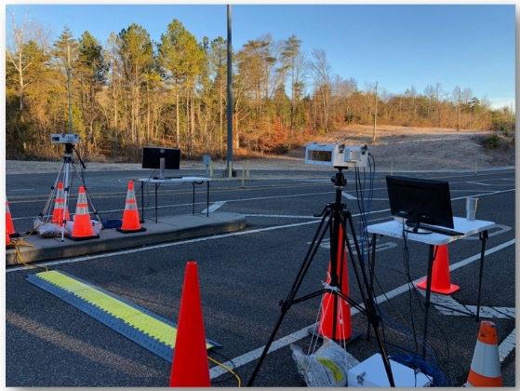
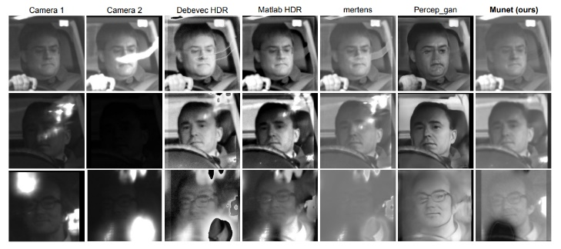
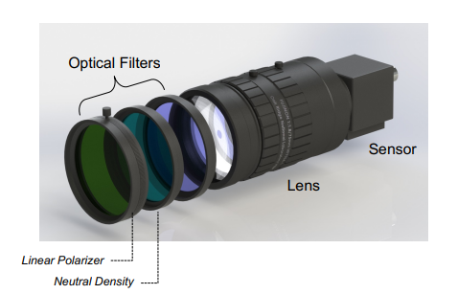

Research

Slide 8
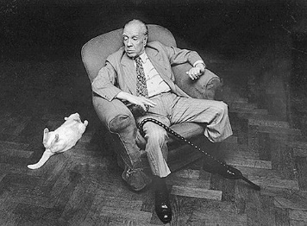



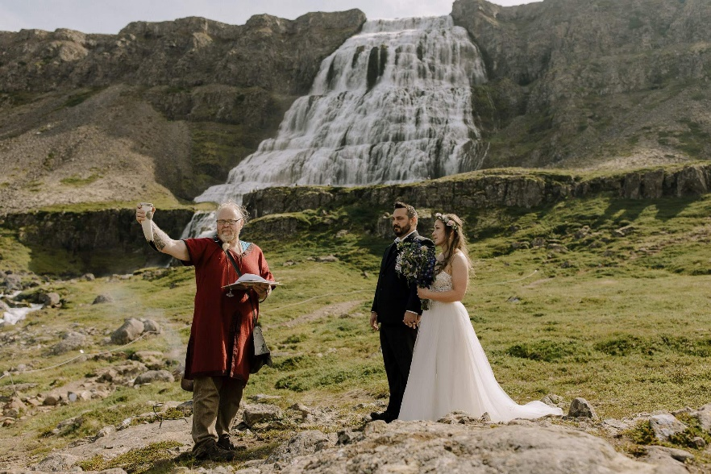
Fun Facts
Bibliophile (2,437 books)
Film
Travel

Slide 9
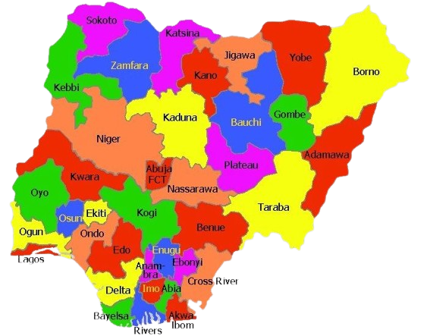
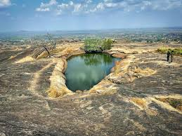
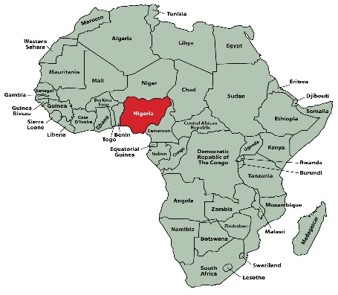
Glory Ademola
BS in Software Engineering, LCU
Phd in Data Science and Engineering, Bredesen Center
Concurrent Masters in Computer Science
Research:Multi-Object Tracking and identification for behavior analytics
Advisors: Dr Zhao and Dr Santos
Over 370+ different ethnic groups
Over 500+ Languages spoken
One of the two suspended lake in the world is in Oyo state, Nigeria.
Rivers State is home for the oldest and largest Oil refinery in Nigeria.

Slide 10


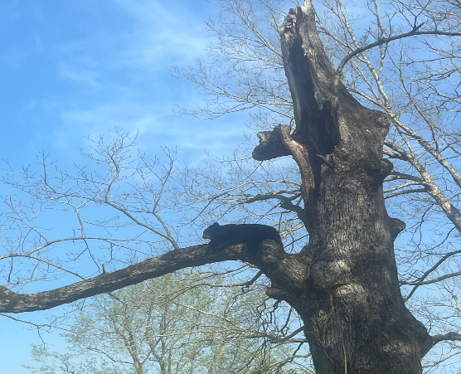
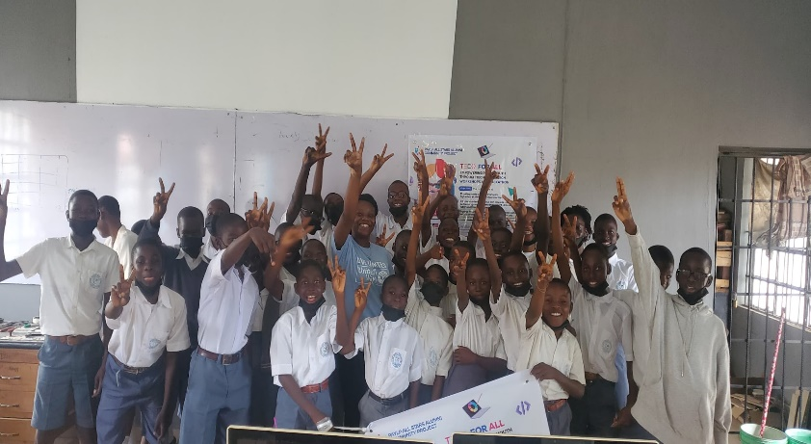
About me!
Interests- Community Service and Campus fellowships
Hobbies - Hiking, Concocting perfumes,travelling,Rafting, dancing
Favorite Pet - Cat
Selectively extroverted
I love Memes and I love my house and my bed.

Slide 11


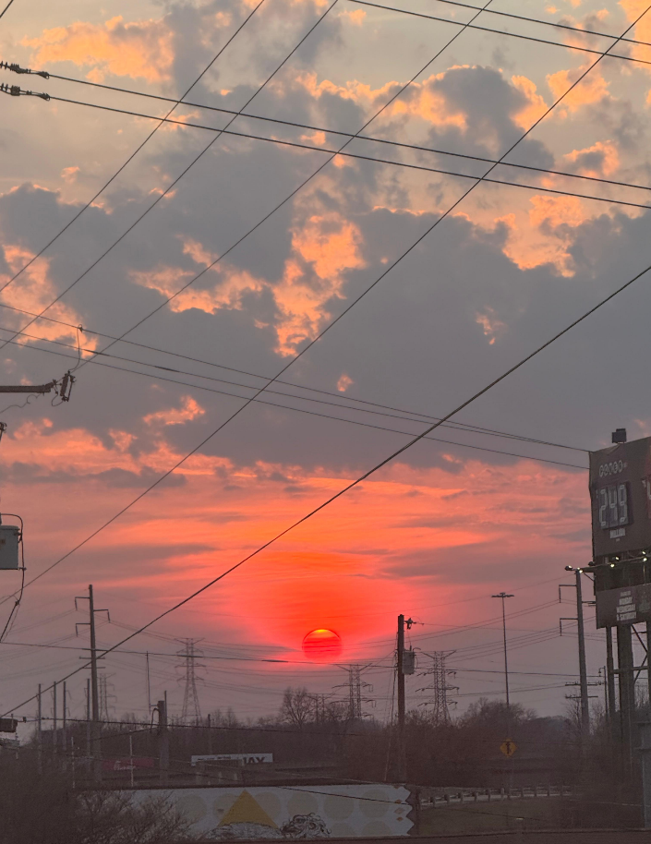
Faves

Slide 12
Presentation Outline
Definitions
History
Dataset Overview
Goals and Motivation
Algorithms
Implementations
Results and Visualizations
Other Applications
Open Issues
Discussion
References

Slide 13
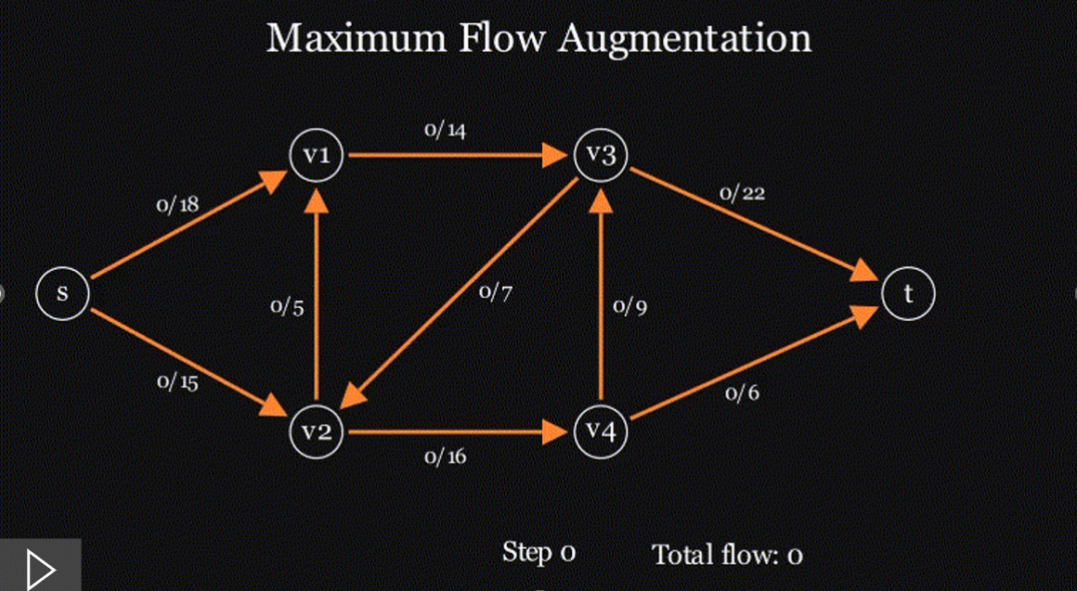
Definitions
A network flow is a directed graph G = (V, E) with a source s, a sink t, and a capacity function c: E → ℝ⁺.
A flow is a function f : E→ ℝ satisfying:
Capacity constraints:
0 ≤ f(u,v) ≤ c(u,v), ∀ (u,v) ∈ E
Flow conservation:
Inflow = Outflow (except s, t)
Maximum flow is the largest total amount of flow that can be routed from the source s to the sink t in a flow network while respecting all edge capacities.

Slide 14
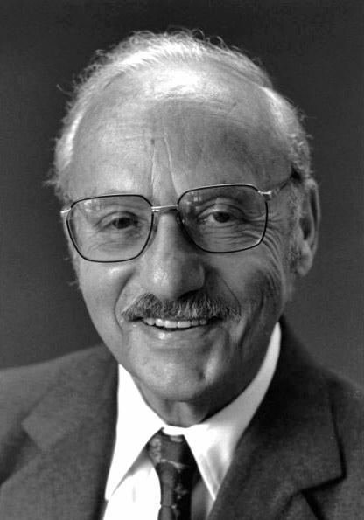
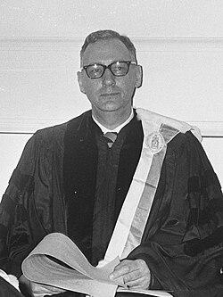
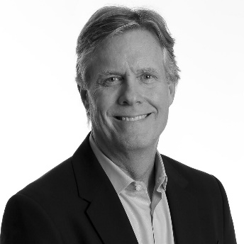
History
Late 1940s Post-WWII → logistics challenges
1947: George Dantzig → Simplex Algorithm
Tjalling Koopmans → resource allocation
1954: T. E. Harris & F. S. Ross → Soviet railway Systems
1956: Lester R. Ford Jr. & Delbert R. Fulkerson → max-flow min-cut
Publish their landmark paper in 1956 “maximal flow through a network”
Ford-Fulkerson → no polynomial guarantee
1972: Jack Edmonds & Richard Karp → Polynomial time guaranteed
1970: Yefim Dinitz → Dinics algorithm
George Dantzig
(1914 -2005)
Tjalling Koopmans
(1910 – 1985)
Theodore Harris
1919–2005
Notes:
Late 1940’s , motivated by post war problems
George Dantzig’s introduced simplex method in 1947 and Tjalling Koopmans' work on optimal allocation of resources.
T.E. Harris and F.S. Ross in 1954 formulated max flow problems to model Soviet railway traffic at RAND corporation during the cold war military analysis.
Lester R. Ford and Delbert Fulkerson formalized the max-flow / min-cut problem and publish their landmark paper in 1956 “maximal flow through a network”
Jack Edmond and Richard Karp implemented the first guaranteed polynomial-time solution of O(VE²) in 1972

Slide 15

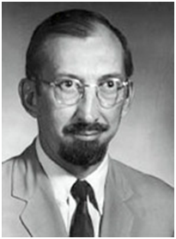
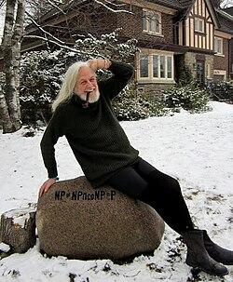
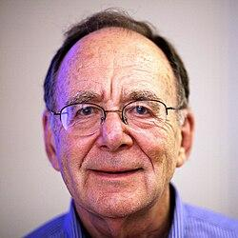
More Faces
Lester Randolph Ford
(1886 - 1967)
Delbert Fulkerson
(1924- 1976)
Jack Edmond
(1934 – Present )
Richard Karp
(1935 - Present)

Slide 16
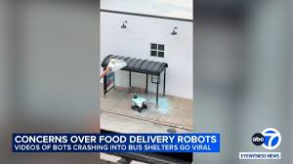
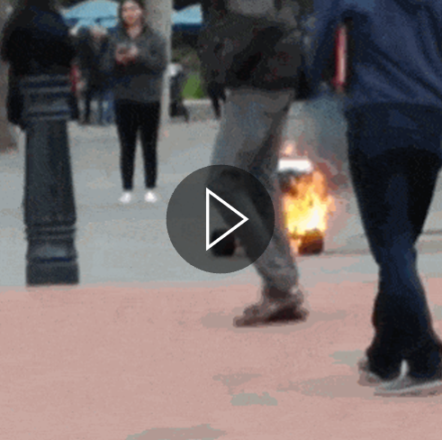
Goals and Motivation
To model a robot food delivery system as a flow network and use network flow algorithms to:
maximize the number of deliveries that can be completed,
minimize the total delivery cost,
compare different network flow algorithms in terms of execution time.

Slide 17
Dataset
OpenStreetMap
  Non-profit, free and editable map of the world
OSMNX
  python package used to visualize street networks and geospatial features from OSM
  structured transformation of OSM data into a graph (graph_from_place function)
Data used to build multidigraph:
  nodes: road intersections
  edges: road segments between intersections
  length of pathway used to determine cost (meters)
  pathway type used to determine capacity (# robots)
Data filtered:
  removed pathways designated as “steps” or roads that were near very busy intersections
  removed pathways that were deemed “non accessible”

Slide 18
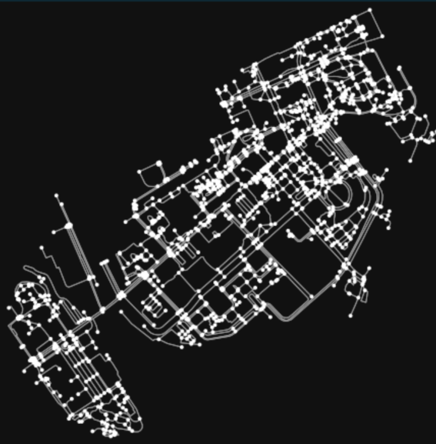
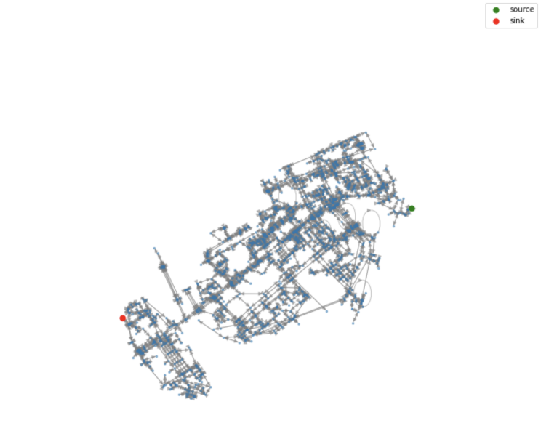
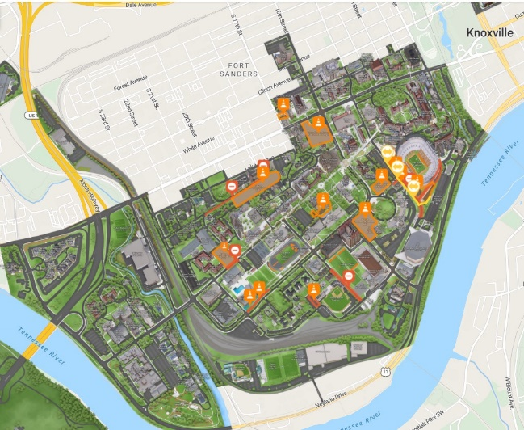
UTK Map As a Multidigraph
UTK map
Before Filtering
After Filtering

Slide 19
Edmonds-Karp Algorithm (Baseline 1)
Initialize Flow:
  Set all flow to zero for all edges.
Find Shortest Augmenting Path:
  Use BFS on residual graph to find shortest path from S to T.
  Compute bottleneck capacity.
Augment Flow:
  Add flow equal to bottleneck capacity.
  Update residual graphs.
Repeat:
  Repeat steps 2 and 3 until no path from S to T exists.
Result:
  When no augmenting path exists, you have maximum flow!
Time Complexity = O(VE²)

Slide 20
Simplex Method - Linear Prog. (Baseline 2)
Formulate Network Flow to Linear Programming:
  Define flow variables for each directed edge.
  Set object function and capacity constraints.
Convert to Standard Form:
  Express objective function as maximization problem.
  Inequalities and non-negativity from constraints, slack variables.
Initialize Simplex Method:
  Basic feasible solution.
Repeat (Pivot Iterations):
  Select entering and exiting variables pivot and update.
Result:
  Max flow when objective coefficients are negative

Slide 21
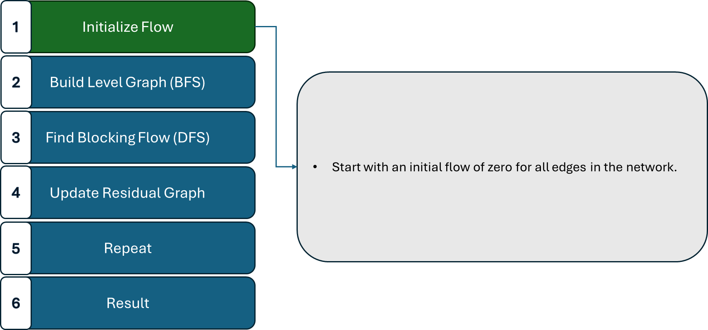
Dinic’s Algorithm

Slide 22
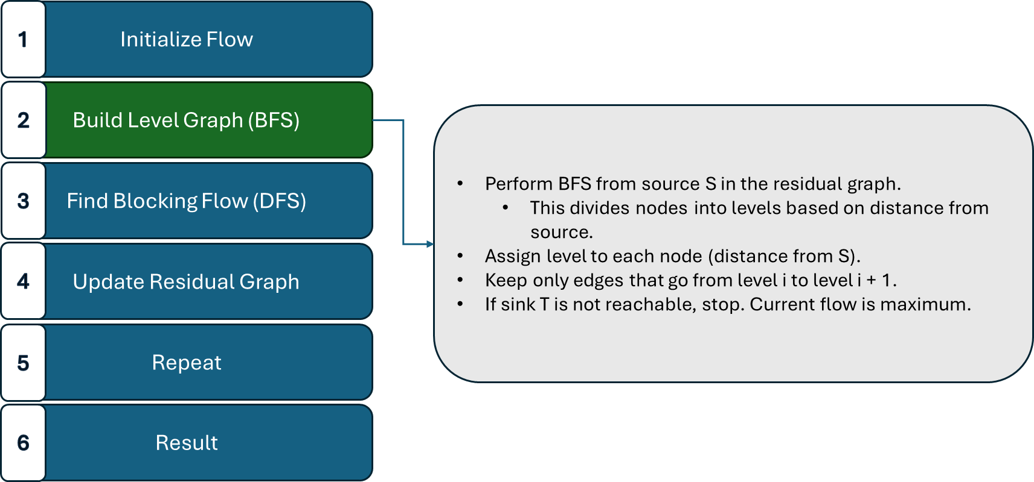
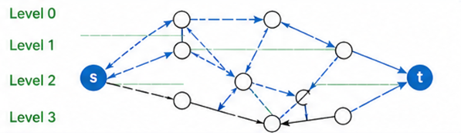
Dinic’s Algorithm

Slide 23
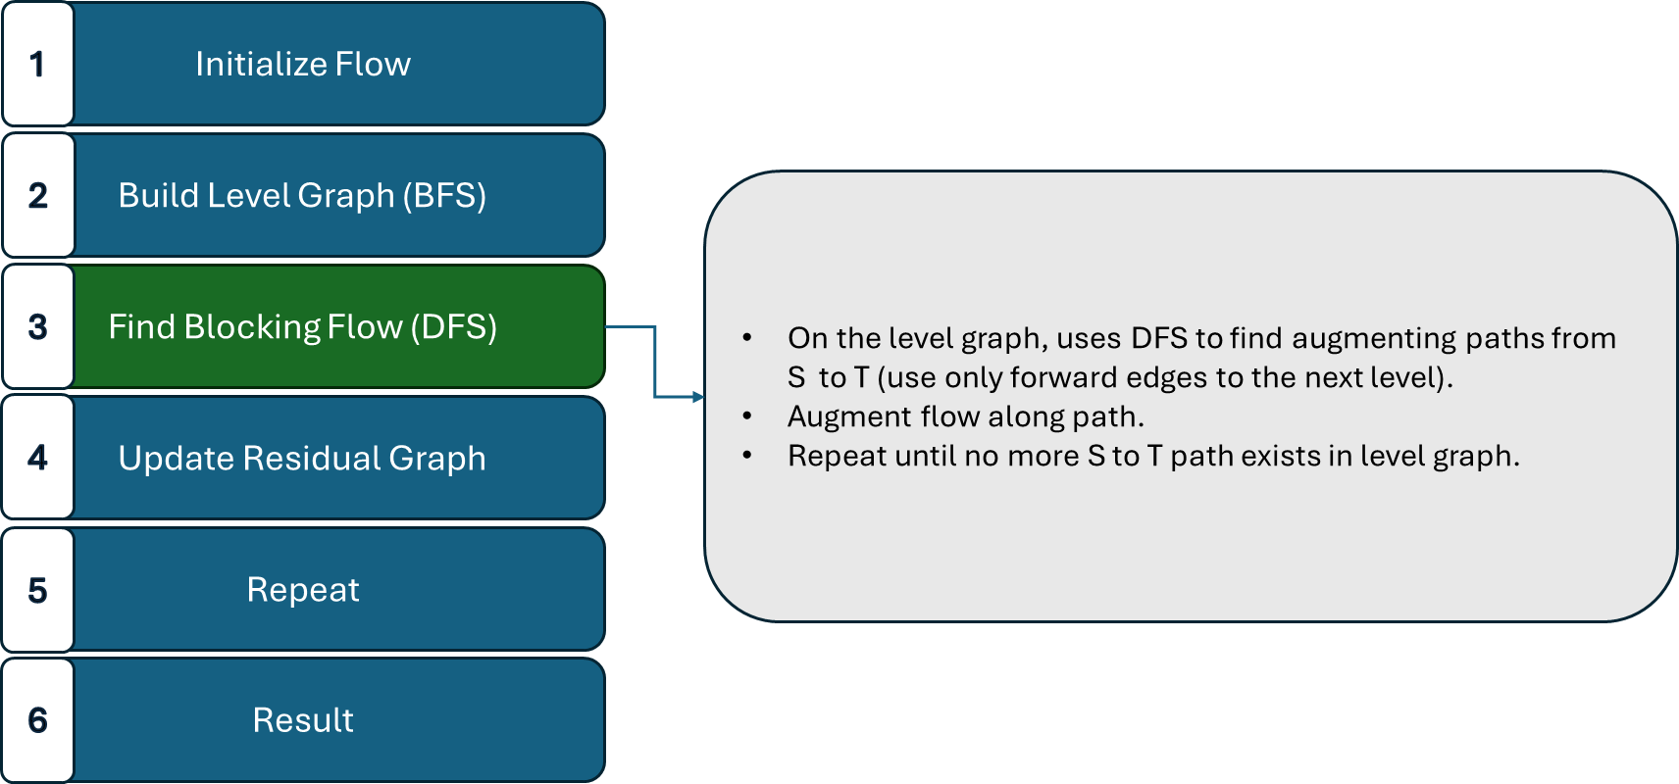
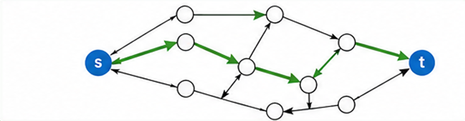
Dinic’s Algorithm

Slide 24
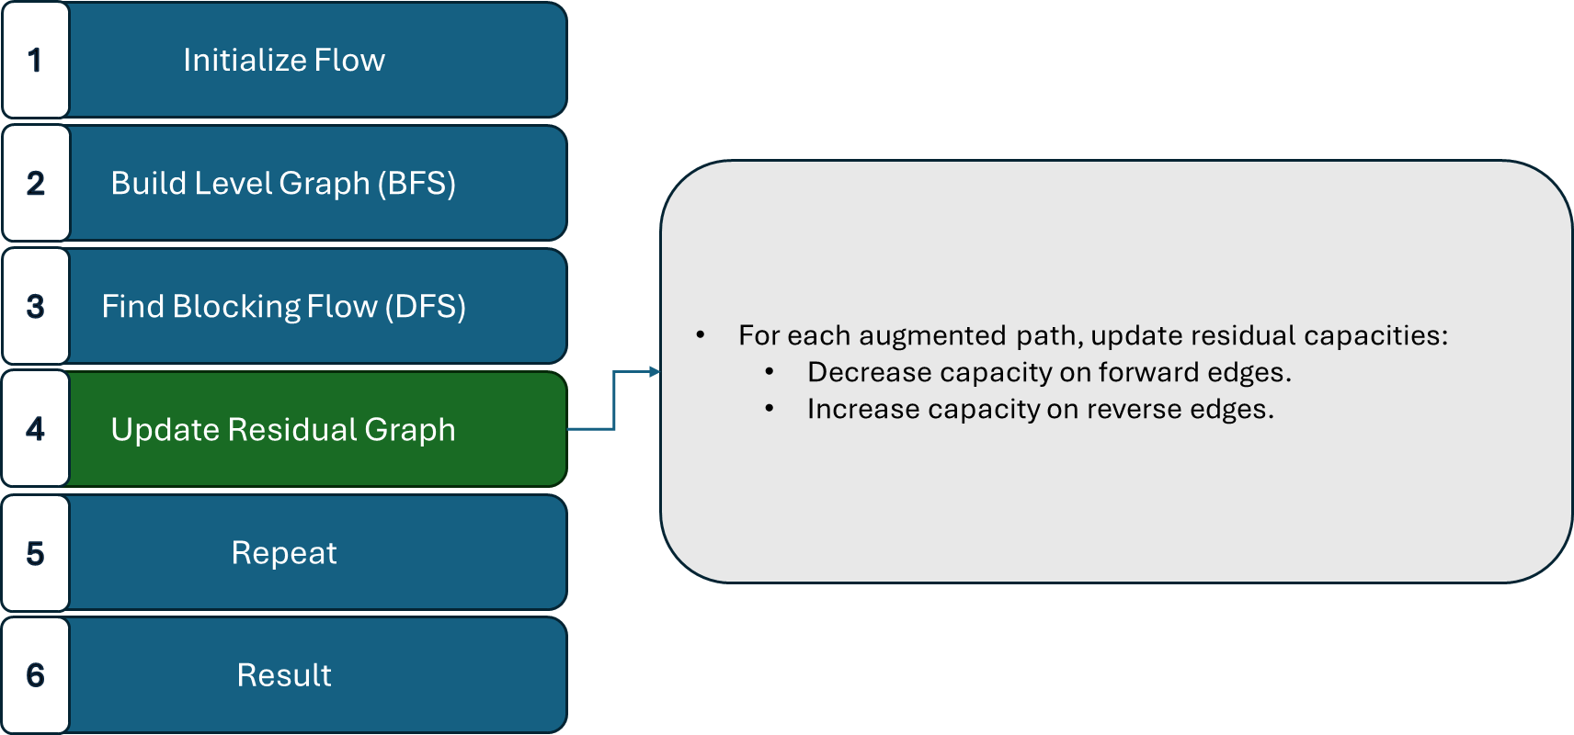
Dinic’s Algorithm

Slide 25
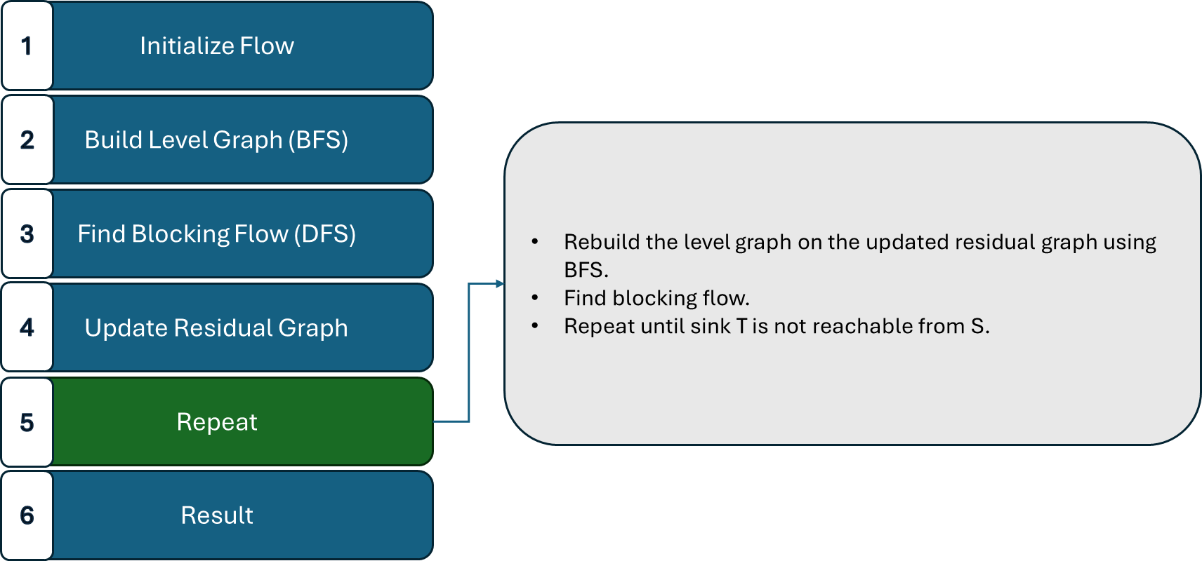
Dinic’s Algorithm

Slide 26
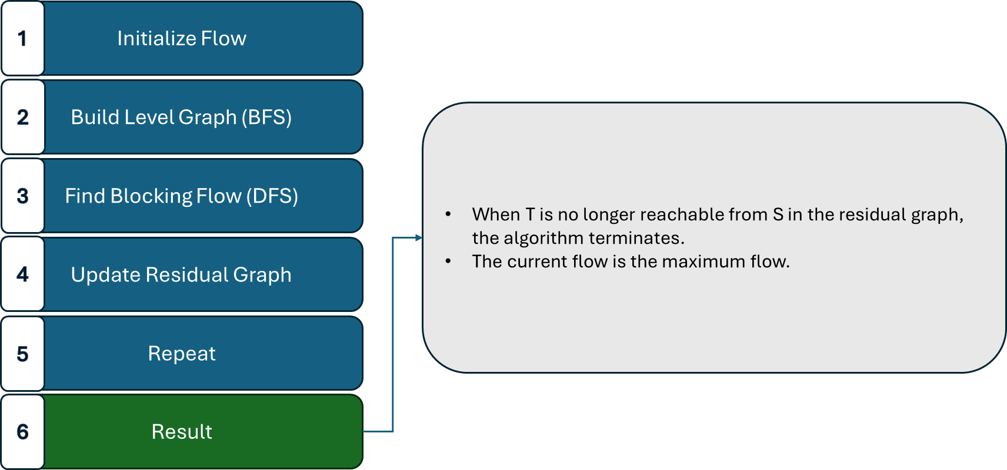
Dinic’s Algorithm
Time Complexity = O(V²E)

Slide 27

Minimum Cost Maximum Flow (MCMF)

Slide 28
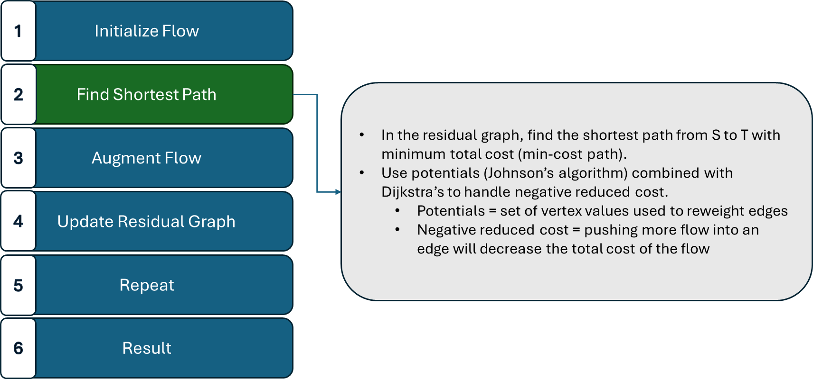
Minimum Cost Maximum Flow (MCMF)

Slide 29
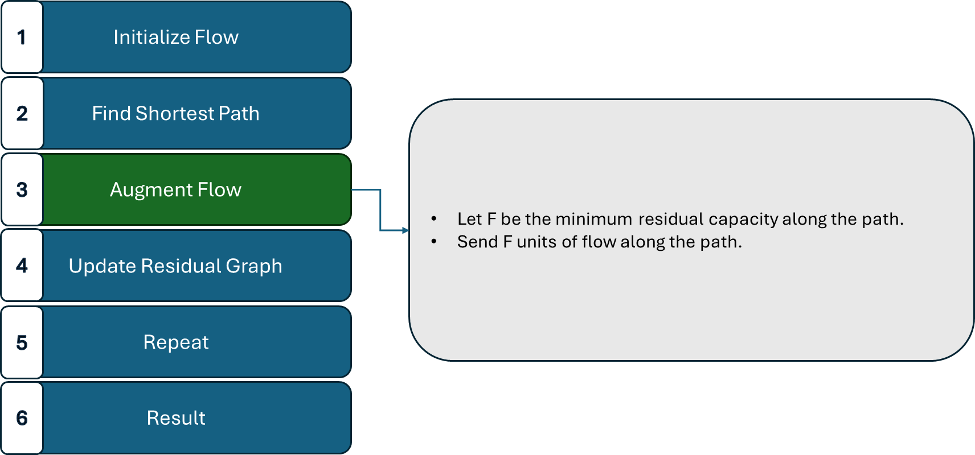
Minimum Cost Maximum Flow (MCMF)

Slide 30

Minimum Cost Maximum Flow (MCMF)

Slide 31

Minimum Cost Maximum Flow (MCMF)

Slide 32

Minimum Cost Maximum Flow (MCMF)
Time Complexity = O(V·E + F·E·log V)

Slide 33

Implementation Details
Graph built, capacity and cost
assigned, data converted to
CSV.
Helper script, 4 algorithms
implemented, results saved in
reports
OpenMap and plotly used,
results overlaid on UTK map

Slide 34


Visualization

Slide 35




Results
VS

Slide 36


Results & Timing Analysis

Slide 37





Other Applications
Power Grid Distribution
Data Network Routing
Vehicle Routing
Crew Scheduling

Slide 38
Open Issues
Time complexity and scalability
  Edmonds-Karp’s and Dinic’s both degrade significantly on large, dense graphs
  residual network updates after each iteration consume additional time and resources, compounding as network grows
Static network assumption
  all 4 algorithms assume fixed topology
  ineffective for real-world scenarios with issues like dynamic capacities, failures, or congestion
Multi-commodity and optimality issues
  real systems require multiple simultaneous flows with competing objectives (i.e. robots being sent to different locations at the same time)
  Approximation algorithms on integer multi-commodity flow remains an open research problem
Notes:
fixed topology → any edge change requires recomputation from scratch

Slide 39
Discussion
How do we characterize capacity and cost for an unconstrained, real-world problem into the framework of a network flow problem? (elevated path, traffic constraints, etc.)

Slide 40
References
Ahuja, Magnanti, Orlin - "Network Flows: Theory, Algorithms, and Applications" (1993)
https://www.topcoder.com/thrive/articles/Minimum%20Cost%20Flow%20Part%20Two:%20Algorithms
https://cp-algorithms.com/graph/min_cost_flow.html
https://osmnx.readthedocs.io/en/stable/
https://taginfo.openstreetmap.org/taginfo/apidoc
https://www.gurobi.com/resources/faq/network-optimization-faq-practical-models-for-flows-routes-and-capacity
Yu, J., LaValle, S.M. (2013). Multi-agent Path Planning and Network Flow. In: Frazzoli, E., Lozano-Perez, T., Roy, N., Rus, D. (eds) Algorithmic Foundations of Robotics X. Springer Tracts in Advanced Robotics, vol 86. Springer, Berlin, Heidelberg. https://doi.org/10.1007/978-3-642-36279-8_10
https://algocademy.com/blog/exploring-the-edmonds-karp-algorithm-a-comprehensive-guide/
Ibrahim, Iman & Mahmood, Ibrahim. (2025). A Comprehensive Review of the Ford-fulkerson Algorithm for Network Flow Problems. Asian Journal of Research in Computer Science. 18. 335-344. 10.9734/ajrcos/2025/v18i3597.

Slide 41
Test Questions
Which Researchers proved the Max Flow=Min cut theorem?
What search algorithm does Dinic’s leverage to construct the level graph?
What function from the osmnx library was used to generate the graph?
https://forms.gle/AS1aE4Zj9ucRtJVo6

Slide 42
Thank you!

