Slide 1
Scheduling Classes With Maximum Bipartite Matching
COSC581
Tyler Duckworth
Michael Hall
Alec Merkle

Slide 2

Test Questions
What is one application of maximum bipartite matching?
What is the complexity of Hopcroft-Karp's Algorithm?
How many of the class sections were we able to match successfully?

Slide 3
About the Presenters

Slide 4

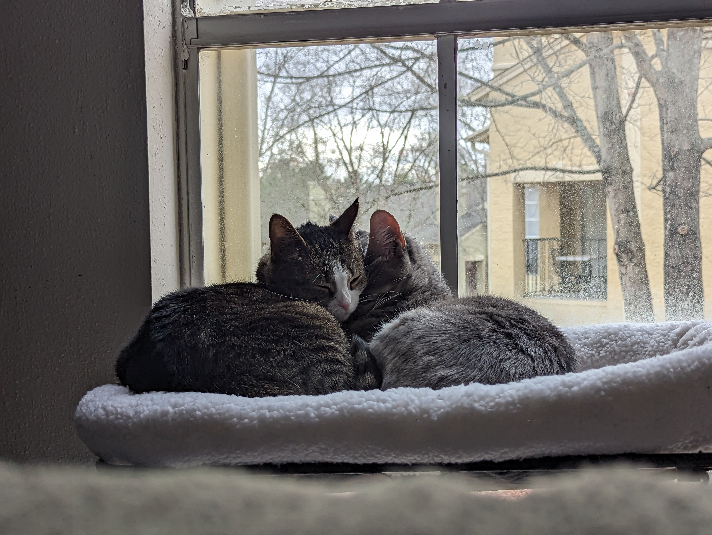
Tyler Duckworth
  MS in Computer Science, May '26
  Software Engineer at Agilaire
    Maintain on our ambient air monitoring software suite and work with clients to set up monitoring projects.
Born and raised here in Knoxville
Hobbies: Baking, hiking, taking care of our cats, and watching awful ghost hunting shows with my fiancé.

Slide 5
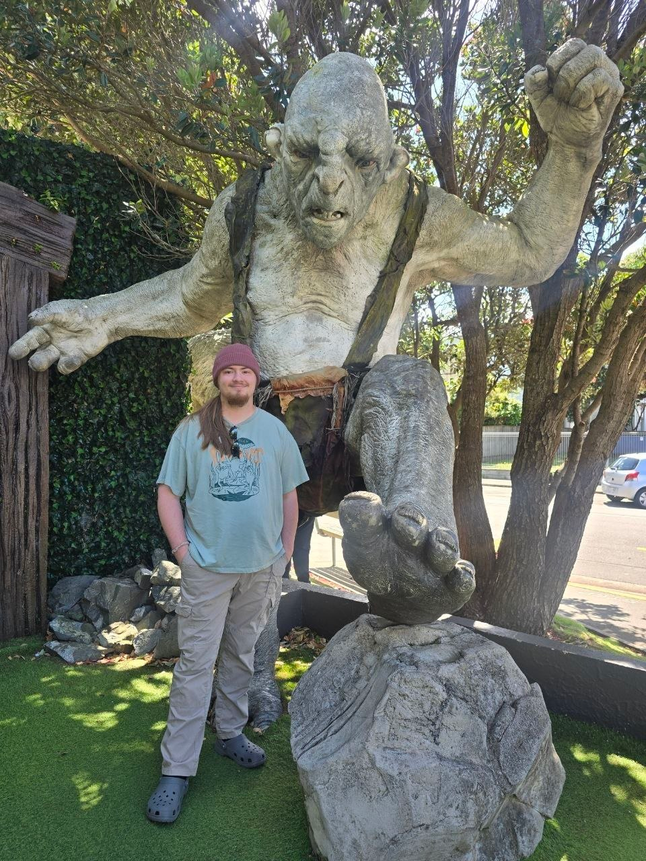
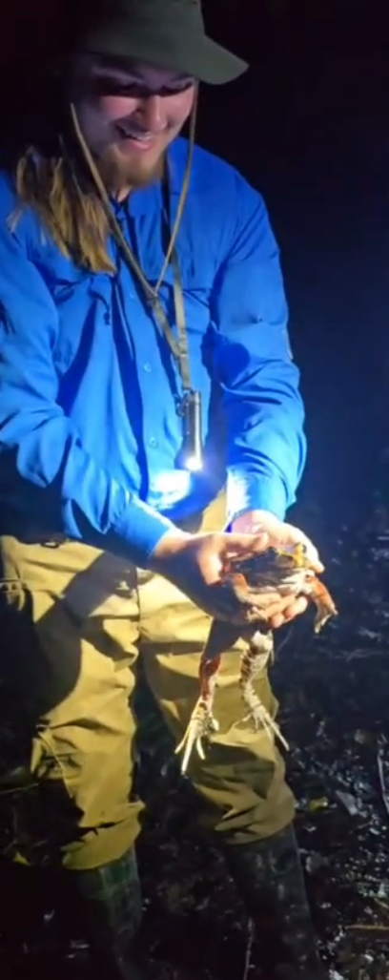
Michael Hall
  MS in Computer Science, Spring '27
  Traveler at heart
    Been to 6 of the 7 continents
  I love my cat Niko
  I love (almost) every type of music
  I play as multiple instruments, such as guitar, piano, and drumkit

Slide 6
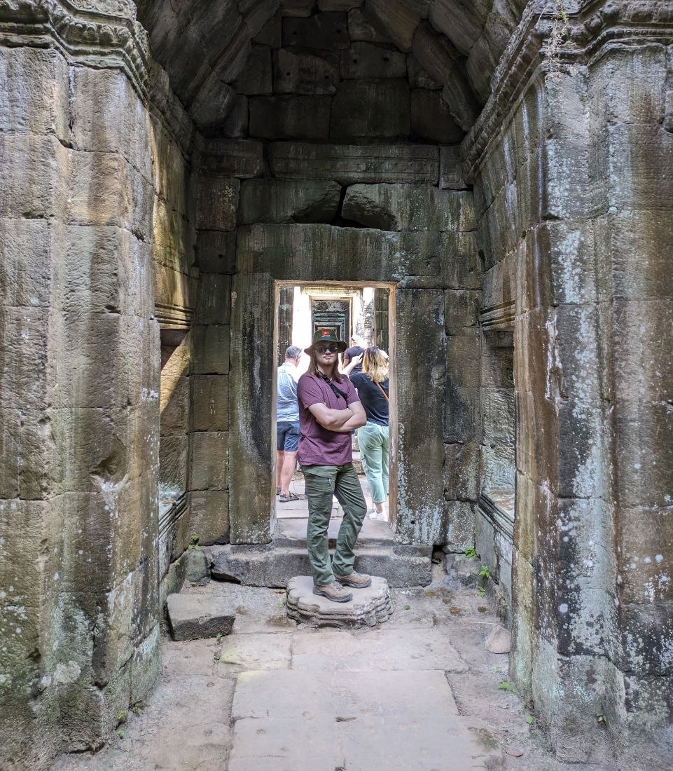
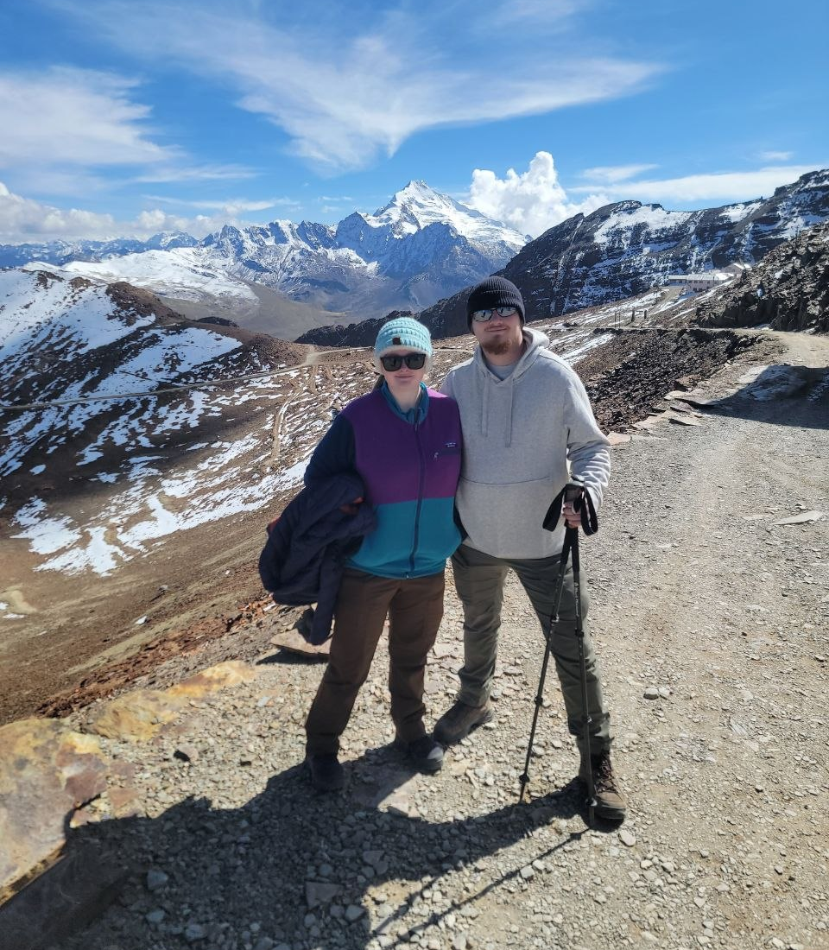
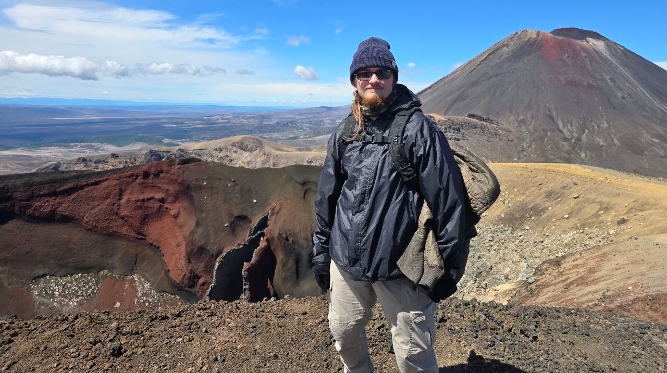
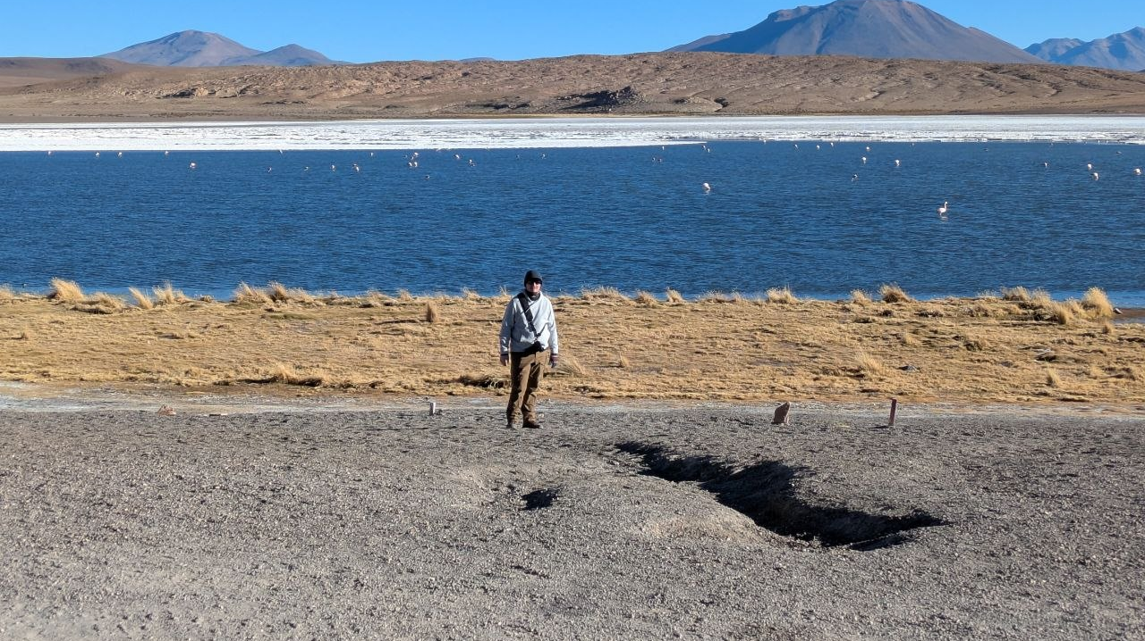
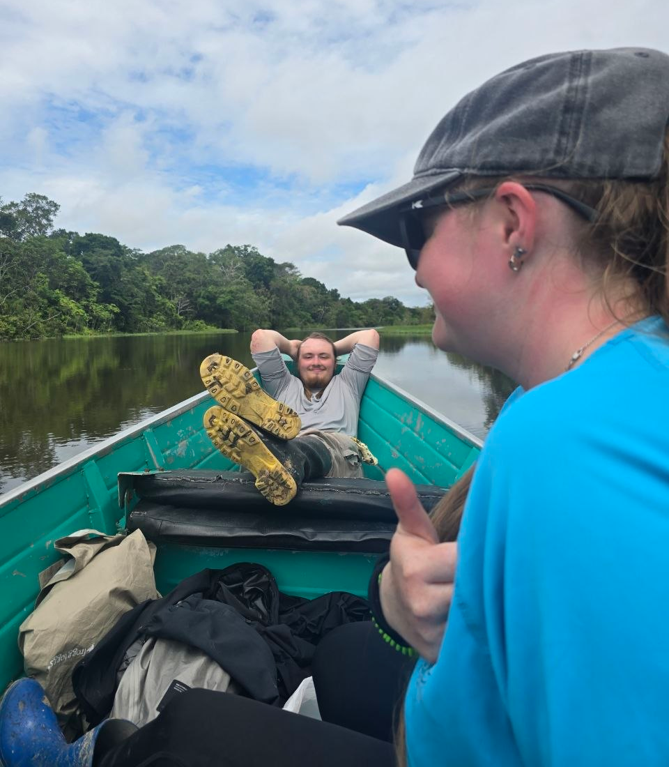
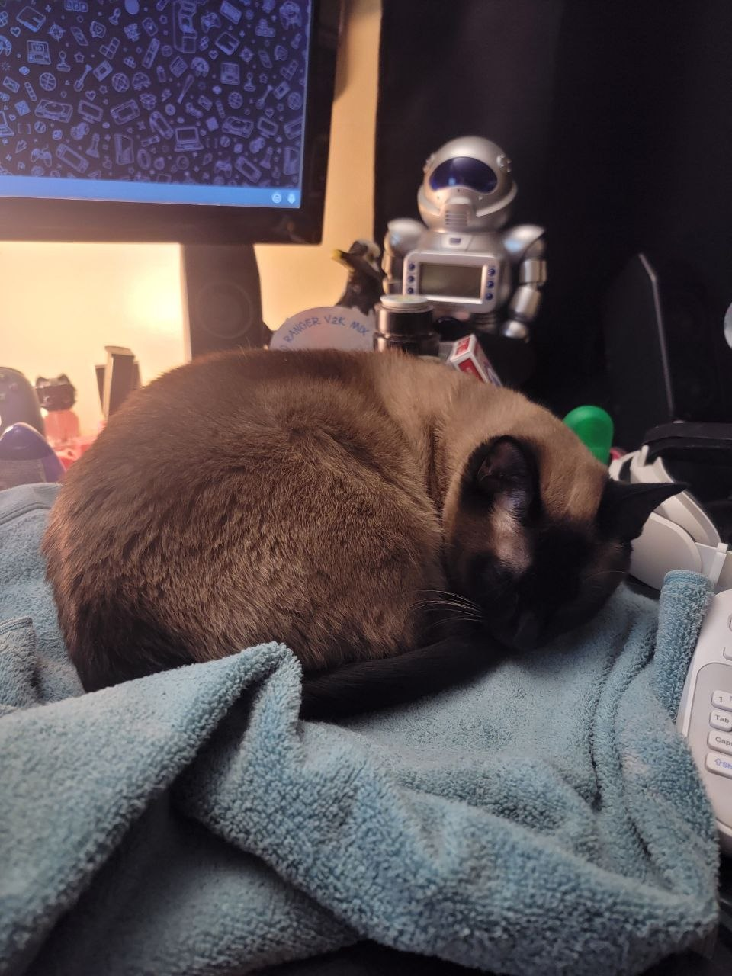

Slide 7
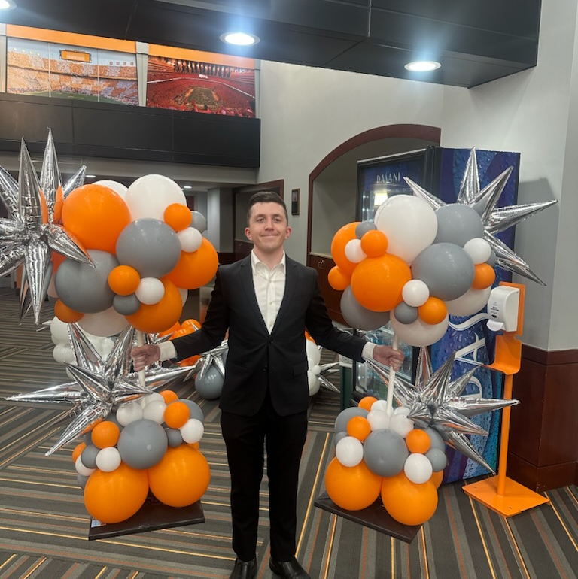
Alec Merkle
  MS Computer Science '26
  Staff member at Haslam College of Business
  Awards GTAs and Scholarships to business students
  Eventual overlapping work with CRM program administration
  Passionate about positive student experience

Slide 8
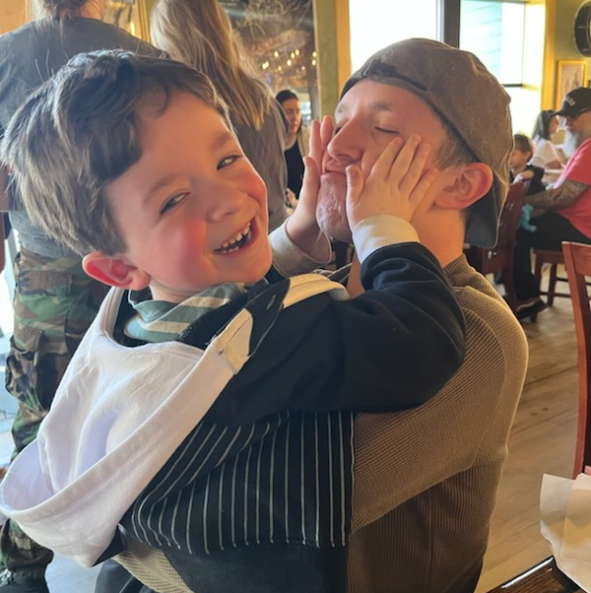
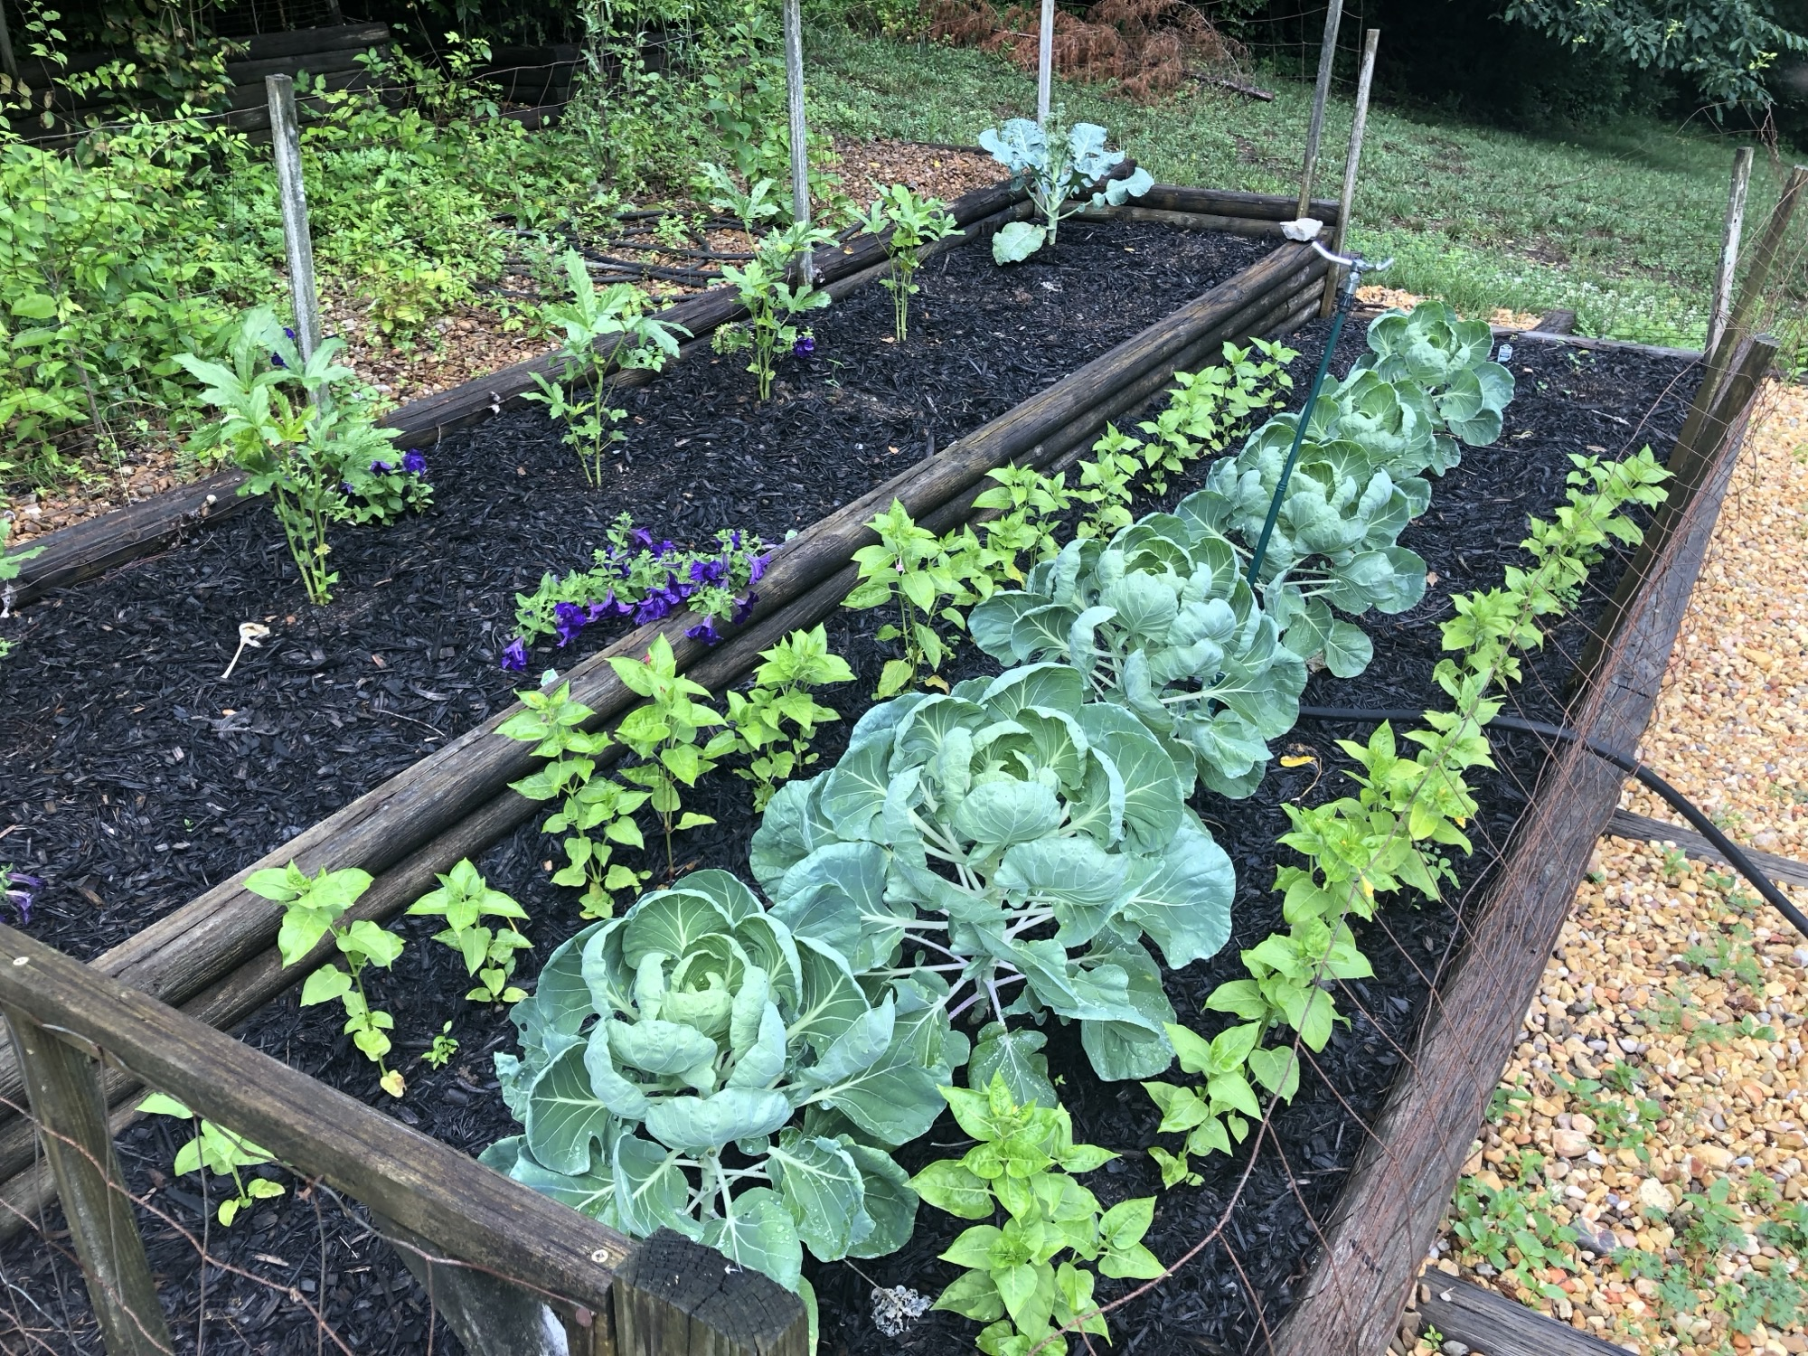
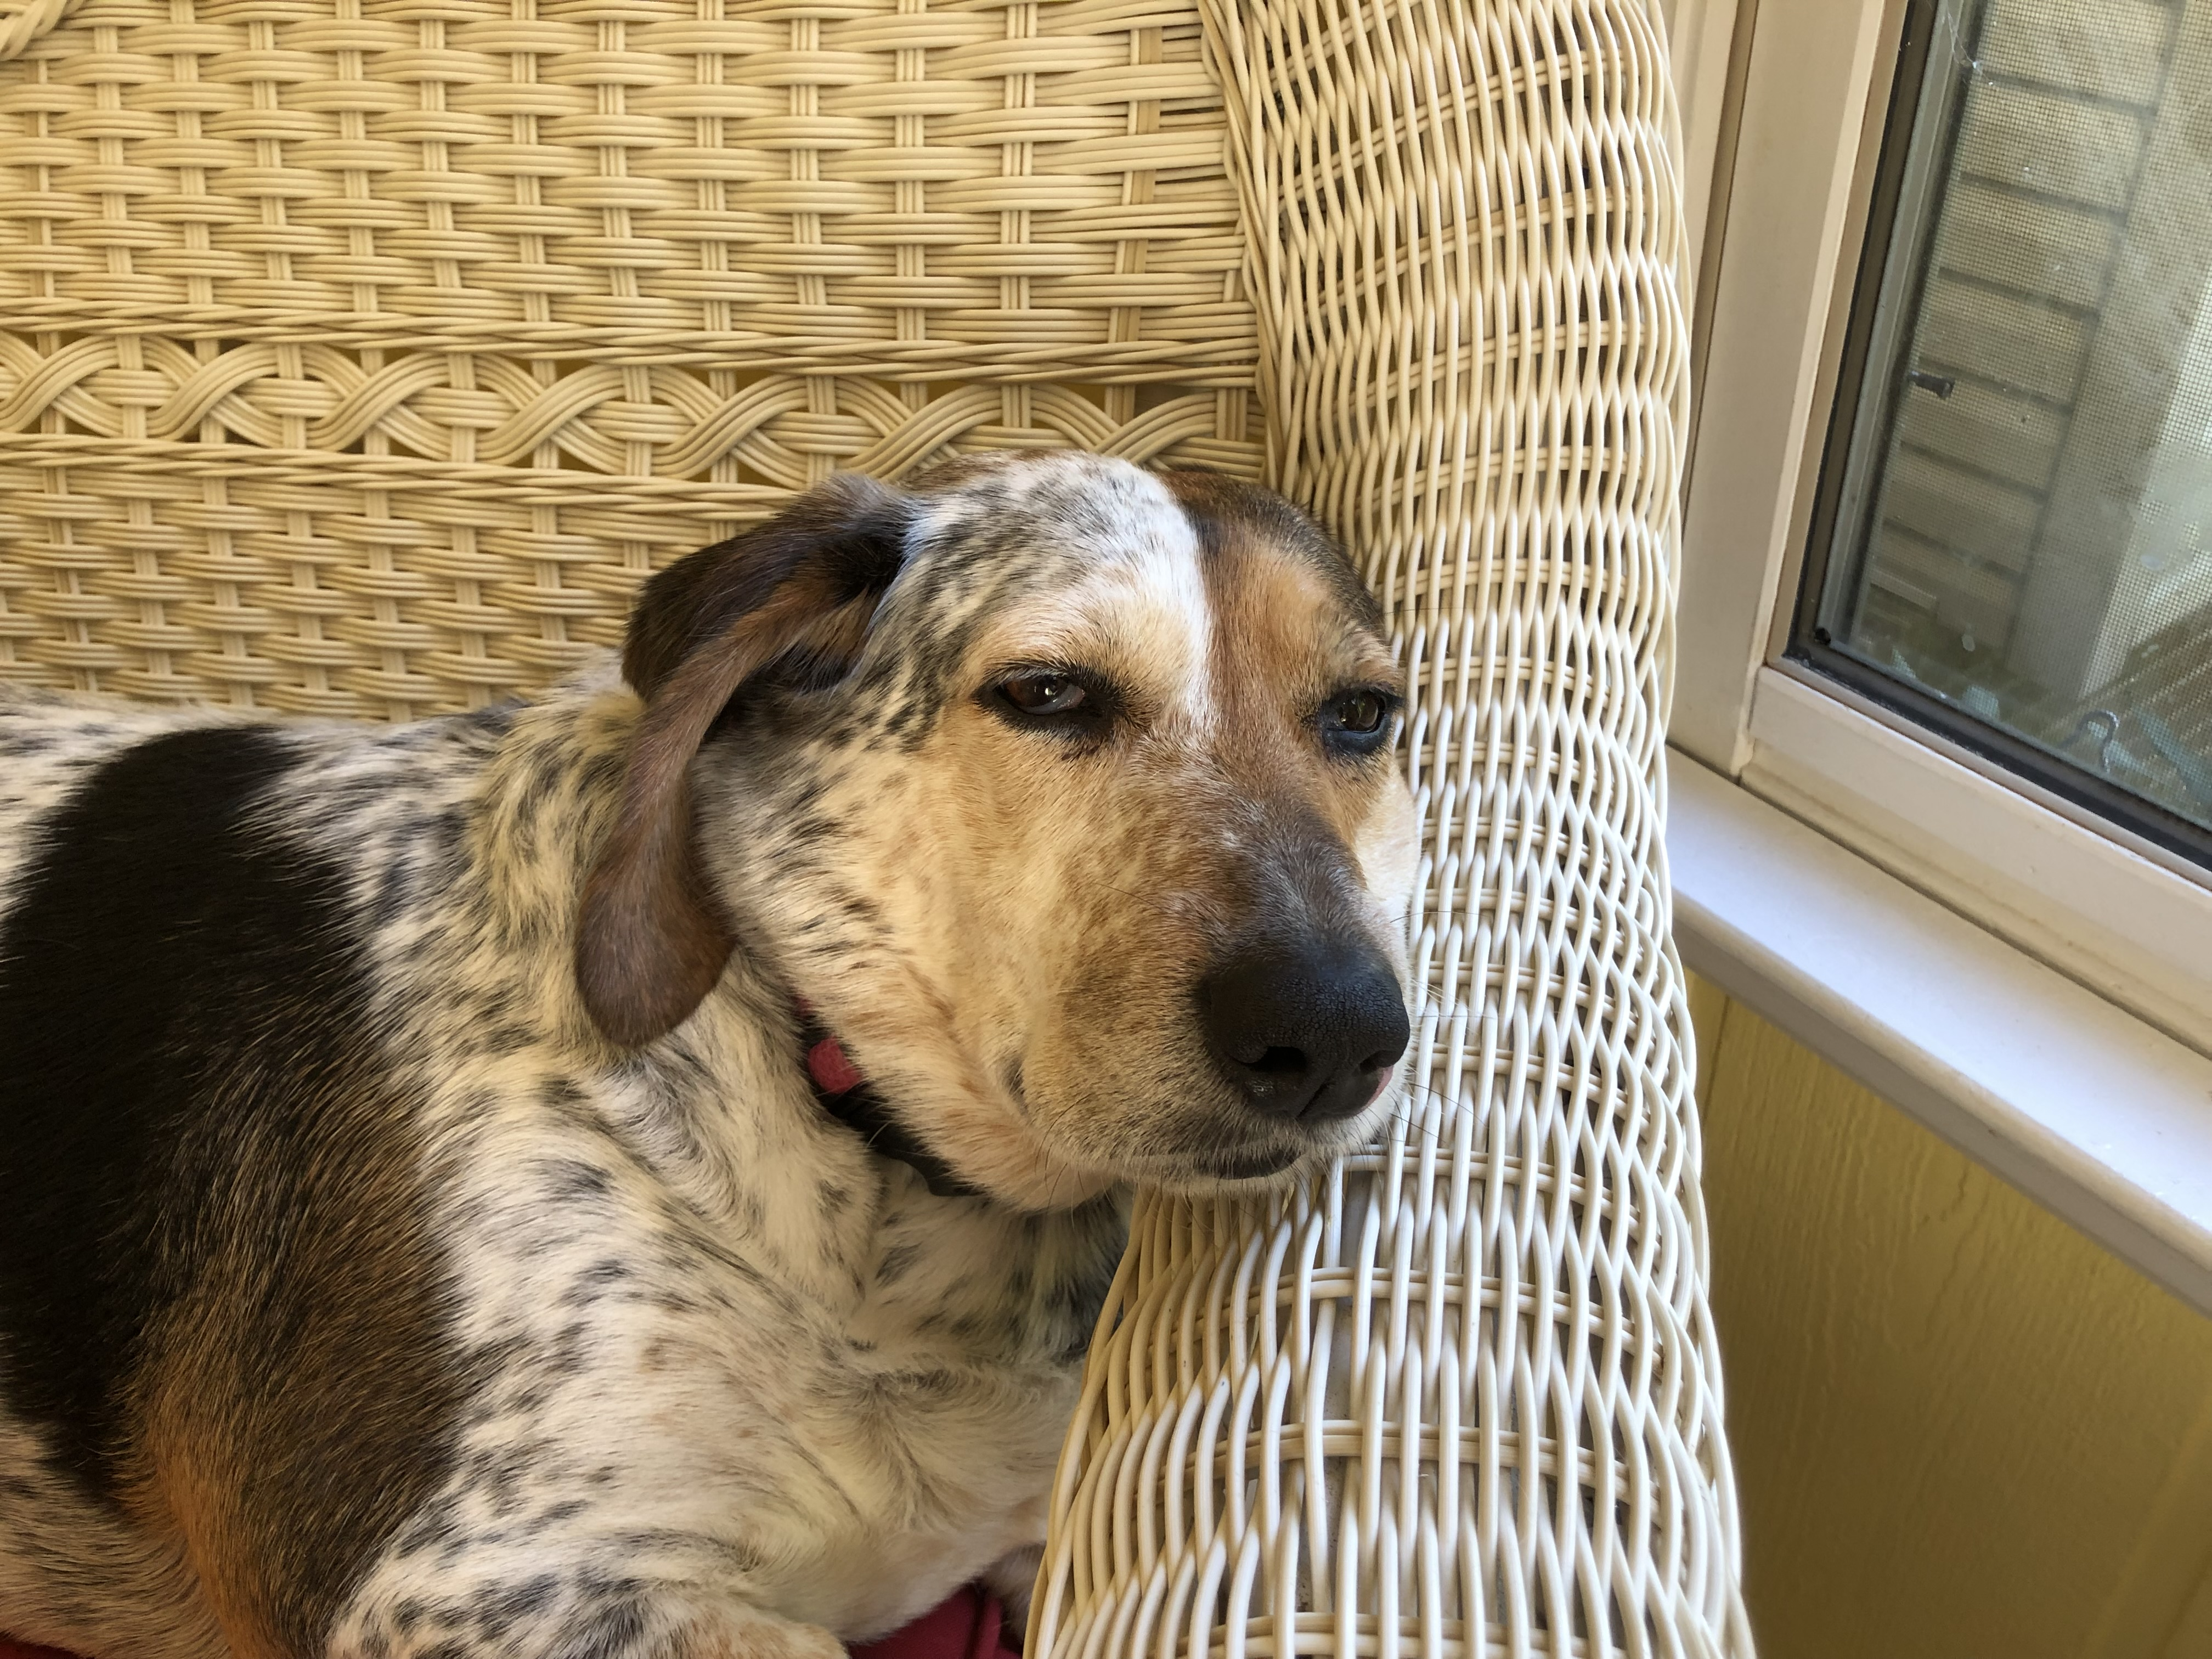
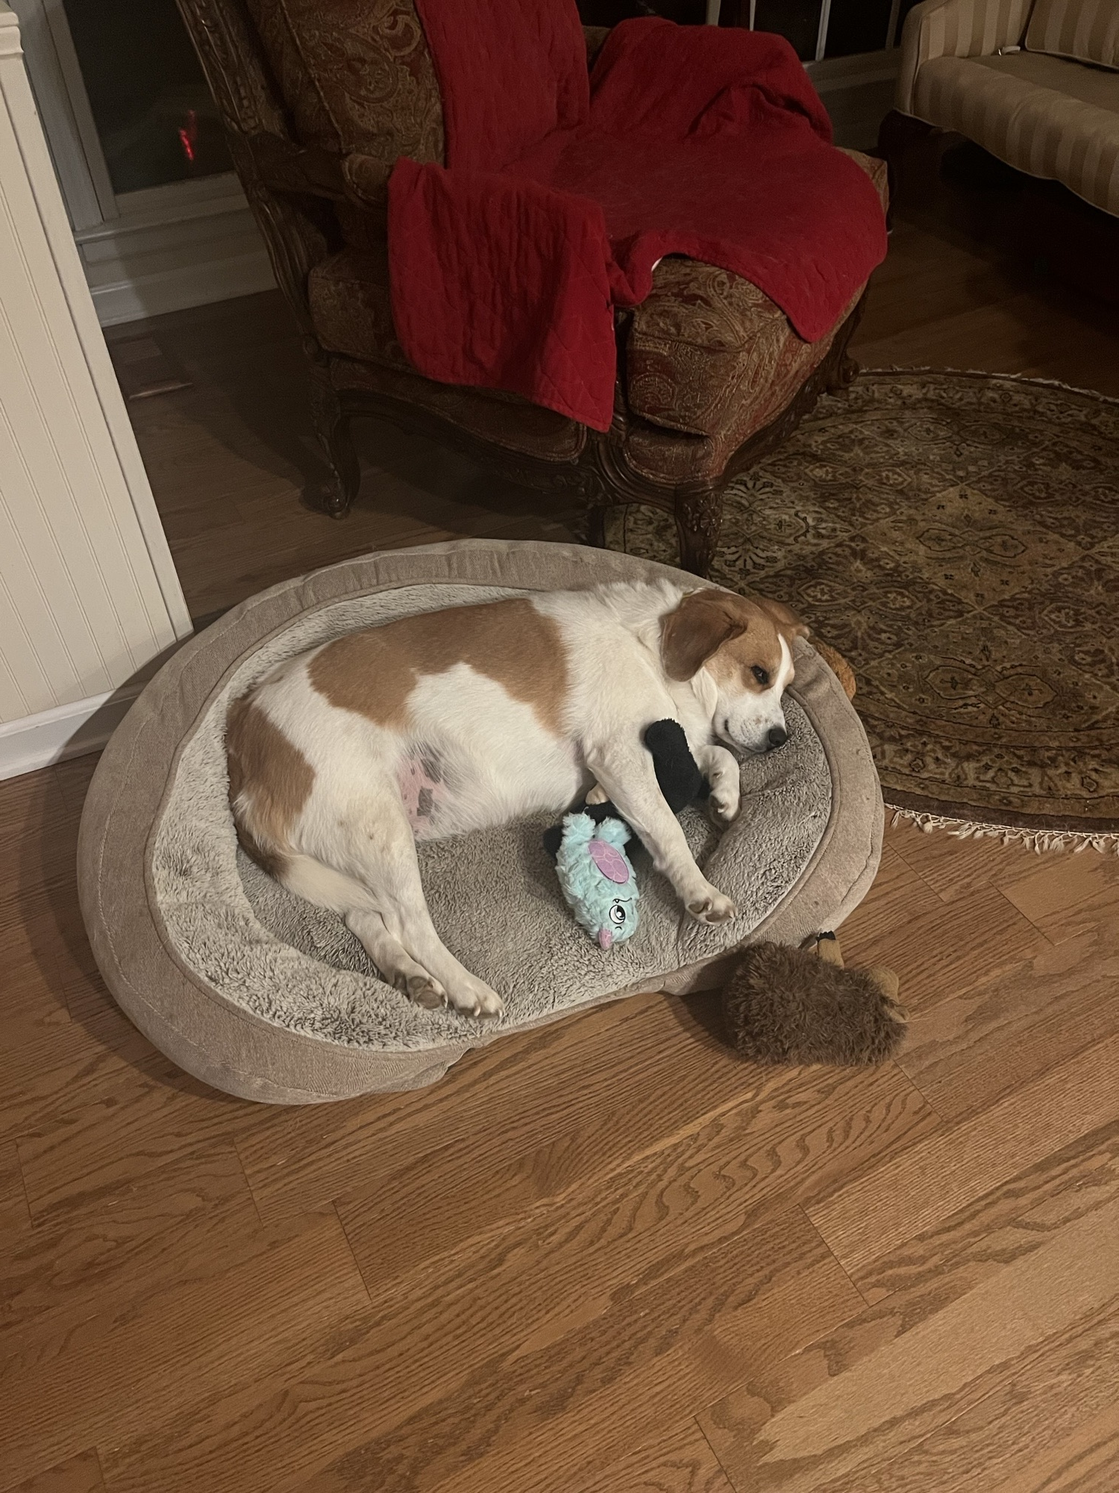
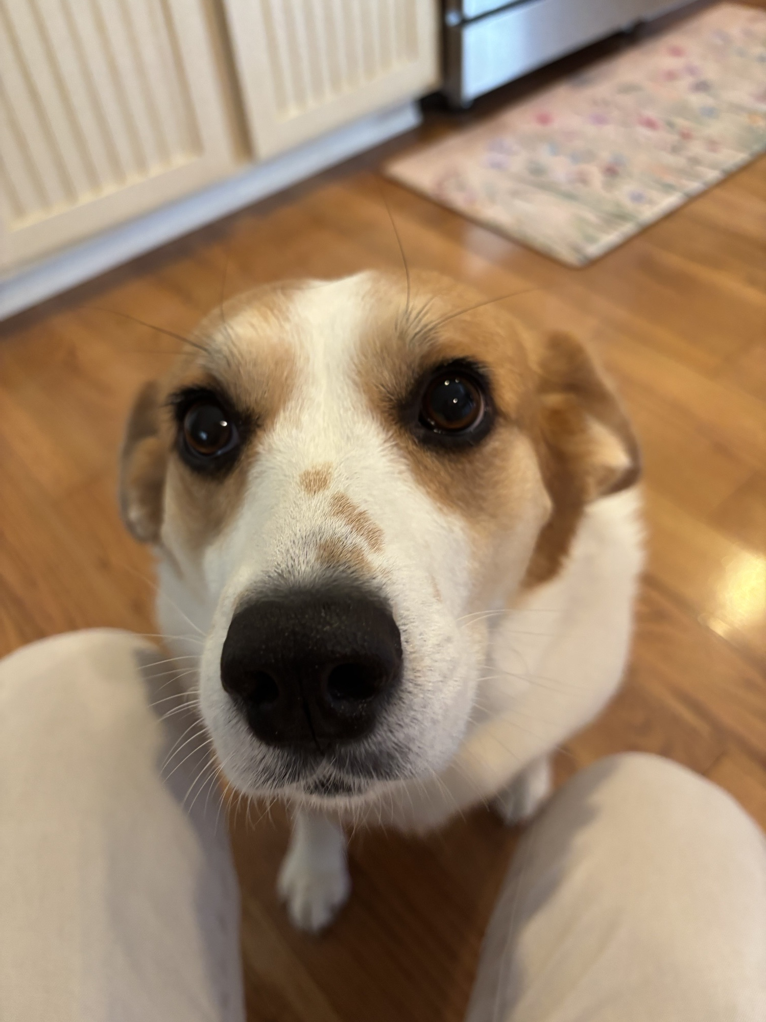
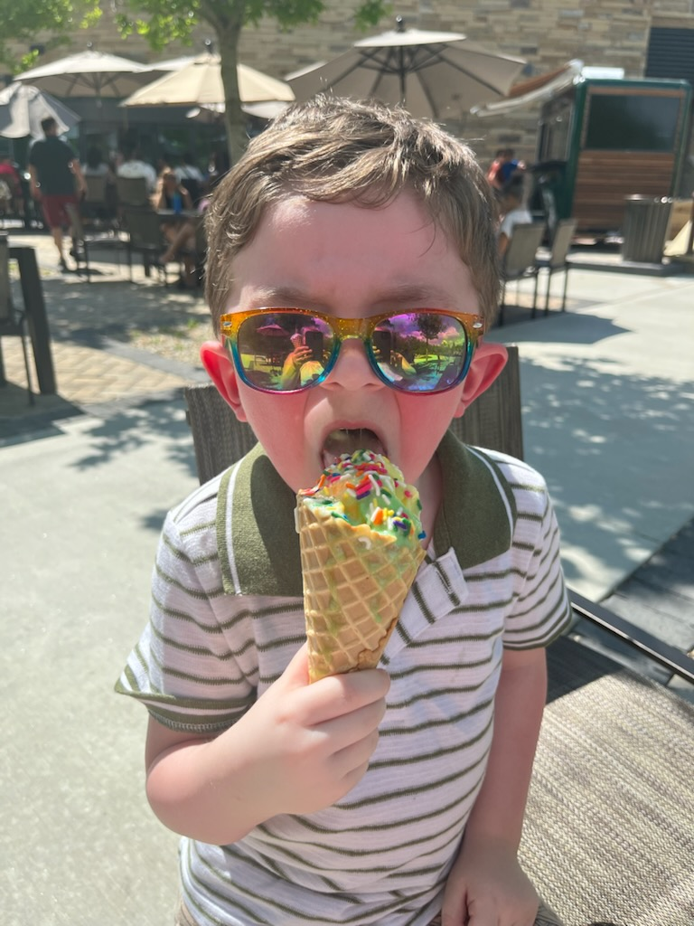
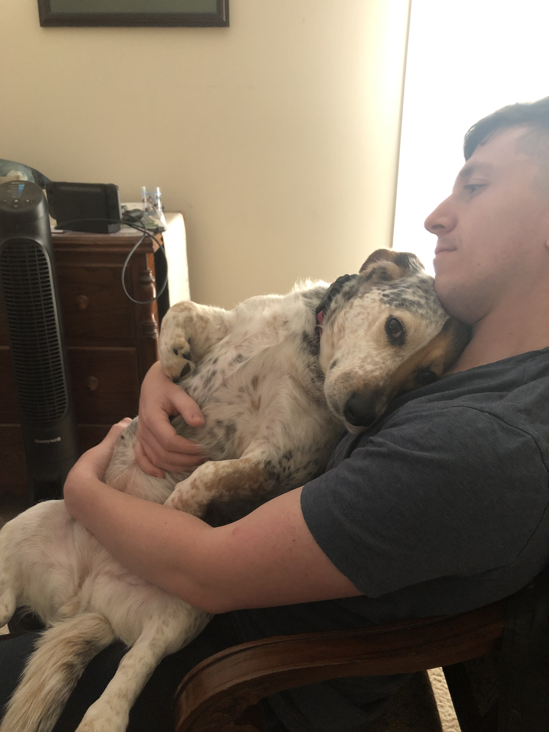
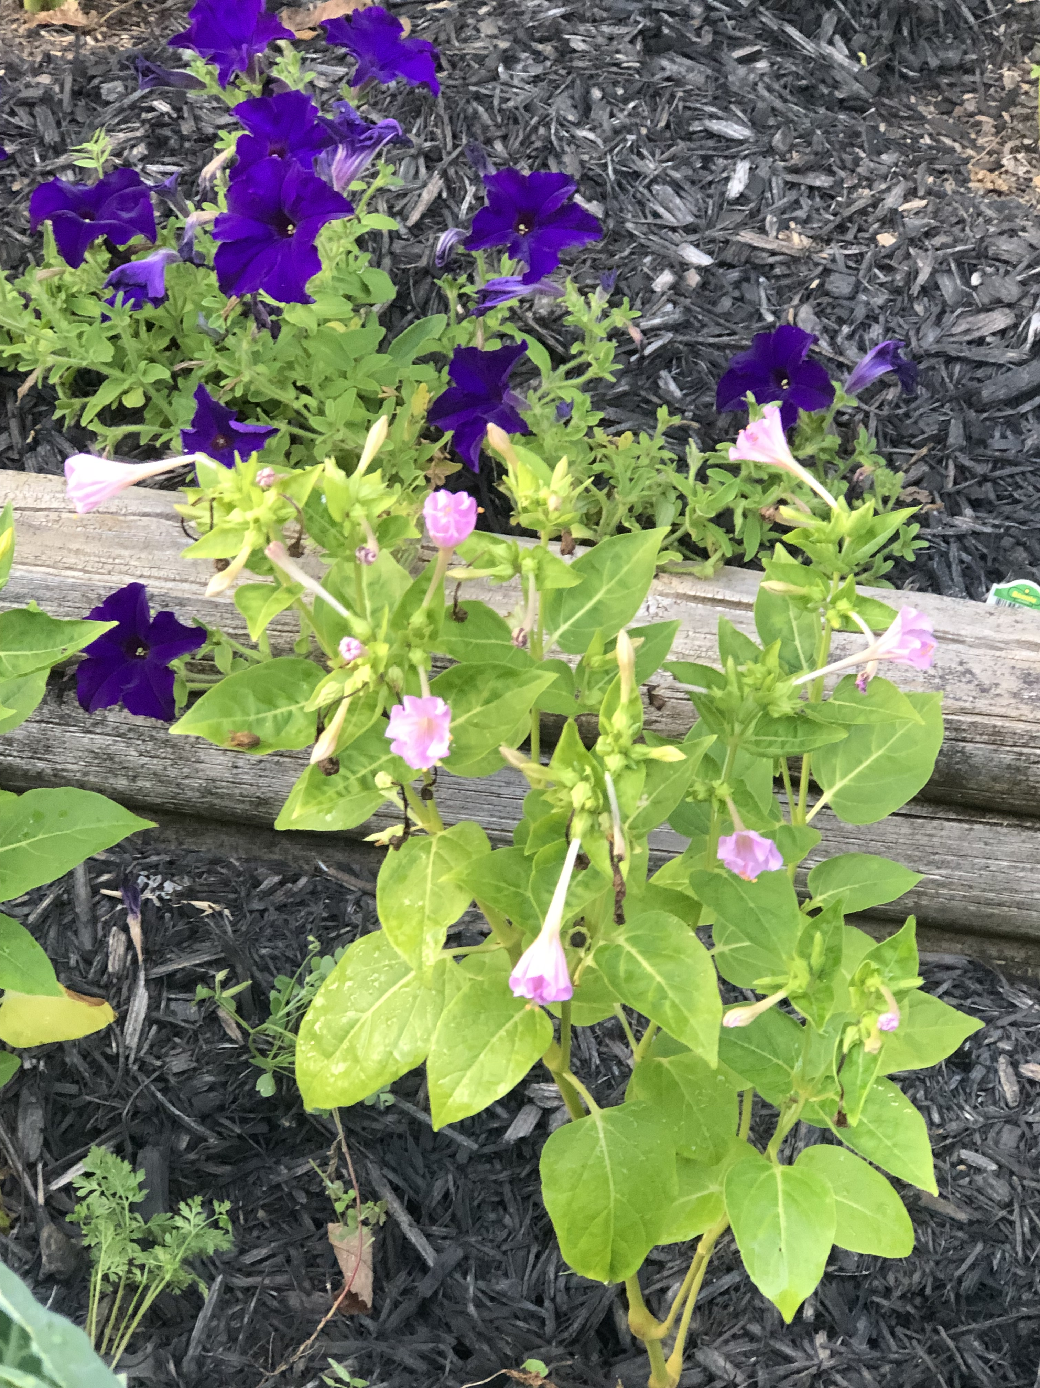
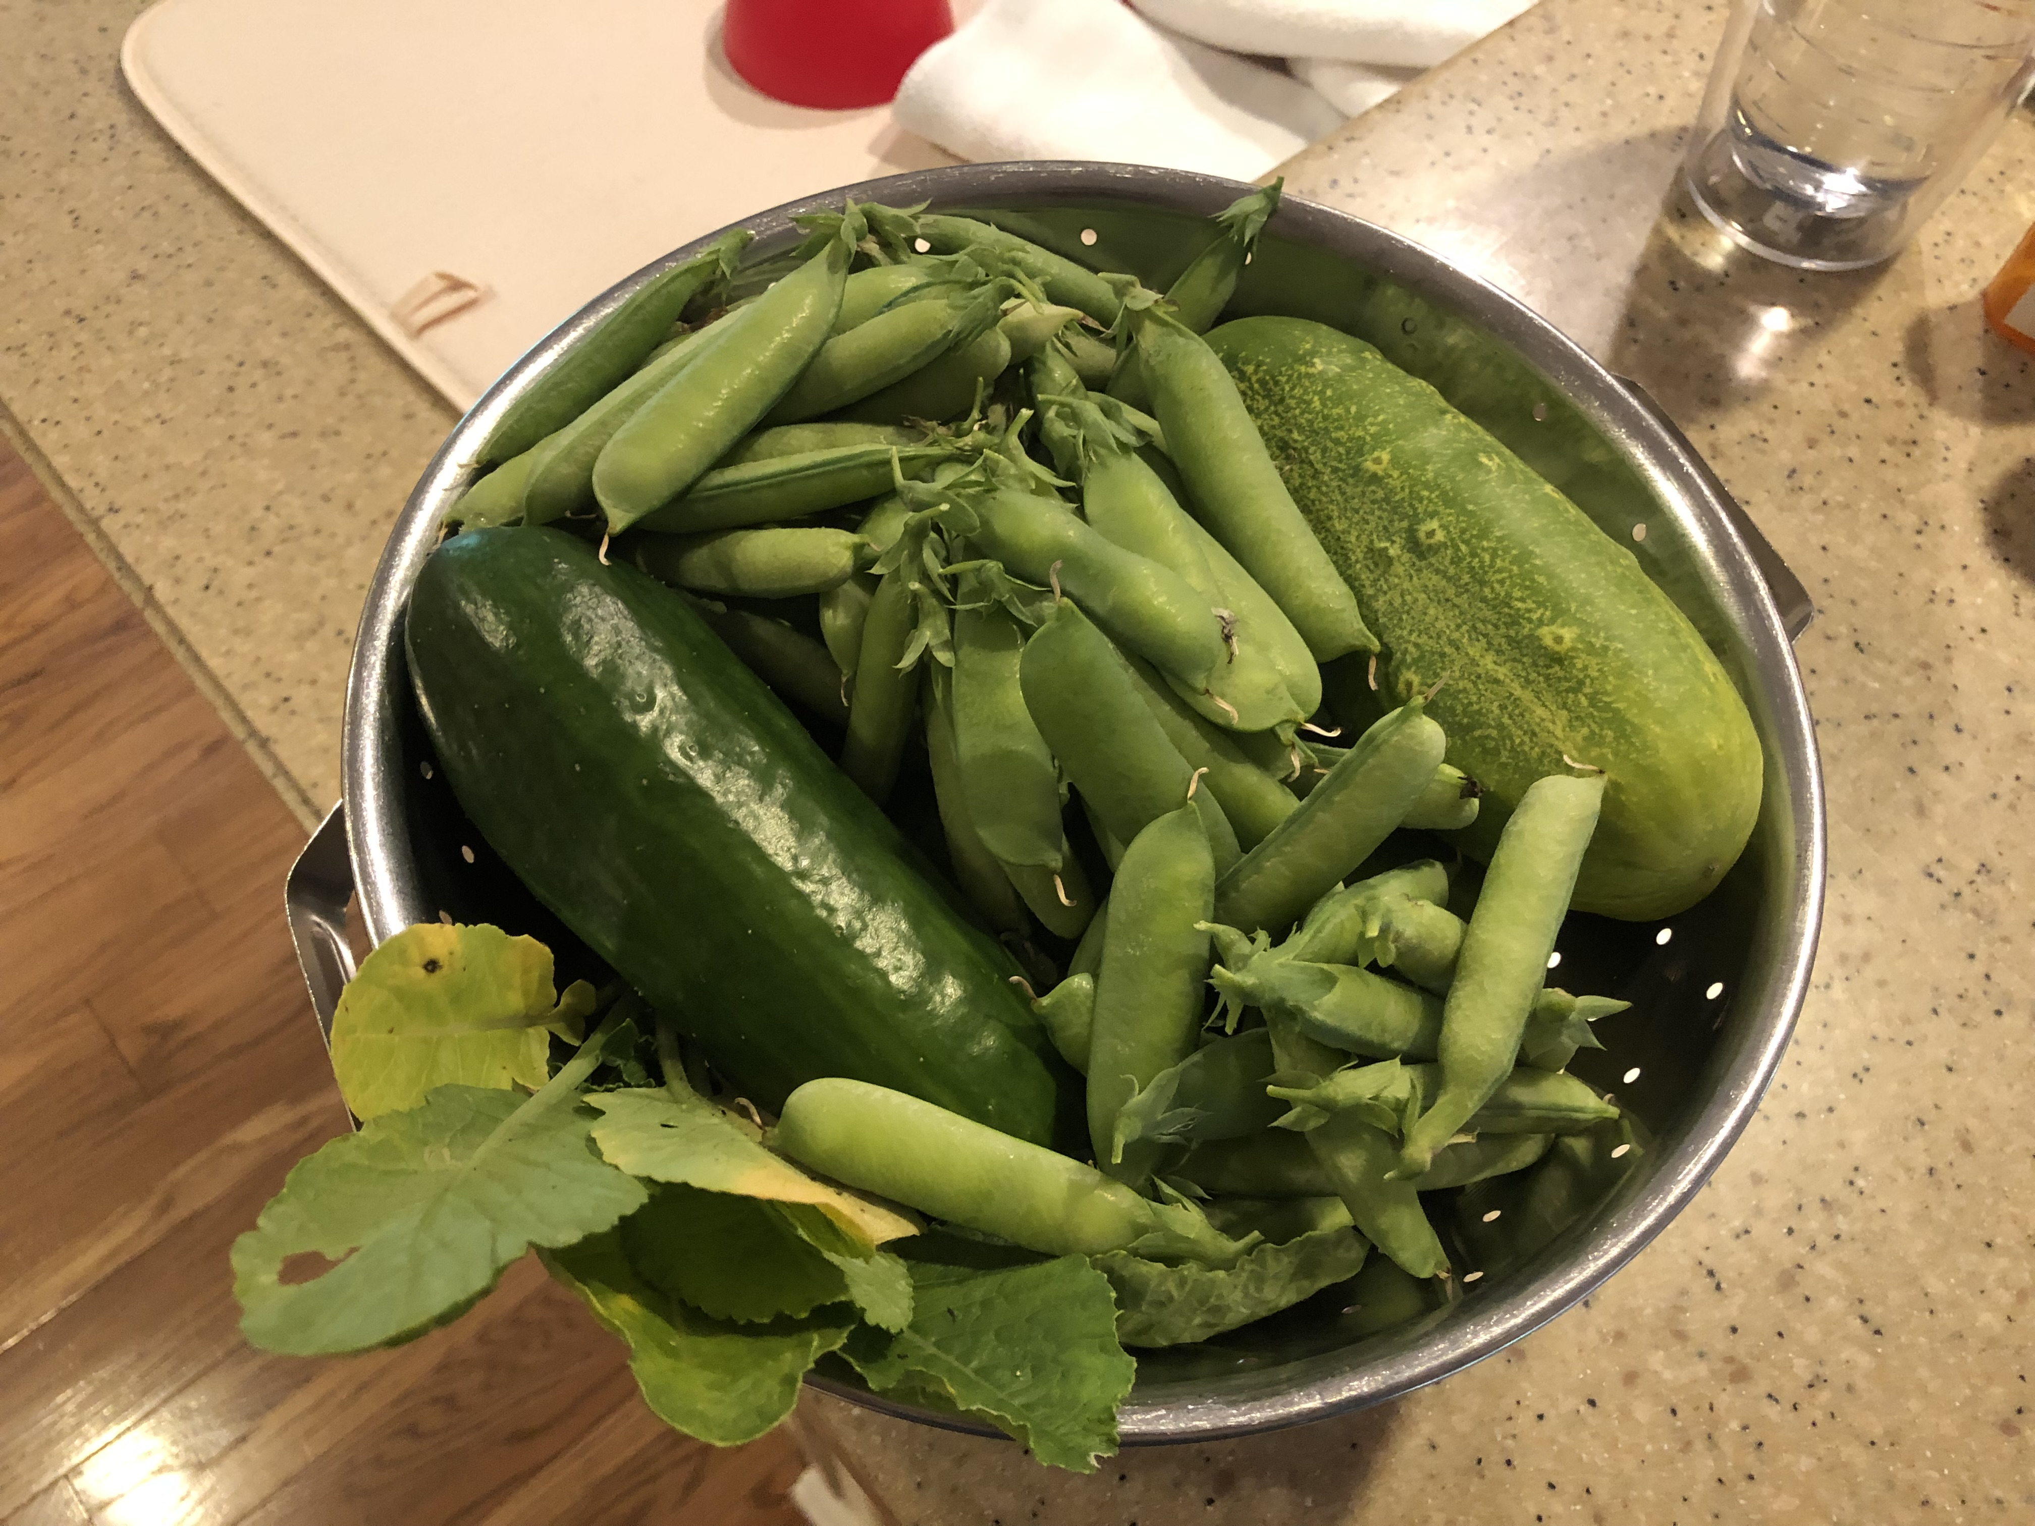
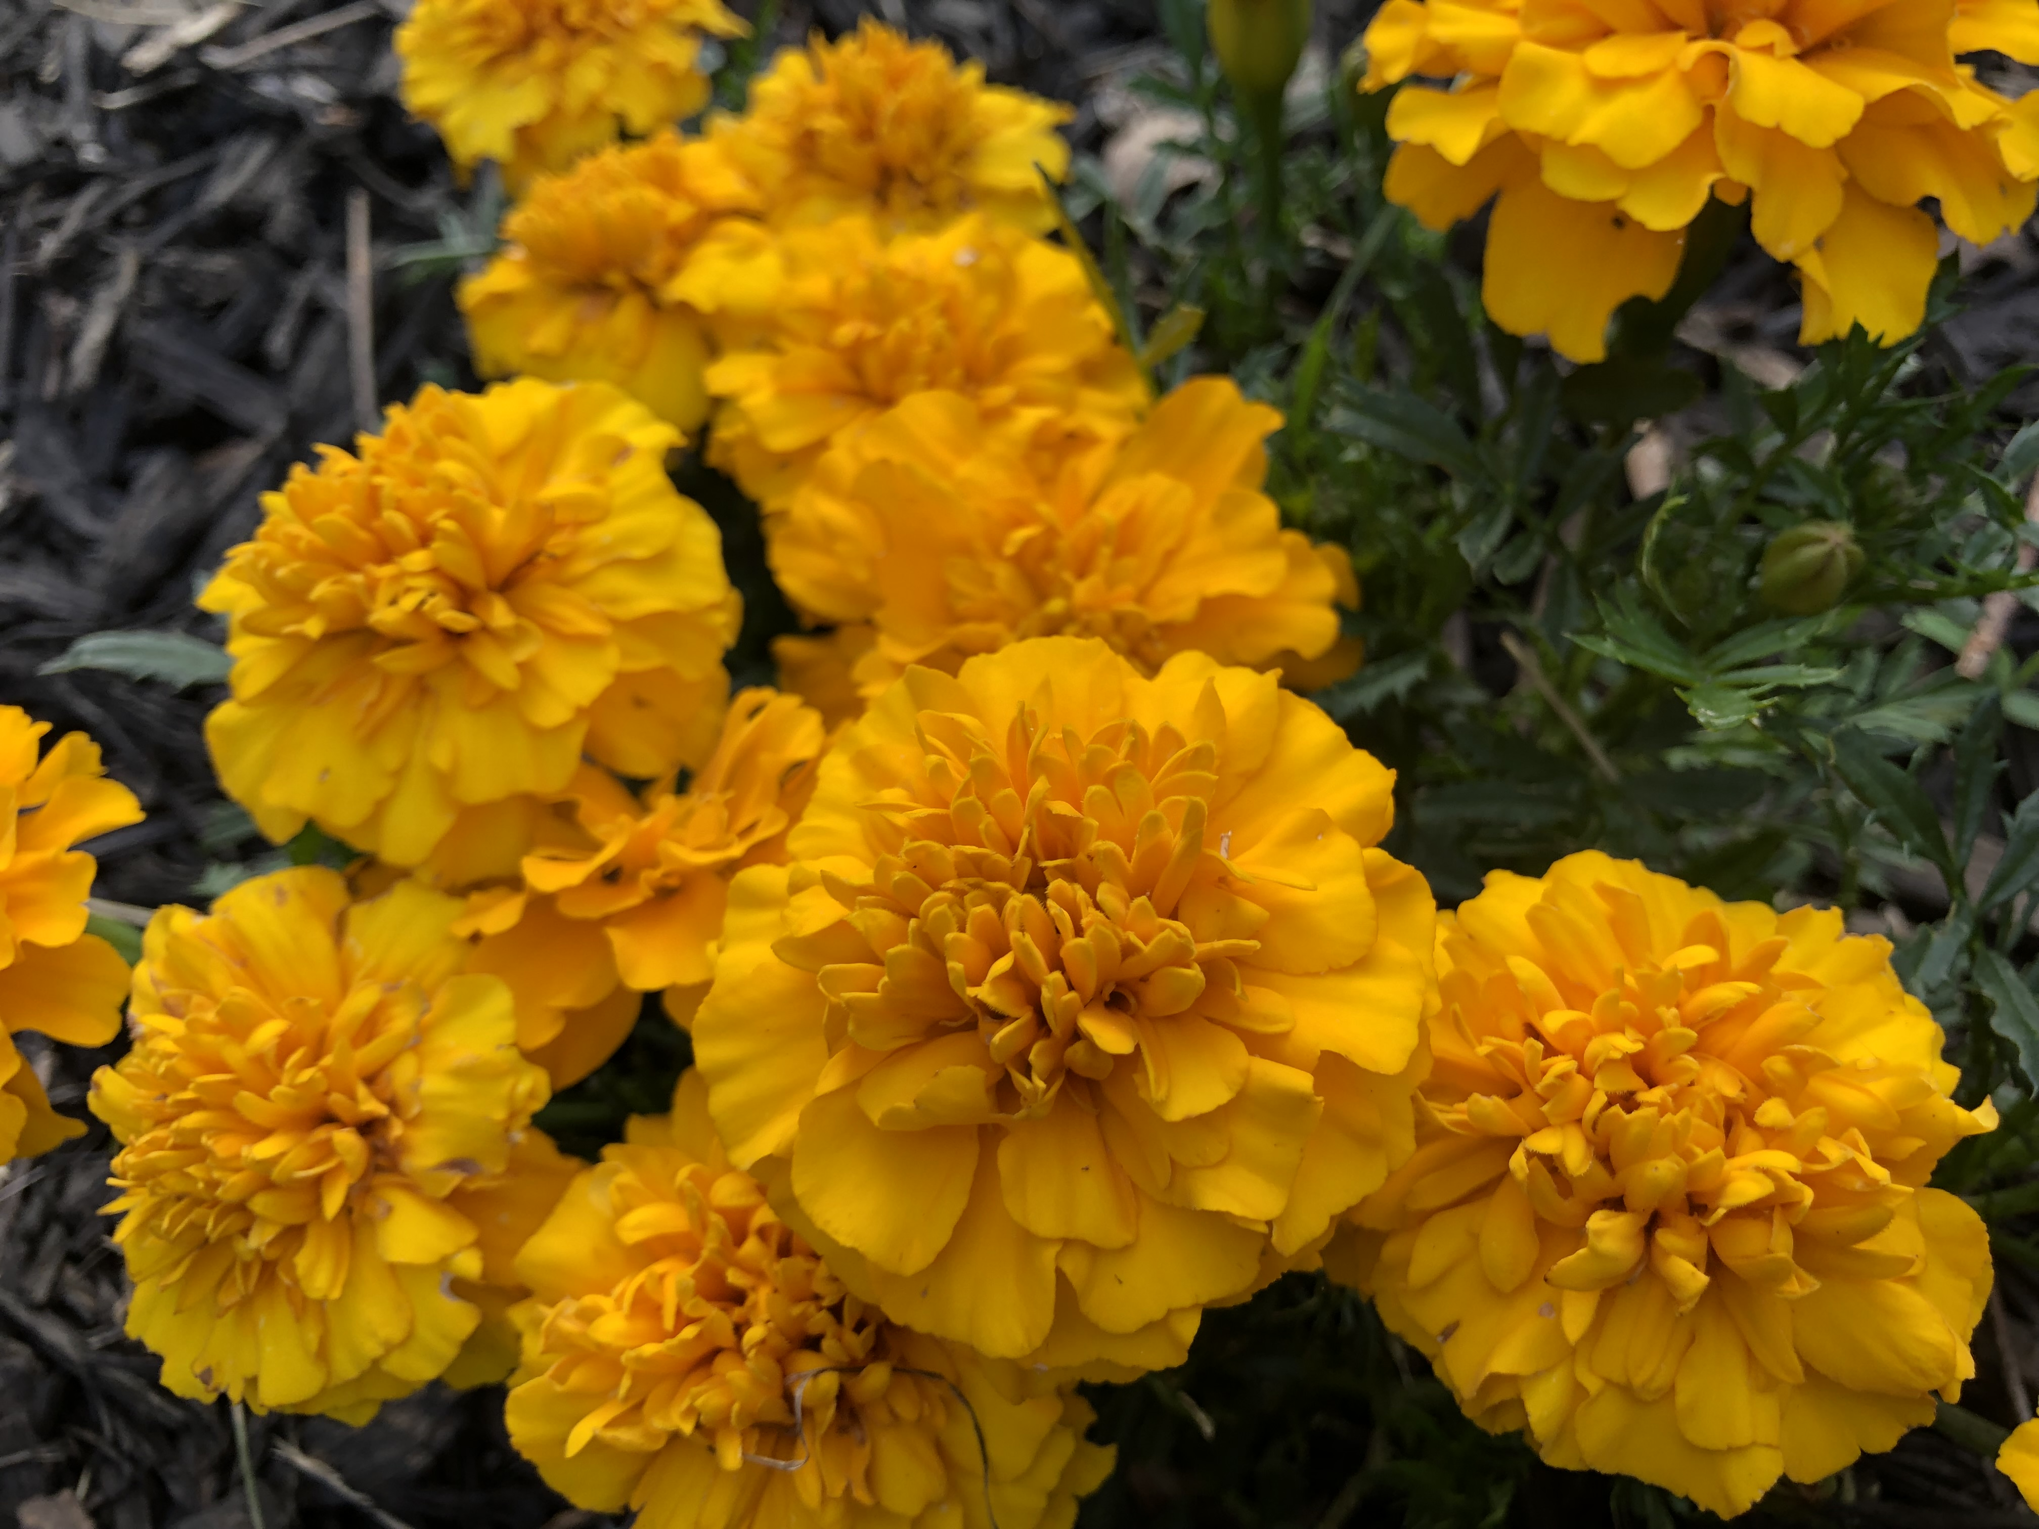

Slide 9
Outline
In this talk we will:
Give a brief review of basic concepts, vocabulary
Dive into the history of Maximum Bipartite Matching
Discuss the different algorithms we can use to solve it
Detail different applications of MBM
Go over the results of our scheduling application, and
Finish by talking about open issues and future work in this area

Slide 10
Overview

Slide 11
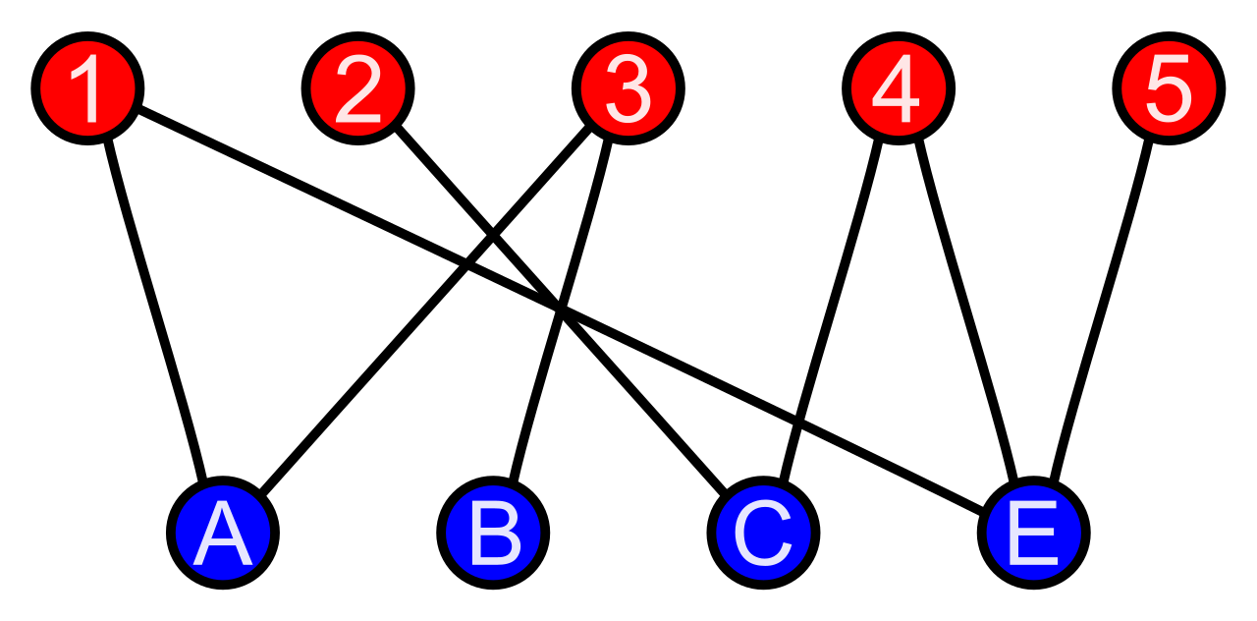
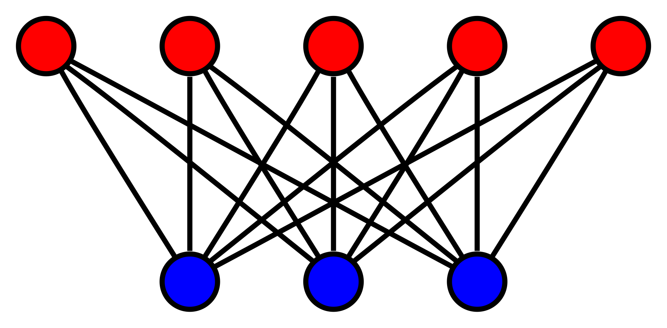
Bipartite Graph
Graph consisting of two disjoint sets of vertices.
Can be colored using only two colors.

Slide 12
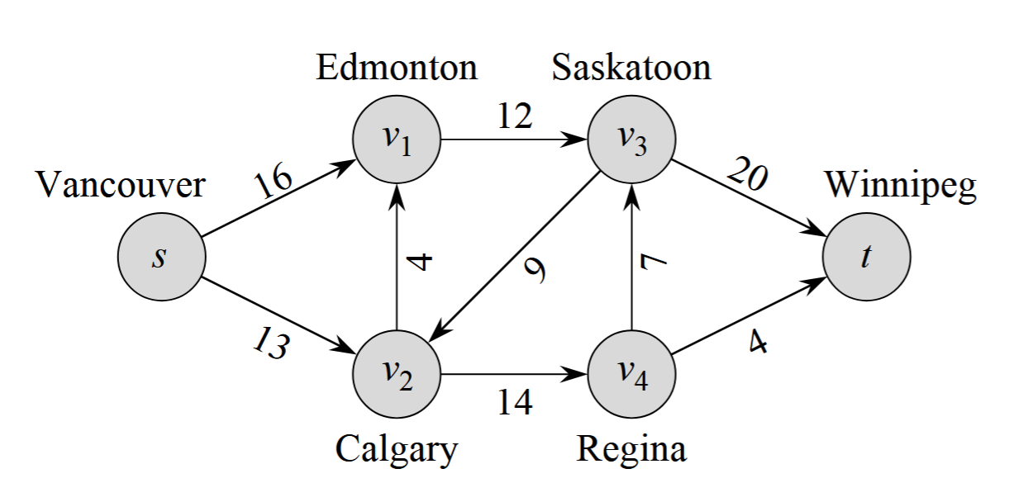
Network Flow
Directed graph with capacities on edges.
Each vertex exists on a path from the source (s) to the sink (t).
Problems optimize the flow in a network for a specific goal (max, min, etc.)
Augmenting Paths

Slide 13
History – The Theoretical Foundations
1849–1913 · Gyula König — Helped solidify the idea of studying matchings in bipartite graphs; father of Dénes König (An important name!).
1891 · Julius Petersen — First systematic matching result: every cubic bridgeless graph has a perfect matching (Die Theorie der regulären Graphen, Acta Math.)
1912–1917 · Georg Frobenius — Proved the perfect matching condition for bipartite graphs via reducible determinants; precursor to Hall's theorem, discovered independently.
1916 & 1931 · Dénes König — (1916) Every regular bipartite graph has a perfect matching; chromatic index = max degree. (1931) König's Theorem: max matching = min vertex cover in Bipartite Graphs.
1931 · Jenő Egerváry — Weighted Bipartite Matching of König's theorem; directly enabled the Hungarian Algorithm.
1935 · Philip Hall — Hall's Marriage Theorem: a perfect matching exists iff |N(S)| ≥ |S| for every subset S.

Slide 14
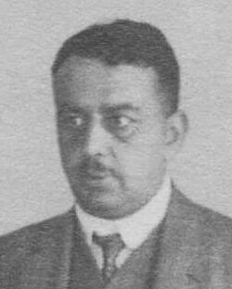
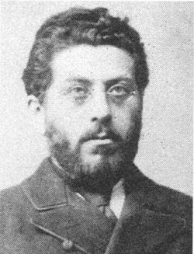
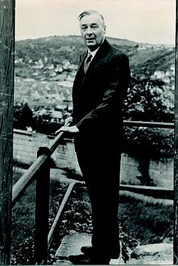
Faces For The Names
Dénes Kőnig
(1884-1944)
Gyula Kőnig
(1849-1913)
Phillip Hall
(1904-1982)

Slide 15
History – The Algorithms
1955 · Kuhn · O(n³) — Hungarian Algorithm for weighted Bipartite Matching; The first poly-time solution. Still widely used. Large, dense graphs push the worst case runtime to O(n³)
1956 · Ford & Fulkerson · O(V·E) — Augmenting path framework; bipartite matching as unit-capacity max-flow
1965 · Edmonds — Blossom Algorithm; solved general (non-bipartite) matching; formalized augmenting path theory
1973 · Hopcroft & Karp · O(√V · E) — BFS and DFS finds maximal sets of shortest augmenting paths per phase; the standard algorithm today
1987 · Mulmuley, Vazirani, Vazirani · RNC — Isolation Lemma + Tutte matrix; max matching in pesudo-randomized parallel poly-log time
2022 · Chen, Kyng, Liu, Peng et al. · O(m¹⁺ᵒ⁽¹⁾) — Nearly-linear-time algorithms for min-cost flow via interior-point methods; implies faster solutions for bipartite matching via reductions

Slide 16
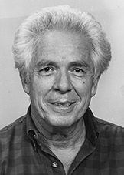
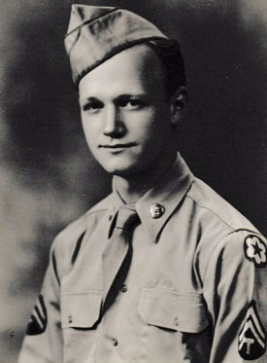
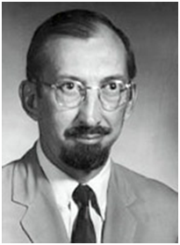
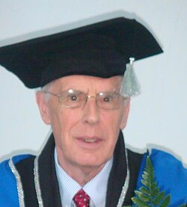
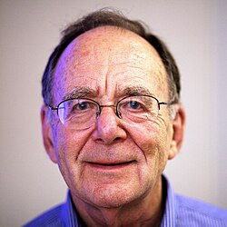
Faces For The Names
Harold W. Kuhn
(1925-2014)
Lester R. Ford, Jr.
(1927-2017)
Delbert Ray Fulkerson
(1924-1976)
John Edward Hopcroft
(1939-Present)
Richard M. Karp
(1935-Present)

Slide 17
Algorithms

Slide 18
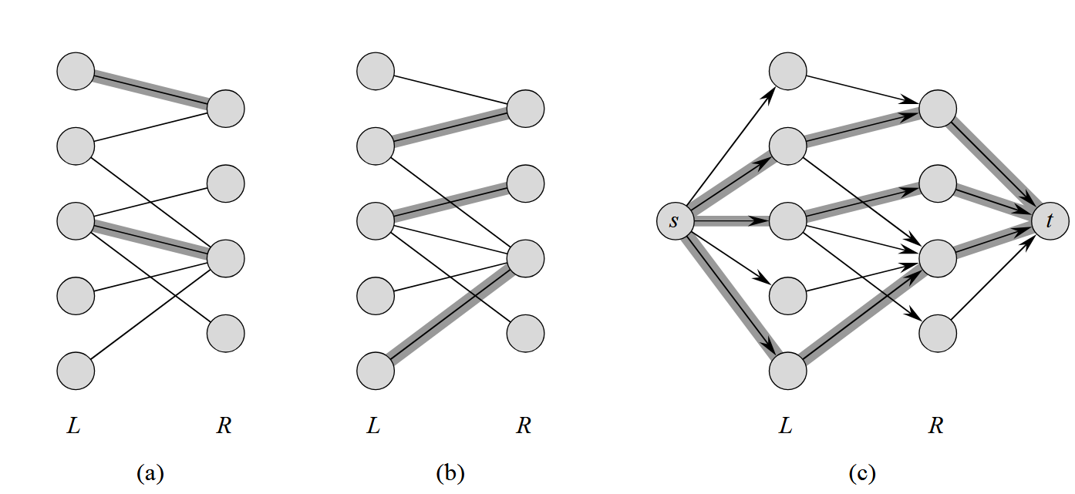
Maximum Bipartite Matching

Slide 19
Maximum Bipartite Matching
Given a bipartite graph, find a maximal matching with the largest number of edges.
Network flow can be applied by giving each edge a capacity of 1 and maximizing the flow of the resulting graph.
Perfect Matching - A matching where all vertices are matched.

Slide 20
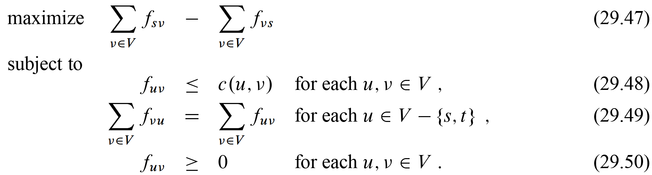
Maximum Bipartite Matching
Linear Programming Implementation:

Slide 21

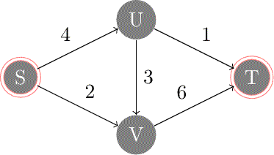
Kuhn's Algorithm (1955)
Application of Ford-Fulkerson Method
Finds an augmenting path via DFS and adds it to maximize the flow in the graph per iteration.
Runs in worst case.

Slide 22


Hopcroft-Karp Algorithm (1973)
Uses BFS and DFS to create a maximal set of shortest augmenting paths rather than one at a time.
  BFS finds the size of the shortest augmenting path.
  DFS finds all disjoint augmenting paths.
Runs in worst case
  Runs in at most phases with BFS + DFS.

Slide 23
Linear Max Flow (almost); Chen Et Al. (2022)
Uses Interior Point Methods (IPM) and Laplacian Solvers rather than augmenting paths
  IPM iteratively follows a central path toward the optimal flow solution
  Laplacian solvers handle the linear algebra required at each IPM step
Runs in O(m^{1+o(1)}) worst case
Runs in m^{1+o(1)} total steps, where the extra factor shrinks slower than any fixed power of m
Bipartite matching is a special case of min-cost flow, so this matching benefits via reductions
Theoretically near-optimal but super complex to implement in practice; Hopcroft-Karp is still the standard for real implementations.
This paper is also 120 pages of Greek letters, good luck reading it!

Slide 24
Applications

Slide 25
Practical Applications of MBM
Applications can be found in areas such as:
  Job Scheduling/Assignment
  Online Advertising – Matching page visits to advertisers
  Organ Donation
  Matchmaking in Dating Software
Many of these fall under the broad category of resource allocation.

Slide 26

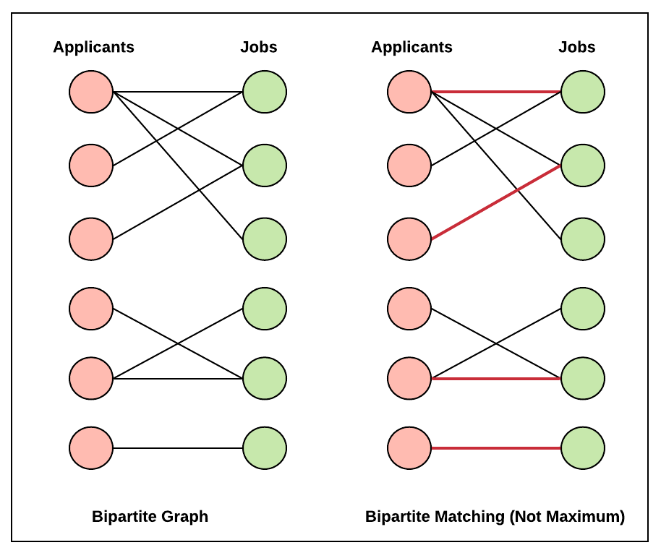
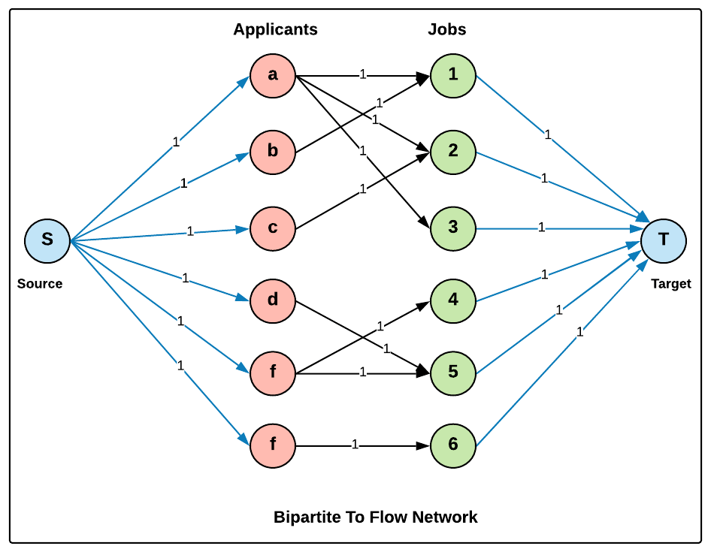


Job Scheduling & Assignment

Slide 27
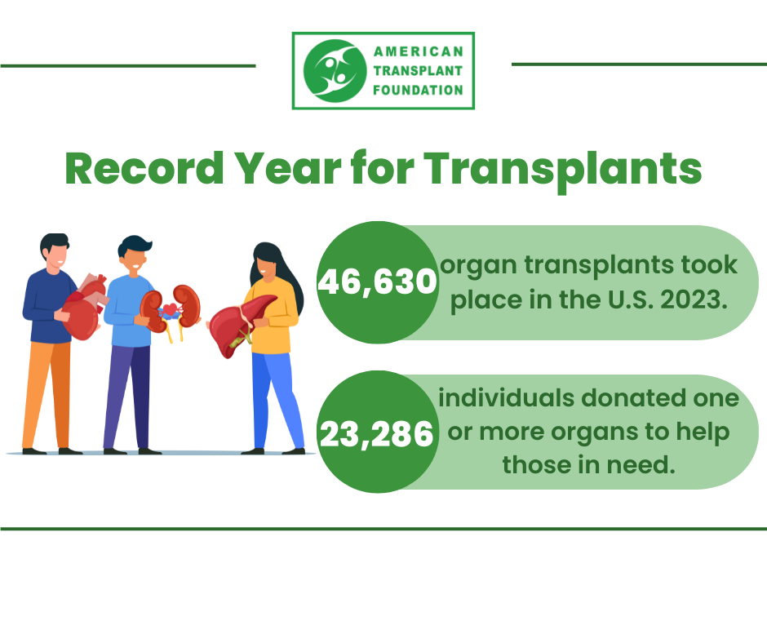
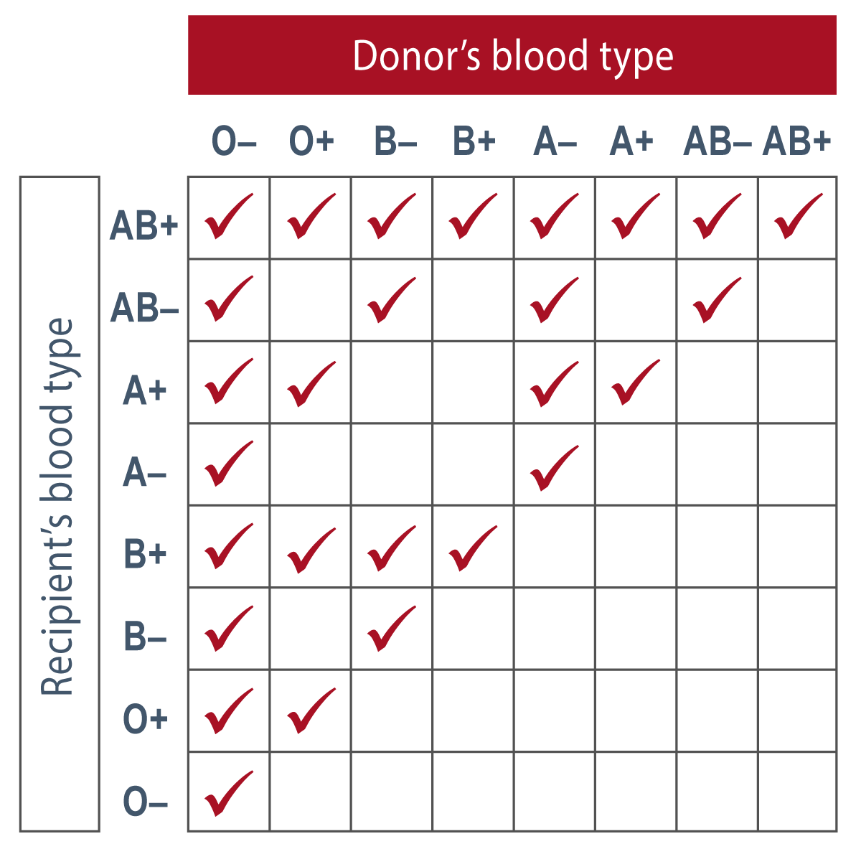
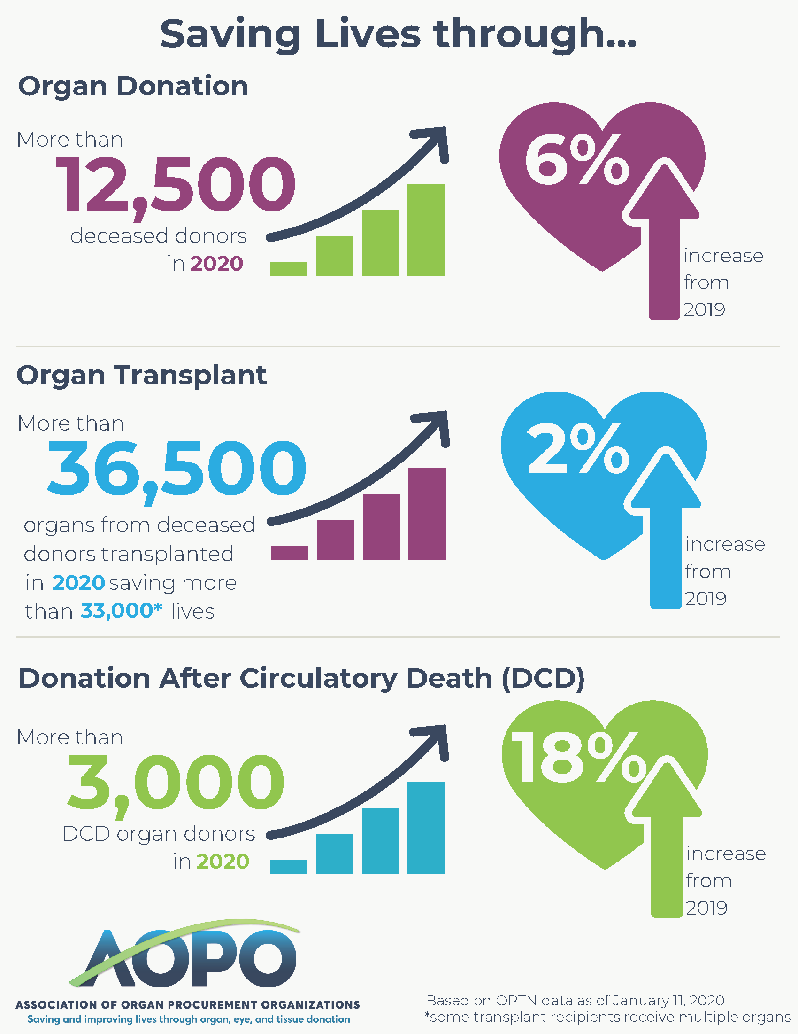


Organ Donation

Slide 28
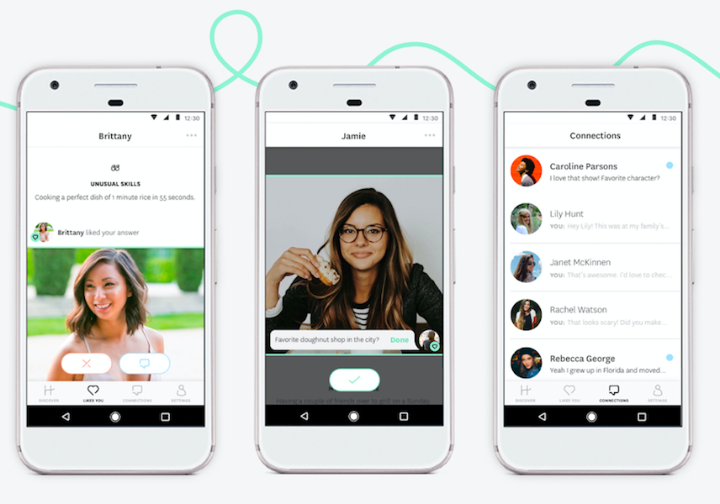
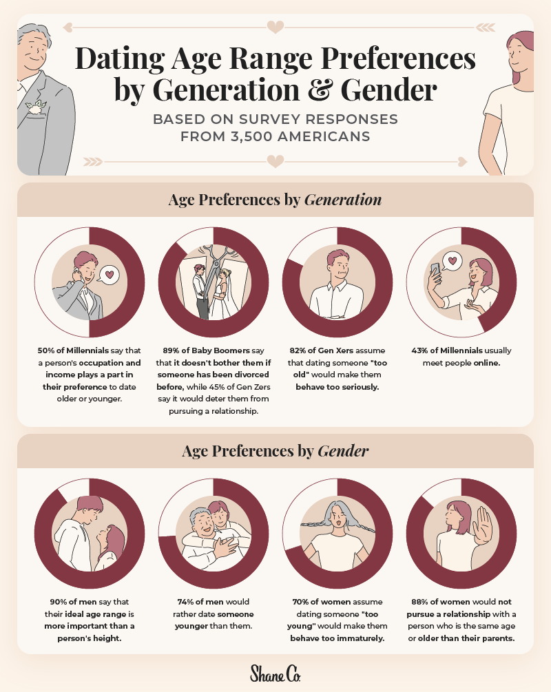
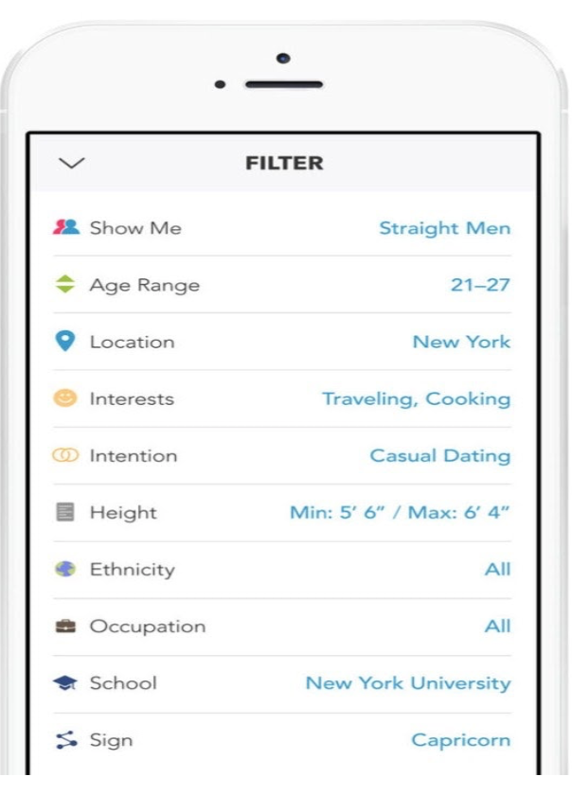
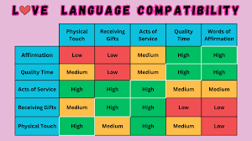
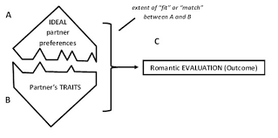
Matchmaking in Dating

Slide 29
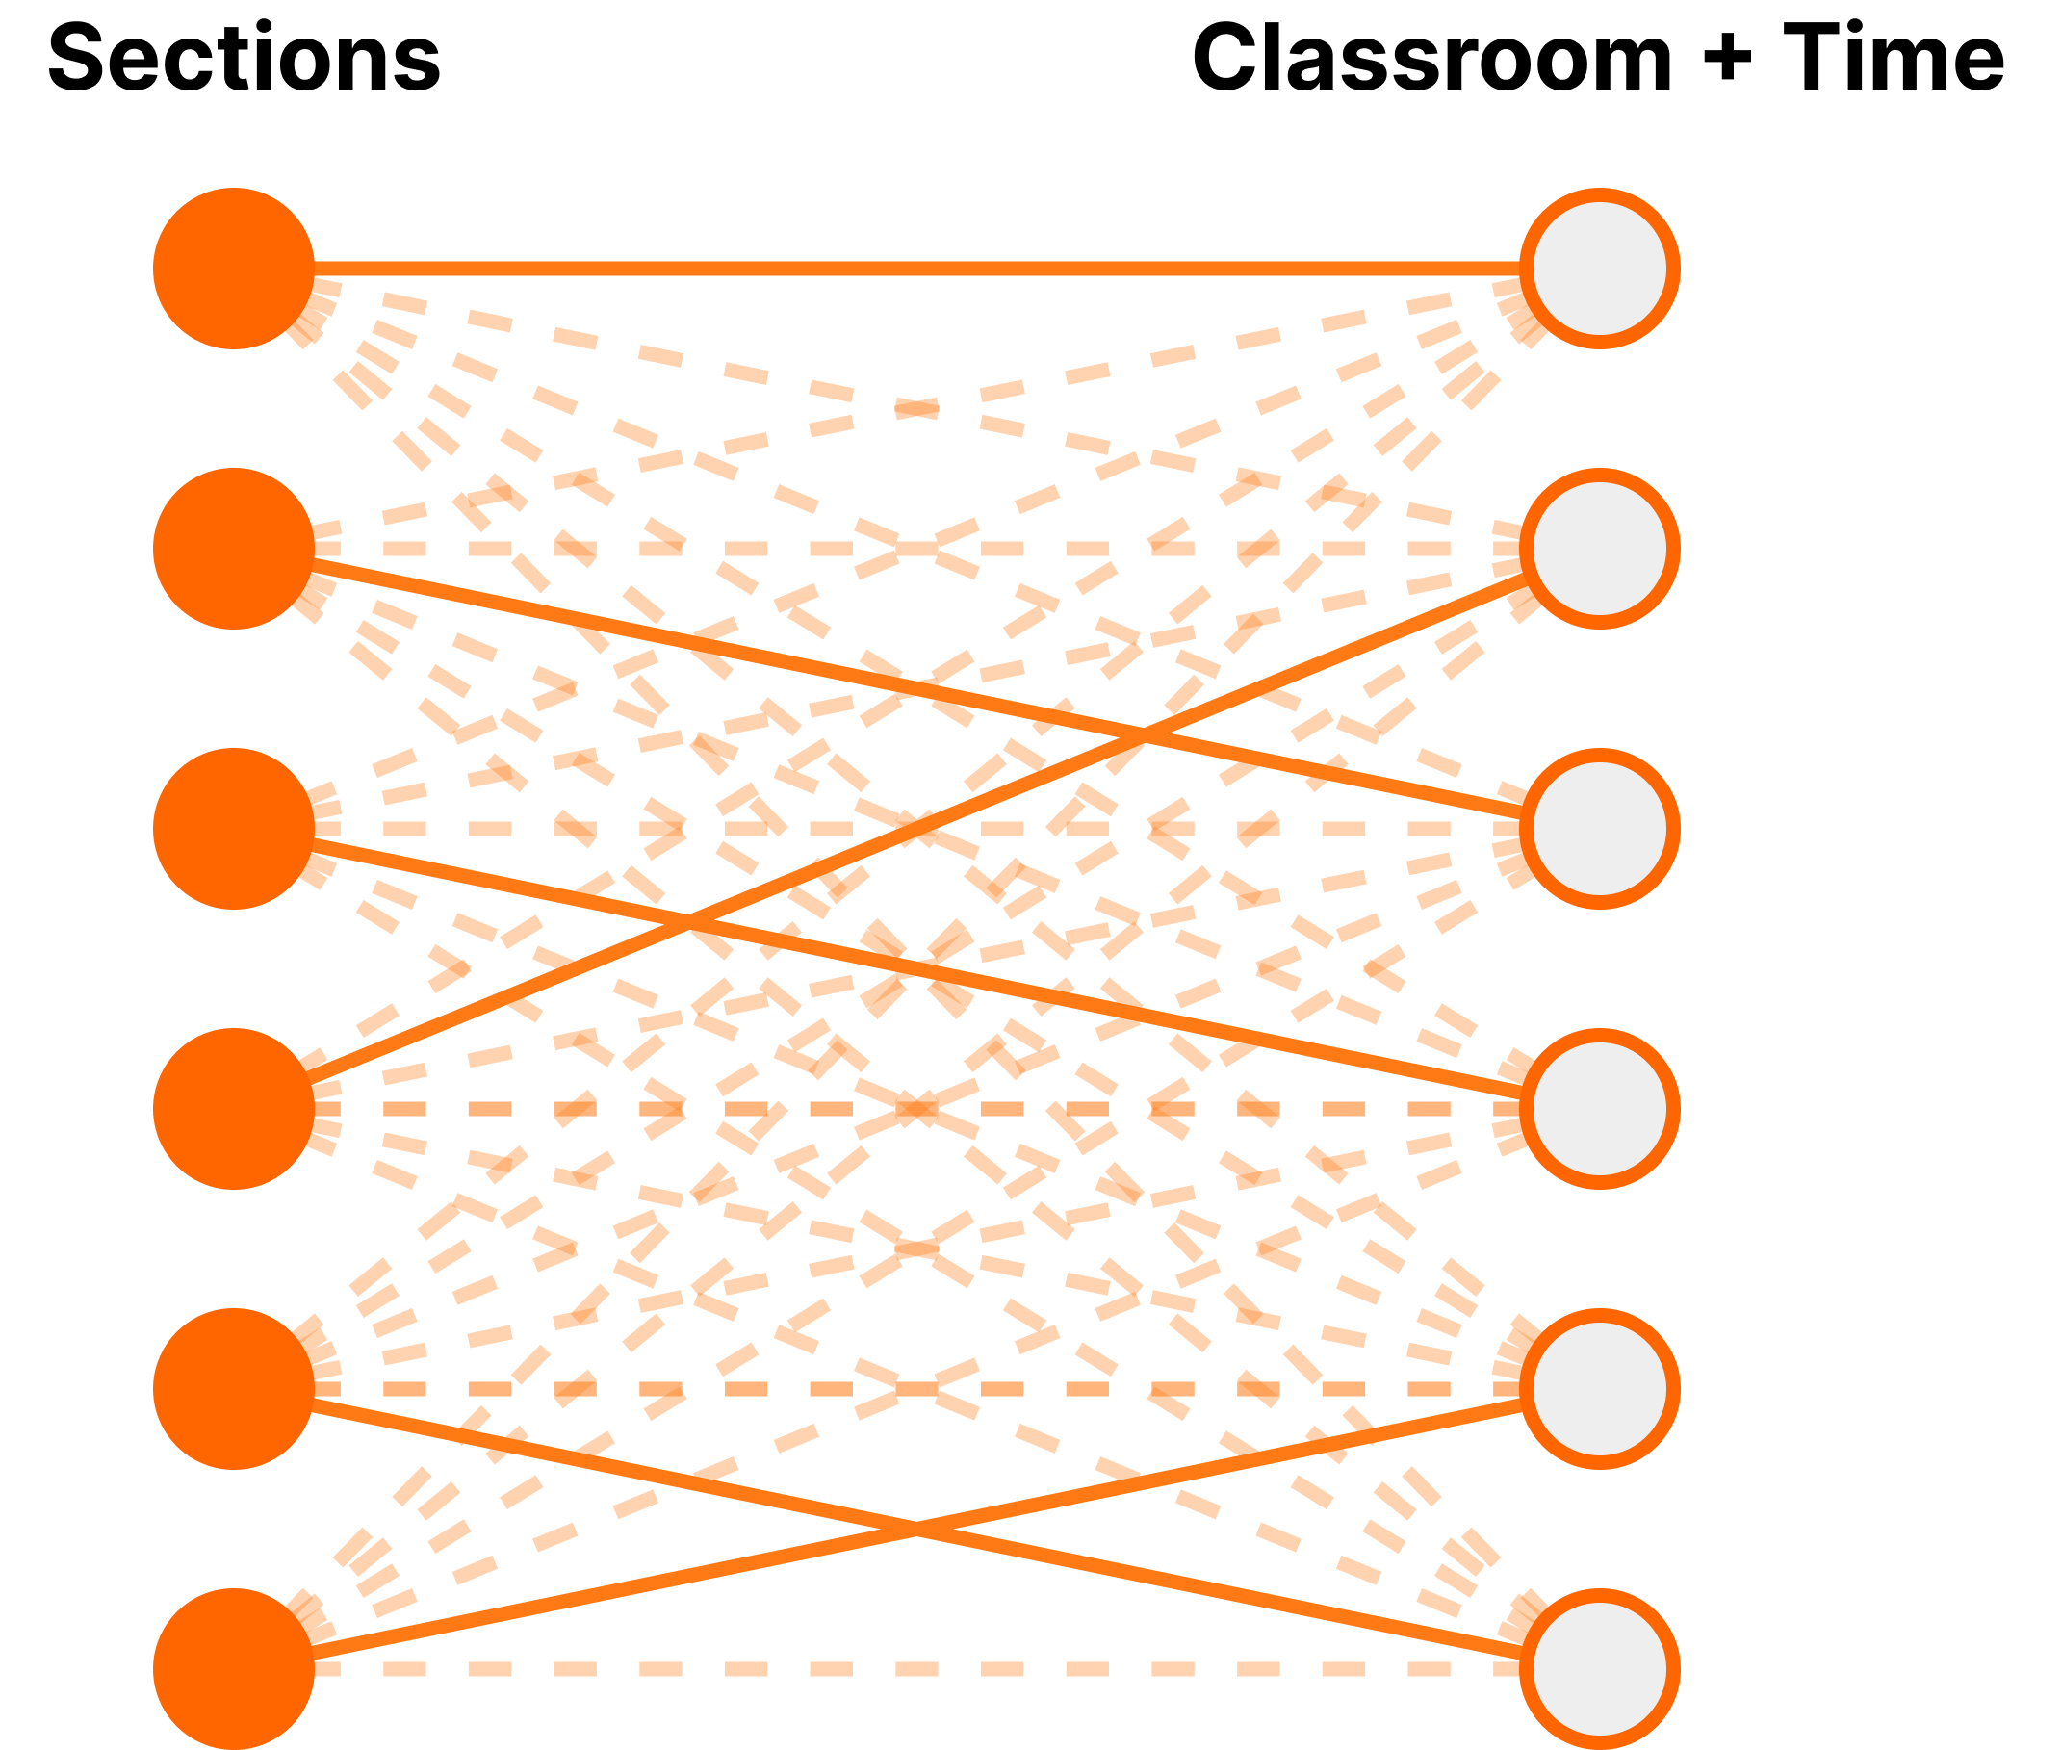
Class Scheduling
Using real data from UT, match class sections to a room and time slot.
Edge Criteria
  Room must have enough seats to fit the section.
  Time slot must have enough minutes per week to fit section.
Limitations

Slide 30
Implementation

Slide 31
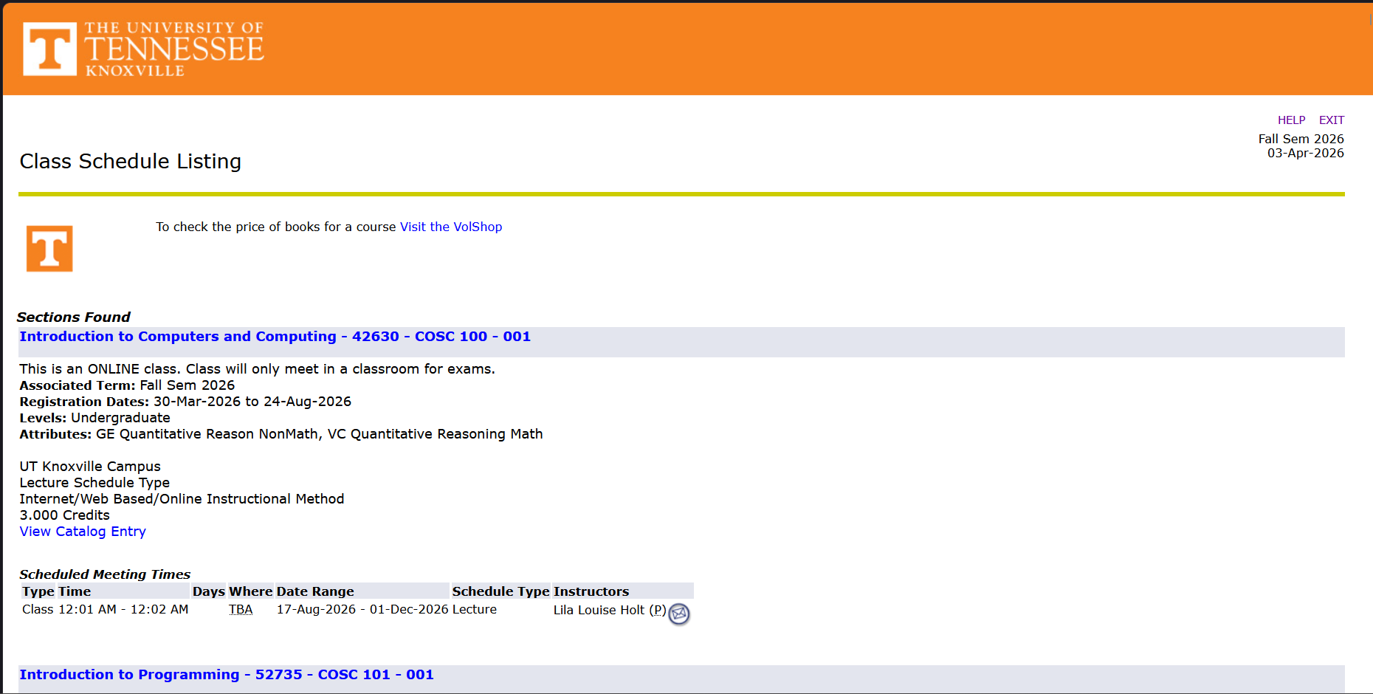

Slide 32
Coding Work
Majority of the coding work was focused on data retrieval.
  Data was fetched from UTK's public timetable for three semesters: Spring 2025, Fall 2025, and Spring 2026 (this semester).
  Non-applicable sections and non-classroom locations were removed.
  Edges were created using the previously-specified criteria.
Gurobi was used for building and running the graphs
  LP-based approach
id | location | time_start | time_end | days | max_capacity | minutes_met
1 | Academic Resource Building 107 | 10:30 AM | 12:25 PM | R | 20 | 115

Slide 33
Spring 2025
Percent Matched
100%
3,992 Sections (pre-filtering)
3,543 Matchable Sections
~5M Edges

Slide 34
Fall 2025
Percent Matched
100%
4,346 Sections (pre-filtering)
3,919 Matchable Sections
~6M Edges

Slide 35
Spring 2026
Percent Matched
100%
4,094 Sections (pre-filtering)
3,627 Matchable Sections
~5.2M Edges

Slide 36
Excerpt from Fall 2026 Matching
 |  | Course Name | Matched Location
COSC | 102 | Introduction to Computer Science | Ag & Natural Resource Building 129
COSC | 401 | Senior Design Theory | Biosystems Engineering and Env 276
COSC | 420 | Biologically-Inspired Computation | Zeanah Engineering Complex 123
COSC | 422 | Tools for Applied Machine Learning | James A Haslam II Business Bld 301
COSC | 424 | Introduction to Deep Learning | Min Kao Engineering 404
COSC | 426 | Introduction to Data Engineering | Min Kao Engineering 405
COSC | 429 | Adv LLMs: Reason, Agents & Int | Jessie Harris Building 104
COSC | 434 | Network Security | John D. Tickle Engineering 405
COSC | 466 | Software Security | Stokely Management Center G4
COSC | 472 | Numerical Algebra | Zeanah Engineering Complex 177
COSC | 494 | Adv. Algorithm & Programming | Austin Peay Building 203
COSC | 494 | Robot Learning | Perkins Hall 319
COSC | 540 | Advanced Software Engineering | Min Kao Engineering 622
COSC | 581 | Algorithms | Min Kao Engineering 622
COSC | 594 | Graph Theory | Bailey Education Complex 238

Slide 37
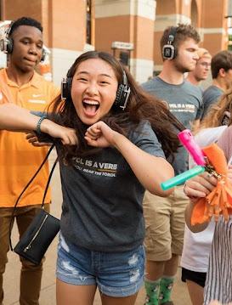
Open Issues / Future Work
Is Hopcroft-Karp's O(√V * E) the best possible, or is there room to improve?
Extending weighted matching: Optimizing for preferences and priorities rather than just maximizing matches
Matrix multiplication: Many algorithms use matrix multiplication. Improvements in these fields could change how these algorithms function.
Dynamic matching: Can we efficiently update a matching as the graph changes in real time?
Applying near-linear time algorithms like Chen et al. (2022) to large-scale real-world problems

Slide 38
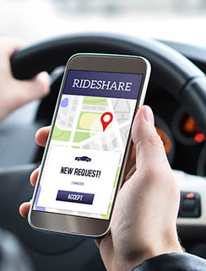
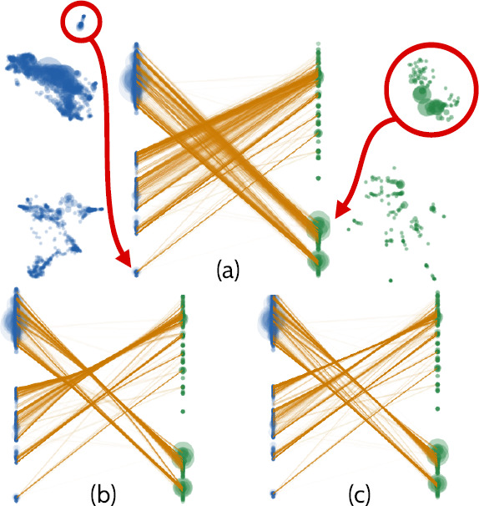

Open Issues / Future Work (cont.)
Large-scale graphing and real-world applications w/ streaming edges
Algorithmic synergy w/ massively parallel processing (e.g. MapReduce, Spark)
Fairness in general applications

Slide 39
References
Images
By Koko90 - Own work Originally uploaded by overwriting File:Biclique K 3 5.svg., CC BY-SA 3.0, https://commons.wikimedia.org/w/index.php?curid=114557662
By Xav65 - Own work, CC BY-SA 4.0, https://commons.wikimedia.org/w/index.php?curid=106981136
By Watchduck - Own work, CC BY-SA 4.0, https://commons.wikimedia.org/w/index.php?curid=121779105
Figure 26.1a (pp. 710) from Introduction to Algorithms, Third Edition (2009) by Cormen et al.
Figure 26.8 (pp.733) from Introduction to Algorithms, Third Edition (2009) by Cormen et al.
Articles
Bury, Marc, Elena Grigorescu, Andrew McGregor, Morteza Monemizadeh, Chris Schwiegelshohn, Sofya Vorotnikova, and Samson Zhou. "Structural results on matching estimation with applications to streaming." Algorithmica 81, no. 1 (2019): 367-392.
Chen, Li, Rasmus Kyng, Yang P. Liu, Richard Peng, Maximilian Probst Gutenberg, and Sushant Sachdeva. "Maximum flow and minimum-cost flow in almost-linear time." arXiv preprint arXiv:2203.00671 (2022).
Castera, Rémi, Felipe Garrido-Lucero, Patrick Loiseau, Simon Mauras, Mathieu Molina, and Vianney Perchet. "The Price of Opportunity Fairness in Matroid Allocation Problems." arXiv preprint arXiv:2403.00397 (2024).
Chuzhoy, Julia, and Sanjeev Khanna. "A faster combinatorial algorithm for maximum bipartite matching." In Proceedings of the 2024 Annual ACM-SIAM Symposium on Discrete Algorithms (SODA), pp. 2185-2235. Society for Industrial and Applied Mathematics, 2024.
Petersen, Julius. "Die Theorie der regulären graphs." Acta Mathematica, vol. 15 (1891): 193–220. https://doi.org/10.1007/BF02392606

Slide 40
Discussion & Q&A

Slide 41
Test Questions
What is one application of maximum bipartite matching?
What is the complexity of Hopcroft-Karp's Algorithm?
How many of the class sections were we able to match successfully?

