Slide 1
Line Drawing Algorithms in Computer Graphics
By Alli Brophy, Matt Brunet, and Tanishq Somani

Slide 2

Quiz Questions
1. What does rastrum mean?
2. What is the time complexity of DDA?
3. What is anti-aliasing?
Notes:
• Test Questions Slide: provide three questions relevant to your subject1
o short answers should suffice
o somewhere during your talk provide the answers, but do not emphasize them
1Provide your listeners with hardcopy answer sheets before you begin or, if you prefer, a way to accept their answers online.

Slide 3

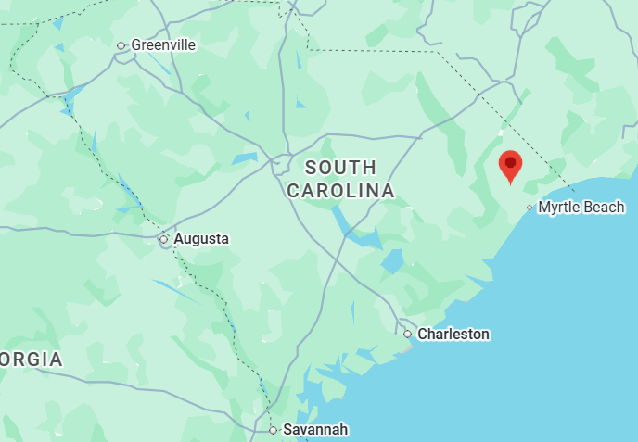
Matt Brunet
First year PhD over at ISE
I work with quantum variational algorithms for optimization
Recursive quantum algorithms for graph problems
4 siblings, second youngest
Conway, SC

Slide 4




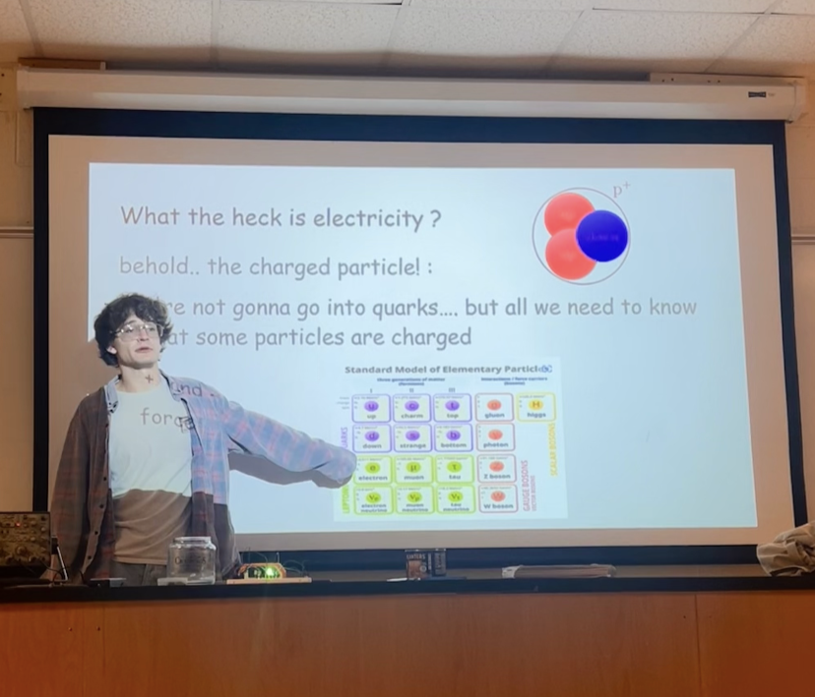
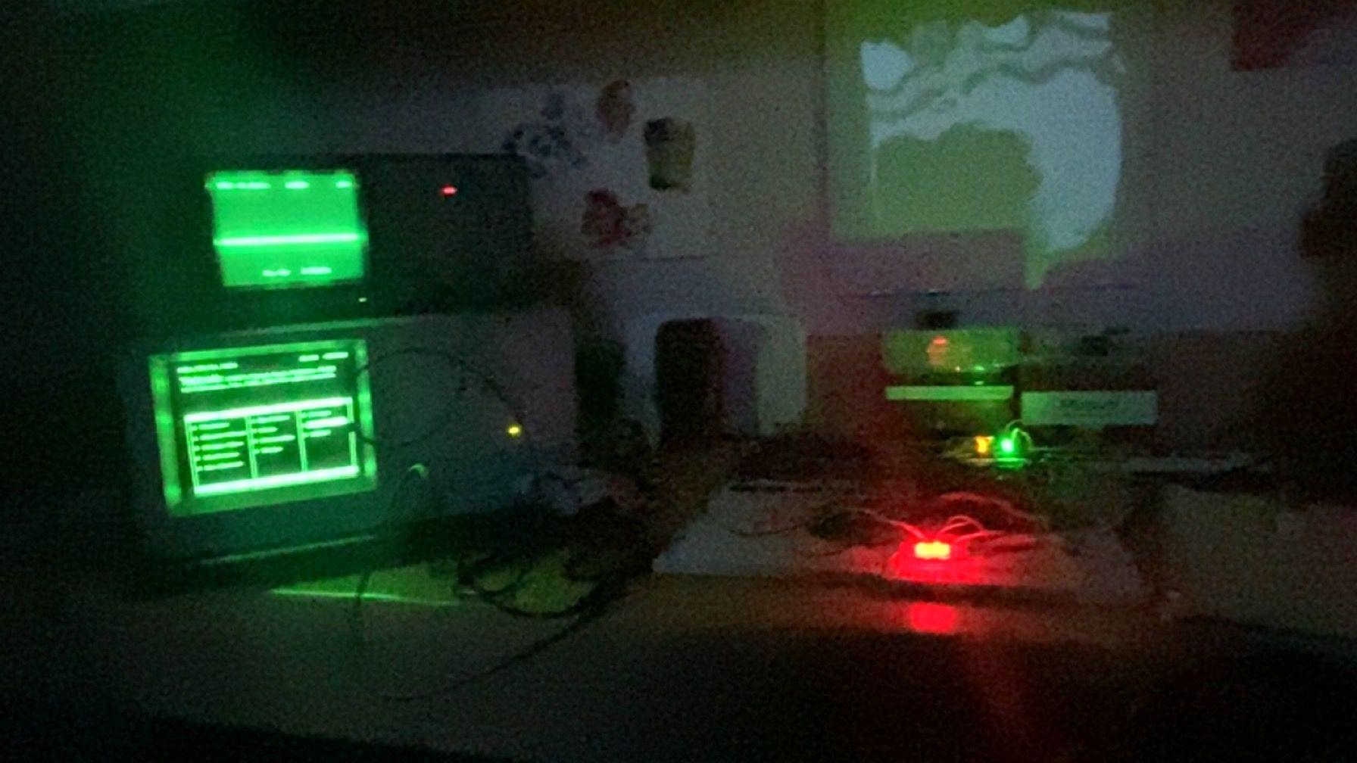
Matt Brunet
I like listening to good music and making bad music
is music bad now?
Art history, British Lit.
But of course, I am a scientist at heart

Slide 5

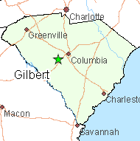
Alli Brophy
First year PhD student in the Mathematics Department
Applied and Computational Mathematics
Interested in numerical PDEs and scientific computing
From Gilbert, SC

Slide 6


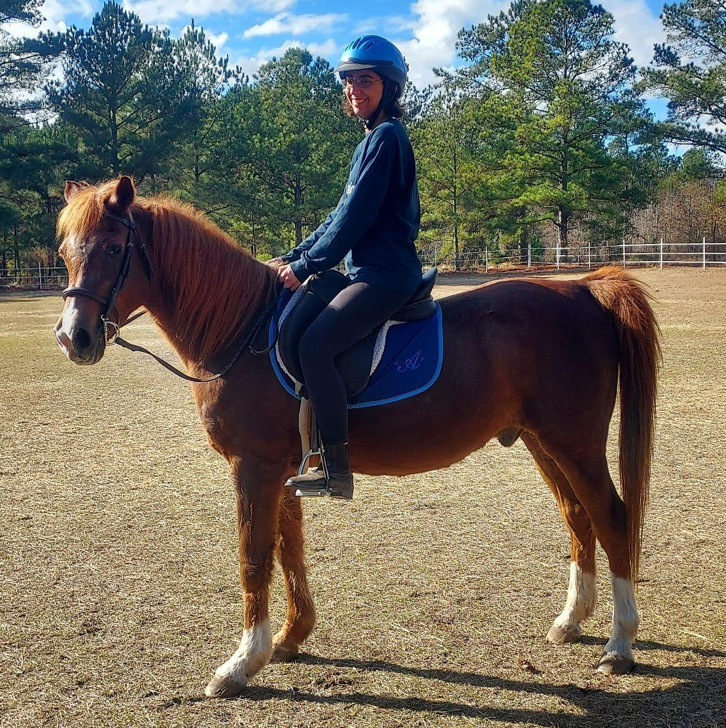

Alli Brophy
I spent 8 weeks at a university in in Mexico one summer
I love horseback riding
I hate cheese

Slide 7

Tanishq Somani
M.S in Computer Science
GA for OIT
Undergraduate in Microbiology
Interested in combining life sciences with software
From Knoxville

Slide 8

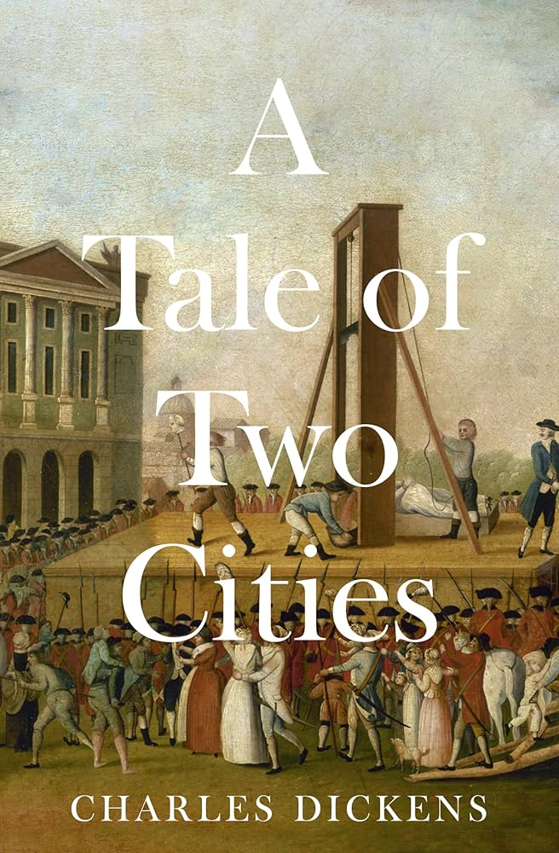

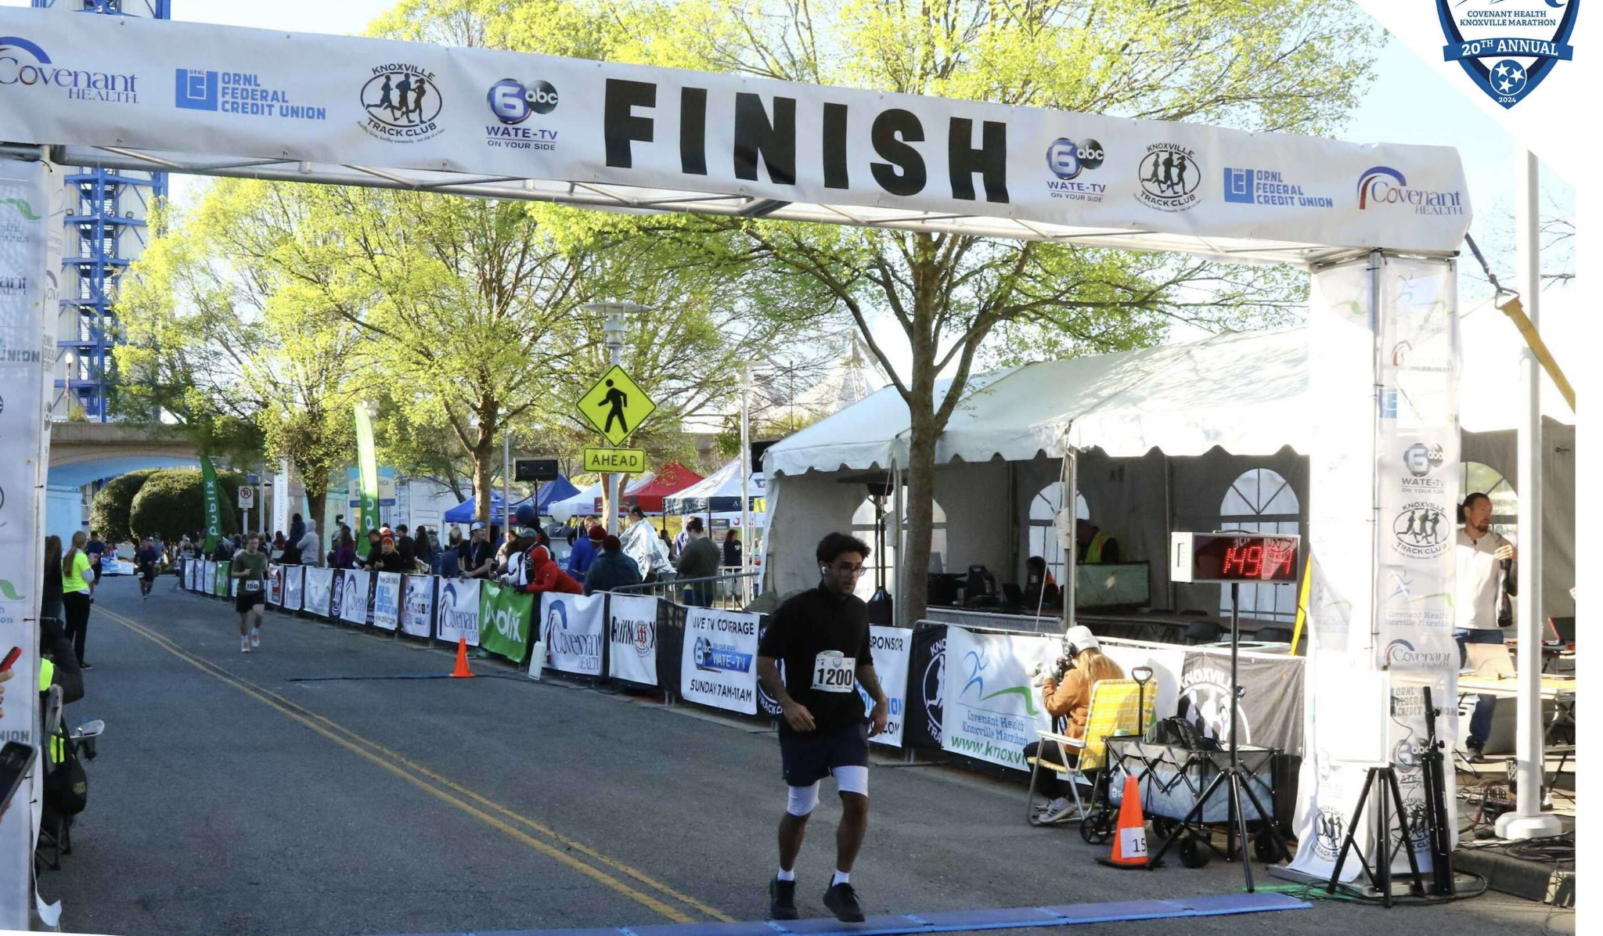


Tanishq Somani
I love to read
I like running
I have a dog
I love Coke Zero

Slide 9
01
Definitions
Notes:
Overview Slide: list important definitions and provide a brief mention of applications

Slide 10
Definitions
Aliasing Effect - visual distortions that occur when representing a continuous signal or function
i.e. jagged edges of smooth lines
Rasterization - converting vector graphics (shapes) into raster images (series of pixels, dots, or lines)
Notes:
Overview Slide: list important definitions and provide a brief mention of application

Slide 11
02
History
Notes:
History Slide: discuss originators, contributors, cool stories, and main developments³
³A few pictures may be helpful.

Slide 12
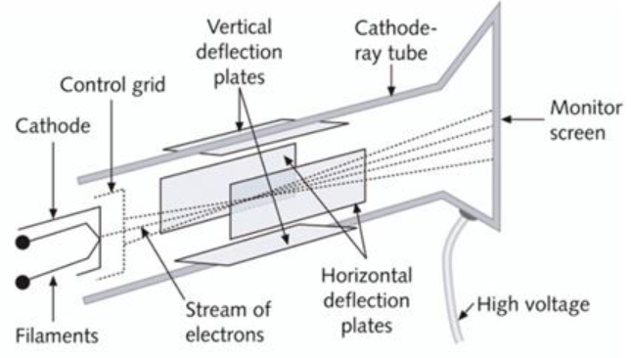
Ye Olde Vector Graphics
CRT Displays had no “pixels”
They instead used a continuous electron beam with parametric control signals as a guide
p = ( Vx, Vy )
Used initially in oscilloscope displays for waveform analysis and analogue circuit design

Slide 13
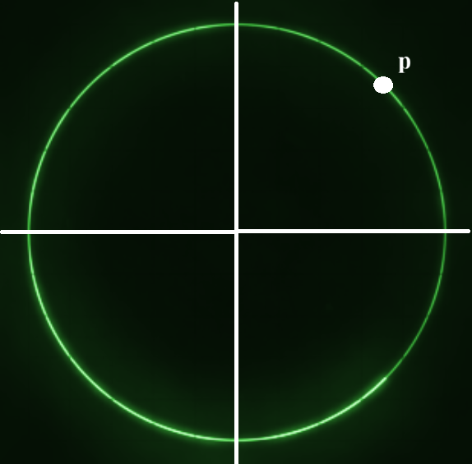
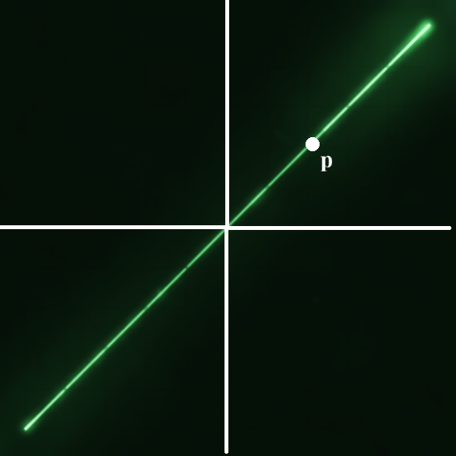
Ye Olde Vector Graphics
0 ≤ t ≤ 2𝛑
p(t) = (x(t), y(t)) s.t. x(t) = cos(t), y = sin(t)
p(t) = (x(t), y(t)) s.t. x(t) = y(t) = sin(t)

Slide 14

Behold! The Raster!
Rastrum : to rake
Raster: A digital image made of
tiny colored squares
The picture element (pixel)

Slide 15
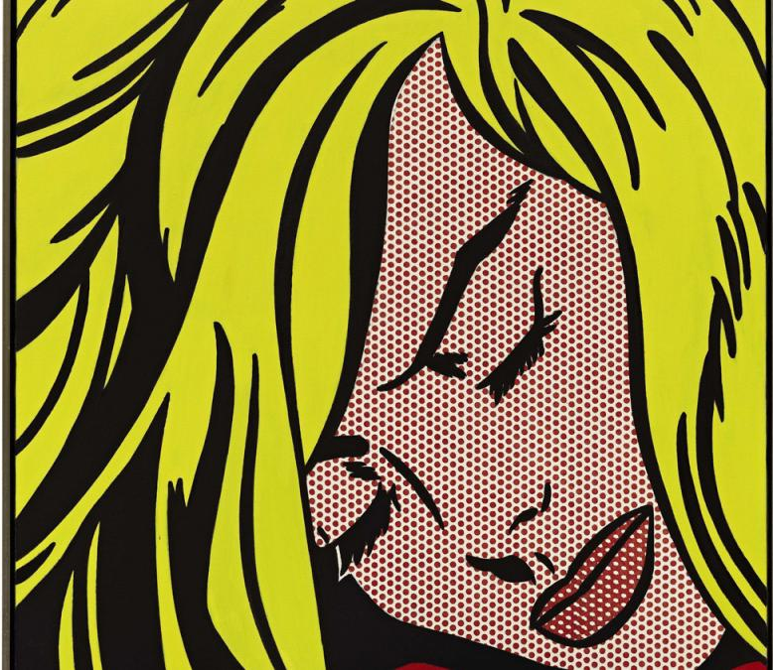
Behold! The Raster!
Sleeping Girl, Lichtenstein, 1964
CRT Store, Manchester Baby, 1967

Slide 16
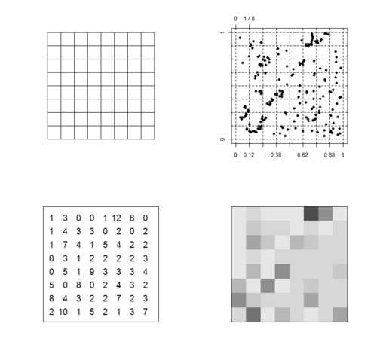
Behold! The Raster!
A tesselation of a plane, often stored as a 2D array

Slide 17
Digital Differential Analyzer (DDA) Algorithm
The name “Digital Differential Analyzer” comes from physical machines built in the 1940s-1950s. These machines were used to solve mathematical problems for tasks such as aiming weapons and navigation.
In the 1960s, screens switched from drawing lines directly (like an Etch a Sketch) to using grids of pixels (like modern monitors). The DDA concept was turned into a software algorithm to figure out which pixels needed to light up to make a line look straight.
DDA is one of the first and simplest line drawing algorithms ever created.

Slide 18
Key Timeline
Time Period | Development
1940s-1950s | Physical DDA machines built to solve math problems for military use.
1960s | DDA adapted into a software algorithm for drawing lines on pixel screens
1965 | Bresenham publishes a faster, integer-only alternative
1991 | Wu introduces a smoother anti-aliased line algorithm

Slide 19
03
Algorithms
Notes:
Algorithms Slides: describe basic procedures and methodological comparisons
this should be the main part of your talk
discuss techniques from the most basic to the state-of-the-art
use examples and figures whenever possible

Slide 20
DDA Line Algorithm
Concept originates from 1940s-1950s machines
Simple incremental line-drawing algorithm
rounds each point to the nearest pixel (no anti-aliasing)
Algorithm steps:
Compute dx and dy from endpoints
Set steps = max(|dx|, |dy|)
Calculate x_inc and y_inc
Iterate: add increments, round, and plot each pixel
Time complexity: O(n)

Slide 21
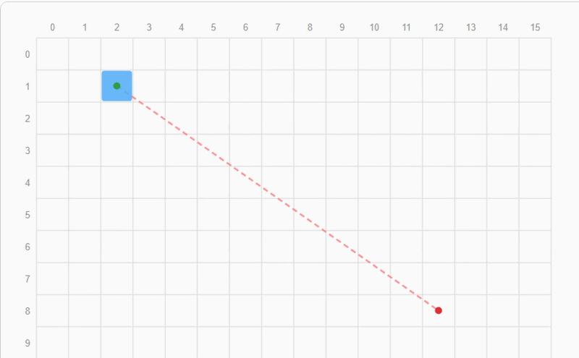
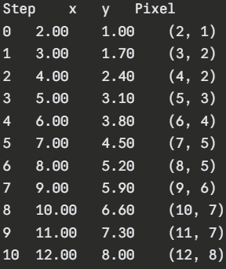
DDA Line Algorithm example
Draw a line from (2,1) to (12,8):
dx = 12 - 2 = 10
dy = 8 - 1 = 7
steps = max(10, 7) = 10
x_inc = 10/10 = 1.000
y_inc = 7/10 = 0.700

Slide 22
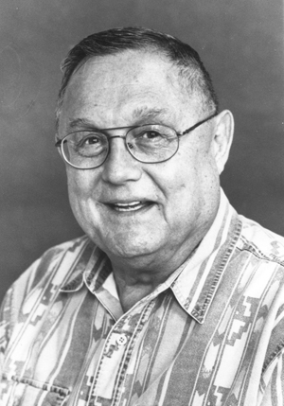
Bresenham’s Line Drawing Algorithm
Jack Elton Bresenham, over at IBM in 1962
Modification of the DDA to correct error and for integer computation
This guy actually taught at my undergraduate school for like 16 years

Slide 23
Bresenham’s Line Drawing Algorithm
Consider drawing a line on a raster grid limited in slope by 0 ≤ m ≤ 1, in the first octant
Start at some (x₀ y₀), and end at some (x₁ y₁ )
If we are always incrementing x as we plot, there’s only ever really two choices of step placement: (x+1, y) or (x+1, y+1)
A simple DDA would just calculate dy/dx, add, then round

Slide 24
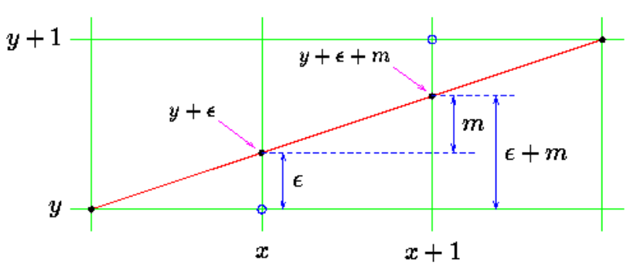
Bresenham’s Line Drawing Algorithm

Slide 25
Bresenham’s Line Drawing Algorithm
“Left justify” each pixel control, and introduce some 𝜺 = 0
For each step, the incoming actual line will be distance 𝜺 from the current y value of selected pixel
If 𝜺 + m is less than 0.5 then we select (x+1, y) and update 𝜺 = 𝜺 + m
Else, select (x + 1, y+1 ) and update 𝜺 = 𝜺 + m - 1

Slide 26
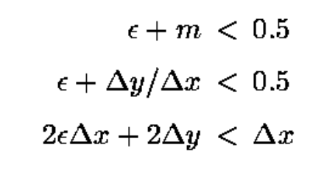
Bresenham’s Line Drawing Algorithm
- Consider multiplying through by 2𝞓x
Now all of these values are integral
D

Slide 27

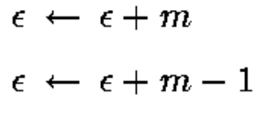
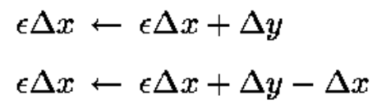
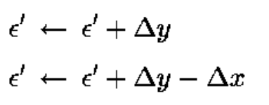
Bresenham’s Line Drawing Algorithm
Letting 𝜺 ‘ = 𝜺 *𝞓x, the new test is:
By multiplying our update rules through by 𝞓x:

Slide 28
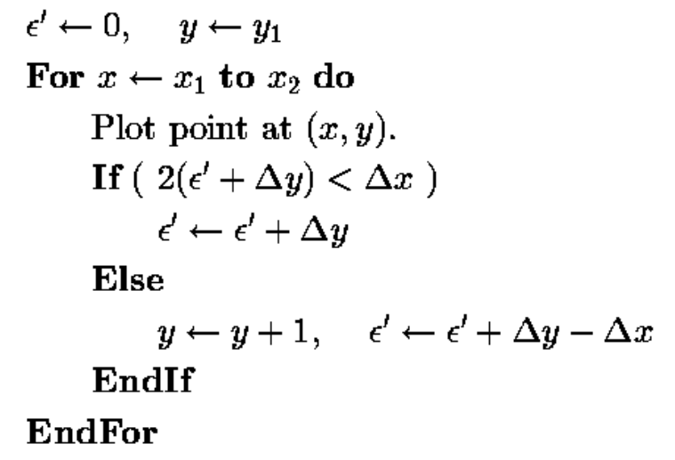
Bresenham’s Line Drawing Algorithm

Slide 29
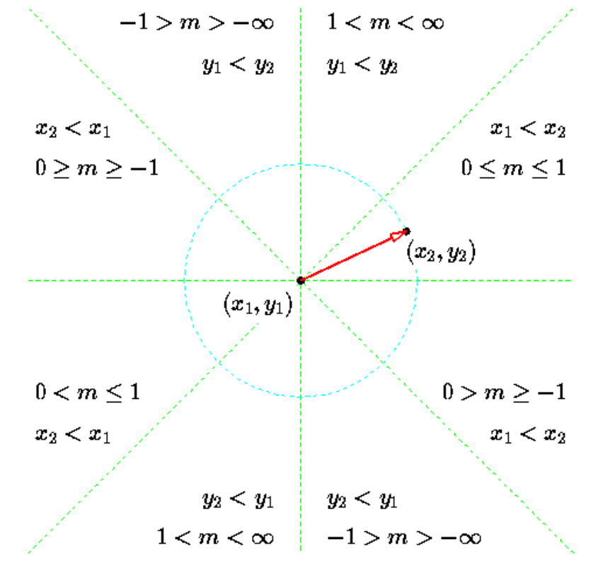
Bresenham’s Line Drawing Algorithm
Slight manipulation allows for changes in slope and octant placement, but nothing that wrecks the algorithm
Written in the firmware of almost every modern GPU

Slide 30

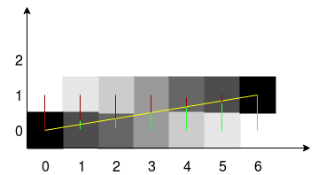
Xiaolin Wu’s Line Algorithm
Published in 1991
Still used today
Anti-aliasing line algorithm
Much smoother looking line
Adjacent pixel are shaded with varying intensity based on distance from the line’s equation
Notes:
Determine the major axis. The algorithm first decides whether the line is more horizontal or more vertical by comparing the absolute differences of the endpoints. The larger difference defines the major axis; the corresponding coordinate will be iterated over.
Compute the gradient. The slope of the line, usually denoted as , is calculated. This slope is then used to determine the increment in the minor axis for each step along the major axis.
Draw the endpoints. The two end points are plotted separately. For each endpoint, the algorithm computes a pixel at the nearest integer coordinate and shades it with an intensity equal to the fractional part of the minor coordinate. The opposite endpoint receives the complementary intensity.
Iterate along the major axis. Starting from the first endpoint, the algorithm steps through every integer coordinate of the major axis. For each step, it calculates the corresponding minor coordinate, takes its fractional part, and shades two adjacent pixels: one at the integer part of the minor coordinate and the other at the integer part plus one. The brightness values are determined by the fractional part and its complement.
Finish the line
When the algorithm reaches the last major‑axis coordinate, the line drawing is complete. The result is a smooth line whose visibility transitions gradually between pixels.

Slide 31

Xiaolin Wu’s Line Algorithm
Given two endpoints (x₀ , y₀) and (x₁, y₁), compute Δx and Δy
If the line is steep, |Δy | > |Δx|, swap x and y for both points
Compute the slope
Notes:
Determine the major axis. The algorithm first decides whether the line is more horizontal or more vertical by comparing the absolute differences of the endpoints. The larger difference defines the major axis; the corresponding coordinate will be iterated over.
Compute the gradient. The slope of the line, usually denoted as , is calculated. This slope is then used to determine the increment in the minor axis for each step along the major axis.
Draw the endpoints. The two end points are plotted separately. For each endpoint, the algorithm computes a pixel at the nearest integer coordinate and shades it with an intensity equal to the fractional part of the minor coordinate. The opposite endpoint receives the complementary intensity.
Iterate along the major axis. Starting from the first endpoint, the algorithm steps through every integer coordinate of the major axis. For each step, it calculates the corresponding minor coordinate, takes its fractional part, and shades two adjacent pixels: one at the integer part of the minor coordinate and the other at the integer part plus one. The brightness values are determined by the fractional part and its complement.
Finish the line
When the algorithm reaches the last major‑axis coordinate, the line drawing is complete. The result is a smooth line whose visibility transitions gradually between pixels.

Slide 32
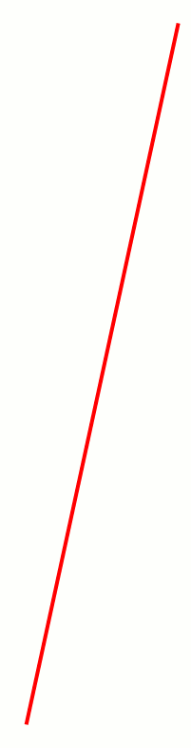
Xiaolin Wu’s Line Algorithm
5. Plot the end points
6. Initialize the “y-intercept”
7. Plot remainder of the line until the endpoint is reached
Plot 2 vertically adjacent pixels at each point:
(x, ⌊y_intercept⌋) with intensity 1 - frac(y_intercept)
(x, ⌊y_intercept⌋+1) with intensity frac(y_intercept)
Update y_intercept += slope
8. Reverse any swaps done in steps 2
Notes:
Determine the major axis. The algorithm first decides whether the line is more horizontal or more vertical by comparing the absolute differences of the endpoints. The larger difference defines the major axis; the corresponding coordinate will be iterated over.
Compute the gradient. The slope of the line, usually denoted as , is calculated. This slope is then used to determine the increment in the minor axis for each step along the major axis.
Draw the endpoints. The two end points are plotted separately. For each endpoint, the algorithm computes a pixel at the nearest integer coordinate and shades it with an intensity equal to the fractional part of the minor coordinate. The opposite endpoint receives the complementary intensity.
Iterate along the major axis. Starting from the first endpoint, the algorithm steps through every integer coordinate of the major axis. For each step, it calculates the corresponding minor coordinate, takes its fractional part, and shades two adjacent pixels: one at the integer part of the minor coordinate and the other at the integer part plus one. The brightness values are determined by the fractional part and its complement.
Finish the line
When the algorithm reaches the last major‑axis coordinate, the line drawing is complete. The result is a smooth line whose visibility transitions gradually between pixels.

Slide 33
Bresenham vs Xiaolin Wu
Wu’s algorithm is more computationally expensive
Bresenham’s algorithm is faster
Wu’s algorithm performs better visually
Bresenham - better for real-time rendering
Wu - better high quality rendering

Slide 34
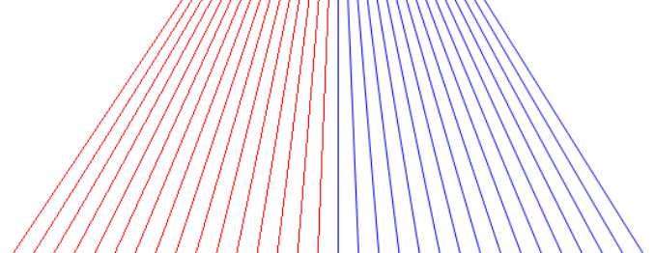
Bresenham vs Xiaolin Wu
Standard lines (red) generated with Bresenham's line algorithm vs anti-aliased lines (blue) generated with Xiaolin Wu's line algorithm

Slide 35
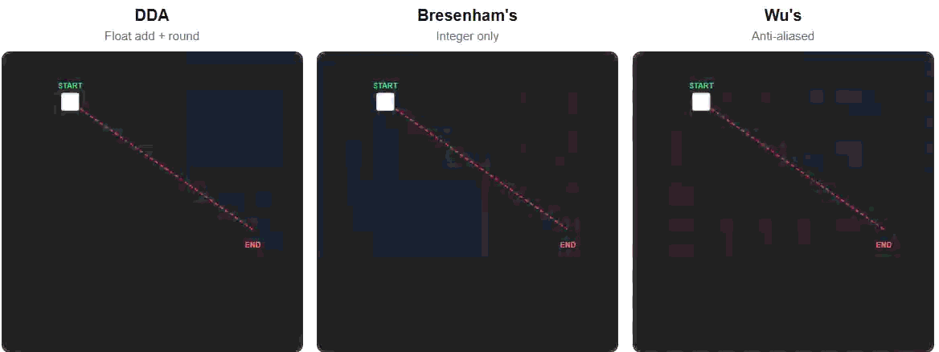
Comparison

Slide 36
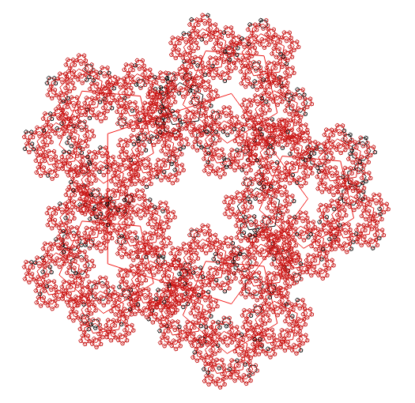
04
Applications
Notes:
Applications Slides: educate the class about amenable problems of interest to you
don’t get bogged down in minutiae
once again use examples and figures whenever possible

Slide 37
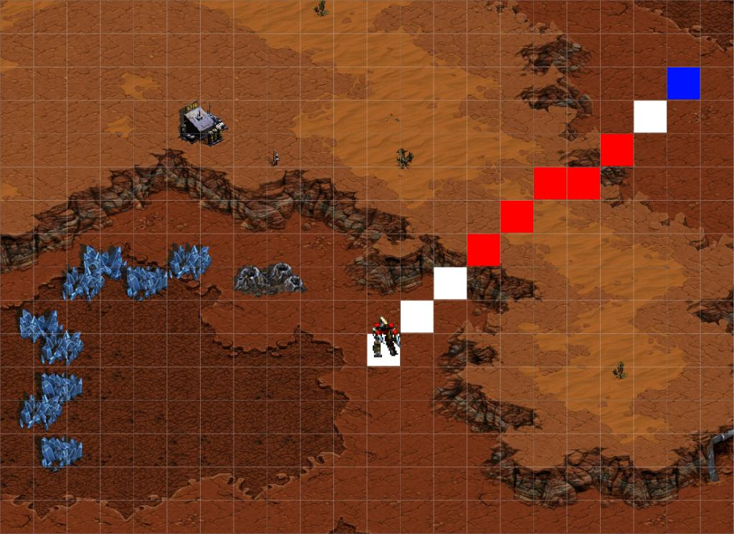
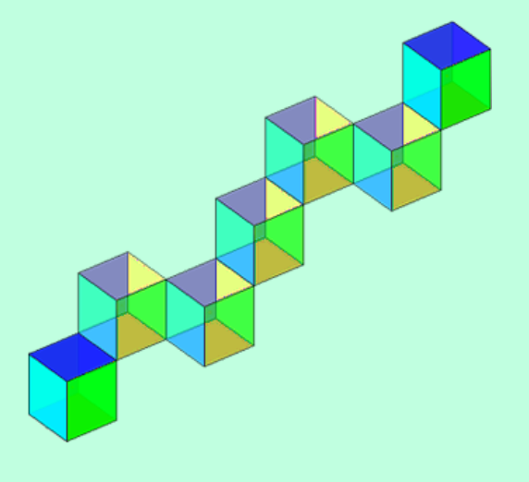
Bresenham’s Extensions
P&C - Determining where to move
Blocked or not?
3D Ray Tracing
Notes:
Current research focusses on increasing efficiency and accuracy
More detail on differentiable rasterization

Slide 38
05
Open Issues
Notes:
Open Issues Slide: enumerate and discuss a few open questions
look at recent research papers for ideas

Slide 39
Open Issues
Increasing efficiency and accuracy
Improving anti-aliasing algorithms
Extensions and modifications of Wu’s algorithm
Optimal rasterization for perceptual accuracy
Adapting line algorithms for parallel architectures
Large scale rasterization
Difficult due to inherent sequential nature of algorithms
Notes:
Current research focusses on increasing efficiency and accuracy
More detail on differentiable rasterization

Slide 40
References
Wu, Chenghao, et al. "Learning to Rasterize Differentiably." Computer Graphics Forum. Vol. 43. No. 4. 2024.
Wu, Xiaolin. "An efficient antialiasing technique." ACM SIGGRAPH Computer Graphics 25.4 (1991): 143-152.
Zhou, Chen, et al. "A parallel scheme for large‐scale polygon rasterization on CUDA‐enabled GPUs." Transactions in GIS 21.3 (2017): 608-631.
The Bresenham Line-Drawing Algorithm https://www.cs.helsinki.fi/group/goa/mallinnus/lines/bresenh.html
Foley, J.D., van Dam, A., Feiner, S.K., & Hughes, J.F. (1990). Computer Graphics: Principles and Practice (2nd ed.). Addison-Wesley.
Notes:
References Slide: provide a handful of key citations

Slide 41
Quiz Questions/ Discussion
What does rastrum mean?
What is the time complexity of DDA?
What is anti-aliasing?
Notes:
• Test Questions Slide: provide three questions relevant to your subject1
o short answers should suffice
o somewhere during your talk provide the answers, but do not emphasize them
1Provide your listeners with hardcopy answer sheets before you begin or, if you prefer, a way to accept their answers online.

