Slide 1

Coding Techniques for LLM Tokenization
Presented By
Rishi
Patel
Phouvadeth Vathana
Joseph Bronyah
Notes:
Welcome everyone. Our presentation today is on "Coding Techniques for LLM Tokenization." We will be diving into the classical compression algorithms that laid the groundwork and the modern sub-word tokenization methods essential for Large Language Models. I'm Joseph Bronyah, and I'm presenting this alongside Rishi Patel and Alex Vathana.

Slide 2


Test Questions
1
Who is considered the Father of the Bit and established the field of Information Theory?
2
Which algorithm starts with a large seed vocabulary and iteratively removes tokens to optimize likelihood?
3
Which classical algorithm provides the best compression ratio but requires significant memory overhead?
Notes:
We will start with a quick set of test questions that we will answer by the end of the presentation. They cover the key figures and core concepts: a sub-word algorithm that uses pruning (Unigram), the "Father of the Bit" (Claude Shannon), and the classical algorithm with the best compression ratio but highest memory use (LZW).

Slide 3
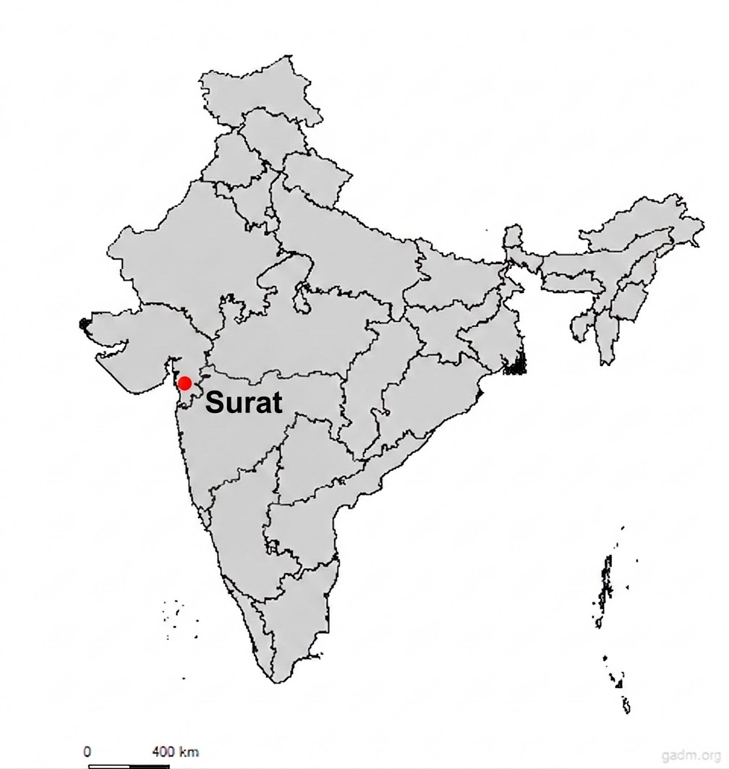





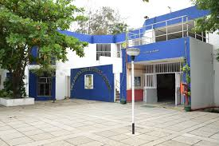



Rishi Patel - Education and Hometown
BS in Computer Science and Minor in Math
Aditya Birla Public School
Mount Juliet Christian Academy
MS in Computer Science in Data Analytics; Advisor: Dr. Berry)
Kindergarten to 10th grade
Junior and Senior Year
Notes:
(Rishi to present) Hi, my name is Rishi Patel. I completed my BS in Computer Science and a Minor in Math. I attended Mount Juliet Christian Academy for my junior and senior year, following my time at Aditya Birla Public School from Kindergarten to 10th grade. I am currently pursuing my MS in Computer Science with a concentration in Data Analytics, advised by Dr. Berry.

Slide 4
Rishi Patel - Work Exp.
Goal: Gain experience in a quant-based company
Current Work:
Previous Expereince:
Technical Interests:
Software Security Engineer @
Securely Yours
Full Stack Developer Intern @ Sports.Exe
M.S. in CS at UT Knoxville
Data Analyst @ Synergy Evaluation Institute
GTA for COSC 429
Part-time role at SDS
Cybersecurity
Data Analytics
Quant / Trading
Technical Interests:
Cybersecurity
Data Analytics
Goal: Interested in gaining experience in a quant-based company
Notes:
(Rishi to present) Currently, I'm a Data Analyst at Synergy Evaluation Institute, a GTA for COSC 429, and have a part-time role at SDS. Previously, I was a Software Security Engineer at Securely Yours and a Full Stack Developer Intern at Sports.Exe. My goal is to gain experience in a quant-based company, leveraging my technical interests in Cybersecurity and Data Analytics.

Slide 5




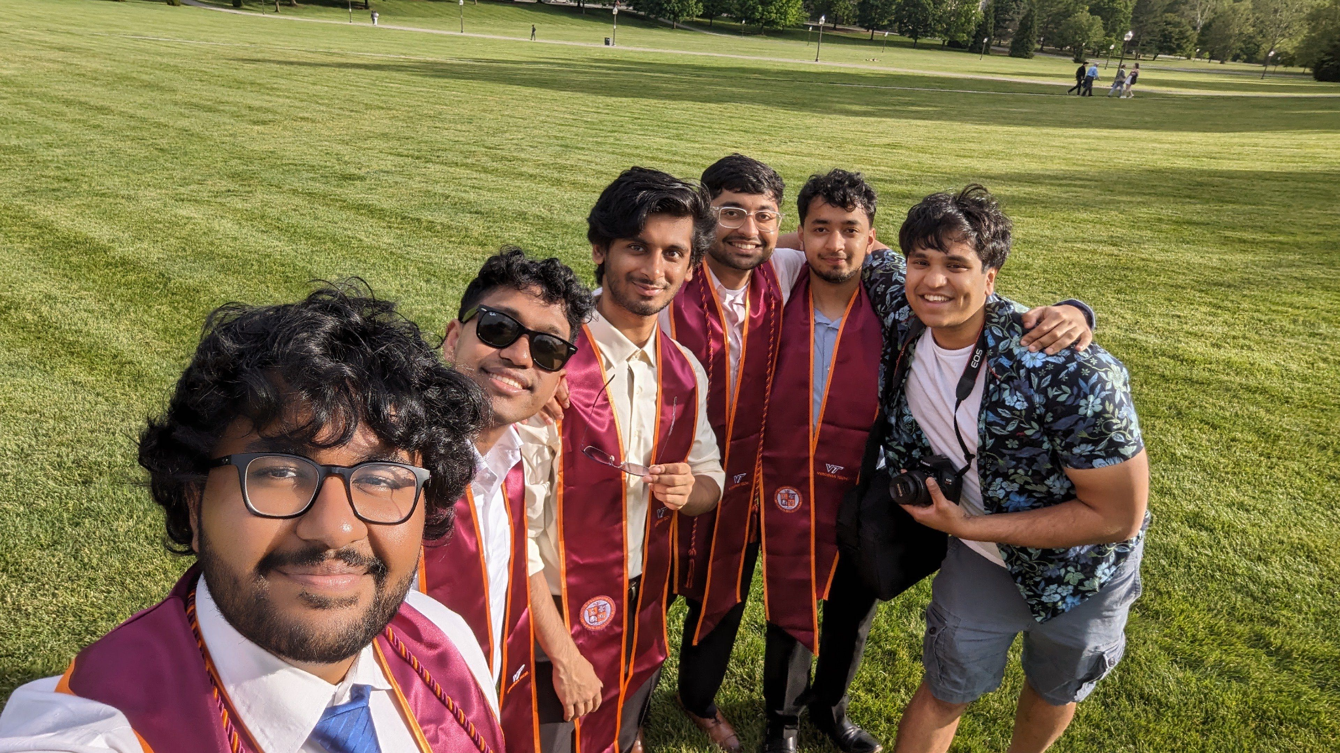
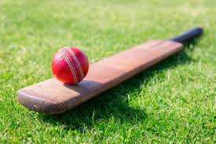
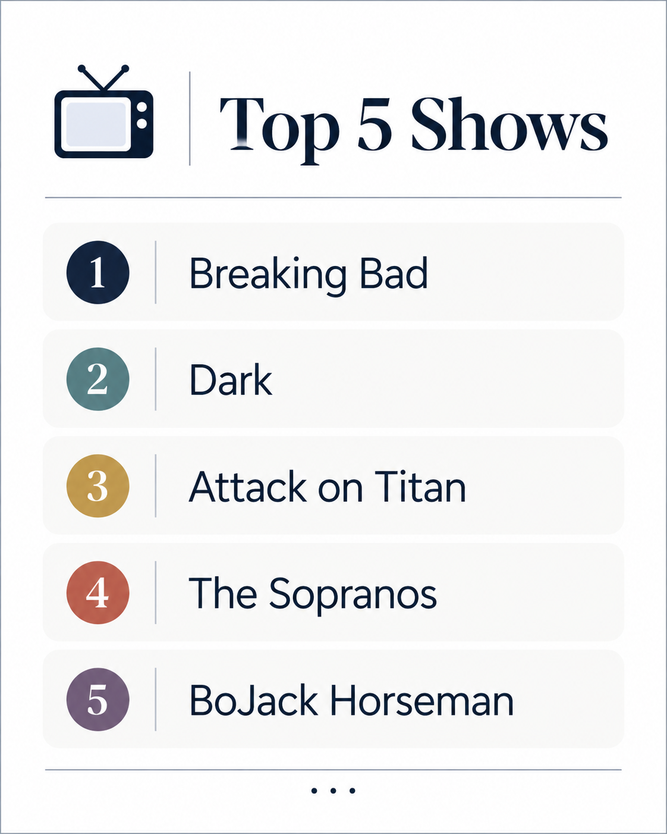
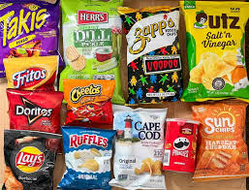


Rishi Patel - Hobbies
Notes:
(Rishi to present) Outside of academics, I enjoy... (Rishi should list some hobbies).

Slide 6
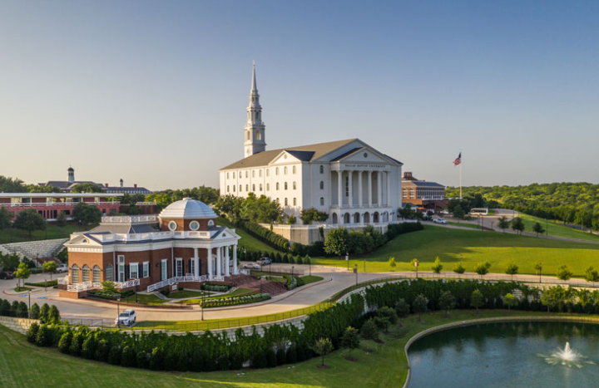

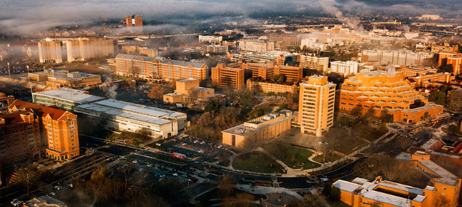
Phouvadeth Vathana - Education
BS in Computer Science at Dallas Baptist University
- Interned as an embedded system researcher
MS in Computer Science at University of Tennesee
- Advised by Dr. Nasir Eisty
- GPU programming
Notes:
(Alex/Phouvadeth to present) Next, Alex Vathana will introduce himself. I earned my BS in Computer Science from Dallas Baptist University, where I also interned in embedded systems. I am currently pursuing my MS in Computer Science here at the University of Tennessee, advised by Dr. Nasir Eisty, with a focus on GPU programming.

Slide 7



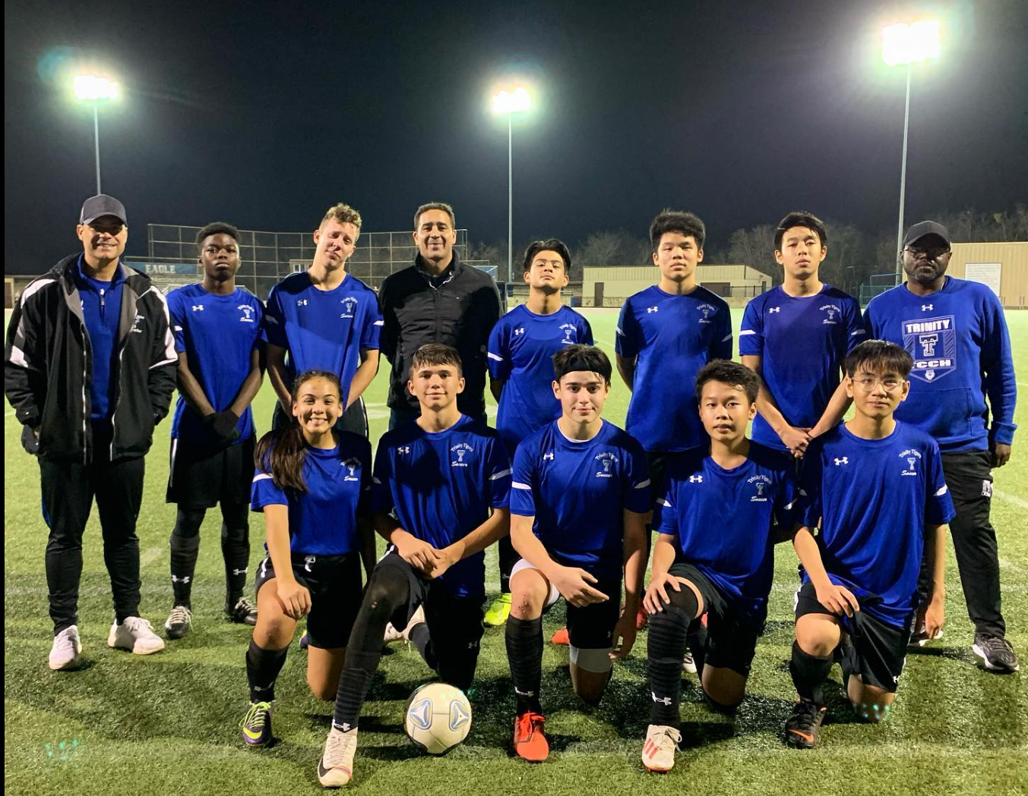
Background
Notes:
(Alex/Phouvadeth to present) (Alex will talk about his background.)

Slide 8
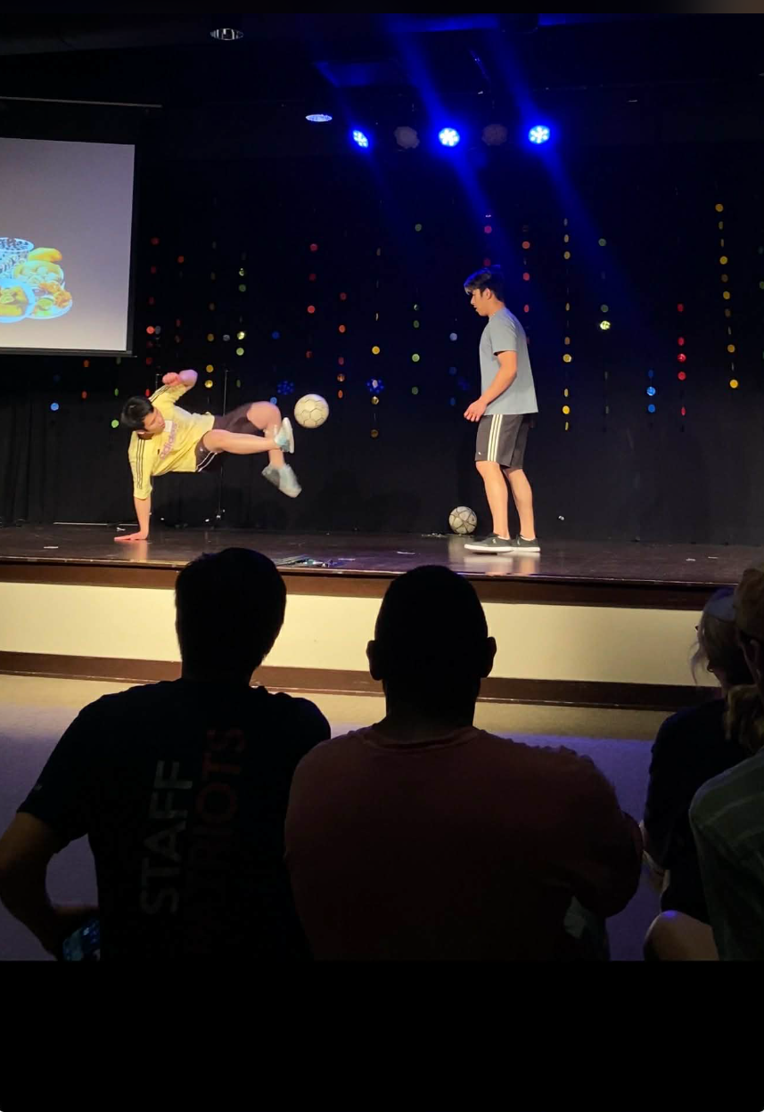
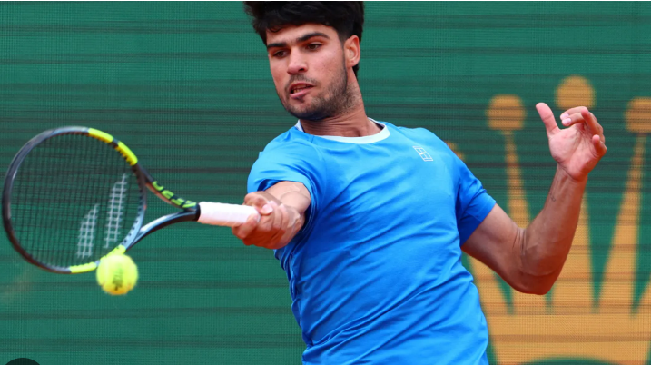







Hobbies
Notes:
(Alex/Phouvadeth to present) For my hobbies, I enjoy...

Slide 9

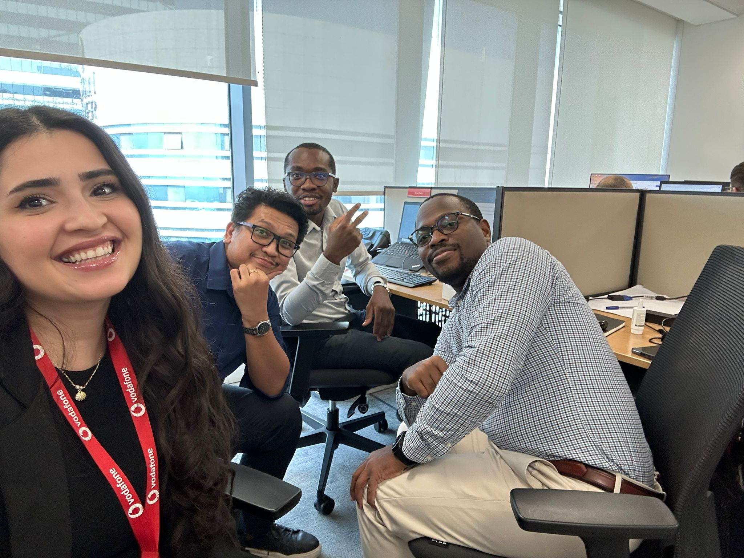

Joseph Bronyah
Background
Born and raised in Ghana. A West African country known for gold, cocoa and good music!!
Education
B.Sc. Electrical/Electronics Engineering, KNUST.
Professional Experience
Telecommunications sector in Ghana & Qatar.
Worked at Huawei, Vodafone Ghana, & Vodafone Qatar.
Current Pursuit
M.S. in Computer Science at University of Tennessee, Knoxville.
Advisor:
Dr. Nasir Eisty
Notes:
I was born and raised in Ghana, a country known for its gold, cocoa, and music. I hold a B.Sc. in Electrical/Electronics Engineering from KNUST. I have professional experience in the telecommunications sector in both Ghana and Qatar, working at companies like Huawei and Vodafone. I am currently pursuing my M.S. in Computer Science at the University of Tennessee, Knoxville, and my advisor is Dr. Nasir Eisty

Slide 10
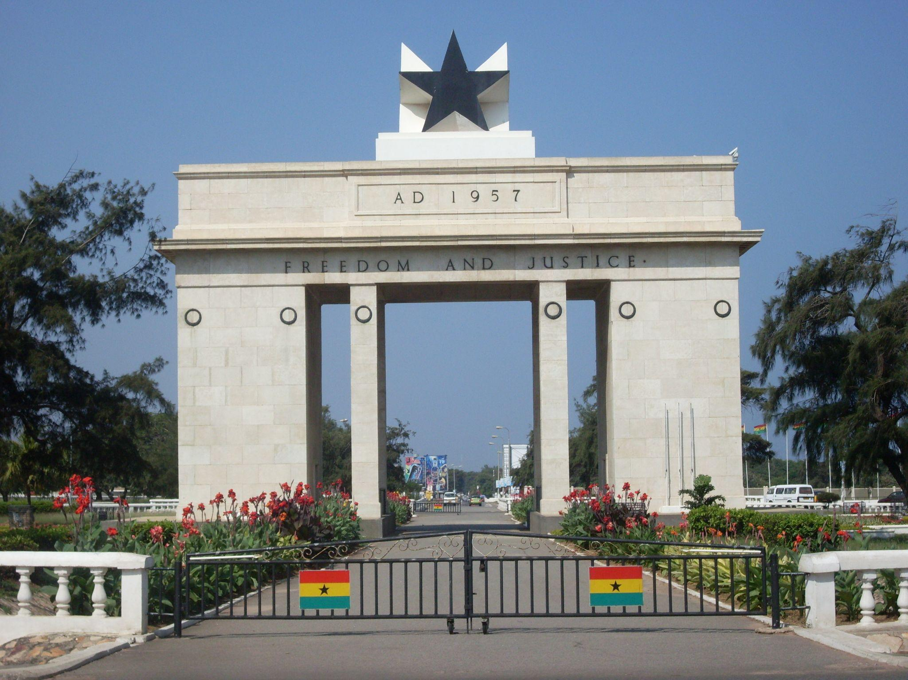




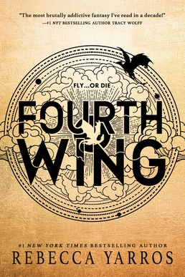

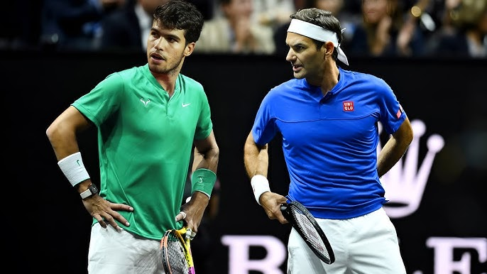



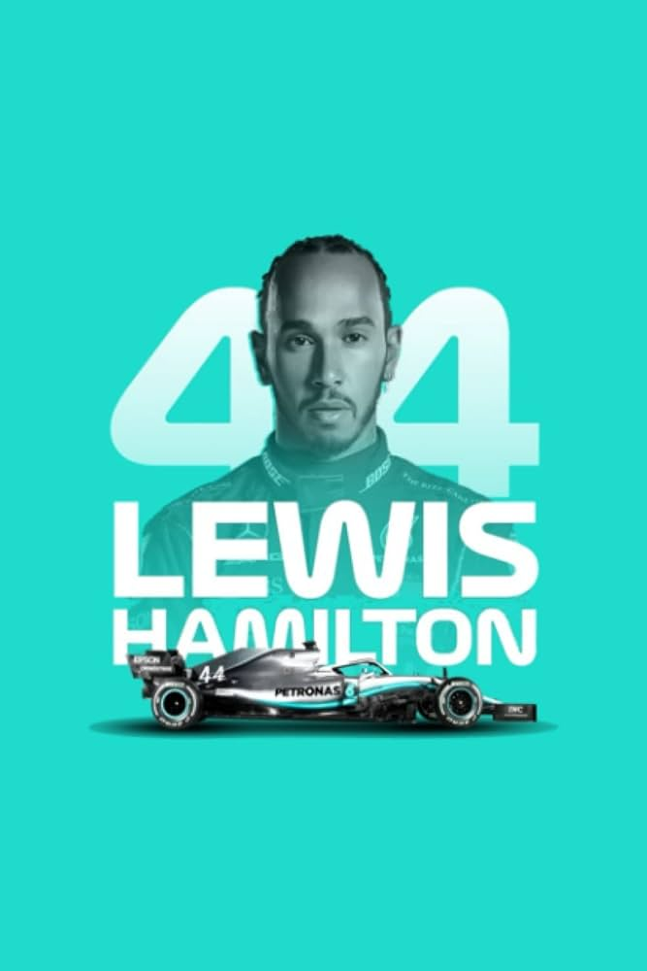

Slide 11
Presentation Outline
01
Overview & Definitions
02
Historical Context
03
Core Algorithms
04
Applications in Industry
05
Results & Benchmarks
06
Open Issues
07
References & Discussion
Notes:
Our journey through coding techniques starts with an Overview & Definitions of Information Theory. Then, we’ll dive into the Historical Context of these algorithms before exploring the Core Algorithms themselves—both classical and modern. We will discuss their Applications in Industry, look at our Results & Benchmarks, and conclude with some Open Issues and a Discussion

Slide 12
Information Theory: The Mathematical Study of Communication
Key Definitions & Concepts
Entropy (H): The measure of uncertainty or randomness in a data source.
The Bit: The fundamental unit of information, introduced by Shannon.
What is Information Theory?
Founded by Claude Shannon in 1948, it is the study of the quantification, storage, and communication of information.
Sub-Divisions
Source Coding: Data compression (e.g., Huffman, LZW) to remove redundancy.
Channel Coding: Error detection and correction to ensure reliability. (e.g., LDPC, Polar Coding)
Practical Applications
Lossless compression (ZIP, PNG) and Lossy (JPEG, MP3, HEVC).
Wireless communication standards like 5G and LTE.
Deep Learning and Large Language Models (LLMs).
Notes:
Information Theory, founded by Claude Shannon in 1948, is the mathematical basis for all communication. Key concepts include Entropy (H), the measure of uncertainty; The Bit, the fundamental unit of information; and Channel Capacity, the maximum reliable data rate. The field is split into Source Coding (compression) and Channel Coding (error correction). This theory has practical applications everywhere from lossless compression to LLMs. Talk about other metrics like mutual information.

Slide 13
Evolution of Source Encoding
Entropy Encoding(1950s)
Uses statistical probability to assign shorter codes to frequent symbols.
Huffman Coding
Dictionary Encoding(1984+)
Builds a dynamic table of strings on the fly, replacing recurring patterns with short indices.
LZW Algorithm
Sub-word Tokenization(2015+)
Modern AI approach that breaks text into meaningful sub-units to handle vast vocabularies.
BPE/Wordpiece
Notes:
Source encoding has evolved through three main eras: Entropy Encoding in the 1950s, exemplified by Huffman Coding, which assigns shorter codes to frequent symbols based on probability. Then came Dictionary Encoding starting around 1984, like LZW, which replaces recurring string patterns with short indices. Finally, the modern AI approach, Sub-word Tokenization, emerged around 2015 with algorithms like BPE and WordPiece, designed to handle the vast and dynamic vocabularies used by LLMs.

Slide 14
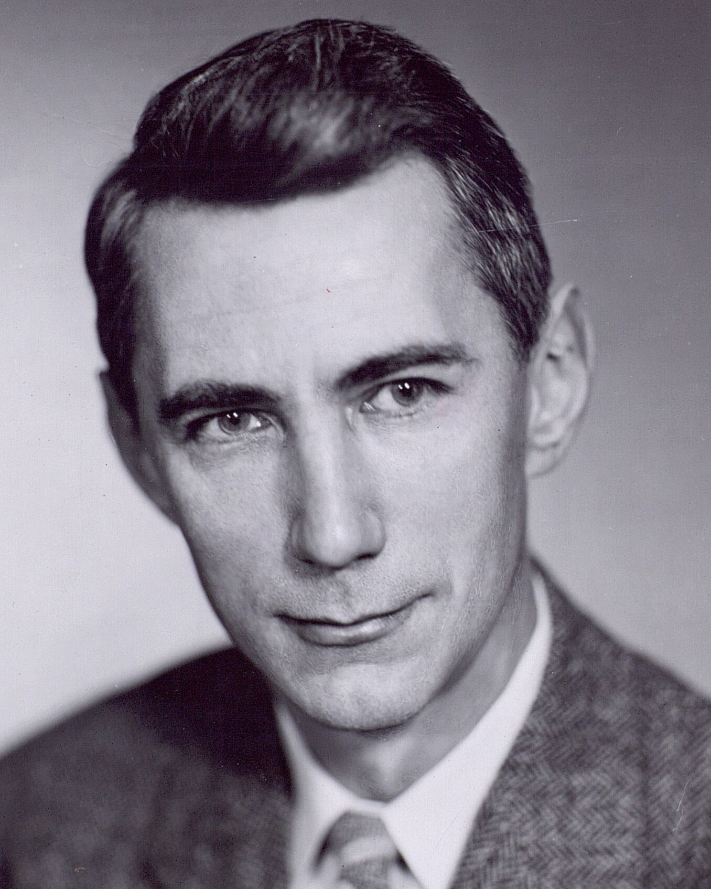
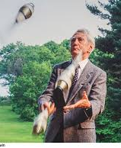
The 1950s: Foundations of Information Theory
Claude Shannon: The Father of the Bit
His 1950s papers defined the limits of communication.
He introduced the "bit" as the fundamental unit of information.
Fun facts
Shannon was a professional juggler and unicyclist at Bell Labs.
Shannon popularized the term bit which was actually suggested by John Tukey
Notes:
Before getting into the definitions and how algorithm works, let’s look at the history behind these algorithms.
Starting with Claude Shannon, the father of informtation theory, and whose work in the late 1940s and early 1950s laid the foundation for information theory.
He defined the mathematical limits of communication, introduced the idea of the bit as a unit of information, and gave us the theoretical basis for compression methods like the ones in our project.
A fun fact is that he was also a juggler and unicyclist at Bell Labs

Slide 15
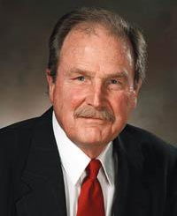
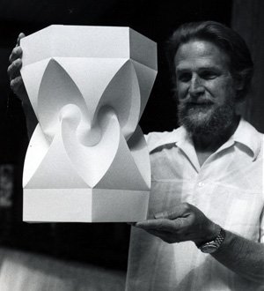
The 1950s: Foundations of Information Theory
David Huffman
David Albert Huffman studied electrical engineering at Ohio State University and later attended the Massachusetts Institute of Technology, where he created Huffman coding.
Fun facts
Movie film fell and creased his skull
Failed doctoral exams
Came up with the algorithm to not take the exam
Notes:
Earn an EE major from Ohio State University at 18 and became a naval officer by 19
Served in the Navy, taking on heavy technical responsibilities
Returned to complete a master’s in electrical engineering but was unsure about his future
Attended Massachusetts Institute of Technology, where he initially struggled (failed doctoral exams)
Discovered interest in digital systems through a switching theory course accidentally
Eventually solved a major coding problem that others had failed to solve

Slide 16
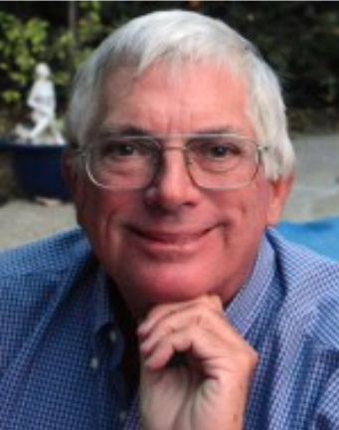
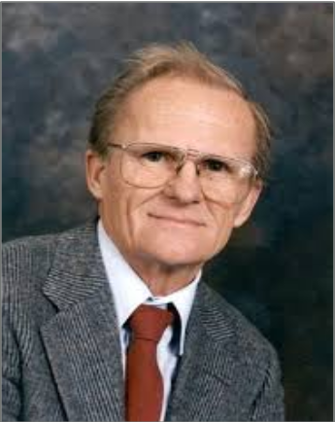
The 1970s–1990s: The Rise of Arithmetic Coding
Formalizing Arithmetic Coding
Took shape in the 1970s. Richard Pasco’s 1976 papers introduced early ideas
Jorma Rissanen and Glen Langdon turned arithmetic coding into a broad and flexible compression technique.
Historical Milestones
1987: Witten, Neal, and Cleary popularized practical arithmetic coding.
1988: IBM developed the adaptive Q-Coder.
1998: Moffat, Neal, and Witten improved implementation speed and flexibility.
Notes:
Now talking about the history behind arithmetic coding.
Arithmetic coding started taking shape in the 1970s.
Pasco introduced early ideas, and then Rissanen and Langdon formalized it in 1979 as a flexible compression technique.
Later work helped make it practical, like in 1987, Witten, Neal, and Cleary popularized it, in 1988 IBM developed the adaptive Q-Coder, and by 1998 researchers had improved its speed and implementation.

Slide 17
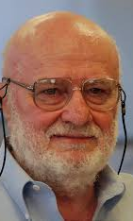
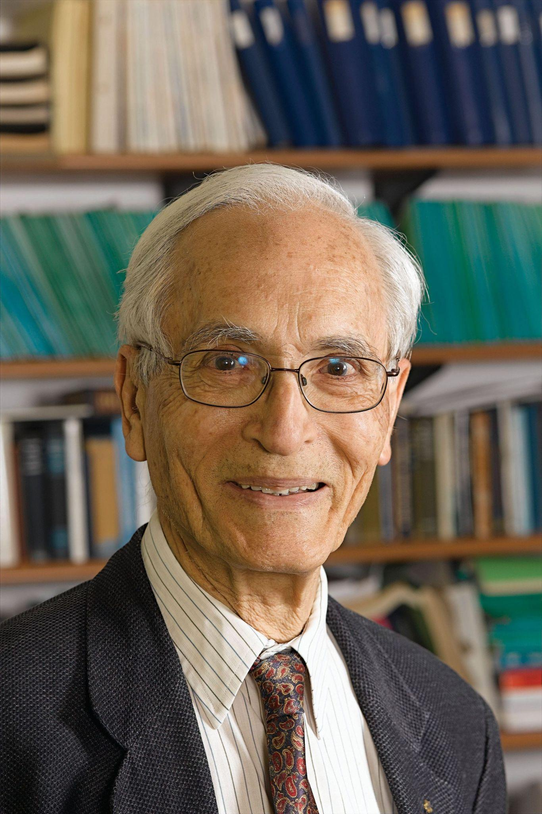
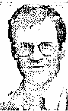
The 1980s: The Revolution of Dictionary Encoding
The LZW Giants
In 1984, Terry Welch refined the LZ77/78 work of Abraham Lempel and Jacob Ziv to create LZW
builds a dynamic dictionary on the fly.
Patent Controversy
LZW was widely used in GIF files, but the algorithm was covered by patents later enforced by Unisys.
In 1994, licensing demands around GIF created backlash among developers and users
Notes:
Now moving onto the next slide, we got history about LZW
LZW was developed from the earlier Lempel–Ziv ideas and refined by Terry Welch in 1984.
One interesting part of LZW’s history is that it became the compression method used in GIF images. Later, patent enforcement by Unisys caused major controversy, and that controversy helped push the development of PNG as a patent-free alternative

Slide 18



The Modern Era: Scaling Data Encoding for AI
Byte Pair Encoding
Invented in 1994 by Philip Gage as a data compression algorithm
Fortran, Basic, Pascal
Adapted for text processing in neural machine translation by Rico Sennrich
Google's WordPiece for BERT
Created by Researchers at Google in 2016 and was used in speech recognition
Handle rare and unknown words better
Gets implemented in BERT
Notes:
In the modern era where tokenizations come in
Adapted for NLP by Rico Senrich
BERT is a machine learning model for understanding words

Slide 19
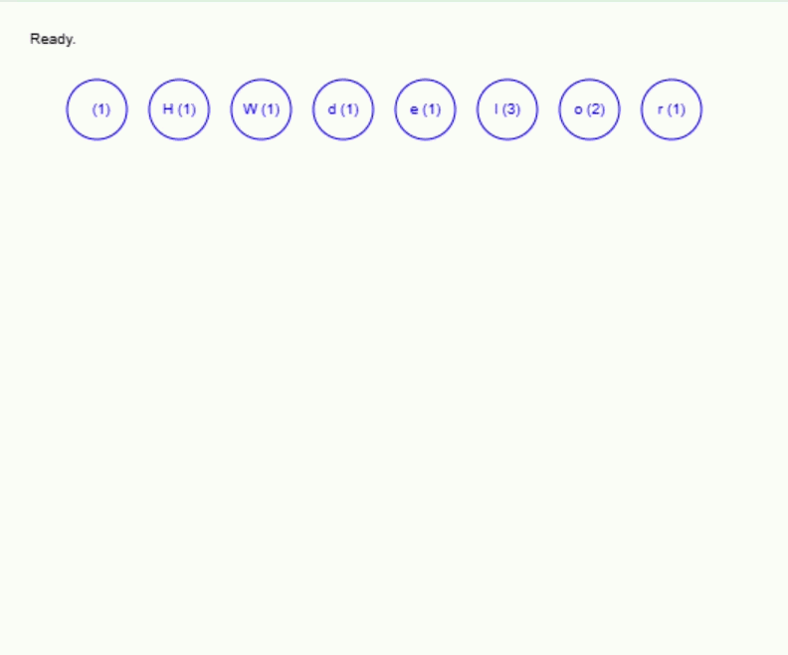
How Huffman Coding Works
Core Idea
A lossless compression algorithm by David Albert Huffman
Frequent symbols → shorter codes
Rare symbols → longer codes
Greedy method that builds a prefix-free binary encoding based on symbol frequencies
Limitations
If all symbols appear equally, compression is minimal
Uses ≥1 bit per symbol
Needs two scans (frequency + encoding), which can slow large files.
Notes:
It’s a compression algorithm without losing any information
It assigns shorter fits to frequent characters while the

Slide 20
How Arithmetic Coding Works
Core Idea
Unlike Huffman, arithmetic coding encodes the entire message as a single value.
Uses probabilities to narrow the interval
Final interval uniquely represents the message
INTERVAL SUBDIVISION VISUALIZATION
0.0
1.0
A (0.5)
B (0.5)
How the algorithm works?
Start with the interval [0,1)
Split it using symbol probabilities
Select the subinterval for the current symbol
Repeat for each next symbol
Output any value inside the final interval
BA
BB
Value: 0.725...
Notes:
This slide explains the main idea behind arithmetic coding. Unlike Huffman coding, which assigns a separate binary code to each symbol, arithmetic coding represents the entire message as a single value inside a shrinking interval, usually between 0 and 1.
We start with the full interval [0,1) and divide it based on symbol probabilities. In this example, A and B each have probability 0.5, so the interval is split into two equal halves. If the first symbol is B, we keep the right half. Then for the next symbol, we split that smaller interval again. If the next symbol is A, we keep the first half of that range, so the interval becomes even smaller.
After processing all symbols, any number inside the final interval represents the whole message. So the key idea is that arithmetic coding compresses by repeatedly narrowing the possible range for the message.”

Slide 21
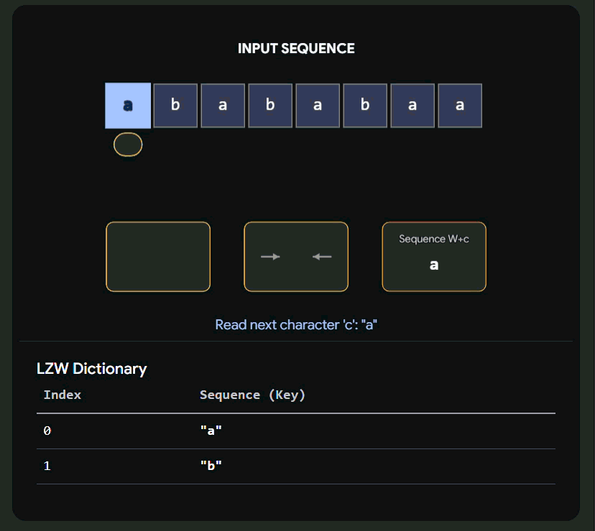
How LZW Coding Works
Lempel-Ziv-Welch
Refined in 1984, LZW builds a dynamic dictionary on the fly to replace recurring patterns with short indices.
Builds a table of strings as it reads data
How the algorithm works?
Find the longest string W in dictionary that matches input
Output the index for W
Add W + next_char to dictionary as new entry
Repeat till entire input processed
Notes:
LZW is a dictionary-based lossless compression technique. It works by building a dynamic dictionary of strings as it reads the data. The key strategy is Longest Substring Matching. The algorithm starts the dictionary with single characters. It finds the longest match, W, in the dictionary, outputs its index, and then adds W plus the next character to the dictionary as a new entry. This greedy process effectively replaces recurring patterns with very short indices.

Slide 22
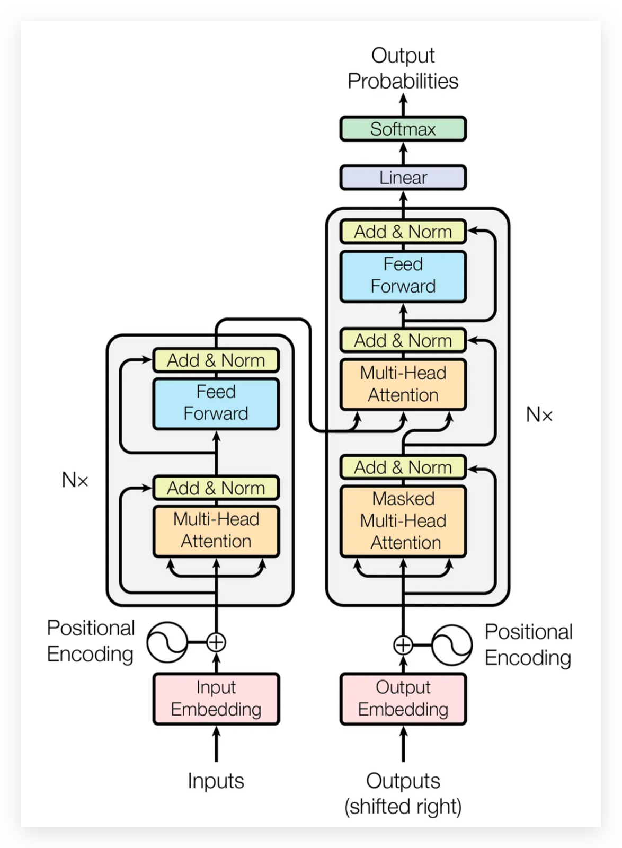
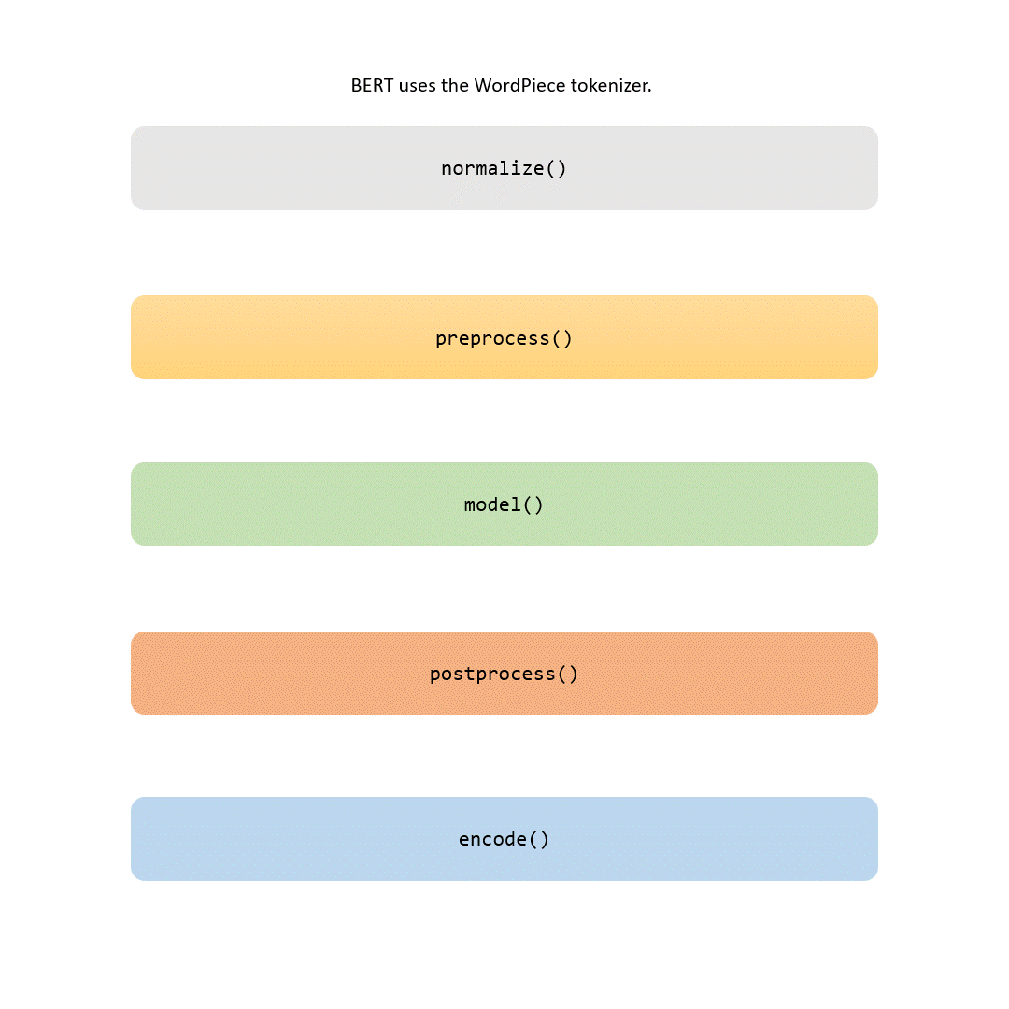
NLP And The Transformer Model
Notes:
We transition now from classical compression to modern tokenization, which is crucial for modern NLP and the Transformer model. The Transformer architecture relies on tokenization to convert raw text into numerical inputs (tokens) that it can process, allowing models like BERT and GPT to handle complex language tasks efficiently.

Slide 23
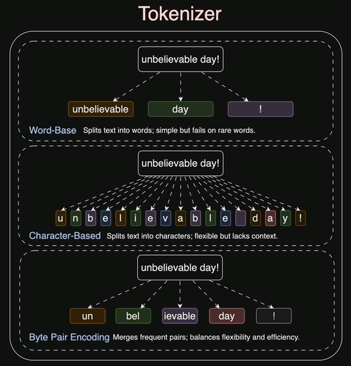
The Modern Tokenizers: BPE
BPE: Frequency-Driven Merging
Byte Pair Encoding (BPE) iteratively replaces the most frequent pair of tokens with a single, new token.
Starts at character level to ensure no out-of-vocabulary (OOV) tokens.
Merges are based on raw frequency count.
Builds the vocabulary size to a pre-defined limit. (eg. 32K Tokens)
Notes:
Byte Pair Encoding (BPE) is one of the most widely used modern tokenizers. It's a frequency-driven, greedy merging approach. It starts at the character level, guaranteeing no 'out-of-vocabulary' (OOV) tokens, and iteratively replaces the most frequent adjacent pair of tokens with a single, new token until a pre-defined vocabulary size (e.g., 32K) is reached.

Slide 24
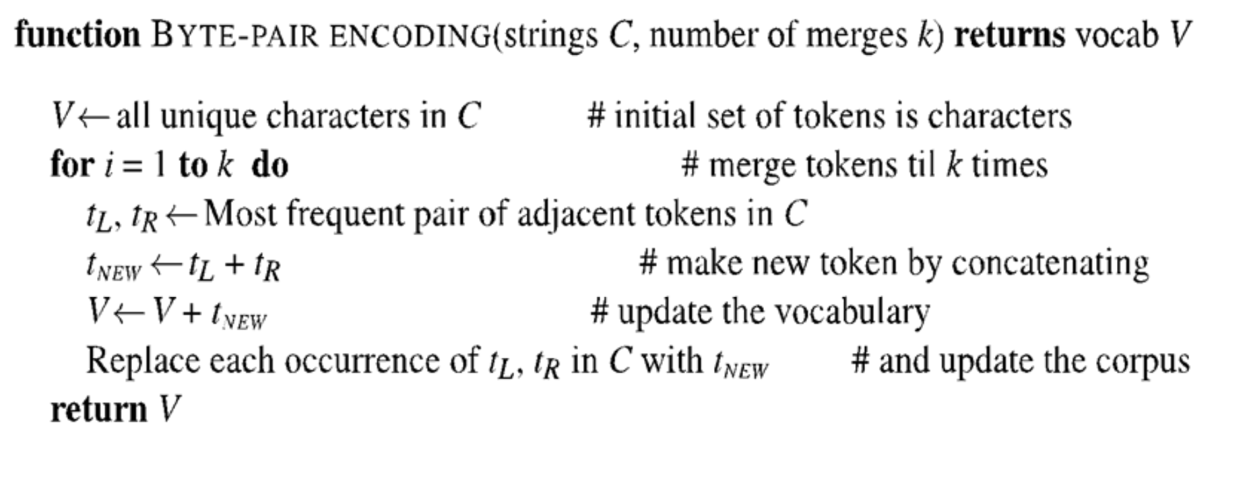
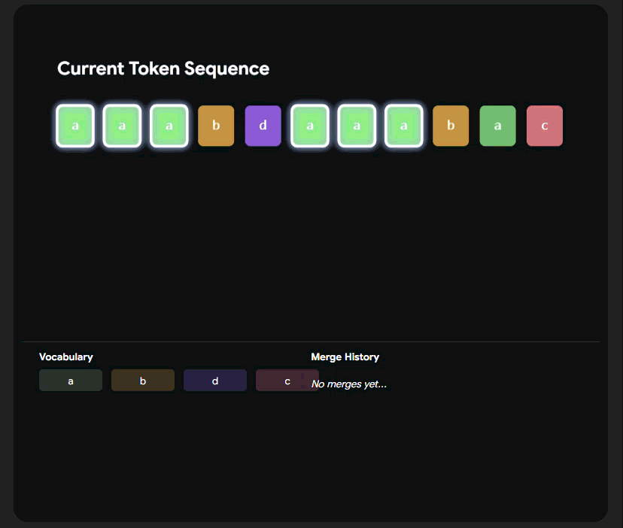
The Modern Tokenizers: BPE In Action
Notes:
This slide is for a visual demonstration of BPE in action. (Walk through an example on the slide). Illustrate how the most frequent pairs are merged, creating sub-word units that efficiently represent common parts of words.

Slide 25
Other Tokenizers: WordPiece & Unigram
WordPiece: Likelihood-Driven Selection
WordPiece chooses merges that maximize the likelihood of the training data.
Selection criteria: score = count(x,y) / (count(x) × count(y)).
Prioritizes pairs that are meaningfully coupled.
Benefit: More linguistically coherent sub-units.
Unigram: A Probabilistic Language Model
Unlike BPE or WordPiece, Unigram starts with a large seed vocabulary and iteratively removes tokens to optimize the model likelihood.
Loss Criteria: Loss = Σ -log(P(token))
Pruning: Removes tokens that increase the overall loss the least.
Benefit: Does not require pre-tokenization. Better on non-English languages
Notes:
While BPE is frequency-based, WordPiece uses a likelihood-driven selection process, choosing merges that maximize the probability of the training data. This often results in more linguistically meaningful sub-units. The Unigram model is distinct: it starts with a large seed vocabulary and then prunes tokens iteratively based on which tokens minimize the overall language model loss. This technique can provide sub-word probabilities, which is useful for Subword Regularization and model robustness.

Slide 26
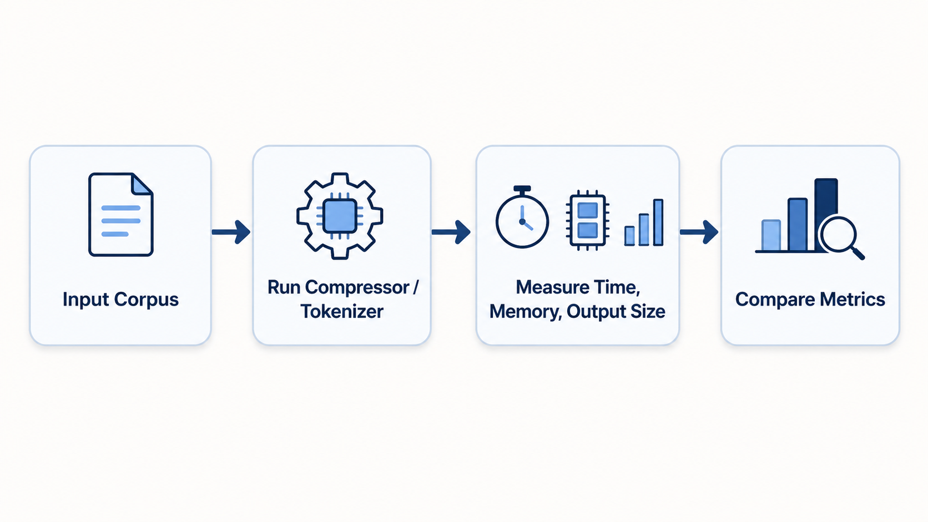
Implementation
Measurement Logic
Compression ratio = original size / compressed size
LLM compression ratio= [compressed size * ceil(log(vocab_size))] / 8
Vocab_size = 5000 tokens
Algorithms Implemented
Classical: Huffman, LZW, Arithmetic
Modern tokenizers: BPE, WordPiece, Unigram
Benchmark Setup
Corpus sizes: 1MB, 10MB, 50MB
Metrics: execution time, peak memory usage, compression ratio
Notes:
We implemented five algorithms for our benchmark: the classical set (Huffman, LZW, Arithmetic) and the modern LLM tokenizers (BPE, WordPiece, and Unigram). We tested these against three different corpus sizes (1MB, 10MB, 50MB) and measured execution time, peak memory usage, and compression ratio. We defined the compression ratio for LLM Tokenizers using the formula shown on the slide, with a vocabulary size of 5000.

Slide 27
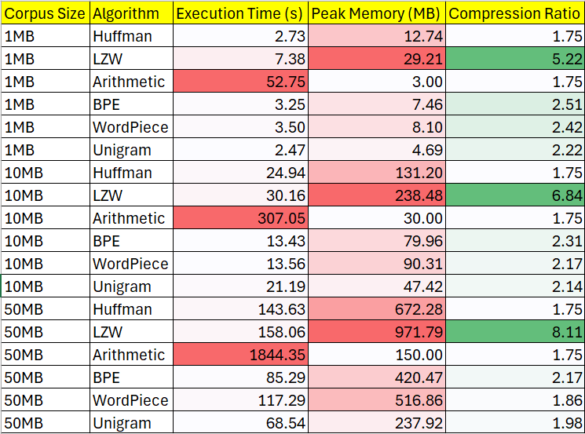
Results - Benchmark Summary
Color Guide
Red = higher time / memory
Green = better compression
Evaluation
Huffman achieves fast runtimes with suboptimal compression ratios
LZW achieves best compression with high memory overhead
Arithmetic slowest runtime with low memory overhead
LLM Tokenizers achieve best balance across all metrics
Notes:
A few main patterns stand out. Huffman is relatively fast, but its compression ratio is not as strong as some of the other methods. LZW consistently achieves the best compression ratios, but that comes with high memory overhead, especially as the corpus size grows. Arithmetic coding uses comparatively low memory, but it has by far the slowest execution time, which reflects the extra computational cost of interval-based encoding. Finally, the modern tokenizers like BPE, WordPiece, and Unigram do not always win a single category, but they show a more balanced tradeoff across runtime, memory, and compression-related efficiency.”

Slide 28
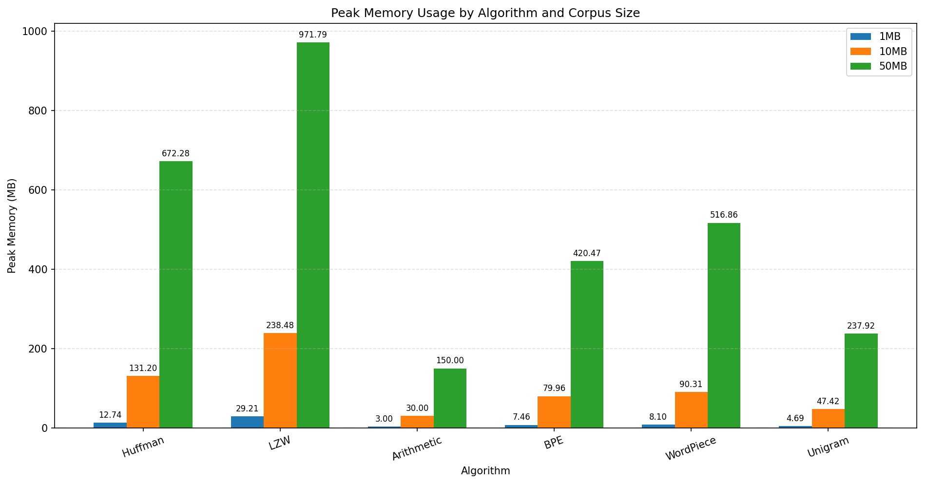
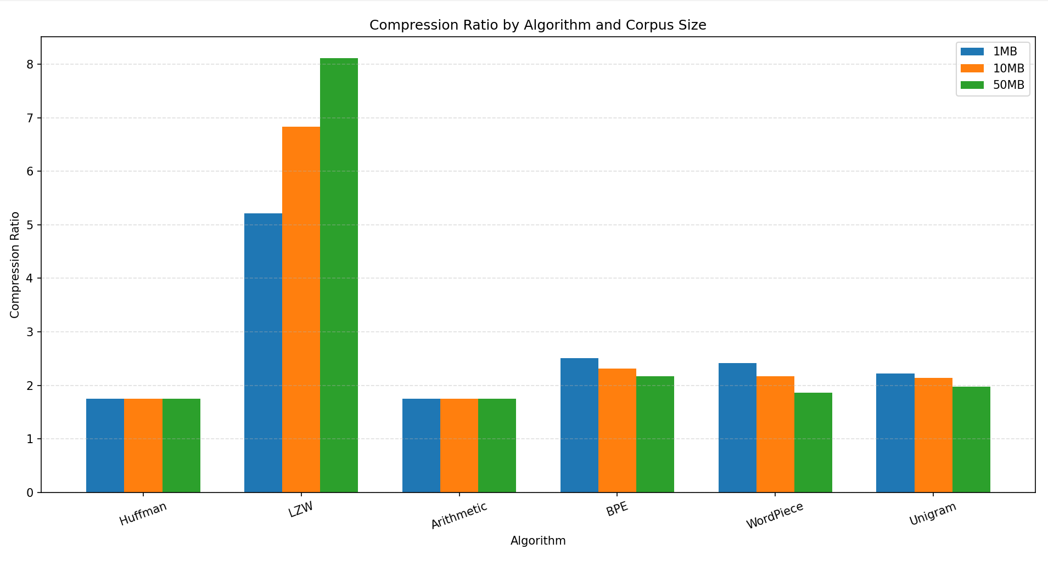
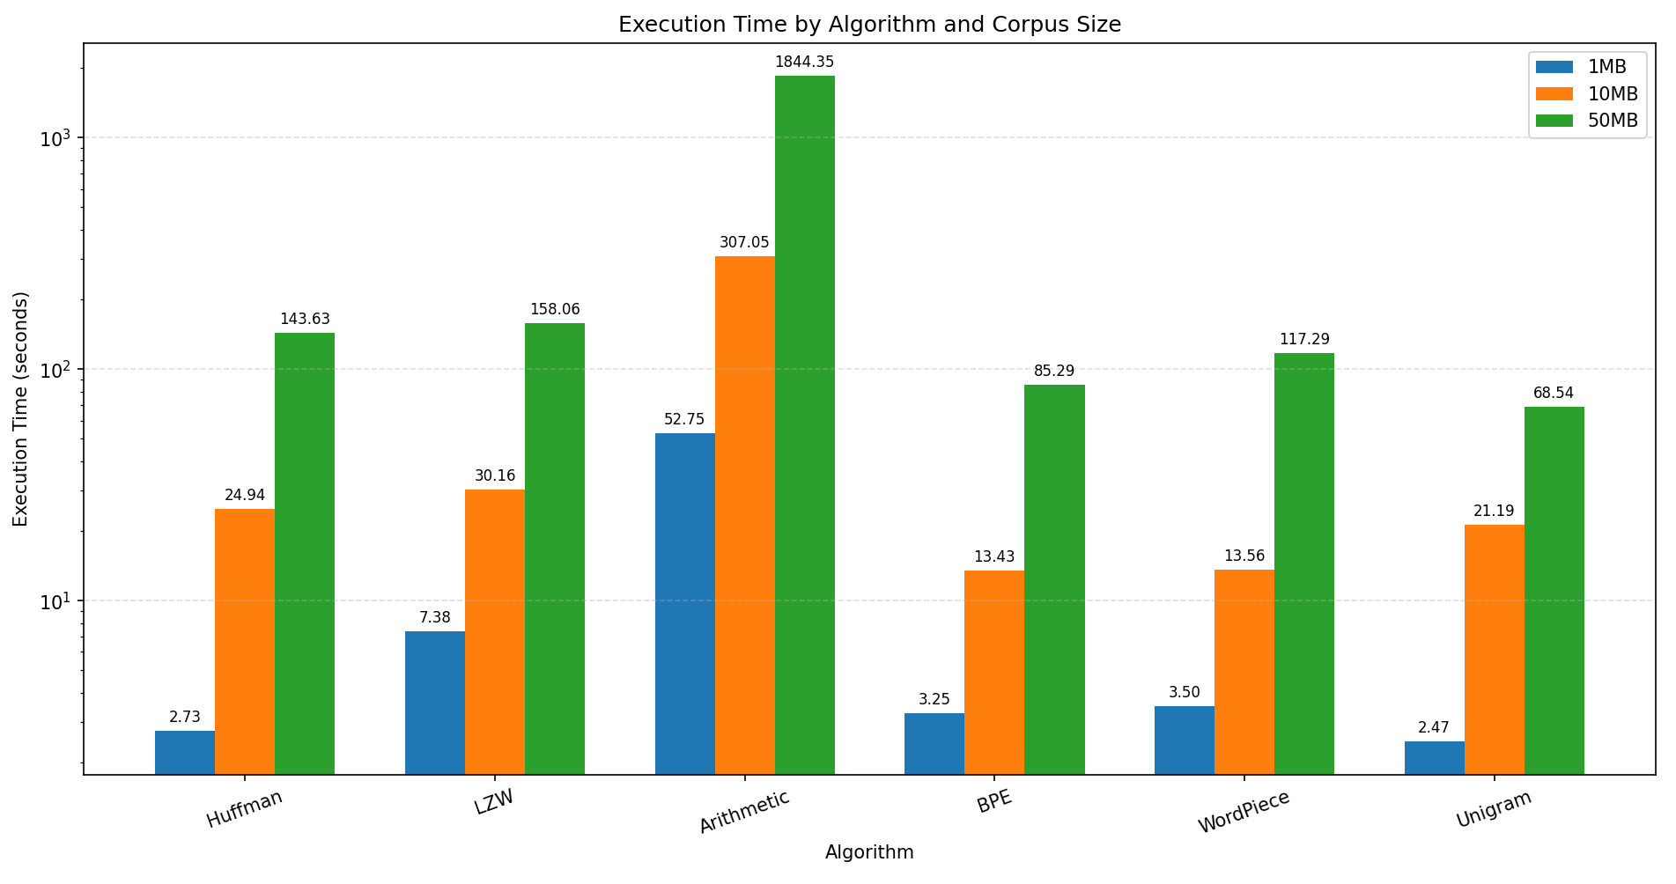
Results - Graphs
Notes:
This slide visually represents the benchmark data.
In the left, the memory graph highlights LZW's significant memory requirement.
On the right, the compression ratio chart on the right confirms LZW's theoretical advantage, but also shows the strong performance of the LLM Tokenizers.
Finally, at the bottom we see the time graph.

Slide 29

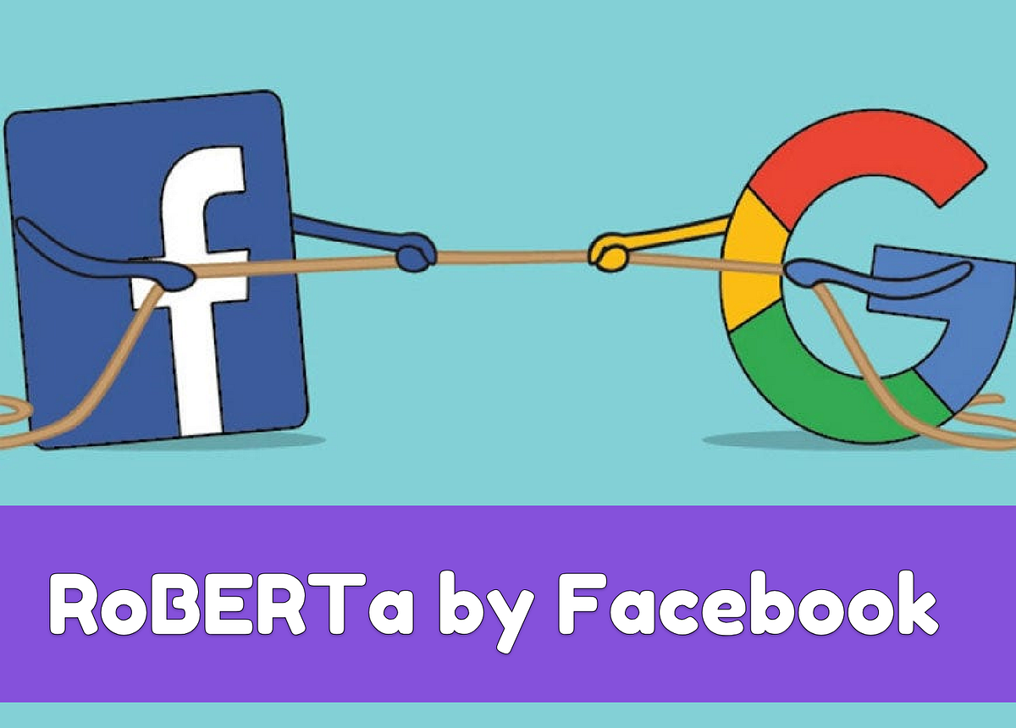





Practical Applications - NLP & CRMs
Decoder
(BPE)
Encoder (Wordpiece)
Natural Language Processing (NLP)
Enabling efficient handling of vast vocabularies and multilingual text without OOV errors.
Transformer (Unigram)
Code Representation Models (CRM)
Effectively capture repetitive structural patterns and naming conventions as code embeddings (e.g. Claude, Codex)
Notes:
This slide shows where modern tokenization methods are used in real systems. In natural language processing, methods like BPE, WordPiece, and Unigram are important because they break text into smaller reusable units, which helps models handle large vocabularies, rare words, and multilingual text more efficiently. On the right, the examples show how different tokenization styles are associated with different model families. BPE is commonly used in decoder-style systems, WordPiece is well known from encoder-based models like BERT, and Unigram appears in transformer systems such as T5 and translation models. The slide also highlights code representation, where tokenization is useful for splitting programming languages into meaningful subunits, helping models capture repeated syntax, structure, and naming patterns.”

Slide 30
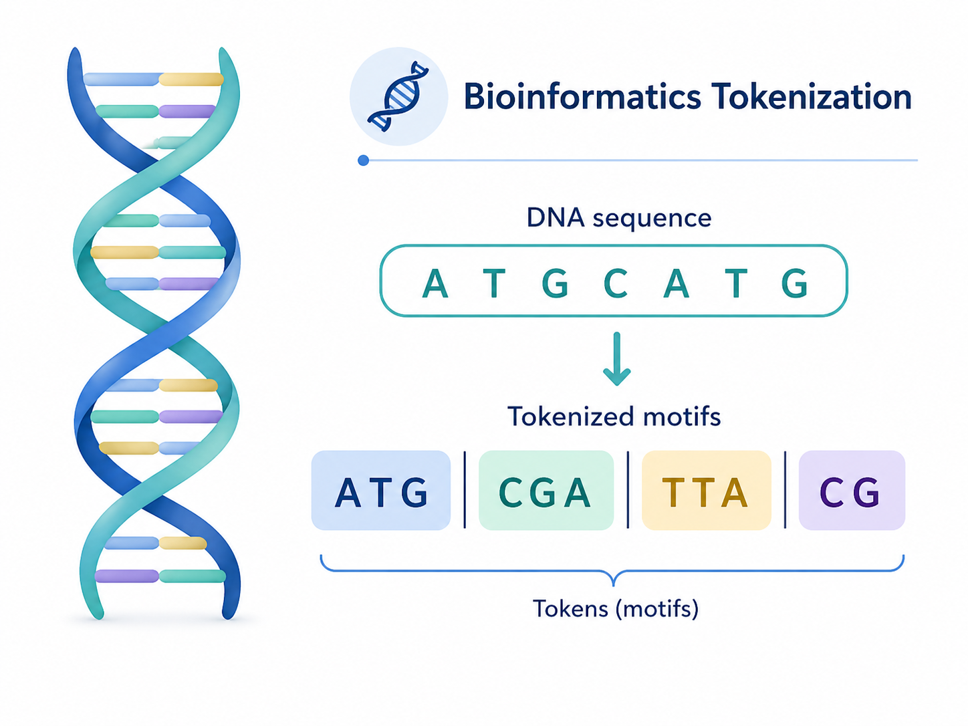
Practical Applications - Bioinformatics & Genomics
BPE and Unigram-style tokenization
Subword tokenizers can be applied to DNA and protein sequences (eg. DNABERT)
They help capture frequent biological motifs and recurring patterns
This supports sequence modeling, classification, and analysis
Notes:
The concept of sub-word tokenization extends to Bioinformatics. BPE and Unigram-style methods are applied to DNA and protein sequences, as seen in models like DNABERT. They help capture frequent biological motifs and recurring patterns, which is crucial for sequence modeling, classification, and analysis.

Slide 31
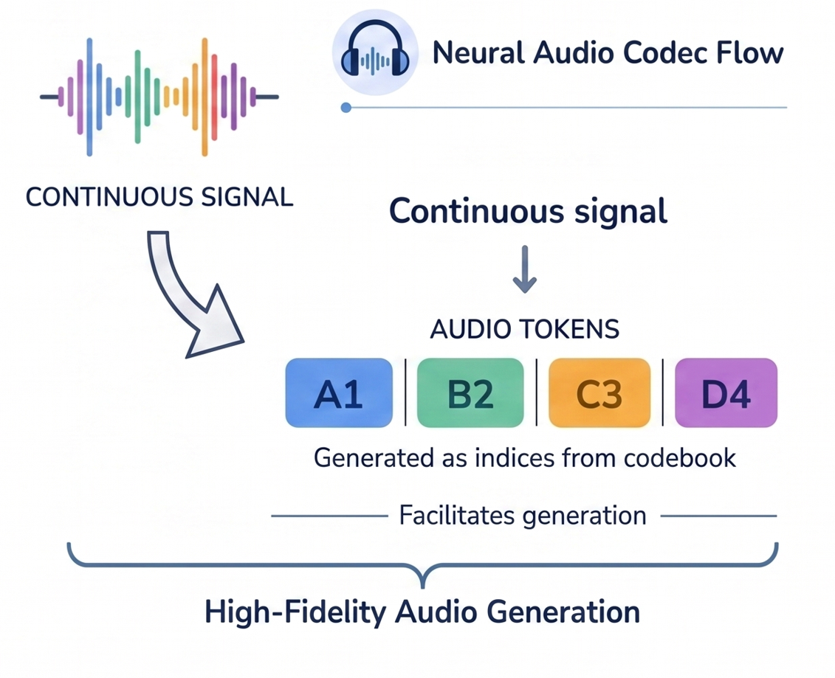
Practical Applications - Audio Synthesis & Processing
Applied in Neural Audio Codecs
Convert continuous audio into discrete “audio tokens” for transformer processing
BPE and Unigram identify acoustic motifs, treating sound sequences like text.
Same idea: convert data → tokens for model processing
Notes:
Similarly, in Audio Synthesis and Processing, these tokenizers are used in Neural Audio Codecs. They convert continuous audio waveforms into discrete "audio tokens" that a transformer model can process, identifying acoustic motifs and treating sound like a sequence of sub-word units. The underlying idea is the same: convert complex data into efficient tokens for model processing

Slide 32
Open Issues in LLM Tokenization
Language Bias: Most tokenizers are trained on English-centric corpora, leading to poor generalization in non-English and low-resource languages.
Reasoning & Spelling: Fragmentation of words into sub-units makes models struggle with character-level tasks (spelling) and precision-based math logic.
Code Inefficiency: Sub-word tokenization captures text patterns but misses the structural hierarchy of code compared to Abstract Syntax Trees (AST).
Notes:
12345 + 1 [123] [45] + [1] Doesnt know where to add
Despite their utility, modern tokenizers introduce new challenges. One is Language Bias—many are trained primarily on English data, which hampers performance in non-English languages. Another issue affects Reasoning & Spelling: when words are fragmented, models can struggle with character-level precision tasks. Finally, Code Inefficiency: sub-word tokenization captures text-like patterns in code but misses the underlying structural hierarchy that an Abstract Syntax Tree would provide.1

Slide 33
References
[1] C. E. Shannon, “A mathematical theory of communication,” The Bell System Technical Journal, vol. 27, no. 3, pp. 379–423, Jul. 1948, doi: 10.1002/j.1538-7305.1948.tb01338.x.
[2] D. A. Huffman, “A Method for the Construction of Minimum-Redundancy Codes,” Proceedings of the IRE, vol. 40, no. 9, pp. 1098–1101, Sep. 1952, doi: 10.1109/JRPROC.1952.273898.
[3] Welch, “A Technique for High-Performance Data Compression,” Computer, vol. 17, no. 6, pp. 8–19, Jun. 1984, doi: 10.1109/MC.1984.1659158.
[4] I. H. Witten, R. M. Neal, and J. G. Cleary, “Arithmetic coding for data compression,” Commun. ACM, vol. 30, no. 6, pp. 520–540, Jun. 1987, doi: 10.1145/214762.214771.
[5] A. Vaswani et al., “Attention is All you Need,” in Advances in Neural Information Processing Systems, Curran Associates, Inc., 2017. Accessed: Apr. 26, 2026. [Online]. Available: https://papers.nips.cc/paper_files/paper/2017/hash/3f5ee243547dee91fbd053c1c4a845aa-Abstract.html
[6] “FEB94 A New Algorithm for Data Compression.” Accessed: Apr. 26, 2026. [Online]. Available: http://www.pennelynn.com/Documents/CUJ/HTML/94HTML/19940045.HTM
[7] M. Schuster and K. Nakajima, “Japanese and Korean voice search,” in 2012 IEEE International Conference on Acoustics, Speech and Signal Processing (ICASSP), Mar. 2012, pp. 5149–5152. doi: 10.1109/ICASSP.2012.6289079.
[8] R. Sennrich, B. Haddow, and A. Birch, “Neural Machine Translation of Rare Words with Subword Units,” Jun. 10, 2016, arXiv: arXiv:1508.07909. doi: 10.48550/arXiv.1508.07909.
[9] T. Kudo, “Subword Regularization: Improving Neural Network Translation Models with Multiple Subword Candidates,” Apr. 29, 2018, arXiv: arXiv:1804.10959. doi: 10.48550/arXiv.1804.10959.
Notes:
This slide lists the key references for our presentation, covering the foundational works of Shannon, Huffman, and Welch, as well as the modern papers that introduced the Transformer architecture and sub-word units

Slide 34
DISCUSSION
Notes:
We've covered the history, core algorithms, benchmarks, and applications. We now open the floor for questions and discussion

Slide 35
Test Questions
1
Who is considered the Father of the Bit and established the field of Information Theory?
2
Which algorithm starts with a large seed vocabulary and iteratively removes tokens to optimize likelihood?
3
Which classical algorithm provides the best compression ratio but requires significant memory overhead?
Notes:
We will start with a quick set of test questions that we will answer by the end of the presentation. They cover the key figures and core concepts: a sub-word algorithm that uses pruning (Unigram), the "Father of the Bit" (Claude Shannon), and the classical algorithm with the best compression ratio but highest memory use (LZW).

