Slide 1
FFT for PDE: Classical Spectral Methods and Modern Operators Learning
By Yucheng Zhao, Hongrui Miao, Tiancheng Ma

Slide 2
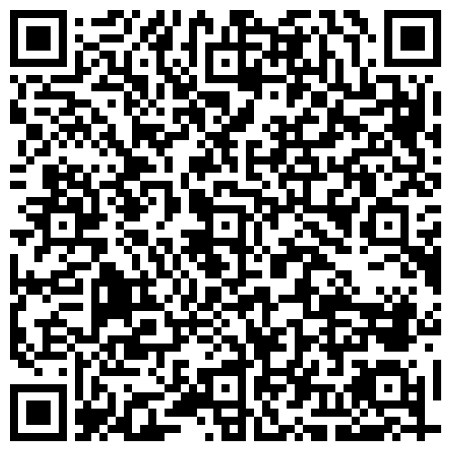
Questions:
Pseudo-spectral solves what term in physical domain?
First name of the person who is considered to be the Father of DFT/FFT?
One reason Fourier Neural Operators enjoys fast computation is because convolution in the physical domain becomes ______ in the frequency domain.

Slide 3
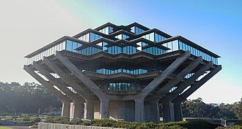
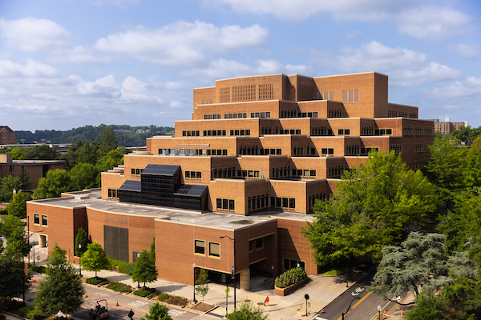
Presenter Introduction: Tiancheng Ma(Felix)
First year PhD student in Software Testing & Causal Inference, advisor Nasir Eisty
Applications of Causality in Software Testing: A Rapid Review - accepted by 30th International Conference on EASE
M.S. and B.S. in UC San Diego: Math + CS(software engineering+ AI theory)
Full-stack developer at NeuroLeap Corp.

Slide 4
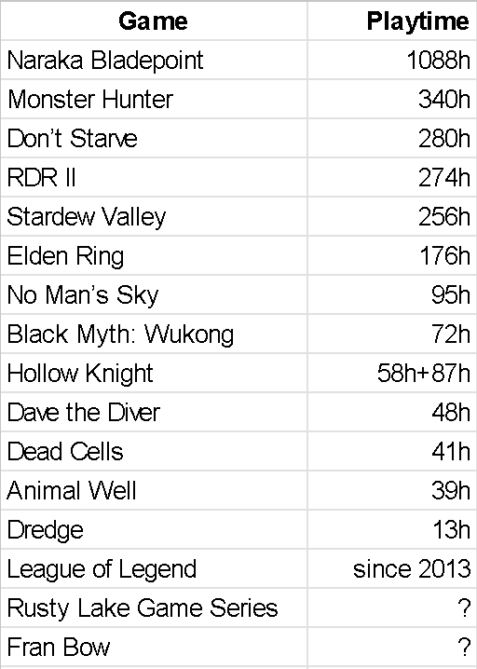




Presenter Introduction: Tiancheng Ma(Felix)
Games:
Story, Art, Puzzles, Action

Slide 5
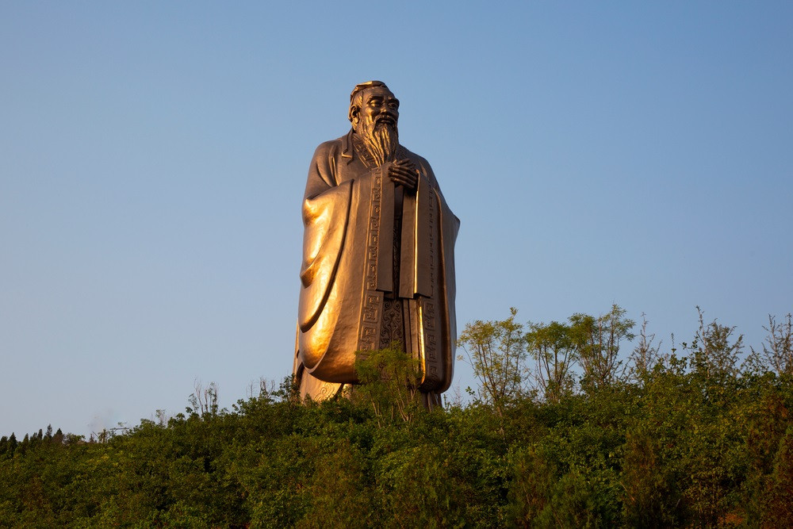
Presenter Introduction: Tiancheng Ma(Felix)
Hometown: Jining, Shandong, China
Only famous for Confucius (educator born in Qu Fu, part of Jining):

Slide 6
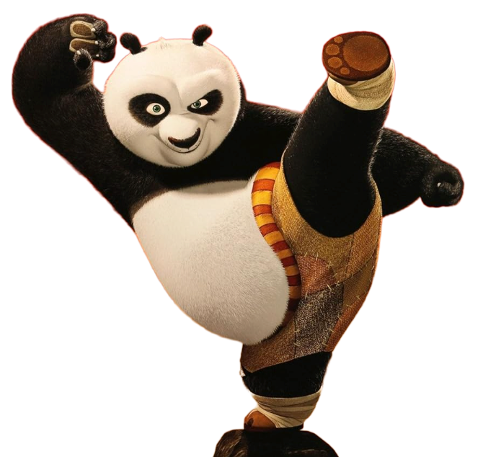



Presenter Introduction: Hongrui Miao (Henry)
Master student in Electrical Engineering
Interest? Watching TV Series
Welcome to Derry
House of the Dragon
Secret Level
Hometown: SiChuan, China

Slide 7


Presenter Introduction: Yucheng Zhao
First-year Ph.D.
Track of Program: Machine Learning and Intelligent Systems
Advisor: Dr. Xiongye Xiao
Previously: 2 technical institutions named after the location - B.S. and M.S.
Now: Glad for the experience in a comprehensive public university

Slide 8
Outline of following presentation
Overview: definition(heavy math)
History
Algorithm: procedures & comparisons
Applications
Implementations: compare & contrast
Open Issues
References
Discussion
Test Questions Revisited

Slide 9
Overview: FFT for PDE: Classical Spectral Methods and Modern Operators Learning
DFT + FFT
Partial Differential Equation (PDE)
Spectral/Pseudo-Spectral Method
Fourier Neural Operator (FNO)
Our Project Focus

Slide 10
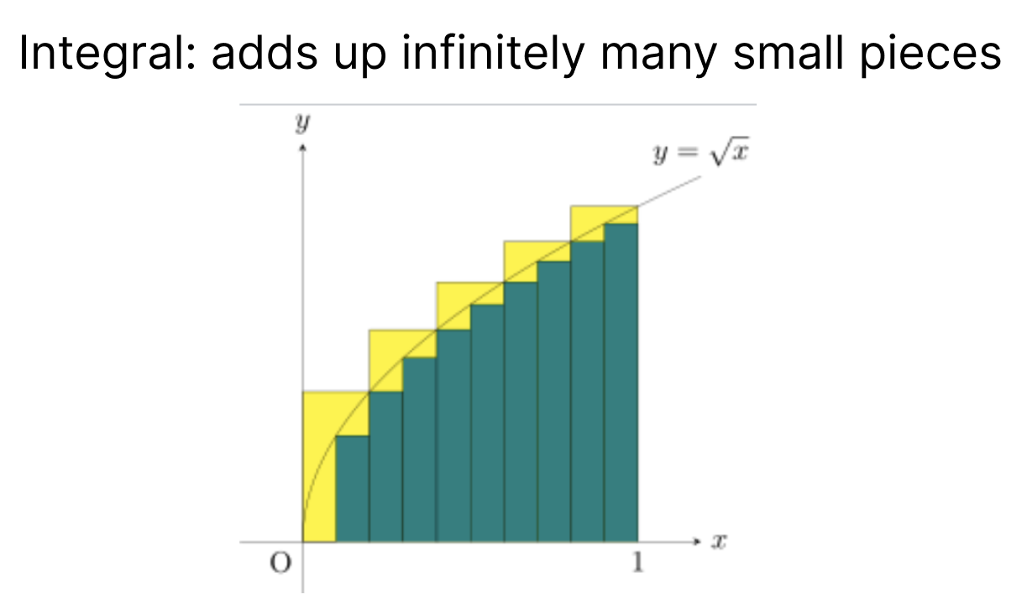
Overview: Track to Fast Fourier Transform(FFT) - Integral
“Sum of rectangles” officially known as Riemann sum

Slide 11
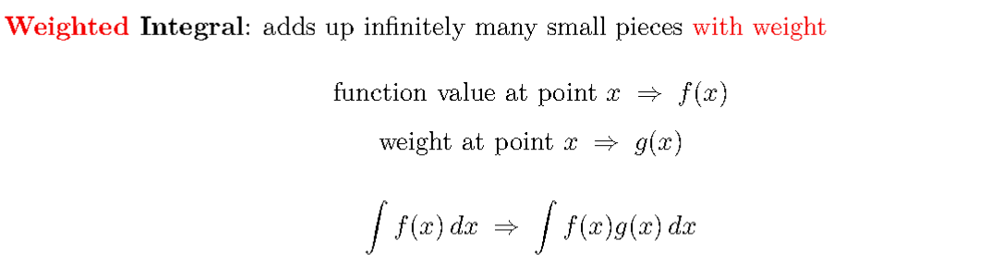
Overview: Track to Fast Fourier Transform(FFT) - Weighted Integral

Slide 12
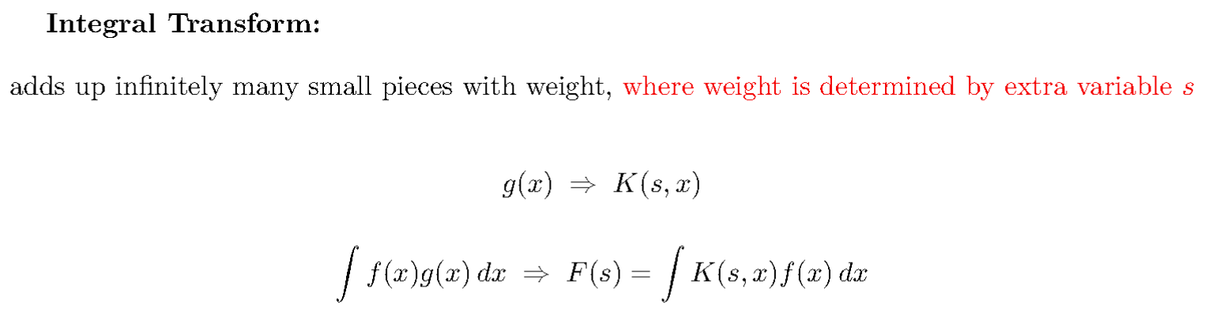
Overview: Track to Fast Fourier Transform(FFT) - Integral Transform

Slide 13
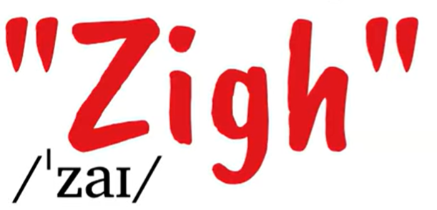
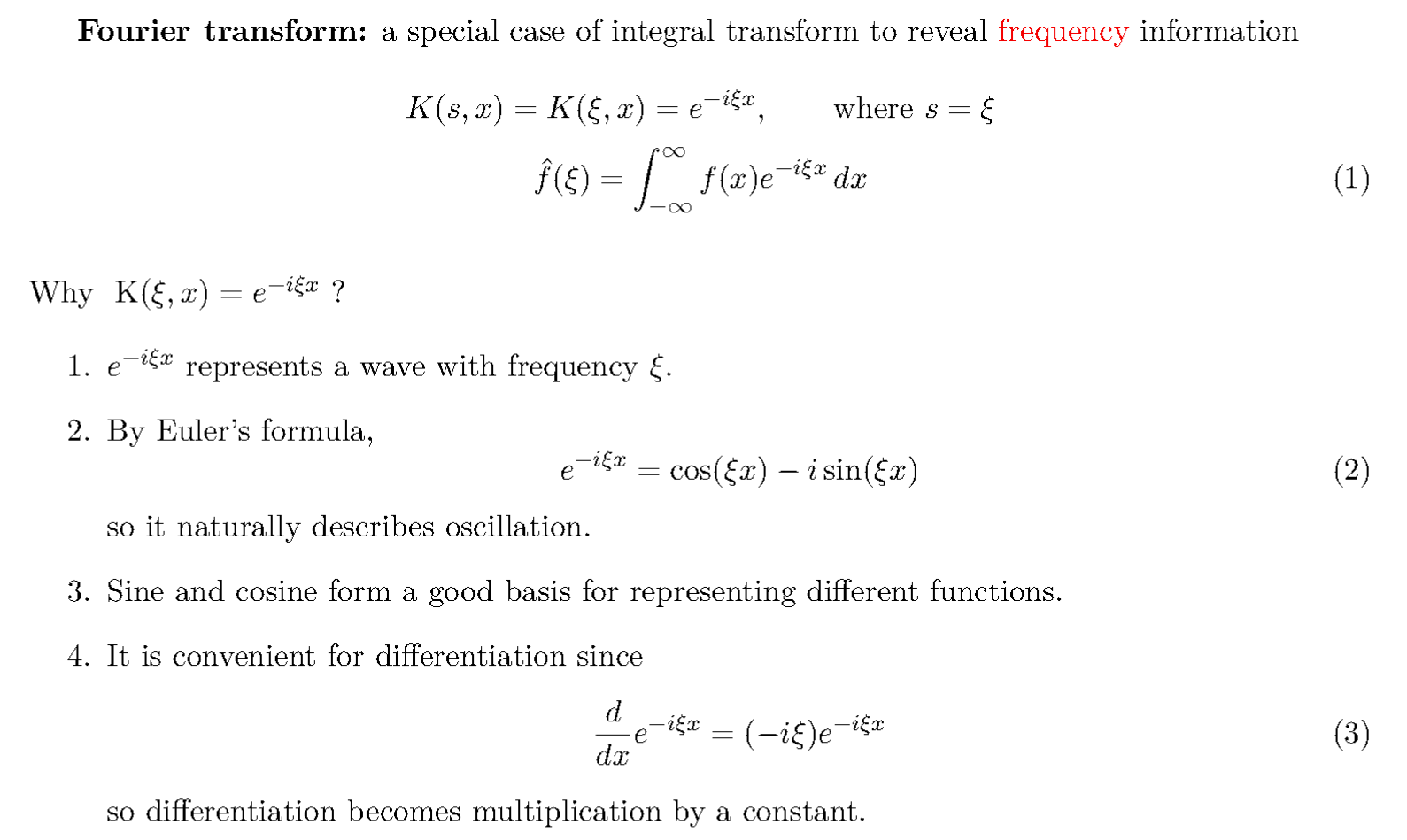
Overview: Track to Fast Fourier Transform(FFT) - Fourier Transform

Slide 14
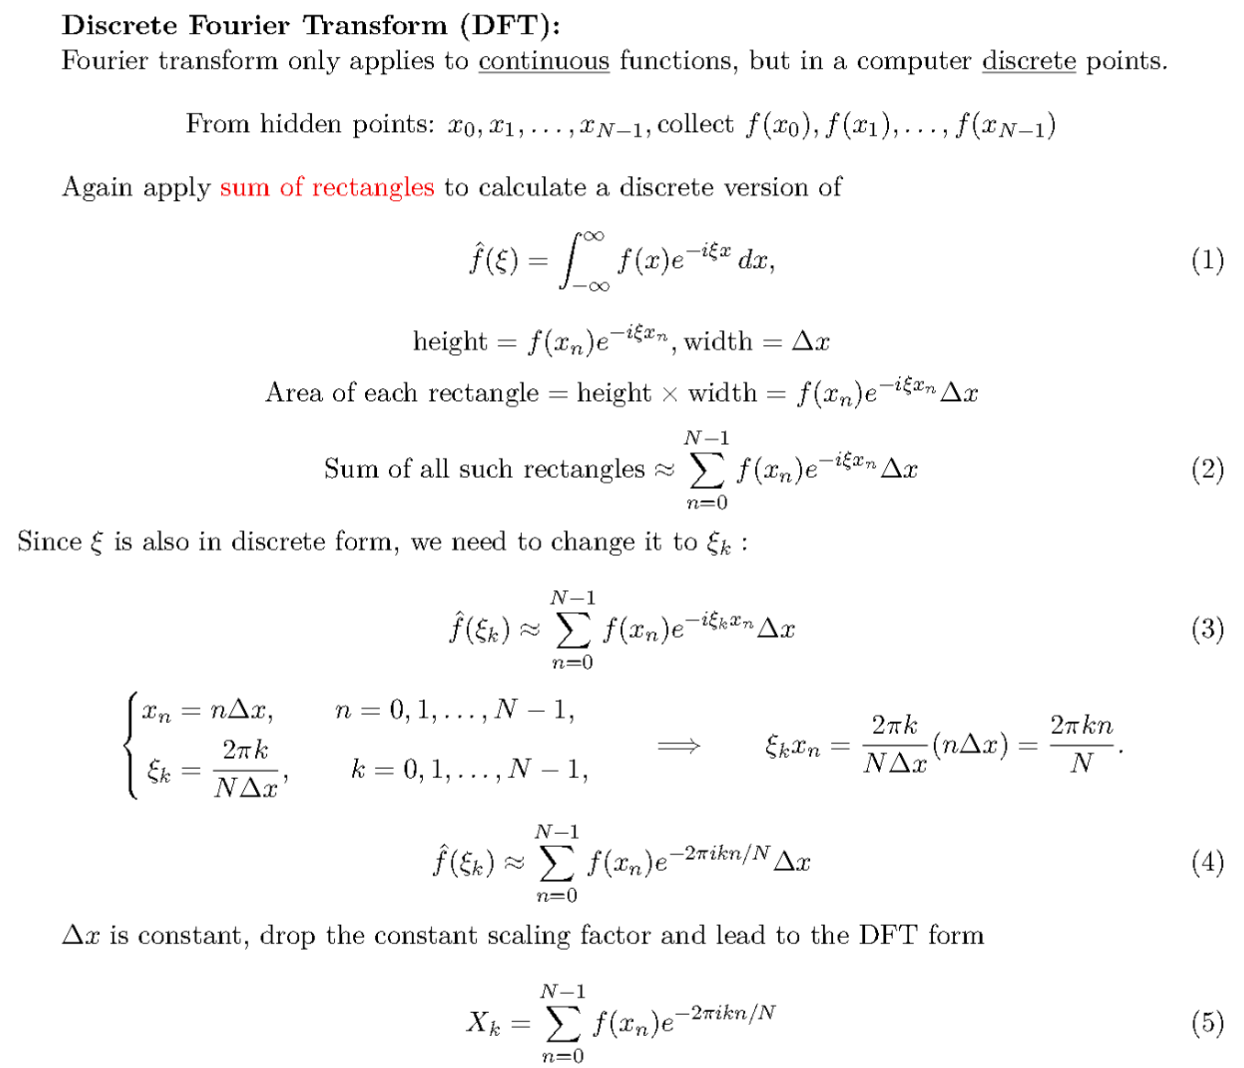
Overview: Track to Fast Fourier Transform(FFT) - Discrete Fourier Transform

Slide 15
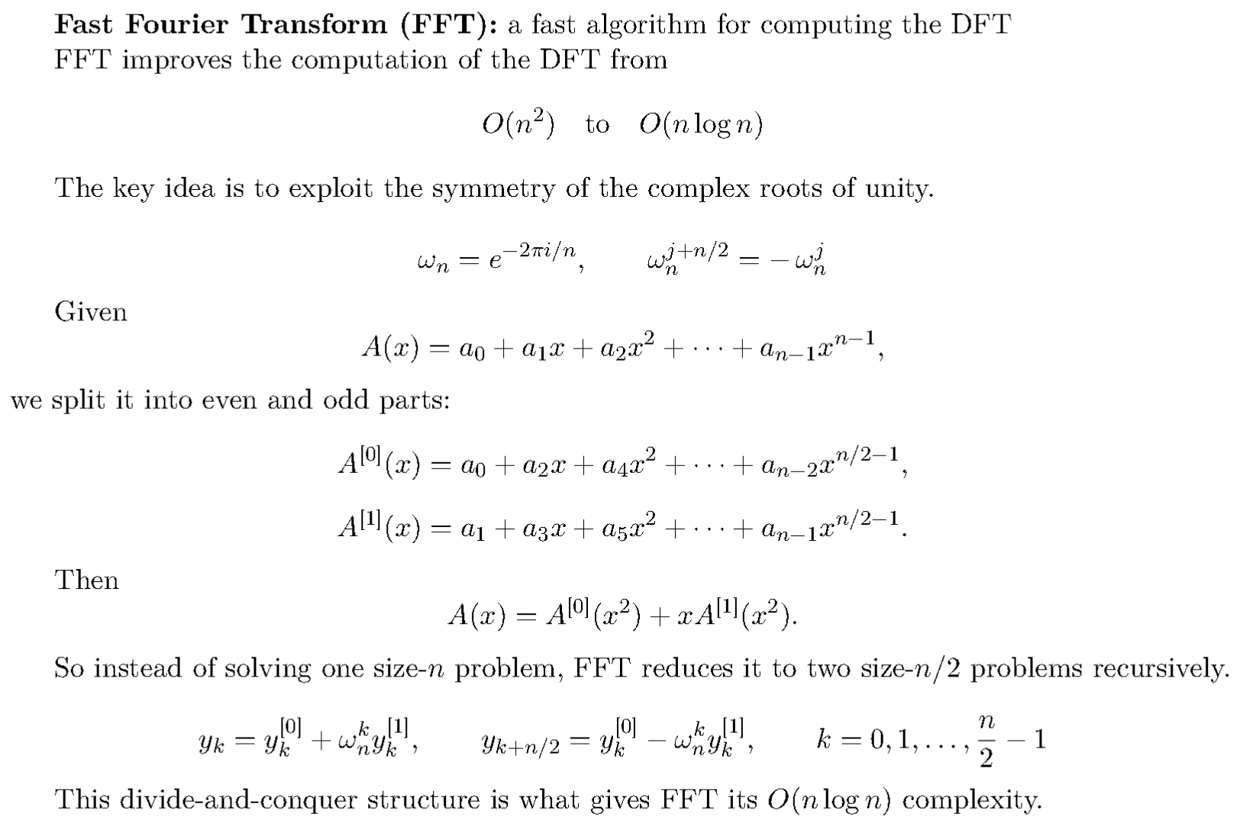
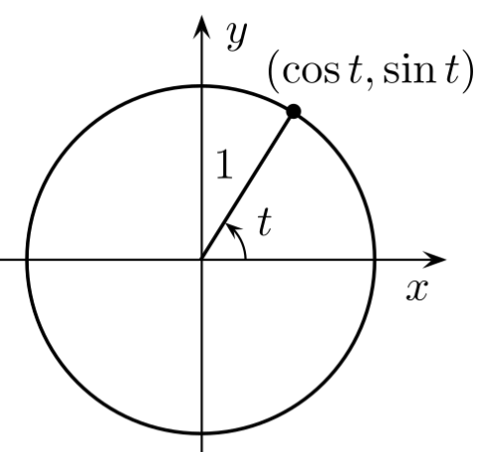
Overview: Track to Fast Fourier Transform(FFT) - Finally

Slide 16
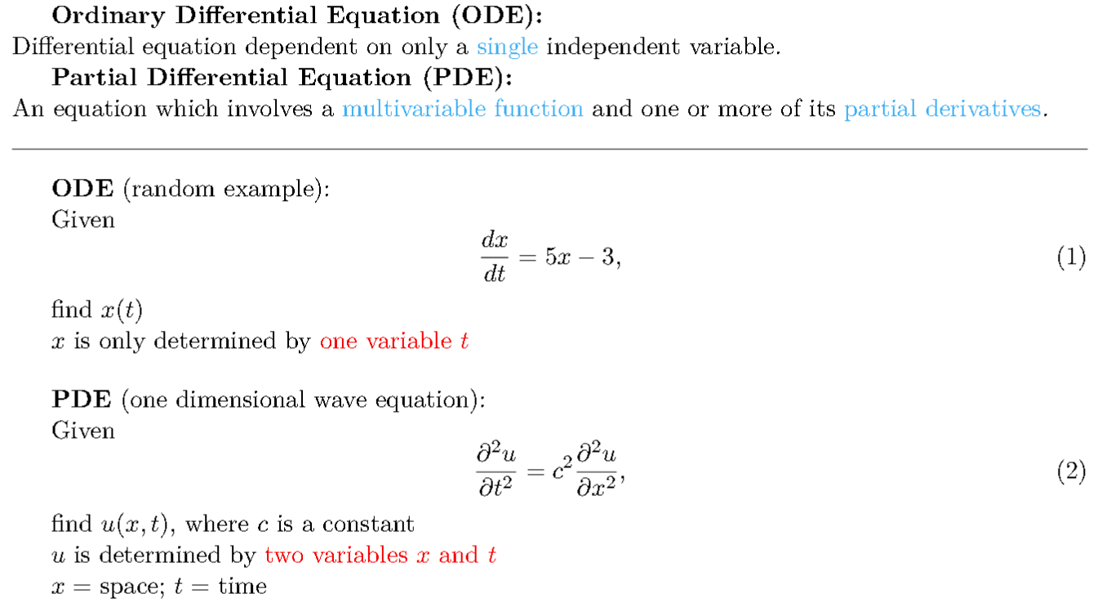
Overview: Partial Differential Equation (PDE) - General Definition

Slide 17
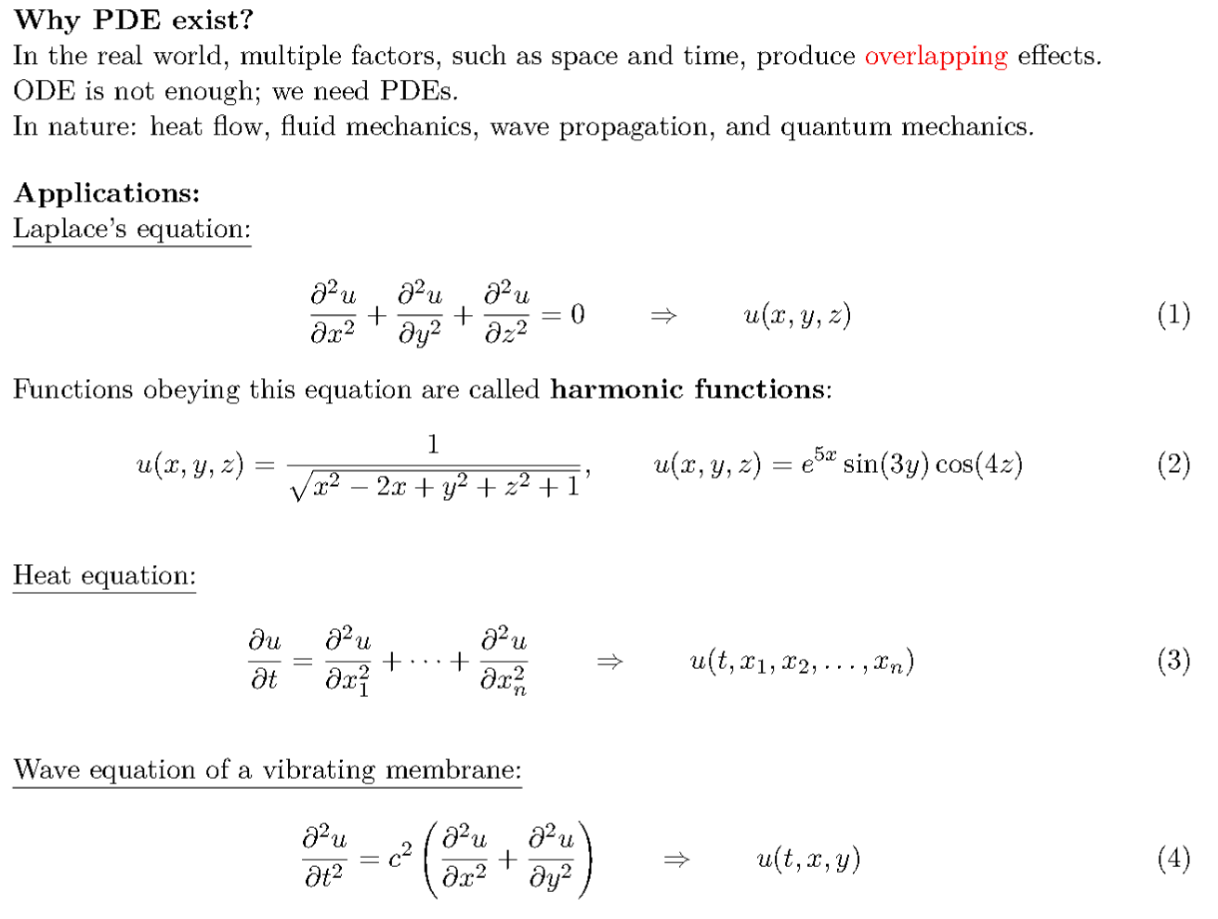
Overview: Partial Differential Equation (PDE) - Examples

Slide 18
Overview: Partial Differential Equation (PDE) - Challenges
Major challenges in solving PDEs:
No single method works for everything:
A technique that works well for one PDE may fail for another.
Nonlinearity and chaotic behavior:
Nonlinear PDEs can behave in very complicated ways. Small input changes can lead to very different outputs. Difficult to model consistently.
Complex geometry:
Many PDEs are solved on complicated shapes or multi-dimensional regions. The boundary conditions also strongly affect the solution.
Curse of dimensionality:
When the number of variables becomes large, the computational cost grows exponentially. This makes high-dimensional PDEs extremely hard to solve using standard numerical methods.

Slide 19
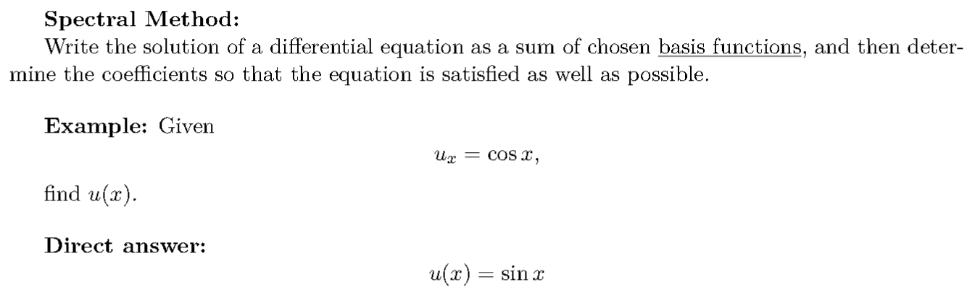
Overview: Spectral Method

Slide 20
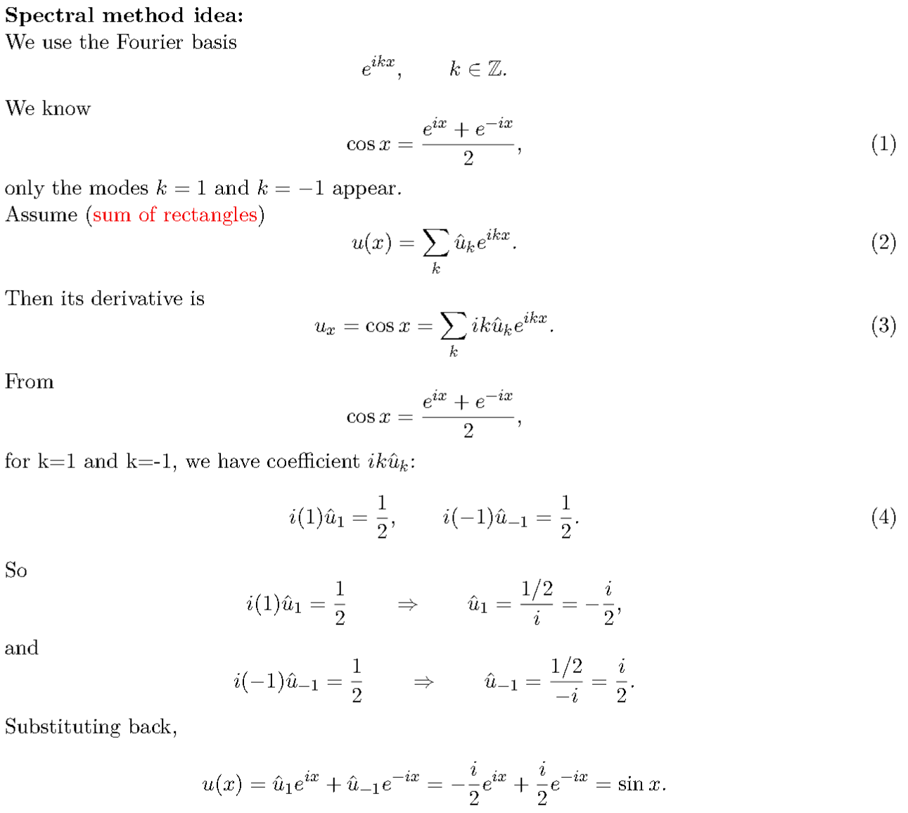

Slide 21
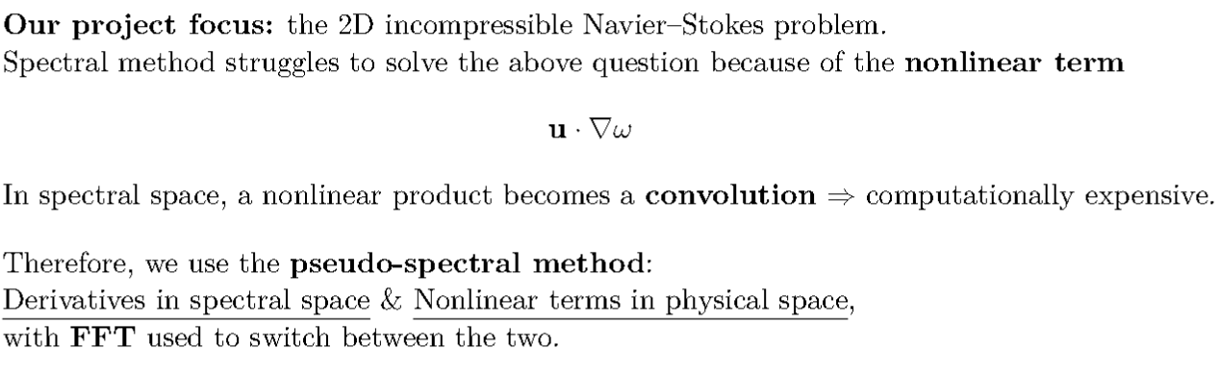

Overview: Spectral to Pseudo-Spectral
**spectral space: basis function and coefficients

Slide 22
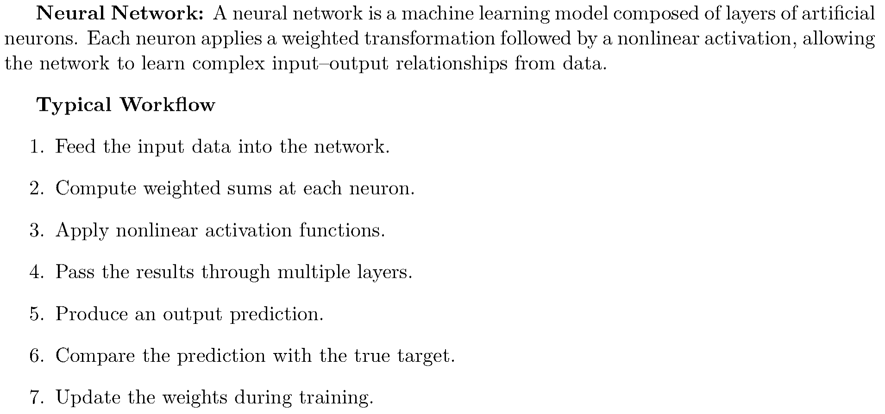
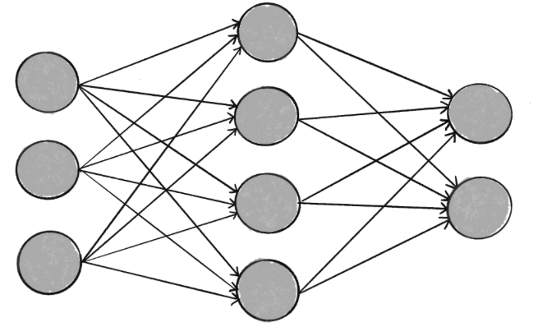
Overview: from Neural Network to Fourier Neural Operator

Slide 23
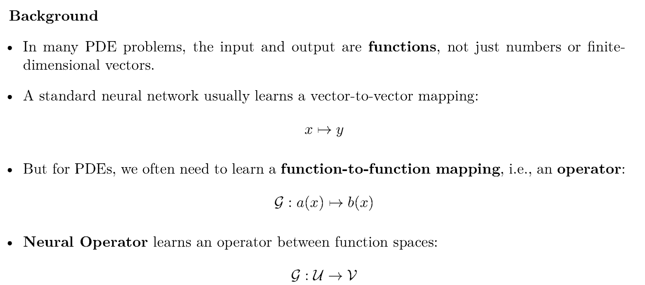
Overview: from Neural Network to Fourier Neural Operator

Slide 24
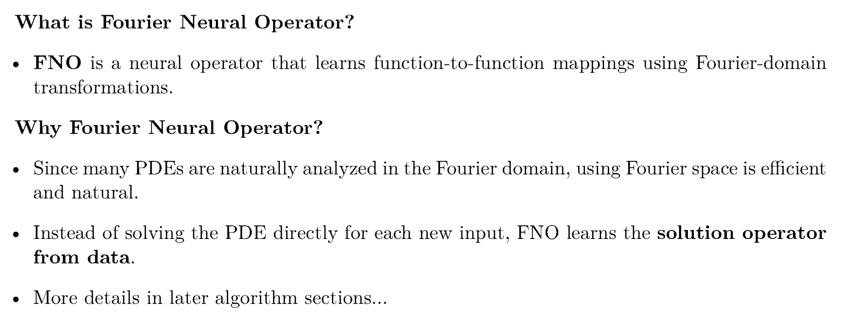
Overview: from Neural Network to Fourier Neural Operator

Slide 25
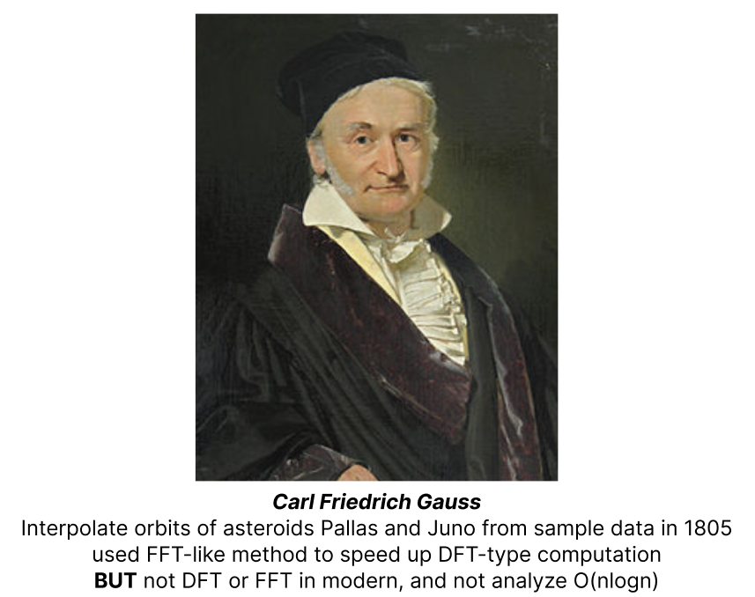
History - DFT/FFT: Idea

Slide 26
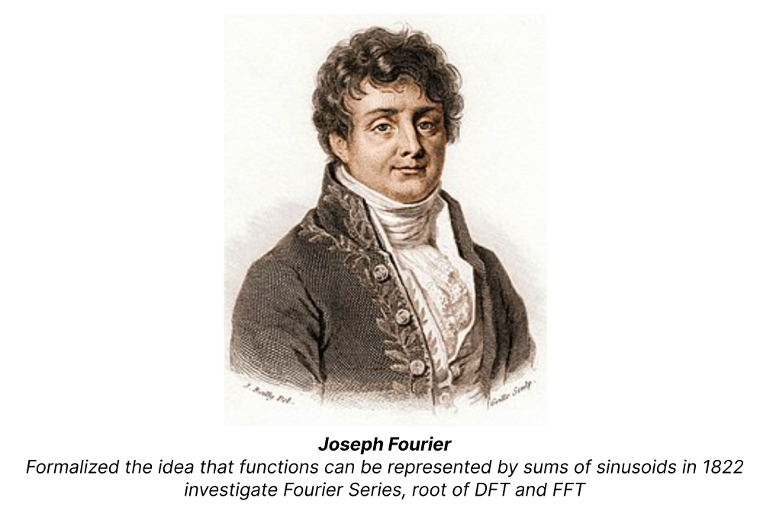
History - DFT/FFT: Father

Slide 27
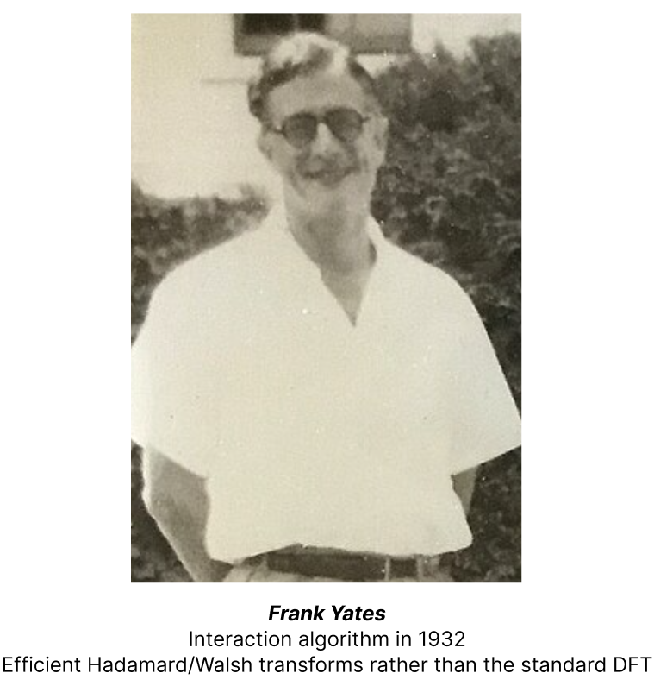
History - DFT/FFT: Development

Slide 28
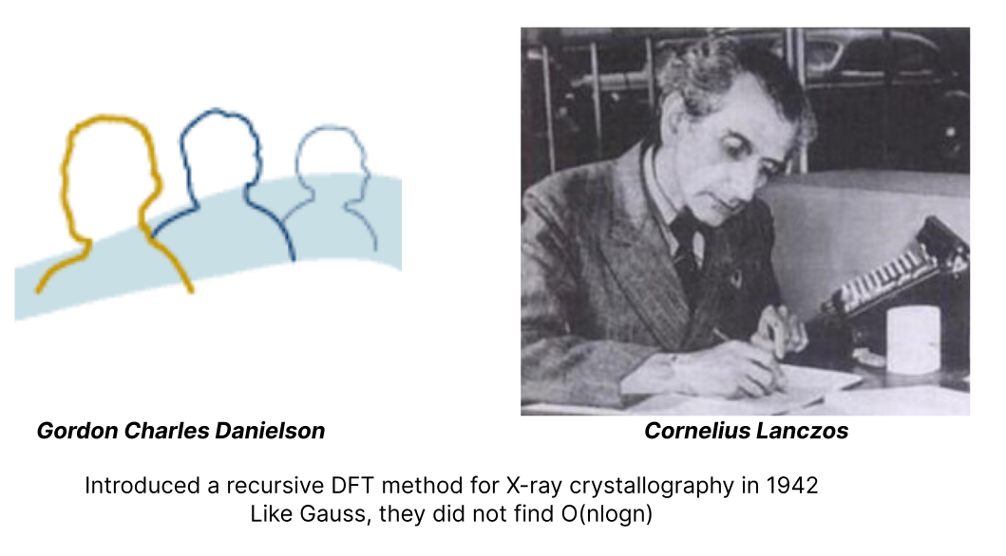
History - DFT/FFT: Development

Slide 29
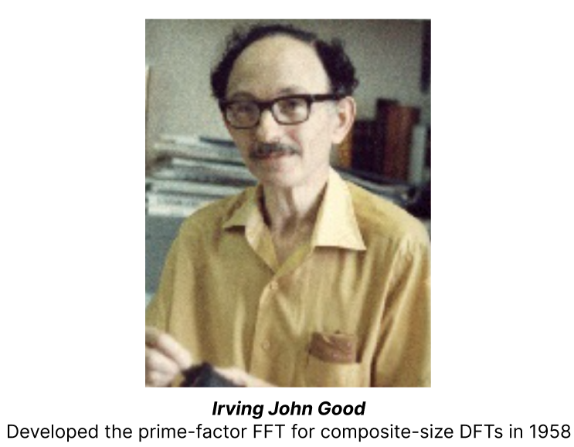
History - DFT/FFT: Development

Slide 30
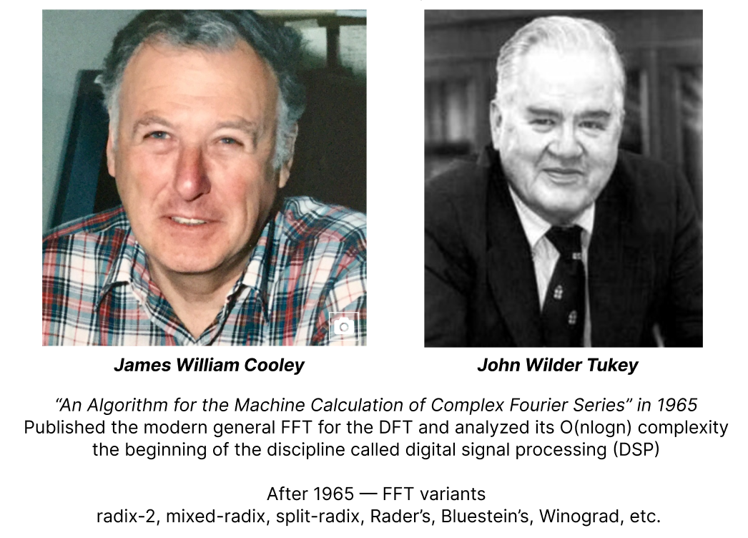
History - DFT/FFT: Modern

Slide 31
History - PDE
Origins: efforts to describe continuous phenomena such as heat flow, wave propagation, and fluid motion.
Early Stage: fundamental equations like Laplace equation, heat equation, and wave equation, together with explicit solution.
Shift Focus: most PDEs cannot be solved -> from finding formulas to understanding the behavior of solutions.
Rise of modern theory: In the 20th century, PDE theory developed around key questions of existence, uniqueness, regularity, and stability of solutions.
Nonlinear PDE: More attention on shock formation, blow-up, pattern formation, and free boundary problems.
Numerical methods: finite difference methods, finite element methods, and spectral methods became essential
Modern PDE: connect pure mathematics, scientific computing, and real-world applications across physics, engineering, biology, and data science.

Slide 32
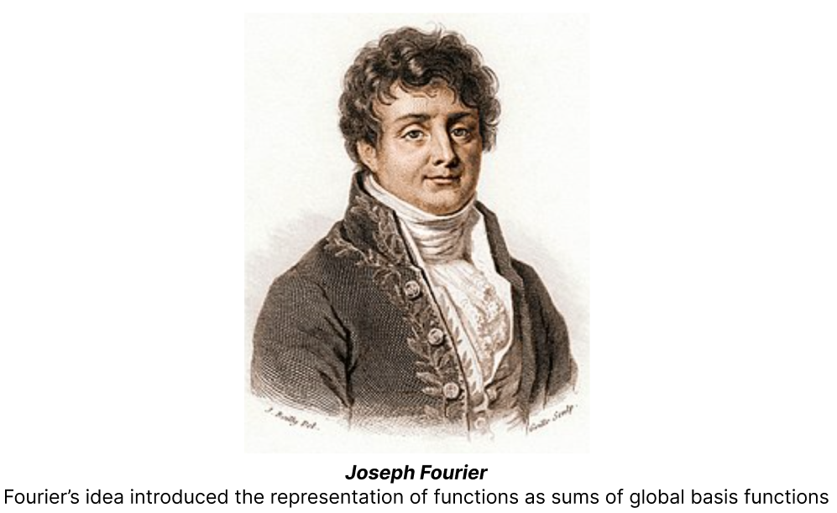
History - Spectral/Pseudo Method: Father

Slide 33
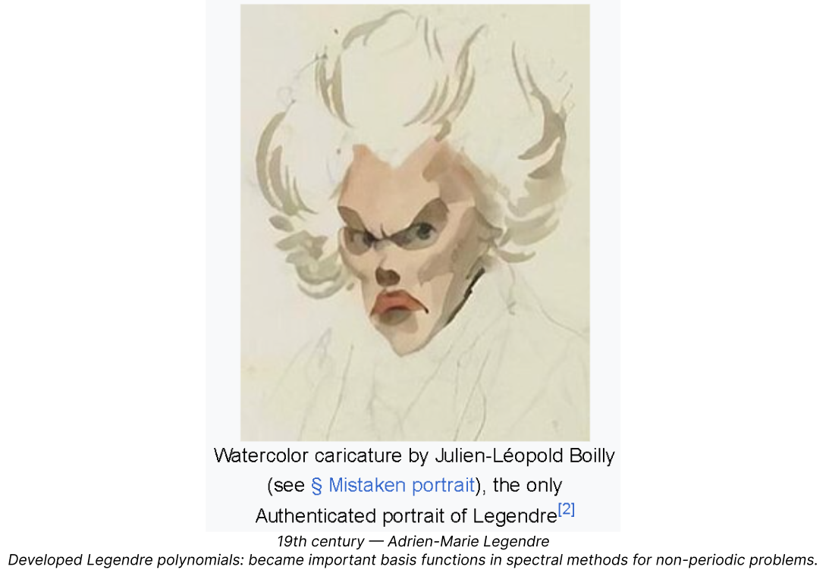
History - Spectral/Pseudo Method: Non-periodic

Slide 34
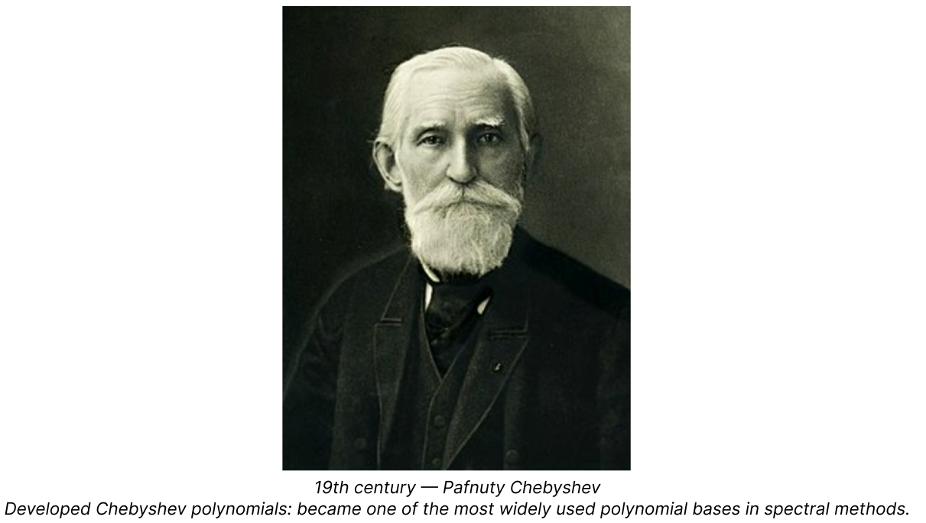
History - Spectral/Pseudo Method: polynomial bases

Slide 35
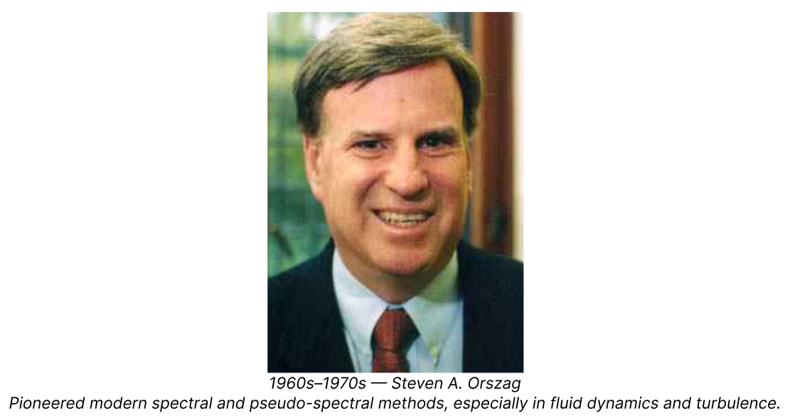
History - Spectral/Pseudo Method: Modern

Slide 36
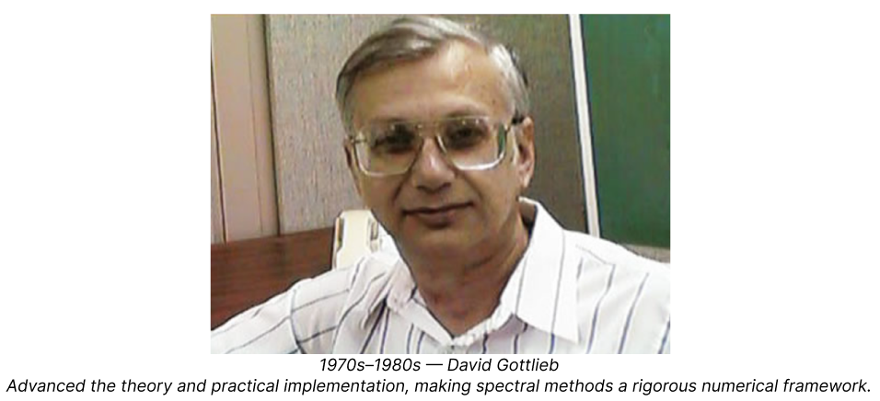
History - Spectral/Pseudo Method: Development

Slide 37
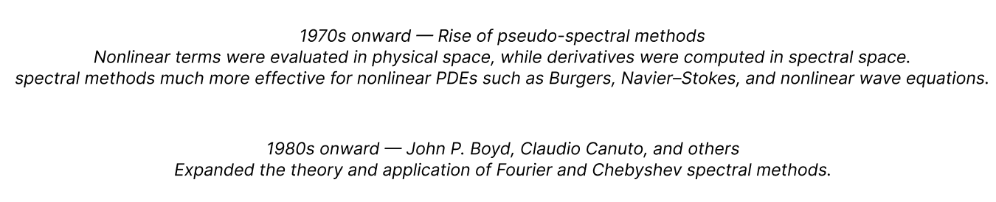
History - Spectral/Pseudo Method: Now

Slide 38
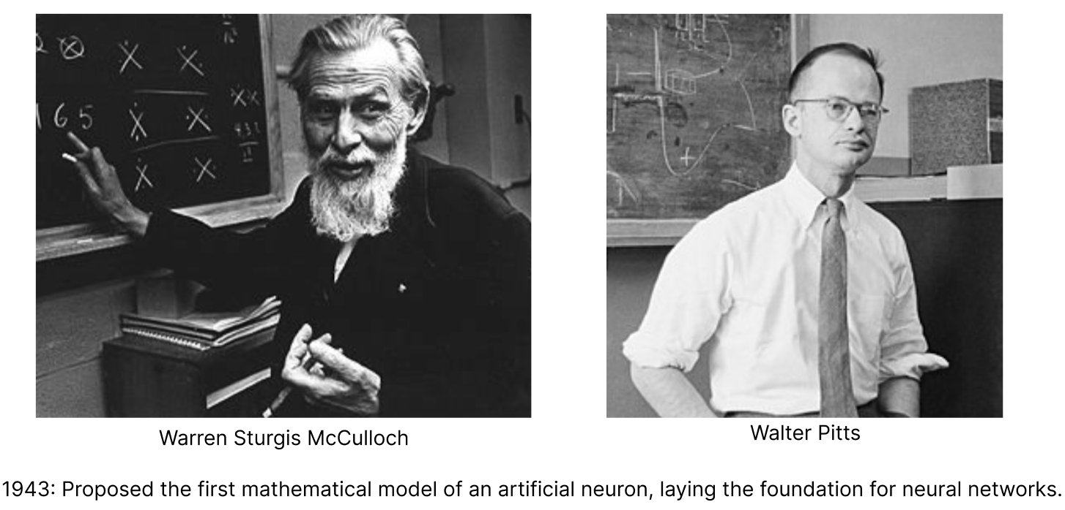
History - from Neural Network to FNO

Slide 39
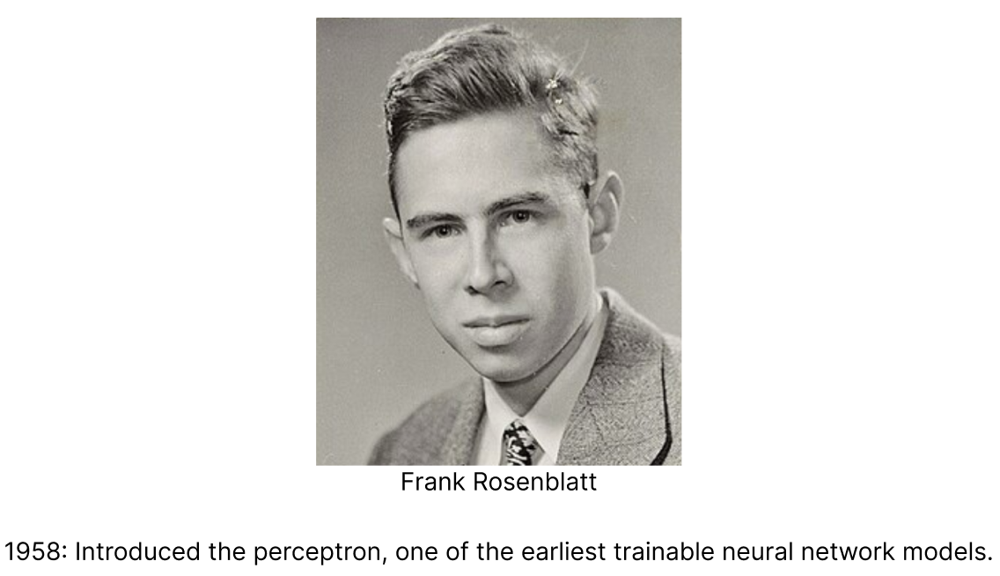
History - from Neural Network to FNO

Slide 40
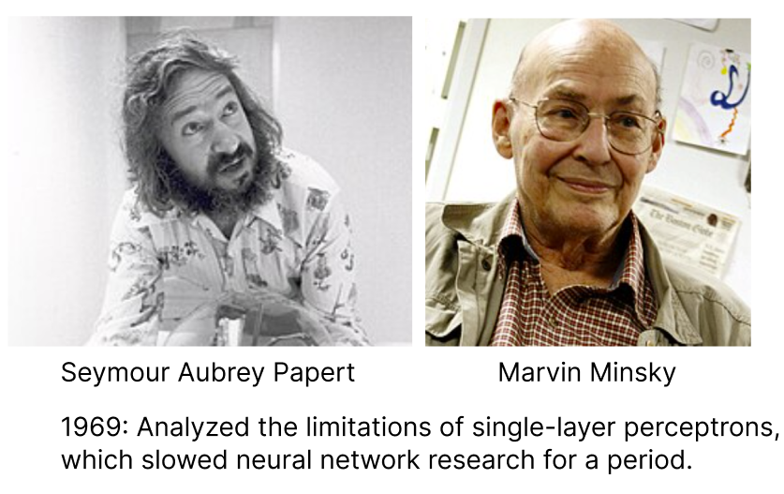
History - from Neural Network to FNO

Slide 41
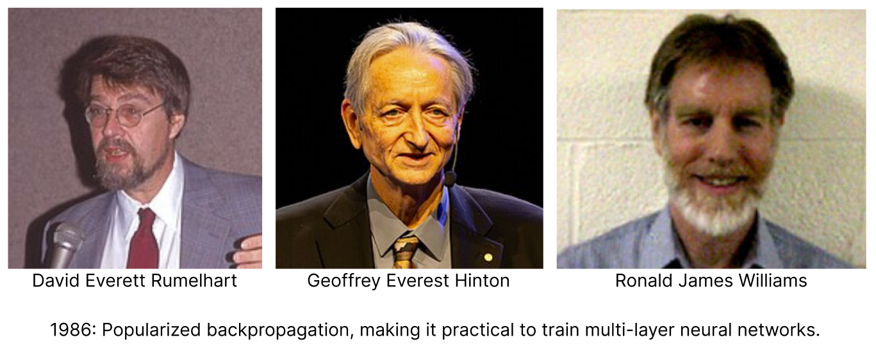
History - from Neural Network to FNO

Slide 42
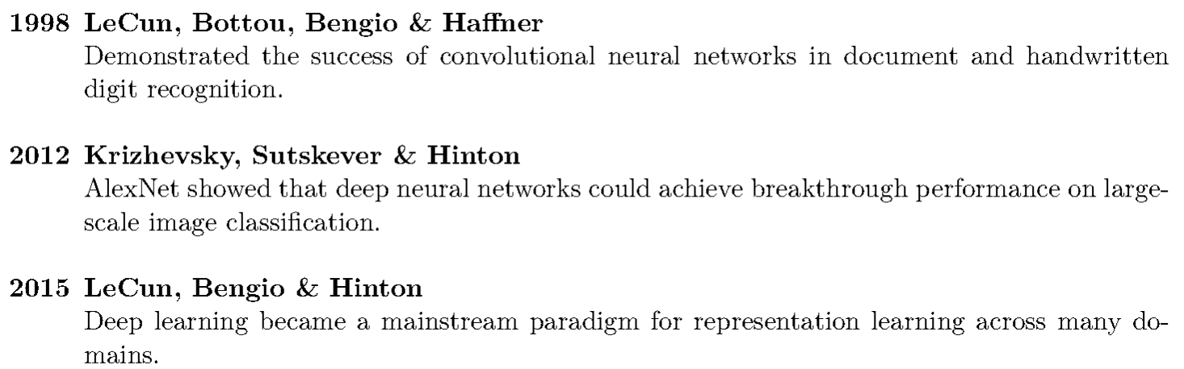
History - from Neural Network to FNO

Slide 43

History - from Neural Network to FNO
Introduced the neural operator framework, extending learning from vector-to-vector mappings to function-to-function mappings.

Slide 44
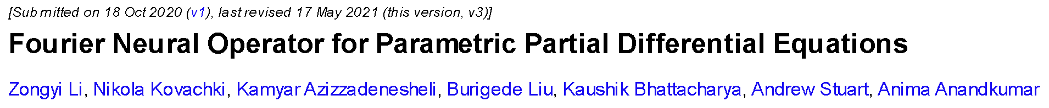
History - from Neural Network to FNO
Same team, almost same year
Proposed the Fourier Neural Operator (FNO), which learns PDE solution operators efficiently in the Fourier domain.

Slide 45
Comparison Experiments: Numerical v.s. Data-driven
Numerical:
Ground truth: for optimization and comparison
Physics-based
Iterative computation
FFT-based Method:
The pseudo-spectral method
Data-driven:
Uses truthful results by numerical methods
Direct mapping inference
Lacks interpretability or guarantee
Highly dependent on data, optimization settings
FFT-based Method:
Operators learning with FNO
(Fourier Neural Operators)

Slide 46
Applications: Numerical v.s. Data-driven for Fluid Dynamics PDE
Numerical:
High-fidelity Fluid Simulation
Fields of application (both methods):
Aerospace and Aviation
Ocean and Climate Simulations
Data-driven:
Fast Surrogate
Parameter Sweeps
Rapid Evaluations

Slide 47






Focus of Question: 2D Incompressible Navier-Stokes Equation
Consider the two-dimensional incompressible Navier–Stokes equation in vorticity form:
On a periodic domain: , with incompressibility:
Where denotes the vorticity field, and denotes the velocity field.
Given the initial condition: Compute
Notes:
This equation describes how swirling motion evolves in a 2D incompressible fluid, like an idealized thin layer of water or air. Here, w(x,t)w(x,t)w(x,t) (read: “double-u of x and t”) is the vorticity, which tells us how much the fluid is spinning locally, and u(x,t)u(x,t)u(x,t) (read: “you of x and t”) is the velocity, which tells us how the fluid is moving.
: ∂tw\partial_t w∂t​w (read: “partial w with respect to t”) means how the local spinning changes over time, and u⋅∇wu \cdot \nabla wu⋅∇w (read: “you dot grad double-u”) means that the flow also carries that spinning from place to place.
, νΔw\nu \Delta wνΔw (read: “new times the laplacian of double-u”) represents viscosity, which smooths out sharp variations in the flow, while f(x)f(x)f(x) (read: “f of x”) is an external forcing that keeps pushing or stirring the fluid.
The domain is periodic, meaning if fluid exits one side, . And ∇⋅u=0\nabla \cdot u = 0∇⋅u=0 (read: “divergence of you equals zero”) means the fluid is incompressible: it can change shape, but not volume. Starting from the initial pattern w0(x)w_0(x)w0​(x) (read: “double-u sub zero of x”), the goal is to determine the vorticity w(x,t)w(x,t)w(x,t) (read: “double-u of x and t”) at later times.

Slide 48
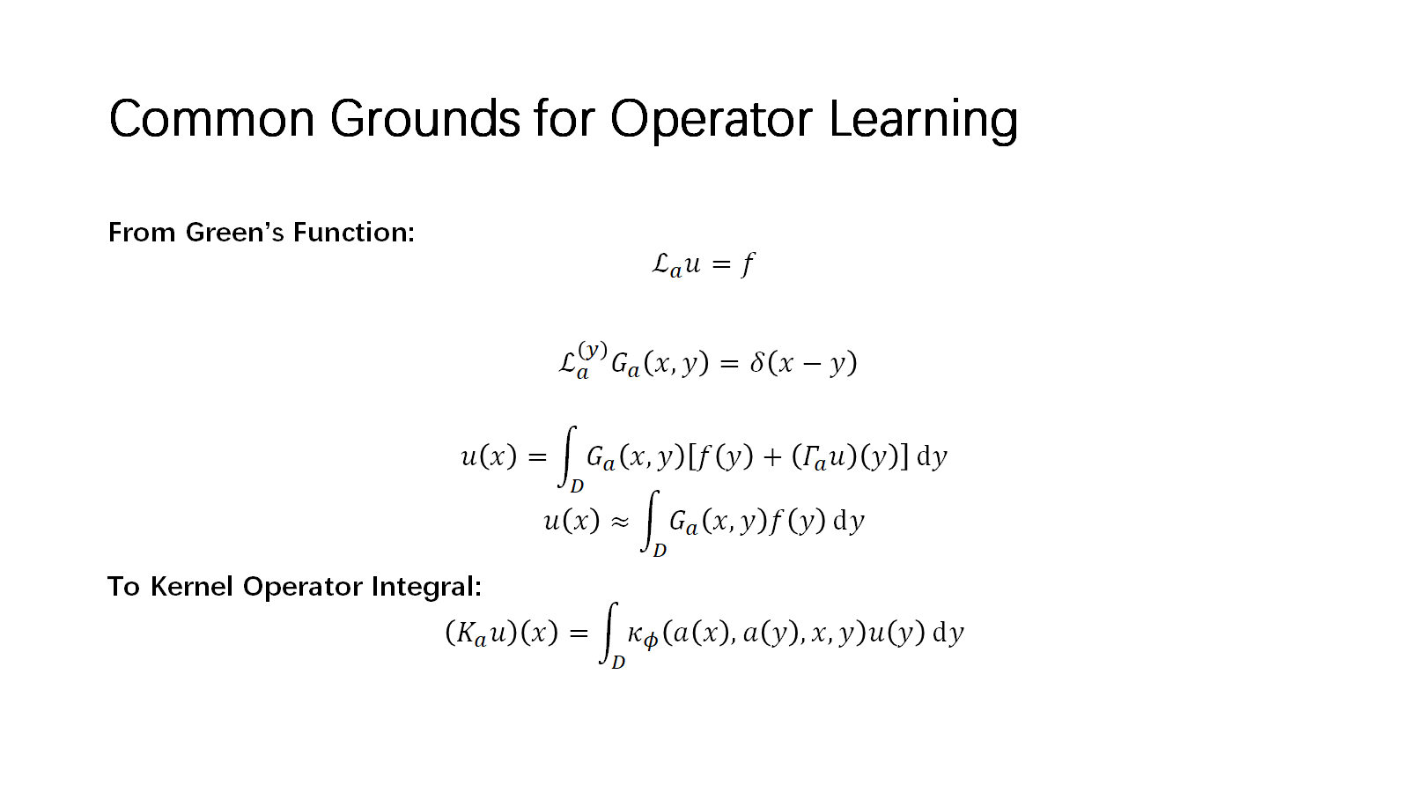


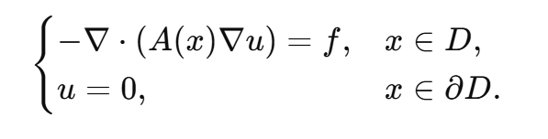
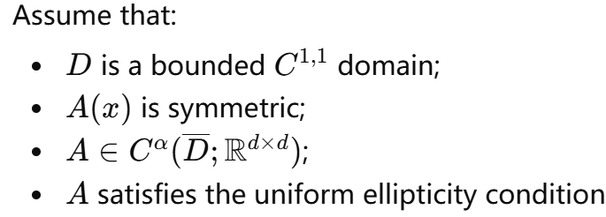

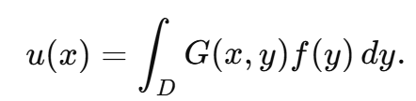
Only then,
Notes:
Kernel Integral Operator

Slide 49
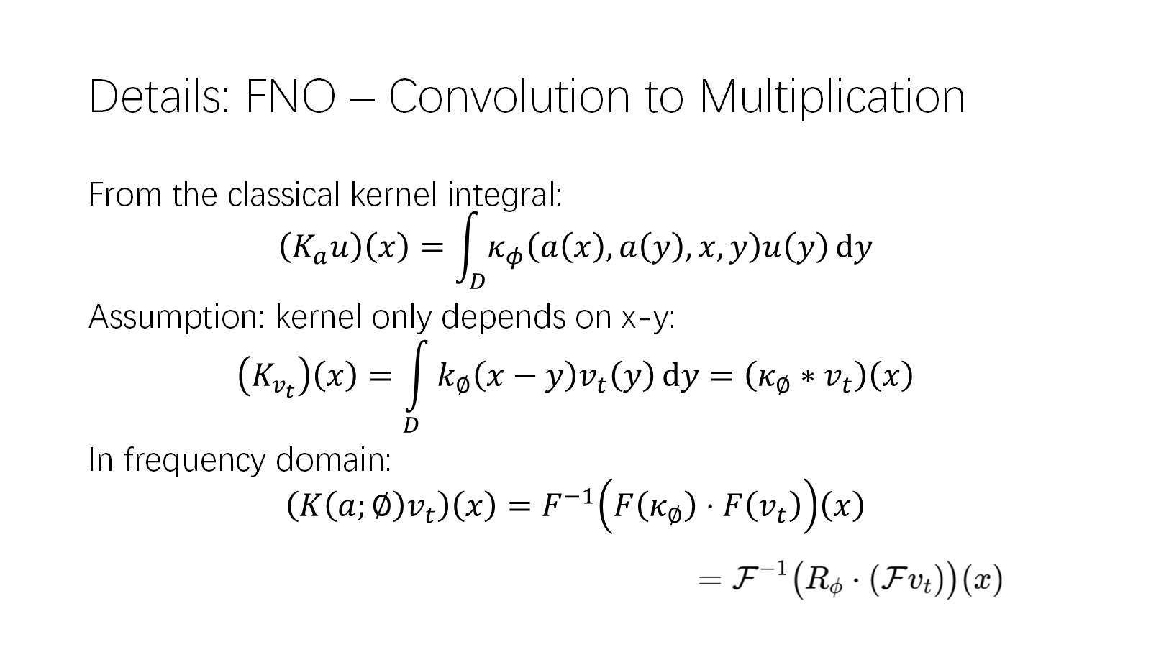
Convolution becomes (element-wise) multiplication in the frequency domain.

Slide 50
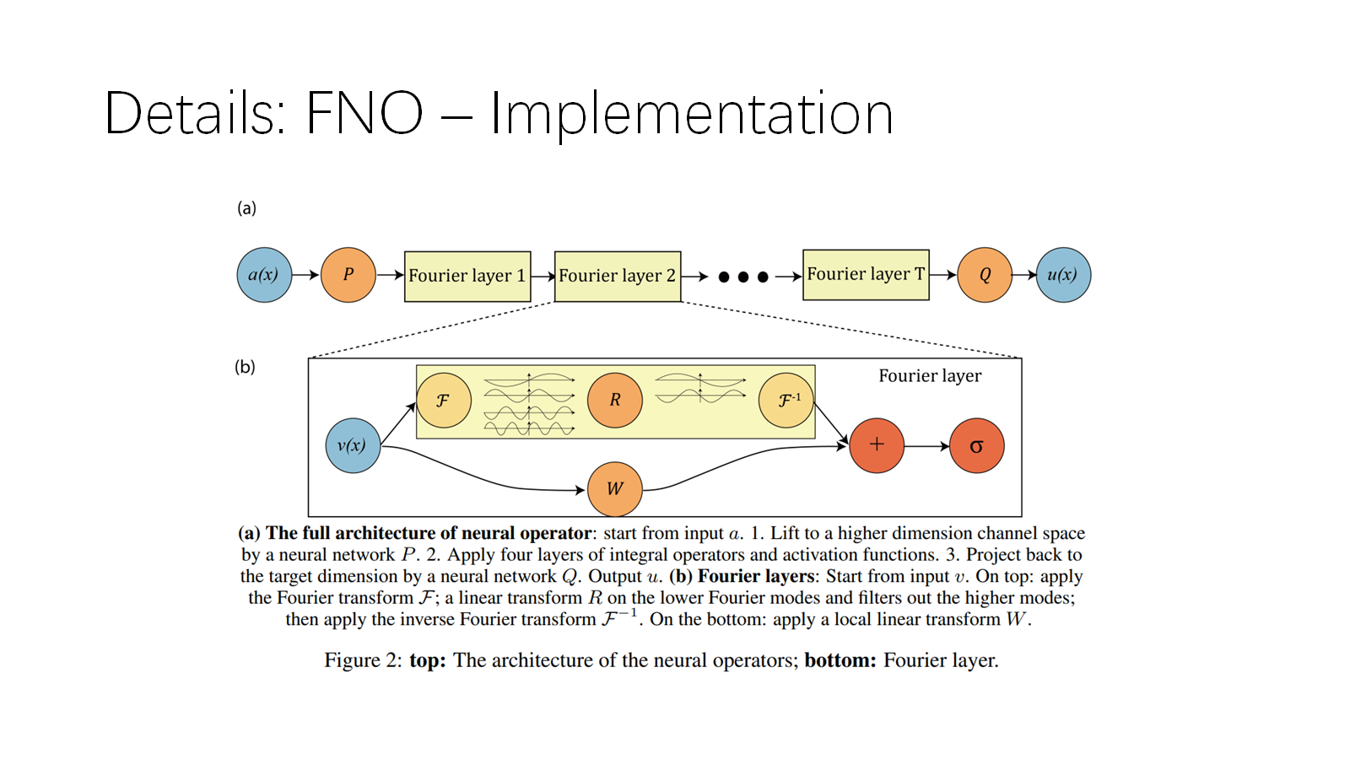


Slide 51

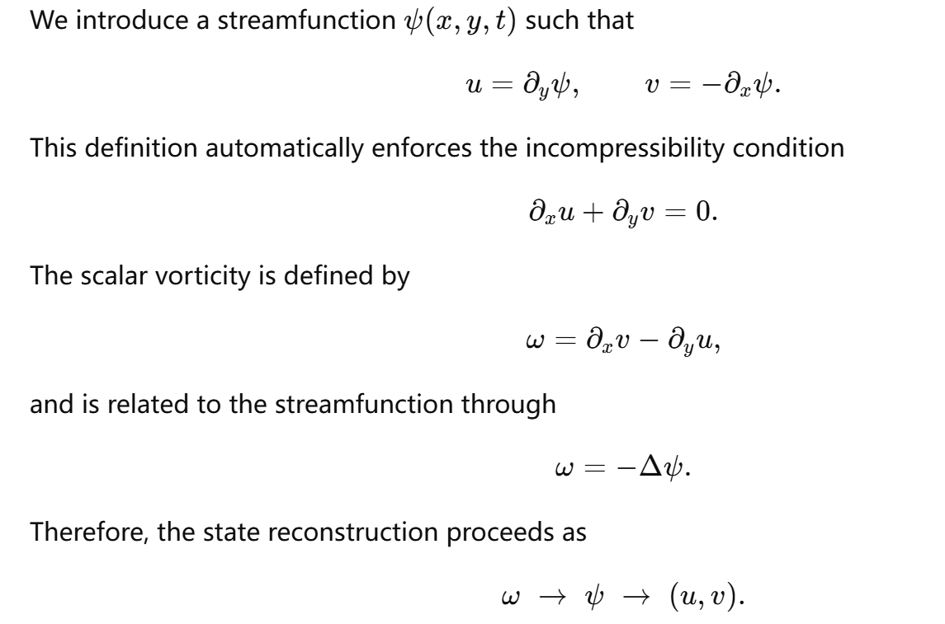
Pseudo Spectral for Navier-Stokes
Notes:
We are looking at a two-dimensional fluid flow. The velocity has two components: u in the x-direction and v in the y-direction.
Instead of tracking both directly, we introduce one helper function called the streamfunction, or psi. The equations tell us that u comes from how psi changes with y, and v comes from how psi changes with x, with a minus sign. So one scalar function lets us reconstruct the whole velocity field.
This is powerful because it automatically enforces incompressibility: the fluid is not locally appearing or disappearing.
Then we define vorticity, or omega, which measures local spinning. It is built from spatial changes in the velocity, and it is also related to psi through a Poisson equation. So if we know omega, we solve for psi; and from psi, we recover u and v.
So the key idea is:
vorticity → streamfunction → velocity.

Slide 52
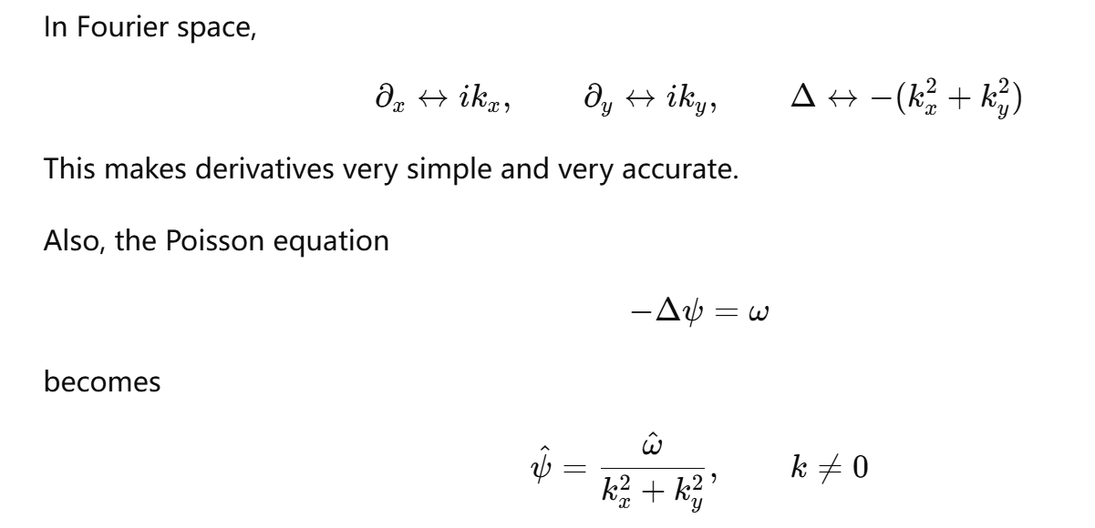
Pseudo Spectral for Navier-Stokes

Slide 53
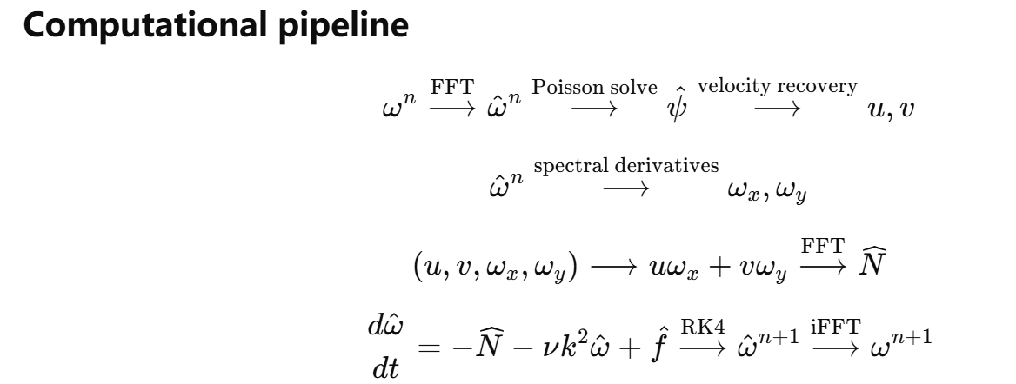
Pseudo Spectral for Navier-Stokes
Again, physical domain, non-linear terms

Slide 54










Comparison Experiment Setup
Vorticity field: , with discretization:
Discretization and numerical parmeter settings:
For each stride parameter, train:
For simple evaluation:

Slide 55

Error Curves Visualization

Slide 56

Computational Cost Comparison
Iterative: constant per iteration
direct mapping: constant per mapping

Slide 57


Evolution Snapshots
Stride = 1
Stride = 16

Slide 58
Open Issues
1.Representation vs. Learning
Universal approximation shows operators can be represented, but not how to train them efficiently.
2.Generalization
Robustness across meshes, geometries, and boundary conditions remains challenging.
3.Incomplete Theory
In infinite-dimensional spaces, existence of minimizers is still open.
4.Training Cost
Large datasets and high cost; need better sampling strategies and inductive bias.

Slide 59

References
1.Chen, T. and H. Chen. Universal Approximation to Nonlinear Operators by Neural Networks. IEEE TNN, 1995.
2.Lu, L. et al. Learning nonlinear operators via DeepONet. Nature Machine Intelligence, 2021.
3.Li, Z. et al. Fourier Neural Operator for PDEs. ICLR, 2021.
4.K. Lou and Z. Yin, A CUDA Pseudo-spectral Solver for Two-Dimensional Navier-Stokes Equation, 11th Distributed Computing and Applications to Business, 2012.
5.Hatziavramidis, D., & Ku, H.-C. A pseudospectral method for the solution of the two-dimensional Navier–Stokes equations in the primitive variable formulation. Journal of Computational Physics, 1986.

Slide 60


Discussion
Theory: still lacks full understanding of learning and generalization.
Architecture: success depends on inductive bias.
Application:
  FNO: efficient for PDEs
  DeepONet: more general

Slide 61
Questions:
Pseudo-spectral solves what term in physical domain?
First name of the person who is considered to be the Father of DFT/FFT?
One reason Fourier Neural Operators enjoys fast computation is because convolution in the physical domain becomes ______ in the frequency domain.

