Slide 1
The FLAC Algorithm
Ethan Miller, Connor Riley, Breanna Slessman

Slide 2

Test Questions
01
02
03
What file type do we say FLAC is most commonly used to compress?
What year was the most recent major update (as of this presentation) made to FLAC?
What is Apple’s version of FLAC encoding?
https://forms.gle/nqFYzfqULVHJCpnr8

Slide 3
01
Introductions

Slide 4
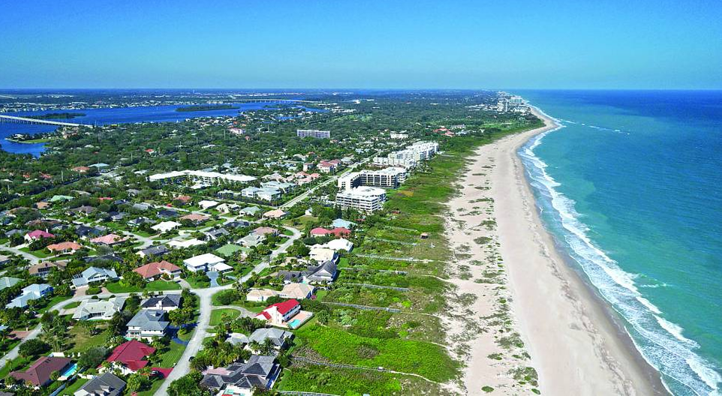
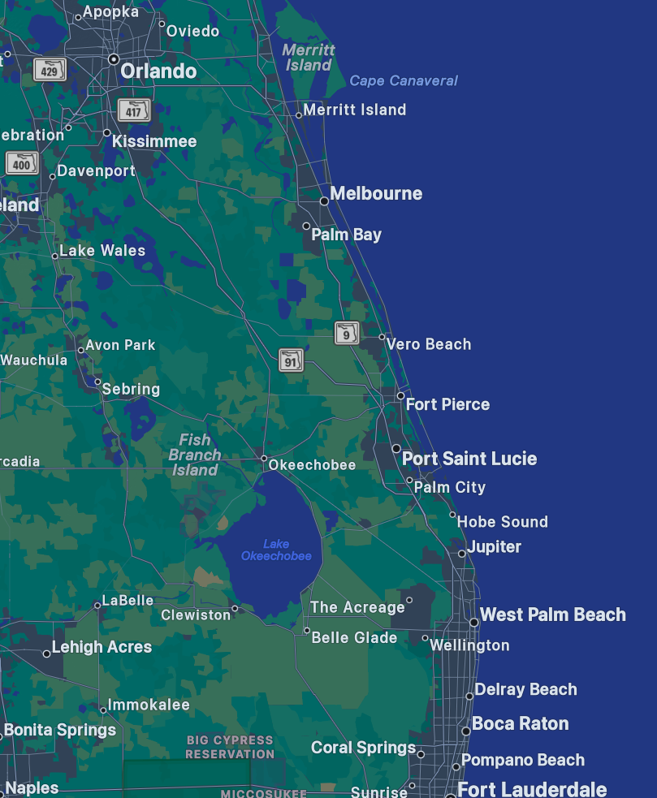
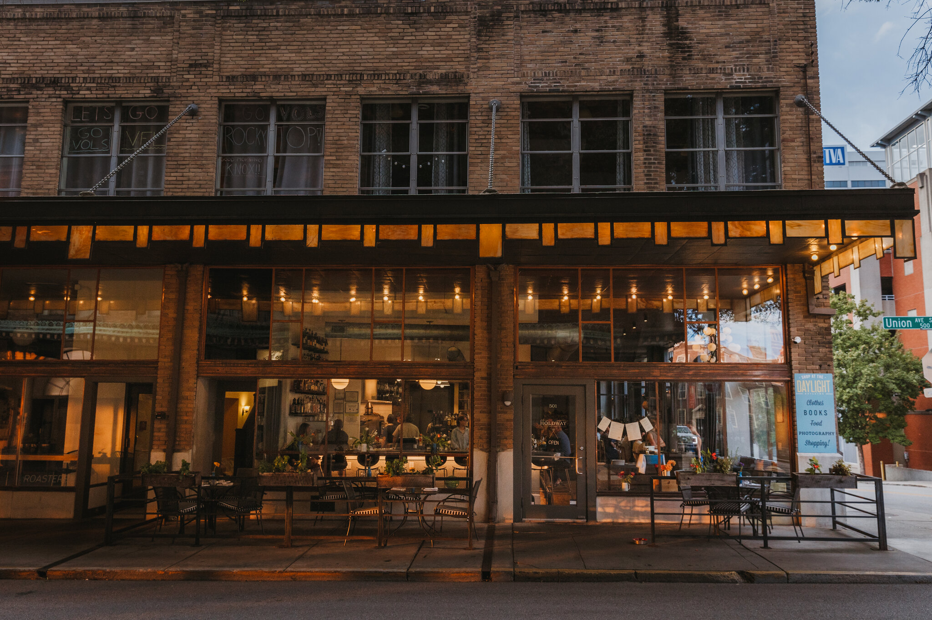
Connor Riley
From Vero Beach, Florida
Attended Vero Beach High School
- Focused on Biology - Certified Lab Tech
- Was part of the school’s band
- Played concert bassoon for 8 years, marched Euphonium
- Performed in london new years parade
Started UTK in 2019, as a Microbiology major
Swapped to CS after Covid, Graduating this semester
Worked downtown at J.C. Holdway for past 6.5 years

Slide 5

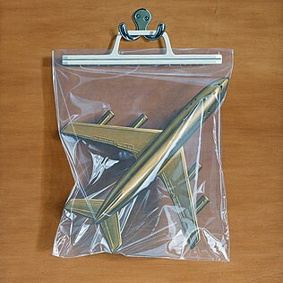
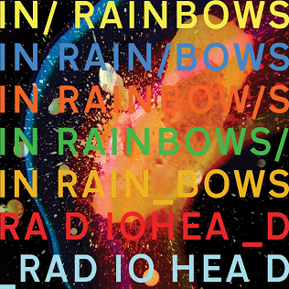

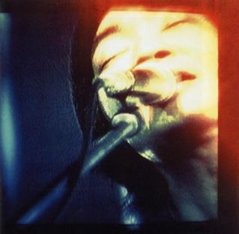
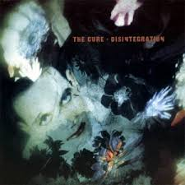
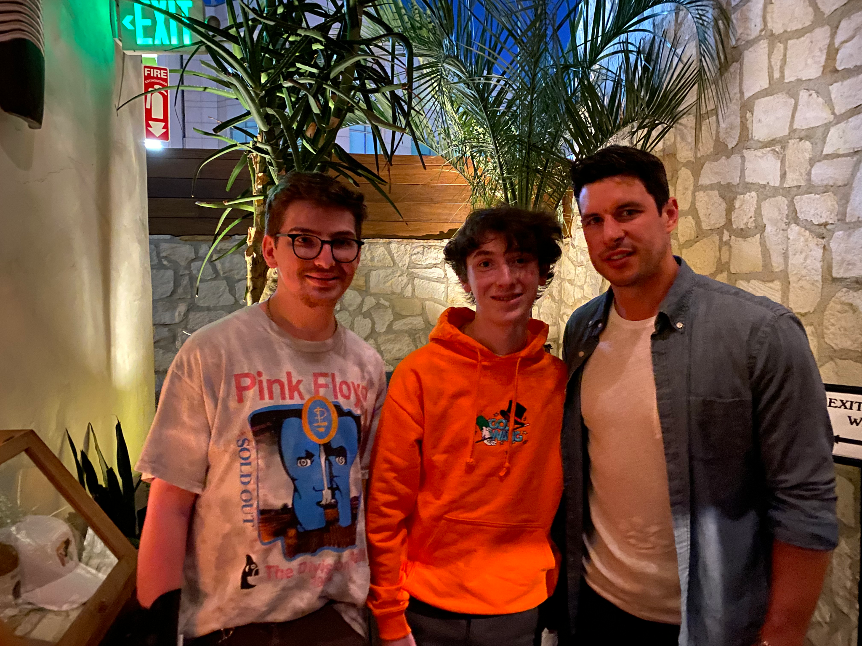
Hobbies:
Formula One - Attended Canadian GP last year
Music - favorite band is Radiohead
Hockey - Pittsburgh Penguins
Movies - top 4:

Slide 6
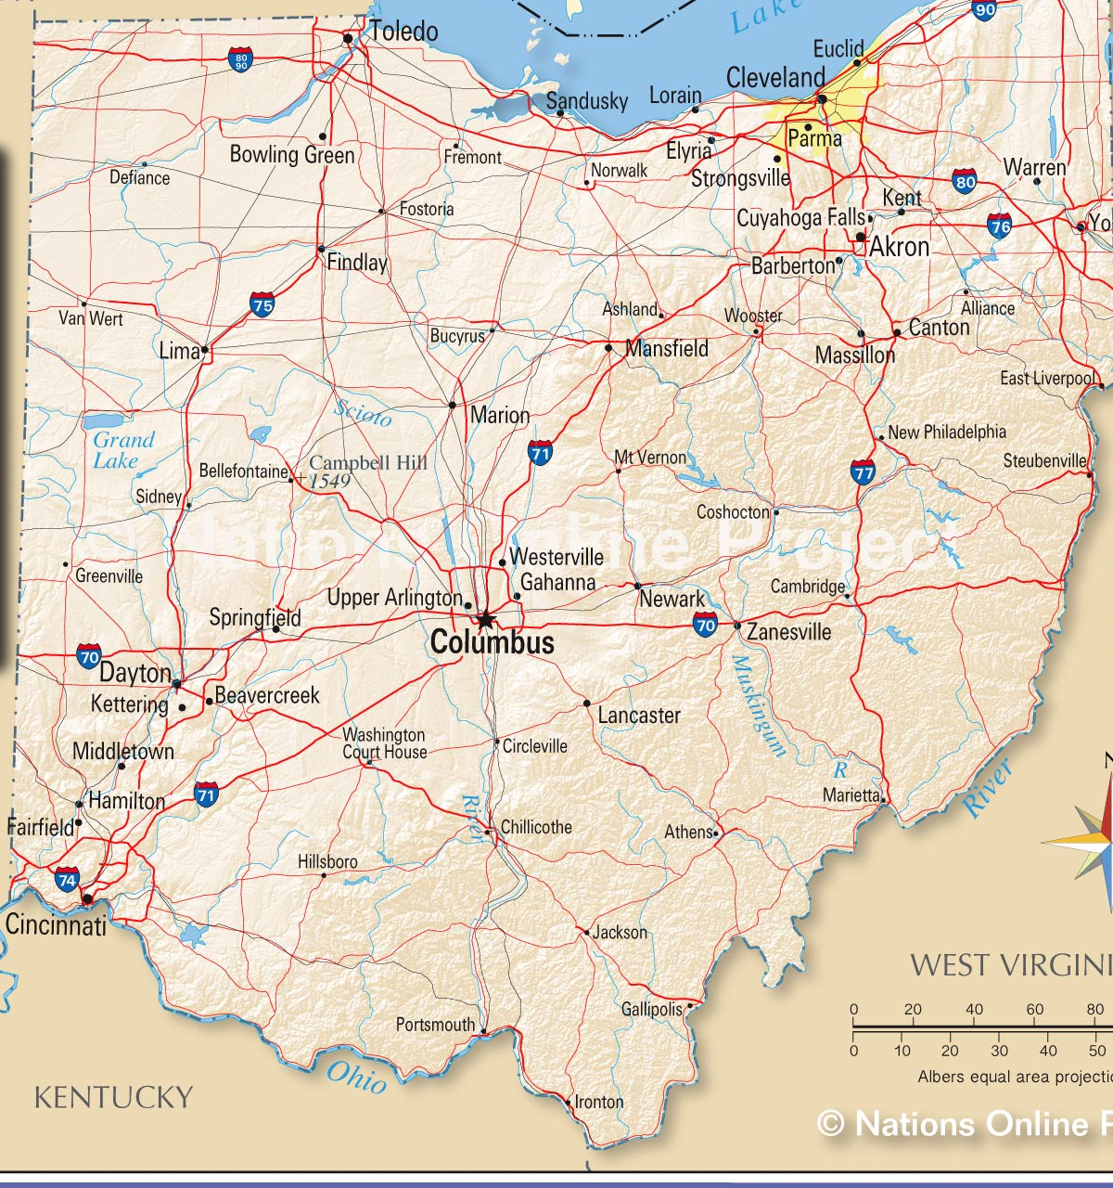
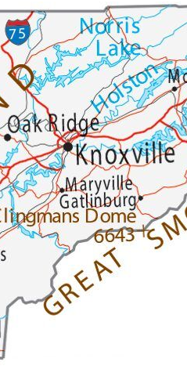
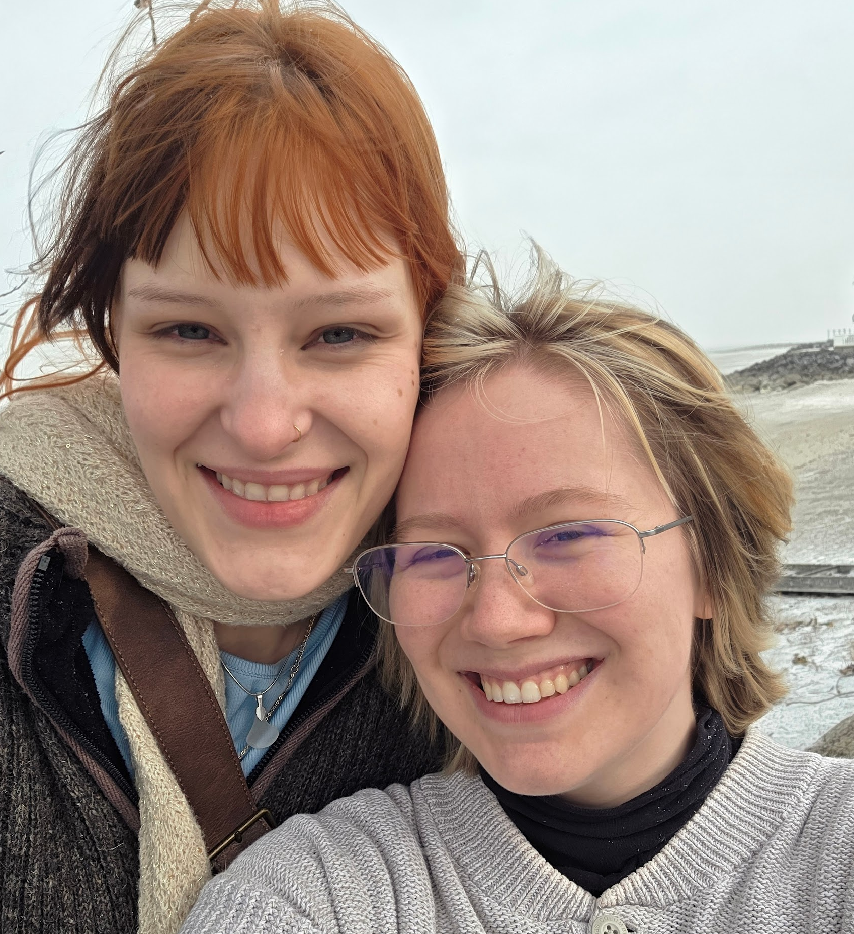

Breanna Slessman
Grew up in northern Ohio
Moved to Clinton, Tennessee at 11
Attended Oak Ridge High School
BS from UTK in 2025
Started my PhD, likely mastering out
  Advised by Dr. Sai
  Research area: HCI, AI Education and Ethics
  Ideally will continue PhD abroad later
Hobbies, Interests, and Favorites
  Being on call with my girlfriend
  Shows: ATLA, One Piece
    Favorite: Mob Psycho 100
  Games: Minecraft, Portal; Hades, Outer Wilds
  Art: digital art, crochet, knitting
  Misc: Watching YouTube videos, learning Dutch, VtM
    Horror/ARG/Gaming/Commentary
Music: Fall Out Boy, Hozier, kiwifroot
Me and my girlfriend in front of Lake Erie, outside of my grandma’s house
Me and my roommates at the OPLA season 2 premiere (they are obsessed with One Piece)

Slide 7
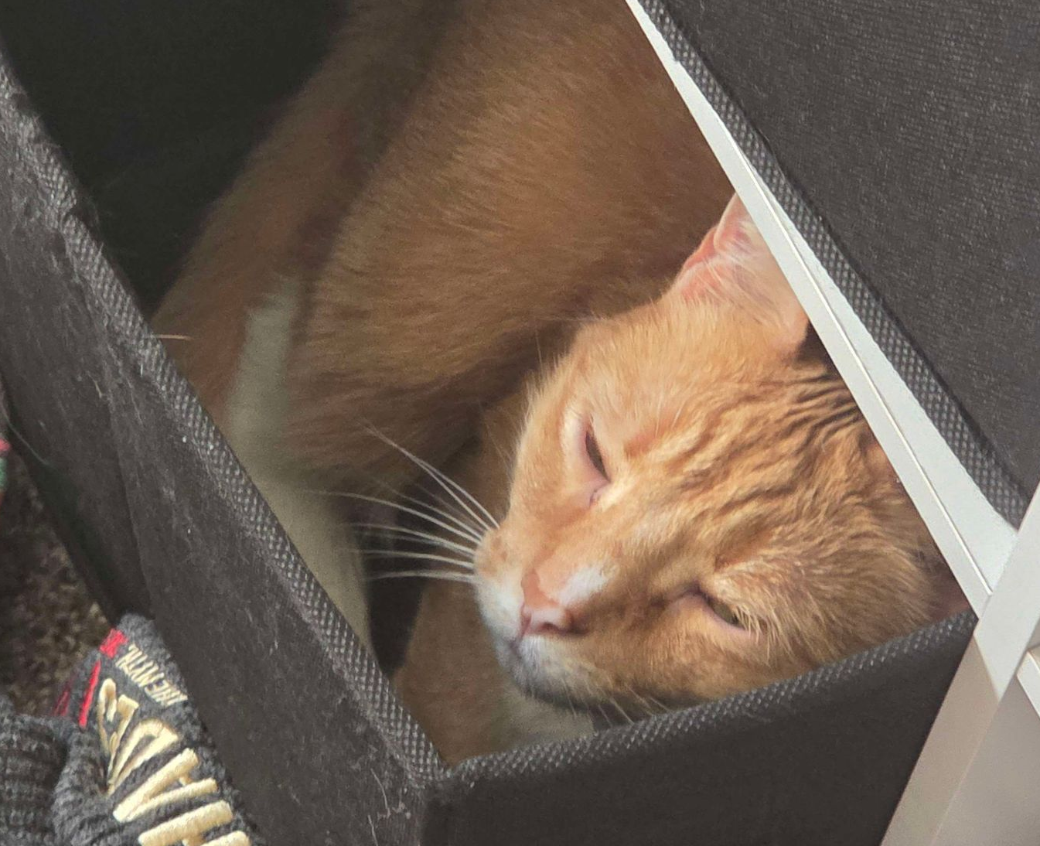
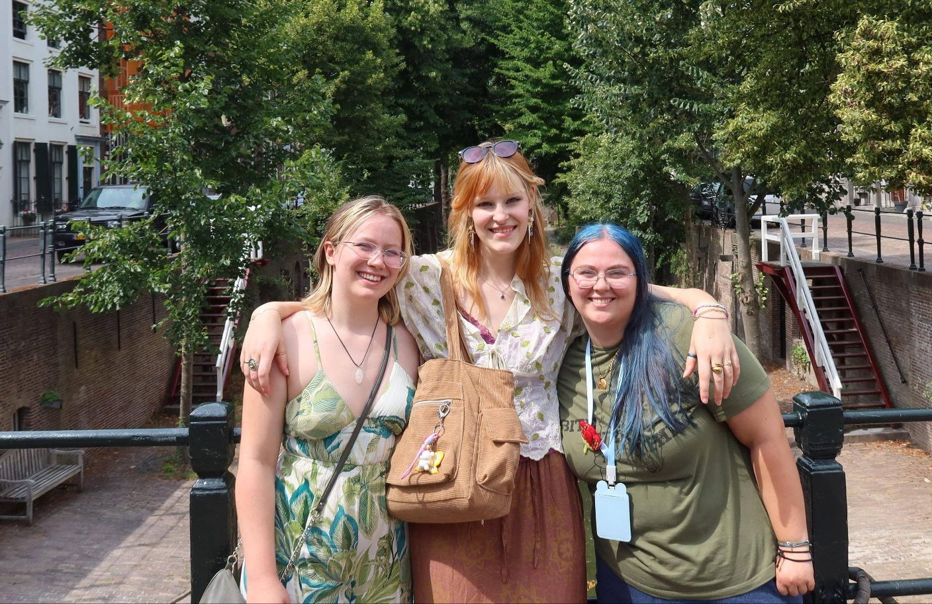
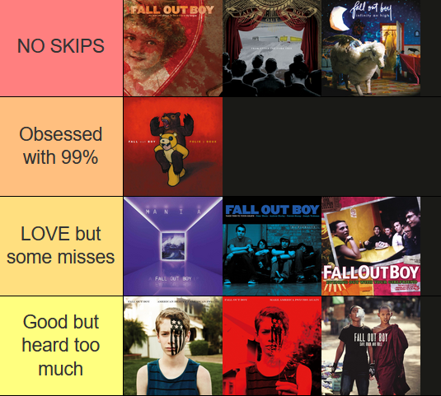
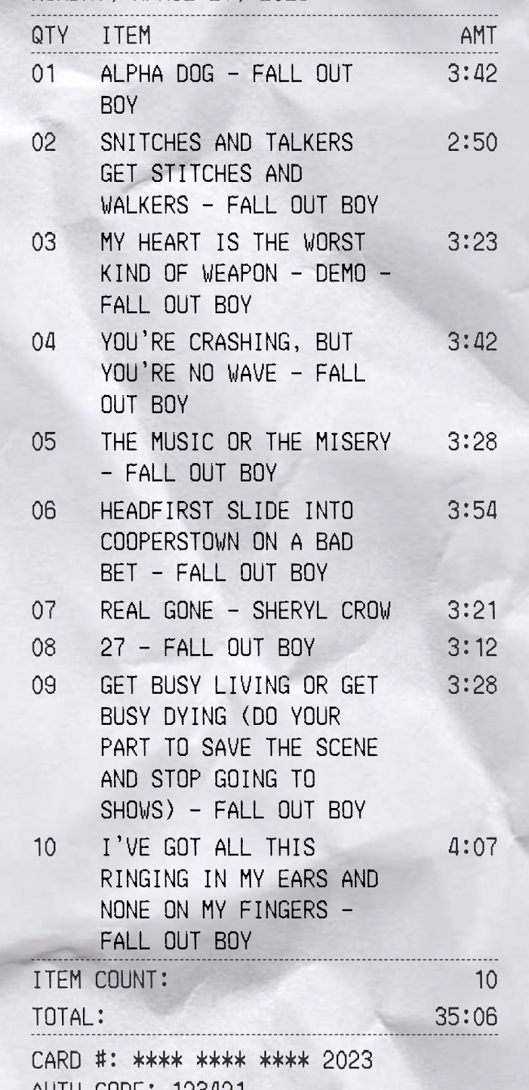
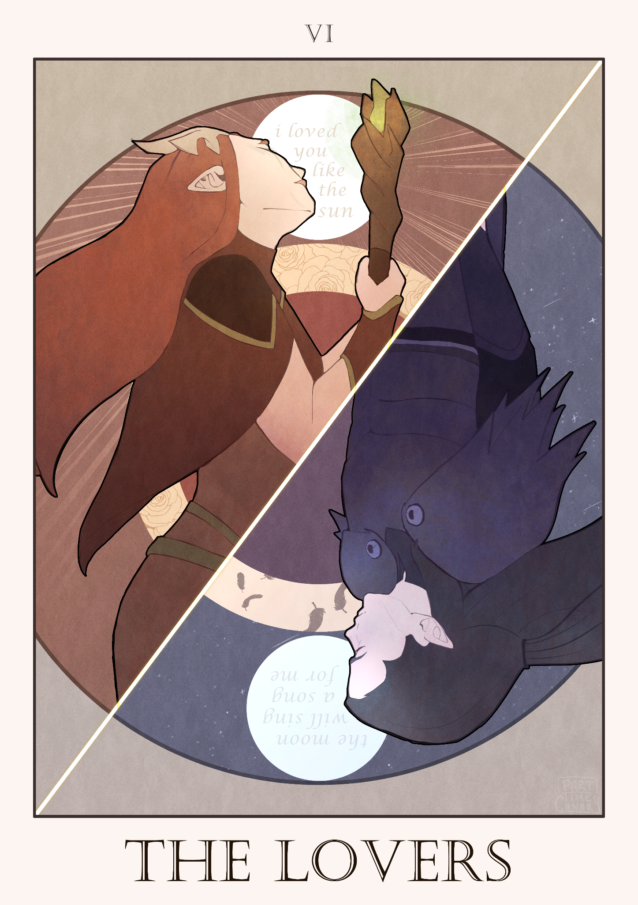
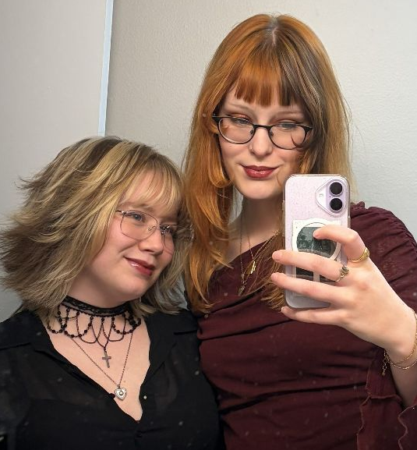
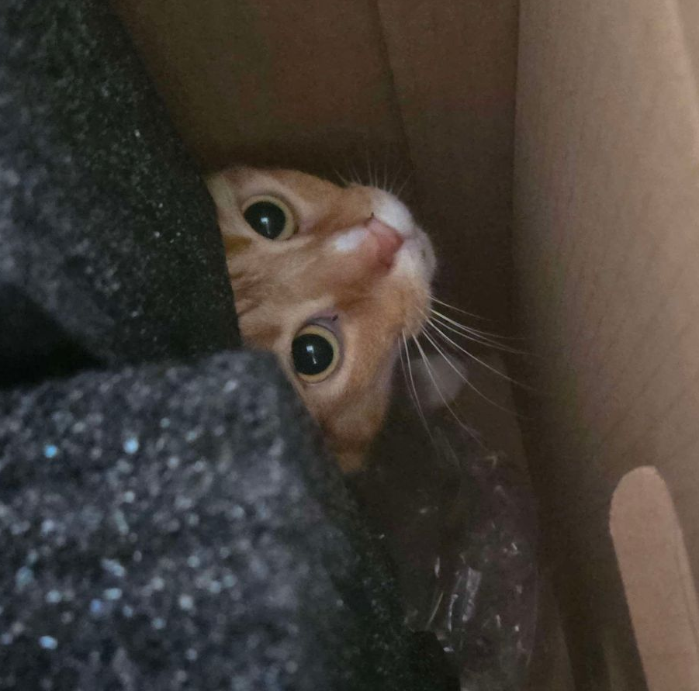
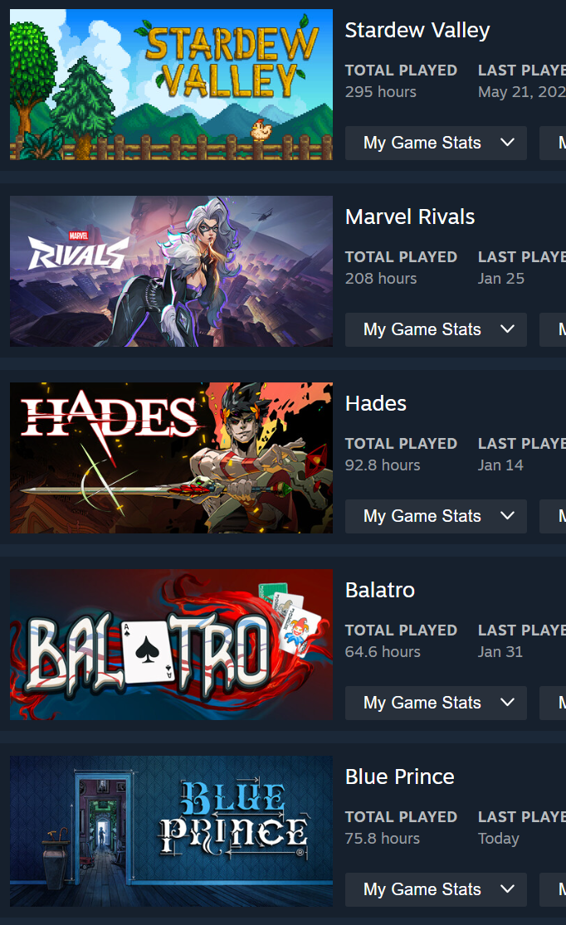
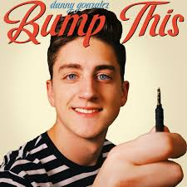
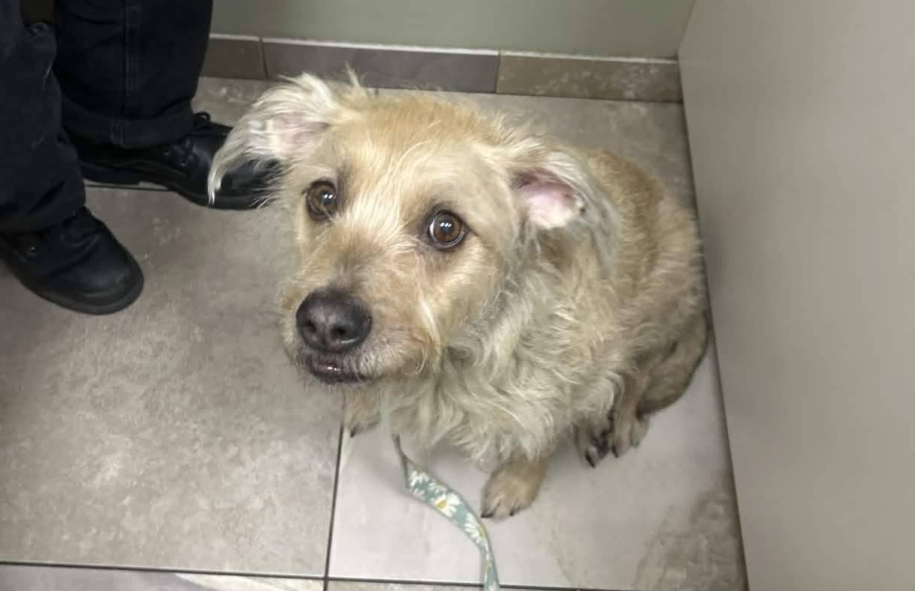
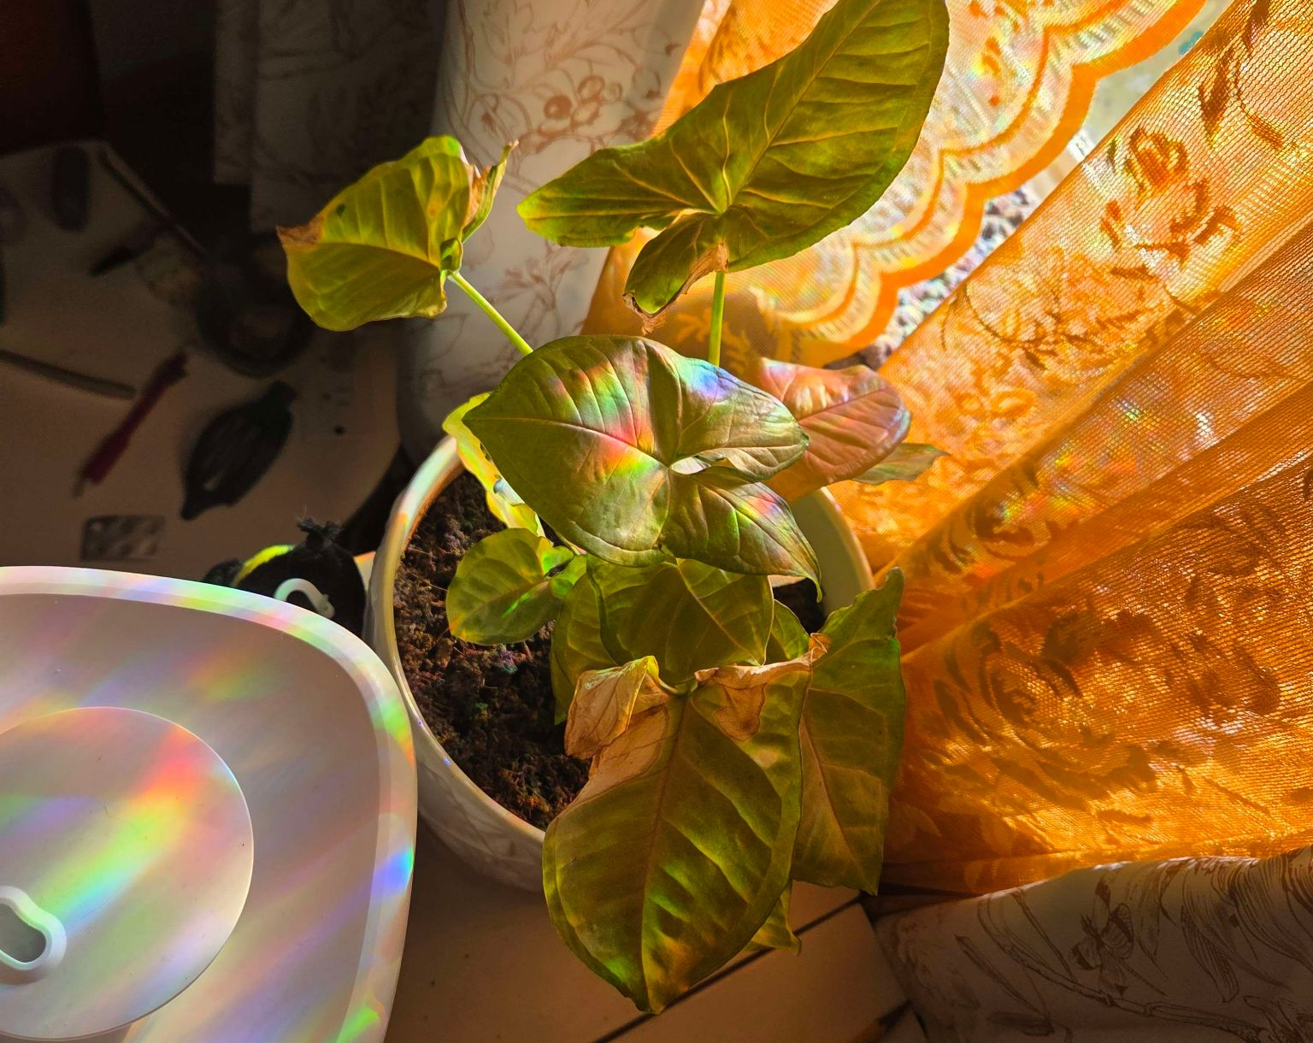


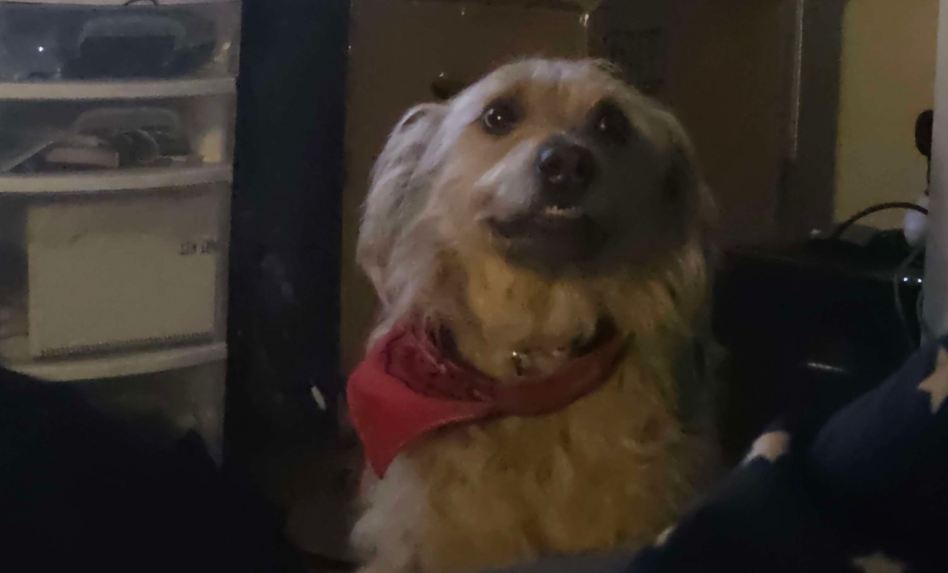
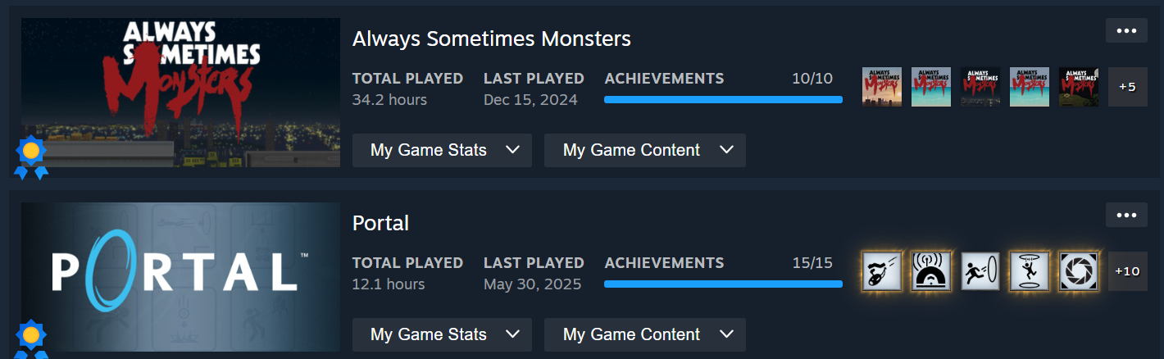
Fall Out Boy
Travel
Momo
Comedy Music
Luna
Madoka
Video Games
Digital Art

Slide 8
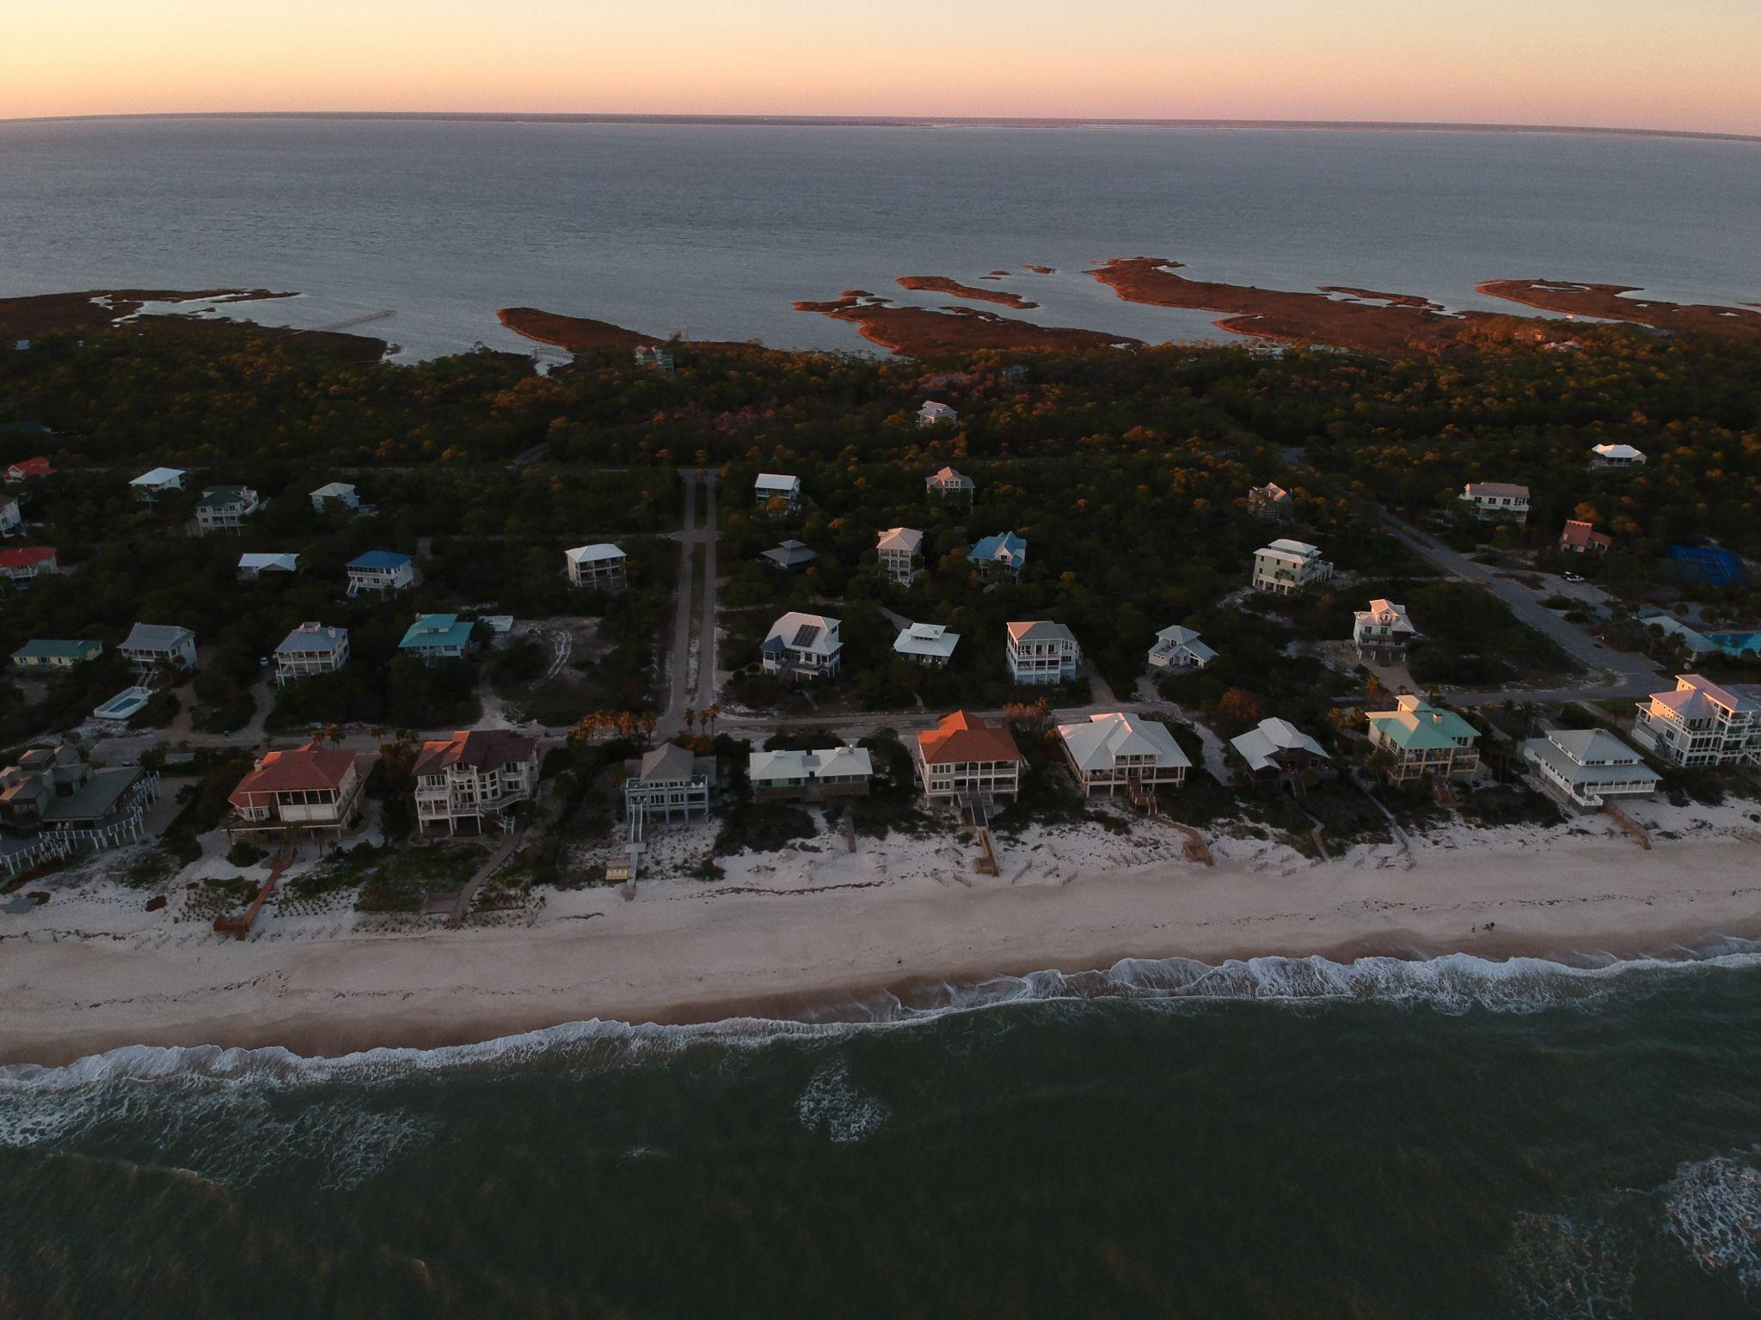
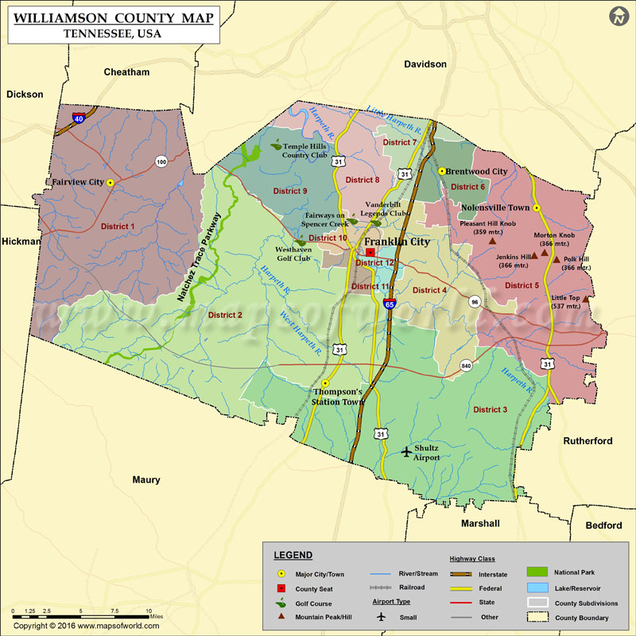
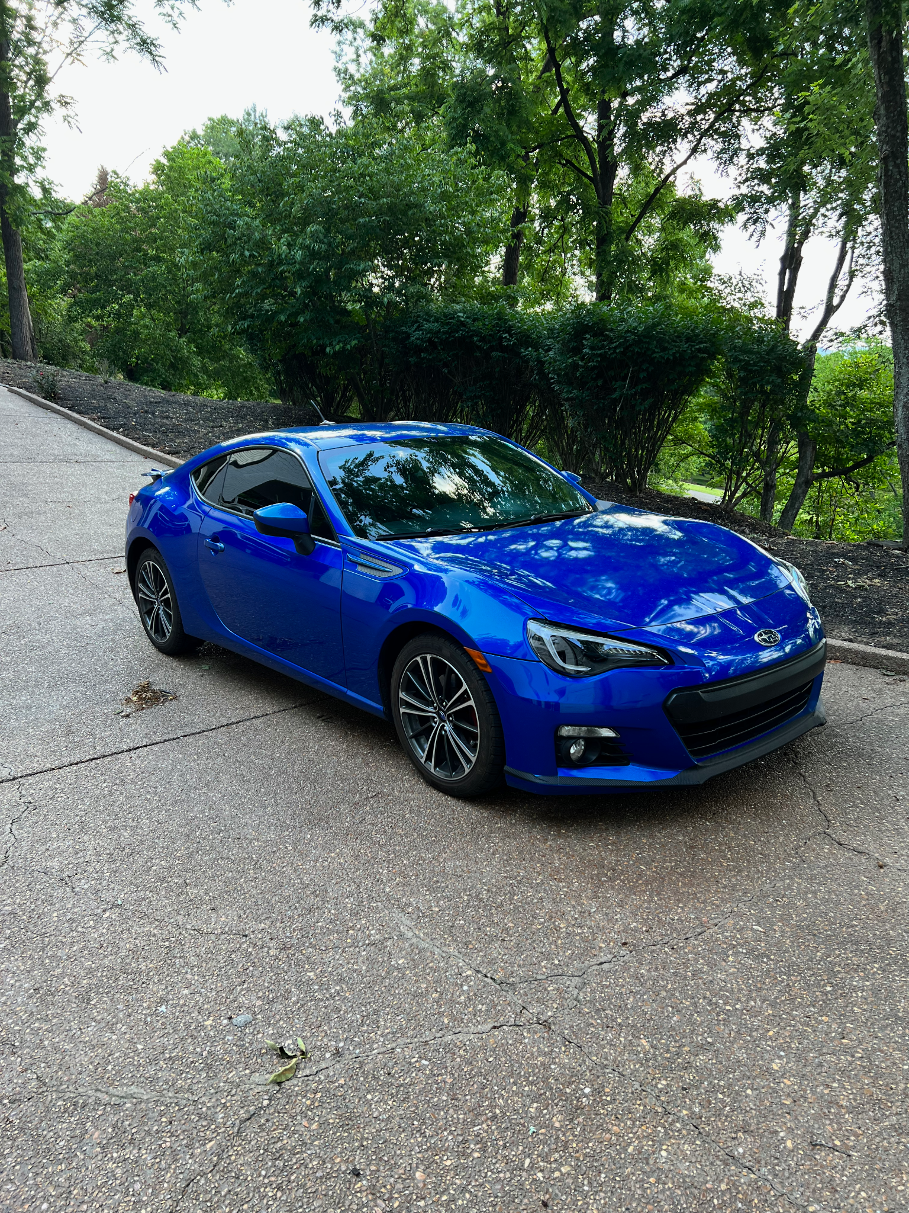
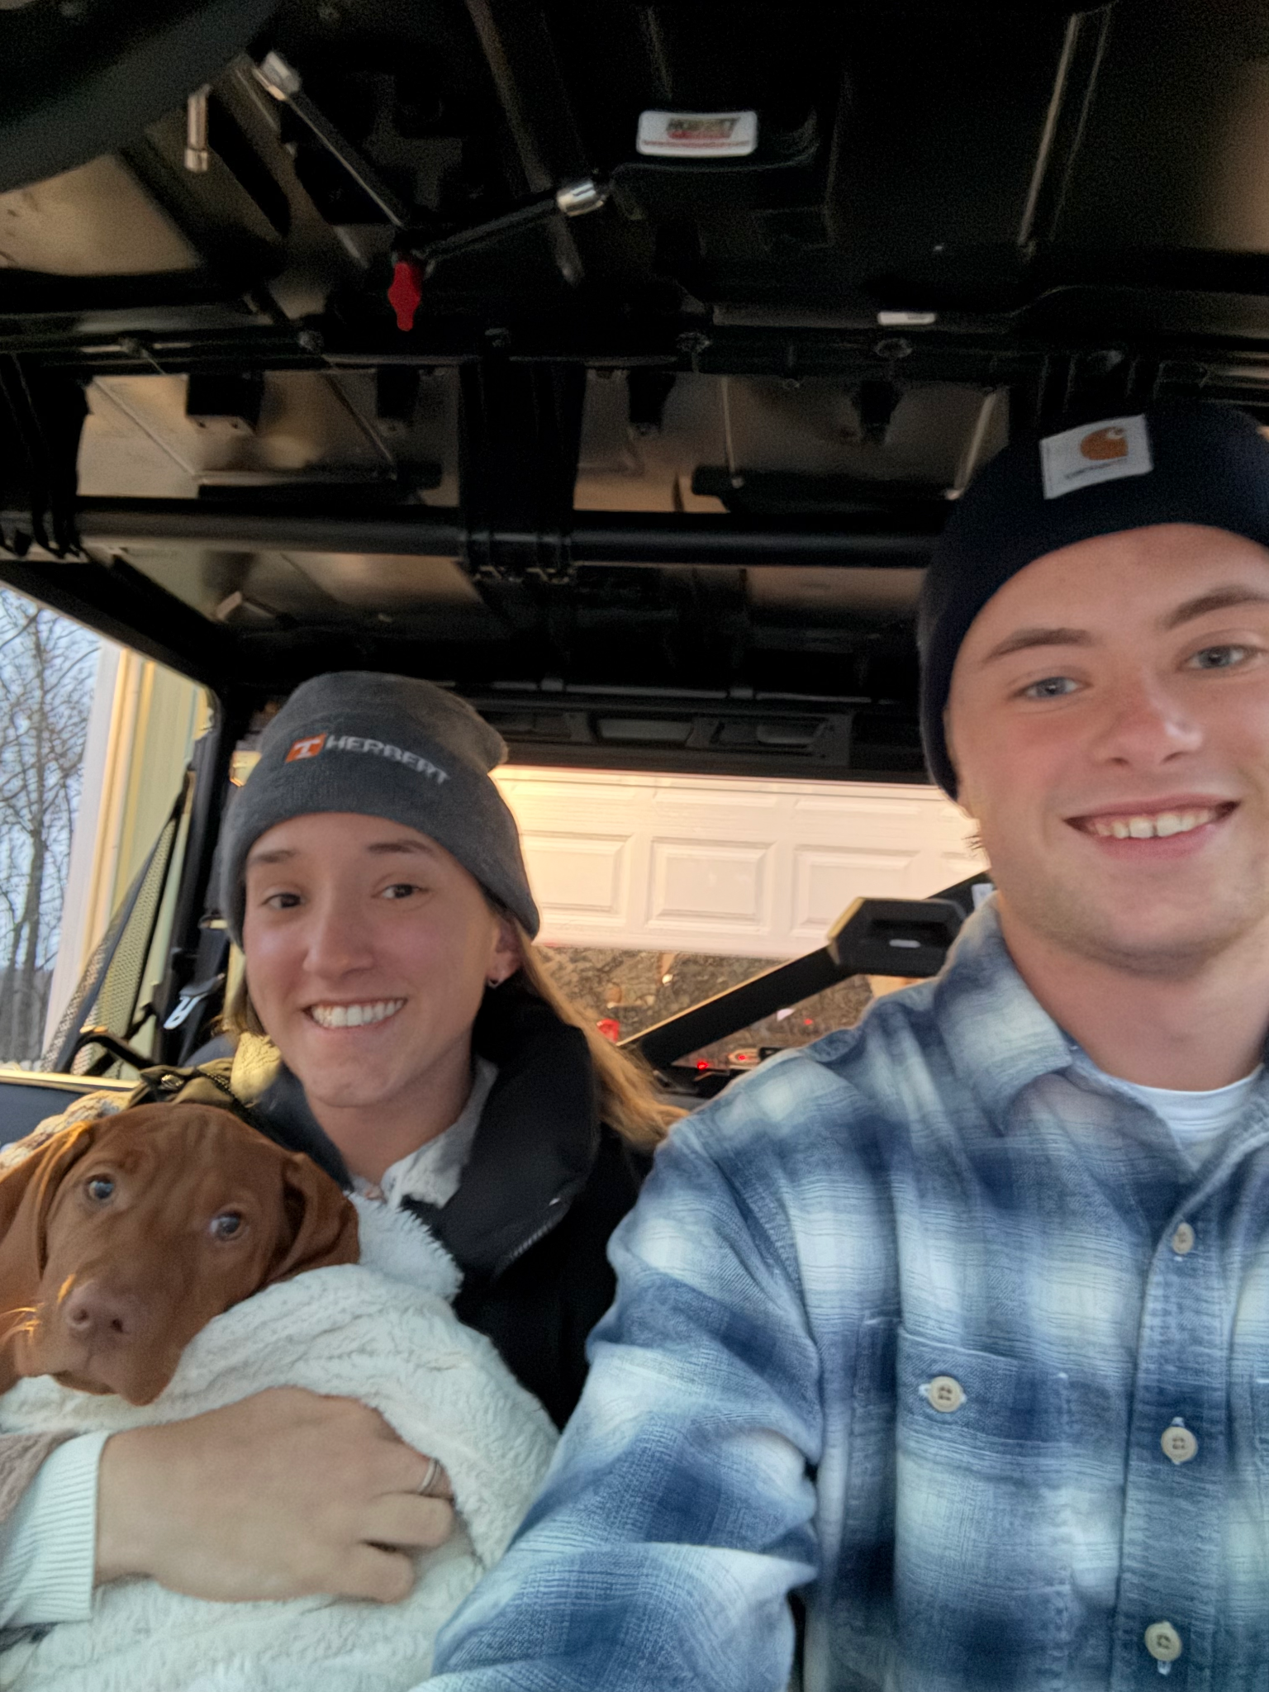
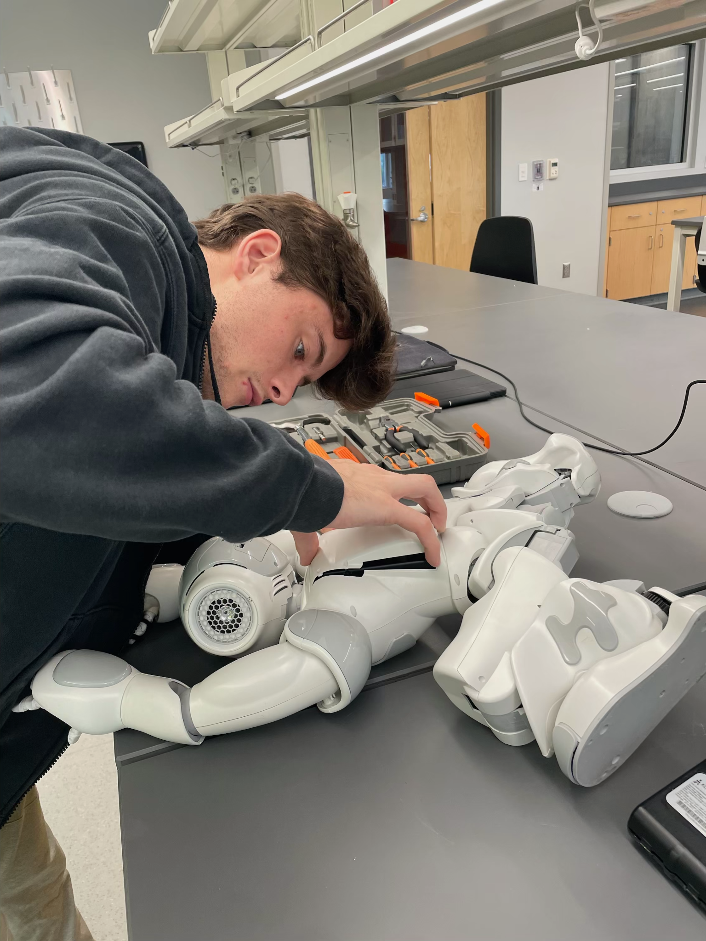
Ethan Miller
Born in Nashville, TN and raised in Williamson County, TN
Lived in Brentwood, TN for most of my life, now in Thompson’s Station, TN
Went to Ravenwood High School (Class of 2022)
5-Year BS/MS in Computer Science program, UTK
  Earning my BS next week!
  Future Advisor: Dr. Rachael Bevill Burns
  Research: HRI, Teaching/Tutoring with a LLM humanoid robot (Nao)
Starting a GTA position this fall with Engineering Fundamentals
Notes:
Add a picture of Bwood

Slide 9
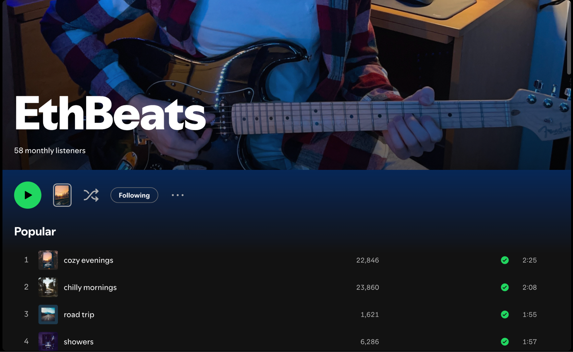
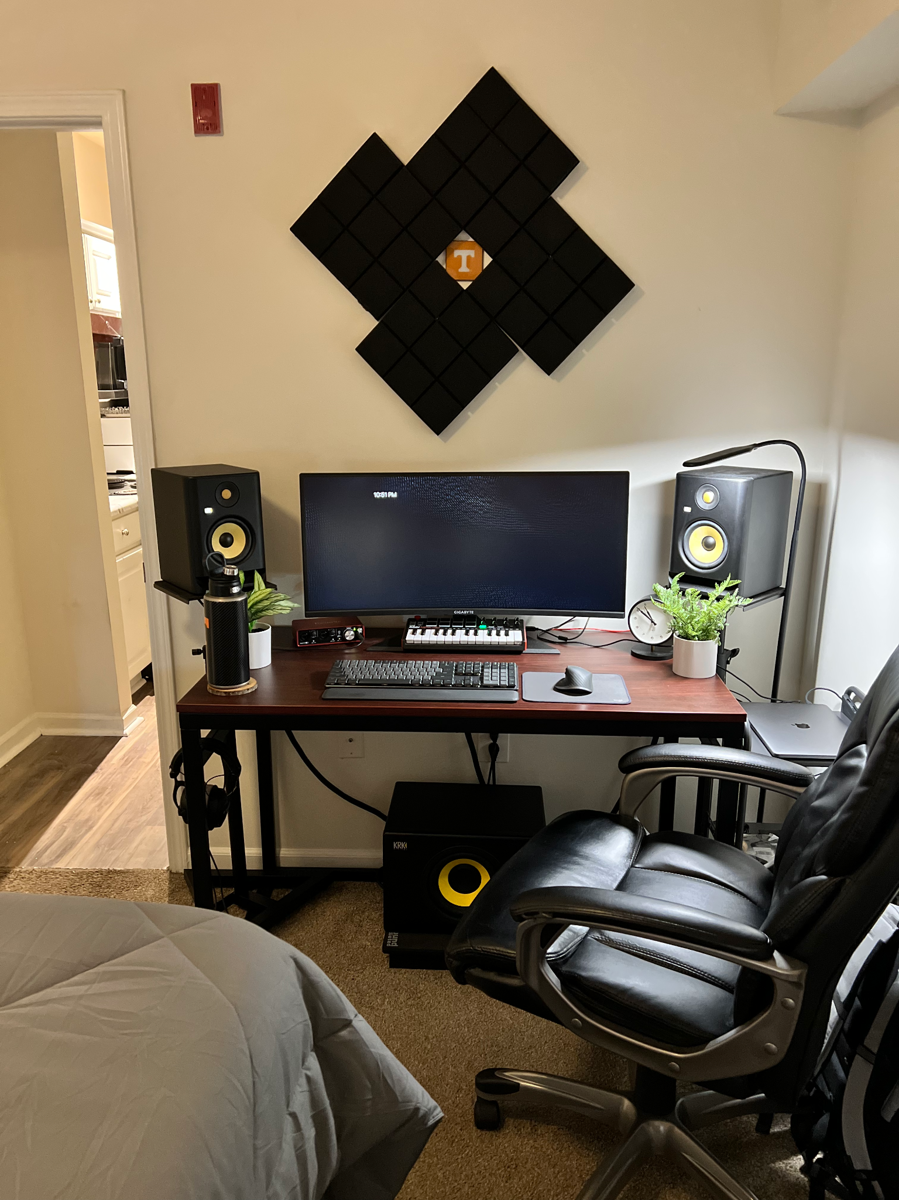
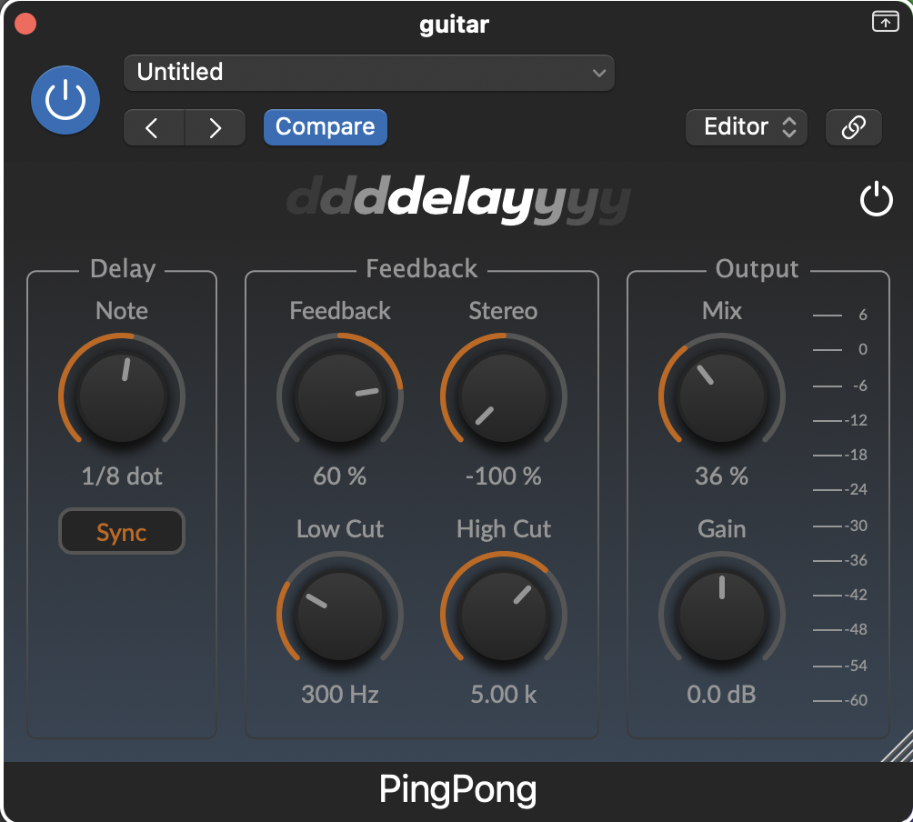
Artist Name: EthBeats
https://listen.eth-beats.com/stream [link in discord]
Hobbies:
  Music Production
    Listen to my music (chill beats to study to - mostly lo-fi hip-hop)
    Guitar is my favorite instrument
    Piano and vocals are close seconds
  Audio Software Development (the reason I am studying Computer Science!)
    Building audio plugins that music producers use in DAWs
    Learning/Testing audio DSP algorithms (delay, reverb, EQ, compression, etc.)
  Running & Lifting (ran the Knoxville Half Marathon last year)

Slide 10
Outline
Overview and Context | What is FLAC?
Important Terminology | Important definitions and vocabulary
History | Development of the algorithm and music digitization
The Algorithm | How the algorithm actually works
What We Found | Our results from implementation
Applications | How this is used in real life
Open Issues | What’s left?
Notes:
Ethan

Slide 11
02
Overview and Context
What is FLAC?
Notes:
Ethan

Slide 12
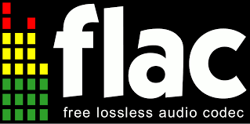
Overview/Context
FLAC stands for the Free Lossless Audio Codec
Used for digital audio
  Lossless
  Compressed
  Open source
Uses its compression algorithm to encode lossless audio files to its own file format
Optimized for audio file compression specifically, commonly WAV files
Has different levels of compression
  More compression = more encoding time
Notes:
Ethan

Slide 13
03
Important Terminology
Notes:
Connor

Slide 14
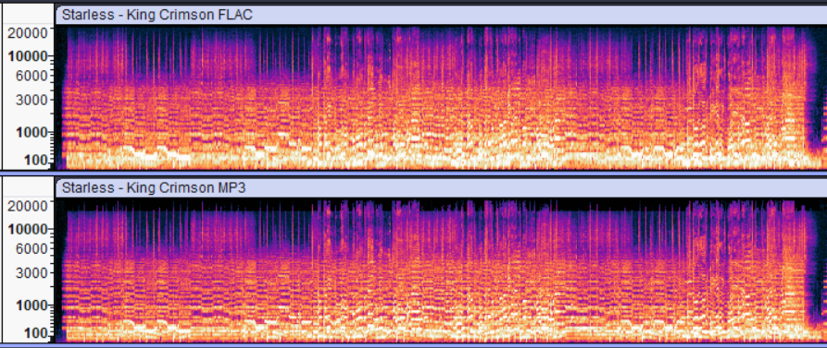
Important Terminology
Lossless Compression: Reduce storage size without losing data
Lossy Compression: Reduce storage size more, but permanently lose data
Lossless
Lossy
Notes:
Connor

Slide 15
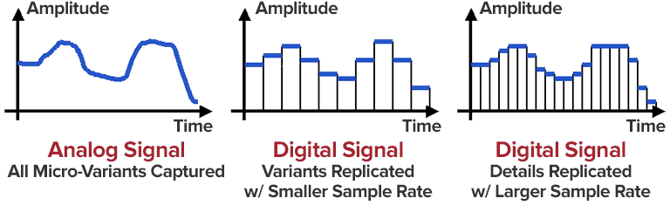
Important Terminology (cont.)
Linear Pulse Code Modulation (PCM) - Uncompressed, digital method for encoding audio signals by sampling amplitude at uniform intervals
Sample Rate - Amount of audio samples (numeric representation of linear PCM audio) per second.
Bit depth - Amount of bits used to represent an audio sample
Notes:
Breanna
Linear pulse code is the number representing each of those bars
Sample rate is how many bars
Bit depth is the amount of bits used to make the pcm numbers
Example: in film, there is no pixel and in ANALOG audio there is no sample. Digital images have pixels, digital audio has samples

Slide 16
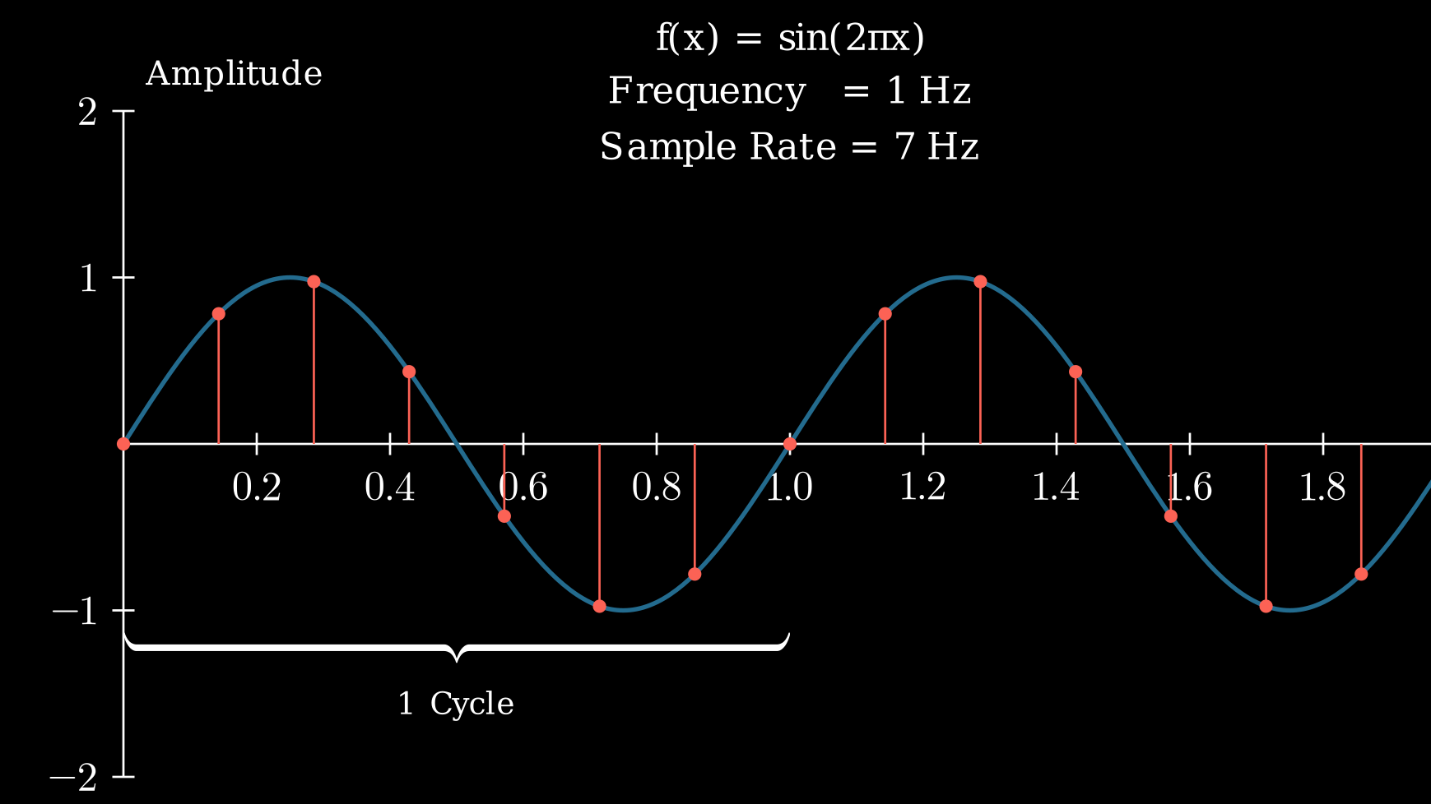
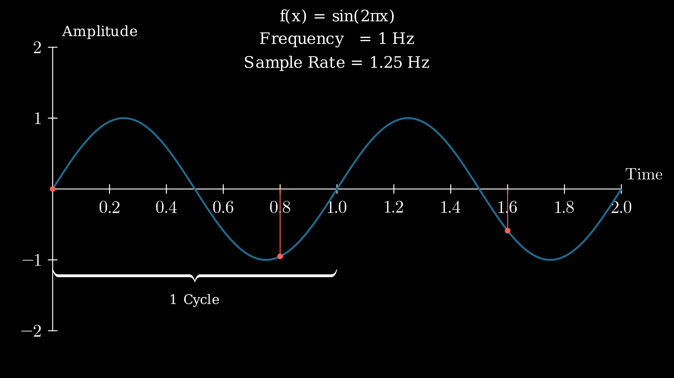
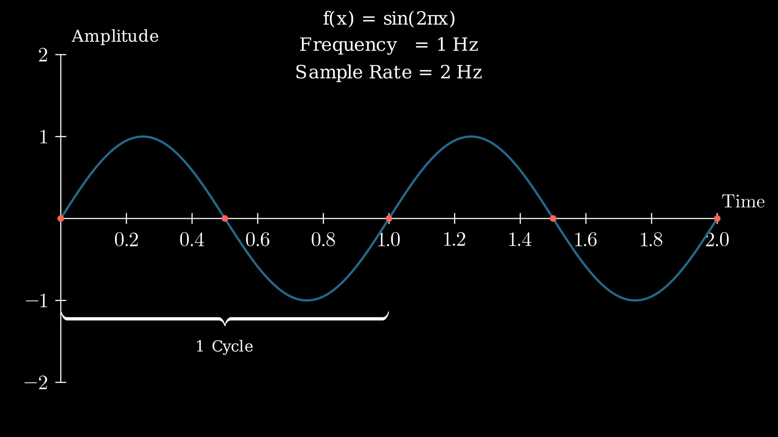
Important Terminology (cont.)
Nyquist-Shannon Theorem - a wave can be reconstructed as long as the sampling rate is greater than twice the audible frequency. 𝑓_{s} > 2𝑓_{max}
  Human hearing can hear up to ~20kHz, lowest sampling rate is 44.1kHz
Notes:
Connor

Slide 17
04
History
Notes:
Ethan

Slide 18
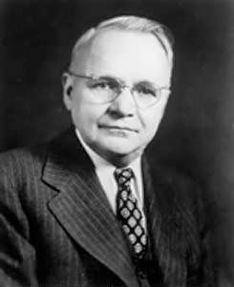
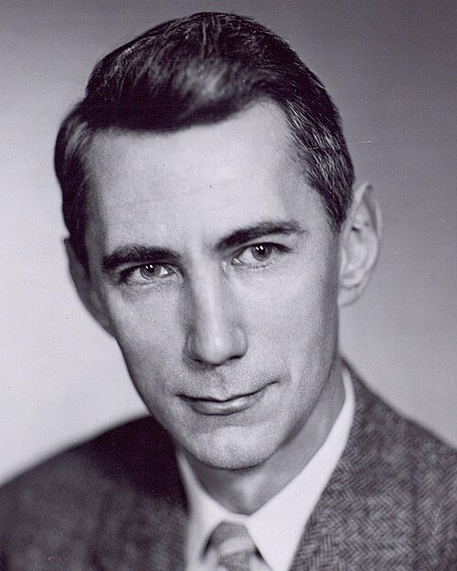
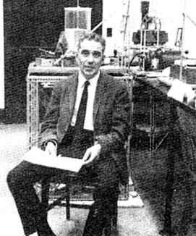
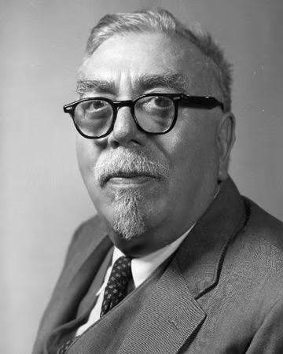
History - Algorithms
Harry Nyquist develops the basis of the Nyquist-Shannon Theorem
Norman Levinson suggests Toeplitz matrix solution to equations
1928
1947
1945
03
1949
Claude Shannon ‘sampling theorem’ findings published
Norbert Wiener published Wiener Filter findings
Harry Nyquist
Claude Shannon
Norman Levinson
Norbert Wiener
Notes:
Ethan
Harry Nyquist develops the basis of the theorem we just covered.
Claude Shannon publishes the sampling theorem with his introduction of information theory, adding onto Nyquist’s findings.
Norman Levinson proposes a solution to solving an equation involving a Toeplitz matrix
Norbert Wiener published theory for calculating best filters and predictors for detecting signals in sound (Wiener Filter)

Slide 19
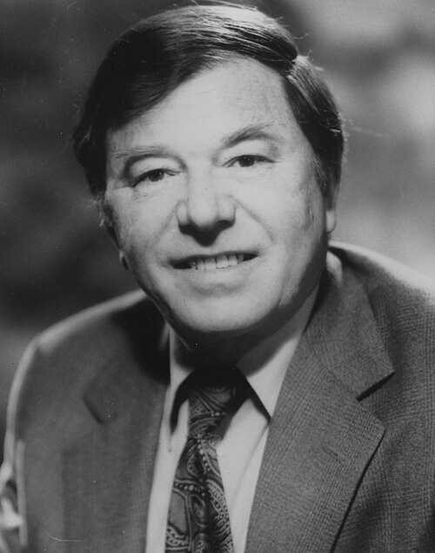
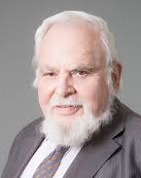

History - Algorithms
James Durbin improves on Levinson’s solution
Robert Rice introduced rice encoding as an application of Golomb coding
1960
1966
1971
Solomon Golomb created Golomb coding
James Durbin
Solomon Golomb
Robert Rice
Notes:
Ethan
James Durbin improves on Levinson’s solution - Durbin-Levinson algorithm is born. We’ll cover it in more detail later.
Solomon Golomb created Golomb coding, a compression algorithm for geometric distributed alphabets
Robert Rice introduced rice encoding as an application of Golomb coding for compressing image data from spacecrafts (couldn’t find a picture of him)

Slide 20
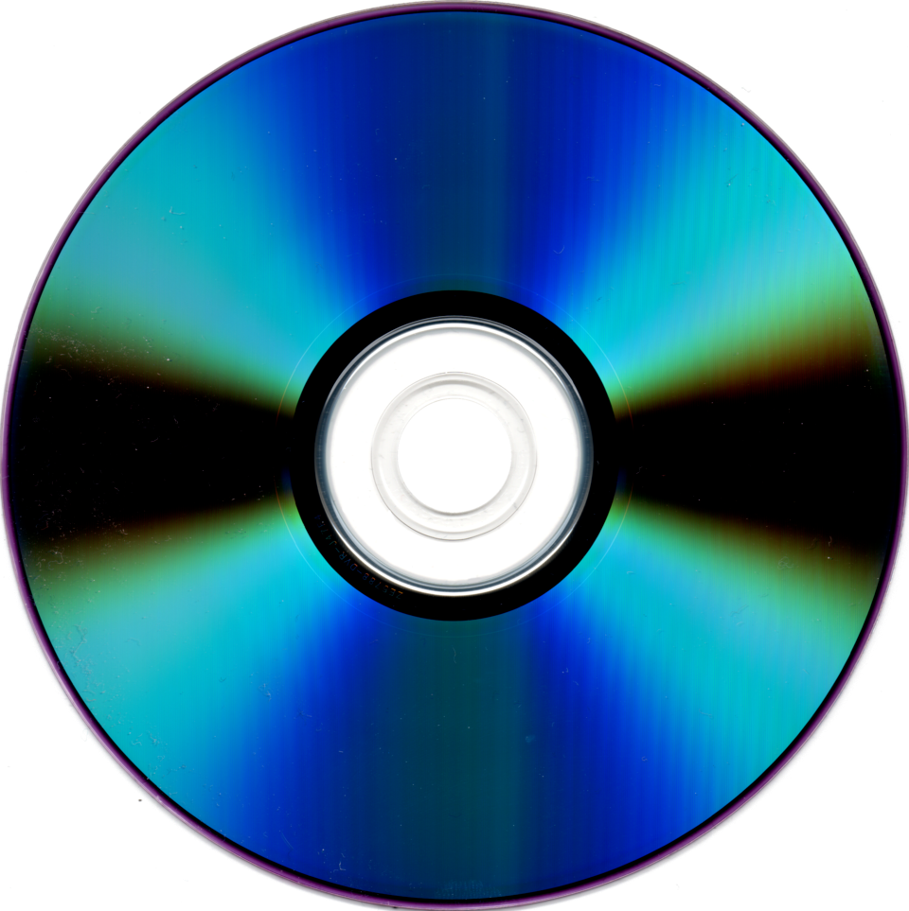
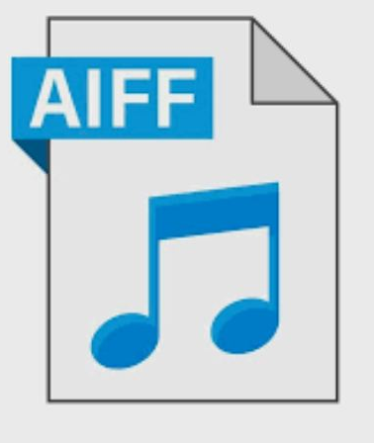
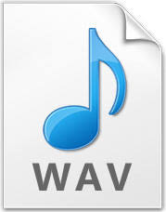
History - Digital Audio
Waveform Audio File Format (WAV)
Audio interchange file format (AIFF)
Compact Disk (CD)
1982
1988
1992
Lossless but physical
Uses Linear PCM
Able to hold 74 minutes of audio
Lossless
Only for Macs
Latest release - 1991
Lossless
Large file sizes
Industry Standard
Notes:
Ethan
WAV is the same thing as AIFF (Microsoft & IBM’s answer)

Slide 21
History - Digital Audio
MP3 is developed by the Fraunhofer Society in Germany
MP3 Encryption Stolen by Australian College Student
Napster founded
1993
1997
1999
Lossy but very compressed
  Takes advantage of human hearing limits
Original plan: sell the decoder at a cheaper price for embedding in software; sell encoders at a way higher price to record labels
What really happened: Australian college student steals a credit card and buys the encoder from a German company
Spreads online quickly to the general public; Napster is created soon after
Notes:
Connor

Slide 22
History - Digital Audio
FLAC is supported by Yahoo music
The encoder has been made multithreaded!
Josh Coalson debuts FLAC
2000
2003
2005
2012
2025
FLAC joins xiph
Javascript FLAC decoder, google play support
Notes:
Breanna
-Josh Coalson debuts FLAC on sourceforge
-FLAC joins xiph, a free codec compilation, which allowed for greater integration
-FLAC is supported by Yahoo music, a major step in its use for ripping/encoding
-Javascript FLAC decoder made available, google play releases FLAC support update
-The encoder has been made multithreaded! Still being updated for efficiency
- The encoder has received continuous support with its most recent update being an efficiency boost in the form of multithreading in its latest update in 2025

Slide 23
05
The FLAC Algorithm
How it works, step by step

Slide 24
The FLAC Encoding Algorithm
Four phases to the algorithm:
  Blocking - O(N)
  Interchannel Decorrelation - O(N)
  Prediction - O(N∙p²) reduced to O(N∙p) due to small p (<32)
  Residual Encoding - O(N)
Total time complexity:
  O(N) + O(N) + O(N∙p) + O(N) = O(N∙p)
Notes:
Breanna
N = number of audio samples
P = prediction order
P is less than 32 so its practically linear, resulting in final time O(N*P)

Slide 25
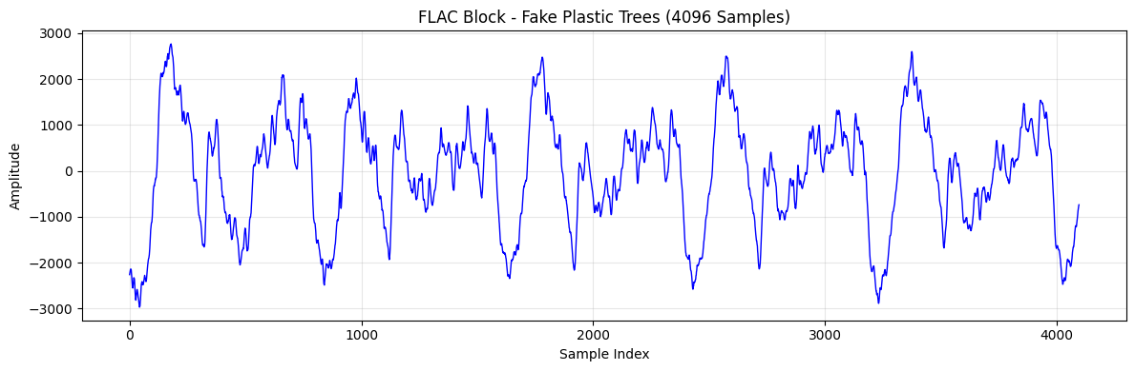
The FLAC Encoding Algorithm - Blocking
Split the audio into blocks of equal sample sizes
  Typically 4096 samples per block
    2048 samples for lower levels of compression
  Last block does not have to be equal so no padding is needed
Notes:
Breanna
one block is typically 4096 - for some it’s 2048 we’ll get into that later
This graph is 1 block with 4096 samples

Slide 26
The FLAC Encoding Algorithm
- Interchannel Decorrelation
Manipulate audio values to decrease the amount of information needed to represent them
Independent - Channels are coded independently of each other
Mid-Side - Left and right sides are averaged to form mid channel, side channel is also calculated and encoded.
Left-Side - Left channel is encoded, along with side shannel.
Side-Right - Right channel is encoded, along with side channel.
  All sides channels are calculated as left channel - right channel
Notes:
Connor

Slide 27
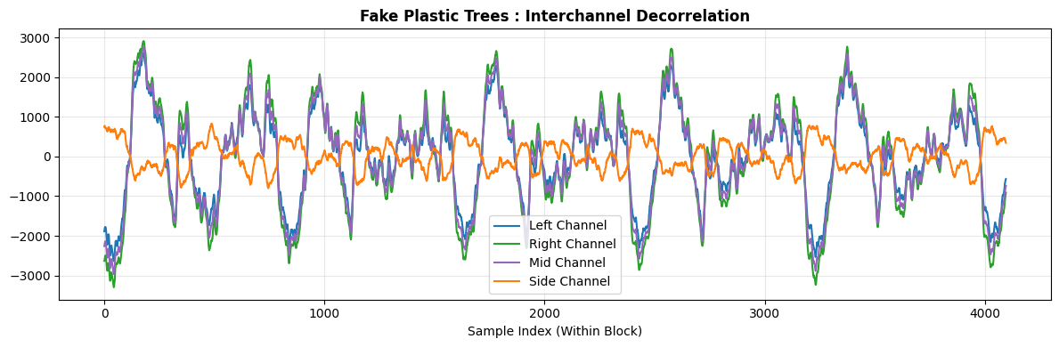
The FLAC Encoding Algorithm
- Interchannel Decorrelation
Notes:
Connor

Slide 28
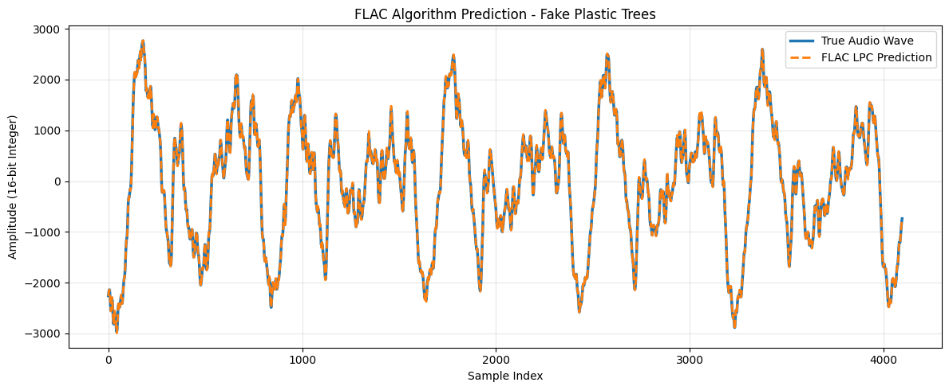
The FLAC Encoding Algorithm - Prediction
Uses Levinson-Durbin to calculate a set of weights called prediction coefficients
  aims to predict weights based on previous weights errors
Higher level of prediction order → more coefficients calculated
An equal number of “warmup samples” are kept
Notes:
Connor

Slide 29


The FLAC Encoding Algorithm - Residual Encoding
Difference between the original and predicted is the residual
Residual undergoes rice encoding to lower the amount of bits needed to represent them
  Typically are near zero, so encoding reduces bits needed
Notes:
Connor
Rice coding

Slide 30
06
What We Found
Our results, graphs, and performance metrics

Slide 31

Implementation Results
Notes:
Breanna
Applied to Connor’s music library ~2000 songs
Measured average encoding speed and average compression ratio
2 uses 2048 block sizes, but has to compress more than one. Inefficient
5 is the default

Slide 32

Implementation Results - Genre Results
Notes:
Breanna
High dotted line = bad (less compression)
High solid line = good (faster)
Metal performed the best -> hypothesis: repeated sounds are encoded more efficiently
Worst compression pop -> hypothesis: lots of vocals and space, human performance varies?
Possibly our dataset

Slide 33
07
Applications
Real life use cases
Notes:
Ethan

Slide 34
Applications
Archiving high quality music
Artists/producers are free of Digital Rights Management (open-source)
Streaming (Spotify - FLAC, Apple Music - ALAC)
Audiophile equipment (Digital-to-Analog converters, studio acoustic panels
Compare to:
MP3: lossy vs lossless
DEFLATE (ZIP): FLAC uses real-time decoding
Notes:
Ethan
DRM: set of technologies, policies, and encryption methods used by hardware manufacturers, publishers, and copyright holders to control the use, modification, and distribution of copyrighted works (restricts access to digital content). This means producers own the flac file outright.
Streaming: Next slide…
Audiophile: someone who is very passionate about high-fidelity (hi-fi) sound…I make low-fidelity (lo-fi) music but I still care about lossless quality!

Slide 35


Spotify - FLAC
Apple Music - ALAC
Notes:
Ethan
Apple Music does offer Hi-res lossless streaming up to 24-bit/192kHz

Slide 36
08
Open Issues
Ongoing work
Notes:
Ethan

Slide 37
Open Issues
Arguable, small amount of loss when repeatedly going from WAV to FLAC and back to WAV
Issues with internet broadcasting in terms of device compatibility and high bandwidth
FLAC files do not play in native Apple applications (Apple Music)
  Must convert FLAC files to ALAC using a conversion tool such as XLD
  Can use third-party application such as VLC Media Player
Notes:
Ethan
ALAC: Apple Lossless Audio Codec
XLD: X Lossless Decoder
VLC: VideoLAN Client

Slide 38
References
[1] “FLAC - Features,” xiph.org. https://xiph.org/flac/news.html
[2] M. Huismann, “Audio timeline | Yale University Library,” web.library.yale.edu, 2006. https://web.library.yale.edu/cataloging/music/audiotimeline
[3] M. Q. C. van Beurden and A. Weaver, “Free Lossless Audio Codec (FLAC),” Dec. 2024, doi: https://doi.org/10.17487/rfc9639.
[4] T. S. Gunawan, S. A. A. Rashid and M. Kartiwi, "Investigation of various algorithms on multichannel audio compression," 2017 IEEE 4th International Conference on Smart Instrumentation, Measurement and Application (ICSIMA), Putrajaya, Malaysia, 2017, pp. 1-5, doi: 10.1109/ICSIMA.2017.8311985.
[5] H. Huang, H. Shu and R. Yu, "Lossless audio compression in the new
IEEE Standard for Advanced Audio Coding," 2014 IEEE
International Conference on Acoustics, Speech and Signal Processing
(ICASSP), Florence, 2014, pp. 6934-6938
‌
‌
Notes:
Ethan

Slide 39
Discussion and Test Questions
01
02
03
What file type do we say FLAC is most commonly used to compress?
What year was the most recent major update (as of this presentation) made to FLAC?
What is Apple’s version of FLAC encoding?
https://forms.gle/nqFYzfqULVHJCpnr8

Slide 40
Thank you!

