Slide 1
fd31acbffebeb2b23393fcdbd02c5ea94fae7568a8554c12dc7aba2f6dd71d94
628da04def87868a761f59d38924d0ad133610f2fe50eb8345e7e0703943fdd2

Slide 2
Understanding Hashing Algorithms and Hash Collisions
Jamin Hanna, Ony Hoque, and Jaehwan Park

Slide 3

Test questions slide
What is the worst case time complexity of hashing?
What hash algorithm performed the best in our Toy experiment?
Which method offers better cache performance (for reading), Chaining or Open Addressing?

Slide 4



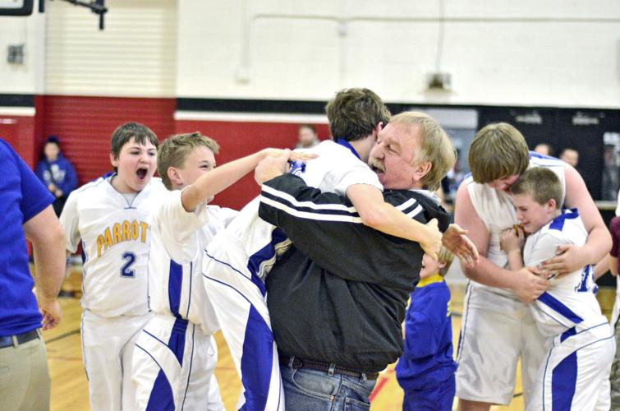
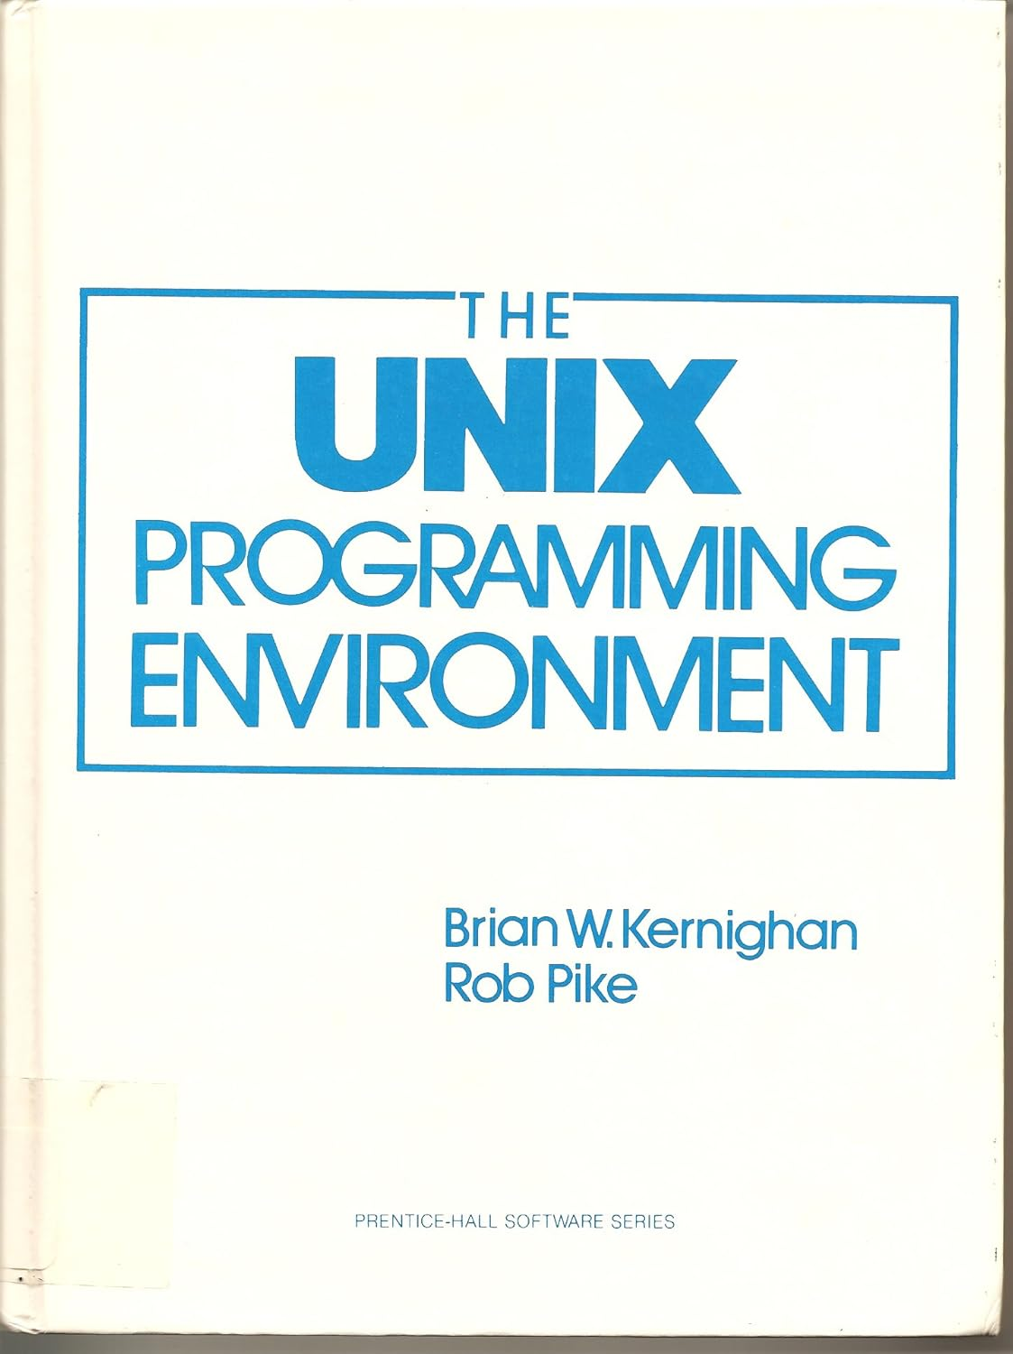
Jamin Hanna
From Parrottsville, TN
First-year CS PhD student under Dr. James Plank
Interests: Philosophy/Religion, Reading books on CS stuff, math, watching classic movies

Slide 5

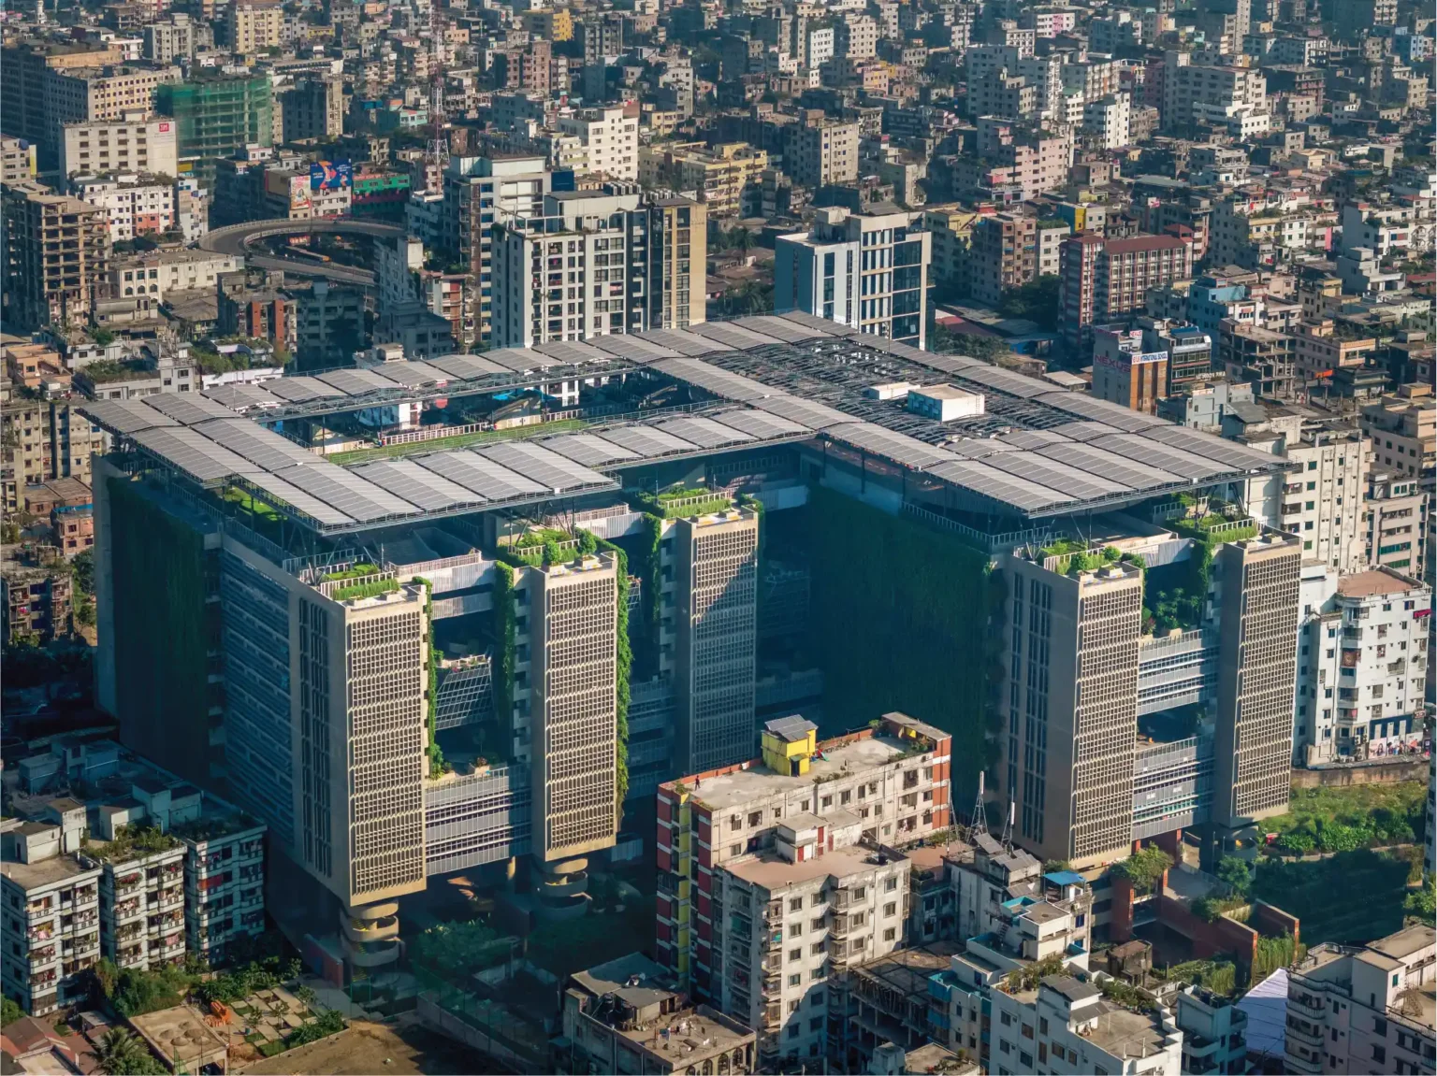

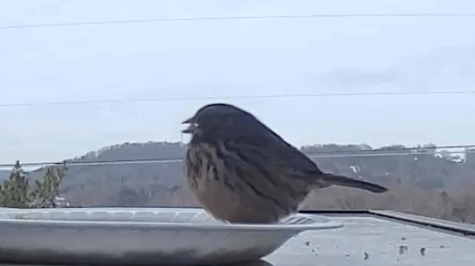
Ony Hoque
From Dhaka, Bangladesh
CS PhD student supervised by Dr. Sun
Enjoy exploring new cities
Undergrad : Brac University

Slide 6
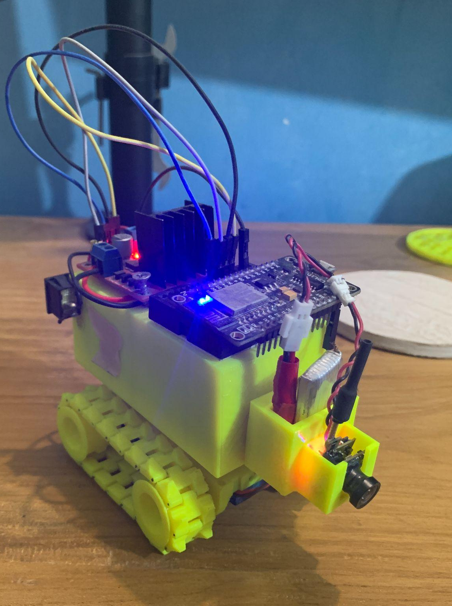
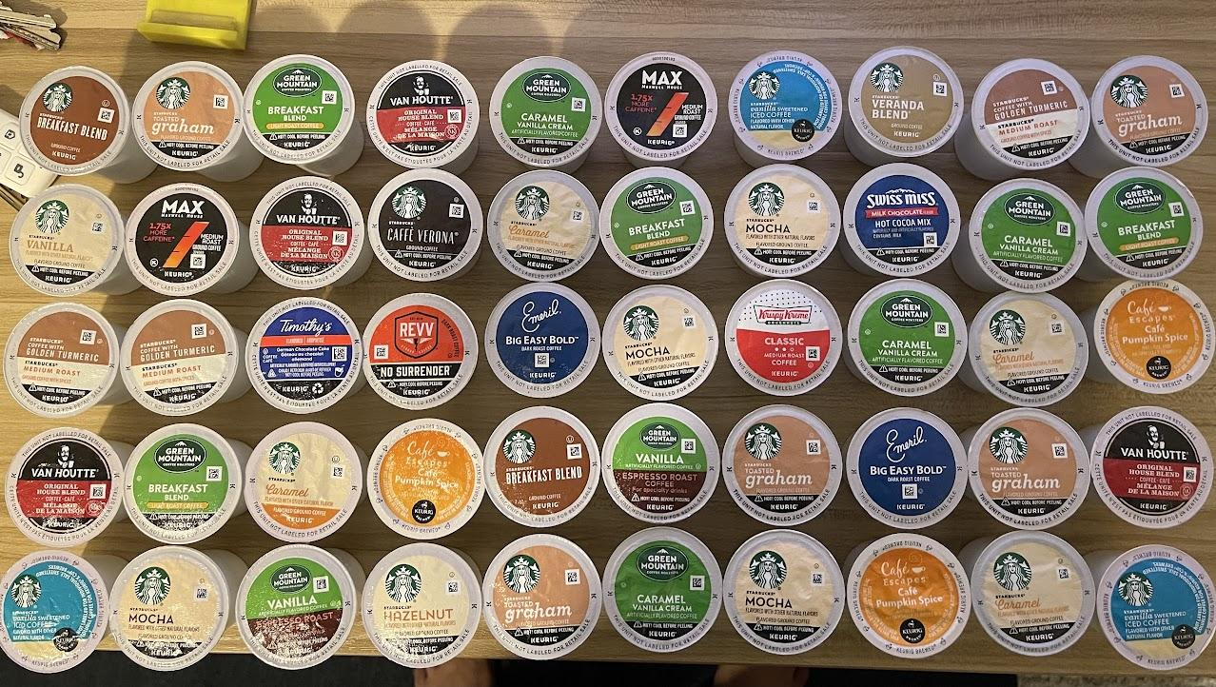
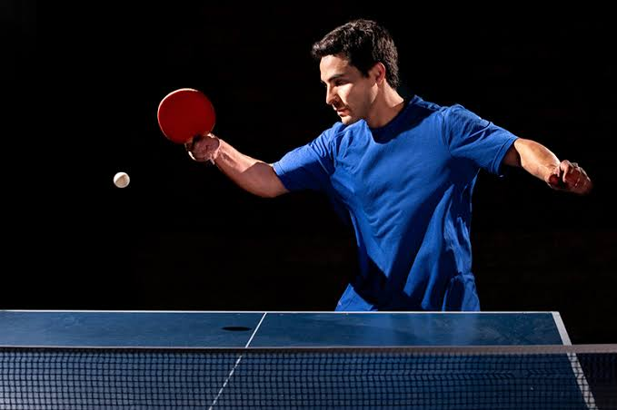
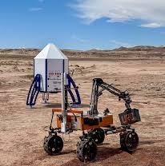
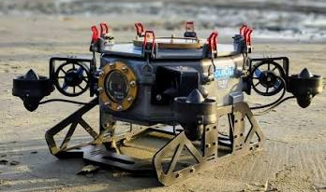
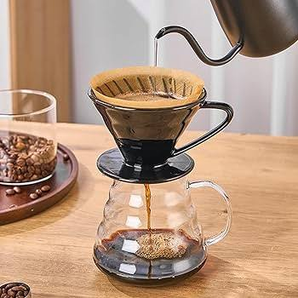


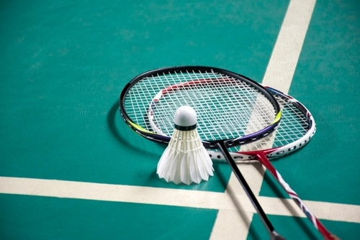
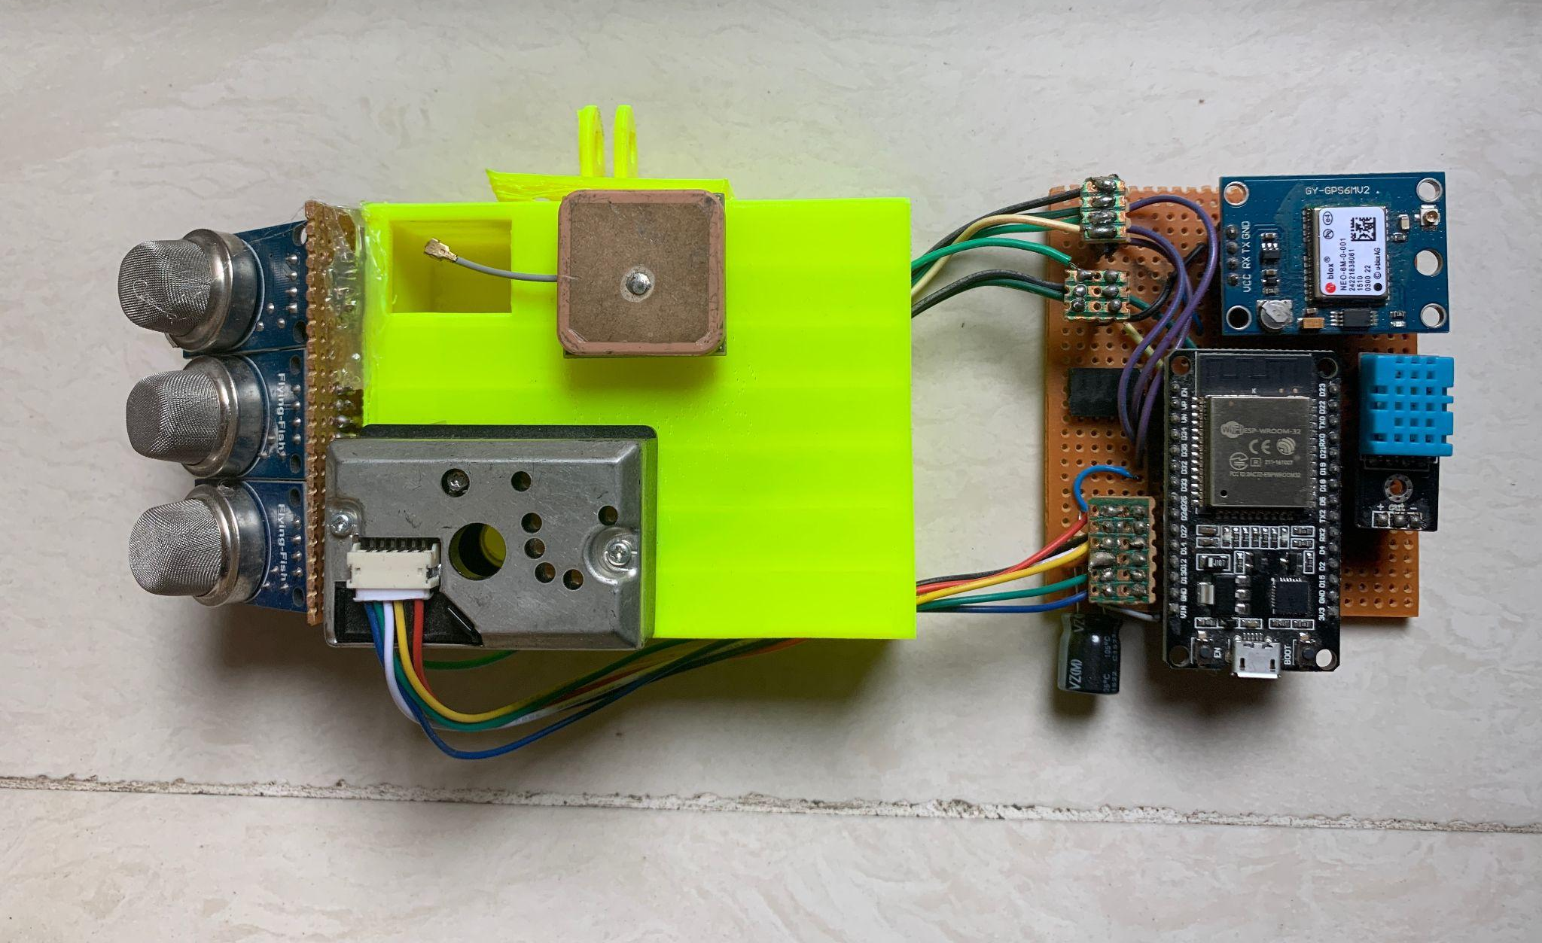
Ony Hoque
Hobbies: Robotics
Thinks I enjoy: Coffee, Games
Notes:
Some of the games I enjoy playing is table tennis and Badminton

Slide 7

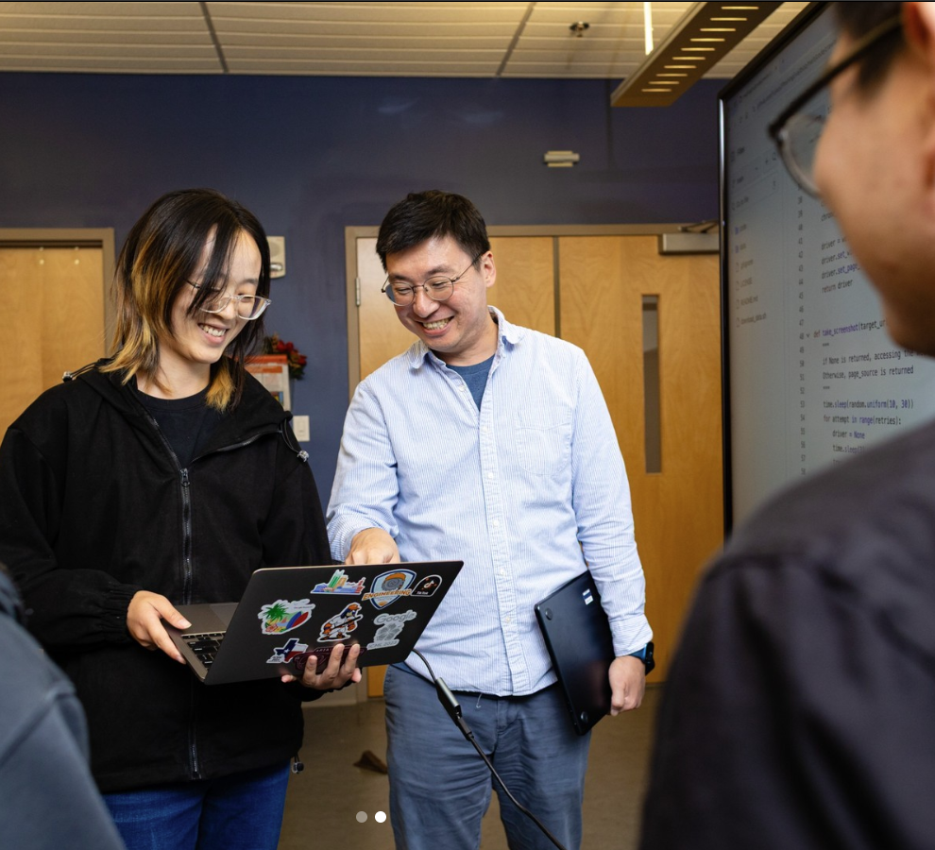

Jaehwan Park
2nd year PhD student advised by Dr.Doowon Kim
Applied cryptography, Web security
From Seoul, South Korea
I have a kimchi refrigerator in my home.

Slide 8
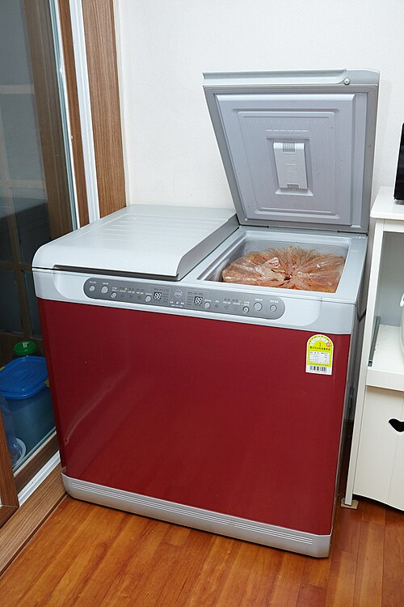


Jaehwan Park
The Best Team in the Universe
Notes:
5 minutes

Slide 9
Outline
The need for hashing and its history
Basic overview of hashing
More on the purpose of hashing
A word on the complexity of hashing
A toy experiment
Collision resolution strategies
A few applications
Open issues
References
Discussion and Q&A
1

Slide 10
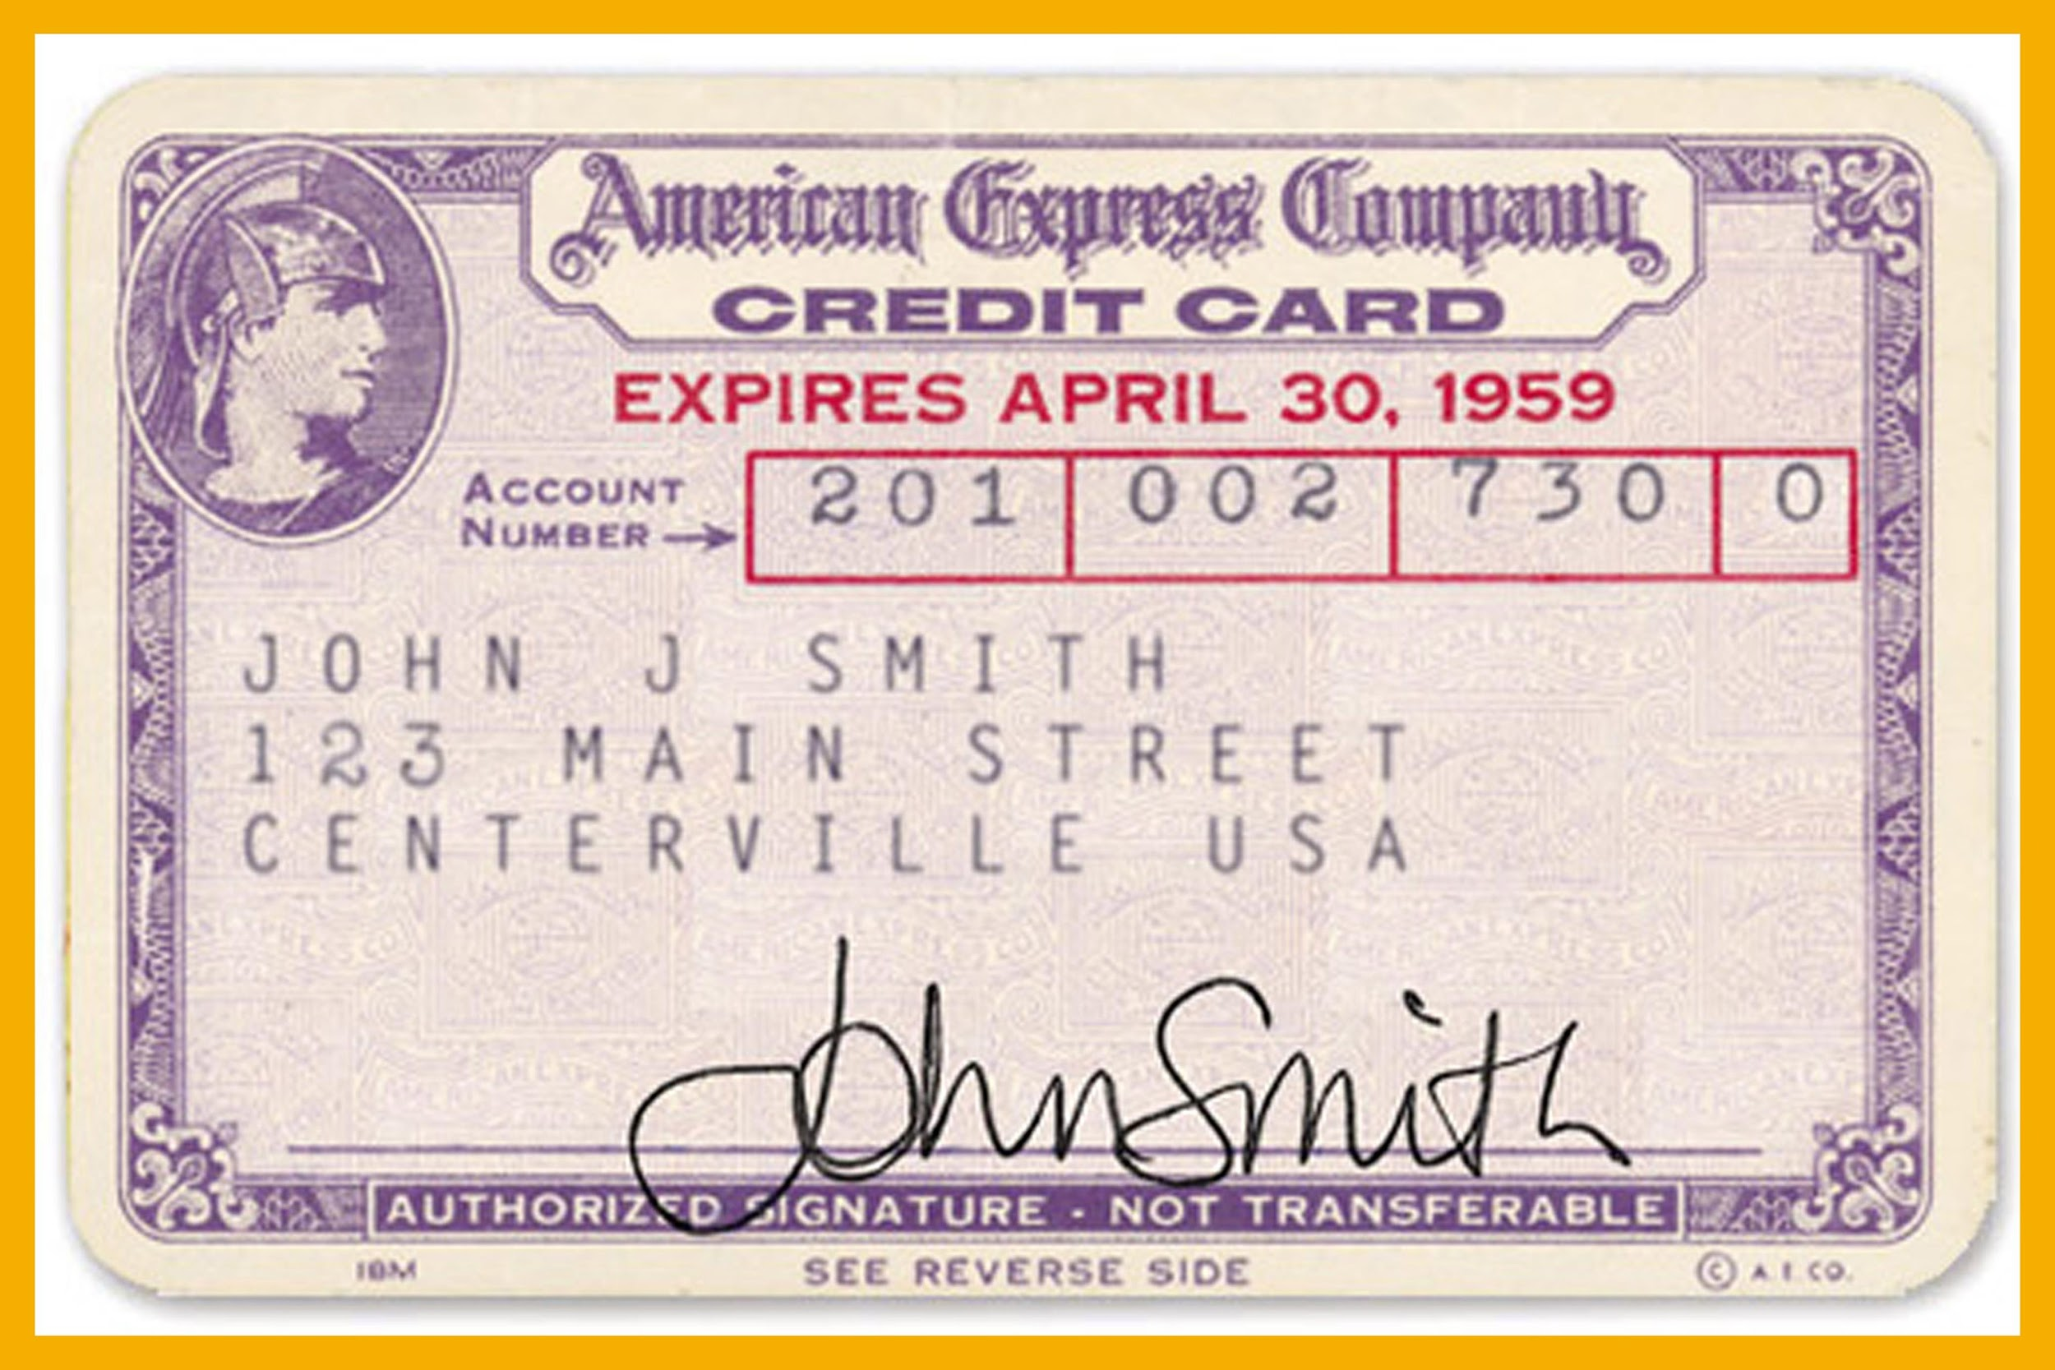
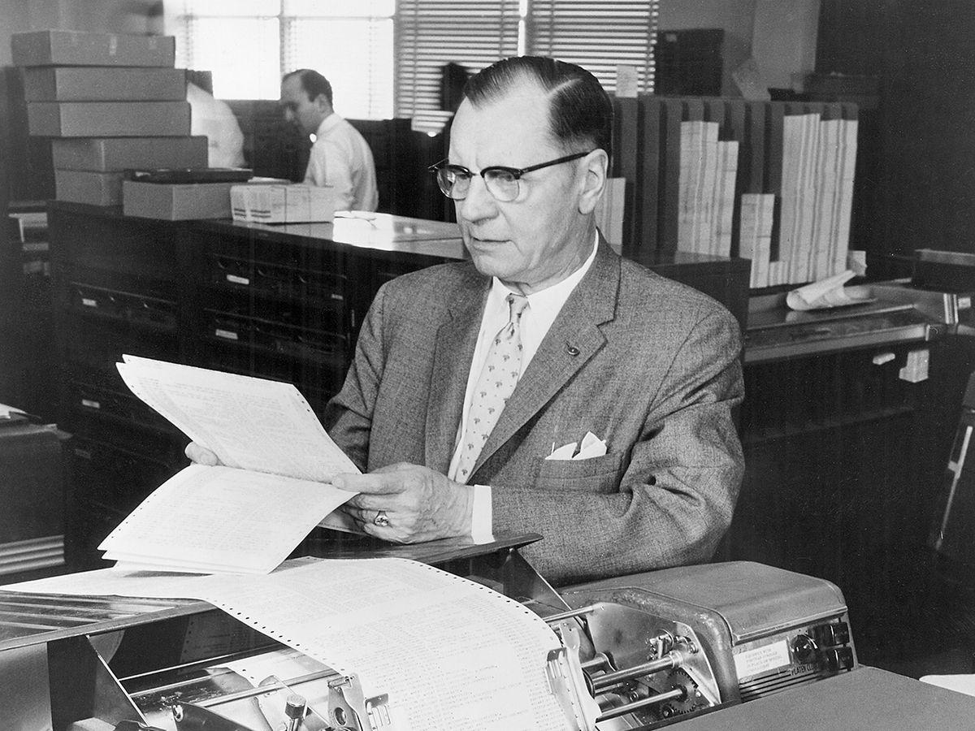
The need for hashing and its history
In the 40’s and 50’s computers were pure number crunchers
And the volume of information in various fields was growing rapidly
  How to deal with all this information?
Similarly, credit cards and official identification were coming into common use
  How to verify the numbers quickly?
IBM’s Hans Peter Luhn seemed to have the answers
2

Slide 11
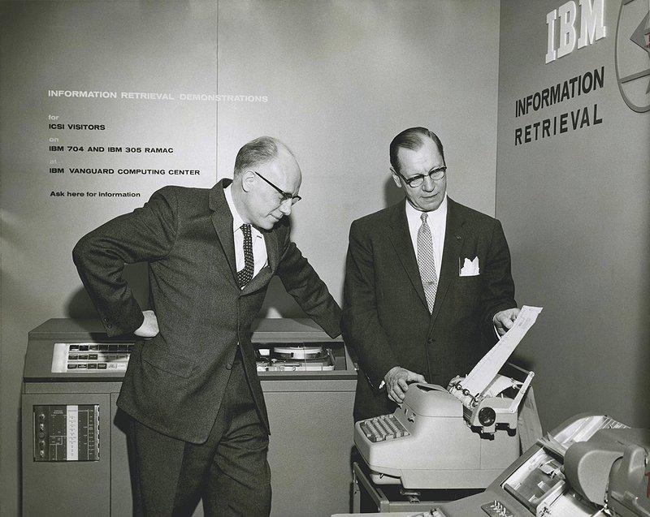
The need for hashing and its history
Luhn joined IBM in 1941 interested in text processing
But he also developed an algorithm for quick verification of numbers
  For example, of credit card and social security numbers
And an algorithm for quickly determining the ownership of a phone number
But perhaps his greatest contribution was an algorithm for automating the indexing of documents
3

Slide 12
Basic overview of hashing
A hash function maps variable-size inputs to fixed-size values
4

Slide 13
Basic overview of hashing
A hash function maps variable-size inputs to fixed-size values
Hash function
4

Slide 14
Basic overview of hashing
A hash function maps variable-size inputs to fixed-size values
“Fred”
Hash function
4

Slide 15
Basic overview of hashing
A hash function maps variable-size inputs to fixed-size values
“Fred”
Hash function
23
4

Slide 16
Basic overview of hashing
A hash function maps variable-size inputs to fixed-size values
These fixed-size values are called hash values or simply hashes
“Fred”
Hash function
23
“Fred”’s hash
4

Slide 17
Basic overview of hashing
A hash function maps variable-size inputs to fixed-size values
These fixed-size values are called hash values or simply hashes
These hashes are often used to index a hash table
“Fred”
Hash function
23
…
…
…
0
1
23
i
A hash table
4

Slide 18
Basic overview of hashing
A hash function maps variable-size inputs to fixed-size values
These fixed-size values are called hash values or simply hashes
These hashes are often used to index a hash table
“Fred”
Hash function
23
“Insert “Fred”’s val here”
…
…
…
0
1
23
i
4

Slide 19
Basic overview of hashing
A hash function maps variable-size inputs to fixed-size values
These fixed-size values are called hash values or simply hashes
These hashes are often used to index a hash table
Using hashes to index a hash table is called hashing
“Fred”
Hash function
23
…
“Fred”’s val
…
…
0
1
23
i
4

Slide 20
More on the purpose of hashing
Hashing allows for quick data storage and retrieval
How quick? O(1) in the average case
  So constant (in the number of elements in the table)
That’s better than with lists (O(n))
That’s also better than with trees (O(log n))
And hashing is more flexible than arrays
5

Slide 21
So is hashing the answer to all our problems?
Well, maybe not everything
For example, you don’t get sorting with hashing
  But you do with trees
Also, if your keys are contiguous integers, just use an array
And so on…
But hashing is good when
  Your keys are variable in size
  You want quick deletion of arbitrary elements
  You don’t want to keep an entry for every possible key
  There are likely more...
6

Slide 22
A closer look at the complexity of hashing
We said hashing is O(1) in the average case
But what about the worst case?
7

Slide 23
A closer look at the complexity of hashing
We said hashing is O(1) in the average case
But what about the worst case?
Let’s go back to our example
“Fred”
Hash function
23
…
“Fred”’s val
…
…
0
1
23
i
7

Slide 24
A closer look at the complexity of hashing
We said hashing is O(1) in the average case
But what about the worst case?
Let’s go back to our example
And add some more entries
“Fred”
Hash function
“Pat”
23
…
“Fred”’s val
…
…
0
1
23
i
7

Slide 25
A closer look at the complexity of hashing
We said hashing is O(1) in the average case
But what about the worst case?
Let’s go back to our example
And add some more entries
“Fred”
01
Hash function
“Pat”
23
…
“Fred”’s val
…
…
0
1
23
i
7

Slide 26
A closer look at the complexity of hashing
We said hashing is O(1) in the average case
But what about the worst case?
Let’s go back to our example
And add some more entries
“Fred”
01
Hash function
“Pat”
“Sam”
23
“Pat”’s val
…
“Fred”’s val
…
…
0
1
23
i
7

Slide 27
A closer look at the complexity of hashing
We said hashing is O(1) in the average case
But what about the worst case?
Let’s go back to our example
And add some more entries
00
“Fred”
01
Hash function
“Pat”
“Sam”
23
“Pat”’s val
…
“Fred”’s val
…
…
0
1
23
i
7

Slide 28
A closer look at the complexity of hashing
We said hashing is O(1) in the average case
But what about the worst case?
Let’s go back to our example
And add some more entries
Now, at some point, we may see a hash reused
00
“Fred”
01
Hash function
“Pat”
“Sam”
23
“Sam”’s val
“Pat”’s val
…
“Fred”’s val
…
…
0
1
23
i
7

Slide 29
A closer look at the complexity of hashing
We said hashing is O(1) in the average case
But what about the worst case?
Let’s go back to our example
And add some more entries
Now, at some point, we may see a hash reused
00
“Fred”
01
Hash function
“Pat”
“Sam”
23
“Ted”
“Sam”’s val
“Pat”’s val
…
“Fred”’s val
…
…
0
1
23
i
7

Slide 30
A closer look at the complexity of hashing
We said hashing is O(1) in the average case
But what about the worst case?
Let’s go back to our example
And add some more entries
Now, at some point, we may see a hash reused
00
“Fred”
01
Hash function
“Pat”
“Sam”
23
“Ted”
Already used!
“Sam”’s val
“Pat”’s val
…
“Fred”’s val
…
…
0
1
23
i
7

Slide 31
A closer look at the complexity of hashing
We said hashing is O(1) in the average case
But what about the worst case?
Let’s go back to our example
And add some more entries
Now, at some point, we may see a hash reused
This is a hash collision
Collisions are unavoidable, but poor handling of them gives you O(n)
00
“Fred”
01
Hash function
“Pat”
“Sam”
23
“Ted”
Already used!
“Sam”’s val
“Pat”’s val
…
“Fred”’s val
…
…
0
1
23
i
7
Notes:
11 minutes

Slide 32
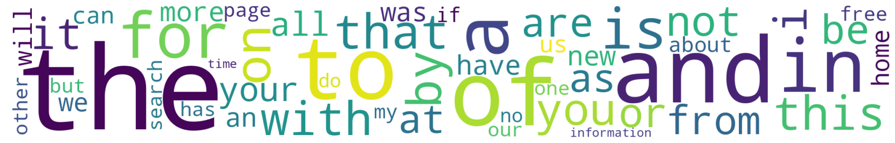
Toy Experiment
Dataset: Top words in English (~300K words with frequency)
Created a hash table with 1 million indices (Plural for index)
We observed the number of hash collisions
Sparsity of the hash table table
8
Notes:
In order to compare the performance of different hashing algorithms we created a toy experiment.
We chose a dataset containing around 300K data samples to store in a hash table containing 1 million indexes
We used different hashing algorithms to generate hashes for the keys
We also recorded the sparsity of the hash table for each of the algorithms
Below you can see the word cloud for the top 50 words in our dataset

Slide 33
Custom Hash Algorithms (ony)
Starts from a fixed seed value as the hash.
Processes each string character one at a time.
Mixes each character into the current hash using XOR and a prime-based multiplication.
Keeps the result within 64 bits after each step.
9
Notes:
to have fun, each of us tried to create our own hashing algorithm and compared it with the popular ones
For example, this is the steps that I use in my hashing algorithm
I start with a seed value
Then I process each character in the string one at a time
Do a few bit wise operations
Clip the entire value by 64 bits

Slide 34
Hash Table Results
Algorithm | Words | Used Indices ↑ | Collisions ↓ | Count ↓ | Sparsity ↓
djb2 | 300000 | 259554 | 40446 | 5 | 74.04%
sha256-hash | 300000 | 259185 | 40815 | 6 | 74.08%
wyhash | 300000 | 259173 | 40827 | 6 | 74.08
md5-hash | 300000 | 259111 | 40889 | 6 | 74.09%
fnv1a | 300000 | 258932 | 41068 | 6 | 74.11%
sdbm | 300000 | 251887 | 48113 | 9 | 74.81%
jay | 300000 | 187649 | 112351 | 9 | 81.24%
ony | 300000 | 76938 | 223062 | 34 | 92.31%
jamin | 300000 | 37304 | 262696 | 75706 | 96.27%
10
Sparsity = 1 - ( total indices used / total indices in table )
Notes:
This is the result that we got from our experiment
The performance of the hash algorithms are sorted by the number of collisions
Djb2 had the least amount of collisions, where as jamin’s algorithm had the most.
The optimal sparsity of our hash table is 70%, and it seems like all the popular algorithms are very close to the optimal sparsity
Daniel J. Bernstein

Slide 35

Hash Table Results
Algorithm | Words | Used Indices ↑ | Collisions ↓ | Count ↓ | Sparsity ↓
djb2 | 300000 | 259554 | 40446 | 5 | 74.04%
sha256-hash | 300000 | 259185 | 40815 | 6 | 74.08%
wyhash | 300000 | 259173 | 40827 | 6 | 74.08
md5-hash | 300000 | 259111 | 40889 | 6 | 74.09%
fnv1a | 300000 | 258932 | 41068 | 6 | 74.11%
sdbm | 300000 | 251887 | 48113 | 9 | 74.81%
djb2 is an older, very simple string hash algorithm
wyhash is a newer non-cryptographic hash algorithm
11
Notes:
One thing to point out is that different hashing algorithms are good for different data types and applications.
Wyhash has been proven to have better performance against other hashing algorithms

Slide 36
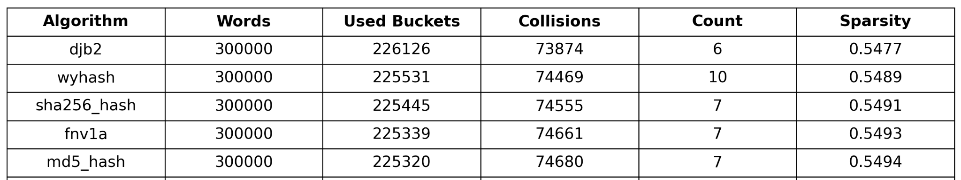
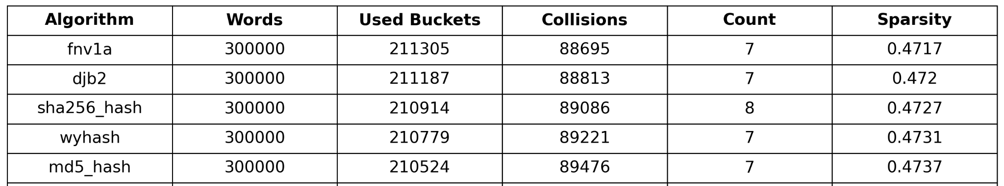
Table Size = 500K (Load Factor = 60%)
Table Size = 400K (Load Factor = 75%)
12
Notes:
Now if we decrease the size of our hash table and increase the load factor,
We can see tha

Slide 37
Understanding the results
Hash table performance depends heavily on the characteristics of the input data.
Different hash functions produce different collision patterns and distribution behavior.
In most cases, well-established hash functions provide strong overall performance.
The best choice depends on the tradeoff between speed and hash quality
13
Notes:
In general hash table performance depends heavily on the characteristics of the input data
One algorithm might work best for string inputs, but perform badly for byte data streams
In most cases, you can select any of the well established algorithms and get a strong overall performance
Ultimately, the best algorithm depends on the target application
17 minutes

Slide 38
Why should we handle the hash collisions?
Pen
Hash
Function
Hash A
Pineapple
Hash B
Collision
Apple
Hash C
14

Slide 39
Why should we handle the hash collisions?
UT sent $200
Hash
Function
Hash A
UT sent $400
Hash B
UT sent $2,000,000
Hash C
Ledger
15

Slide 40
Why should we handle the hash collisions?
UT sent $200
Hash
Function
Hash A
UT sent $400
Hash B
UT sent $2,000,000
Hash C
Ledger
15

Slide 41
Why should we handle the hash collisions?
UT sent $200
Hash
Function
Hash A
UT sent $400
Hash B
UT sent $2,000,000
Hash C
Ledger
15

Slide 42
Why should we handle the hash collisions?
UT sent $200
Hash
Function
Hash A
UT sent $400
Hash B
Collision
UT sent $2,000,000
Hash C
Ledger
15

Slide 43
Why shoule we handle the hash collisions?
UT sent $200
Hash
Function
Hash A
UT sent $400
Hash B
Collision
UT sent $2,000,000
Hash C
IT IS REALLY IMPORTANT TO HANDLE COLLISIONS
15

Slide 44
How to handle the hash collisions?
Chaining
Open Addressing
16

Slide 45
How to handle the hash collisions?
Hash Table
17

Slide 46
How to handle the hash collisions?
Chaining
Hash Table
17

Slide 47
How to handle the hash collisions?
Chaining
Open Addressing
Hash Table
17

Slide 48
Chaining - Store
Each slot of the hash table stores a vector of data, so multiple items can be chained together at the same index.
UT sent $200
18

Slide 49
Chaining - Store
Each slot of the hash table stores a vector of data, so multiple items can be chained together at the same index.
UT sent $200
UT sent $200
Hash Table
18

Slide 50
Chaining - Store
Each slot of the hash table stores a vector of data, so multiple items can be chained together at the same index.
UT sent $200
UT sent $400
UT sent $200
UT sent $400
Hash Table
18

Slide 51
Chaining - Store
Each slot of the hash table stores a vector of data, so multiple items can be chained together at the same index.
UT sent $200
UT sent $400
UT sent $200
UT sent $400
UT sent $2,000,000
Collision
Hash Table
18

Slide 52
Chaining - Store
Each slot of the hash table stores a vector of data, so multiple items can be chained together at the same index.
UT sent $200
UT sent $400
UT sent $200 | UT sent $2,000,000
UT sent $400
UT sent $2,000,000
Hash Table
18

Slide 53
Chaining - Retrieving
Each slot of the hash table stores a vector of data, so multiple items can be chained together at the same index.
UT sent $2,000,000
UT sent $400
UT sent $200 | UT sent $2,000,000
Hash Table
19

Slide 54
Chaining - Retrieving
Each slot of the hash table stores a vector of data, so multiple items can be chained together at the same index.
Hash Table
UT sent $400
UT sent $200 | UT sent $2,000,000
Not match
UT sent $2,000,000
19

Slide 55
Chaining - Retrieving
Each slot of the hash table stores a vector of data, so multiple items can be chained together at the same index.
Hash Table
UT sent $400
UT sent $200 | UT sent $2,000,000
Match
UT sent $2,000,000
19

Slide 56
Open Addressing
Instead of storing multiple items per slot, Open Addressing finds the next available empty slot in the table itself when a collision occurs.
h_{i} = H(key) + F(i, key) mod the size of table
20

Slide 57
Open Addressing
Instead of storing multiple items per slot, Open Addressing finds the next available empty slot in the table itself when a collision occurs.
h_{i} = H(key) + F(i, key) mod the size of table
There are several methods to find available empty slots:
Linear Probing
Quadratic Probing
Double Hashing
20

Slide 58
Open Addressing
Instead of storing multiple items per slot, Open Addressing finds the next available empty slot in the table itself when a collision occurs.
h_{i} = H(key) + F(i, key) mod the size of table
There are several methods to find available empty slots:
Linear Probing → F(i, key) = i → Find Consecutive Empty Slots
Quadratic Probing → F(i, key) = i^2
Double Hashing → F(i, key) = H_2(key) * i
20

Slide 59
Open Addressing - Linear Probing
UT sent $200
UT sent $200
Hash Table
21

Slide 60
Open Addressing - Linear Probing
UT sent $200
UT sent $400
UT sent $200
UT sent $400
Hash Table
21

Slide 61
Open Addressing - Linear Probing
UT sent $200
UT sent $400
UT sent $200
UT sent $400
UT sent $2,000,000
Hash Table
21

Slide 62
Open Addressing - Linear Probing
UT sent $200
UT sent $400
UT sent $200
UT sent $400
UT sent $2,000,000
Hash Table
21

Slide 63
Open Addressing - Linear Probing
UT sent $200
UT sent $400
UT sent $200
UT sent $2,000,000
UT sent $400
UT sent $2,000,000
Hash Table
21

Slide 64
Open Addressing - Linear Probing
UT sent $400
UT sent $200
UT sent $2,000,000
UT sent $2,000,000
Not match
Hash Table
21

Slide 65
Open Addressing - Linear Probing
UT sent $400
UT sent $200
UT sent $2,000,000
UT sent $2,000,000
Not match
Hash Table
21

Slide 66
Open Addressing - Linear Probing
UT sent $400
UT sent $200
UT sent $2,000,000
UT sent $2,000,000
Match
Hash Table
21

Slide 67
Comparing the collision resolution strategies
 | Chaining | Open addressing
Cache performance (Reading) | Bad | Good
Load factor* > 1.0 supported | Yes | No
*Load factor is a measure how full the table is
22
Notes:
22 minutes

Slide 68
A few applications of hashing
Sets and associative arrays
  For example, dictionaries in Python
  Also unordered_set and unordered_map in C++11
  There are many others
Caches
  How to deal with collisions?
Transposition tables in game playing programs
  Their usage is a form of dynamic programming
  These tables are also a kind of cache
23

Slide 69
Open issues
This is an active area of research!
An optimal space-time tradeoff is desired
We also want optimal bounds for query time, insertion, and deletion
Multiple open addressing approaches are being explored
  Both greedy and non-greedy
A long-standing conjecture about optimality was recently overturned
  By an undergraduate!
24

Slide 70
References
https://github.com/wangyi-fudan/wyhash
https://github.com/Nicoshev/rapidhash
https://spectrum.ieee.org/hans-peter-luhn-and-the-birth-of-the-hashing-algorithm
https://www.geeksforgeeks.org/dsa/separate-chaining-collision-handling-technique-in-hashing/
https://dl.acm.org/doi/full/10.1145/3772375
https://en.wikipedia.org/wiki/Hash_table#Applications
https://en.wikipedia.org/wiki/Transposition_table

Slide 71
Discussion and Q&A
Is it possible to find a general hashing algorithm that will be the best for hash table generation for all applications?

Slide 72
Test questions
What is the worst case time complexity of hashing?
What hash algorithm performed the best in our Toy experiment?
Which method offers better cache performance (for reading), Chaining or Open Addressing?

Slide 73
Thank you

