Slide 1

Matchmaking Algorithms in Videogames

Slide 2

Questions
Which two organizations adopted the Elo system?
What does volatility represent in Glicko 2?
What is the difference between TrueSkill 1 and 2?
https://forms.gle/UB1DusX4RyXSFMtEA

Slide 3
Introductions

Slide 4
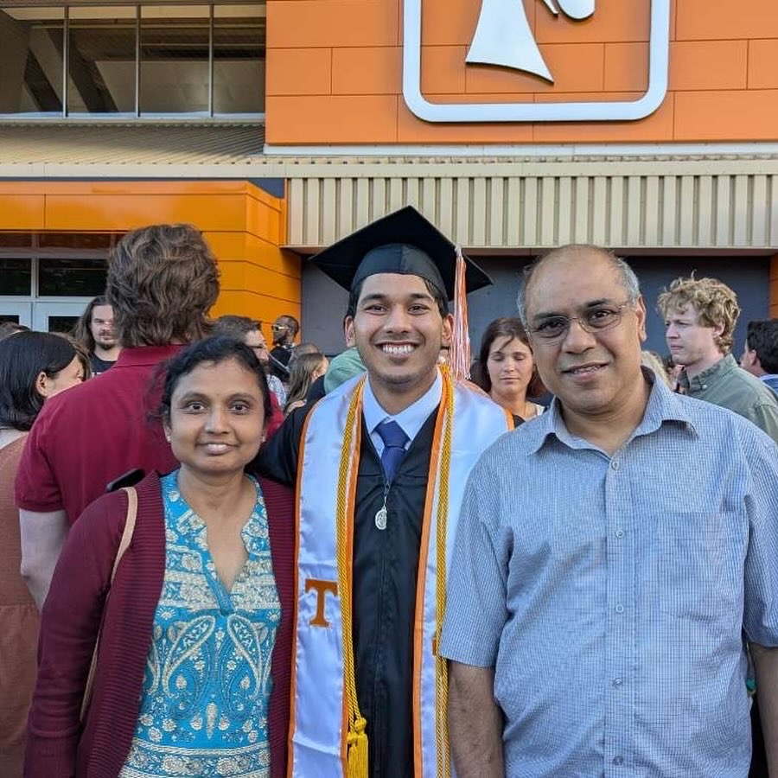
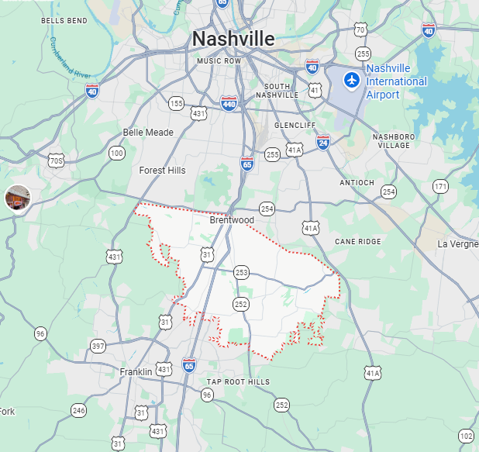
Vineeth Konjeti
Born in: Topeka, KS
Hometown: Brentwood, TN
Attended Ravenwood High School
TA for 202
BS in CS with a minor in Data Science
Finishing 5-YR MS/BS in CS focusing in AI/ML

Slide 5



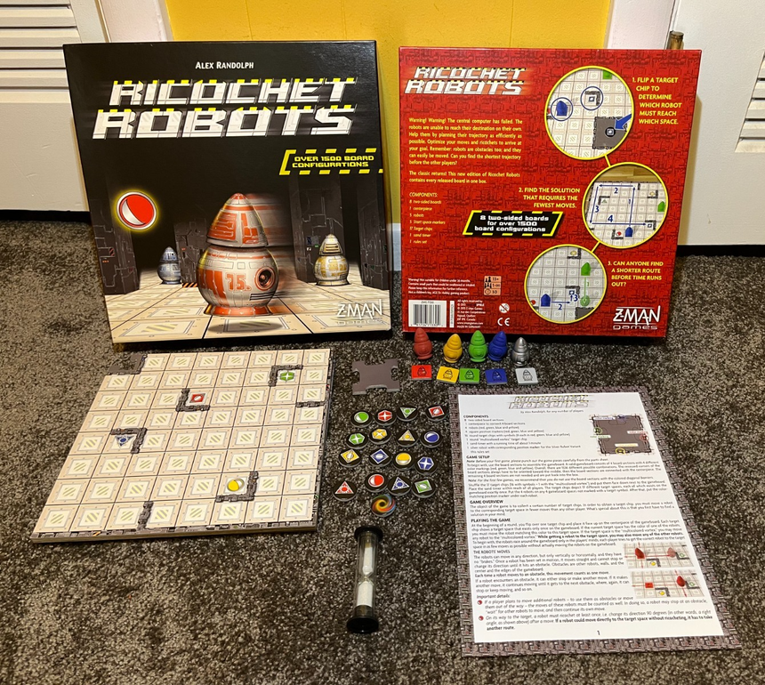







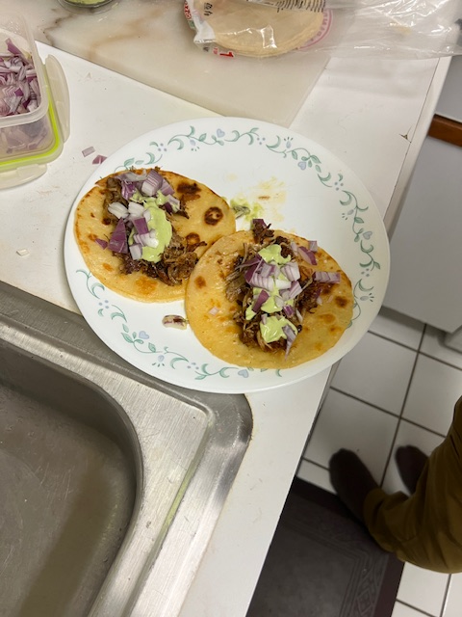
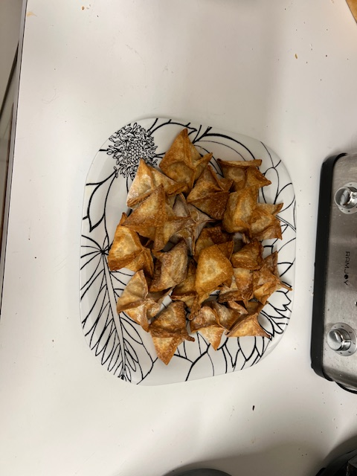
Vineeth Konjeti
Always willing to try new things
Hobbies
  Digital Art
  Rock Climbing
  Videogames
  Boardgames
  Anime
  Cooking
  Traveling
Notes:
Cypress MT<->Grouse MT

Slide 6

Shashank Bandaru
BS in Computer Science,
Finishing MS in Computer Science
Advisor: Dr. Suya
Born in: Kansas City, KS
Hometown: Memphis, TN
Attended White Station High School

Slide 7






Shashank Bandaru
Interests
  Travelling
  Video games
  Learning languages (attempted)
  Politics
  Sci-fi
  Urban Planning
Notes:
Glacier Bay (top)
Vancouver Harbor (bottom)
FlyingMooseCA -> Hong Kong MTR

Slide 8
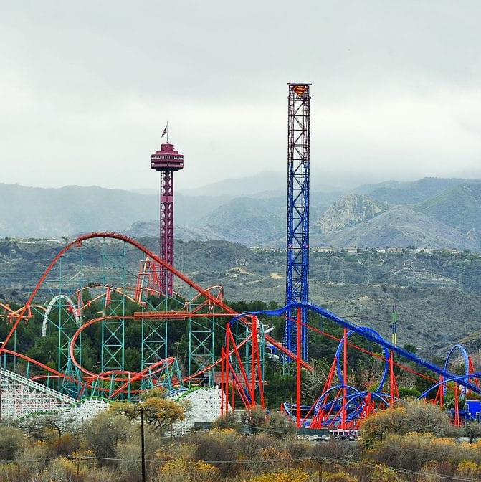
Chris White
BS in Computer Science,
Finishing MS in Computer Science... in Summer
Advisor: Dr. Plank
Born in Santa Clarita, CA
Attended Saugus High School
Not Really Hometown: Friendsville, TN

Slide 9





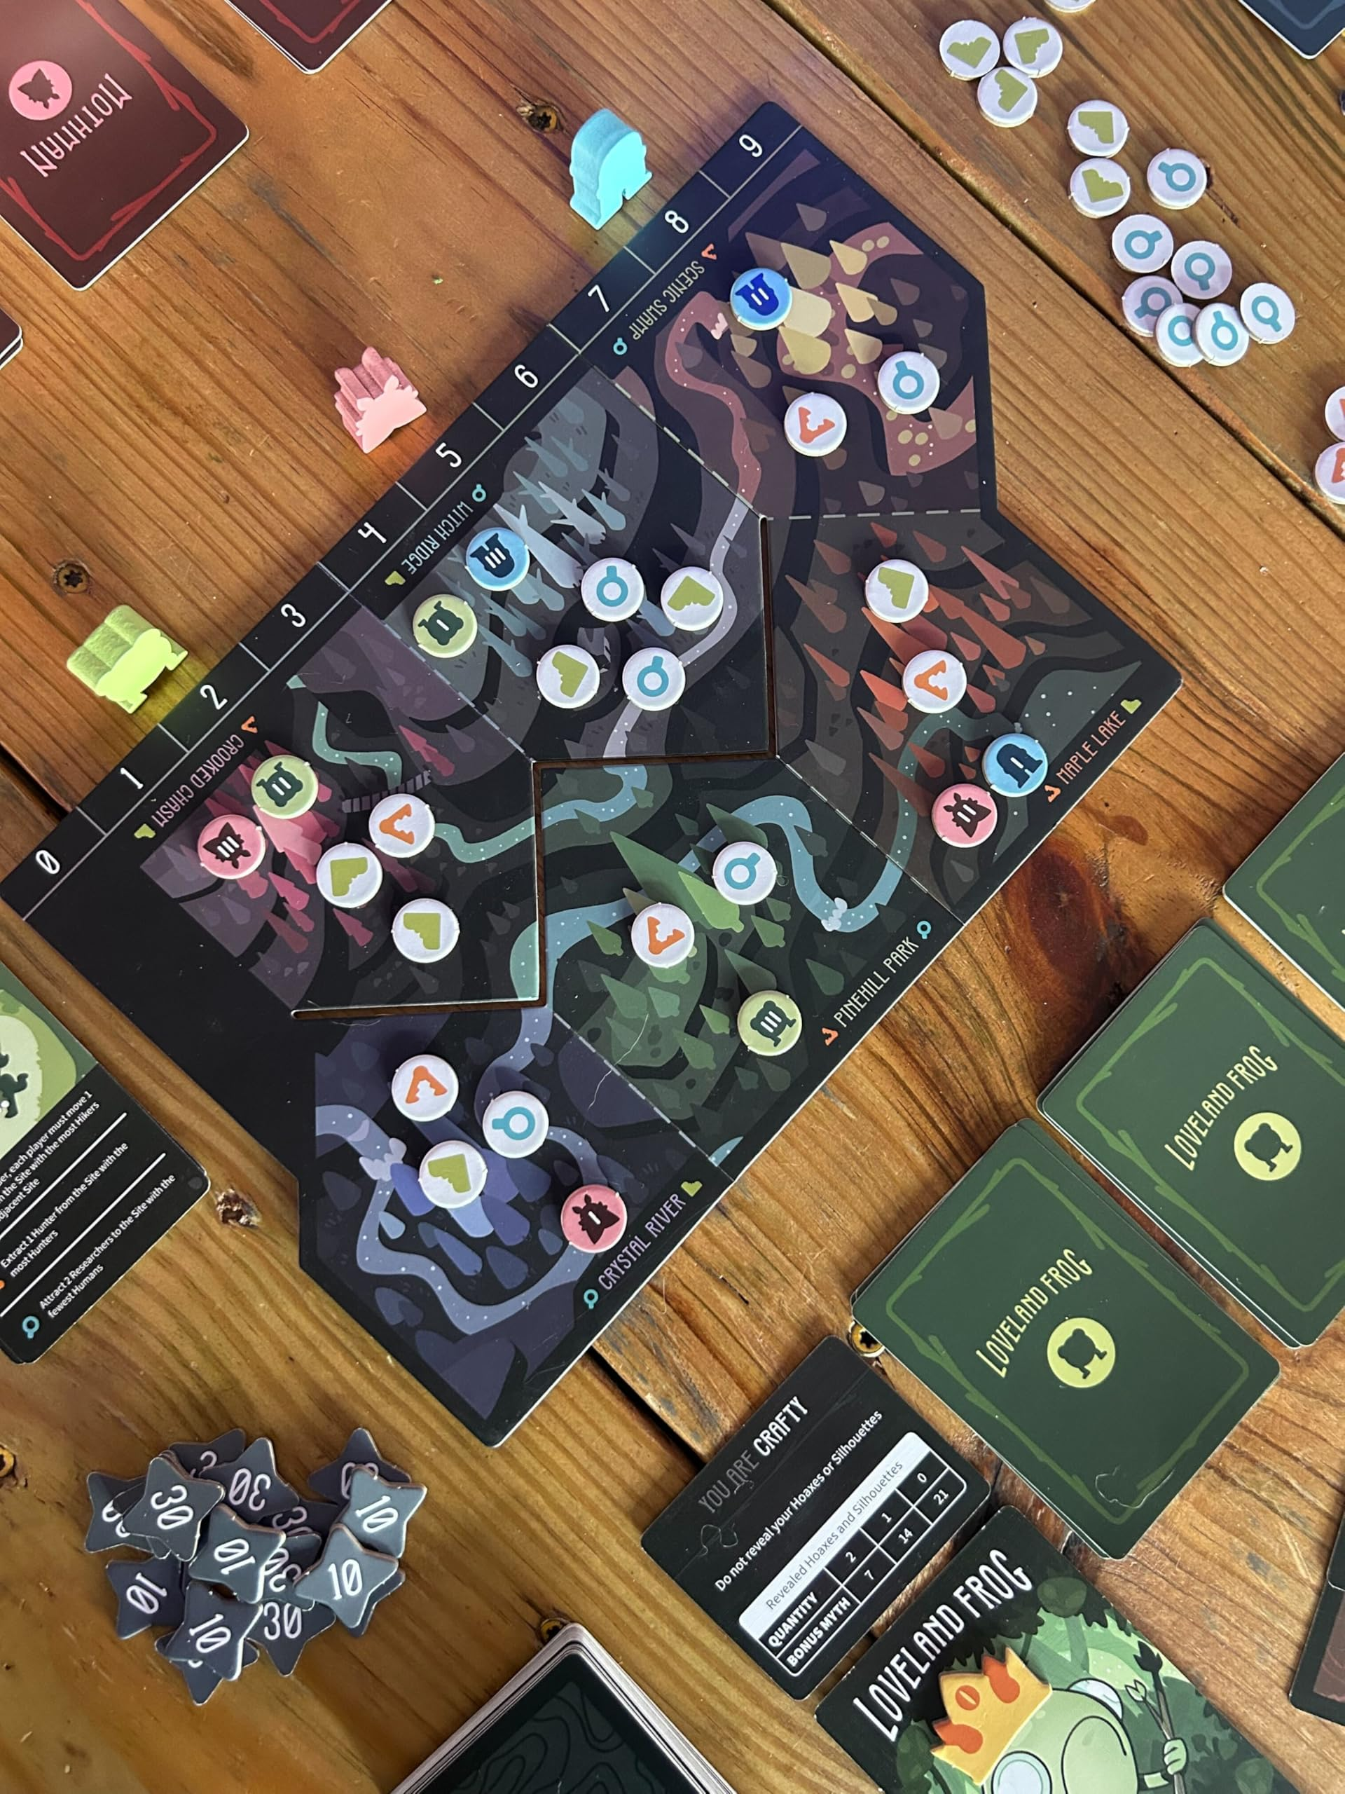
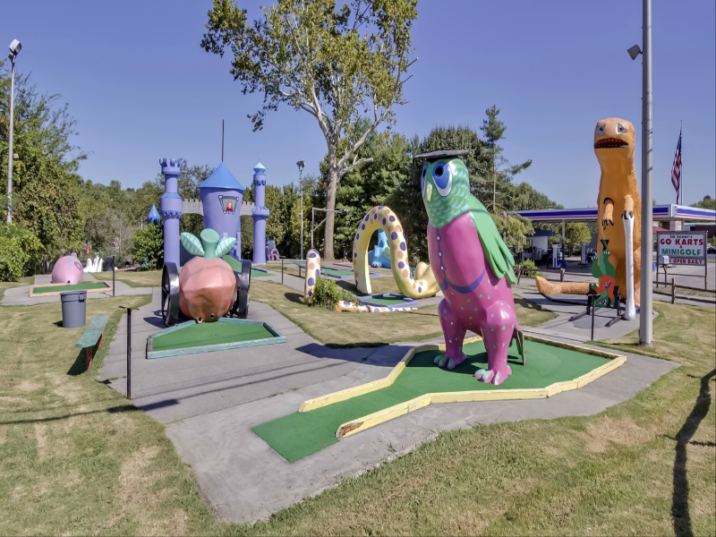
Chris White
Interests
  Rock Climbing
  Video Games
  Hiking
  Board Games
  Mini Golf
  My Fiancé

Slide 10
Outline
Overview & Definitions
History of Rating Algorithms
Timeline History
Algorithmic Analysis
  Elo Rating System
  Glicko 1 & 2
  TrueSkill 1 & 2
Applications
Open Issues
Discussion

Slide 11
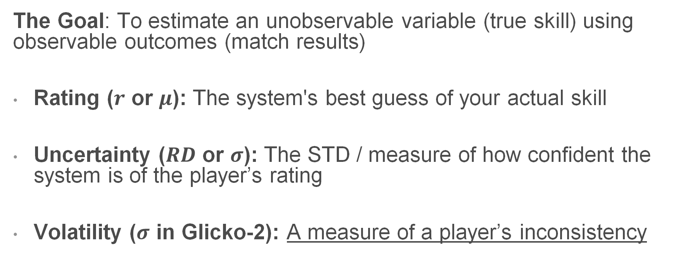
Overview & Definitions
The Goal: To estimate an unobservable variable (true skill) using observable outcomes (match results)
Rating ($r$ or $μ$): The system's best guess of your actual skill
Uncertainty ($RD$ or $σ$): The STD / measure of how confident the system is of the player’s rating
Volatility ($σ$ in Glicko-2): A measure of a player’s inconsistency
Notes:
Before Glicko, older systems just guessed your skill with a single number. But Mark Glickman realized that a guess isn't helpful unless you know how confident you are in it. So, he introduced two numbers. First is your Rating—the system's best guess of your skill. Second is the Rating Deviation. Think of this as a margin of error. It's the system's way of saying, 'I think you are a 1500, give or take 200 points.' This 'margin of error' was the massive breakthrough that changed matchmaking forever.

Slide 12
History

Slide 13
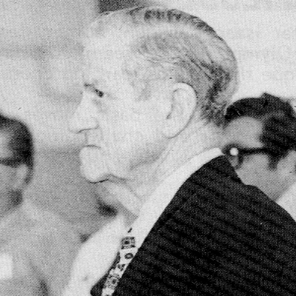
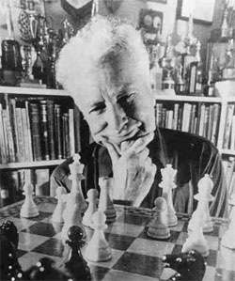
History: Elo
Kenneth Harkness created an early algorithmic ranking approach used in chess in 1950
Arpad Elo perfected it by 1960 using his own formula which added a statistical basis on top of Harkness’s formula
Elo’s algorithm was used from 1960 in the US Chess Federation in St. Louis
In 1970, FIDE agreed to adopt the Elo Rating System
Kenneth Harkness
Arpad Emmerich Elo
Notes:
To understand where we are, we have to look at how we got here. In the 1960s, Arpad Elo formalized the Elo system for the US Chess Federation.
Kenneth Harkness: When a player competes in a tournament, the average rating of his competition is calculated. If the player scores 50% he receives the average competition rating as his performance rating. If he scores more than 50% his new rating is the competition average plus 10 points for each percentage point above 50. If he scores less than 50% his new rating is the competition average minus 10 points for each percentage point below 50.

Slide 14

History: Glicko
Mark Glickman critiqued that Elo treated all ratings as reliable
In 1995, he created Glicko, which added a form of standard deviation to the ratings called “ratings deviation”
Some older video games and regional chess organizations adopted Glicko
FIDE notably did not

Slide 15



History: TrueSkill
Halo 2 launched in 2004, using
a customized implementation of Elo.
Elo proved to be ineffective for team-based games, as it could not accurately account for player skill disparity amongst teams
Ralf Herbrich, Tom Minka, and Thore Graepel created TrueSkill 2006, using data from Halo 2 to validate the system
Microsoft published TrueSkill 2 in 2018, this time with a greater focus on player stats
Ralf Herbrich
Tom Minka
Thore Graepel

Slide 16
Timeline
NNs and gradient boosting replace factor graphs.
Features: playstyle embeddings, churn prediction, real-time lobby optimization
1960
1995
2000
2006
2011
2018
Present
Adopted by FIDE in 1970
Added statistical basis to Harkness System
Volatility 𝝈 added for inconsistent performers.
Still public domain
Patent-free True-Skill alternative.
Elo Rating System
Glicko-2
Weng-Lin
Mixed-ML models
Glicko Rating System
True-Skill
True-Skill 2
Added Rating Deviation (RD), the first uncertainty parameter
Microsoft Research: Expectation Propagation
Xbox Live launch Nov 2007
Additional Data including:
Individual stats, squad offsets
Notes:
"In 1995, Mark Glickman realized Elo had a fatal flaw: it didn't track uncertainty. So, he invented Glicko-1 to introduce the RD parameter. Five years later, he published Glicko-2 to add the Volatility metric.
But these were all 1v1 systems. As team-based games like Halo exploded in the mid-2000s, Microsoft Research created TrueSkill, which shifted the entire industry toward complex Bayesian networks, leading directly to the machine learning-assisted models we use today."

Slide 17
Algorithms

Slide 18
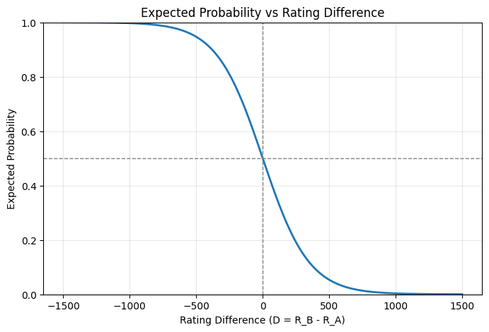
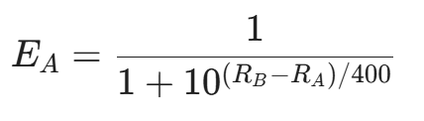
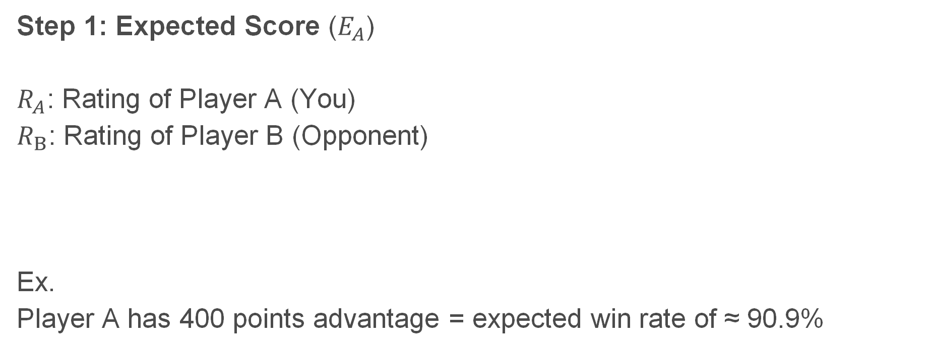
Elo
Step 1: Expected Score ($E_{A}$)
$R_{A}$: Rating of Player A (You)
$R_{B}$: Rating of Player B (Opponent)
Ex.
Player A has 400 points advantage = expected win rate of ≈ 90.9%

Slide 19

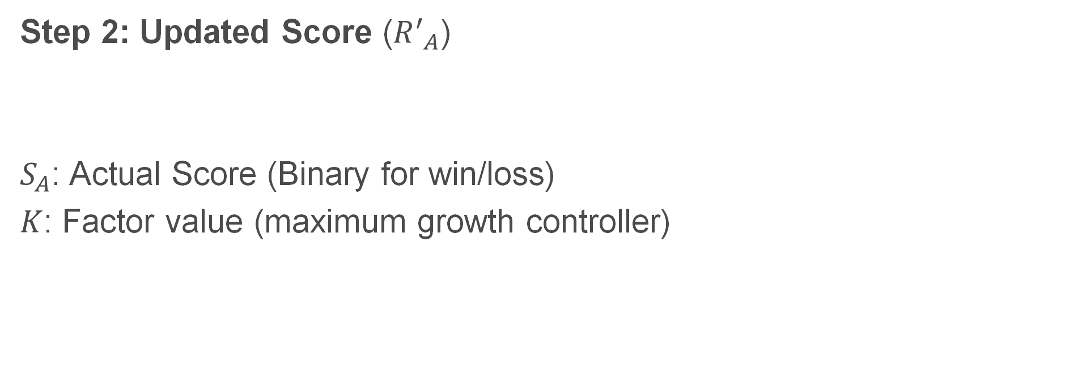
Elo
Step 2: Updated Score (${R^{′}}_{A}$)
$S_{A}$: Actual Score (Binary for win/loss)
$K$: Factor value (maximum growth controller)

Slide 20
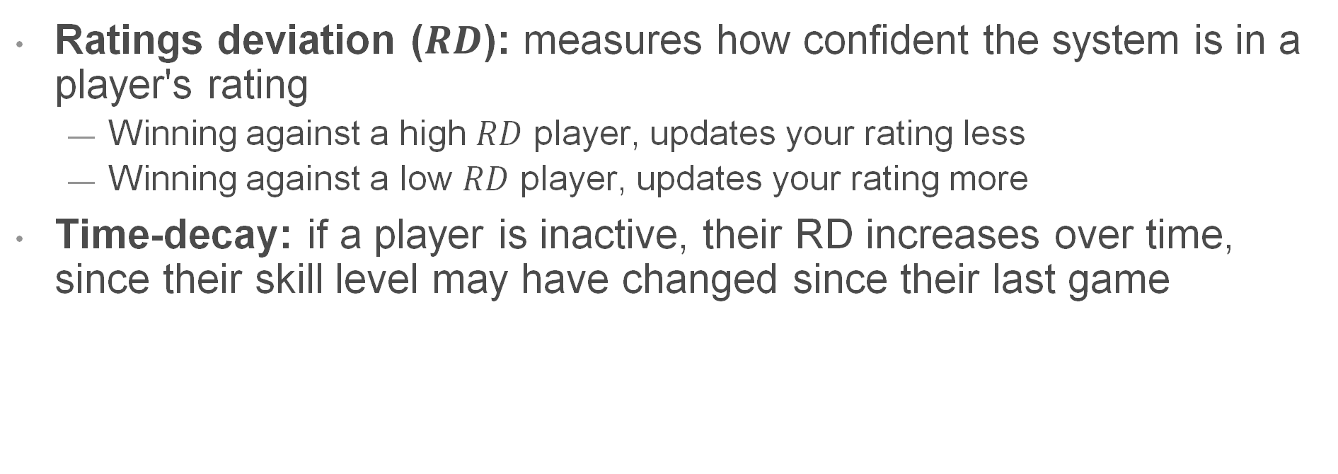
Glicko
Ratings deviation ($RD$): measures how confident the system is in a player's rating
  Winning against a high $RD$ player, updates your rating less
  Winning against a low $RD$ player, updates your rating more
Time-decay: if a player is inactive, their RD increases over time, since their skill level may have changed since their last game
Notes:
RD
For example: a new player has a high RD, a veteran has a low one
For winning example: because high RD player’s rating is uncertain.
TD
For example: some games like League of Legends, decrease your competitive ranking daily at higher ranks if you stop playing…

Slide 21

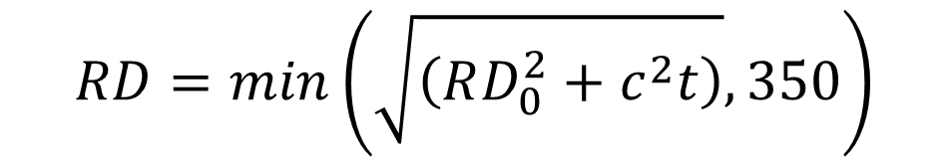
Glicko
Step 1: Adjust RD for inactivity
$350$ is the RD of a new player
$RD0$ is the initial RD
$t$ is the time since the last game
$c$ is a constant
$$RD=min\left(\sqrt{\left(RD_{0}^{2}+c^{2}t\right)},350\right)$$

Slide 22
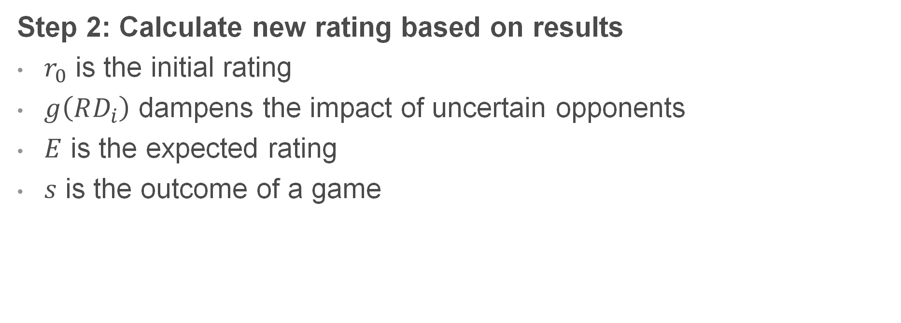
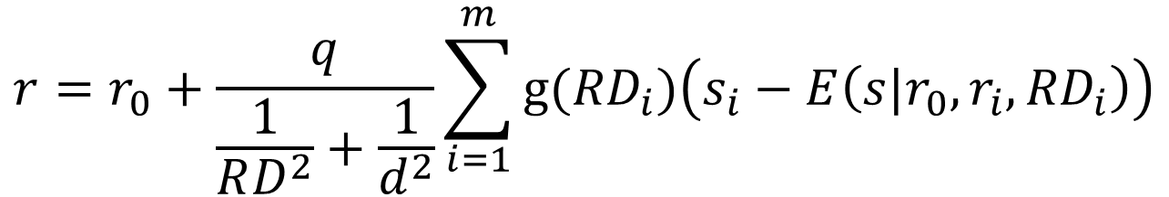
Glicko
Step 2: Calculate new rating based on results
$r_{0}$ is the initial rating
$g\left(RD_{i}\right)$ dampens the impact of uncertain opponents
$E$ is the expected rating
$s$ is the outcome of a game
$$r=r_{0}+\frac{q}{\frac{1}{RD^{2}}+\frac{1}{d^{2}}}\sum_{i=1}^{m}{g({RD}_{i})\left(s_{i}−E\left(s|r_{0},r_{i},{RD}_{i}\right)\right)}$$
Notes:
Essentially, we create a new rating by altering the old rating using the outcomes of the games played. But for each outcome, we dampen the outcome by a certain amount using the RD of the opposing player. This plays into the RD mechanic we covered earlier.
q and d are scaling factors.

Slide 23

Glicko
Step 3: Update RD based on games played
$$RD^{′}=\sqrt{{\left(\frac{1}{RD^{2}}+\frac{1}{d^{2}}\right)}^{−1}}$$
Notes:
low d² = Lots of games against low-RD opponents = high information = bigger RD drop.
high d² = Few games against high-RD opponents = low information = smaller RD drop.

Slide 24
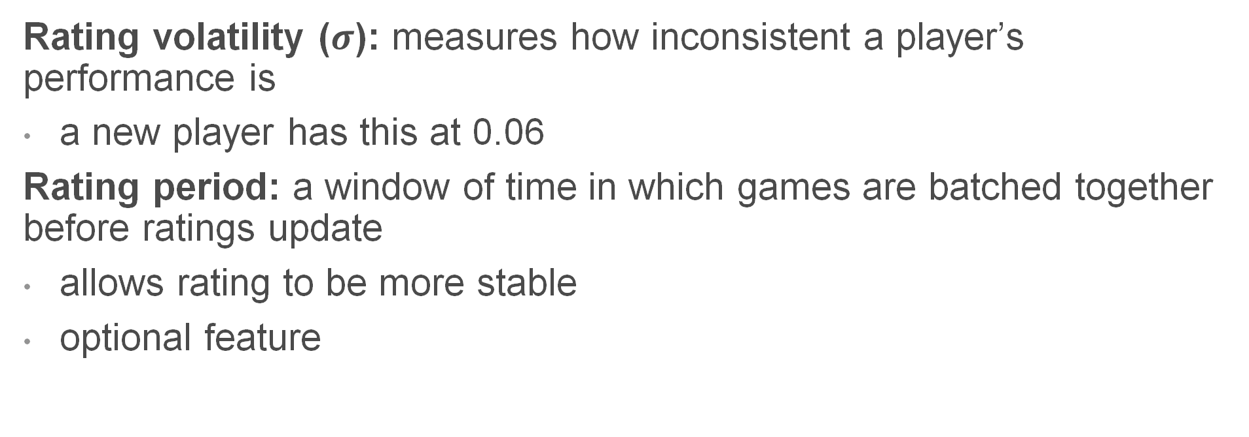
Glicko 2
Rating volatility ($σ$): measures how inconsistent a player’s performance is
a new player has this at 0.06
Rating period: a window of time in which games are batched together before ratings update
allows rating to be more stable
optional feature
Notes:
In a simple case, rating period would be one game.

Slide 25
Glicko 2
Procedure is similar to Glicko:
Compute expected score against each opponent
Calculate new volatility
  Increases if the results were surprising
  Decreases if the results were expected
Update RD using new volatility
Calculate new rating
Notes:
The actual math behind it is a lot to show for a presentation so…
Bold is the only parts added.

Slide 26
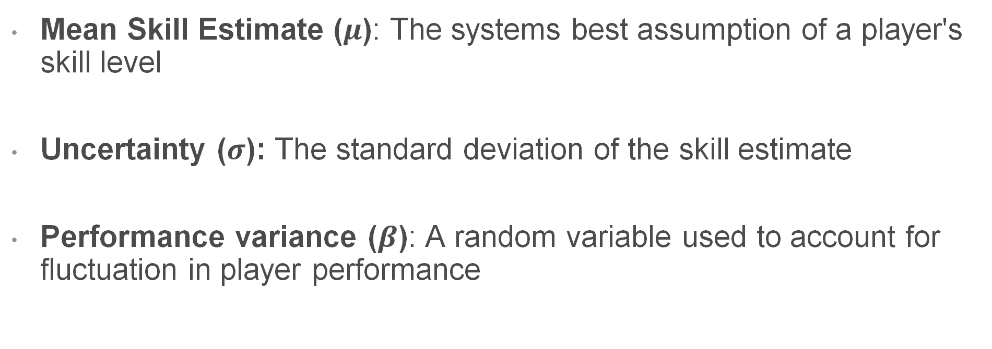
TrueSkill
Mean Skill Estimate ($μ$): The systems best assumption of a player's skill level
Uncertainty ($σ$): The standard deviation of the skill estimate
Performance variance ($β$): A random variable used to account for fluctuation in player performance

Slide 27
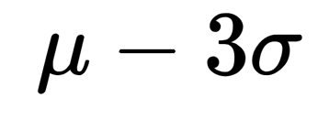
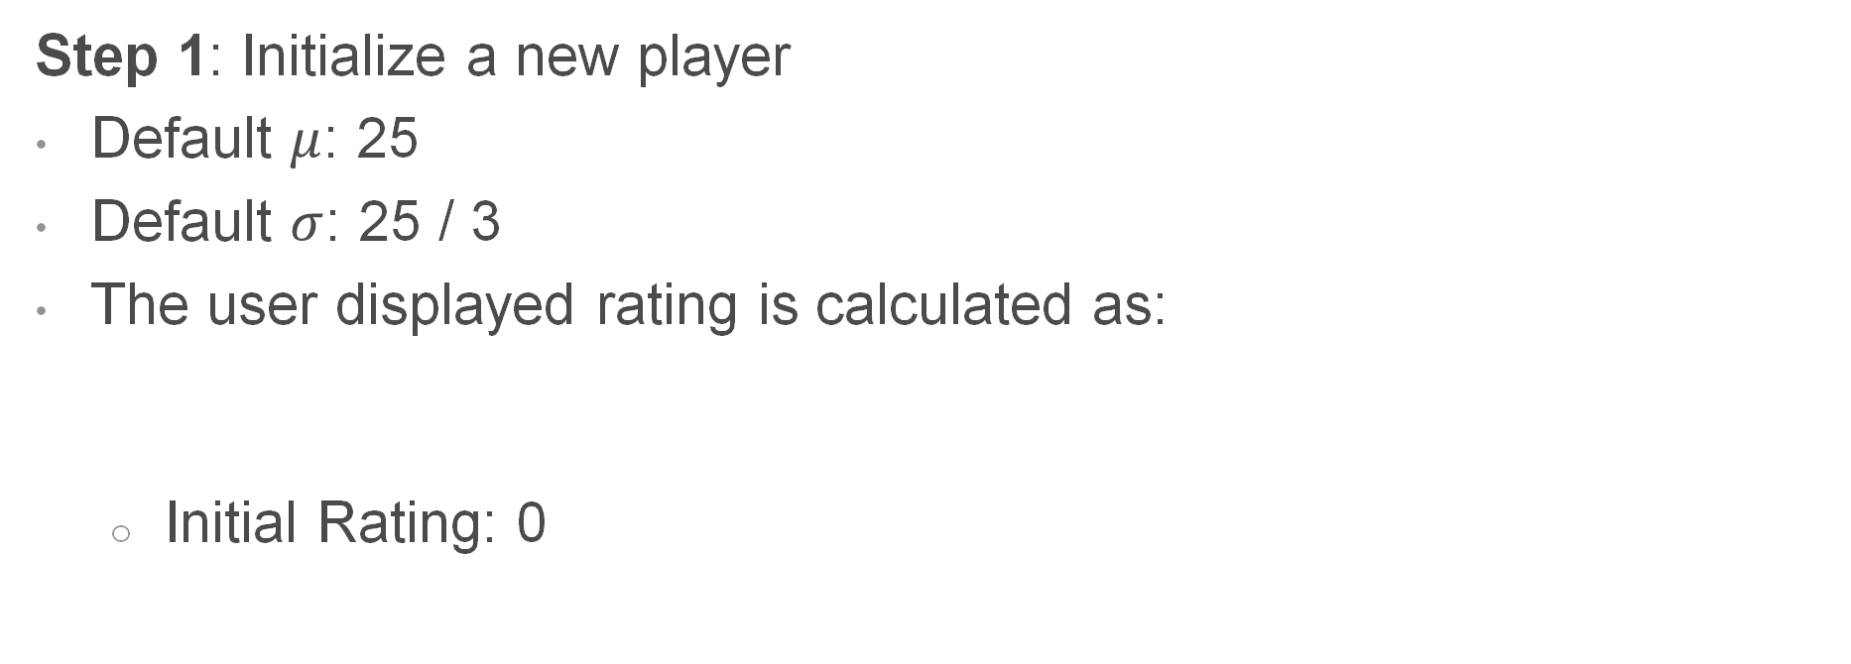
TrueSkill
Step 1: Initialize a new player
Default $μ$: 25
Default $σ$: 25 / 3
The user displayed rating is calculated as:
  Initial Rating: 0

Slide 28
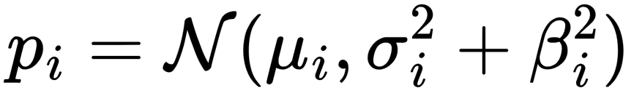
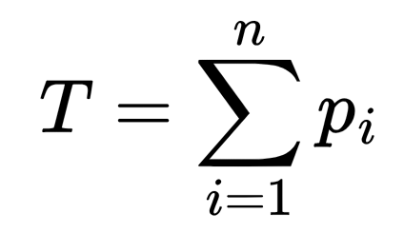
TrueSkill
Step 2: Individual and Team Performance Calculation
Individual Performance is calculated as:
Team Performance is the calculated as:

Slide 29
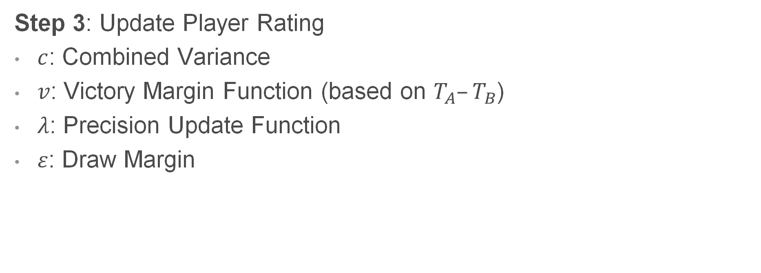
TrueSkill
Step 3: Update Player Rating
$c$: Combined Variance
$v$: Victory Margin Function (based on $T_{A}–T_{B}$)
$λ$: Precision Update Function
$ε$: Draw Margin

Slide 30
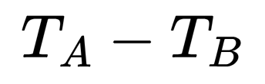
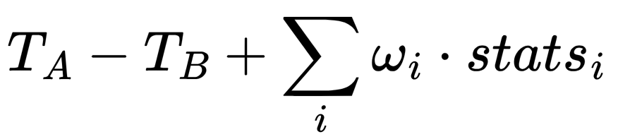
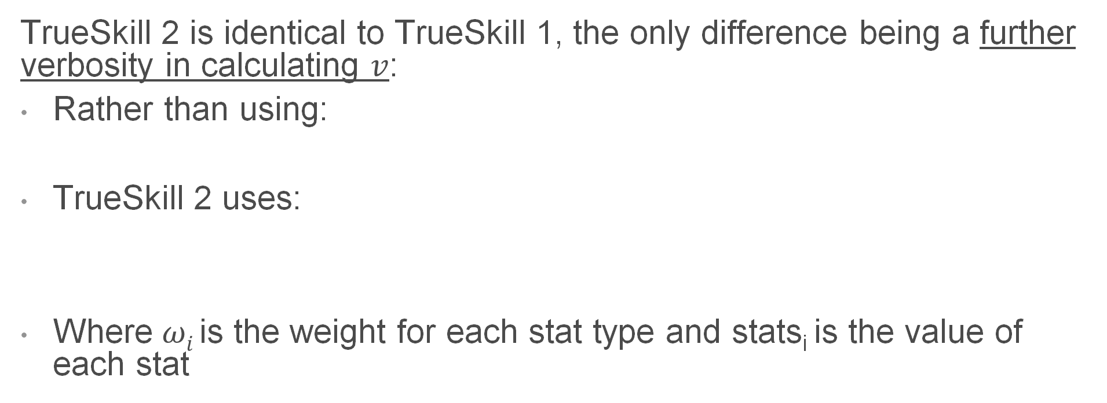
TrueSkill 2
TrueSkill 2 is identical to TrueSkill 1, the only difference being a further verbosity in calculating $v$:
Rather than using:
TrueSkill 2 uses:
Where $ωi$is the weight for each stat type and stats_{i} is the value of each stat

Slide 31
Applications
Chess and Chess Organizations
Board Games and Online Games
Team Sports Analytics / Sports Gambling
  NFL, NBA analytics
Educational Platforms
  Duolingo, Khan Academy
  Standardized tests
Dating & Recommendation Apps
Notes:
NFL analytics teams use Elo variants for predictive modeling.
Standardized testing use it to dynamically assign questions difficulty and score based on that.
Glicko-2 used by the Australian Chess Federation

Slide 32
Open Issues
Transitivity assumption
  A beats B, B beats C, A should beat C
Elo: K value is hand-picked,
  Too high = volatile ratings, too low = slow convergence
Glicko: volatility can be manipulated, resulting in unfair gains in ratings
TrueSkill 2: Statistic weights are static
  Playstyles can be optimized to target higher weighted stats
Notes:
Using individual ratings to form team ratings is flawed and may not accurately represent the team’s skill.

Slide 33
References
M. Glickman, “Welcome to Glicko ratings,” Mark Glickman’s World. Accessed: May 04, 2026. [Online]. Available: https://www.glicko.net/glicko.html
N. Sfetcu, “Chess guide,” Chess Guide > ELO Rating System, https://www.museum.am/chess/com_chessguide/elo.html
R. Herbrich, T. Minka, and T. Graepel, "TrueSkill™: A Bayesian skill rating system," in Advances in Neural Information Processing Systems 19, MIT Press, 2006, pp. 569–576.

Slide 34
Questions and Discussion
Which two organizations adopted the Elo system?
What does volatility represent in Glicko 2?
What is the difference between TrueSkill 1 and 2?
https://forms.gle/UB1DusX4RyXSFMtEA

Slide 35
Rating System ≠ Matchmaking System
Rating System
“How skilled is this player?”
Updates a value after each match
Runs once per game after the result of the match is known.
Ex:
Elo: O(1) point swap formula
Glicko-2: Batch Bayesian update
TrueSkill: Factor Graph Inference
Matchmaking System
“Who should play each other right now?”
Runs in real time, against a live queue of players
Must balance several factors before any game has been played
Notes:
Tells us “What does this result tell us about skill?”
Does not tell us “who should play who”

Slide 36
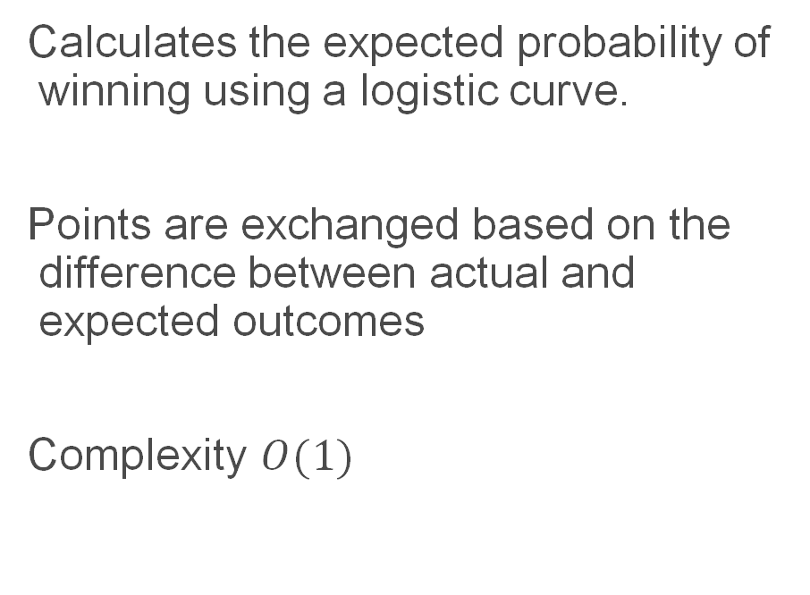
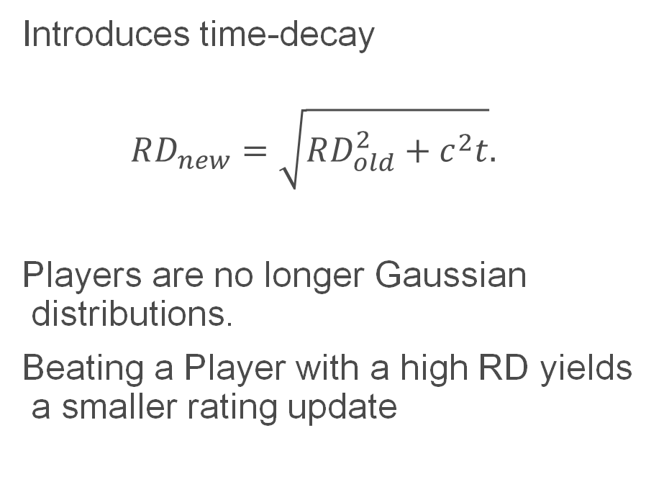
Glicko TODO
Glicko System
Elo System
Calculates the expected probability of winning using a logistic curve.
Points are exchanged based on the difference between actual and expected outcomes
Complexity $O(1)$
Introduces time-decay
$$RD_{new}=\sqrt{RD_{old}^{2}+c^{2}t}.$$
Players are no longer Gaussian distributions.
Beating a Player with a high RD yields a smaller rating update

