Slide 1
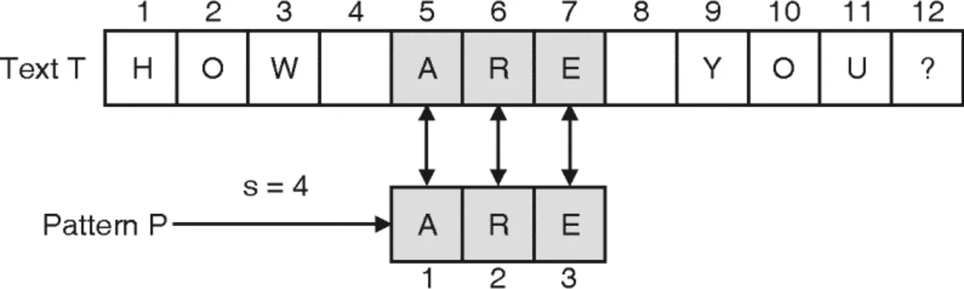
String Matching: How does Word do it?
Daniel Joy, Brigitte Turner, Andy Zeng
Notes:
Dan

Slide 2


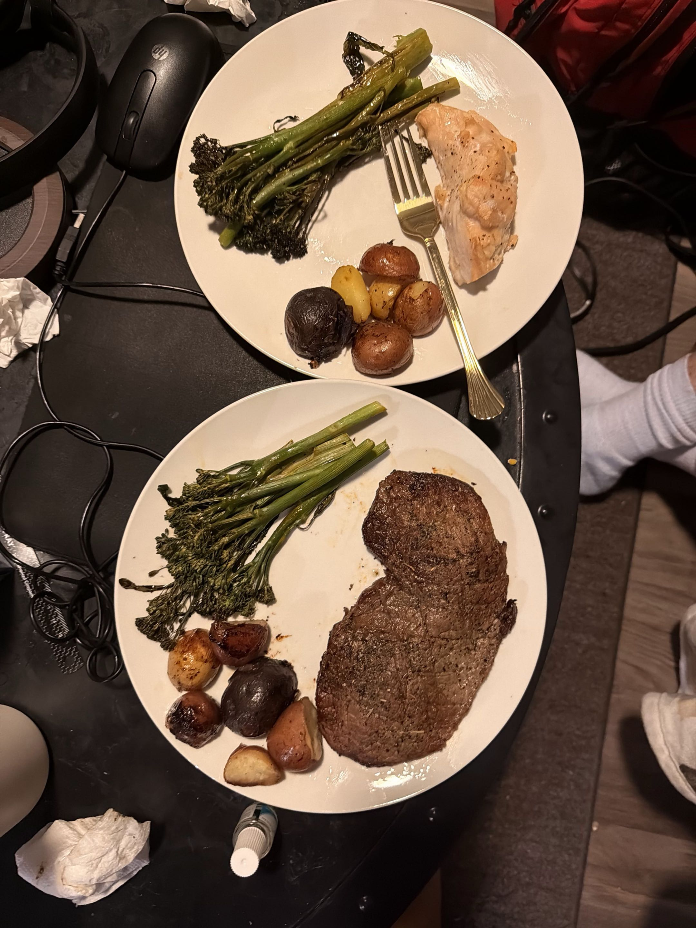
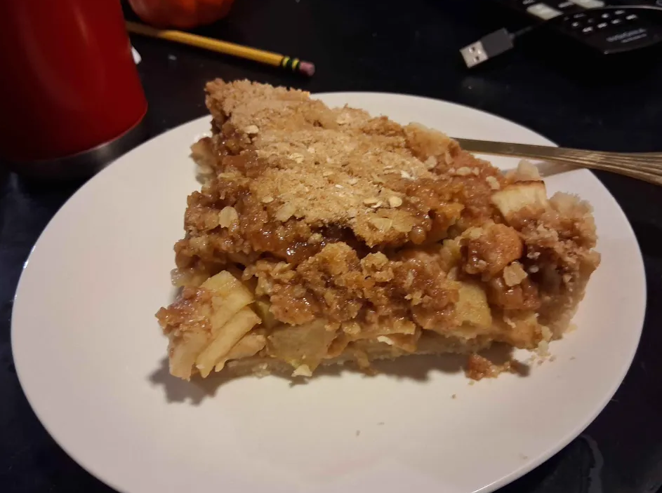
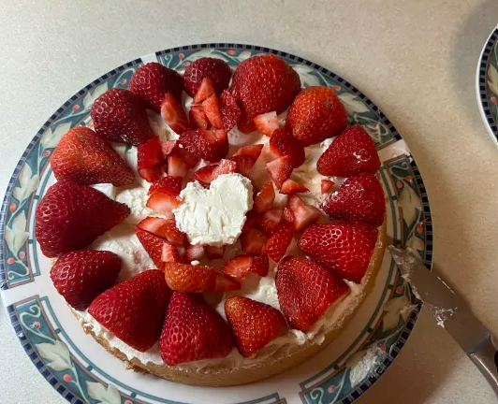
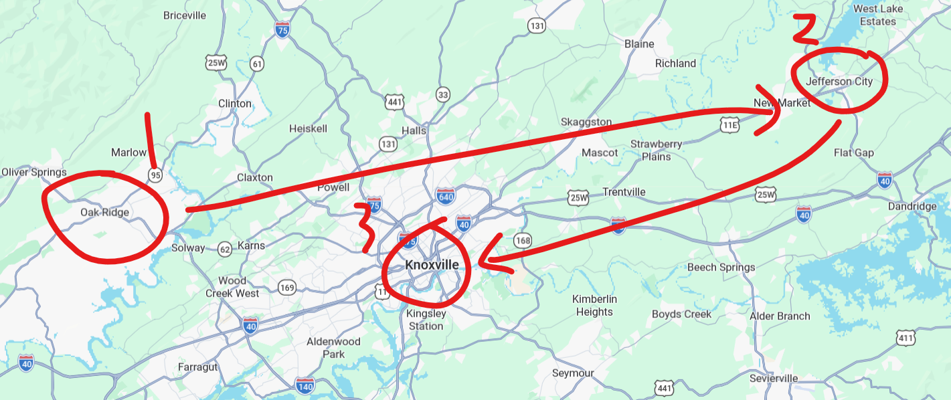
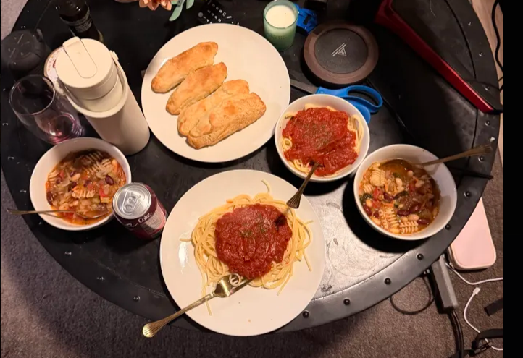
Daniel Joy
Hometown: Oak Ridge, TN
Undergraduate at Carson-Newman University
2nd semester of Master Program, Advised by Dr. Stephen Marz
Hobbies: Running (5k), Writing, Cooking
“Chicken Sandwich”
Notes:
Dan

Slide 3
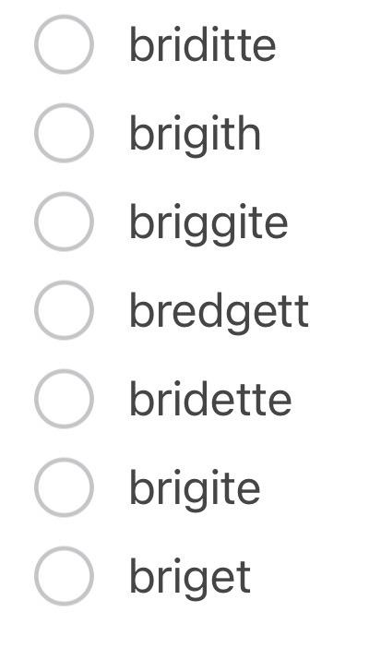



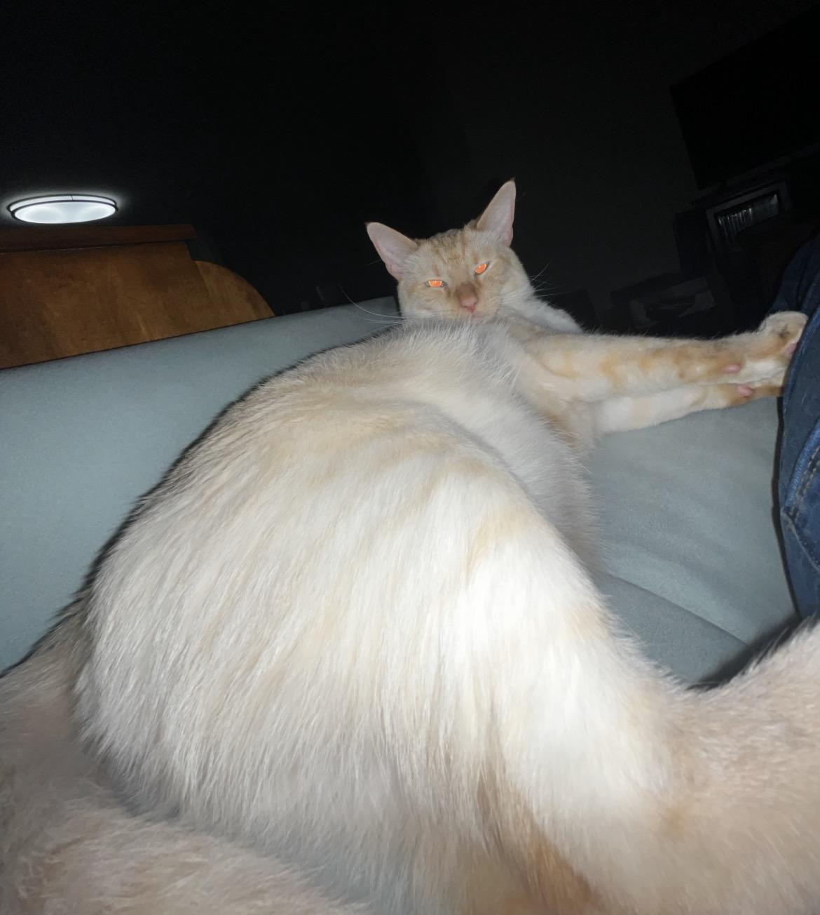


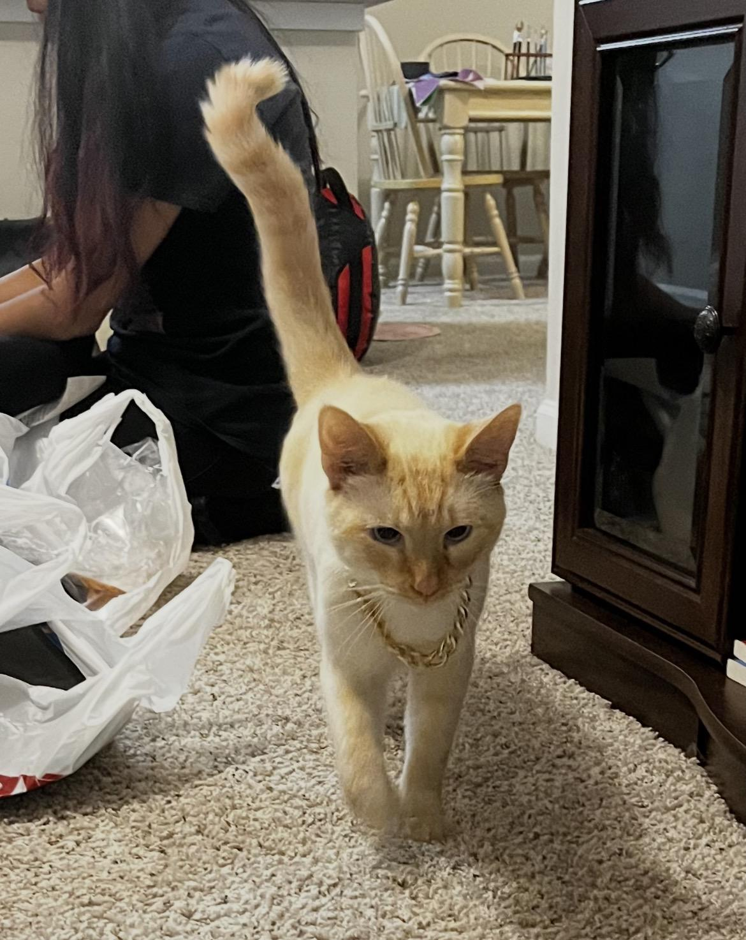
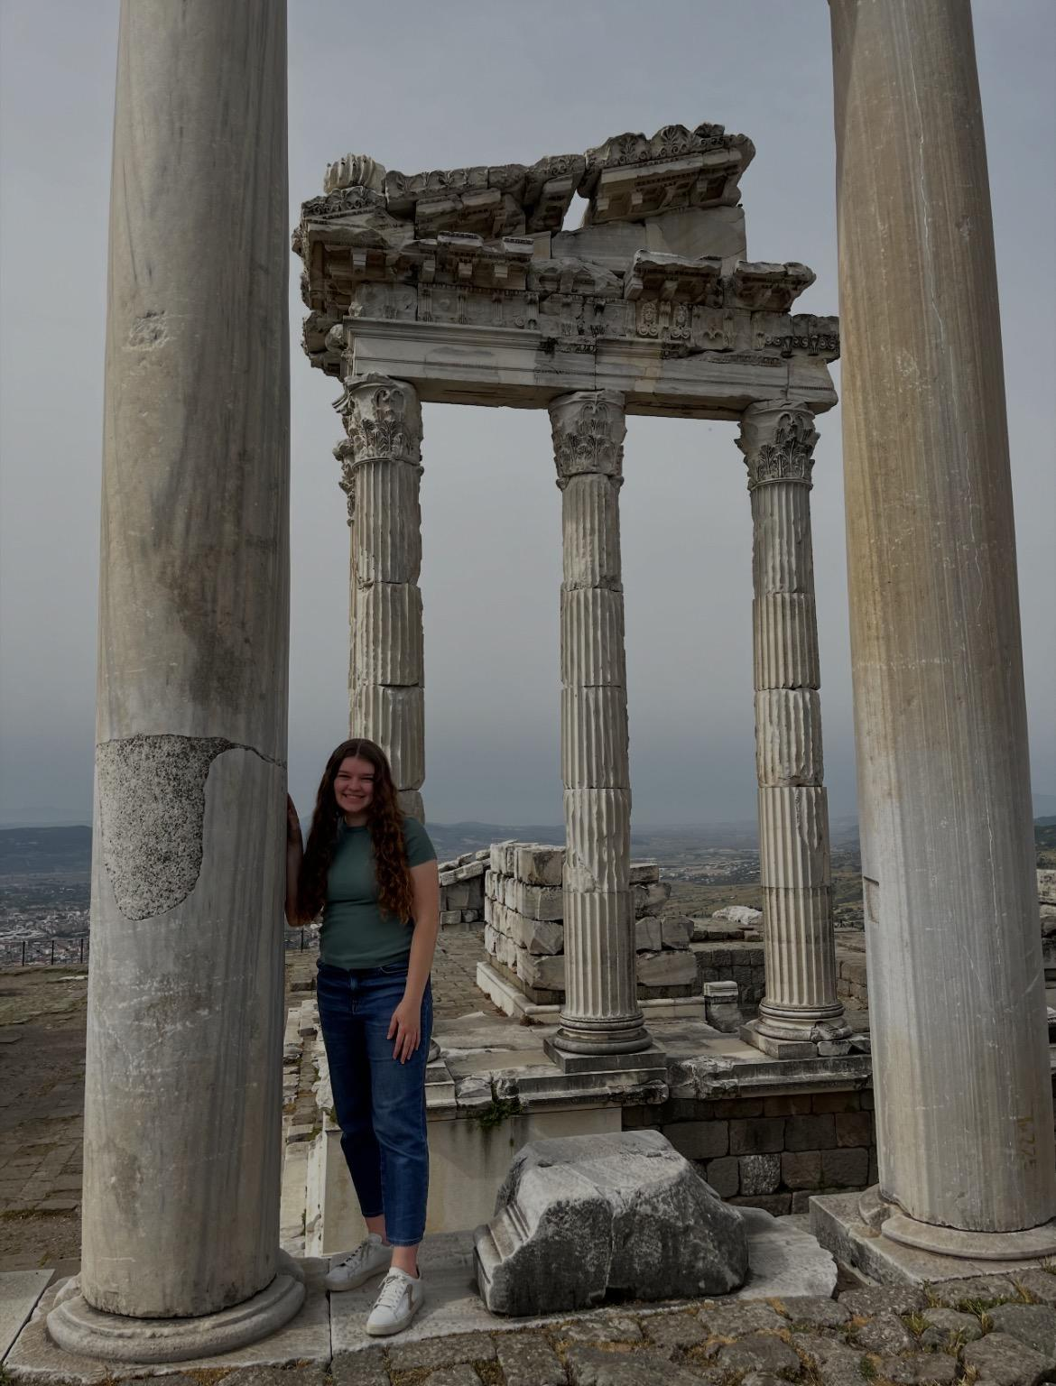



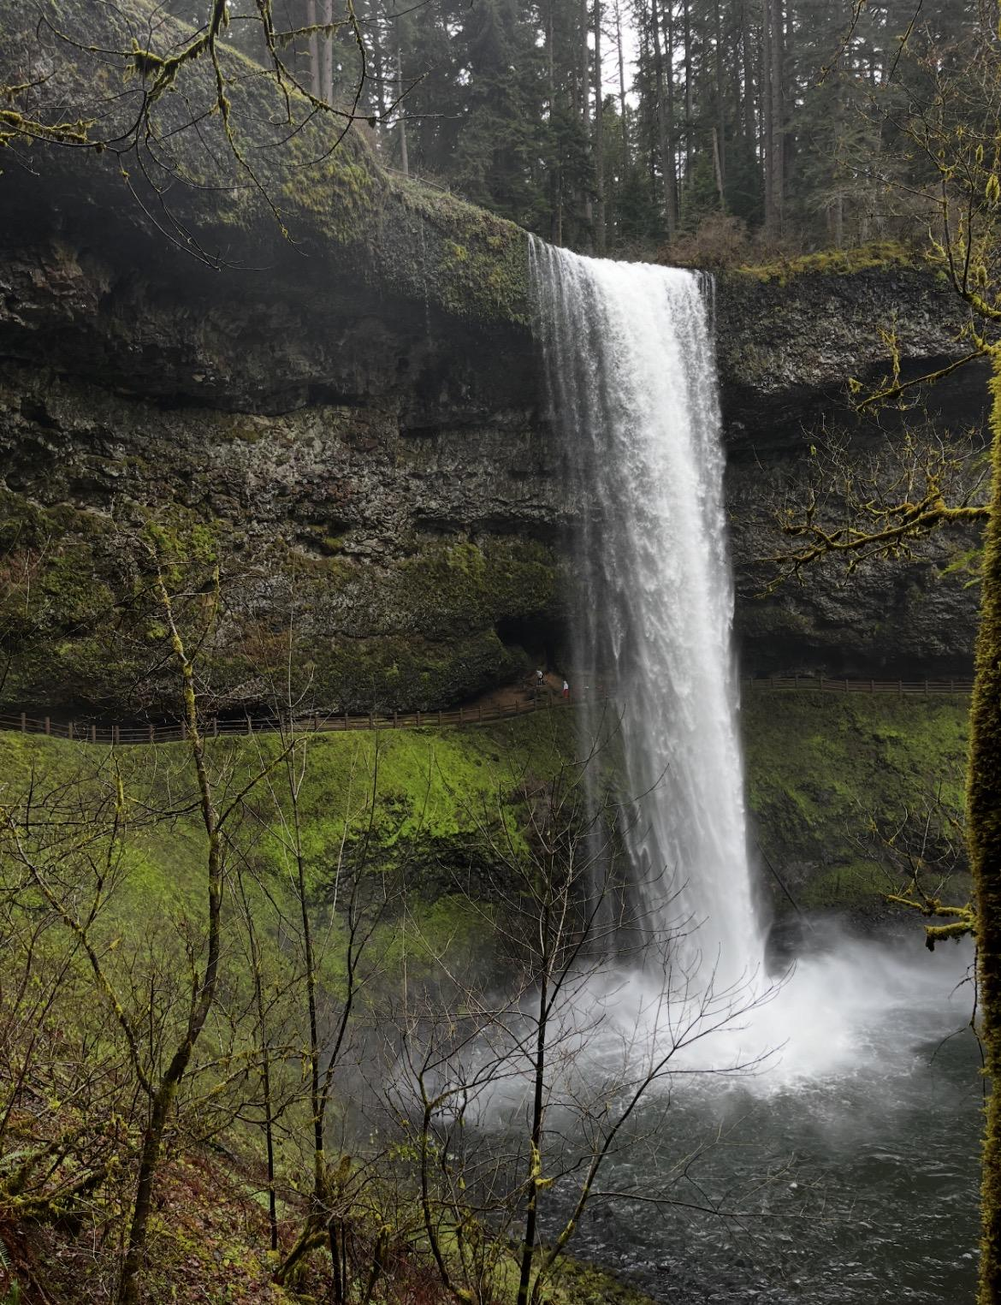

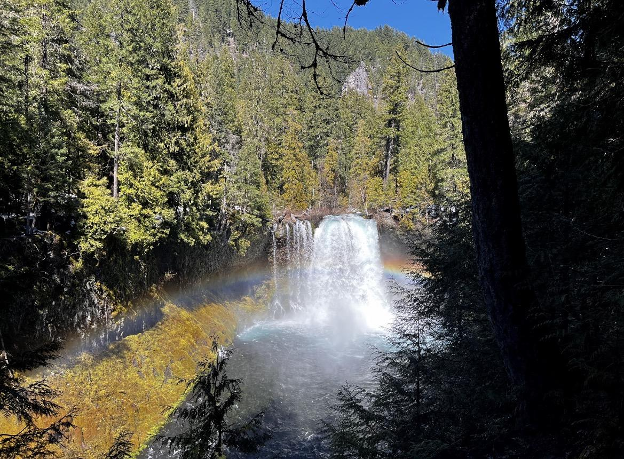
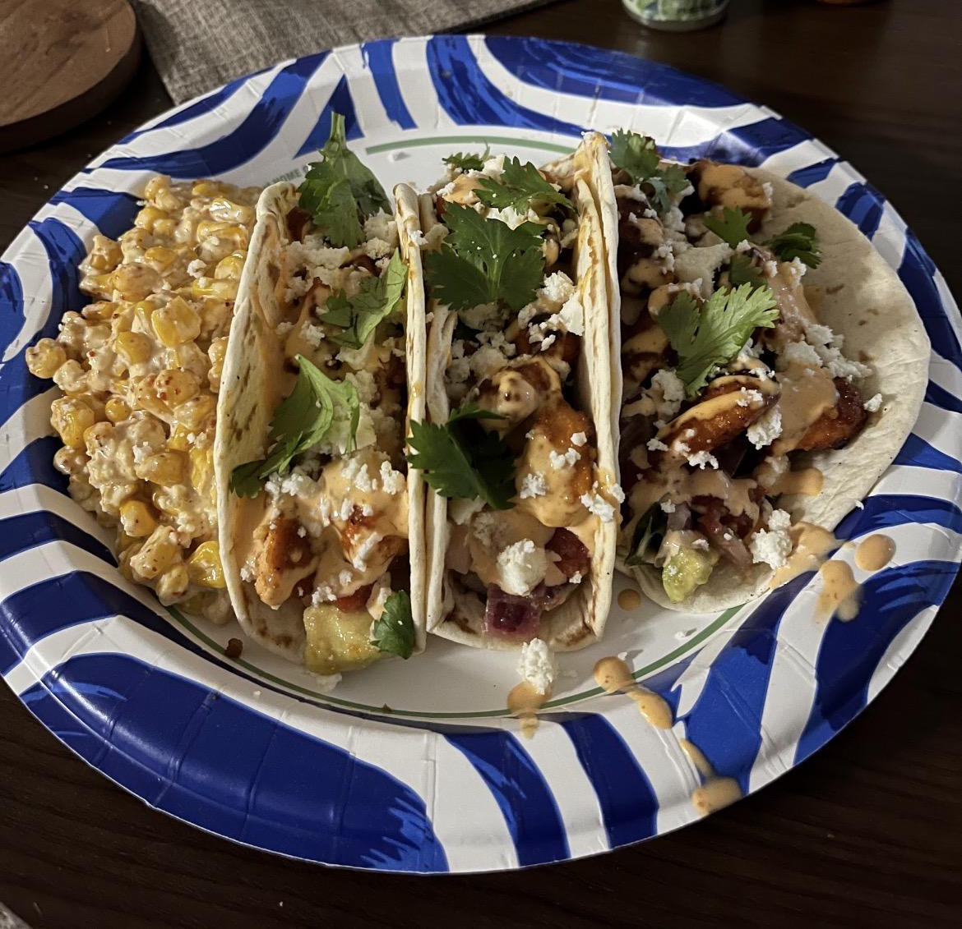
Brigitte Turner
Born in Fort Riley, KS and grew up in Oak Ridge, TN
Bachelor’s in CS from Freed-Hardeman University
Master program in CS (Intelligent Systems and Machine Learning), advised by Dr. Katie Schuman
Hobbies: reading, traveling, hiking, cooking
Cat: Dart
Notes:
Brigitte

Slide 4
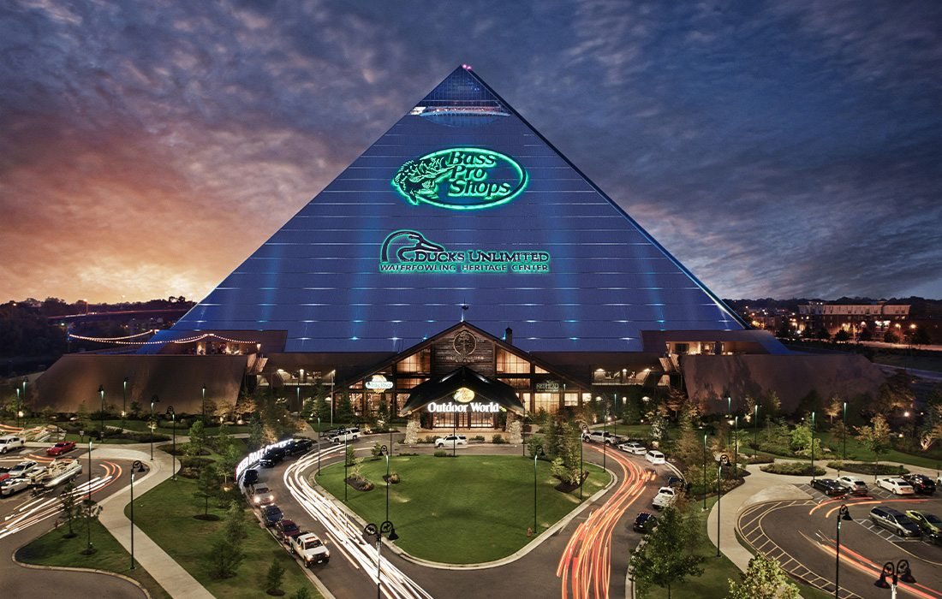
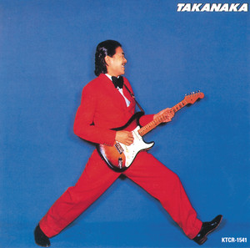
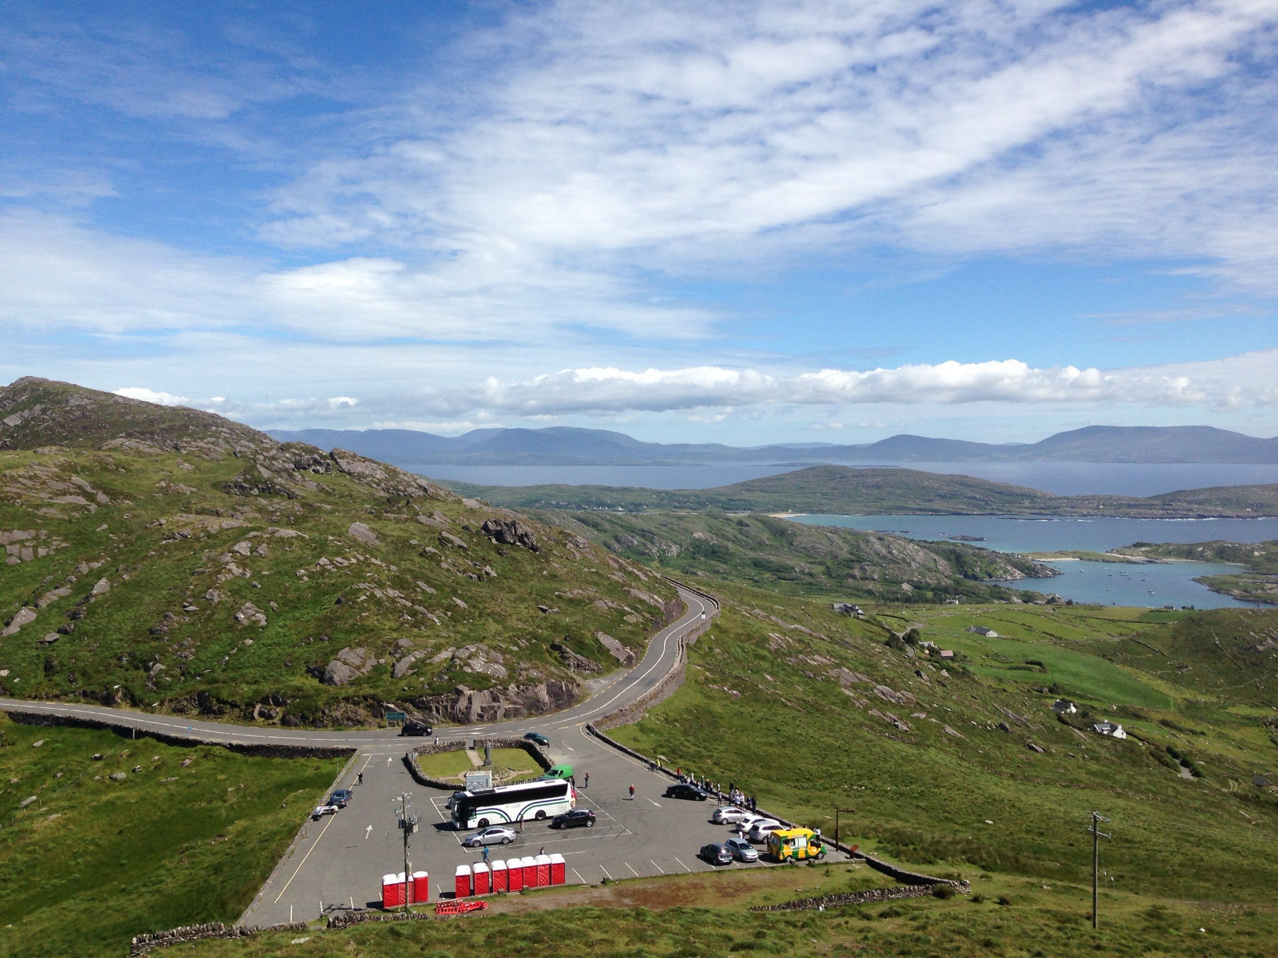
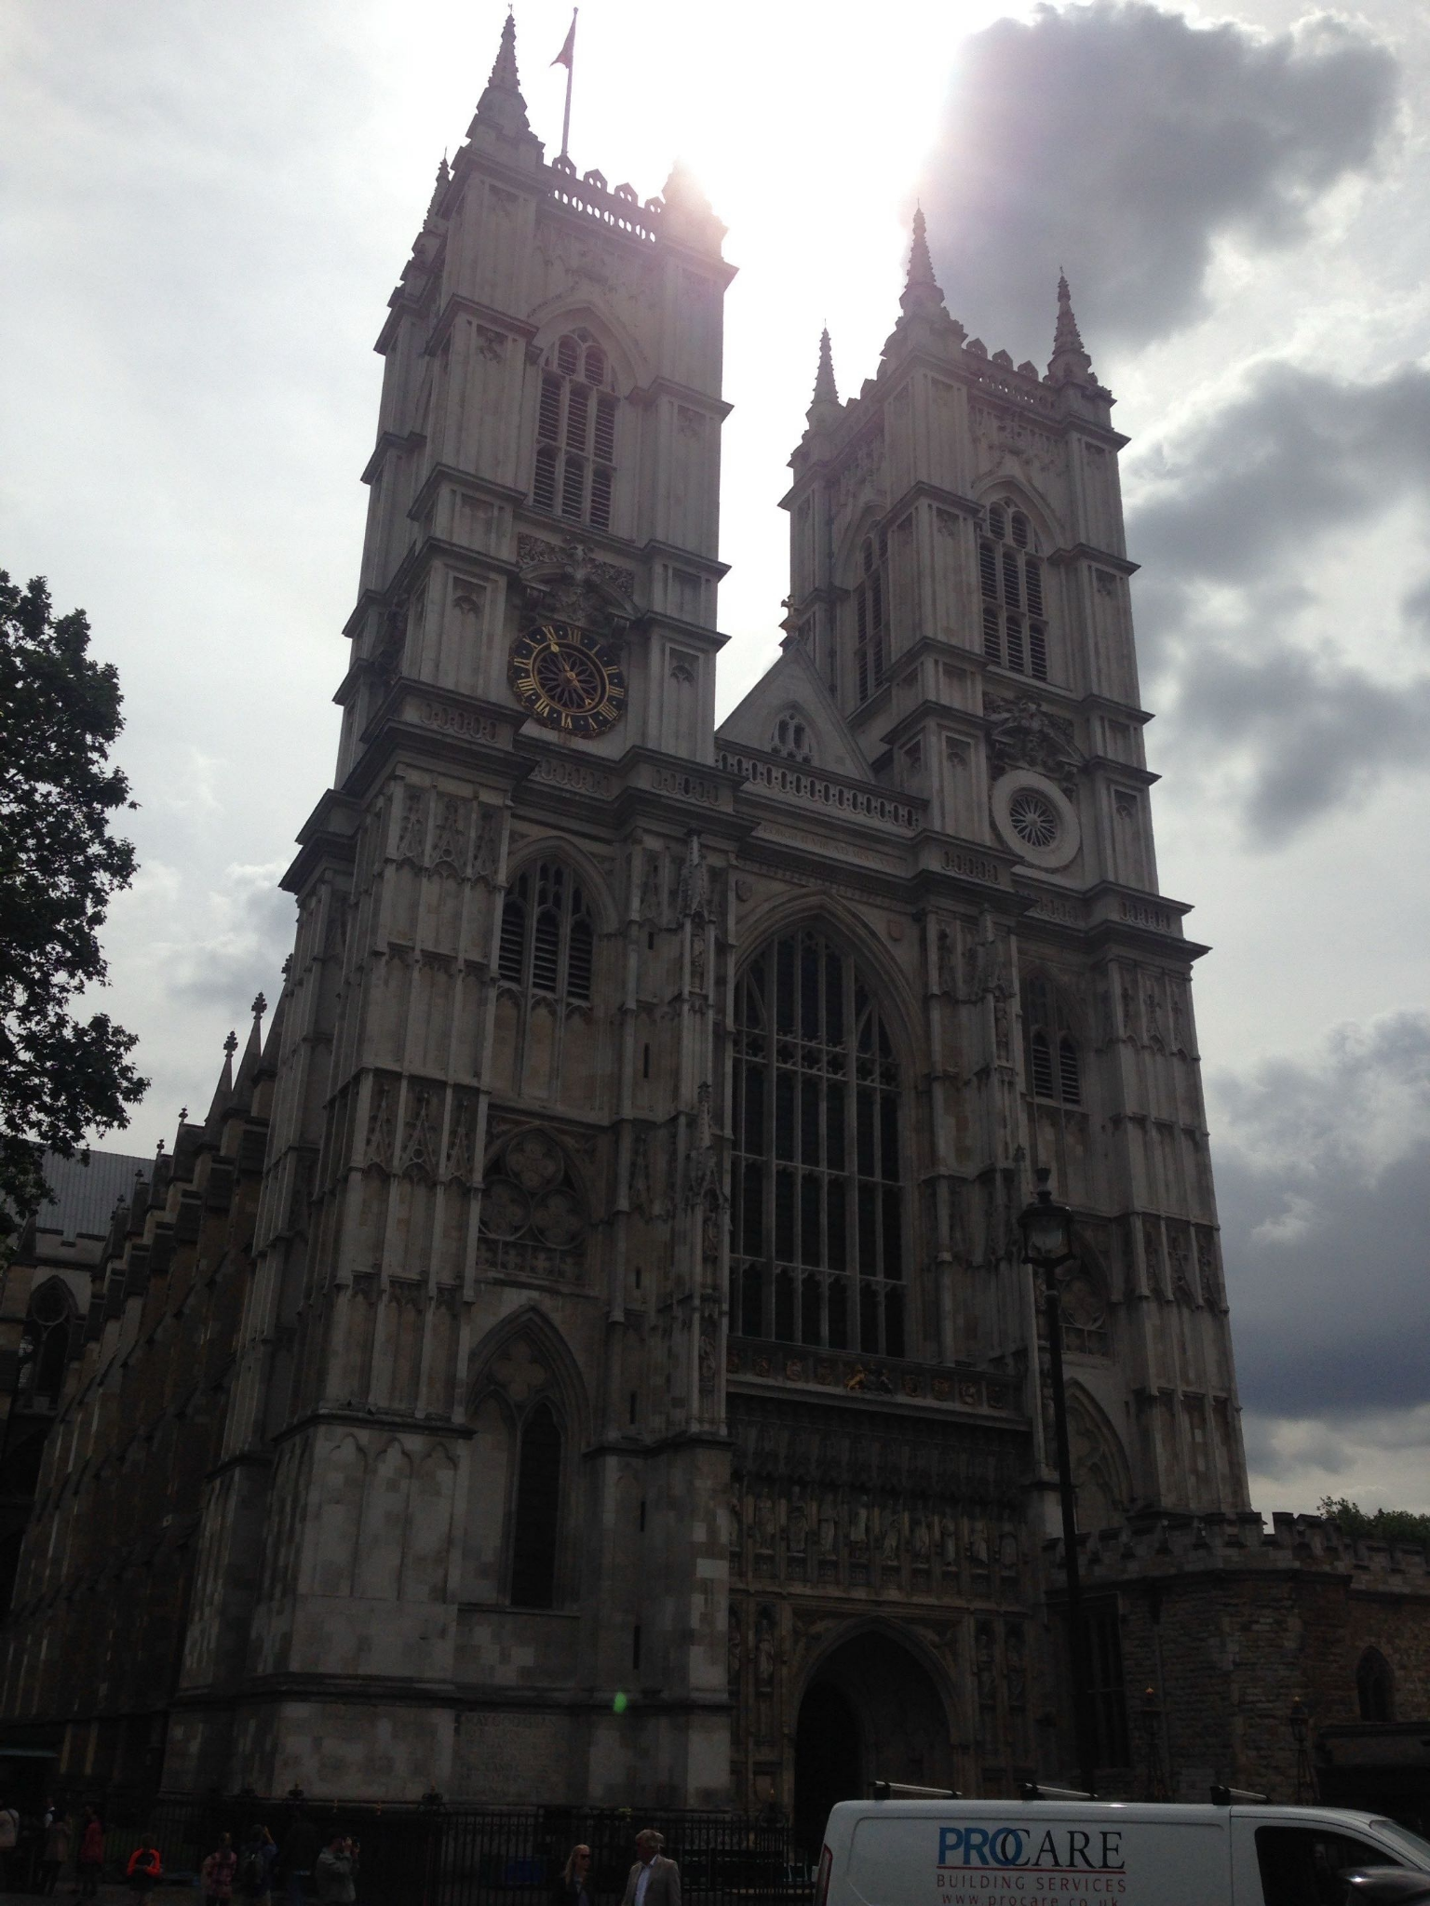
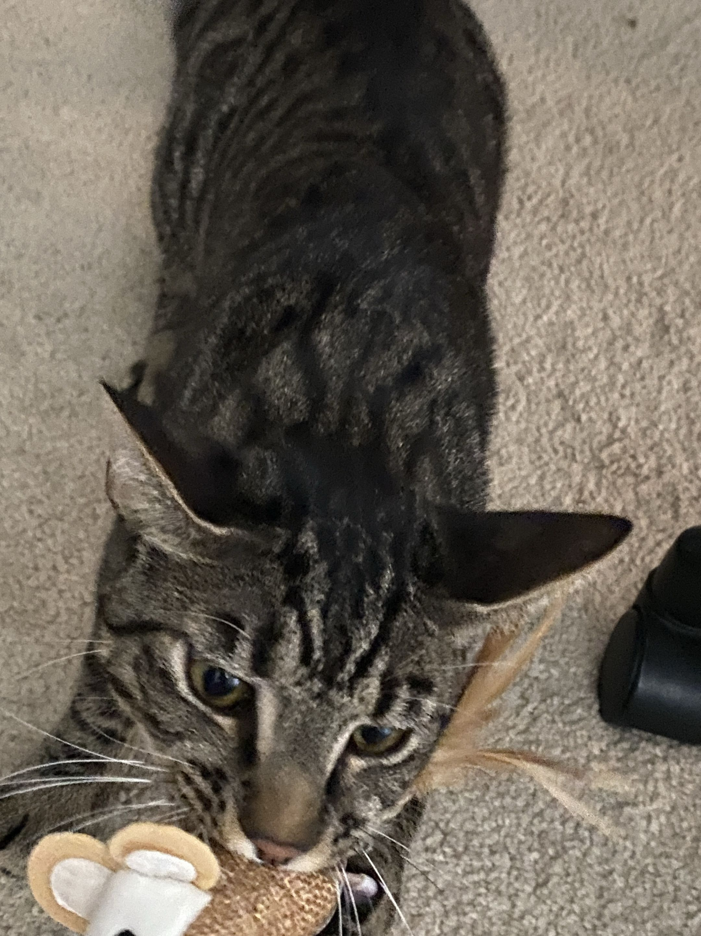
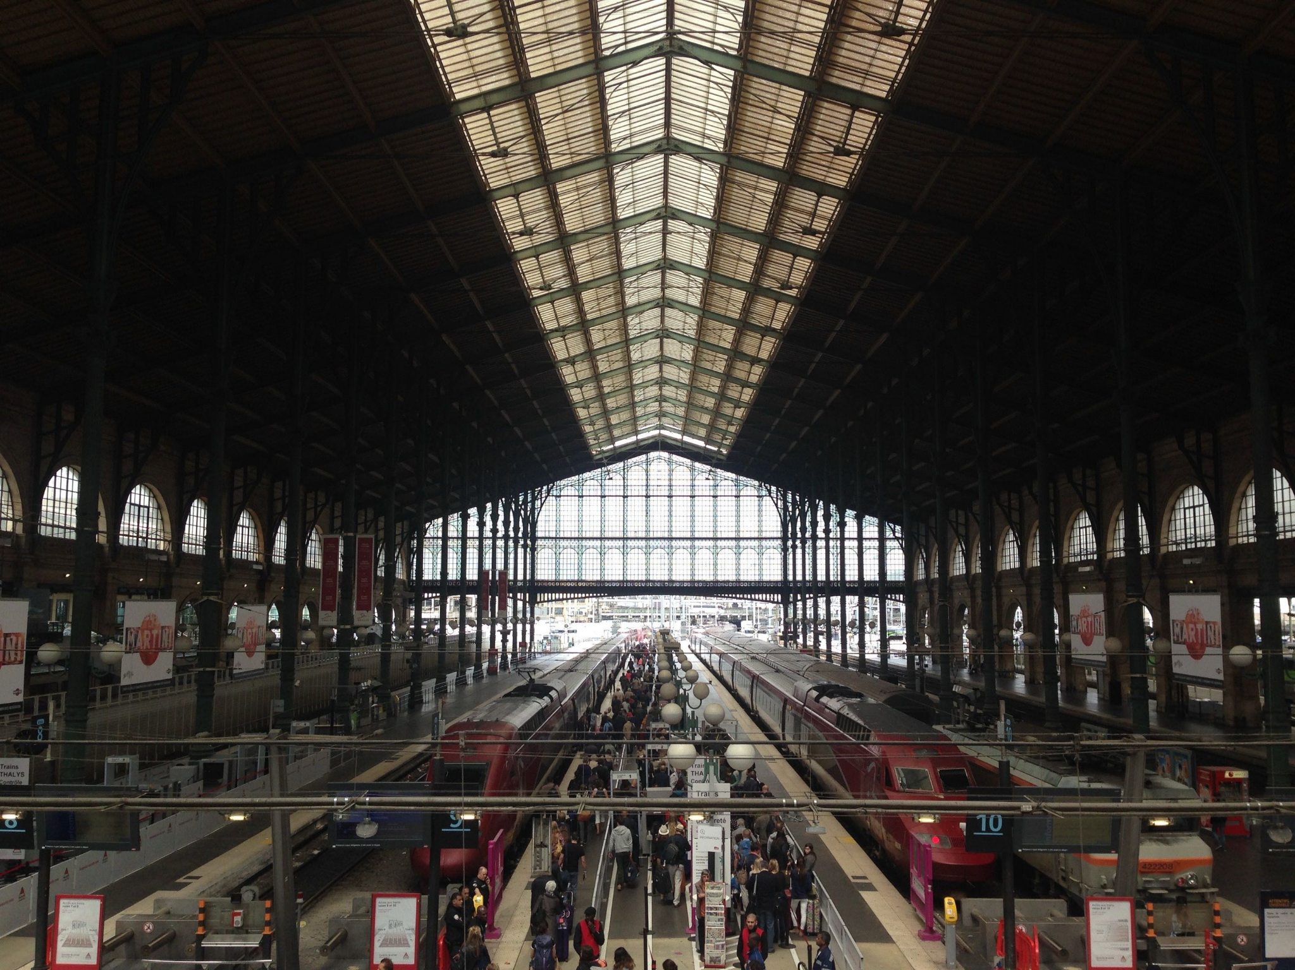
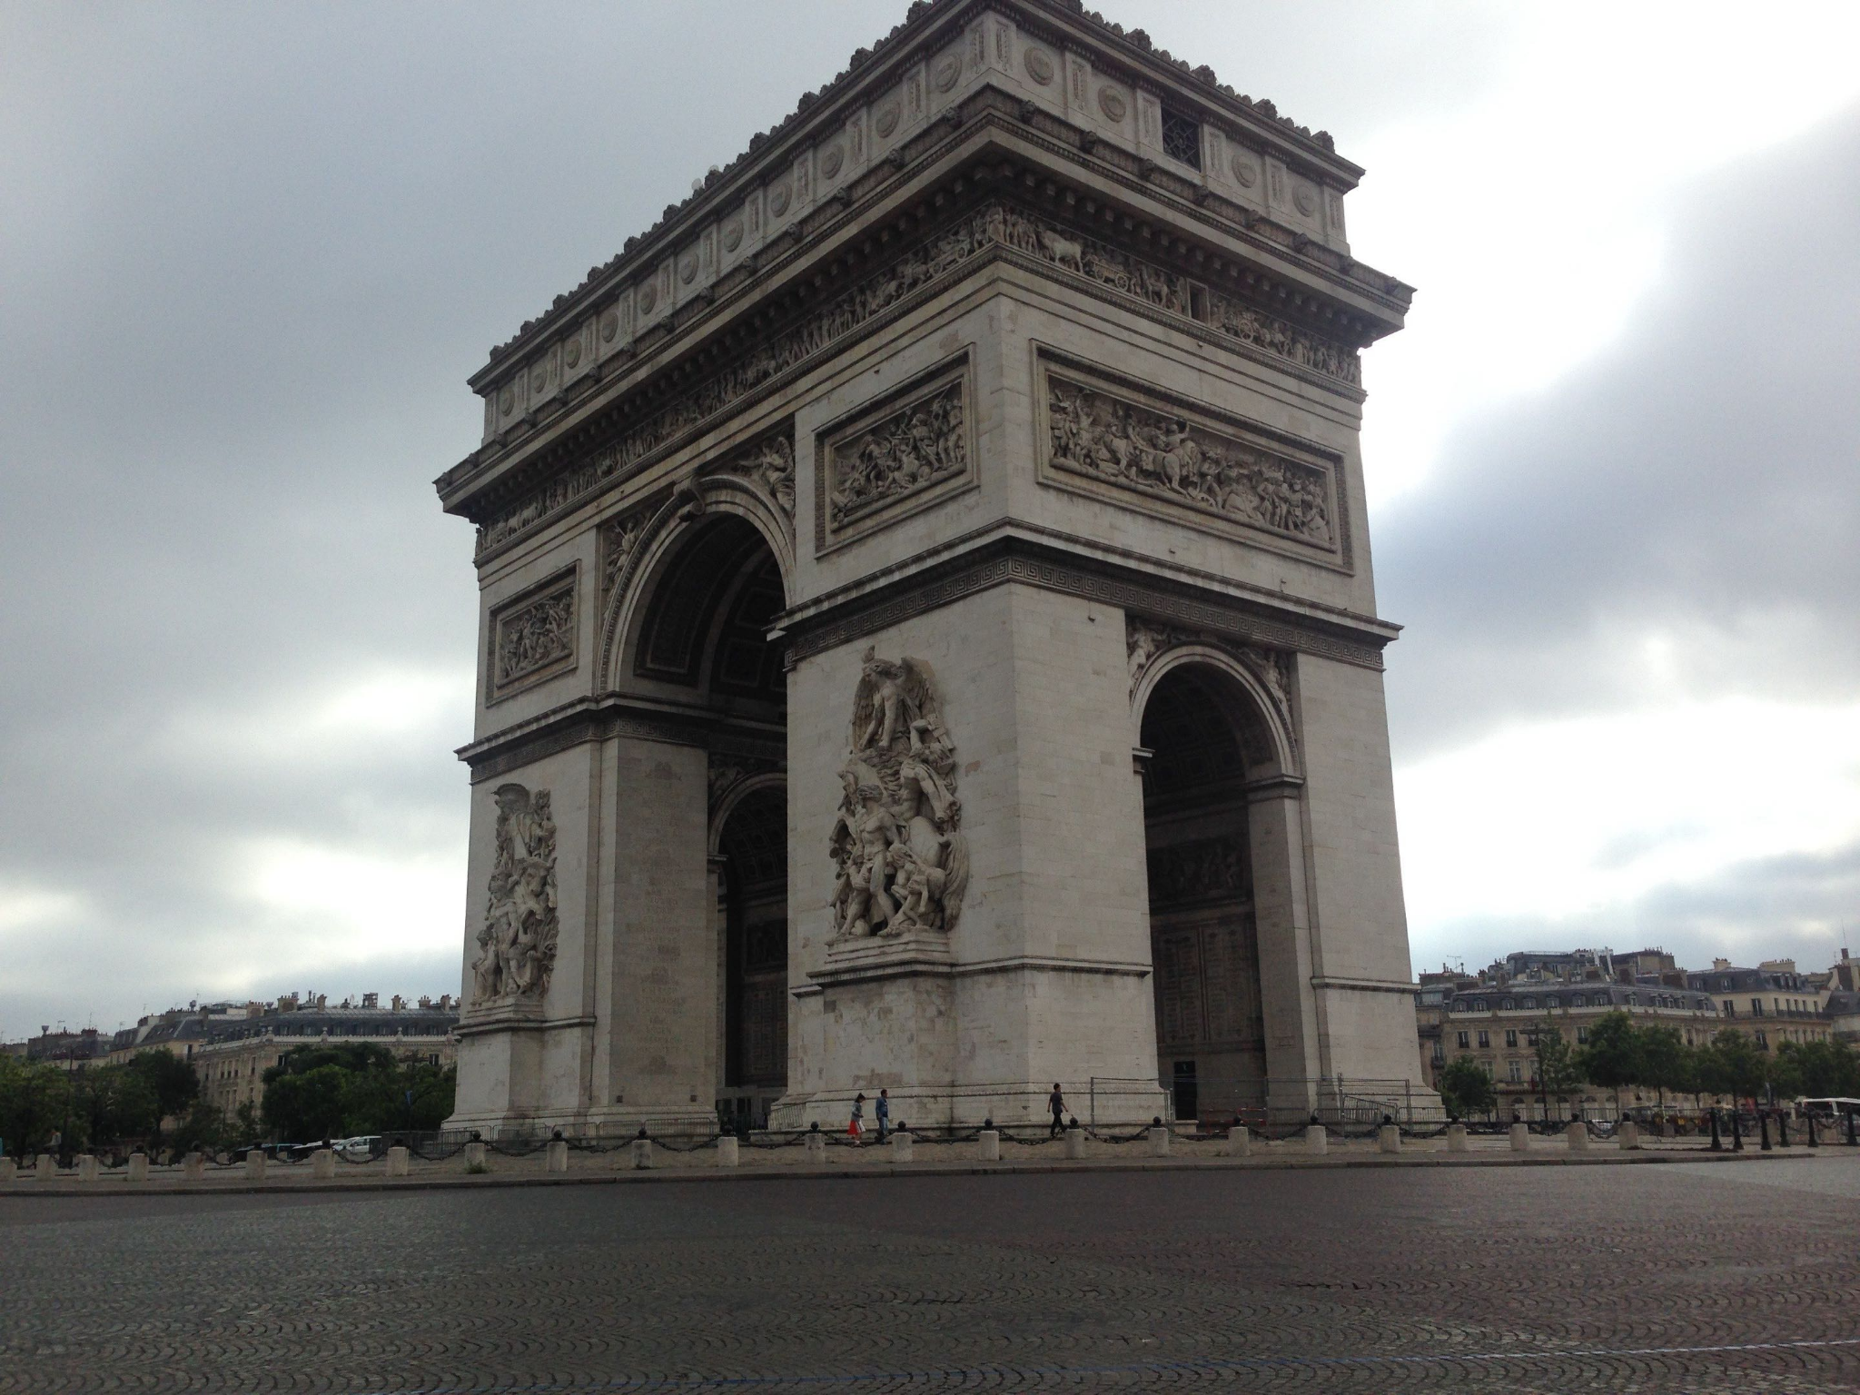
Andy Zeng
M.S. degree in Computer Science
Hometown: Memphis, TN
Hobbies: Traveling, working out, listening to music, video games, hiking, and camping
Notes:
Andy

Slide 5

Questions
Why is it important for q to be large in Rabin-Karp?
What are the advantages of using a finite automaton?
Which other algorithm is KMP similar to?
https://forms.gle/k62EAyr6Hoo68KuGA
Notes:
Dan

Slide 6
Outline
Fun Game
Introduction to the Algorithms
  Naive Brute Force
  Rabin-Karp
  Finite Automata
  Knuth Morris Pratt
  Boyer Moore
Datasets
Implementation + Results
Currently-used Approaches
Open Issues
Discussion
Notes:
Dan

Slide 7
Game Time!
Notes:
Andy

Slide 8
You practice!
Welcome to the jungle, we got fun and games
Pattern: fun
Notes:
Andy

Slide 9
You practice!
Welcome to the jungle, we got fun and games
Pattern: fun
Notes:
Andy

Slide 10
You practice!
tagccggtgttgggagaatataatgttgatccagagcacgttg
gatagccgaatgtcagagtgaacaggggttcgtcaatcattg
ctattgtggtcctccctcattttcattaagtagacacgtgggac
Pattern: tga
Notes:
Andy

Slide 11
You practice!
tagccggtgttgggagaatataatgttgatccagagcacgttg
gatagccgaatgtcagagtgaacaggggttcgtcaatcattg
ctattgtggtcctccctcattttcattaagtagacacgtgggac
Pattern: tga
Notes:
Andy

Slide 12
You practice!
8917398510960915370813513807806718305810735017840826137484932836470135110158376842797624580890138543971403871
Pattern: 583768
Notes:
Andy

Slide 13
You practice!
8917398510960915370813513807806718305810735017840826137484932836470135110158376842797624580890138543971403871
Pattern: 583768
Notes:
Andy

Slide 14
From the thirty-five volumes of scriptures that are in the treasury, we've selected altogether five thousand and forty-eight scrolls? for the sage monk to take back to the Tang in the Land of the East. Most of these’ve been properly packed, loaded on the horse, and a few have also been arranged in a pannier. The pilgrims now wish to express their thanks to you.” Having tethered the horse and set down the poles, Tripitaka led his 3 disciples to bow to God, each pressing his palms together in front of him. Siddhartha said to the Tang Monk, “The efficacy of these scriptures can’t be measured. Not only are they the mirror of our faith but they are also the source of the Three Religions. They mustn't be lightly handled, especially when you return to your South Jambidvipa Continent and display them to the multitude. No one should open a scroll without fasting and bathing first. Treasure them! Honour them! Therein will be found the mysteries of gaining mortality and comprehending the Way, the wondrous formulas for the execution of ten thousand transformations.” Tripitaka respected to thank him and to express his faith and obedience. As before, he saluted himself in homage three times to the Religious Patriarch with all earnestness and sincerity before he took the scriptures and left. As he went through the three monastery gates, he again thanked each of the sages. After he had sent away the Tang Monk, Siddhartha dismissed the assembly for the transmission of scriptures. From one side stepped forth the Nun Guanshiyin who pressed her palms together to say to the Religious Patriarch, “This disciple received your golden decree that year to search for someone in the Land of the East to be a scripture seeker. Today he has succeeded. Altogether, his journey took fourteen years, or five thousand and forty days. Eight more days and the perfect canonical number will be attained. Would you permit me to surrender in return your golden decree?” Highly pleased, Siddhartha said, “What you said is most appropriate. You're certainly permitted to surrender my golden decree.” He then gave this instruction to the Eight Lightning Guardians: “Quickly exercise your magic powers to lift the sage monk back to the East. As soon as he has imparted the true scriptures to the people there, bring him back here to the West. You must accomplish all this within eight days, so as to fulfil the perfect canonical number of five thousand and forty-eight. Do not delay.” The Lightning Guardians at once caught up with the Tang Monk, crying, “Scripture seekers, follow us!” The Tang Monk and his companions, all with healthy frames and buoyant bodies, followed the Lightning Guardians to rise in the air astride the clouds. Truly their minds enlightened, they saluted to God; merit perfected, they ascended on high.
Pattern = monastery
Notes:
Andy

Slide 15
From the thirty-five volumes of scriptures that are in the treasury, we've selected altogether five thousand and forty-eight scrolls? for the sage monk to take back to the Tang in the Land of the East. Most of these’ve been properly packed, loaded on the horse, and a few have also been arranged in a pannier. The pilgrims now wish to express their thanks to you.” Having tethered the horse and set down the poles, Tripitaka led his 3 disciples to bow to God, each pressing his palms together in front of him. Siddhartha said to the Tang Monk, “The efficacy of these scriptures can’t be measured. Not only are they the mirror of our faith but they are also the source of the Three Religions. They mustn't be lightly handled, especially when you return to your South Jambidvipa Continent and display them to the multitude. No one should open a scroll without fasting and bathing first. Treasure them! Honour them! Therein will be found the mysteries of gaining mortality and comprehending the Way, the wondrous formulas for the execution of ten thousand transformations.” Tripitaka respected to thank him and to express his faith and obedience. As before, he saluted himself in homage three times to the Religious Patriarch with all earnestness and sincerity before he took the scriptures and left. As he went through the three monastery gates, he again thanked each of the sages. After he had sent away the Tang Monk, Siddhartha dismissed the assembly for the transmission of scriptures. From one side stepped forth the Nun Guanshiyin who pressed her palms together to say to the Religious Patriarch, “This disciple received your golden decree that year to search for someone in the Land of the East to be a scripture seeker. Today he has succeeded. Altogether, his journey took fourteen years, or five thousand and forty days. Eight more days and the perfect canonical number will be attained. Would you permit me to surrender in return your golden decree?” Highly pleased, Siddhartha said, “What you said is most appropriate. You're certainly permitted to surrender my golden decree.” He then gave this instruction to the Eight Lightning Guardians: “Quickly exercise your magic powers to lift the sage monk back to the East. As soon as he has imparted the true scriptures to the people there, bring him back here to the West. You must accomplish all this within eight days, so as to fulfil the perfect canonical number of five thousand and forty-eight. Do not delay.” The Lightning Guardians at once caught up with the Tang Monk, crying, “Scripture seekers, follow us!” The Tang Monk and his companions, all with healthy frames and buoyant bodies, followed the Lightning Guardians to rise in the air astride the clouds. Truly their minds enlightened, they saluted to God; merit perfected, they ascended on high.
Pattern = monastery
Notes:
Andy

Slide 16
Word Search
As you can see, it’s not so simple. As you had to scan the majority of the text to find the word.
The intuitively way we do it is with naive string matching method
A better way this could be done would be looking at the initial letter if there are spaces but for us humans this is probably the best way to string match.
Notes:
Andy

Slide 17
Definitions
Text: The text you are looking through. Size n
Pattern: the string we are looking for in larger text. Size m
Valid shift: the offset at which the pattern occurs
  Text “abcabaabcabac” with pattern “abaa” - valid shift 3
Prefix/Suffix: “ab” is a prefix of “abcdefg”, “efg” is a suffix
Finite automaton: is a mathematical machine with a finite number of states that reads the input and changes state according to fixed transition rule
Notes:
Andy

Slide 18
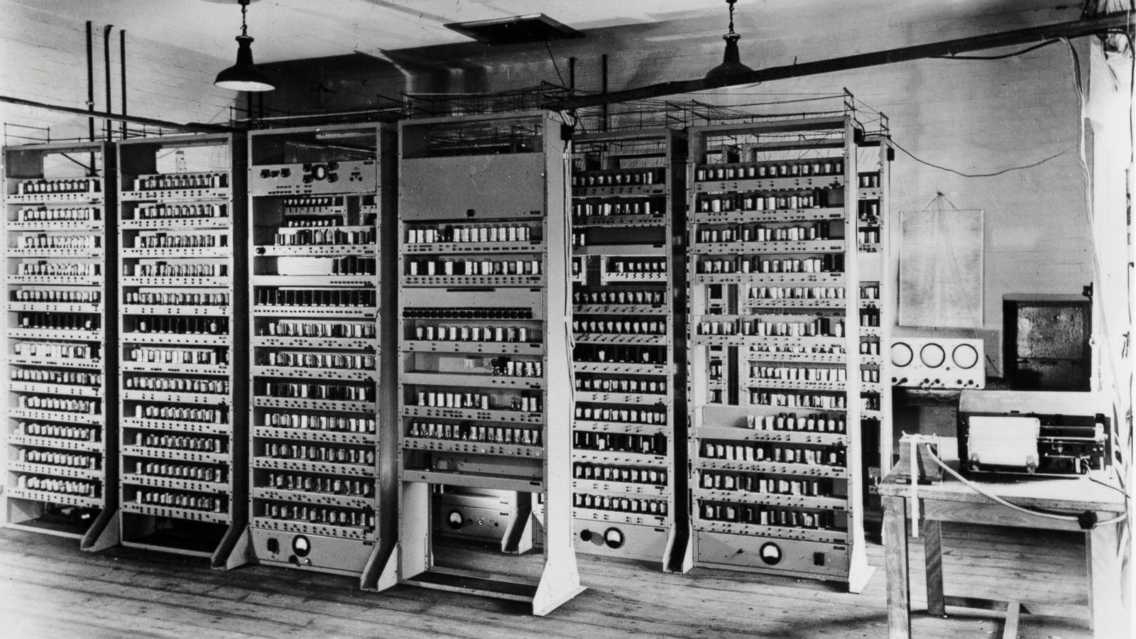
Early History
“String matching has been used for as long as text has been around”
Could we prove this statement?
Answer: Maybe
COMIT (1957):
First string processing language
SNOBAL (1962): Pattern-focused
Knuth Morris Pratt (1977)
Rabin-Karp (1987)
Boyer-Moore (1977)
Notes:
Dan

Slide 19
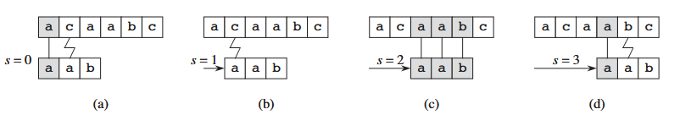
Naive (Brute Force)
Big Idea: Try everything sequentially.
Look at every position:
If text[shift] = pattern[0], compare text[shift+1] to pattern[1], etc
If they don’t match, shift 1 more to the right
Pros:
Easy to implement
No preprocessing!
Cons:
Repeats a lot of information
Worst case: near misses, Θ((n-m+1)m)
Notes:
Dan

Slide 20
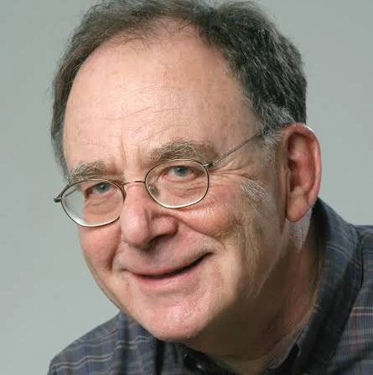
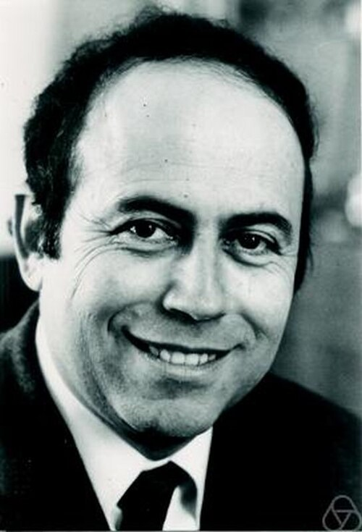
Rabin & Karp
Held-Karp algorithm - traveling salesman problem
Edmonds-Karp algorithm - maximum flow problem
Hopcroft-Karp algorithm - maximum cardinality matchings in bipartite graphs
Miller-Rabin primality test - prime numbers
Rabin Signature algorithm - cyptography
2 Turing Awards
Dr. Richard Karp
Dr. Michael Rabin - died April 14th (94)
Notes:
Dan

Slide 21
Rabin-Karp Algorithm (1987)
Big idea: We convert to numbers, modulo by a big prime, if equal to pattern’s result then the numbers/strings are likely equal
Ex: (base 10, pattern = 12345, text = 1353141512345
Pattern % (10⁹ + 7) = 12345
t₀ = 13531 % (10⁹ + 7) = 13531 != pattern result
t₁ = 35314 % (10⁹ + 7) = 35314 != pattern result
…
t₈ = 12345 % (10⁹ + 7) = 12345 == pattern, valid shift found
Notes:
Dan

Slide 22

Rabin-Karp Algorithm - Rolling Hash
Rolling hash: Effective Θ(1)
Ex: (base 10, pattern size m = 5)
T = 1353141512345
t_{s} = 31415
t_{s+1} = 10(31415 - 10000 * 3) + 1
= 10(1415) + 1
= 14150 + 1
= 14151
Notes:
Dan

Slide 23
Rabin-Karp Algorithm - Parameters + Complexity
Pattern is size m, Text is size n
Parameters:
d - alphabet size (256)
q - large prime to avoid false positive hits
If we have a hit, fall back to brute-force to check for pattern match
Complexity:
Preprocessing: Θ(m)
Each shift, recomputing modulus only takes Θ(1)
Matching Time (Average Case): Θ(n+m) with big enough prime q
Matching Time (Worst Case): Θ((n-m+1)m)
Notes:
Dan

Slide 24
Finite Automaton – DFA
Build a DFA from the pattern P
  Each state q represents the q pattern characters have been matched so far
  For each state and input symbol, the transition function gives the next state
  Scan the text once, updating the state for each character
  When the automaton reaches state m, a match is found
Complexity
  Preprocessing: O(m∣Σ∣)
  Matching: Θ(n)
Advantages of using DFA
  No backtracking
  Linear time string matching
Notes:
Andy

Slide 25
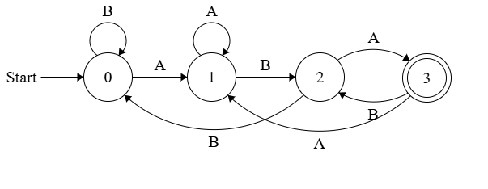
Finite Automaton – DFA Example
Transition Table
Matching pattern ABA
0: Nothing matching
1: Matched A
2: Matched AB
3: Matched ABA (accept)
Text: ABBABA
Sequence:
0→1→2→0→1→2→3
q | A | B
0 | 1 | 0
1 | 1 | 2
2 | 3 | 0
3 | 1 | 2
Notes:
Andy

Slide 26
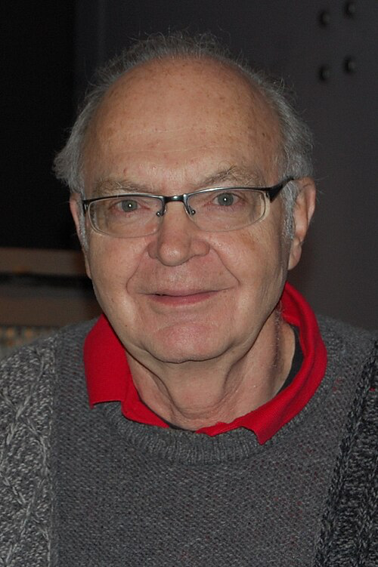
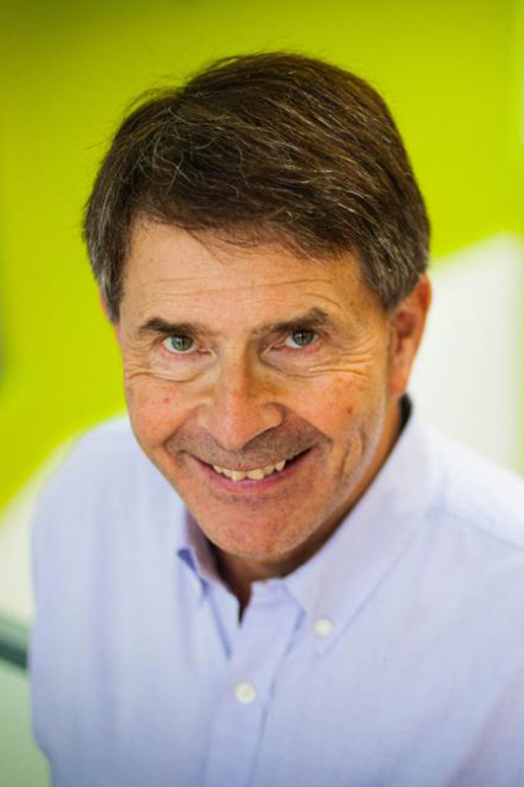
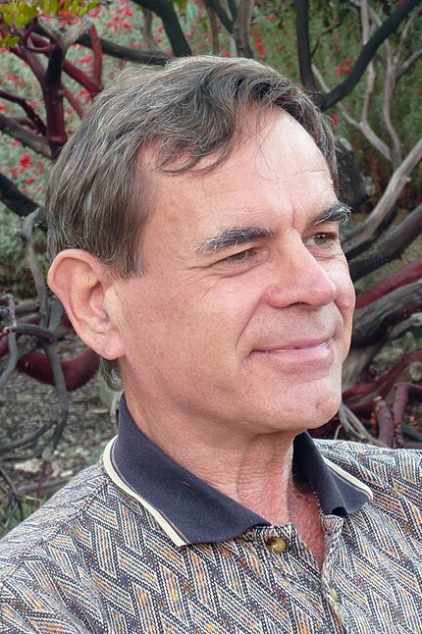
Knuth-Morris-Pratt Algorithm
Donald Knuth
James H. Morris
Vaughan Pratt
Notes:
Brigitte
You may remember Donald Knuth from his counting sort that we learned in class, and here is James H Morris and Vaughan Pratt
They are professors at Stanford, Carnegie Mellon, and Stanford, respectively
The Knuth-Morris-Pratt algorithm, or KMP, was discovered by Morris and then by Knuth separately in close succession
Morris and Pratt published a technical report in 1970, and then the three of them published the algorithm together in 1977

Slide 27
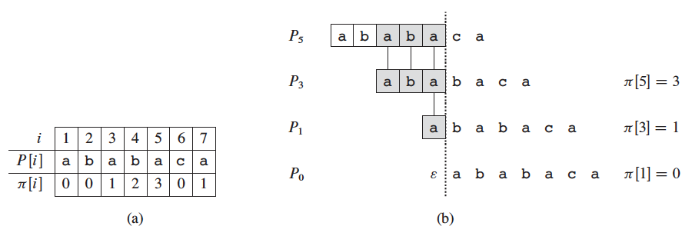
Knuth-Morris-Pratt Algorithm
Similar to naive, but requires preprocessing
Prefix function (pi) stores information about repetitions within the pattern
Notes:
Brigitte
KMP is similar to the naive approach, but requires preprocessing to create the prefix function of the pattern, which is called pi in the textbook
This prefix function stores information about how the pattern matches against itself, so whether there are any repetitions within the pattern

Slide 28
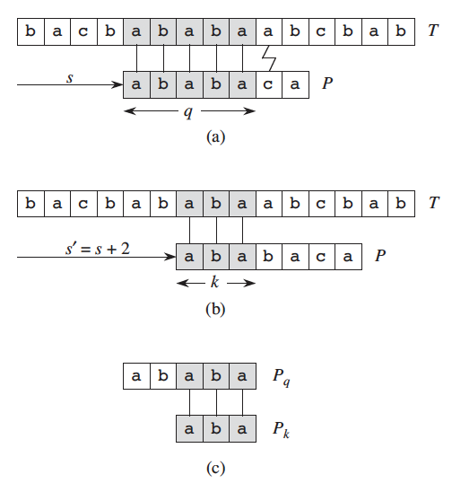
Knuth-Morris-Pratt Algorithm
Check a character, then shift to the next character with potential to be a match
Use prefix function to determine the next index to check
Notes:
Brigitte
So then, the process of actually checking for matches works by checking the pattern against the text like in the naive approach, but the prefix function is used to determine the next index to check (as opposed to just checking every index)
This way, the algorithm only checks at indexes with potential to be a match

Slide 29
Boyer-Moore (1977)
Serves as a good benchmark for exact string matching
Look at matching the end of the pattern first
We can “jump” some distance if pattern doesn’t match - Bad character Rule:
A T C A A C A C T C G A T A C
A T C A A C A C T C G A T A C C A C
T A T C A C
T A T C A C
A T C A A C A C T C G A T A C
A G C A T G A C T C G A T A C C A C
T A T C A C
T A A C A C
Notes:
Dan

Slide 30
Time Complexity
Algorithm | Preprocessing Time | Matching Time
Naive | 0 | O((n - m + 1)m)
Rabin-Karp | Θ(m) | O((n - m + 1)m)
Finite Automaton | O(m|Σ|) | Θ(n)
Knuth-Morris-Pratt | Θ(m) | Θ(n)
Boyer-Moore | O(m + Σ) | O(n/m)
Notes:
Dan
All other algorithms perform worse than naive if the text is small
Rabin-Karp worse than Naive unless the parameters are tuned well
For large texts, KMP is the best algorithm in the textbook

Slide 31
Implementation Text & Patterns Dataset
Texts
Text1
  pseudo random string of 37 characters
News Article
  CNN Strait of Hormuz article
DNAReallySmall
  1000 pseudo randomly generated DNA sequence
Rotp (Remembrance Of Things Past)
Jtw (Journey to the west)
Harry Potter (All 7 Harry Potter books)
Combined Text
  Rotp, jtw, harry potter, Lord of the Rings
DNASmall
  Wuhan 1
DNABig
  Colletotrichum orchidophilum
Patterns
TextPattern1 - “hello”
TextPattern2 - ~5000 characters from Lord of the Rings text
DNAPattern1 - “cgatt”
DNAPattern2 - 4000 characters of DNA sequence
Notes:
Andy

Slide 32
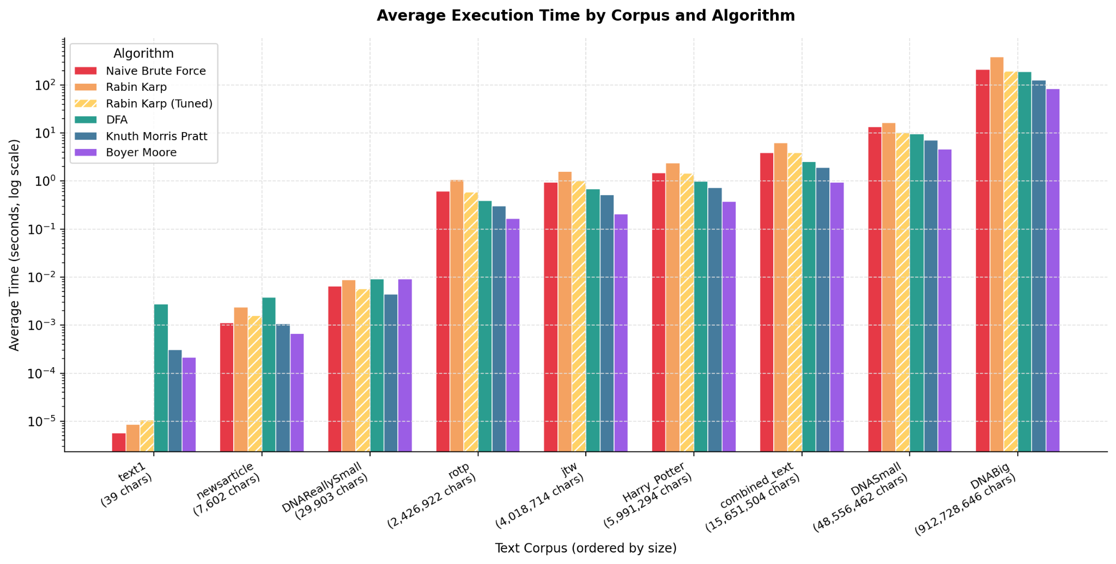
Implementations
Notes:
Dan

Slide 33
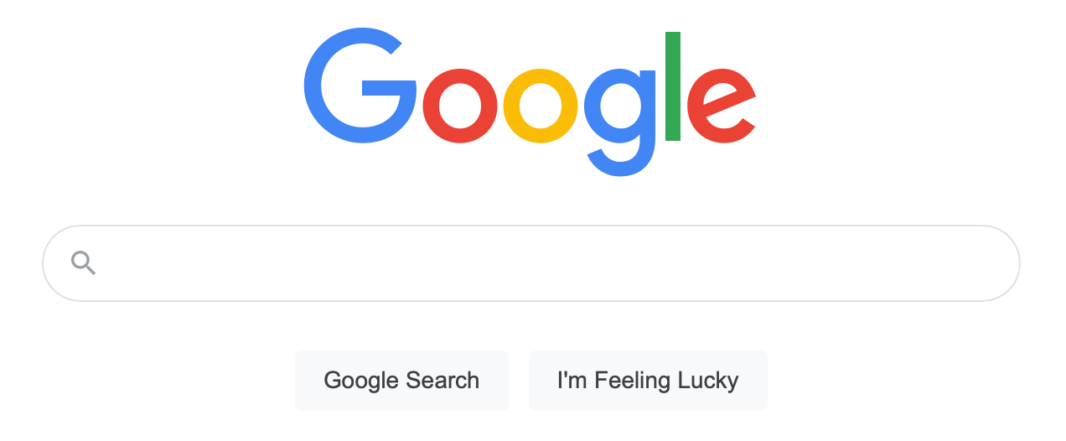

Applications
Search engines - web page keywords
DNA/Genome analysis
  Bioinformatics
Plagiarism detection
Intrusion detection
  Network Security
Text editors
  IDE’s
Plagiarism is the act of using someone else’s words or ideas without giving proper credit. It undermines academic integrity and can lead to serious consequences
Plagiarism is the act of using someone else’s words or thoughts as your own without giving proper credit. It violates standards of academic integrity and can have serious future repercussions..
Notes:
Andy

Slide 34
Commonly Used and State of the Art Algorithms
Boyer-Moore Algorithm – Used in practice in text-search implementation such as in ctrl + F searches
Bowtie Algorithm – Enables ultrafast and memory-efficient alignment of large sets of sequencing reads to a reference sequence_{[5]}
Notes:
Andy

Slide 35
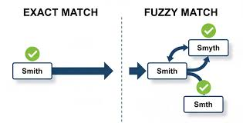
Open Issues
Fuzzy matching - misspellings, spaces
Too much preprocessing for small texts
Constraints provide speedups, but are different for each application
Not easily parallelizable
Compressed text
Notes:
Brigitte
Algorithms dont account for fuzzy matching- if there are small, unintentional inconsistencies between the text and pattern, there won’t be a match
The best algorithms require too much preprocessing for small texts, so they actually perform worse than the naive approach
Constraints provide speedups, but are different for each application
These algorithms are not easily parallelizable
These algorithms can’t perform well on compressed text without decompression

Slide 36
References
Thomas H. Cormen, Charles E. Leiserson, Ronald L. Rivest, Clifford Stein: Introduction to Algorithms, 3rd Edition. MIT Press 2009, ISBN 978-0-262-03384-8, pp. I-XIX, 985-1013
https://www.geeksforgeeks.org/theory-of-computation/introduction-of-finite-automata/
https://www.geeksforgeeks.org/dsa/boyer-moore-algorithm-for-pattern-searching/
https://arxiv.org/abs/2110.13802
https://pmc.ncbi.nlm.nih.gov/articles/PMC3010897/
https://www.ncbi.nlm.nih.gov/datasets/genome/

Slide 37
Questions
Why is it important for q to be large in Rabin-Karp?
What are the advantages of using a finite automaton?
Which other algorithm is KMP similar to?
https://forms.gle/k62EAyr6Hoo68KuGA

Slide 38
Discussion
At what point do you think the tradeoff of no processing for smaller texts doesn’t become worth it? Will this ever happen in live production?
Which was your favorite algorithm? Why?

