Slide 1
MSP 430
Microprocessor Project
Group 4
Matt Ezell
Albert Daniel
Phillip Sutherland
Ben Hardy
ECE 300 Spring 2007
Instructor: Dr. Walter Green

Slide 2
Objectives
Gain experience working in a team environment.
Develop skills of soldering and assembling a printed circuit board.
Learning to program and debug a microprocessor.
Utilizing different temperature sensors in a circuit.

Slide 3
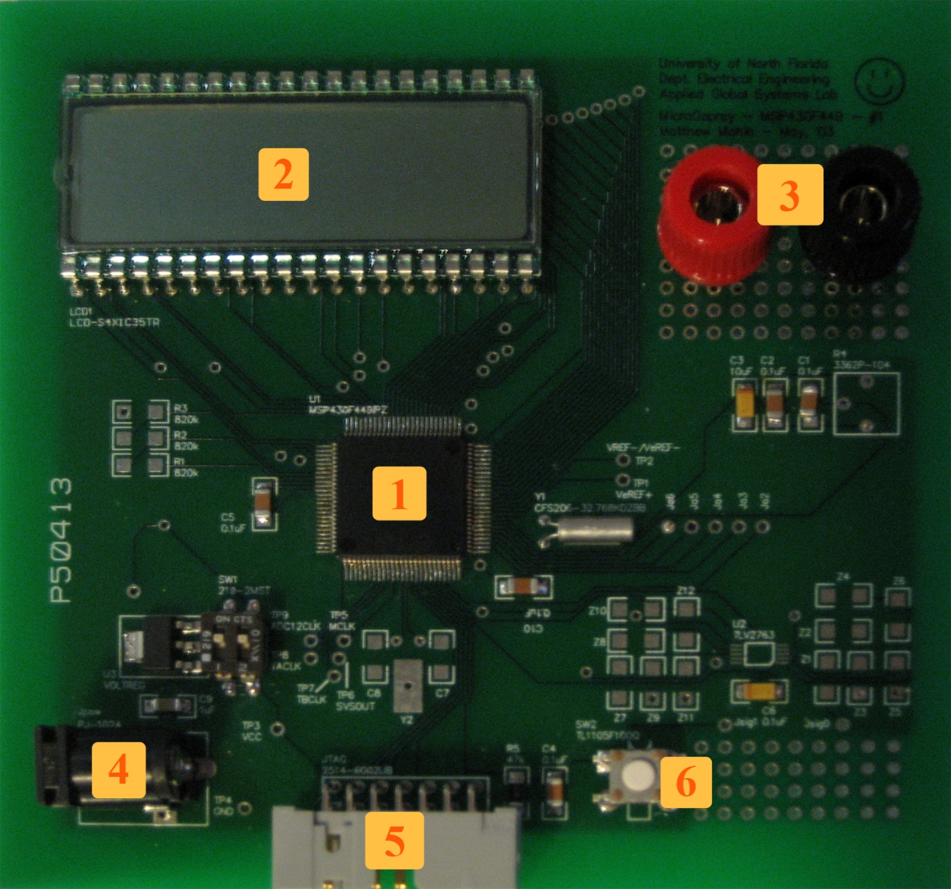
Specs: MSP 430 Project Board
MSP 430 Chip
LCD Display
Sensor Board
Connectors
Power Supply
Connector
JTAG Connector
Reset Switch

Slide 4
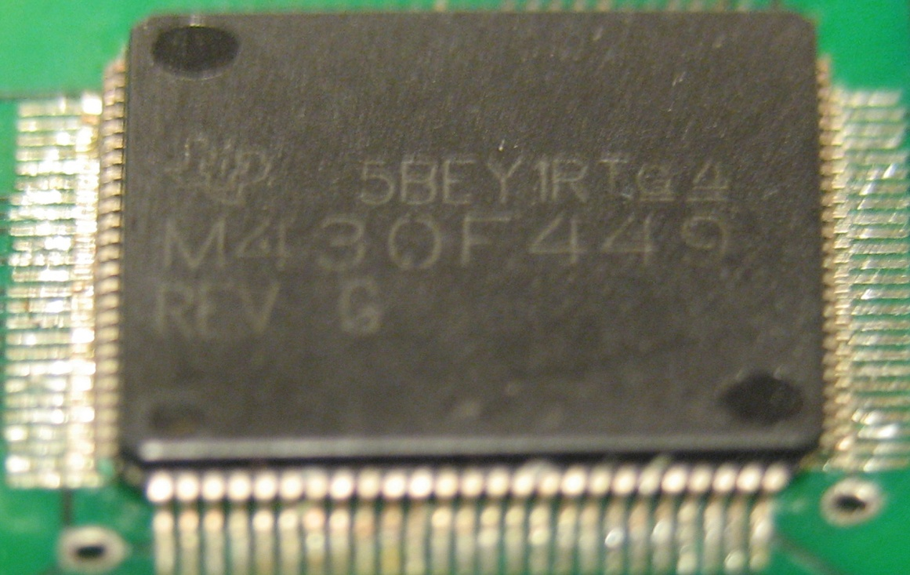
Specs: MSP 430 Microprocessor
16 bit RISC architecture
Integrated 12 bit A/D
converter
Ultralow-Power
consumption (280μA)
Integrated LCD driver
Integrated 60 KB flash
memory and 2KB RAM

Slide 5
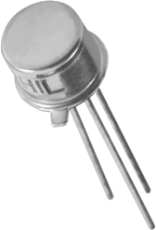
Specs: Temperature Sensors
AD590
AD22103
Wide temperature range
of -55°C to150°C
Excellent linearity ± .3°C
Wide power supply range
4V to 30V
100°C temperature range
Accuracy better than 2.5% of full range
Single power supply operation at 3.3V

Slide 6
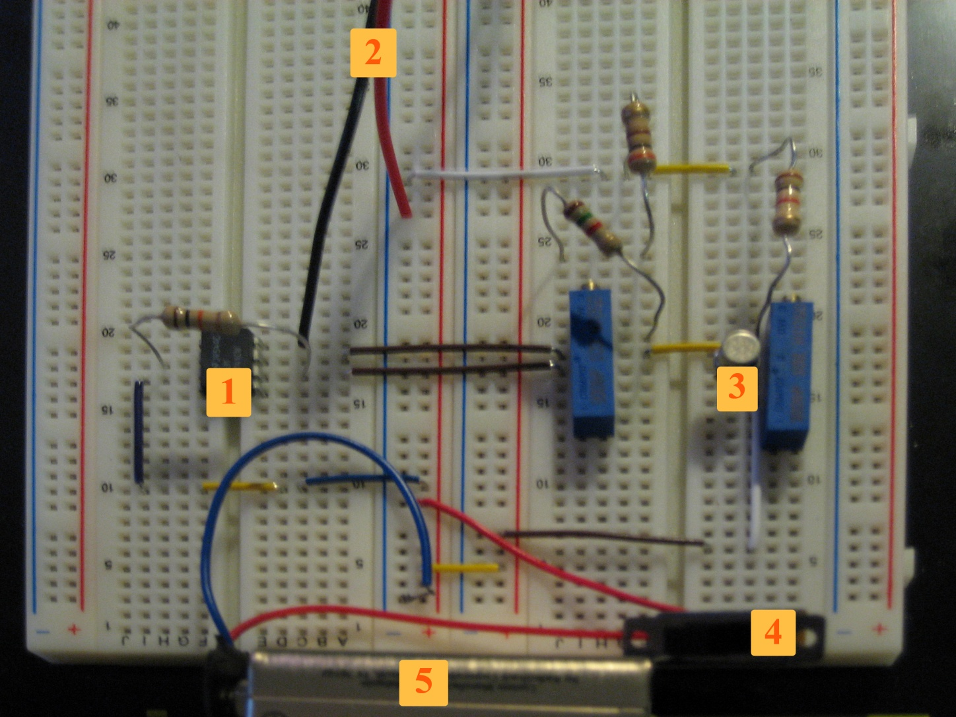
Specs: Sensor Circuit Board
Op Amp
To 9V Battery
Temperature
Sensor
Power Switch
9V Battery

Slide 7
Specs: Code
Switch between AD590 and AD22103 by setting a variable to true or false
Uses a queue to implement a 6th
order moving average filter
Scrolls “reading sensor”
if no input is detected
Display works with values
over 200 degrees
Obtain Data from Sensor
Add Valid Data to Queue
Average Data in Queue
Convert it into Usable form

Slide 8
Results
Heat stimuli added at time 40 and removed at time 120
Note: Tests were run at different times and at different ambient temperatures

Slide 9
Issues
Soldering
  LCD stopped working properly because a MSP430 pin became unsoldered in transit.
Ethanol vapor sensor
  Unable to locate a cheap sensor.

Slide 10
Conclusions
We learned to function as a team while working on an engineering project.
We gained experience building and troubleshooting a temperature sensor circuit.
We acquired basic soldering techniques.
We learned to program and debug
a microprocessor.

